Slide 1
OSCILLATIONS · STANDING WAVES
GIOPHYSICS LESSON
23 · Oscillations
Waves that travel nowhere
Standing Waves
Send two identical waves through each other in opposite directions and the travelling stops: the sum is a pattern of lobes that grow, shrink, and reverse in place. Every string instrument and every wind instrument is built on this trick.
POSITION
Lesson 5 of 6 in Oscillations
PLAN
16 slides in the 45-minute core run, about 44.5 minutes of it
LESSON PAGE
https://giophysics.com/chapter-45/standing-waves/
Built by GioPhysics from the lesson's own page. Every word on these slides is the lesson's; nothing here is re-authored. Teaching material, not an awarding body's document.
Oscillations — Standing Waves. Built by GioPhysics from the lesson's own copy; nothing on these slides is re-authored.
1 / 32
Notes:
[Lesson] Oscillations — Standing Waves. Lesson 5 of 6.
[Intro] Send two identical waves through each other in opposite directions and the travelling stops: the sum is a pattern of lobes that grow, shrink, and reverse in place. Every string instrument and every wind instrument is built on this trick.
[Source] https://giophysics.com/chapter-45/standing-waves/
[Disclaimer] Built by GioPhysics from the lesson's own page. Every word on these slides is the lesson's; nothing here is re-authored. Teaching material, not an awarding body's document.

Slide 2
OSCILLATIONS · STANDING WAVES
GIOPHYSICS LESSON
WHAT THIS NEEDS
What you already know
Starter — Recall what this lesson stands on
Recall
Simple harmonic motion
https://giophysics.com/chapter-45/shm-basics/
Recall
Resonance
https://giophysics.com/chapter-45/resonance/
Oscillations — Standing Waves. Built by GioPhysics from the lesson's own copy; nothing on these slides is re-authored.
2 / 32
Notes:
[Phase] Starter: Recall what this lesson stands on (minutes 0–5 of 45)
[Starter] Recall: Simple harmonic motion; Resonance

Slide 3
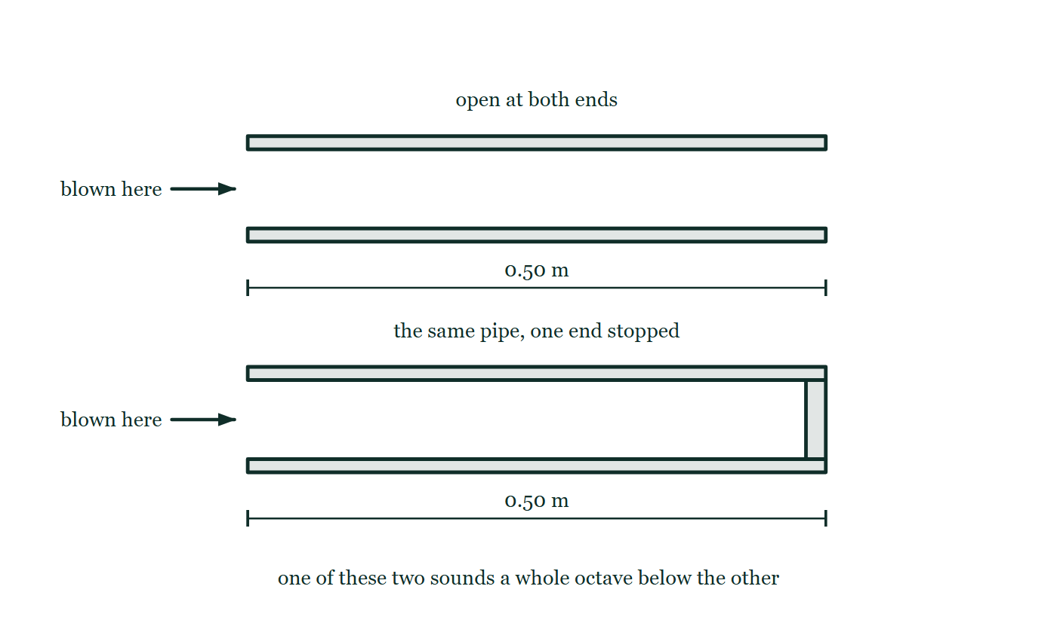
OSCILLATIONS · STANDING WAVES
GIOPHYSICS LESSON
THINK FIRST
Stop one end of an organ pipe and the note drops a whole octave. You have made the air column shorter — so why does the pitch fall?
Take answers before you click — the point is the commitment
Shorter strings give higher notes, shorter pipes give higher notes, and everyone has proved it by covering the holes on a recorder. This pipe just got shorter and went down.
THE ANSWER
Because a stopped end has to hold a node and an open end an antinode, and the shortest pattern satisfying that is a quarter of a wavelength — where the open pipe fitted half of one. The wavelength doubles, so the frequency halves. The length of the pipe did not change at all; what changed is how much of a wave has to fit inside it.
A 0.50 m pipe drawn open at both ends with an arrow showing where it is blown, and beneath it the same 0.50 m pipe with a stopper filling the far end, both drawn empty with no wave inside either of them.
The live version of this figure — click here
Oscillations — Standing Waves. Built by GioPhysics from the lesson's own copy; nothing on these slides is re-authored.
3 / 32
Notes:
[Phase] Starter: Recall what this lesson stands on (minutes 0–5 of 45)
[Hook] Stop one end of an organ pipe and the note drops a whole octave. You have made the air column shorter — so why does the pitch fall? Shorter strings give higher notes, shorter pipes give higher notes, and everyone has proved it by covering the holes on a recorder. This pipe just got shorter and went down.
[Answer] Because a stopped end has to hold a node and an open end an antinode, and the shortest pattern satisfying that is a quarter of a wavelength — where the open pipe fitted half of one. The wavelength doubles, so the frequency halves. The length of the pipe did not change at all; what changed is how much of a wave has to fit inside it.
[Figure] A 0.50 m pipe drawn open at both ends with an arrow showing where it is blown, and beneath it the same 0.50 m pipe with a stopper filling the far end, both drawn empty with no wave inside either of them.

Slide 4
OSCILLATIONS · STANDING WAVES
GIOPHYSICS LESSON
EXPLAINED SIMPLY
In one sentence
Introduce the idea — The big idea and the definition
A standing wave is the superposition of two identical counter-propagating waves: fixed nodes of zero amplitude, antinodes of maximum amplitude, and no net energy transport.
Oscillations — Standing Waves. Built by GioPhysics from the lesson's own copy; nothing on these slides is re-authored.
4 / 32
Notes:
[Phase] Introduce the idea: The big idea and the definition (minutes 5–13 of 45)
[Definition] A standing wave is the superposition of two identical counter-propagating waves: fixed nodes of zero amplitude, antinodes of maximum amplitude, and no net energy transport.

Slide 5
OSCILLATIONS · STANDING WAVES
GIOPHYSICS LESSON
EXPLAINED SIMPLY
What that looks like
Introduce the idea — The big idea and the definition
FOR EXAMPLE
Pluck a guitar string: waves race to both fixed ends, reflect, and overlap into a standing wave with a node at each end — the first harmonic whose frequency is the note you hear.
Oscillations — Standing Waves. Built by GioPhysics from the lesson's own copy; nothing on these slides is re-authored.
5 / 32
Notes:
[Phase] Introduce the idea: The big idea and the definition (minutes 5–13 of 45)
[Worked illustration] Pluck a guitar string: waves race to both fixed ends, reflect, and overlap into a standing wave with a node at each end — the first harmonic whose frequency is the note you hear.

Slide 6
OSCILLATIONS · STANDING WAVES
GIOPHYSICS LESSON
THE BIG IDEA
Waves that travel nowhere
Introduce the idea — The big idea and the definition
When two identical waves travel in opposite directions — most often an outgoing wave and its own reflection — superposition produces a standing wave. Some points, the nodes, never move; between them the antinodes swell and collapse with maximum amplitude. Unlike a travelling wave, the pattern transports no energy: the two underlying waves carry equal energy opposite ways.
Boundaries decide which patterns fit. A string fixed at both ends must hold a node at each end, so it supports wavelengths λ = 2L/n and frequencies fₙ = nv/2L — the harmonics. A pipe open at both ends mirrors the string with antinodes at the ends and the same frequency ladder; a pipe closed at one end holds a node at the closed end and an antinode at the open end, giving f = v/4L and odd harmonics only.
Oscillations — Standing Waves. Built by GioPhysics from the lesson's own copy; nothing on these slides is re-authored.
6 / 32
Notes:
[Phase] Introduce the idea: The big idea and the definition (minutes 5–13 of 45)
[Big idea] When two identical waves travel in opposite directions — most often an outgoing wave and its own reflection — superposition produces a standing wave. Some points, the nodes, never move; between them the antinodes swell and collapse with maximum amplitude. Unlike a travelling wave, the pattern transports no energy: the two underlying waves carry equal energy opposite ways. Boundaries decide which patterns fit. A string fixed at both ends must hold a node at each end, so it supports wavelengths λ = 2L/n and frequencies fₙ = nv/2L — the harmonics. A pipe open at both ends mirrors the string with antinodes at the ends and the same frequency ladder; a pipe closed at one end holds a node at the closed end and an antinode at the open end, giving f = v/4L and odd harmonics only.

Slide 7
OSCILLATIONS · STANDING WAVES
GIOPHYSICS LESSON
THE PHYSICS · 1 OF 3
Standing versus travelling
Build the model — The formulae, one at a time, in plain English
A travelling wave moves its crests along and delivers energy; every point oscillates with the same amplitude, each lagging the last. A standing wave moves nothing along: each point has its own fixed amplitude — zero at nodes, maximal at antinodes — and all points between two nodes oscillate in phase. The energy carried in by one travelling wave is carried out by the other, so the net flow is zero.
Oscillations — Standing Waves. Built by GioPhysics from the lesson's own copy; nothing on these slides is re-authored.
7 / 32
Notes:
[Phase] Build the model: The formulae, one at a time, in plain English (minutes 13–22 of 45)
[Section] A travelling wave moves its crests along and delivers energy; every point oscillates with the same amplitude, each lagging the last. A standing wave moves nothing along: each point has its own fixed amplitude — zero at nodes, maximal at antinodes — and all points between two nodes oscillate in phase. The energy carried in by one travelling wave is carried out by the other, so the net flow is zero.

Slide 8
OSCILLATIONS · STANDING WAVES
GIOPHYSICS LESSON
THE PHYSICS · 2 OF 3
Why only certain frequencies survive
Build the model — The formulae, one at a time, in plain English
Reflections at the boundaries send waves back and forth continuously. For most wavelengths the overlapping reflections scramble and cancel.
Only wavelengths that respect the boundary conditions — nodes at fixed ends, antinodes at open ones — reinforce cycle after cycle. A string of length L therefore rings only at v/2L and its multiples: the boundary conditions quantise the spectrum, the same logic that later quantises electron energies in atoms.
Oscillations — Standing Waves. Built by GioPhysics from the lesson's own copy; nothing on these slides is re-authored.
8 / 32
Notes:
[Phase] Build the model: The formulae, one at a time, in plain English (minutes 13–22 of 45)
[Section] Reflections at the boundaries send waves back and forth continuously. For most wavelengths the overlapping reflections scramble and cancel. Only wavelengths that respect the boundary conditions — nodes at fixed ends, antinodes at open ones — reinforce cycle after cycle. A string of length L therefore rings only at v/2L and its multiples: the boundary conditions quantise the spectrum, the same logic that later quantises electron energies in atoms.

Slide 9
OSCILLATIONS · STANDING WAVES
GIOPHYSICS LESSON
THE PHYSICS · 3 OF 3
Measuring λ with a water tube
Build the model — The formulae, one at a time, in plain English
Hold a tuning fork over a tube of water and let the level fall. The air column resonates loudly first at length x — a quarter wavelength, so λ = 4x — and next at length y, three-quarters of a wavelength.
The spacing between loud points is λ/2 = y − x, giving λ = 2(y − x) without touching the fork’s frequency. Chladni patterns on a drumhead show the two-dimensional version: sand collects along the nodal lines where the surface never moves.
Oscillations — Standing Waves. Built by GioPhysics from the lesson's own copy; nothing on these slides is re-authored.
9 / 32
Notes:
[Phase] Build the model: The formulae, one at a time, in plain English (minutes 13–22 of 45)
[Section] Hold a tuning fork over a tube of water and let the level fall. The air column resonates loudly first at length x — a quarter wavelength, so λ = 4x — and next at length y, three-quarters of a wavelength. The spacing between loud points is λ/2 = y − x, giving λ = 2(y − x) without touching the fork’s frequency. Chladni patterns on a drumhead show the two-dimensional version: sand collects along the nodal lines where the surface never moves.

Slide 10
OSCILLATIONS · STANDING WAVES
GIOPHYSICS LESSON
FORMULA 1 OF 3
String / open pipe harmonics
Build the model — The formulae, one at a time, in plain English
fₙ = n·v/(2L)
n = 1, 2, 3, … · λₙ = 2L/n
IN PLAIN ENGLISH
Fixed ends demand nodes (open pipe ends demand antinodes); either way half-wavelengths must tile the length exactly. The first harmonic f₁ = v/2L is the lowest note; the rest are whole-number multiples.
Oscillations — Standing Waves. Built by GioPhysics from the lesson's own copy; nothing on these slides is re-authored.
10 / 32
Notes:
[Phase] Build the model: The formulae, one at a time, in plain English (minutes 13–22 of 45)
[Formula] String / open pipe harmonics: fₙ = n·v/(2L)
[In plain English] Fixed ends demand nodes (open pipe ends demand antinodes); either way half-wavelengths must tile the length exactly. The first harmonic f₁ = v/2L is the lowest note; the rest are whole-number multiples.
[Note] n = 1, 2, 3, … · λₙ = 2L/n

Slide 11
OSCILLATIONS · STANDING WAVES
GIOPHYSICS LESSON
FORMULA 2 OF 3
Closed pipe harmonics
Build the model — The formulae, one at a time, in plain English
fₙ = n·v/(4L), odd n only
n = 1, 3, 5, … — no even harmonics
IN PLAIN ENGLISH
A node at the closed end and an antinode at the open end fit a quarter wavelength at minimum, and only odd multiples after that. A closed pipe plays an octave deeper than an open pipe of the same length.
Oscillations — Standing Waves. Built by GioPhysics from the lesson's own copy; nothing on these slides is re-authored.
11 / 32
Notes:
[Phase] Build the model: The formulae, one at a time, in plain English (minutes 13–22 of 45)
[Formula] Closed pipe harmonics: fₙ = n·v/(4L), odd n only
[In plain English] A node at the closed end and an antinode at the open end fit a quarter wavelength at minimum, and only odd multiples after that. A closed pipe plays an octave deeper than an open pipe of the same length.
[Note] n = 1, 3, 5, … — no even harmonics

Slide 12
OSCILLATIONS · STANDING WAVES
GIOPHYSICS LESSON
FORMULA 3 OF 3
Nodes and antinodes
Build the model — The formulae, one at a time, in plain English
node spacing = λ/2
Adjacent lobes are π out of phase
IN PLAIN ENGLISH
Nodes sit half a wavelength apart, antinodes midway between them. Every point between two nodes moves in step; cross a node and the motion flips sign.
Oscillations — Standing Waves. Built by GioPhysics from the lesson's own copy; nothing on these slides is re-authored.
12 / 32
Notes:
[Phase] Build the model: The formulae, one at a time, in plain English (minutes 13–22 of 45)
[Formula] Nodes and antinodes: node spacing = λ/2
[In plain English] Nodes sit half a wavelength apart, antinodes midway between them. Every point between two nodes moves in step; cross a node and the motion flips sign.
[Note] Adjacent lobes are π out of phase

Slide 13
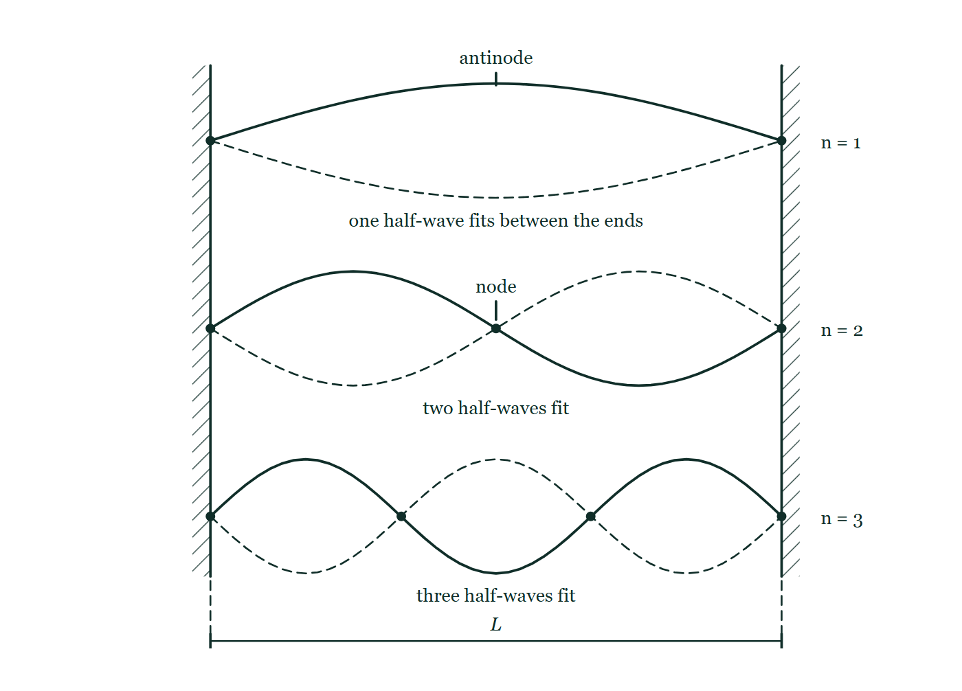
OSCILLATIONS · STANDING WAVES
GIOPHYSICS LESSON
THE PICTURE
What fits between two fixed ends
Drawn for this lesson
A string clamped between two hatched walls, drawn three times: one lobe, then two, then three, each shown as a solid curve and its dashed mirror image, with dots on the nodes and the string length L dimensioned below.
The live version of this figure — click here
Oscillations — Standing Waves. Built by GioPhysics from the lesson's own copy; nothing on these slides is re-authored.
13 / 32
Notes:
[Phase] Build the model: The formulae, one at a time, in plain English (minutes 13–22 of 45)
[Figure] A string clamped between two hatched walls, drawn three times: one lobe, then two, then three, each shown as a solid curve and its dashed mirror image, with dots on the nodes and the string length L dimensioned below.

Slide 14
OSCILLATIONS · STANDING WAVES
GIOPHYSICS LESSON
WATCH OUT
The common trap
Check and misconception — The quick check and the trap
A standing wave does not stand still, and it is not a wave that has stopped carrying energy because it stopped moving. Every point (bar the nodes) oscillates continuously — what stands is the pattern. And the energy statement is about net transport: two travelling waves are still there inside it, ferrying equal energy in opposite directions.
Oscillations — Standing Waves. Built by GioPhysics from the lesson's own copy; nothing on these slides is re-authored.
14 / 32
Notes:
[Phase] Check and misconception: The quick check and the trap (minutes 35–41 of 45)
[Misconception] A standing wave does not stand still, and it is not a wave that has stopped carrying energy because it stopped moving. Every point (bar the nodes) oscillates continuously — what stands is the pattern. And the energy statement is about net transport: two travelling waves are still there inside it, ferrying equal energy in opposite directions.

Slide 15
OSCILLATIONS · STANDING WAVES
GIOPHYSICS LESSON
WORKED EXAMPLE 1 OF 2 · EASY
The question
Easy
Worked examples — I do, we do — one step revealed at a time
A 0.80 m string fixed at both ends carries waves at 320 m s⁻¹. Find the wavelength and frequency of the first harmonic.
Oscillations — Standing Waves. Built by GioPhysics from the lesson's own copy; nothing on these slides is re-authored.
15 / 32
Notes:
[Phase] Worked examples: I do, we do — one step revealed at a time (minutes 22–35 of 45)
[Question] A 0.80 m string fixed at both ends carries waves at 320 m s⁻¹. Find the wavelength and frequency of the first harmonic.
[Answer] λ = 1.6 m; f₁ = 200 Hz

Slide 16
OSCILLATIONS · STANDING WAVES
GIOPHYSICS LESSON
WORKED EXAMPLE 1 OF 2 · EASY · THE WORKING
How to solve it
Easy
Worked examples — I do, we do — one step revealed at a time
A 0.80 m string fixed at both ends carries waves at 320 m s⁻¹. Find the wavelength and frequency of the first harmonic.
1.
First harmonic: half a wavelength fits the string, so λ = 2L = 1.6 m.
2.
f₁ = v/λ = 320 ÷ 1.6 = 200 Hz.
Oscillations — Standing Waves. Built by GioPhysics from the lesson's own copy; nothing on these slides is re-authored.
16 / 32
Notes:
[Phase] Worked examples: I do, we do — one step revealed at a time (minutes 22–35 of 45)
[Reveal] One click per step. The class works each line before the next appears.
[Step 1] First harmonic: half a wavelength fits the string, so λ = 2L = 1.6 m.
[Step 2] f₁ = v/λ = 320 ÷ 1.6 = 200 Hz.

Slide 17
OSCILLATIONS · STANDING WAVES
GIOPHYSICS LESSON
WORKED EXAMPLE 1 OF 2 · EASY
Answer
Easy
Worked examples — I do, we do — one step revealed at a time
λ = 1.6 m; f₁ = 200 Hz
Oscillations — Standing Waves. Built by GioPhysics from the lesson's own copy; nothing on these slides is re-authored.
17 / 32
Notes:
[Phase] Worked examples: I do, we do — one step revealed at a time (minutes 22–35 of 45)
[Answer] λ = 1.6 m; f₁ = 200 Hz

Slide 18
OSCILLATIONS · STANDING WAVES
GIOPHYSICS LESSON
WORKED EXAMPLE 2 OF 2 · MEDIUM
The question
Medium
Worked examples — I do, we do — one step revealed at a time
For the same string, sketch and solve the third harmonic: wavelength, frequency, and the number of nodes and antinodes.
Oscillations — Standing Waves. Built by GioPhysics from the lesson's own copy; nothing on these slides is re-authored.
18 / 32
Notes:
[Phase] Worked examples: I do, we do — one step revealed at a time (minutes 22–35 of 45)
[Question] For the same string, sketch and solve the third harmonic: wavelength, frequency, and the number of nodes and antinodes.
[Answer] λ ≈ 0.53 m; f₃ = 600 Hz; 4 nodes, 3 antinodes

Slide 19
OSCILLATIONS · STANDING WAVES
GIOPHYSICS LESSON
WORKED EXAMPLE 2 OF 2 · MEDIUM · THE WORKING
How to solve it
Medium
Worked examples — I do, we do — one step revealed at a time
For the same string, sketch and solve the third harmonic: wavelength, frequency, and the number of nodes and antinodes.
1.
Third harmonic: three half-wavelengths tile the string, λ = 2L/3 ≈ 0.53 m.
2.
f₃ = 3v/2L = 3 × 320 ÷ 1.6 = 600 Hz — three times the first harmonic.
3.
Count the pattern: 4 nodes (including both ends) and 3 antinodes.
Oscillations — Standing Waves. Built by GioPhysics from the lesson's own copy; nothing on these slides is re-authored.
19 / 32
Notes:
[Phase] Worked examples: I do, we do — one step revealed at a time (minutes 22–35 of 45)
[Reveal] One click per step. The class works each line before the next appears.
[Step 1] Third harmonic: three half-wavelengths tile the string, λ = 2L/3 ≈ 0.53 m.
[Step 2] f₃ = 3v/2L = 3 × 320 ÷ 1.6 = 600 Hz — three times the first harmonic.
[Step 3] Count the pattern: 4 nodes (including both ends) and 3 antinodes.

Slide 20
OSCILLATIONS · STANDING WAVES
GIOPHYSICS LESSON
WORKED EXAMPLE 2 OF 2 · MEDIUM
Answer
Medium
Worked examples — I do, we do — one step revealed at a time
λ ≈ 0.53 m; f₃ = 600 Hz; 4 nodes, 3 antinodes
Oscillations — Standing Waves. Built by GioPhysics from the lesson's own copy; nothing on these slides is re-authored.
20 / 32
Notes:
[Phase] Worked examples: I do, we do — one step revealed at a time (minutes 22–35 of 45)
[Answer] λ ≈ 0.53 m; f₃ = 600 Hz; 4 nodes, 3 antinodes

Slide 21
OSCILLATIONS · STANDING WAVES
GIOPHYSICS LESSON
SPOT THE MISTAKE
One line here is wrong
The whole working is up — find the bad line before you click
1.
A pipe 0.50 m long is closed at one end. Taking v = 340 m s⁻¹, find its fundamental frequency.
2.
The closed end must hold a node and the open end an antinode.
3.
So half a wavelength fits the pipe: λ = 2L = 1.0 m.
4.
f = v/λ = 340 / 1.0 = 340 Hz.
5.
The stopped pipe sounds at 340 Hz.
LINE 3 IS WRONG
The boundary conditions on line 1 are stated perfectly and then not used. From a node to the next antinode is a quarter of a wavelength, not a half — a half runs node to node, which is the open-open and the string case. The answer that comes out, 340 Hz, is the frequency of the open pipe of the same length, which is exactly the confusion the line has made.
IT SHOULD SAY
So a quarter of a wavelength fits the pipe: λ = 4L = 2.0 m, and f = 340/2.0 = 170 Hz.
Oscillations — Standing Waves. Built by GioPhysics from the lesson's own copy; nothing on these slides is re-authored.
21 / 32
Notes:
[Phase] Worked examples: I do, we do — one step revealed at a time (minutes 22–35 of 45)
[Spot the mistake] The working is complete and one line of it is wrong. Let the room hunt: one click names the line, a second shows it done correctly.
[Line 3 is wrong] The boundary conditions on line 1 are stated perfectly and then not used. From a node to the next antinode is a quarter of a wavelength, not a half — a half runs node to node, which is the open-open and the string case. The answer that comes out, 340 Hz, is the frequency of the open pipe of the same length, which is exactly the confusion the line has made.
[It should say] So a quarter of a wavelength fits the pipe: λ = 4L = 2.0 m, and f = 340/2.0 = 170 Hz.

Slide 22
OSCILLATIONS · STANDING WAVES
GIOPHYSICS LESSON
PREDICT · TAKE THE VOTE
Commit before you are told
Hands up for each option, then click
The pattern on this string does not travel anywhere. So what are the points between two nodes doing?
A Standing still, exactly like the nodes
B Swinging up and down between the two drawn curves, all in step with one another
C Creeping slowly along the string towards the nearest node
A string clamped between two hatched walls, drawn three times: one lobe, then two, then three, each shown as a solid curve and its dashed mirror image, with dots on the nodes and the string length L dimensioned below.
The live version of this figure — click here
Oscillations — Standing Waves. Built by GioPhysics from the lesson's own copy; nothing on these slides is re-authored.
22 / 32
Notes:
[Phase] Build the model: The formulae, one at a time, in plain English (minutes 13–22 of 45)
[Predict] The pattern on this string does not travel anywhere. So what are the points between two nodes doing?
[Options] A Standing still, exactly like the nodes B Swinging up and down between the two drawn curves, all in step with one another C Creeping slowly along the string towards the nearest node
[Figure] A string clamped between two hatched walls, drawn three times: one lobe, then two, then three, each shown as a solid curve and its dashed mirror image, with dots on the nodes and the string length L dimensioned below.

Slide 23
OSCILLATIONS · STANDING WAVES
GIOPHYSICS LESSON
PREDICT · THE OUTCOME
What actually happens
Ask the room who changed their mind, and why
B Swinging up and down between the two drawn curves, all in step with one another
WHY
What stands still is the pattern, not the string. The solid curve and its dashed mirror are the two extremes of the same lobe, and every point between two nodes swings between them — each with its own fixed amplitude, largest at the antinode, and all of them reaching their extremes at the same instant. Two travelling waves are still inside it, ferrying equal energy in opposite directions; it is only the net transport that is zero.
Oscillations — Standing Waves. Built by GioPhysics from the lesson's own copy; nothing on these slides is re-authored.
23 / 32
Notes:
[Phase] Build the model: The formulae, one at a time, in plain English (minutes 13–22 of 45)
[Answer] B — Swinging up and down between the two drawn curves, all in step with one another. What stands still is the pattern, not the string. The solid curve and its dashed mirror are the two extremes of the same lobe, and every point between two nodes swings between them — each with its own fixed amplitude, largest at the antinode, and all of them reaching their extremes at the same instant. Two travelling waves are still inside it, ferrying equal energy in opposite directions; it is only the net transport that is zero.

Slide 24
OSCILLATIONS · STANDING WAVES
GIOPHYSICS LESSON
QUICK CHECK
Decide before the answer goes up
Check and misconception — The quick check and the trap
A string fixed at both ends plays its first harmonic at 120 Hz. What is the frequency of its third harmonic?
A
180 Hz
B
240 Hz
C
360 Hz
Oscillations — Standing Waves. Built by GioPhysics from the lesson's own copy; nothing on these slides is re-authored.
24 / 32
Notes:
[Phase] Check and misconception: The quick check and the trap (minutes 35–41 of 45)
[Question] A string fixed at both ends plays its first harmonic at 120 Hz. What is the frequency of its third harmonic?
[Options] A 180 Hz B 240 Hz C 360 Hz

Slide 25
OSCILLATIONS · STANDING WAVES
GIOPHYSICS LESSON
QUICK CHECK · THE ANSWER
The answer, and why
Check and misconception — The quick check and the trap
C 360 Hz
HOW TO GET THERE
String harmonics are whole-number multiples of the first: f₃ = 3f₁ = 3 × 120 = 360 Hz.
WHY THE OTHERS TEMPT
A 180 Hz is 1.5 × 120, which is exactly what you get if the first harmonic is taken to be a whole wavelength on the string instead of half of one. Count the picture: the first harmonic is a single lobe, one half-wave. Three half-waves against one half-wave is a factor of three, not a factor of three-halves.
B 240 Hz is 2f₁ — the second harmonic, the pattern with one node in the middle. It is where you land if the fundamental is counted as the first overtone and then stepped up. The harmonics are numbered so that the nth is simply n times the first, and the third is the one with two nodes between the ends.
C Correct. On a string fixed at both ends the harmonics are whole-number multiples of the first, so f₃ = 3f₁ = 360 Hz — three half-wavelengths tiling the same length, at three times the frequency.
Oscillations — Standing Waves. Built by GioPhysics from the lesson's own copy; nothing on these slides is re-authored.
25 / 32
Notes:
[Phase] Check and misconception: The quick check and the trap (minutes 35–41 of 45)
[Question] A string fixed at both ends plays its first harmonic at 120 Hz. What is the frequency of its third harmonic?
[Option by option] A: 180 Hz is 1.5 × 120, which is exactly what you get if the first harmonic is taken to be a whole wavelength on the string instead of half of one. Count the picture: the first harmonic is a single lobe, one half-wave. Three half-waves against one half-wave is a factor of three, not a factor of three-halves. B: 240 Hz is 2f₁ — the second harmonic, the pattern with one node in the middle. It is where you land if the fundamental is counted as the first overtone and then stepped up. The harmonics are numbered so that the nth is simply n times the first, and the third is the one with two nodes between the ends. C: Correct. On a string fixed at both ends the harmonics are whole-number multiples of the first, so f₃ = 3f₁ = 360 Hz — three half-wavelengths tiling the same length, at three times the frequency.
[Answer] C — 360 Hz
[Why] String harmonics are whole-number multiples of the first: f₃ = 3f₁ = 3 × 120 = 360 Hz.
[Reveal] One click for the answer, then one for the reason.

Slide 26
OSCILLATIONS · STANDING WAVES
GIOPHYSICS LESSON
EXTENSION 1 OF 2 · HARD
The question
Hard
Worked examples — I do, we do — one step revealed at a time
A tuning fork held over a draining water tube sounds loudest at air-column lengths of 0.19 m and 0.57 m. Taking v = 340 m s⁻¹, find λ and the fork’s frequency.
Oscillations — Standing Waves. Built by GioPhysics from the lesson's own copy; nothing on these slides is re-authored.
26 / 32
Notes:
[Phase] Worked examples: I do, we do — one step revealed at a time (minutes 22–35 of 45)
[Question] A tuning fork held over a draining water tube sounds loudest at air-column lengths of 0.19 m and 0.57 m. Taking v = 340 m s⁻¹, find λ and the fork’s frequency.
[Answer] λ = 0.76 m; f ≈ 450 Hz

Slide 27
OSCILLATIONS · STANDING WAVES
GIOPHYSICS LESSON
EXTENSION 1 OF 2 · HARD · THE WORKING
How to solve it
Hard
Worked examples — I do, we do — one step revealed at a time
A tuning fork held over a draining water tube sounds loudest at air-column lengths of 0.19 m and 0.57 m. Taking v = 340 m s⁻¹, find λ and the fork’s frequency.
1.
Successive resonances of a closed column are λ/2 apart: λ/2 = 0.57 − 0.19 = 0.38 m → λ = 0.76 m.
2.
Check the first: λ/4 = 0.19 m ✓ — the quarter-wave fundamental.
3.
f = v/λ = 340 ÷ 0.76 ≈ 447 Hz ≈ 450 Hz.
Oscillations — Standing Waves. Built by GioPhysics from the lesson's own copy; nothing on these slides is re-authored.
27 / 32
Notes:
[Phase] Worked examples: I do, we do — one step revealed at a time (minutes 22–35 of 45)
[Reveal] One click per step. The class works each line before the next appears.
[Step 1] Successive resonances of a closed column are λ/2 apart: λ/2 = 0.57 − 0.19 = 0.38 m → λ = 0.76 m.
[Step 2] Check the first: λ/4 = 0.19 m ✓ — the quarter-wave fundamental.
[Step 3] f = v/λ = 340 ÷ 0.76 ≈ 447 Hz ≈ 450 Hz.

Slide 28
OSCILLATIONS · STANDING WAVES
GIOPHYSICS LESSON
EXTENSION 1 OF 2 · HARD
Answer
Hard
Worked examples — I do, we do — one step revealed at a time
λ = 0.76 m; f ≈ 450 Hz
Oscillations — Standing Waves. Built by GioPhysics from the lesson's own copy; nothing on these slides is re-authored.
28 / 32
Notes:
[Phase] Worked examples: I do, we do — one step revealed at a time (minutes 22–35 of 45)
[Answer] λ = 0.76 m; f ≈ 450 Hz

Slide 29
OSCILLATIONS · STANDING WAVES
GIOPHYSICS LESSON
EXTENSION 2 OF 2 · CHALLENGING
The question
Challenging
Worked examples — I do, we do — one step revealed at a time
An organ builder has a 0.50 m pipe. Compare its fundamental when open at both ends and when closed at one end (v = 340 m s⁻¹), and explain which harmonics each version can play.
Oscillations — Standing Waves. Built by GioPhysics from the lesson's own copy; nothing on these slides is re-authored.
29 / 32
Notes:
[Phase] Worked examples: I do, we do — one step revealed at a time (minutes 22–35 of 45)
[Question] An organ builder has a 0.50 m pipe. Compare its fundamental when open at both ends and when closed at one end (v = 340 m s⁻¹), and explain which harmonics each version can play.
[Answer] Open: 340 Hz, all harmonics. Closed: 170 Hz, odd harmonics only — an octave lower with a hollower timbre

Slide 30
OSCILLATIONS · STANDING WAVES
GIOPHYSICS LESSON
EXTENSION 2 OF 2 · CHALLENGING · THE WORKING
How to solve it
Challenging
Worked examples — I do, we do — one step revealed at a time
An organ builder has a 0.50 m pipe. Compare its fundamental when open at both ends and when closed at one end (v = 340 m s⁻¹), and explain which harmonics each version can play.
1.
Open–open: antinode at each end, λ = 2L = 1.0 m → f₁ = 340 Hz, with every harmonic n = 1, 2, 3, … available.
2.
Closed–open: node at the closed end, λ = 4L = 2.0 m → f₁ = 170 Hz — a full octave lower from the same pipe.
3.
The closed pipe only supports odd harmonics (170, 510, 850 Hz …): an even harmonic would need a node at the open end, which the boundary forbids. That missing-evens spectrum is why closed pipes sound hollower.
Oscillations — Standing Waves. Built by GioPhysics from the lesson's own copy; nothing on these slides is re-authored.
30 / 32
Notes:
[Phase] Worked examples: I do, we do — one step revealed at a time (minutes 22–35 of 45)
[Reveal] One click per step. The class works each line before the next appears.
[Step 1] Open–open: antinode at each end, λ = 2L = 1.0 m → f₁ = 340 Hz, with every harmonic n = 1, 2, 3, … available.
[Step 2] Closed–open: node at the closed end, λ = 4L = 2.0 m → f₁ = 170 Hz — a full octave lower from the same pipe.
[Step 3] The closed pipe only supports odd harmonics (170, 510, 850 Hz …): an even harmonic would need a node at the open end, which the boundary forbids. That missing-evens spectrum is why closed pipes sound hollower.

Slide 31
OSCILLATIONS · STANDING WAVES
GIOPHYSICS LESSON
EXTENSION 2 OF 2 · CHALLENGING
Answer
Challenging
Worked examples — I do, we do — one step revealed at a time
Open: 340 Hz, all harmonics. Closed: 170 Hz, odd harmonics only — an octave lower with a hollower timbre
Oscillations — Standing Waves. Built by GioPhysics from the lesson's own copy; nothing on these slides is re-authored.
31 / 32
Notes:
[Phase] Worked examples: I do, we do — one step revealed at a time (minutes 22–35 of 45)
[Answer] Open: 340 Hz, all harmonics. Closed: 170 Hz, odd harmonics only — an octave lower with a hollower timbre

Slide 32
OSCILLATIONS · STANDING WAVES
GIOPHYSICS LESSON
OSCILLATIONS
Where to go next
Plenary — What to take away, what to practise next
Next
23.6 Oscillations Calculus
https://giophysics.com/chapter-45/oscillations-calculus/
Lesson
This lesson on giophysics.com
https://giophysics.com/chapter-45/standing-waves/
Live
The live, interactive version of these slides
https://giophysics.com/chapter-45/presentation/?lesson=standing
Chapter
All Oscillations lessons
https://giophysics.com/chapter-45/
PDF
Download the lesson PDF
https://giophysics.com/downloads/45-5-standing-waves.pdf
Oscillations — Standing Waves. Built by GioPhysics from the lesson's own copy; nothing on these slides is re-authored.
32 / 32
Notes:
[Phase] Plenary: What to take away, what to practise next (minutes 41–45 of 45)
[Interactive] The graphs and the circuit topology on these slides are frozen. The live version at https://giophysics.com/chapter-45/presentation/?lesson=standing moves them.

