Slide 1
ATOMIC PHYSICS · RADIOACTIVE DECAY
GIOPHYSICS LESSON
24 · Atomic Physics
Nuclei that rebuild themselves
Radioactive Decay
Becquerel found photographic film fogged by uranium rocks that had never seen light. The culprit was the nucleus itself: unstable nuclei spontaneously rebuild into more stable ones, and the debris — alpha, beta, gamma — flies out with millions of electronvolts.
POSITION
Lesson 2 of 6 in Atomic Physics
PLAN
15 slides in the 45-minute core run, about 43.5 minutes of it
LESSON PAGE
https://giophysics.com/chapter-46/radioactivity/
Built by GioPhysics from the lesson's own page. Every word on these slides is the lesson's; nothing here is re-authored. Teaching material, not an awarding body's document.
Atomic Physics — Radioactive Decay. Built by GioPhysics from the lesson's own copy; nothing on these slides is re-authored.
1 / 36
Notes:
[Lesson] Atomic Physics — Radioactive Decay. Lesson 2 of 6.
[Intro] Becquerel found photographic film fogged by uranium rocks that had never seen light. The culprit was the nucleus itself: unstable nuclei spontaneously rebuild into more stable ones, and the debris — alpha, beta, gamma — flies out with millions of electronvolts.
[Source] https://giophysics.com/chapter-46/radioactivity/
[Disclaimer] Built by GioPhysics from the lesson's own page. Every word on these slides is the lesson's; nothing here is re-authored. Teaching material, not an awarding body's document.

Slide 2
ATOMIC PHYSICS · RADIOACTIVE DECAY
GIOPHYSICS LESSON
WHAT THIS NEEDS
What you already know
Starter — Recall what this lesson stands on
Recall
Coulomb’s law
https://giophysics.com/chapter-19/coulombs-law/
Recall
Charge conservation
https://giophysics.com/chapter-19/charge-conservation-quantisation/
Atomic Physics — Radioactive Decay. Built by GioPhysics from the lesson's own copy; nothing on these slides is re-authored.
2 / 36
Notes:
[Phase] Starter: Recall what this lesson stands on (minutes 0–5 of 45)
[Starter] Recall: Coulomb’s law; Charge conservation

Slide 3
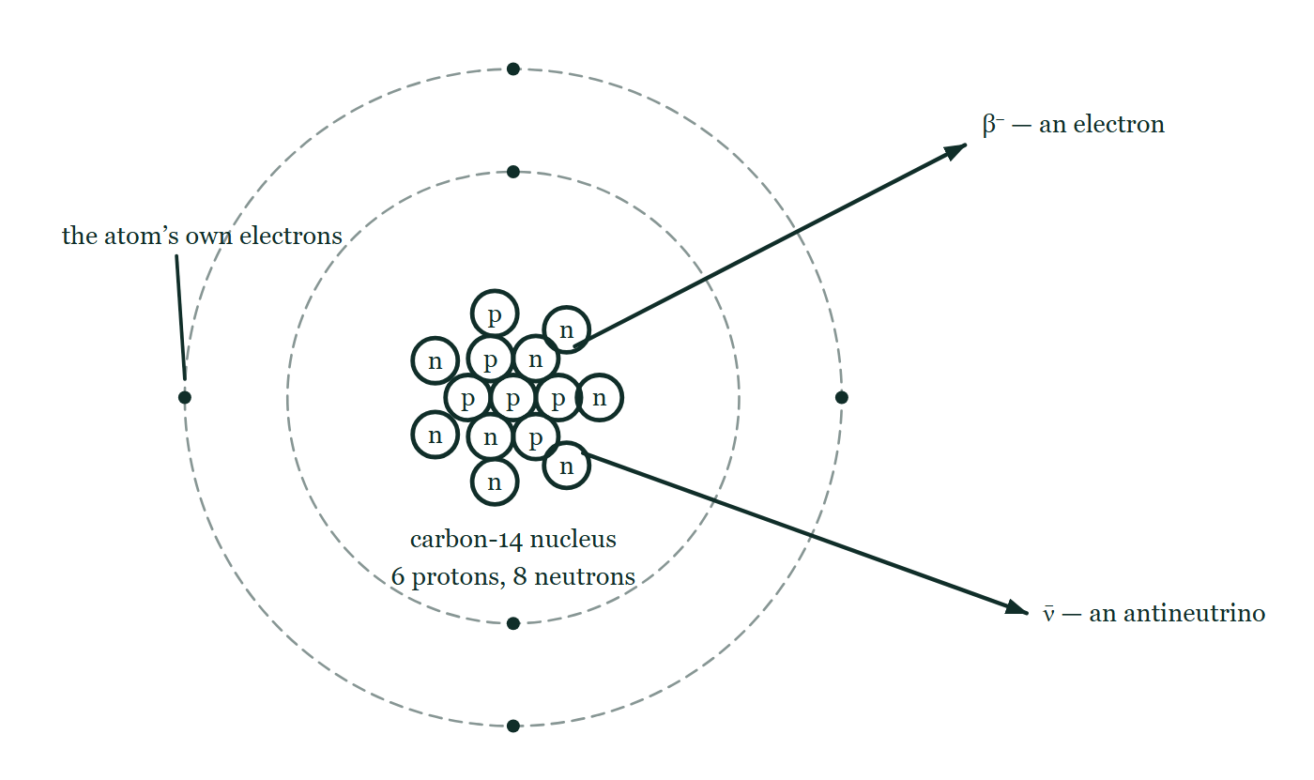
ATOMIC PHYSICS · RADIOACTIVE DECAY
GIOPHYSICS LESSON
THINK FIRST
A beta particle is an electron. An atom is full of electrons. So which one comes out?
Take answers before you click — the point is the commitment
Carbon-14 has six electrons in shells around its nucleus and emits beta particles for thousands of years. The obvious question is whether it starts with the outermost one and works inwards.
THE ANSWER
None of them. The beta electron did not exist a moment before it left: it is created inside the nucleus at the instant a neutron turns into a proton, along with an antineutrino. The atom's own six electrons are spectators throughout — a nucleus contains no electrons to lose.
A carbon-14 atom with its own electron shells drawn faint but plainly around a nucleus of six protons and eight neutrons, and two particles leaving it — a β⁻ electron and an antineutrino — with nothing on the figure saying where either of them was made.
The live version of this figure — click here
Atomic Physics — Radioactive Decay. Built by GioPhysics from the lesson's own copy; nothing on these slides is re-authored.
3 / 36
Notes:
[Phase] Starter: Recall what this lesson stands on (minutes 0–5 of 45)
[Hook] A beta particle is an electron. An atom is full of electrons. So which one comes out? Carbon-14 has six electrons in shells around its nucleus and emits beta particles for thousands of years. The obvious question is whether it starts with the outermost one and works inwards.
[Answer] None of them. The beta electron did not exist a moment before it left: it is created inside the nucleus at the instant a neutron turns into a proton, along with an antineutrino. The atom's own six electrons are spectators throughout — a nucleus contains no electrons to lose.
[Figure] A carbon-14 atom with its own electron shells drawn faint but plainly around a nucleus of six protons and eight neutrons, and two particles leaving it — a β⁻ electron and an antineutrino — with nothing on the figure saying where either of them was made.

Slide 4
ATOMIC PHYSICS · RADIOACTIVE DECAY
GIOPHYSICS LESSON
EXPLAINED SIMPLY
In one sentence
Introduce the idea — The big idea and the definition
Radioactive decay is the spontaneous, random transformation of an unstable nucleus into a more stable one, emitting alpha particles (⁴He nuclei), beta particles (electrons or positrons, with antineutrinos or neutrinos), or gamma rays (photons).
Atomic Physics — Radioactive Decay. Built by GioPhysics from the lesson's own copy; nothing on these slides is re-authored.
4 / 36
Notes:
[Phase] Introduce the idea: The big idea and the definition (minutes 5–13 of 45)
[Definition] Radioactive decay is the spontaneous, random transformation of an unstable nucleus into a more stable one, emitting alpha particles (⁴He nuclei), beta particles (electrons or positrons, with antineutrinos or neutrinos), or gamma rays (photons).

Slide 5
ATOMIC PHYSICS · RADIOACTIVE DECAY
GIOPHYSICS LESSON
EXPLAINED SIMPLY
What that looks like
Introduce the idea — The big idea and the definition
FOR EXAMPLE
Americium-241 in a smoke detector fires out alpha particles: ²⁴¹Am → ²³⁷Np + ⁴He. The alphas ionise the air in the sensing chamber; smoke interrupts the tiny current and the alarm sounds.
Atomic Physics — Radioactive Decay. Built by GioPhysics from the lesson's own copy; nothing on these slides is re-authored.
5 / 36
Notes:
[Phase] Introduce the idea: The big idea and the definition (minutes 5–13 of 45)
[Worked illustration] Americium-241 in a smoke detector fires out alpha particles: ²⁴¹Am → ²³⁷Np + ⁴He. The alphas ionise the air in the sensing chamber; smoke interrupts the tiny current and the alarm sounds.

Slide 6
ATOMIC PHYSICS · RADIOACTIVE DECAY
GIOPHYSICS LESSON
THE BIG IDEA
Nuclei that rebuild themselves
Introduce the idea — The big idea and the definition
A nuclide is written with nucleon number A and proton number Z, where A = Z + N. Isotopes of an element share Z but differ in N. A nucleus is stable only if its neutron–proton mix balances the strong nuclear force against Coulomb repulsion; stray from the valley of stability and it decays.
Alpha decay throws out a helium nucleus (A drops 4, Z drops 2). Beta-minus decay turns a neutron into a proton, emitting an electron and an antineutrino; beta-plus turns a proton into a neutron, emitting a positron and a neutrino. Gamma decay is an excited nucleus shedding a photon — no change to A or Z.
Every decay equation must balance both A and Z, the process is random for any single nucleus, and a steady background of natural radiation is everywhere.
Atomic Physics — Radioactive Decay. Built by GioPhysics from the lesson's own copy; nothing on these slides is re-authored.
6 / 36
Notes:
[Phase] Introduce the idea: The big idea and the definition (minutes 5–13 of 45)
[Big idea] A nuclide is written with nucleon number A and proton number Z, where A = Z + N. Isotopes of an element share Z but differ in N. A nucleus is stable only if its neutron–proton mix balances the strong nuclear force against Coulomb repulsion; stray from the valley of stability and it decays. Alpha decay throws out a helium nucleus (A drops 4, Z drops 2). Beta-minus decay turns a neutron into a proton, emitting an electron and an antineutrino; beta-plus turns a proton into a neutron, emitting a positron and a neutrino. Gamma decay is an excited nucleus shedding a photon — no change to A or Z. Every decay equation must balance both A and Z, the process is random for any single nucleus, and a steady background of natural radiation is everywhere.

Slide 7
ATOMIC PHYSICS · RADIOACTIVE DECAY
GIOPHYSICS LESSON
THE PHYSICS · 1 OF 3
Three radiations, three characters
Build the model — The formulae, one at a time, in plain English
Alpha: heavy, charge +2, ferociously ionising, stopped by paper or a few centimetres of air. Beta: light, charge −1 (or +1), moderately ionising, stopped by a few millimetres of aluminium.
Gamma: an uncharged photon, weakly ionising but penetrating — it takes centimetres of lead to tame it. A magnetic field sorts all three: alphas and betas bend opposite ways, gammas fly straight through.
Atomic Physics — Radioactive Decay. Built by GioPhysics from the lesson's own copy; nothing on these slides is re-authored.
7 / 36
Notes:
[Phase] Build the model: The formulae, one at a time, in plain English (minutes 13–22 of 45)
[Section] Alpha: heavy, charge +2, ferociously ionising, stopped by paper or a few centimetres of air. Beta: light, charge −1 (or +1), moderately ionising, stopped by a few millimetres of aluminium. Gamma: an uncharged photon, weakly ionising but penetrating — it takes centimetres of lead to tame it. A magnetic field sorts all three: alphas and betas bend opposite ways, gammas fly straight through.

Slide 8
ATOMIC PHYSICS · RADIOACTIVE DECAY
GIOPHYSICS LESSON
THE PHYSICS · 2 OF 3
The valley of stability
Build the model — The formulae, one at a time, in plain English
Up to about Z = 20 stable nuclei keep N ≈ Z. Beyond that, extra neutrons are needed — they add strong-force glue without adding Coulomb repulsion — so the stable line bends toward N ≈ 1.5Z. Too many neutrons and the nucleus beta-minus decays; too many protons and it beta-plus decays; above Z = 83 no mix works and heavy nuclei shed alphas, often in long chains ending at stable lead.
Atomic Physics — Radioactive Decay. Built by GioPhysics from the lesson's own copy; nothing on these slides is re-authored.
8 / 36
Notes:
[Phase] Build the model: The formulae, one at a time, in plain English (minutes 13–22 of 45)
[Section] Up to about Z = 20 stable nuclei keep N ≈ Z. Beyond that, extra neutrons are needed — they add strong-force glue without adding Coulomb repulsion — so the stable line bends toward N ≈ 1.5Z. Too many neutrons and the nucleus beta-minus decays; too many protons and it beta-plus decays; above Z = 83 no mix works and heavy nuclei shed alphas, often in long chains ending at stable lead.

Slide 9
ATOMIC PHYSICS · RADIOACTIVE DECAY
GIOPHYSICS LESSON
THE PHYSICS · 3 OF 3
Random, and everywhere
Build the model — The formulae, one at a time, in plain English
No experiment can predict when a particular nucleus will decay — only the probability. Decay is unaffected by temperature, pressure, or chemistry: the nucleus does not care what the electrons are doing. Meanwhile radon from the ground, carbon-14 in food, cosmic rays, and medical scans give everyone a background dose of a few millisieverts a year — the baseline any measurement must subtract.
Atomic Physics — Radioactive Decay. Built by GioPhysics from the lesson's own copy; nothing on these slides is re-authored.
9 / 36
Notes:
[Phase] Build the model: The formulae, one at a time, in plain English (minutes 13–22 of 45)
[Section] No experiment can predict when a particular nucleus will decay — only the probability. Decay is unaffected by temperature, pressure, or chemistry: the nucleus does not care what the electrons are doing. Meanwhile radon from the ground, carbon-14 in food, cosmic rays, and medical scans give everyone a background dose of a few millisieverts a year — the baseline any measurement must subtract.

Slide 10
ATOMIC PHYSICS · RADIOACTIVE DECAY
GIOPHYSICS LESSON
FORMULA 1 OF 3
Nuclide notation
Build the model — The formulae, one at a time, in plain English
A = Z + N
A nucleons = Z protons + N neutrons
IN PLAIN ENGLISH
Written as the element symbol with A up and Z down. Z fixes the element and its chemistry; N only adds mass — isotopes are chemically identical twins of different weight.
Atomic Physics — Radioactive Decay. Built by GioPhysics from the lesson's own copy; nothing on these slides is re-authored.
10 / 36
Notes:
[Phase] Build the model: The formulae, one at a time, in plain English (minutes 13–22 of 45)
[Formula] Nuclide notation: A = Z + N
[In plain English] Written as the element symbol with A up and Z down. Z fixes the element and its chemistry; N only adds mass — isotopes are chemically identical twins of different weight.
[Note] A nucleons = Z protons + N neutrons

Slide 11
ATOMIC PHYSICS · RADIOACTIVE DECAY
GIOPHYSICS LESSON
FORMULA 2 OF 3
Alpha decay
Build the model — The formulae, one at a time, in plain English
ᴬX → ᴬ⁻⁴Y + ⁴He
Z drops by 2, A drops by 4
IN PLAIN ENGLISH
Heavy nuclei shed a tightly bound helium-4 package. Each alpha leaves with a definite energy of a few MeV — enough to ionise thousands of atoms, which is exactly why alphas are dangerous and useful.
Atomic Physics — Radioactive Decay. Built by GioPhysics from the lesson's own copy; nothing on these slides is re-authored.
11 / 36
Notes:
[Phase] Build the model: The formulae, one at a time, in plain English (minutes 13–22 of 45)
[Formula] Alpha decay: ᴬX → ᴬ⁻⁴Y + ⁴He
[In plain English] Heavy nuclei shed a tightly bound helium-4 package. Each alpha leaves with a definite energy of a few MeV — enough to ionise thousands of atoms, which is exactly why alphas are dangerous and useful.
[Note] Z drops by 2, A drops by 4

Slide 12
ATOMIC PHYSICS · RADIOACTIVE DECAY
GIOPHYSICS LESSON
FORMULA 3 OF 3
Beta-minus decay
Build the model — The formulae, one at a time, in plain English
n → p + e⁻ + ν̄
Z rises by 1, A unchanged; antineutrino required
IN PLAIN ENGLISH
A neutron-rich nucleus converts a neutron to a proton. The electron shares the released energy with an antineutrino — which is why beta particles emerge with a spread of energies, not one.
Atomic Physics — Radioactive Decay. Built by GioPhysics from the lesson's own copy; nothing on these slides is re-authored.
12 / 36
Notes:
[Phase] Build the model: The formulae, one at a time, in plain English (minutes 13–22 of 45)
[Formula] Beta-minus decay: n → p + e⁻ + ν̄
[In plain English] A neutron-rich nucleus converts a neutron to a proton. The electron shares the released energy with an antineutrino — which is why beta particles emerge with a spread of energies, not one.
[Note] Z rises by 1, A unchanged; antineutrino required

Slide 13
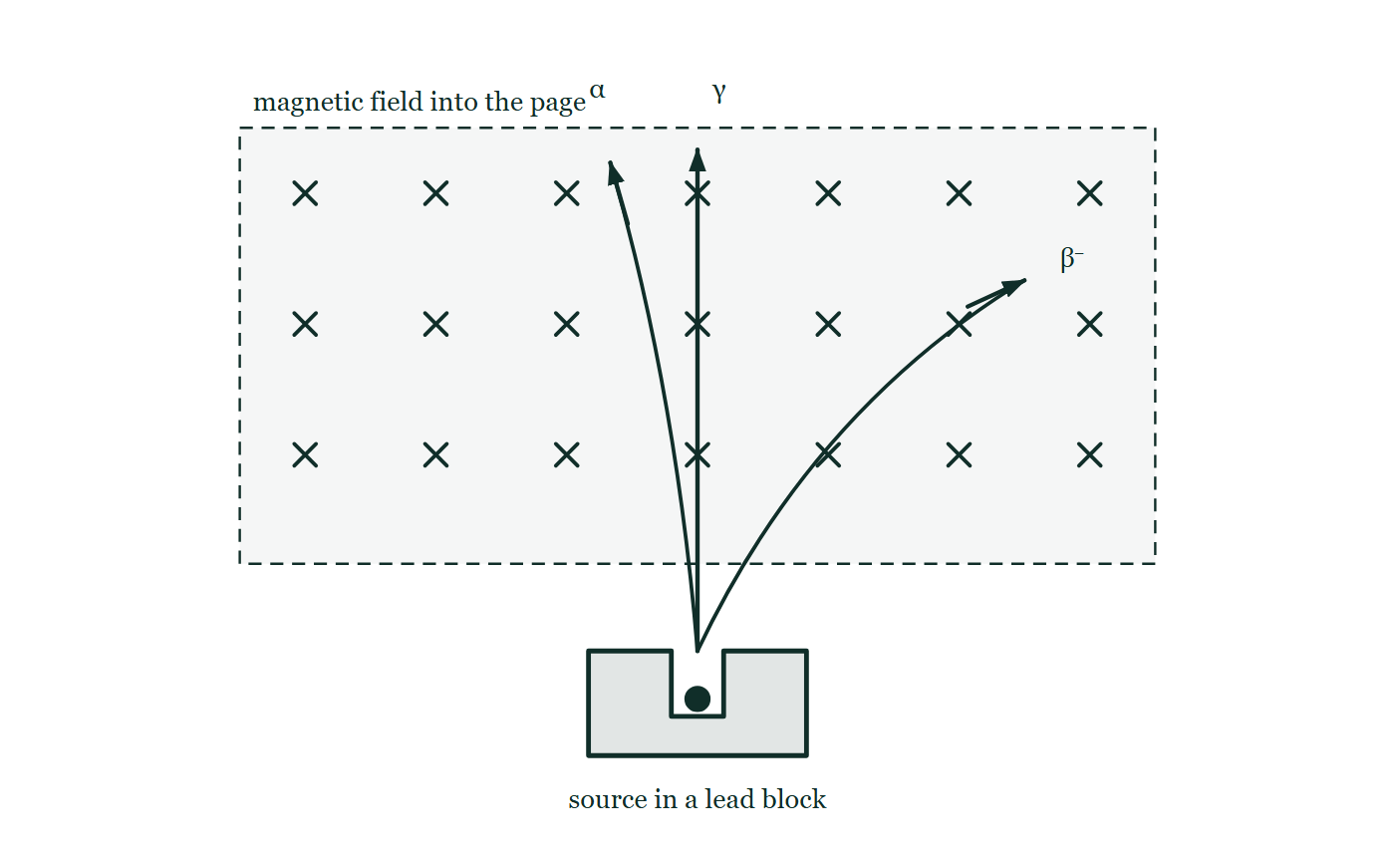
ATOMIC PHYSICS · RADIOACTIVE DECAY
GIOPHYSICS LESSON
THE PICTURE
Sorted by a magnetic field
Drawn for this lesson
A source in a lead block fires three tracks up the page across a field directed into it: one bending gently to the left marked α, one bending sharply the other way marked β⁻, and one running straight through marked γ.
The live version of this figure — click here
Atomic Physics — Radioactive Decay. Built by GioPhysics from the lesson's own copy; nothing on these slides is re-authored.
13 / 36
Notes:
[Phase] Build the model: The formulae, one at a time, in plain English (minutes 13–22 of 45)
[Figure] A source in a lead block fires three tracks up the page across a field directed into it: one bending gently to the left marked α, one bending sharply the other way marked β⁻, and one running straight through marked γ.

Slide 14
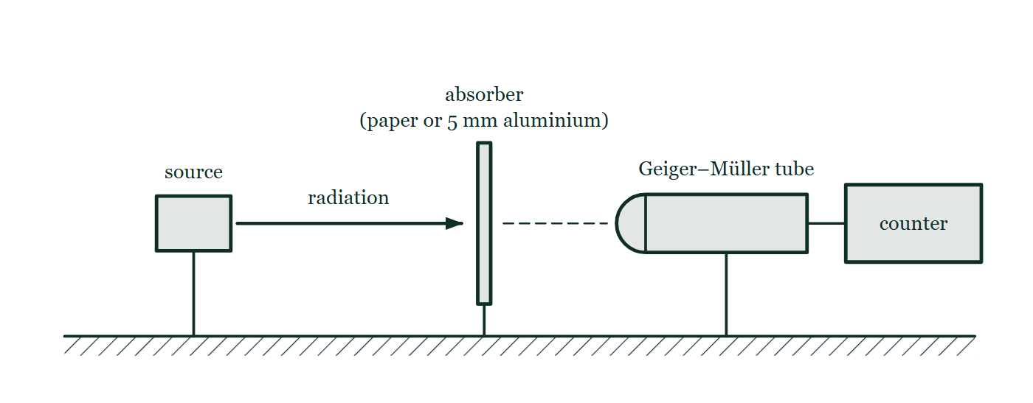
ATOMIC PHYSICS · RADIOACTIVE DECAY
GIOPHYSICS LESSON
FIGURE 1 OF 4
Fig. 2.1 — IGCSE Topic 5 · Nuclear physics
Drawn for question 2 of that paper · syllabus 5.2
A radioactive source in a holder stands on the bench facing a Geiger–Müller tube that is joined by a lead to a counter. Between them an absorber is held upright in the path of the radiation: either a sheet of paper or a 5 mm sheet of aluminium. The source, the absorber and the window of the tube all lie on the same horizontal line, and the distance between the source and the tube is not changed when the absorber is put in place.
See the question this was drawn for — click here
Atomic Physics — Radioactive Decay. Built by GioPhysics from the lesson's own copy; nothing on these slides is re-authored.
14 / 36
Notes:
[Phase] Build the model: The formulae, one at a time, in plain English (minutes 13–22 of 45)
[Figure] Fig. 2.1. A radioactive source in a holder stands on the bench facing a Geiger–Müller tube that is joined by a lead to a counter. Between them an absorber is held upright in the path of the radiation: either a sheet of paper or a 5 mm sheet of aluminium. The source, the absorber and the window of the tube all lie on the same horizontal line, and the distance between the source and the tube is not changed when the absorber is put in place.
[Where it came from] IGCSE Topic 5 · Nuclear physics, question 2; syllabus 5.2.

Slide 15
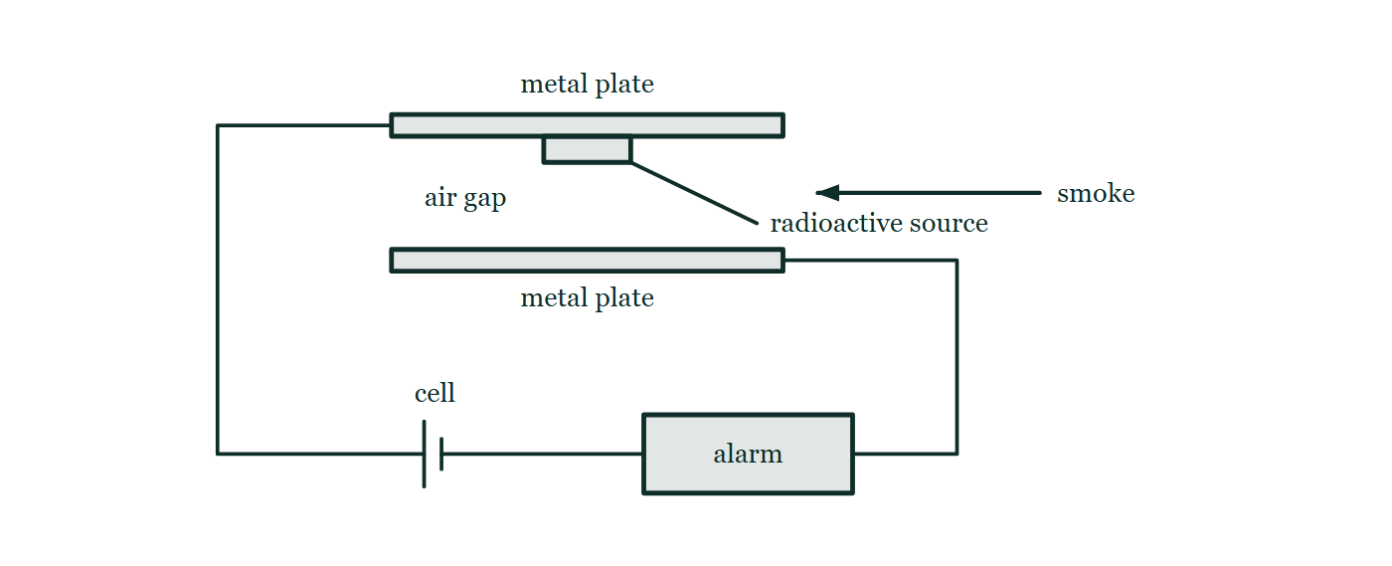
ATOMIC PHYSICS · RADIOACTIVE DECAY
GIOPHYSICS LESSON
FIGURE 2 OF 4
Fig. 6.1 — IGCSE Topic 5 · Nuclear physics
Drawn for question 6 of that paper · syllabus 5.2
A cut-through view of the ionisation chamber of a smoke alarm. Two horizontal metal plates face each other across a small air gap, and a radioactive source is fixed to the underside of the upper plate so that it irradiates the gap. A wire from the upper plate leads to a cell and a wire from the lower plate leads to the alarm, so the two plates and the air gap between them form part of one complete series circuit. An arrow shows smoke drifting sideways into the gap.
See the question this was drawn for — click here
Atomic Physics — Radioactive Decay. Built by GioPhysics from the lesson's own copy; nothing on these slides is re-authored.
15 / 36
Notes:
[Phase] Build the model: The formulae, one at a time, in plain English (minutes 13–22 of 45)
[Figure] Fig. 6.1. A cut-through view of the ionisation chamber of a smoke alarm. Two horizontal metal plates face each other across a small air gap, and a radioactive source is fixed to the underside of the upper plate so that it irradiates the gap. A wire from the upper plate leads to a cell and a wire from the lower plate leads to the alarm, so the two plates and the air gap between them form part of one complete series circuit. An arrow shows smoke drifting sideways into the gap.
[Where it came from] IGCSE Topic 5 · Nuclear physics, question 6; syllabus 5.2.

Slide 16
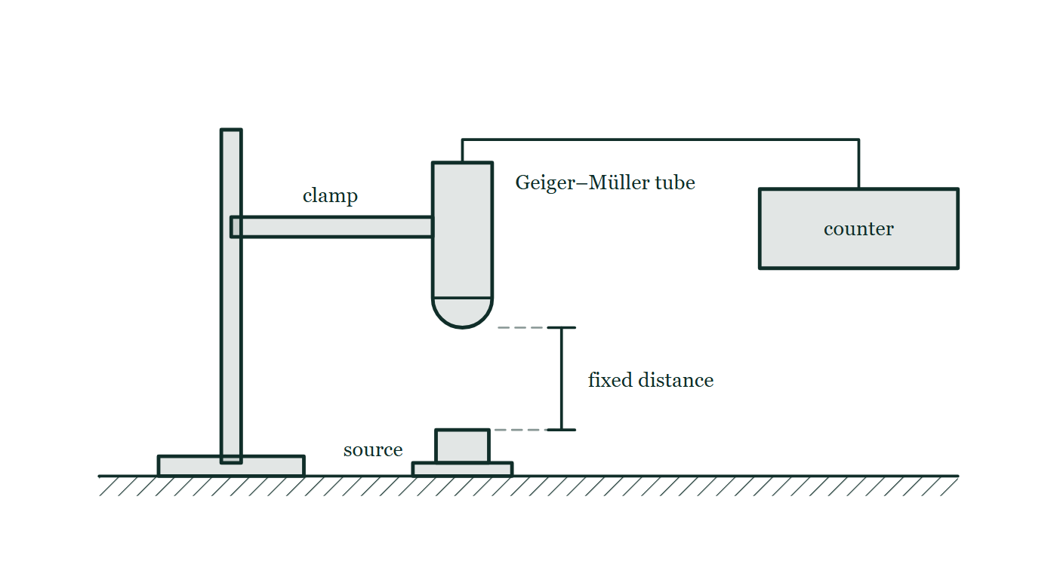
ATOMIC PHYSICS · RADIOACTIVE DECAY
GIOPHYSICS LESSON
FIGURE 3 OF 4
Fig. 10.1 — IGCSE Topic 5 · Nuclear physics
Drawn for question 10 of that paper · syllabus 5.2
The arrangement used for the measurements. A Geiger–Müller tube is held vertically in a clamp on a retort stand with its window facing downwards, and is joined by a lead to a counter standing on the bench. The radioactive source sits on the bench directly beneath the tube, and the vertical gap between the tube window and the source is marked as a fixed distance which is kept the same for every reading.
See the question this was drawn for — click here
Atomic Physics — Radioactive Decay. Built by GioPhysics from the lesson's own copy; nothing on these slides is re-authored.
16 / 36
Notes:
[Phase] Build the model: The formulae, one at a time, in plain English (minutes 13–22 of 45)
[Figure] Fig. 10.1. The arrangement used for the measurements. A Geiger–Müller tube is held vertically in a clamp on a retort stand with its window facing downwards, and is joined by a lead to a counter standing on the bench. The radioactive source sits on the bench directly beneath the tube, and the vertical gap between the tube window and the source is marked as a fixed distance which is kept the same for every reading.
[Where it came from] IGCSE Topic 5 · Nuclear physics, question 10; syllabus 5.2.

Slide 17
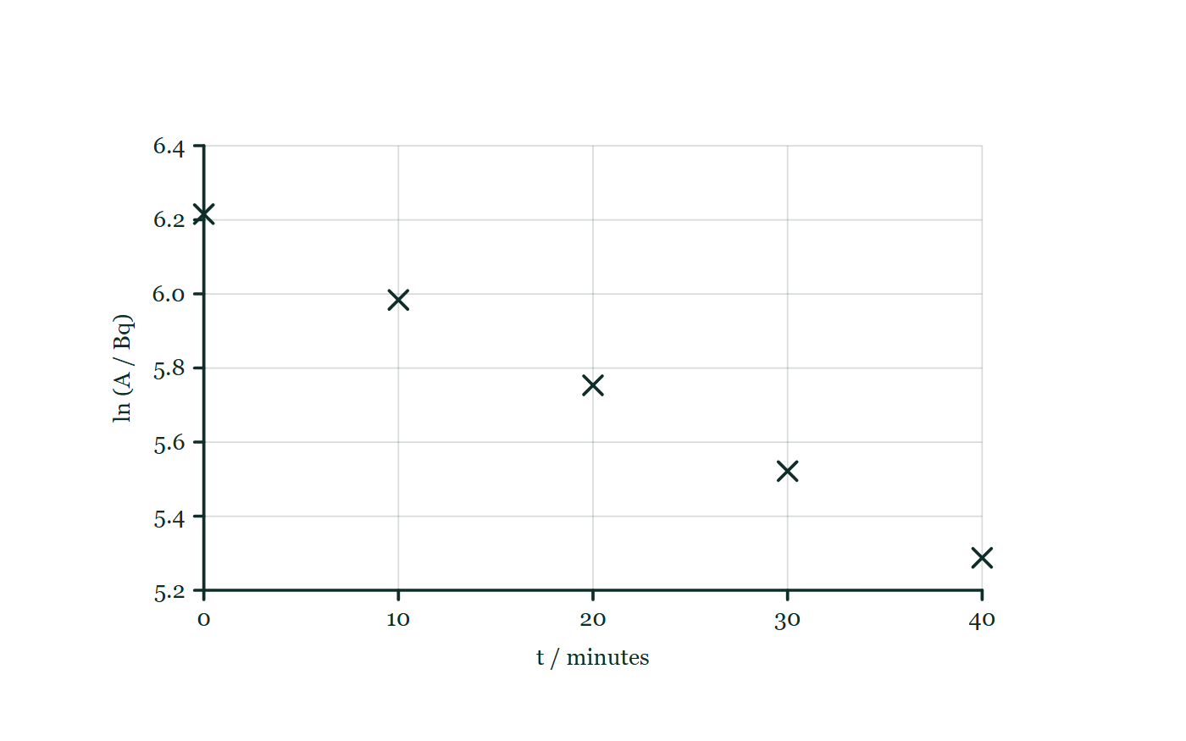
ATOMIC PHYSICS · RADIOACTIVE DECAY
GIOPHYSICS LESSON
FIGURE 4 OF 4
Fig. 7.1 — IB Theme E · Nuclear and quantum physics
Drawn for question 7 of that paper · syllabus E.3
A gridded graph with ln (A / Bq) on the vertical axis, scaled from 5.2 to 6.4 in steps of 0.2, plotted against t / minutes on the horizontal axis, scaled from 0 to 40 in steps of 10. The five processed readings given in the table are plotted as small crosses, one at each ten-minute interval, and they fall steadily from left to right. No line has been drawn through the points.
See the question this was drawn for — click here
Atomic Physics — Radioactive Decay. Built by GioPhysics from the lesson's own copy; nothing on these slides is re-authored.
17 / 36
Notes:
[Phase] Build the model: The formulae, one at a time, in plain English (minutes 13–22 of 45)
[Figure] Fig. 7.1. A gridded graph with ln (A / Bq) on the vertical axis, scaled from 5.2 to 6.4 in steps of 0.2, plotted against t / minutes on the horizontal axis, scaled from 0 to 40 in steps of 10. The five processed readings given in the table are plotted as small crosses, one at each ten-minute interval, and they fall steadily from left to right. No line has been drawn through the points.
[Where it came from] IB Theme E · Nuclear and quantum physics, question 7; syllabus E.3.

Slide 18
ATOMIC PHYSICS · RADIOACTIVE DECAY
GIOPHYSICS LESSON
WATCH OUT
The common trap
Check and misconception — The quick check and the trap
Beta particles are electrons, but they do not come from the atom’s electron shells. They are created in the nucleus at the instant a neutron converts into a proton — a nucleus that contains no electrons at all until the moment one is born and ejected. The antineutrino born alongside it is why beta energies form a spectrum rather than a single value.
Atomic Physics — Radioactive Decay. Built by GioPhysics from the lesson's own copy; nothing on these slides is re-authored.
18 / 36
Notes:
[Phase] Check and misconception: The quick check and the trap (minutes 35–41 of 45)
[Misconception] Beta particles are electrons, but they do not come from the atom’s electron shells. They are created in the nucleus at the instant a neutron converts into a proton — a nucleus that contains no electrons at all until the moment one is born and ejected. The antineutrino born alongside it is why beta energies form a spectrum rather than a single value.

Slide 19
ATOMIC PHYSICS · RADIOACTIVE DECAY
GIOPHYSICS LESSON
WORKED EXAMPLE 1 OF 2 · EASY
The question
Easy
Worked examples — I do, we do — one step revealed at a time
Radium-226 (Z = 88) decays by alpha emission. Complete the equation ²²⁶Ra → ?Rn + ⁴He and check it balances.
Atomic Physics — Radioactive Decay. Built by GioPhysics from the lesson's own copy; nothing on these slides is re-authored.
19 / 36
Notes:
[Phase] Worked examples: I do, we do — one step revealed at a time (minutes 22–35 of 45)
[Question] Radium-226 (Z = 88) decays by alpha emission. Complete the equation ²²⁶Ra → ?Rn + ⁴He and check it balances.
[Answer] ²²²Rn (radon-222) — both A and Z balance

Slide 20
ATOMIC PHYSICS · RADIOACTIVE DECAY
GIOPHYSICS LESSON
WORKED EXAMPLE 1 OF 2 · EASY · THE WORKING
How to solve it
Easy
Worked examples — I do, we do — one step revealed at a time
Radium-226 (Z = 88) decays by alpha emission. Complete the equation ²²⁶Ra → ?Rn + ⁴He and check it balances.
1.
Alpha decay removes 2 protons and 2 neutrons: A = 226 − 4 = 222, Z = 88 − 2 = 86.
2.
²²⁶₈₈Ra → ²²²₈₆Rn + ⁴₂He.
3.
Check: nucleons 226 = 222 + 4 ✓; charge 88 = 86 + 2 ✓.
Atomic Physics — Radioactive Decay. Built by GioPhysics from the lesson's own copy; nothing on these slides is re-authored.
20 / 36
Notes:
[Phase] Worked examples: I do, we do — one step revealed at a time (minutes 22–35 of 45)
[Reveal] One click per step. The class works each line before the next appears.
[Step 1] Alpha decay removes 2 protons and 2 neutrons: A = 226 − 4 = 222, Z = 88 − 2 = 86.
[Step 2] ²²⁶₈₈Ra → ²²²₈₆Rn + ⁴₂He.
[Step 3] Check: nucleons 226 = 222 + 4 ✓; charge 88 = 86 + 2 ✓.

Slide 21
ATOMIC PHYSICS · RADIOACTIVE DECAY
GIOPHYSICS LESSON
WORKED EXAMPLE 1 OF 2 · EASY
Answer
Easy
Worked examples — I do, we do — one step revealed at a time
²²²Rn (radon-222) — both A and Z balance
Atomic Physics — Radioactive Decay. Built by GioPhysics from the lesson's own copy; nothing on these slides is re-authored.
21 / 36
Notes:
[Phase] Worked examples: I do, we do — one step revealed at a time (minutes 22–35 of 45)
[Answer] ²²²Rn (radon-222) — both A and Z balance

Slide 22
ATOMIC PHYSICS · RADIOACTIVE DECAY
GIOPHYSICS LESSON
WORKED EXAMPLE 2 OF 2 · MEDIUM
The question
Medium
Worked examples — I do, we do — one step revealed at a time
Write the full equation for the beta-minus decay of carbon-14 (Z = 6) into nitrogen.
Atomic Physics — Radioactive Decay. Built by GioPhysics from the lesson's own copy; nothing on these slides is re-authored.
22 / 36
Notes:
[Phase] Worked examples: I do, we do — one step revealed at a time (minutes 22–35 of 45)
[Question] Write the full equation for the beta-minus decay of carbon-14 (Z = 6) into nitrogen.
[Answer] ¹⁴C → ¹⁴N + e⁻ + ν̄

Slide 23
ATOMIC PHYSICS · RADIOACTIVE DECAY
GIOPHYSICS LESSON
WORKED EXAMPLE 2 OF 2 · MEDIUM · THE WORKING
How to solve it
Medium
Worked examples — I do, we do — one step revealed at a time
Write the full equation for the beta-minus decay of carbon-14 (Z = 6) into nitrogen.
1.
A neutron becomes a proton, so Z: 6 → 7 while A stays 14.
2.
The emitted electron carries A = 0, Z = −1, and beta-minus decay must include an antineutrino.
3.
¹⁴₆C → ¹⁴₇N + ⁰₋₁e + ν̄. Nucleons: 14 = 14 + 0 ✓; charge: 6 = 7 − 1 ✓.
Atomic Physics — Radioactive Decay. Built by GioPhysics from the lesson's own copy; nothing on these slides is re-authored.
23 / 36
Notes:
[Phase] Worked examples: I do, we do — one step revealed at a time (minutes 22–35 of 45)
[Reveal] One click per step. The class works each line before the next appears.
[Step 1] A neutron becomes a proton, so Z: 6 → 7 while A stays 14.
[Step 2] The emitted electron carries A = 0, Z = −1, and beta-minus decay must include an antineutrino.
[Step 3] ¹⁴₆C → ¹⁴₇N + ⁰₋₁e + ν̄. Nucleons: 14 = 14 + 0 ✓; charge: 6 = 7 − 1 ✓.

Slide 24
ATOMIC PHYSICS · RADIOACTIVE DECAY
GIOPHYSICS LESSON
WORKED EXAMPLE 2 OF 2 · MEDIUM
Answer
Medium
Worked examples — I do, we do — one step revealed at a time
¹⁴C → ¹⁴N + e⁻ + ν̄
Atomic Physics — Radioactive Decay. Built by GioPhysics from the lesson's own copy; nothing on these slides is re-authored.
24 / 36
Notes:
[Phase] Worked examples: I do, we do — one step revealed at a time (minutes 22–35 of 45)
[Answer] ¹⁴C → ¹⁴N + e⁻ + ν̄

Slide 25
ATOMIC PHYSICS · RADIOACTIVE DECAY
GIOPHYSICS LESSON
SPOT THE MISTAKE
One line here is wrong
The whole working is up — find the bad line before you click
1.
Write the full equation for the beta-minus decay of carbon-14 (Z = 6) into nitrogen.
2.
A neutron becomes a proton, so Z rises from 6 to 7.
3.
A is unchanged at 14.
4.
¹⁴₆C → ¹⁴₇N + ⁰₋₁e
5.
Nucleons: 14 = 14 + 0 ✓. Charge: 6 = 7 − 1 ✓. The equation balances.
LINE 4 IS WRONG
The antineutrino is missing. What makes this the hardest slip in the chapter to catch is that the check on the line below genuinely passes: A and Z do balance without it. Lepton number does not — the right-hand side has L = +1 against L = 0 on the left — and the experimental evidence is the beta energy spectrum, which is a continuous spread rather than a single value because two particles share the energy released.
IT SHOULD SAY
¹⁴₆C → ¹⁴₇N + ⁰₋₁e + ν̄ₑ
Atomic Physics — Radioactive Decay. Built by GioPhysics from the lesson's own copy; nothing on these slides is re-authored.
25 / 36
Notes:
[Phase] Worked examples: I do, we do — one step revealed at a time (minutes 22–35 of 45)
[Spot the mistake] The working is complete and one line of it is wrong. Let the room hunt: one click names the line, a second shows it done correctly.
[Line 4 is wrong] The antineutrino is missing. What makes this the hardest slip in the chapter to catch is that the check on the line below genuinely passes: A and Z do balance without it. Lepton number does not — the right-hand side has L = +1 against L = 0 on the left — and the experimental evidence is the beta energy spectrum, which is a continuous spread rather than a single value because two particles share the energy released.
[It should say] ¹⁴₆C → ¹⁴₇N + ⁰₋₁e + ν̄ₑ

Slide 26
ATOMIC PHYSICS · RADIOACTIVE DECAY
GIOPHYSICS LESSON
PREDICT · TAKE THE VOTE
Commit before you are told
Hands up for each option, then click
Carbon-14 emits a beta particle. Which of the electrons in this picture is it?
A One of the outer shell electrons — the most loosely held
B One from the innermost shell, closest to the nucleus
C None of them — it is made in the nucleus at the moment of decay
A carbon-14 atom with its own electron shells drawn faint but plainly around a nucleus of six protons and eight neutrons, and two particles leaving it — a β⁻ electron and an antineutrino — with nothing on the figure saying where either of them was made.
The live version of this figure — click here
Atomic Physics — Radioactive Decay. Built by GioPhysics from the lesson's own copy; nothing on these slides is re-authored.
26 / 36
Notes:
[Phase] Build the model: The formulae, one at a time, in plain English (minutes 13–22 of 45)
[Predict] Carbon-14 emits a beta particle. Which of the electrons in this picture is it?
[Options] A One of the outer shell electrons — the most loosely held B One from the innermost shell, closest to the nucleus C None of them — it is made in the nucleus at the moment of decay
[Figure] A carbon-14 atom with its own electron shells drawn faint but plainly around a nucleus of six protons and eight neutrons, and two particles leaving it — a β⁻ electron and an antineutrino — with nothing on the figure saying where either of them was made.

Slide 27
ATOMIC PHYSICS · RADIOACTIVE DECAY
GIOPHYSICS LESSON
PREDICT · THE OUTCOME
What actually happens
Ask the room who changed their mind, and why
C None of them — it is made in the nucleus at the moment of decay
WHY
The shells are drawn precisely so this can be voted on and then ruled out. Beta-minus decay is n → p + e⁻ + ν̄: a neutron in the nucleus becomes a proton, and the electron and the antineutrino are both created on the spot to balance charge and lepton number. Nothing leaves the shells; the atom simply finds itself a nitrogen atom with one electron too few, and picks one up later.
Atomic Physics — Radioactive Decay. Built by GioPhysics from the lesson's own copy; nothing on these slides is re-authored.
27 / 36
Notes:
[Phase] Build the model: The formulae, one at a time, in plain English (minutes 13–22 of 45)
[Answer] C — None of them — it is made in the nucleus at the moment of decay. The shells are drawn precisely so this can be voted on and then ruled out. Beta-minus decay is n → p + e⁻ + ν̄: a neutron in the nucleus becomes a proton, and the electron and the antineutrino are both created on the spot to balance charge and lepton number. Nothing leaves the shells; the atom simply finds itself a nitrogen atom with one electron too few, and picks one up later.

Slide 28
ATOMIC PHYSICS · RADIOACTIVE DECAY
GIOPHYSICS LESSON
QUICK CHECK
Decide before the answer goes up
Check and misconception — The quick check and the trap
In beta-minus decay the nucleon number A of the nucleus…
A
Falls by 1, because a particle is emitted
B
Stays the same, because a neutron became a proton
C
Rises by 1, because a proton is created
Atomic Physics — Radioactive Decay. Built by GioPhysics from the lesson's own copy; nothing on these slides is re-authored.
28 / 36
Notes:
[Phase] Check and misconception: The quick check and the trap (minutes 35–41 of 45)
[Question] In beta-minus decay the nucleon number A of the nucleus…
[Options] A Falls by 1, because a particle is emitted B Stays the same, because a neutron became a proton C Rises by 1, because a proton is created

Slide 29
ATOMIC PHYSICS · RADIOACTIVE DECAY
GIOPHYSICS LESSON
QUICK CHECK · THE ANSWER
The answer, and why
Check and misconception — The quick check and the trap
B Stays the same, because a neutron became a proton
HOW TO GET THERE
n → p + e⁻ + ν̄ swaps one nucleon type for another: Z rises by 1, N falls by 1, and A = Z + N is unchanged.
WHY THE OTHERS TEMPT
A Something certainly leaves — but an electron is not a nucleon. A counts protons and neutrons only, and the count stays at 14 all the way from carbon-14 to nitrogen-14.
B Correct. n → p + e⁻ + ν̄ swaps one nucleon type for another: Z rises by 1, N falls by 1, and A = Z + N does not move.
C A proton is created, but not out of nothing — it is the neutron that became it. So the nucleus holds the same number of nucleons as before and A is unchanged. Z is the number that rises by 1.
Atomic Physics — Radioactive Decay. Built by GioPhysics from the lesson's own copy; nothing on these slides is re-authored.
29 / 36
Notes:
[Phase] Check and misconception: The quick check and the trap (minutes 35–41 of 45)
[Question] In beta-minus decay the nucleon number A of the nucleus…
[Option by option] A: Something certainly leaves — but an electron is not a nucleon. A counts protons and neutrons only, and the count stays at 14 all the way from carbon-14 to nitrogen-14. B: Correct. n → p + e⁻ + ν̄ swaps one nucleon type for another: Z rises by 1, N falls by 1, and A = Z + N does not move. C: A proton is created, but not out of nothing — it is the neutron that became it. So the nucleus holds the same number of nucleons as before and A is unchanged. Z is the number that rises by 1.
[Answer] B — Stays the same, because a neutron became a proton
[Why] n → p + e⁻ + ν̄ swaps one nucleon type for another: Z rises by 1, N falls by 1, and A = Z + N is unchanged.
[Reveal] One click for the answer, then one for the reason.

Slide 30
ATOMIC PHYSICS · RADIOACTIVE DECAY
GIOPHYSICS LESSON
EXTENSION 1 OF 2 · HARD
The question
Hard
Worked examples — I do, we do — one step revealed at a time
Uranium-238 (Z = 92) undergoes one alpha decay followed by two beta-minus decays. Identify the resulting nuclide.
Atomic Physics — Radioactive Decay. Built by GioPhysics from the lesson's own copy; nothing on these slides is re-authored.
30 / 36
Notes:
[Phase] Worked examples: I do, we do — one step revealed at a time (minutes 22–35 of 45)
[Question] Uranium-238 (Z = 92) undergoes one alpha decay followed by two beta-minus decays. Identify the resulting nuclide.
[Answer] ²³⁴U — uranium again, with A down by 4

Slide 31
ATOMIC PHYSICS · RADIOACTIVE DECAY
GIOPHYSICS LESSON
EXTENSION 1 OF 2 · HARD · THE WORKING
How to solve it
Hard
Worked examples — I do, we do — one step revealed at a time
Uranium-238 (Z = 92) undergoes one alpha decay followed by two beta-minus decays. Identify the resulting nuclide.
1.
Alpha: ²³⁸U (Z = 92) → ²³⁴Th (Z = 90).
2.
First beta-minus: ²³⁴Th → ²³⁴Pa (Z = 91); second: ²³⁴Pa → ²³⁴U (Z = 92).
3.
The chain returns to uranium — same element, four nucleons lighter. This α, β, β step opens the long decay series that ends at stable lead-206.
Atomic Physics — Radioactive Decay. Built by GioPhysics from the lesson's own copy; nothing on these slides is re-authored.
31 / 36
Notes:
[Phase] Worked examples: I do, we do — one step revealed at a time (minutes 22–35 of 45)
[Reveal] One click per step. The class works each line before the next appears.
[Step 1] Alpha: ²³⁸U (Z = 92) → ²³⁴Th (Z = 90).
[Step 2] First beta-minus: ²³⁴Th → ²³⁴Pa (Z = 91); second: ²³⁴Pa → ²³⁴U (Z = 92).
[Step 3] The chain returns to uranium — same element, four nucleons lighter. This α, β, β step opens the long decay series that ends at stable lead-206.

Slide 32
ATOMIC PHYSICS · RADIOACTIVE DECAY
GIOPHYSICS LESSON
EXTENSION 1 OF 2 · HARD
Answer
Hard
Worked examples — I do, we do — one step revealed at a time
²³⁴U — uranium again, with A down by 4
Atomic Physics — Radioactive Decay. Built by GioPhysics from the lesson's own copy; nothing on these slides is re-authored.
32 / 36
Notes:
[Phase] Worked examples: I do, we do — one step revealed at a time (minutes 22–35 of 45)
[Answer] ²³⁴U — uranium again, with A down by 4

Slide 33
ATOMIC PHYSICS · RADIOACTIVE DECAY
GIOPHYSICS LESSON
EXTENSION 2 OF 2 · CHALLENGING
The question
Challenging
Worked examples — I do, we do — one step revealed at a time
Two protons in a nucleus sit about 1.0 × 10⁻¹⁵ m apart. Estimate their Coulomb repulsion, and explain why heavy nuclei need extra neutrons.
Atomic Physics — Radioactive Decay. Built by GioPhysics from the lesson's own copy; nothing on these slides is re-authored.
33 / 36
Notes:
[Phase] Worked examples: I do, we do — one step revealed at a time (minutes 22–35 of 45)
[Question] Two protons in a nucleus sit about 1.0 × 10⁻¹⁵ m apart. Estimate their Coulomb repulsion, and explain why heavy nuclei need extra neutrons.
[Answer] ≈ 230 N; neutrons add strong-force glue without Coulomb cost

Slide 34
ATOMIC PHYSICS · RADIOACTIVE DECAY
GIOPHYSICS LESSON
EXTENSION 2 OF 2 · CHALLENGING · THE WORKING
How to solve it
Challenging
Worked examples — I do, we do — one step revealed at a time
Two protons in a nucleus sit about 1.0 × 10⁻¹⁵ m apart. Estimate their Coulomb repulsion, and explain why heavy nuclei need extra neutrons.
1.
F = ke²/r² = 9 × 10⁹ × (1.6 × 10⁻¹⁹)² ÷ (1.0 × 10⁻¹⁵)².
2.
F ≈ 230 N — an enormous force on something of mass 10⁻²⁷ kg. Only the strong nuclear force, powerful but short-ranged, can hold protons this close.
3.
Every added proton repels every other proton across the whole nucleus, but the strong force only binds nearest neighbours. Neutrons add attraction without repulsion, so heavy nuclei run neutron-rich — and past Z = 83 even that fails, which is why every element beyond bismuth is radioactive.
Atomic Physics — Radioactive Decay. Built by GioPhysics from the lesson's own copy; nothing on these slides is re-authored.
34 / 36
Notes:
[Phase] Worked examples: I do, we do — one step revealed at a time (minutes 22–35 of 45)
[Reveal] One click per step. The class works each line before the next appears.
[Step 1] F = ke²/r² = 9 × 10⁹ × (1.6 × 10⁻¹⁹)² ÷ (1.0 × 10⁻¹⁵)².
[Step 2] F ≈ 230 N — an enormous force on something of mass 10⁻²⁷ kg. Only the strong nuclear force, powerful but short-ranged, can hold protons this close.
[Step 3] Every added proton repels every other proton across the whole nucleus, but the strong force only binds nearest neighbours. Neutrons add attraction without repulsion, so heavy nuclei run neutron-rich — and past Z = 83 even that fails, which is why every element beyond bismuth is radioactive.

Slide 35
ATOMIC PHYSICS · RADIOACTIVE DECAY
GIOPHYSICS LESSON
EXTENSION 2 OF 2 · CHALLENGING
Answer
Challenging
Worked examples — I do, we do — one step revealed at a time
≈ 230 N; neutrons add strong-force glue without Coulomb cost
Atomic Physics — Radioactive Decay. Built by GioPhysics from the lesson's own copy; nothing on these slides is re-authored.
35 / 36
Notes:
[Phase] Worked examples: I do, we do — one step revealed at a time (minutes 22–35 of 45)
[Answer] ≈ 230 N; neutrons add strong-force glue without Coulomb cost

Slide 36
ATOMIC PHYSICS · RADIOACTIVE DECAY
GIOPHYSICS LESSON
ATOMIC PHYSICS
Where to go next
Plenary — What to take away, what to practise next
Next
24.3 Half-Life & Activity
https://giophysics.com/chapter-46/half-life/
Lesson
This lesson on giophysics.com
https://giophysics.com/chapter-46/radioactivity/
Live
The live, interactive version of these slides
https://giophysics.com/chapter-46/presentation/?lesson=decay
Chapter
All Atomic Physics lessons
https://giophysics.com/chapter-46/
PDF
Download the lesson PDF
https://giophysics.com/downloads/46-2-radioactivity.pdf
Atomic Physics — Radioactive Decay. Built by GioPhysics from the lesson's own copy; nothing on these slides is re-authored.
36 / 36
Notes:
[Phase] Plenary: What to take away, what to practise next (minutes 41–45 of 45)
[Interactive] The graphs and the circuit topology on these slides are frozen. The live version at https://giophysics.com/chapter-46/presentation/?lesson=decay moves them.

