Slide 1
ATOMIC PHYSICS · HALF-LIFE & ACTIVITY
GIOPHYSICS LESSON
24 · Atomic Physics
Random alone, exponential together
Half-Life & Activity
You cannot say when one nucleus will decay — ever. But give me a trillion of them and I will tell you, to high precision, how many will survive the hour. Half-life is the bridge from perfect randomness to perfect predictability.
POSITION
Lesson 3 of 6 in Atomic Physics
PLAN
16 slides in the 45-minute core run, about 44.5 minutes of it
LESSON PAGE
https://giophysics.com/chapter-46/half-life/
Built by GioPhysics from the lesson's own page. Every word on these slides is the lesson's; nothing here is re-authored. Teaching material, not an awarding body's document.
Atomic Physics — Half-Life & Activity. Built by GioPhysics from the lesson's own copy; nothing on these slides is re-authored.
1 / 32
Notes:
[Lesson] Atomic Physics — Half-Life & Activity. Lesson 3 of 6.
[Intro] You cannot say when one nucleus will decay — ever. But give me a trillion of them and I will tell you, to high precision, how many will survive the hour. Half-life is the bridge from perfect randomness to perfect predictability.
[Source] https://giophysics.com/chapter-46/half-life/
[Disclaimer] Built by GioPhysics from the lesson's own page. Every word on these slides is the lesson's; nothing here is re-authored. Teaching material, not an awarding body's document.

Slide 2
ATOMIC PHYSICS · HALF-LIFE & ACTIVITY
GIOPHYSICS LESSON
WHAT THIS NEEDS
What you already know
Starter — Recall what this lesson stands on
Recall
Radioactive decay
https://giophysics.com/chapter-46/radioactivity/
Recall
Exponential decay (cooling)
https://giophysics.com/chapter-40/thermal-calculus/
Atomic Physics — Half-Life & Activity. Built by GioPhysics from the lesson's own copy; nothing on these slides is re-authored.
2 / 32
Notes:
[Phase] Starter: Recall what this lesson stands on (minutes 0–5 of 45)
[Starter] Recall: Radioactive decay; Exponential decay (cooling)

Slide 3
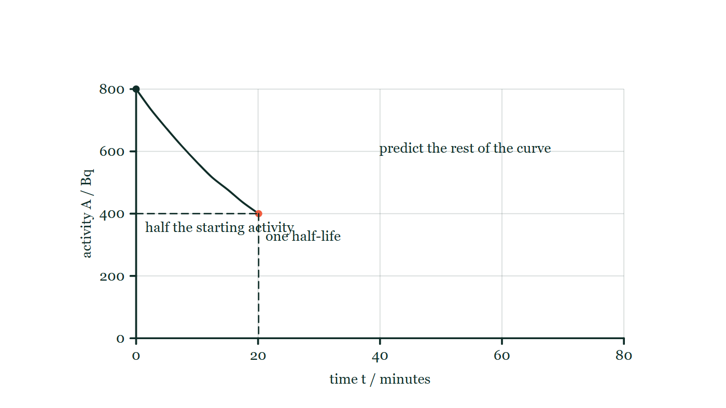
ATOMIC PHYSICS · HALF-LIFE & ACTIVITY
GIOPHYSICS LESSON
THINK FIRST
A source has a half-life of ten hours. How long until it has gone?
Take answers before you click — the point is the commitment
The technician needs to know when the sample can be treated as ordinary waste, and half of it is already gone by lunchtime.
THE ANSWER
Never, on paper. After ten hours half is left, after twenty a quarter, after thirty an eighth — halving does not terminate. What ends is the measurement: sooner or later the count rate drops into the background that was always there, and the honest statement is not 'it has gone' but 'it is no longer distinguishable from the room'.
Activity against time for a source starting at 800 Bq, plotted only as far as the point where it reaches 400 Bq at 20 minutes, with that halving dashed in and the grid running on empty to 80 minutes.
The live version of this figure — click here
Atomic Physics — Half-Life & Activity. Built by GioPhysics from the lesson's own copy; nothing on these slides is re-authored.
3 / 32
Notes:
[Phase] Starter: Recall what this lesson stands on (minutes 0–5 of 45)
[Hook] A source has a half-life of ten hours. How long until it has gone? The technician needs to know when the sample can be treated as ordinary waste, and half of it is already gone by lunchtime.
[Answer] Never, on paper. After ten hours half is left, after twenty a quarter, after thirty an eighth — halving does not terminate. What ends is the measurement: sooner or later the count rate drops into the background that was always there, and the honest statement is not 'it has gone' but 'it is no longer distinguishable from the room'.
[Figure] Activity against time for a source starting at 800 Bq, plotted only as far as the point where it reaches 400 Bq at 20 minutes, with that halving dashed in and the grid running on empty to 80 minutes.

Slide 4
ATOMIC PHYSICS · HALF-LIFE & ACTIVITY
GIOPHYSICS LESSON
EXPLAINED SIMPLY
In one sentence
Introduce the idea — The big idea and the definition
Half-life is the time taken for half the nuclei in a sample to decay (or for the activity to halve); activity is the number of decays per second, measured in becquerels, and is proportional to the surviving population.
Atomic Physics — Half-Life & Activity. Built by GioPhysics from the lesson's own copy; nothing on these slides is re-authored.
4 / 32
Notes:
[Phase] Introduce the idea: The big idea and the definition (minutes 5–13 of 45)
[Definition] Half-life is the time taken for half the nuclei in a sample to decay (or for the activity to halve); activity is the number of decays per second, measured in becquerels, and is proportional to the surviving population.

Slide 5
ATOMIC PHYSICS · HALF-LIFE & ACTIVITY
GIOPHYSICS LESSON
EXPLAINED SIMPLY
What that looks like
Introduce the idea — The big idea and the definition
FOR EXAMPLE
Iodine-123 for medical scans has a 13-hour half-life: a dose prepared at dawn has halved by evening and is 1/16 as strong two days later — strong enough to image, gone before it overstays.
Atomic Physics — Half-Life & Activity. Built by GioPhysics from the lesson's own copy; nothing on these slides is re-authored.
5 / 32
Notes:
[Phase] Introduce the idea: The big idea and the definition (minutes 5–13 of 45)
[Worked illustration] Iodine-123 for medical scans has a 13-hour half-life: a dose prepared at dawn has halved by evening and is 1/16 as strong two days later — strong enough to image, gone before it overstays.

Slide 6
ATOMIC PHYSICS · HALF-LIFE & ACTIVITY
GIOPHYSICS LESSON
THE BIG IDEA
Random alone, exponential together
Introduce the idea — The big idea and the definition
The half-life T½ of a nuclide is the time for half of any sample of it to decay — equivalently, the time for the activity to halve. After n half-lives, N = N₀/2ⁿ remains.
Activity, measured in becquerels (1 Bq = 1 decay per second), is proportional to the number of undecayed nuclei, so the N-versus-t curve and the A-versus-t curve have the same halving shape. Half-lives run from nanoseconds to billions of years and are fixed constants of each nuclide, untouched by temperature or chemistry — which is what makes radioactive dating possible: carbon-14’s 5730-year clock ticks identically in a living tree and an ancient one.
Atomic Physics — Half-Life & Activity. Built by GioPhysics from the lesson's own copy; nothing on these slides is re-authored.
6 / 32
Notes:
[Phase] Introduce the idea: The big idea and the definition (minutes 5–13 of 45)
[Big idea] The half-life T½ of a nuclide is the time for half of any sample of it to decay — equivalently, the time for the activity to halve. After n half-lives, N = N₀/2ⁿ remains. Activity, measured in becquerels (1 Bq = 1 decay per second), is proportional to the number of undecayed nuclei, so the N-versus-t curve and the A-versus-t curve have the same halving shape. Half-lives run from nanoseconds to billions of years and are fixed constants of each nuclide, untouched by temperature or chemistry — which is what makes radioactive dating possible: carbon-14’s 5730-year clock ticks identically in a living tree and an ancient one.

Slide 7
ATOMIC PHYSICS · HALF-LIFE & ACTIVITY
GIOPHYSICS LESSON
THE PHYSICS · 1 OF 3
Why halving, and not a steady slide
Build the model — The formulae, one at a time, in plain English
Each nucleus has a fixed probability of decaying per unit time, regardless of its age. So the number decaying per second is proportional to the number still present: a big sample loses nuclei fast, a depleted one slowly. A quantity that shrinks in proportion to itself always follows the halving curve.
Atomic Physics — Half-Life & Activity. Built by GioPhysics from the lesson's own copy; nothing on these slides is re-authored.
7 / 32
Notes:
[Phase] Build the model: The formulae, one at a time, in plain English (minutes 13–22 of 45)
[Section] Each nucleus has a fixed probability of decaying per unit time, regardless of its age. So the number decaying per second is proportional to the number still present: a big sample loses nuclei fast, a depleted one slowly. A quantity that shrinks in proportion to itself always follows the halving curve.

Slide 8
ATOMIC PHYSICS · HALF-LIFE & ACTIVITY
GIOPHYSICS LESSON
THE PHYSICS · 2 OF 3
Counting statistics
Build the model — The formulae, one at a time, in plain English
A Geiger counter clicks irregularly because decay is random — a reading of 400 counts carries a scatter of about ±20 (√400). Real measurements repeat and average, run long counts, and always subtract the background rate first. The smooth curve only emerges from large numbers.
Atomic Physics — Half-Life & Activity. Built by GioPhysics from the lesson's own copy; nothing on these slides is re-authored.
8 / 32
Notes:
[Phase] Build the model: The formulae, one at a time, in plain English (minutes 13–22 of 45)
[Section] A Geiger counter clicks irregularly because decay is random — a reading of 400 counts carries a scatter of about ±20 (√400). Real measurements repeat and average, run long counts, and always subtract the background rate first. The smooth curve only emerges from large numbers.

Slide 9
ATOMIC PHYSICS · HALF-LIFE & ACTIVITY
GIOPHYSICS LESSON
THE PHYSICS · 3 OF 3
Dating with a nuclear clock
Build the model — The formulae, one at a time, in plain English
Living things constantly refresh their carbon-14; death stops the intake and the 5730-year clock starts. A bone with one quarter of the living activity is two half-lives old — about 11 500 years.
Uranium-238’s 4.5-billion-year half-life does the same job for rocks, and dates the Earth itself. Handling rules follow from the physics too: distance, shielding, minimal exposure time, and never pointing an open source at anyone.
Atomic Physics — Half-Life & Activity. Built by GioPhysics from the lesson's own copy; nothing on these slides is re-authored.
9 / 32
Notes:
[Phase] Build the model: The formulae, one at a time, in plain English (minutes 13–22 of 45)
[Section] Living things constantly refresh their carbon-14; death stops the intake and the 5730-year clock starts. A bone with one quarter of the living activity is two half-lives old — about 11 500 years. Uranium-238’s 4.5-billion-year half-life does the same job for rocks, and dates the Earth itself. Handling rules follow from the physics too: distance, shielding, minimal exposure time, and never pointing an open source at anyone.

Slide 10
ATOMIC PHYSICS · HALF-LIFE & ACTIVITY
GIOPHYSICS LESSON
FORMULA 1 OF 3
Halving rule
Build the model — The formulae, one at a time, in plain English
N = N₀/2ⁿ after n = t/T½
Works for activity too: A = A₀/2ⁿ
IN PLAIN ENGLISH
Each half-life halves whatever remains — 100%, 50%, 25%, 12.5%… The curve never quite reaches zero; it just keeps halving.
Atomic Physics — Half-Life & Activity. Built by GioPhysics from the lesson's own copy; nothing on these slides is re-authored.
10 / 32
Notes:
[Phase] Build the model: The formulae, one at a time, in plain English (minutes 13–22 of 45)
[Formula] Halving rule: N = N₀/2ⁿ after n = t/T½
[In plain English] Each half-life halves whatever remains — 100%, 50%, 25%, 12.5%… The curve never quite reaches zero; it just keeps halving.
[Note] Works for activity too: A = A₀/2ⁿ

Slide 11
ATOMIC PHYSICS · HALF-LIFE & ACTIVITY
GIOPHYSICS LESSON
FORMULA 2 OF 3
Activity
Build the model — The formulae, one at a time, in plain English
A in Bq · 1 Bq = 1 decay s⁻¹
Measured with a Geiger–Müller counter
IN PLAIN ENGLISH
Counting decays is far easier than counting surviving atoms, and since A ∝ N the count-rate curve hands you the half-life directly.
Atomic Physics — Half-Life & Activity. Built by GioPhysics from the lesson's own copy; nothing on these slides is re-authored.
11 / 32
Notes:
[Phase] Build the model: The formulae, one at a time, in plain English (minutes 13–22 of 45)
[Formula] Activity: A in Bq · 1 Bq = 1 decay s⁻¹
[In plain English] Counting decays is far easier than counting surviving atoms, and since A ∝ N the count-rate curve hands you the half-life directly.
[Note] Measured with a Geiger–Müller counter

Slide 12
ATOMIC PHYSICS · HALF-LIFE & ACTIVITY
GIOPHYSICS LESSON
FORMULA 3 OF 3
Reading a decay curve
Build the model — The formulae, one at a time, in plain English
T½ = time for N (or A) to halve
Same answer wherever you start on the curve
IN PLAIN ENGLISH
Pick any point, find when the value has halved, and the gap is T½ — from 80 to 40 takes exactly as long as from 40 to 20. That constancy is the signature of exponential decay.
Atomic Physics — Half-Life & Activity. Built by GioPhysics from the lesson's own copy; nothing on these slides is re-authored.
12 / 32
Notes:
[Phase] Build the model: The formulae, one at a time, in plain English (minutes 13–22 of 45)
[Formula] Reading a decay curve: T½ = time for N (or A) to halve
[In plain English] Pick any point, find when the value has halved, and the gap is T½ — from 80 to 40 takes exactly as long as from 40 to 20. That constancy is the signature of exponential decay.
[Note] Same answer wherever you start on the curve

Slide 13
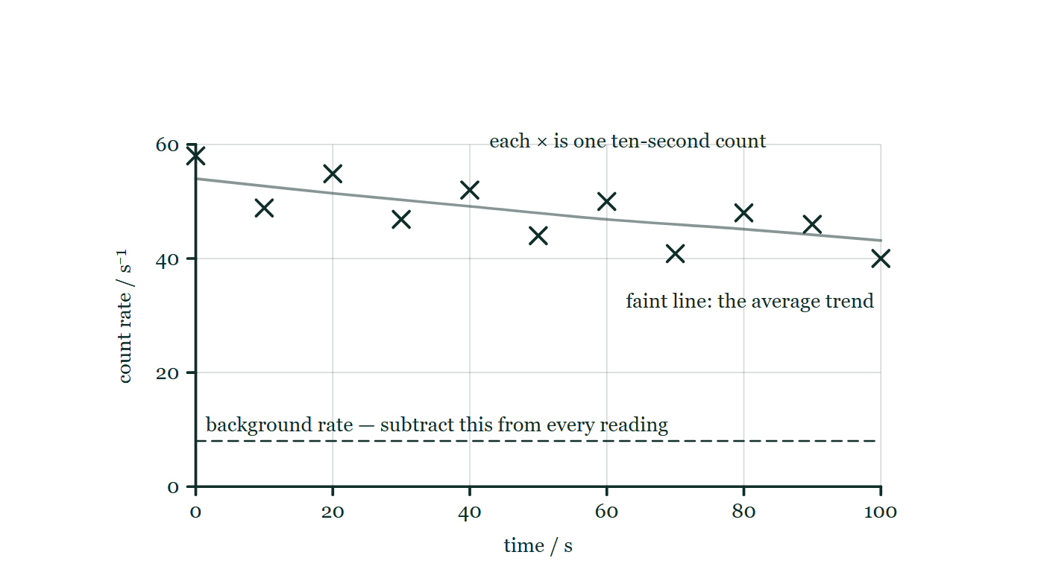
ATOMIC PHYSICS · HALF-LIFE & ACTIVITY
GIOPHYSICS LESSON
THE PICTURE
What a counter actually gives you
Drawn for this lesson
Eleven ten-second counts drawn as crosses scattering by a few counts either side of a faint falling trend line, with the background rate marked as a dashed horizontal that has to be taken off every reading before anything else is done.
The live version of this figure — click here
Atomic Physics — Half-Life & Activity. Built by GioPhysics from the lesson's own copy; nothing on these slides is re-authored.
13 / 32
Notes:
[Phase] Build the model: The formulae, one at a time, in plain English (minutes 13–22 of 45)
[Figure] Eleven ten-second counts drawn as crosses scattering by a few counts either side of a faint falling trend line, with the background rate marked as a dashed horizontal that has to be taken off every reading before anything else is done.

Slide 14
ATOMIC PHYSICS · HALF-LIFE & ACTIVITY
GIOPHYSICS LESSON
WATCH OUT
The common trap
Check and misconception — The quick check and the trap
A half-life of 10 hours does not mean the whole sample is gone in 20. After 10 hours half remains; after 20, a quarter; after 30, an eighth. Two half-lives never empty the box — they leave 25%, and the sample fades by endless halving, not by countdown.
Atomic Physics — Half-Life & Activity. Built by GioPhysics from the lesson's own copy; nothing on these slides is re-authored.
14 / 32
Notes:
[Phase] Check and misconception: The quick check and the trap (minutes 35–41 of 45)
[Misconception] A half-life of 10 hours does not mean the whole sample is gone in 20. After 10 hours half remains; after 20, a quarter; after 30, an eighth. Two half-lives never empty the box — they leave 25%, and the sample fades by endless halving, not by countdown.

Slide 15
ATOMIC PHYSICS · HALF-LIFE & ACTIVITY
GIOPHYSICS LESSON
WORKED EXAMPLE 1 OF 2 · EASY
The question
Easy
Worked examples — I do, we do — one step revealed at a time
A sample’s activity falls from X Bq to X/16 Bq in 80 minutes. Find the half-life.
Atomic Physics — Half-Life & Activity. Built by GioPhysics from the lesson's own copy; nothing on these slides is re-authored.
15 / 32
Notes:
[Phase] Worked examples: I do, we do — one step revealed at a time (minutes 22–35 of 45)
[Question] A sample’s activity falls from X Bq to X/16 Bq in 80 minutes. Find the half-life.
[Answer] 20 minutes

Slide 16
ATOMIC PHYSICS · HALF-LIFE & ACTIVITY
GIOPHYSICS LESSON
WORKED EXAMPLE 1 OF 2 · EASY · THE WORKING
How to solve it
Easy
Worked examples — I do, we do — one step revealed at a time
A sample’s activity falls from X Bq to X/16 Bq in 80 minutes. Find the half-life.
1.
X → X/2 → X/4 → X/8 → X/16 is four halvings.
2.
4 T½ = 80 min, so T½ = 20 min.
Atomic Physics — Half-Life & Activity. Built by GioPhysics from the lesson's own copy; nothing on these slides is re-authored.
16 / 32
Notes:
[Phase] Worked examples: I do, we do — one step revealed at a time (minutes 22–35 of 45)
[Reveal] One click per step. The class works each line before the next appears.
[Step 1] X → X/2 → X/4 → X/8 → X/16 is four halvings.
[Step 2] 4 T½ = 80 min, so T½ = 20 min.

Slide 17
ATOMIC PHYSICS · HALF-LIFE & ACTIVITY
GIOPHYSICS LESSON
WORKED EXAMPLE 1 OF 2 · EASY
Answer
Easy
Worked examples — I do, we do — one step revealed at a time
20 minutes
Atomic Physics — Half-Life & Activity. Built by GioPhysics from the lesson's own copy; nothing on these slides is re-authored.
17 / 32
Notes:
[Phase] Worked examples: I do, we do — one step revealed at a time (minutes 22–35 of 45)
[Answer] 20 minutes

Slide 18
ATOMIC PHYSICS · HALF-LIFE & ACTIVITY
GIOPHYSICS LESSON
WORKED EXAMPLE 2 OF 2 · MEDIUM
The question
Medium
Worked examples — I do, we do — one step revealed at a time
An isotope of radium has a half-life of 4 days. How long until 7/8 of a fresh sample has decayed?
Atomic Physics — Half-Life & Activity. Built by GioPhysics from the lesson's own copy; nothing on these slides is re-authored.
18 / 32
Notes:
[Phase] Worked examples: I do, we do — one step revealed at a time (minutes 22–35 of 45)
[Question] An isotope of radium has a half-life of 4 days. How long until 7/8 of a fresh sample has decayed?
[Answer] 12 days

Slide 19
ATOMIC PHYSICS · HALF-LIFE & ACTIVITY
GIOPHYSICS LESSON
WORKED EXAMPLE 2 OF 2 · MEDIUM · THE WORKING
How to solve it
Medium
Worked examples — I do, we do — one step revealed at a time
An isotope of radium has a half-life of 4 days. How long until 7/8 of a fresh sample has decayed?
1.
If 7/8 has decayed, 1/8 remains — read the question carefully.
2.
N₀ → N₀/2 → N₀/4 → N₀/8 is three half-lives.
3.
t = 3 × 4 = 12 days.
Atomic Physics — Half-Life & Activity. Built by GioPhysics from the lesson's own copy; nothing on these slides is re-authored.
19 / 32
Notes:
[Phase] Worked examples: I do, we do — one step revealed at a time (minutes 22–35 of 45)
[Reveal] One click per step. The class works each line before the next appears.
[Step 1] If 7/8 has decayed, 1/8 remains — read the question carefully.
[Step 2] N₀ → N₀/2 → N₀/4 → N₀/8 is three half-lives.
[Step 3] t = 3 × 4 = 12 days.

Slide 20
ATOMIC PHYSICS · HALF-LIFE & ACTIVITY
GIOPHYSICS LESSON
WORKED EXAMPLE 2 OF 2 · MEDIUM
Answer
Medium
Worked examples — I do, we do — one step revealed at a time
12 days
Atomic Physics — Half-Life & Activity. Built by GioPhysics from the lesson's own copy; nothing on these slides is re-authored.
20 / 32
Notes:
[Phase] Worked examples: I do, we do — one step revealed at a time (minutes 22–35 of 45)
[Answer] 12 days

Slide 21
ATOMIC PHYSICS · HALF-LIFE & ACTIVITY
GIOPHYSICS LESSON
SPOT THE MISTAKE
One line here is wrong
The whole working is up — find the bad line before you click
1.
64 g of a nuclide decays until only 1 g of it is left, taking 10 hours. Find the half-life.
2.
Halve the mass until it reaches 1 g: 64 → 32 → 16 → 8 → 4 → 2 → 1
3.
That is seven numbers, so seven half-lives.
4.
T½ = 10 h ÷ 7 = 86 minutes
5.
The half-life is about 86 minutes.
LINE 3 IS WRONG
Seven numbers, but six arrows. A halving is the step between two numbers, not one of the numbers, so counting the entries on the line above always gives one too many. The check that settles it in a second is the ratio: 64 ÷ 1 = 64, and 64 = 2⁶.
IT SHOULD SAY
That is six steps between seven numbers, so six half-lives — and 64 = 2⁶ confirms it, giving T½ = 600 ÷ 6 = 100 minutes.
Atomic Physics — Half-Life & Activity. Built by GioPhysics from the lesson's own copy; nothing on these slides is re-authored.
21 / 32
Notes:
[Phase] Worked examples: I do, we do — one step revealed at a time (minutes 22–35 of 45)
[Spot the mistake] The working is complete and one line of it is wrong. Let the room hunt: one click names the line, a second shows it done correctly.
[Line 3 is wrong] Seven numbers, but six arrows. A halving is the step between two numbers, not one of the numbers, so counting the entries on the line above always gives one too many. The check that settles it in a second is the ratio: 64 ÷ 1 = 64, and 64 = 2⁶.
[It should say] That is six steps between seven numbers, so six half-lives — and 64 = 2⁶ confirms it, giving T½ = 600 ÷ 6 = 100 minutes.

Slide 22
ATOMIC PHYSICS · HALF-LIFE & ACTIVITY
GIOPHYSICS LESSON
PREDICT · TAKE THE VOTE
Commit before you are told
Hands up for each option, then click
The curve has been drawn only as far as the first half-life: 800 Bq down to 400 Bq in 20 minutes. Where has it got to at 40 minutes?
A Zero — it lost 400 Bq in the first 20 minutes, and another 400 Bq empties it
B 200 Bq — it halves again in the same 20 minutes
C About 300 Bq — the curve is flattening, so it cannot manage a whole halving
Activity against time for a source starting at 800 Bq, plotted only as far as the point where it reaches 400 Bq at 20 minutes, with that halving dashed in and the grid running on empty to 80 minutes.
The live version of this figure — click here
Atomic Physics — Half-Life & Activity. Built by GioPhysics from the lesson's own copy; nothing on these slides is re-authored.
22 / 32
Notes:
[Phase] Build the model: The formulae, one at a time, in plain English (minutes 13–22 of 45)
[Predict] The curve has been drawn only as far as the first half-life: 800 Bq down to 400 Bq in 20 minutes. Where has it got to at 40 minutes?
[Options] A Zero — it lost 400 Bq in the first 20 minutes, and another 400 Bq empties it B 200 Bq — it halves again in the same 20 minutes C About 300 Bq — the curve is flattening, so it cannot manage a whole halving
[Figure] Activity against time for a source starting at 800 Bq, plotted only as far as the point where it reaches 400 Bq at 20 minutes, with that halving dashed in and the grid running on empty to 80 minutes.

Slide 23
ATOMIC PHYSICS · HALF-LIFE & ACTIVITY
GIOPHYSICS LESSON
PREDICT · THE OUTCOME
What actually happens
Ask the room who changed their mind, and why
B 200 Bq — it halves again in the same 20 minutes
WHY
Each nucleus has the same chance of decaying per second whatever the sample has already done, so what is constant is the fraction lost per unit time, never the number. The first option extends the curve as a straight line, which is the commonest error on decay graphs; the third notices the flattening and over-corrects. Equal times take equal fractions: 800 → 400 → 200 → 100, twenty minutes at a time, for as long as anyone watches.
Atomic Physics — Half-Life & Activity. Built by GioPhysics from the lesson's own copy; nothing on these slides is re-authored.
23 / 32
Notes:
[Phase] Build the model: The formulae, one at a time, in plain English (minutes 13–22 of 45)
[Answer] B — 200 Bq — it halves again in the same 20 minutes. Each nucleus has the same chance of decaying per second whatever the sample has already done, so what is constant is the fraction lost per unit time, never the number. The first option extends the curve as a straight line, which is the commonest error on decay graphs; the third notices the flattening and over-corrects. Equal times take equal fractions: 800 → 400 → 200 → 100, twenty minutes at a time, for as long as anyone watches.

Slide 24
ATOMIC PHYSICS · HALF-LIFE & ACTIVITY
GIOPHYSICS LESSON
QUICK CHECK
Decide before the answer goes up
Check and misconception — The quick check and the trap
A nuclide’s activity falls from 8000 Bq to 1000 Bq in 36 minutes. Its half-life is…
A
4.5 minutes
B
12 minutes
C
18 minutes
Atomic Physics — Half-Life & Activity. Built by GioPhysics from the lesson's own copy; nothing on these slides is re-authored.
24 / 32
Notes:
[Phase] Check and misconception: The quick check and the trap (minutes 35–41 of 45)
[Question] A nuclide’s activity falls from 8000 Bq to 1000 Bq in 36 minutes. Its half-life is…
[Options] A 4.5 minutes B 12 minutes C 18 minutes

Slide 25
ATOMIC PHYSICS · HALF-LIFE & ACTIVITY
GIOPHYSICS LESSON
QUICK CHECK · THE ANSWER
The answer, and why
Check and misconception — The quick check and the trap
B 12 minutes
HOW TO GET THERE
8000 → 4000 → 2000 → 1000 is three halvings, so 3 T½ = 36 min and T½ = 12 min.
WHY THE OTHERS TEMPT
A 4.5 minutes is 36 ÷ 8 — the time divided by the factor the activity fell by. That would be the answer if activity fell by a fixed amount per unit time; it falls by a fixed fraction, so what has to be counted is halvings, not becquerels.
B Correct. 8000 → 4000 → 2000 → 1000 is three halvings, so 3T½ = 36 min and T½ = 12 min.
C 18 minutes is 36 ÷ 2, which counts one halving where there are three. The factor is eight, and eight is 2³ — the exponent is what the half-life divides into.
Atomic Physics — Half-Life & Activity. Built by GioPhysics from the lesson's own copy; nothing on these slides is re-authored.
25 / 32
Notes:
[Phase] Check and misconception: The quick check and the trap (minutes 35–41 of 45)
[Question] A nuclide’s activity falls from 8000 Bq to 1000 Bq in 36 minutes. Its half-life is…
[Option by option] A: 4.5 minutes is 36 ÷ 8 — the time divided by the factor the activity fell by. That would be the answer if activity fell by a fixed amount per unit time; it falls by a fixed fraction, so what has to be counted is halvings, not becquerels. B: Correct. 8000 → 4000 → 2000 → 1000 is three halvings, so 3T½ = 36 min and T½ = 12 min. C: 18 minutes is 36 ÷ 2, which counts one halving where there are three. The factor is eight, and eight is 2³ — the exponent is what the half-life divides into.
[Answer] B — 12 minutes
[Why] 8000 → 4000 → 2000 → 1000 is three halvings, so 3 T½ = 36 min and T½ = 12 min.
[Reveal] One click for the answer, then one for the reason.

Slide 26
ATOMIC PHYSICS · HALF-LIFE & ACTIVITY
GIOPHYSICS LESSON
EXTENSION 1 OF 2 · HARD
The question
Hard
Worked examples — I do, we do — one step revealed at a time
64 g of a radioactive nuclide decays until only 1 g of it remains, taking 10 hours. Find the half-life.
Atomic Physics — Half-Life & Activity. Built by GioPhysics from the lesson's own copy; nothing on these slides is re-authored.
26 / 32
Notes:
[Phase] Worked examples: I do, we do — one step revealed at a time (minutes 22–35 of 45)
[Question] 64 g of a radioactive nuclide decays until only 1 g of it remains, taking 10 hours. Find the half-life.
[Answer] 100 minutes

Slide 27
ATOMIC PHYSICS · HALF-LIFE & ACTIVITY
GIOPHYSICS LESSON
EXTENSION 1 OF 2 · HARD · THE WORKING
How to solve it
Hard
Worked examples — I do, we do — one step revealed at a time
64 g of a radioactive nuclide decays until only 1 g of it remains, taking 10 hours. Find the half-life.
1.
64 → 32 → 16 → 8 → 4 → 2 → 1: six halvings.
2.
6 T½ = 10 h = 600 min.
3.
T½ = 100 min.
Atomic Physics — Half-Life & Activity. Built by GioPhysics from the lesson's own copy; nothing on these slides is re-authored.
27 / 32
Notes:
[Phase] Worked examples: I do, we do — one step revealed at a time (minutes 22–35 of 45)
[Reveal] One click per step. The class works each line before the next appears.
[Step 1] 64 → 32 → 16 → 8 → 4 → 2 → 1: six halvings.
[Step 2] 6 T½ = 10 h = 600 min.
[Step 3] T½ = 100 min.

Slide 28
ATOMIC PHYSICS · HALF-LIFE & ACTIVITY
GIOPHYSICS LESSON
EXTENSION 1 OF 2 · HARD
Answer
Hard
Worked examples — I do, we do — one step revealed at a time
100 minutes
Atomic Physics — Half-Life & Activity. Built by GioPhysics from the lesson's own copy; nothing on these slides is re-authored.
28 / 32
Notes:
[Phase] Worked examples: I do, we do — one step revealed at a time (minutes 22–35 of 45)
[Answer] 100 minutes

Slide 29
ATOMIC PHYSICS · HALF-LIFE & ACTIVITY
GIOPHYSICS LESSON
EXTENSION 2 OF 2 · CHALLENGING
The question
Challenging
Worked examples — I do, we do — one step revealed at a time
A bone fragment’s carbon-14 activity is 25% of that of living bone (T½ = 5730 y). Date the bone, and explain two practical limits on the precision.
Atomic Physics — Half-Life & Activity. Built by GioPhysics from the lesson's own copy; nothing on these slides is re-authored.
29 / 32
Notes:
[Phase] Worked examples: I do, we do — one step revealed at a time (minutes 22–35 of 45)
[Question] A bone fragment’s carbon-14 activity is 25% of that of living bone (T½ = 5730 y). Date the bone, and explain two practical limits on the precision.
[Answer] ≈ 11 500 years old, with precision set by counting statistics and calibration

Slide 30
ATOMIC PHYSICS · HALF-LIFE & ACTIVITY
GIOPHYSICS LESSON
EXTENSION 2 OF 2 · CHALLENGING · THE WORKING
How to solve it
Challenging
Worked examples — I do, we do — one step revealed at a time
A bone fragment’s carbon-14 activity is 25% of that of living bone (T½ = 5730 y). Date the bone, and explain two practical limits on the precision.
1.
25% = two half-lives, so age ≈ 2 × 5730 = 11 460 years.
2.
Limit one: counting statistics — old samples decay so rarely that the count scatter (√counts) becomes a large fraction of the signal, so beyond ~10 half-lives there is almost nothing left to count.
3.
Limit two: the method assumes the starting C-14 level; atmospheric levels drift (and were disturbed by nuclear testing), so raw ages need calibration against tree rings and other records.
Atomic Physics — Half-Life & Activity. Built by GioPhysics from the lesson's own copy; nothing on these slides is re-authored.
30 / 32
Notes:
[Phase] Worked examples: I do, we do — one step revealed at a time (minutes 22–35 of 45)
[Reveal] One click per step. The class works each line before the next appears.
[Step 1] 25% = two half-lives, so age ≈ 2 × 5730 = 11 460 years.
[Step 2] Limit one: counting statistics — old samples decay so rarely that the count scatter (√counts) becomes a large fraction of the signal, so beyond ~10 half-lives there is almost nothing left to count.
[Step 3] Limit two: the method assumes the starting C-14 level; atmospheric levels drift (and were disturbed by nuclear testing), so raw ages need calibration against tree rings and other records.

Slide 31
ATOMIC PHYSICS · HALF-LIFE & ACTIVITY
GIOPHYSICS LESSON
EXTENSION 2 OF 2 · CHALLENGING
Answer
Challenging
Worked examples — I do, we do — one step revealed at a time
≈ 11 500 years old, with precision set by counting statistics and calibration
Atomic Physics — Half-Life & Activity. Built by GioPhysics from the lesson's own copy; nothing on these slides is re-authored.
31 / 32
Notes:
[Phase] Worked examples: I do, we do — one step revealed at a time (minutes 22–35 of 45)
[Answer] ≈ 11 500 years old, with precision set by counting statistics and calibration

Slide 32
ATOMIC PHYSICS · HALF-LIFE & ACTIVITY
GIOPHYSICS LESSON
ATOMIC PHYSICS
Where to go next
Plenary — What to take away, what to practise next
Next
24.4 Nuclear Reactions & Binding Energy
https://giophysics.com/chapter-46/nuclear-reactions/
Lesson
This lesson on giophysics.com
https://giophysics.com/chapter-46/half-life/
Live
The live, interactive version of these slides
https://giophysics.com/chapter-46/presentation/?lesson=halflife
Chapter
All Atomic Physics lessons
https://giophysics.com/chapter-46/
PDF
Download the lesson PDF
https://giophysics.com/downloads/46-3-half-life.pdf
Atomic Physics — Half-Life & Activity. Built by GioPhysics from the lesson's own copy; nothing on these slides is re-authored.
32 / 32
Notes:
[Phase] Plenary: What to take away, what to practise next (minutes 41–45 of 45)
[Interactive] The graphs and the circuit topology on these slides are frozen. The live version at https://giophysics.com/chapter-46/presentation/?lesson=halflife moves them.

