Slide 1
ATOMIC PHYSICS · DISCRETE ENERGY & SPECTRA
GIOPHYSICS LESSON
24 · Atomic Physics
Photons pay the exact difference
Discrete Energy & Spectra
Pass a current through hydrogen gas and it glows — but not with every colour. A spectroscope splits the glow into a handful of razor-sharp lines, always the same ones. Those lines are the atom’s energy ledger, printed in light.
POSITION
Lesson 1 of 6 in Atomic Physics
PLAN
16 slides in the 45-minute core run, about 45 minutes of it
LESSON PAGE
https://giophysics.com/chapter-46/energy-levels/
Built by GioPhysics from the lesson's own page. Every word on these slides is the lesson's; nothing here is re-authored. Teaching material, not an awarding body's document.
Atomic Physics — Discrete Energy & Spectra. Built by GioPhysics from the lesson's own copy; nothing on these slides is re-authored.
1 / 34
Notes:
[Lesson] Atomic Physics — Discrete Energy & Spectra. Lesson 1 of 6.
[Intro] Pass a current through hydrogen gas and it glows — but not with every colour. A spectroscope splits the glow into a handful of razor-sharp lines, always the same ones. Those lines are the atom’s energy ledger, printed in light.
[Source] https://giophysics.com/chapter-46/energy-levels/
[Disclaimer] Built by GioPhysics from the lesson's own page. Every word on these slides is the lesson's; nothing here is re-authored. Teaching material, not an awarding body's document.

Slide 2
ATOMIC PHYSICS · DISCRETE ENERGY & SPECTRA
GIOPHYSICS LESSON
WHAT THIS NEEDS
What you already know
Starter — Recall what this lesson stands on
Recall
Describing waves
https://giophysics.com/chapter-24/describing-waves/
Recall
Electromagnetic waves
https://giophysics.com/chapter-24/electromagnetic-waves/
Atomic Physics — Discrete Energy & Spectra. Built by GioPhysics from the lesson's own copy; nothing on these slides is re-authored.
2 / 34
Notes:
[Phase] Starter: Recall what this lesson stands on (minutes 0–5 of 45)
[Starter] Recall: Describing waves; Electromagnetic waves

Slide 3
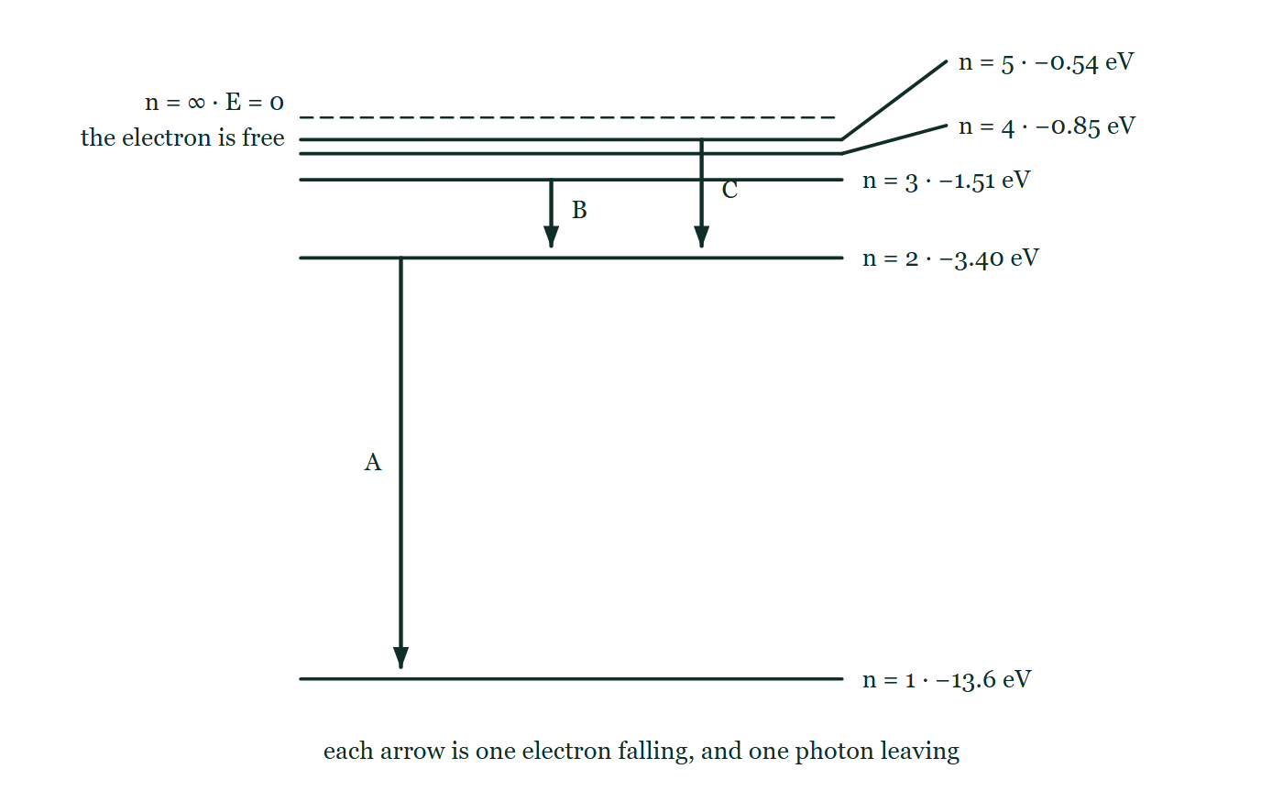
ATOMIC PHYSICS · DISCRETE ENERGY & SPECTRA
GIOPHYSICS LESSON
THINK FIRST
A tungsten filament glows white. A tube of hot hydrogen glows pink, and only pink. Why doesn't the gas glow white too?
Take answers before you click — the point is the commitment
Both are hot, both are emitting light, and both contain the same kind of thing — atoms with electrons in them. One gives you every colour there is; the other gives you four lines and nothing in between.
THE ANSWER
Because a lone atom can only emit the exact gaps in its own energy ladder, and hydrogen has four of them in the visible range. In a solid the atoms are jammed together and their levels smear into continuous bands, so a filament can emit anything. The line spectrum is not a limitation of the gas — it is a photograph of the ladder.
Hydrogen's energy levels drawn to scale from −13.6 eV at n = 1 up to the ionisation line at E = 0, with n = 4 and n = 5 crowded so close to it that they are labelled off leader lines, and three downward arrows marked only A, B and C.
The live version of this figure — click here
Atomic Physics — Discrete Energy & Spectra. Built by GioPhysics from the lesson's own copy; nothing on these slides is re-authored.
3 / 34
Notes:
[Phase] Starter: Recall what this lesson stands on (minutes 0–5 of 45)
[Hook] A tungsten filament glows white. A tube of hot hydrogen glows pink, and only pink. Why doesn't the gas glow white too? Both are hot, both are emitting light, and both contain the same kind of thing — atoms with electrons in them. One gives you every colour there is; the other gives you four lines and nothing in between.
[Answer] Because a lone atom can only emit the exact gaps in its own energy ladder, and hydrogen has four of them in the visible range. In a solid the atoms are jammed together and their levels smear into continuous bands, so a filament can emit anything. The line spectrum is not a limitation of the gas — it is a photograph of the ladder.
[Figure] Hydrogen's energy levels drawn to scale from −13.6 eV at n = 1 up to the ionisation line at E = 0, with n = 4 and n = 5 crowded so close to it that they are labelled off leader lines, and three downward arrows marked only A, B and C.

Slide 4
ATOMIC PHYSICS · DISCRETE ENERGY & SPECTRA
GIOPHYSICS LESSON
EXPLAINED SIMPLY
In one sentence
Introduce the idea — The big idea and the definition
Atomic electrons occupy discrete energy levels; a photon is emitted or absorbed only when an electron jumps between two levels, with photon energy E = hf equal to the exact energy difference.
Atomic Physics — Discrete Energy & Spectra. Built by GioPhysics from the lesson's own copy; nothing on these slides is re-authored.
4 / 34
Notes:
[Phase] Introduce the idea: The big idea and the definition (minutes 5–13 of 45)
[Definition] Atomic electrons occupy discrete energy levels; a photon is emitted or absorbed only when an electron jumps between two levels, with photon energy E = hf equal to the exact energy difference.

Slide 5
ATOMIC PHYSICS · DISCRETE ENERGY & SPECTRA
GIOPHYSICS LESSON
EXPLAINED SIMPLY
What that looks like
Introduce the idea — The big idea and the definition
FOR EXAMPLE
Sodium street lamps glow that particular orange because sodium’s ladder has a gap of 2.1 eV — a 589 nm photon — and essentially nothing else in the visible range.
Atomic Physics — Discrete Energy & Spectra. Built by GioPhysics from the lesson's own copy; nothing on these slides is re-authored.
5 / 34
Notes:
[Phase] Introduce the idea: The big idea and the definition (minutes 5–13 of 45)
[Worked illustration] Sodium street lamps glow that particular orange because sodium’s ladder has a gap of 2.1 eV — a 589 nm photon — and essentially nothing else in the visible range.

Slide 6
ATOMIC PHYSICS · DISCRETE ENERGY & SPECTRA
GIOPHYSICS LESSON
THE BIG IDEA
Photons pay the exact difference
Introduce the idea — The big idea and the definition
Electrons in an atom cannot hold just any energy: they sit on a ladder of discrete energy levels. An atom absorbs a photon only if the photon’s energy E = hf exactly matches a gap between two levels, lifting the electron up; when the electron falls back it emits a photon carrying exactly the gap, E = E₂ − E₁.
Because every element has its own ladder, every element has its own set of spectral lines — a fingerprint. Hydrogen’s ladder, Eₙ = −13.6/n² eV, produces the Lyman (ultraviolet), Balmer (visible), and Paschen (infrared) series, and the very existence of line spectra rather than a continuous rainbow is the direct evidence that atomic energy is discrete.
Atomic Physics — Discrete Energy & Spectra. Built by GioPhysics from the lesson's own copy; nothing on these slides is re-authored.
6 / 34
Notes:
[Phase] Introduce the idea: The big idea and the definition (minutes 5–13 of 45)
[Big idea] Electrons in an atom cannot hold just any energy: they sit on a ladder of discrete energy levels. An atom absorbs a photon only if the photon’s energy E = hf exactly matches a gap between two levels, lifting the electron up; when the electron falls back it emits a photon carrying exactly the gap, E = E₂ − E₁. Because every element has its own ladder, every element has its own set of spectral lines — a fingerprint. Hydrogen’s ladder, Eₙ = −13.6/n² eV, produces the Lyman (ultraviolet), Balmer (visible), and Paschen (infrared) series, and the very existence of line spectra rather than a continuous rainbow is the direct evidence that atomic energy is discrete.

Slide 7
ATOMIC PHYSICS · DISCRETE ENERGY & SPECTRA
GIOPHYSICS LESSON
THE PHYSICS · 1 OF 3
Emission and absorption fingerprints
Build the model — The formulae, one at a time, in plain English
A hot low-pressure gas emits its signature wavelengths only: bright lines on black. Put a cool gas in front of a continuous white source instead and it steals exactly those same wavelengths: black lines on a rainbow. Same ladder, same fingerprint — helium was discovered in the Sun’s absorption spectrum before anyone found it on Earth.
Atomic Physics — Discrete Energy & Spectra. Built by GioPhysics from the lesson's own copy; nothing on these slides is re-authored.
7 / 34
Notes:
[Phase] Build the model: The formulae, one at a time, in plain English (minutes 13–22 of 45)
[Section] A hot low-pressure gas emits its signature wavelengths only: bright lines on black. Put a cool gas in front of a continuous white source instead and it steals exactly those same wavelengths: black lines on a rainbow. Same ladder, same fingerprint — helium was discovered in the Sun’s absorption spectrum before anyone found it on Earth.

Slide 8
ATOMIC PHYSICS · DISCRETE ENERGY & SPECTRA
GIOPHYSICS LESSON
THE PHYSICS · 2 OF 3
Reading the hydrogen series
Build the model — The formulae, one at a time, in plain English
Every drop that lands on n = 1 emits ultraviolet (Lyman series). Drops landing on n = 2 emit visible light (Balmer — the red 656 nm line is n = 3 → 2).
Drops landing on n = 3 are infrared (Paschen). The bigger the fall, the bigger the photon energy and the shorter the wavelength.
Atomic Physics — Discrete Energy & Spectra. Built by GioPhysics from the lesson's own copy; nothing on these slides is re-authored.
8 / 34
Notes:
[Phase] Build the model: The formulae, one at a time, in plain English (minutes 13–22 of 45)
[Section] Every drop that lands on n = 1 emits ultraviolet (Lyman series). Drops landing on n = 2 emit visible light (Balmer — the red 656 nm line is n = 3 → 2). Drops landing on n = 3 are infrared (Paschen). The bigger the fall, the bigger the photon energy and the shorter the wavelength.

Slide 9
ATOMIC PHYSICS · DISCRETE ENERGY & SPECTRA
GIOPHYSICS LESSON
THE PHYSICS · 3 OF 3
Excite, then de-excite
Build the model — The formulae, one at a time, in plain English
Collisions or photons kick the electron up to an excited state; it typically stays there only nanoseconds before tumbling back down, sometimes in several small hops — each hop its own photon. Give the atom 13.6 eV or more and the electron leaves entirely: the atom is ionised.
Atomic Physics — Discrete Energy & Spectra. Built by GioPhysics from the lesson's own copy; nothing on these slides is re-authored.
9 / 34
Notes:
[Phase] Build the model: The formulae, one at a time, in plain English (minutes 13–22 of 45)
[Section] Collisions or photons kick the electron up to an excited state; it typically stays there only nanoseconds before tumbling back down, sometimes in several small hops — each hop its own photon. Give the atom 13.6 eV or more and the electron leaves entirely: the atom is ionised.

Slide 10
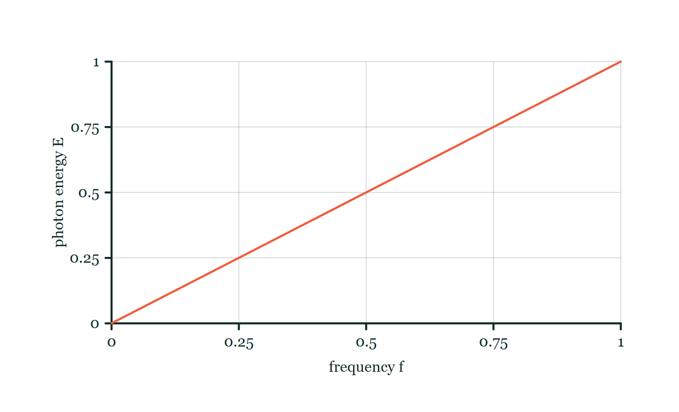
ATOMIC PHYSICS · DISCRETE ENERGY & SPECTRA
GIOPHYSICS LESSON
FORMULA 1 OF 3
Photon energy
Build the model — The formulae, one at a time, in plain English
E = hf = hc/λ
h = 6.63 × 10⁻³⁴ J s
IN PLAIN ENGLISH
Light delivers its energy in lumps called photons. High frequency (short wavelength) means a big lump — an ultraviolet photon carries more energy than a red one.
Photon energy–frequency explorer
Move this graph on the live version — click here
Atomic Physics — Discrete Energy & Spectra. Built by GioPhysics from the lesson's own copy; nothing on these slides is re-authored.
10 / 34
Notes:
[Phase] Build the model: The formulae, one at a time, in plain English (minutes 13–22 of 45)
[Formula] Photon energy: E = hf = hc/λ
[In plain English] Light delivers its energy in lumps called photons. High frequency (short wavelength) means a big lump — an ultraviolet photon carries more energy than a red one.
[Note] h = 6.63 × 10⁻³⁴ J s
[Graph] Photon energy–frequency explorer. Planck's constant h is fixed, so photon energy is directly proportional to frequency.
[Axes] Horizontal: frequency f. Vertical: photon energy E. Values are normalised — the graph teaches the shape, not a measurement.

Slide 11
ATOMIC PHYSICS · DISCRETE ENERGY & SPECTRA
GIOPHYSICS LESSON
FORMULA 2 OF 3
Transition energy
Build the model — The formulae, one at a time, in plain English
hf = E₂ − E₁
Emission going down, absorption going up
IN PLAIN ENGLISH
The photon pays for the jump exactly. No change, no credit: a photon with almost the right energy is simply not absorbed at all.
Atomic Physics — Discrete Energy & Spectra. Built by GioPhysics from the lesson's own copy; nothing on these slides is re-authored.
11 / 34
Notes:
[Phase] Build the model: The formulae, one at a time, in plain English (minutes 13–22 of 45)
[Formula] Transition energy: hf = E₂ − E₁
[In plain English] The photon pays for the jump exactly. No change, no credit: a photon with almost the right energy is simply not absorbed at all.
[Note] Emission going down, absorption going up

Slide 12
ATOMIC PHYSICS · DISCRETE ENERGY & SPECTRA
GIOPHYSICS LESSON
FORMULA 3 OF 3
Hydrogen’s ladder
Build the model — The formulae, one at a time, in plain English
Eₙ = −13.6/n² eV
n = 1 is the ground state; E∞ = 0
IN PLAIN ENGLISH
The levels are negative because the electron is bound — you must add energy to free it. The rungs crowd together as n grows, which is why each series has a short-wavelength limit.
Atomic Physics — Discrete Energy & Spectra. Built by GioPhysics from the lesson's own copy; nothing on these slides is re-authored.
12 / 34
Notes:
[Phase] Build the model: The formulae, one at a time, in plain English (minutes 13–22 of 45)
[Formula] Hydrogen’s ladder: Eₙ = −13.6/n² eV
[In plain English] The levels are negative because the electron is bound — you must add energy to free it. The rungs crowd together as n grows, which is why each series has a short-wavelength limit.
[Note] n = 1 is the ground state; E∞ = 0

Slide 13
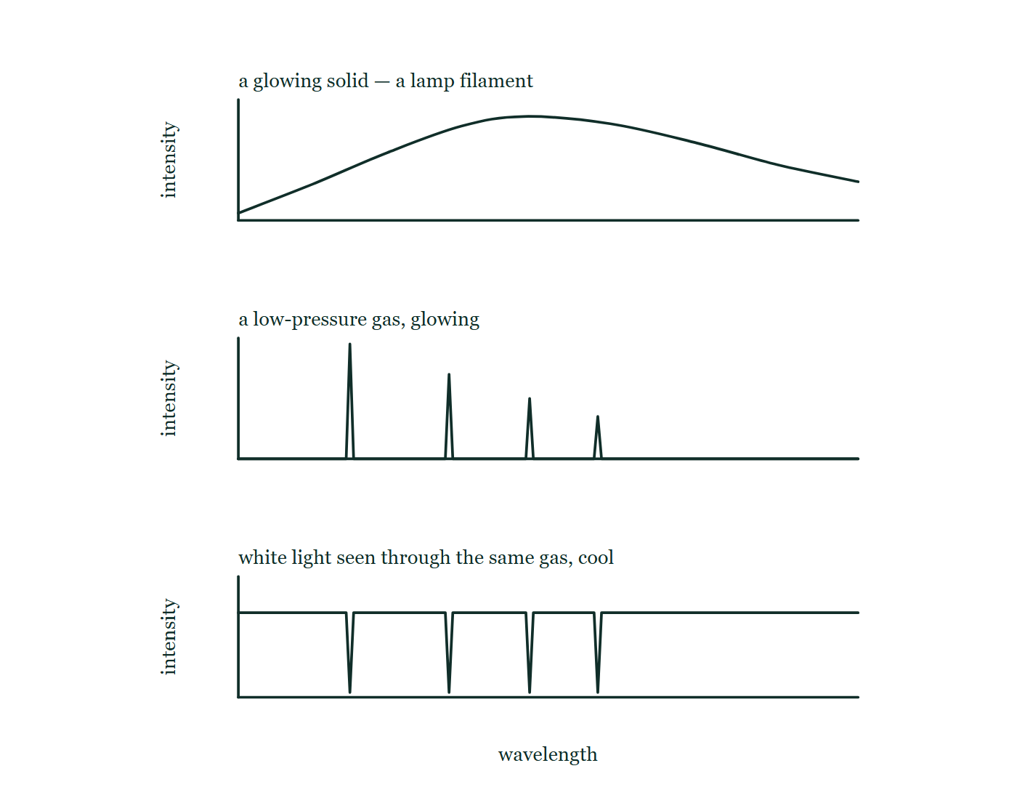
ATOMIC PHYSICS · DISCRETE ENERGY & SPECTRA
GIOPHYSICS LESSON
THE PICTURE
Three spectra from one ladder
Drawn for this lesson
Three intensity-against-wavelength plots stacked: a lamp filament's smooth continuous hump, the same gas glowing with four sharp spikes standing on an empty baseline, and white light seen through the cool gas showing four dips at exactly those wavelengths.
The live version of this figure — click here
Atomic Physics — Discrete Energy & Spectra. Built by GioPhysics from the lesson's own copy; nothing on these slides is re-authored.
13 / 34
Notes:
[Phase] Build the model: The formulae, one at a time, in plain English (minutes 13–22 of 45)
[Figure] Three intensity-against-wavelength plots stacked: a lamp filament's smooth continuous hump, the same gas glowing with four sharp spikes standing on an empty baseline, and white light seen through the cool gas showing four dips at exactly those wavelengths.

Slide 14
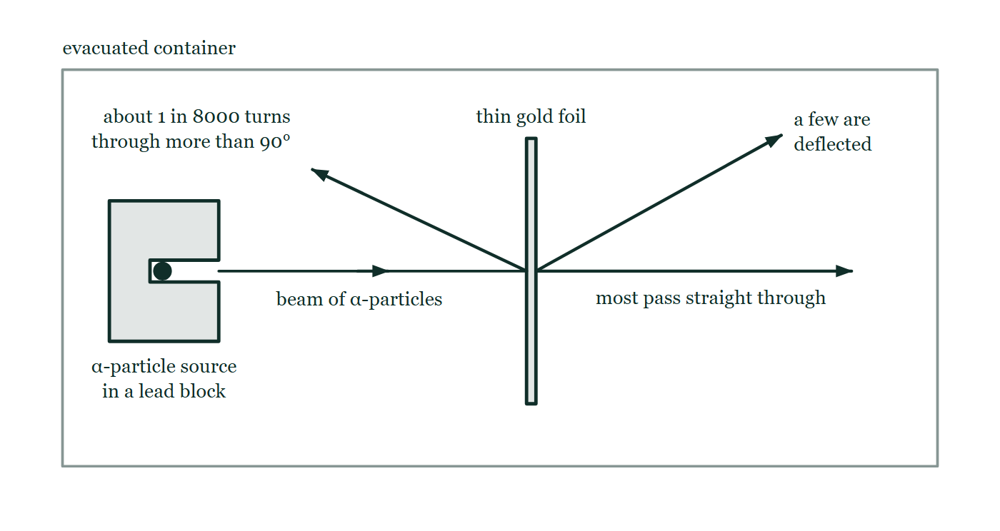
ATOMIC PHYSICS · DISCRETE ENERGY & SPECTRA
GIOPHYSICS LESSON
FIGURE 1 OF 2
Fig. 7.1 — IGCSE Topic 5 · Nuclear physics
Drawn for question 7 of that paper · syllabus 5.1
The scattering apparatus, drawn inside an evacuated container. A source of α-particles sits in a lead block with a narrow channel cut through it, so a fine beam travels horizontally to a very thin vertical sheet of gold foil. Three paths are drawn from the point where the beam meets the foil: one carrying straight on in the original direction and labelled as the path of most of the particles, one deflected upwards through a moderate angle, and one turned back towards the source side of the foil through more than 90°.
See the question this was drawn for — click here
Atomic Physics — Discrete Energy & Spectra. Built by GioPhysics from the lesson's own copy; nothing on these slides is re-authored.
14 / 34
Notes:
[Phase] Build the model: The formulae, one at a time, in plain English (minutes 13–22 of 45)
[Figure] Fig. 7.1. The scattering apparatus, drawn inside an evacuated container. A source of α-particles sits in a lead block with a narrow channel cut through it, so a fine beam travels horizontally to a very thin vertical sheet of gold foil. Three paths are drawn from the point where the beam meets the foil: one carrying straight on in the original direction and labelled as the path of most of the particles, one deflected upwards through a moderate angle, and one turned back towards the source side of the foil through more than 90°.
[Where it came from] IGCSE Topic 5 · Nuclear physics, question 7; syllabus 5.1.

Slide 15
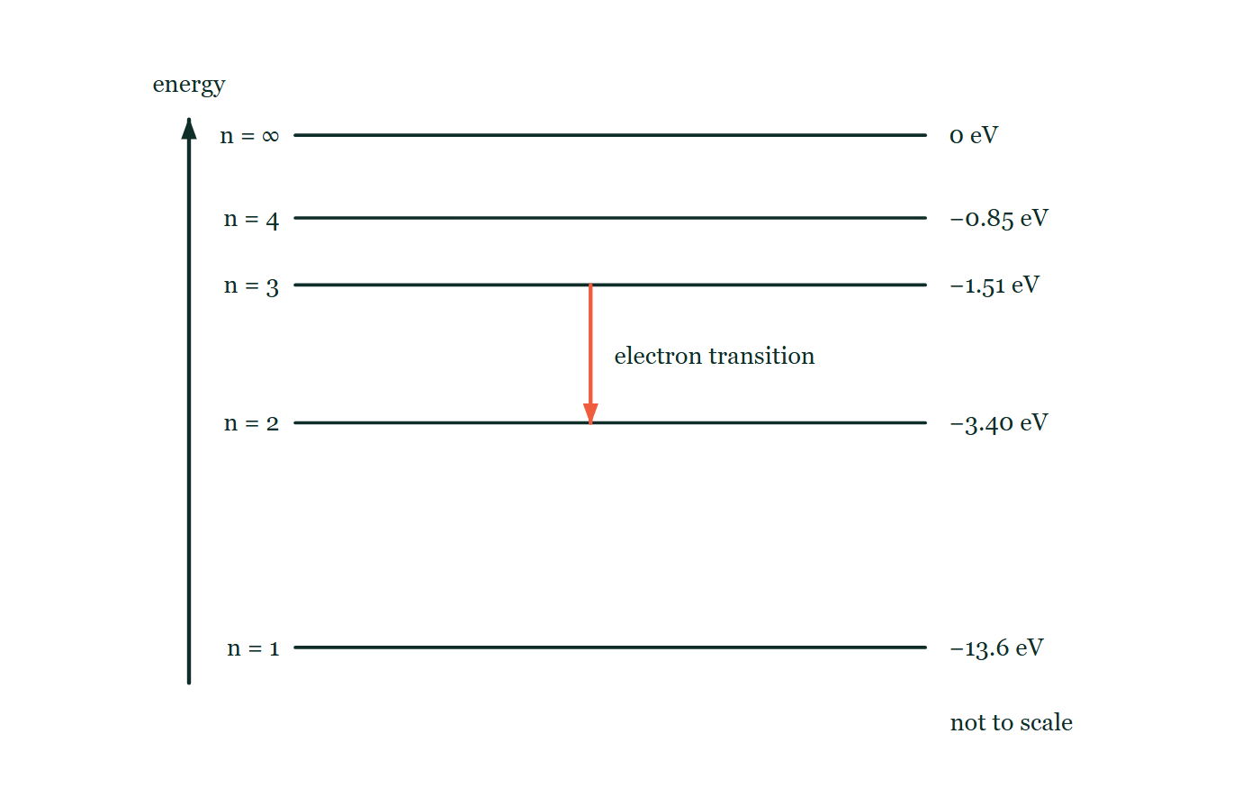
ATOMIC PHYSICS · DISCRETE ENERGY & SPECTRA
GIOPHYSICS LESSON
FIGURE 2 OF 2
Fig. 1.1 — IB Theme E · Nuclear and quantum physics
Drawn for question 1 of that paper · syllabus E.1
An energy level diagram for a hydrogen atom, drawn not to scale, with energy increasing up the page. Five horizontal levels are shown: the ground state n = 1 at −13.6 eV, then n = 2 at −3.40 eV, n = 3 at −1.51 eV, n = 4 at −0.85 eV, and n = ∞ at 0 eV. A vertical arrow drawn between the −1.51 eV level and the −3.40 eV level points downwards, marking the electron transition the question describes.
See the question this was drawn for — click here
Atomic Physics — Discrete Energy & Spectra. Built by GioPhysics from the lesson's own copy; nothing on these slides is re-authored.
15 / 34
Notes:
[Phase] Build the model: The formulae, one at a time, in plain English (minutes 13–22 of 45)
[Figure] Fig. 1.1. An energy level diagram for a hydrogen atom, drawn not to scale, with energy increasing up the page. Five horizontal levels are shown: the ground state n = 1 at −13.6 eV, then n = 2 at −3.40 eV, n = 3 at −1.51 eV, n = 4 at −0.85 eV, and n = ∞ at 0 eV. A vertical arrow drawn between the −1.51 eV level and the −3.40 eV level points downwards, marking the electron transition the question describes.
[Where it came from] IB Theme E · Nuclear and quantum physics, question 1; syllabus E.1.

Slide 16
ATOMIC PHYSICS · DISCRETE ENERGY & SPECTRA
GIOPHYSICS LESSON
WATCH OUT
The common trap
Check and misconception — The quick check and the trap
An atom cannot absorb part of a photon. A 3.0 eV photon meeting an atom whose available gap is 1.9 eV is not partly absorbed with change left over — it is not absorbed at all. Absorption is all-or-nothing, and that is precisely why absorption lines are as sharp as emission lines.
Atomic Physics — Discrete Energy & Spectra. Built by GioPhysics from the lesson's own copy; nothing on these slides is re-authored.
16 / 34
Notes:
[Phase] Check and misconception: The quick check and the trap (minutes 35–41 of 45)
[Misconception] An atom cannot absorb part of a photon. A 3.0 eV photon meeting an atom whose available gap is 1.9 eV is not partly absorbed with change left over — it is not absorbed at all. Absorption is all-or-nothing, and that is precisely why absorption lines are as sharp as emission lines.

Slide 17
ATOMIC PHYSICS · DISCRETE ENERGY & SPECTRA
GIOPHYSICS LESSON
WORKED EXAMPLE 1 OF 2 · EASY
The question
Easy
Worked examples — I do, we do — one step revealed at a time
Find the energy of a 500 nm photon of green light, in joules and electronvolts.
Atomic Physics — Discrete Energy & Spectra. Built by GioPhysics from the lesson's own copy; nothing on these slides is re-authored.
17 / 34
Notes:
[Phase] Worked examples: I do, we do — one step revealed at a time (minutes 22–35 of 45)
[Question] Find the energy of a 500 nm photon of green light, in joules and electronvolts.
[Answer] ≈ 4.0 × 10⁻¹⁹ J ≈ 2.5 eV

Slide 18
ATOMIC PHYSICS · DISCRETE ENERGY & SPECTRA
GIOPHYSICS LESSON
WORKED EXAMPLE 1 OF 2 · EASY · THE WORKING
How to solve it
Easy
Worked examples — I do, we do — one step revealed at a time
Find the energy of a 500 nm photon of green light, in joules and electronvolts.
1.
E = hc/λ = (6.63 × 10⁻³⁴ × 3.00 × 10⁸) ÷ (500 × 10⁻⁹).
2.
E = 3.98 × 10⁻¹⁹ J.
3.
In eV: 3.98 × 10⁻¹⁹ ÷ 1.60 × 10⁻¹⁹ ≈ 2.5 eV — atomic gaps are a few eV, which is why atoms trade visible light.
Atomic Physics — Discrete Energy & Spectra. Built by GioPhysics from the lesson's own copy; nothing on these slides is re-authored.
18 / 34
Notes:
[Phase] Worked examples: I do, we do — one step revealed at a time (minutes 22–35 of 45)
[Reveal] One click per step. The class works each line before the next appears.
[Step 1] E = hc/λ = (6.63 × 10⁻³⁴ × 3.00 × 10⁸) ÷ (500 × 10⁻⁹).
[Step 2] E = 3.98 × 10⁻¹⁹ J.
[Step 3] In eV: 3.98 × 10⁻¹⁹ ÷ 1.60 × 10⁻¹⁹ ≈ 2.5 eV — atomic gaps are a few eV, which is why atoms trade visible light.

Slide 19
ATOMIC PHYSICS · DISCRETE ENERGY & SPECTRA
GIOPHYSICS LESSON
WORKED EXAMPLE 1 OF 2 · EASY
Answer
Easy
Worked examples — I do, we do — one step revealed at a time
≈ 4.0 × 10⁻¹⁹ J ≈ 2.5 eV
Atomic Physics — Discrete Energy & Spectra. Built by GioPhysics from the lesson's own copy; nothing on these slides is re-authored.
19 / 34
Notes:
[Phase] Worked examples: I do, we do — one step revealed at a time (minutes 22–35 of 45)
[Answer] ≈ 4.0 × 10⁻¹⁹ J ≈ 2.5 eV

Slide 20
ATOMIC PHYSICS · DISCRETE ENERGY & SPECTRA
GIOPHYSICS LESSON
WORKED EXAMPLE 2 OF 2 · MEDIUM
The question
Medium
Worked examples — I do, we do — one step revealed at a time
A hydrogen electron drops from n = 3 (−1.51 eV) to n = 2 (−3.40 eV). Find the photon’s energy, frequency, and wavelength.
Atomic Physics — Discrete Energy & Spectra. Built by GioPhysics from the lesson's own copy; nothing on these slides is re-authored.
20 / 34
Notes:
[Phase] Worked examples: I do, we do — one step revealed at a time (minutes 22–35 of 45)
[Question] A hydrogen electron drops from n = 3 (−1.51 eV) to n = 2 (−3.40 eV). Find the photon’s energy, frequency, and wavelength.
[Answer] 1.89 eV; 4.56 × 10¹⁴ Hz; ≈ 660 nm (red)

Slide 21
ATOMIC PHYSICS · DISCRETE ENERGY & SPECTRA
GIOPHYSICS LESSON
WORKED EXAMPLE 2 OF 2 · MEDIUM · THE WORKING
How to solve it
Medium
Worked examples — I do, we do — one step revealed at a time
A hydrogen electron drops from n = 3 (−1.51 eV) to n = 2 (−3.40 eV). Find the photon’s energy, frequency, and wavelength.
1.
ΔE = E₃ − E₂ = −1.51 − (−3.40) = 1.89 eV = 3.02 × 10⁻¹⁹ J.
2.
f = E/h = 3.02 × 10⁻¹⁹ ÷ 6.63 × 10⁻³⁴ = 4.56 × 10¹⁴ Hz.
3.
λ = c/f = 3.00 × 10⁸ ÷ 4.56 × 10¹⁴ ≈ 6.6 × 10⁻⁷ m — the red Balmer line.
Atomic Physics — Discrete Energy & Spectra. Built by GioPhysics from the lesson's own copy; nothing on these slides is re-authored.
21 / 34
Notes:
[Phase] Worked examples: I do, we do — one step revealed at a time (minutes 22–35 of 45)
[Reveal] One click per step. The class works each line before the next appears.
[Step 1] ΔE = E₃ − E₂ = −1.51 − (−3.40) = 1.89 eV = 3.02 × 10⁻¹⁹ J.
[Step 2] f = E/h = 3.02 × 10⁻¹⁹ ÷ 6.63 × 10⁻³⁴ = 4.56 × 10¹⁴ Hz.
[Step 3] λ = c/f = 3.00 × 10⁸ ÷ 4.56 × 10¹⁴ ≈ 6.6 × 10⁻⁷ m — the red Balmer line.

Slide 22
ATOMIC PHYSICS · DISCRETE ENERGY & SPECTRA
GIOPHYSICS LESSON
WORKED EXAMPLE 2 OF 2 · MEDIUM
Answer
Medium
Worked examples — I do, we do — one step revealed at a time
1.89 eV; 4.56 × 10¹⁴ Hz; ≈ 660 nm (red)
Atomic Physics — Discrete Energy & Spectra. Built by GioPhysics from the lesson's own copy; nothing on these slides is re-authored.
22 / 34
Notes:
[Phase] Worked examples: I do, we do — one step revealed at a time (minutes 22–35 of 45)
[Answer] 1.89 eV; 4.56 × 10¹⁴ Hz; ≈ 660 nm (red)

Slide 23
ATOMIC PHYSICS · DISCRETE ENERGY & SPECTRA
GIOPHYSICS LESSON
SPOT THE MISTAKE
One line here is wrong
The whole working is up — find the bad line before you click
1.
Find the energy of a 500 nm photon of green light, in electronvolts.
2.
E = hc/λ
3.
E = (6.63 × 10⁻³⁴ × 3.00 × 10⁸) ÷ (500 × 10⁻⁹)
4.
E = 3.98 × 10⁻¹⁹ J
5.
In electronvolts: E = 3.98 × 10⁻¹⁹ × 1.60 × 10⁻¹⁹ = 6.4 × 10⁻³⁸ eV
LINE 5 IS WRONG
Multiplied by the electronic charge instead of divided by it. The direction is worth fixing in the head once and for all: an electronvolt is a tiny unit — 1.6 × 10⁻¹⁹ J — so counting an energy in electronvolts always gives a far bigger number than counting it in joules. Anything that comes out smaller has gone the wrong way.
IT SHOULD SAY
In electronvolts: E = 3.98 × 10⁻¹⁹ ÷ 1.60 × 10⁻¹⁹ = 2.5 eV
Atomic Physics — Discrete Energy & Spectra. Built by GioPhysics from the lesson's own copy; nothing on these slides is re-authored.
23 / 34
Notes:
[Phase] Worked examples: I do, we do — one step revealed at a time (minutes 22–35 of 45)
[Spot the mistake] The working is complete and one line of it is wrong. Let the room hunt: one click names the line, a second shows it done correctly.
[Line 5 is wrong] Multiplied by the electronic charge instead of divided by it. The direction is worth fixing in the head once and for all: an electronvolt is a tiny unit — 1.6 × 10⁻¹⁹ J — so counting an energy in electronvolts always gives a far bigger number than counting it in joules. Anything that comes out smaller has gone the wrong way.
[It should say] In electronvolts: E = 3.98 × 10⁻¹⁹ ÷ 1.60 × 10⁻¹⁹ = 2.5 eV

Slide 24
ATOMIC PHYSICS · DISCRETE ENERGY & SPECTRA
GIOPHYSICS LESSON
PREDICT · TAKE THE VOTE
Commit before you are told
Hands up for each option, then click
A 2.2 eV photon meets a hydrogen atom sitting on the n = 2 rung. The gap up to n = 3 is 1.89 eV. What happens?
A The electron climbs to n = 3 and the spare 0.31 eV carries on as a second, smaller photon
B The electron climbs to n = 3 and the spare energy is taken up by the atom recoiling
C Nothing at all — the photon is not absorbed
Hydrogen's energy levels drawn to scale from −13.6 eV at n = 1 up to the ionisation line at E = 0, with n = 4 and n = 5 crowded so close to it that they are labelled off leader lines, and three downward arrows marked only A, B and C.
The live version of this figure — click here
Atomic Physics — Discrete Energy & Spectra. Built by GioPhysics from the lesson's own copy; nothing on these slides is re-authored.
24 / 34
Notes:
[Phase] Build the model: The formulae, one at a time, in plain English (minutes 13–22 of 45)
[Predict] A 2.2 eV photon meets a hydrogen atom sitting on the n = 2 rung. The gap up to n = 3 is 1.89 eV. What happens?
[Options] A The electron climbs to n = 3 and the spare 0.31 eV carries on as a second, smaller photon B The electron climbs to n = 3 and the spare energy is taken up by the atom recoiling C Nothing at all — the photon is not absorbed
[Figure] Hydrogen's energy levels drawn to scale from −13.6 eV at n = 1 up to the ionisation line at E = 0, with n = 4 and n = 5 crowded so close to it that they are labelled off leader lines, and three downward arrows marked only A, B and C.

Slide 25
ATOMIC PHYSICS · DISCRETE ENERGY & SPECTRA
GIOPHYSICS LESSON
PREDICT · THE OUTCOME
What actually happens
Ask the room who changed their mind, and why
C Nothing at all — the photon is not absorbed
WHY
Absorption is all or nothing: a photon is taken whole or it is not taken. 2.2 eV matches no gap from n = 2 — the next ones up the ladder are 2.55 eV to n = 4 and 2.86 eV to n = 5, and 3.40 eV frees the electron entirely — so the photon sails straight past and the atom is left exactly as it was. This is precisely why absorption lines are as needle-sharp as emission lines: an atom that could take part of a photon would swallow a smear of wavelengths, not a line.
Atomic Physics — Discrete Energy & Spectra. Built by GioPhysics from the lesson's own copy; nothing on these slides is re-authored.
25 / 34
Notes:
[Phase] Build the model: The formulae, one at a time, in plain English (minutes 13–22 of 45)
[Answer] C — Nothing at all — the photon is not absorbed. Absorption is all or nothing: a photon is taken whole or it is not taken. 2.2 eV matches no gap from n = 2 — the next ones up the ladder are 2.55 eV to n = 4 and 2.86 eV to n = 5, and 3.40 eV frees the electron entirely — so the photon sails straight past and the atom is left exactly as it was. This is precisely why absorption lines are as needle-sharp as emission lines: an atom that could take part of a photon would swallow a smear of wavelengths, not a line.

Slide 26
ATOMIC PHYSICS · DISCRETE ENERGY & SPECTRA
GIOPHYSICS LESSON
QUICK CHECK
Decide before the answer goes up
Check and misconception — The quick check and the trap
Which observation is direct evidence that atomic energy levels are discrete?
A
White-hot metal emits a continuous spectrum
B
A low-pressure gas emits a line spectrum
C
Alpha particles ionise the gas they pass through
Atomic Physics — Discrete Energy & Spectra. Built by GioPhysics from the lesson's own copy; nothing on these slides is re-authored.
26 / 34
Notes:
[Phase] Check and misconception: The quick check and the trap (minutes 35–41 of 45)
[Question] Which observation is direct evidence that atomic energy levels are discrete?
[Options] A White-hot metal emits a continuous spectrum B A low-pressure gas emits a line spectrum C Alpha particles ionise the gas they pass through

Slide 27
ATOMIC PHYSICS · DISCRETE ENERGY & SPECTRA
GIOPHYSICS LESSON
QUICK CHECK · THE ANSWER
The answer, and why
Check and misconception — The quick check and the trap
B A low-pressure gas emits a line spectrum
HOW TO GET THERE
Sharp emission lines mean only certain photon energies occur — so only certain energy differences exist in the atom. Discrete gaps require discrete levels.
WHY THE OTHERS TEMPT
A A continuous spectrum is evidence of the opposite. Every wavelength present means nothing is being picked out, which is what happens when atoms are packed together in a solid and their levels smear into bands. It is why a glowing filament tells you its temperature and nothing whatever about which element it is made of.
B Correct. Sharp lines mean only certain photon energies leave the gas, and hf = E₂ − E₁ means only certain energy differences exist inside the atom. Discrete differences require discrete levels.
C Ionisation shows that an alpha particle carries enough energy to tear an electron off, which would be just as true of an atom with a continuous range of energies. It says the atom can be broken; it says nothing about whether the rungs on the way up are picked out or smoothly spread.
Atomic Physics — Discrete Energy & Spectra. Built by GioPhysics from the lesson's own copy; nothing on these slides is re-authored.
27 / 34
Notes:
[Phase] Check and misconception: The quick check and the trap (minutes 35–41 of 45)
[Question] Which observation is direct evidence that atomic energy levels are discrete?
[Option by option] A: A continuous spectrum is evidence of the opposite. Every wavelength present means nothing is being picked out, which is what happens when atoms are packed together in a solid and their levels smear into bands. It is why a glowing filament tells you its temperature and nothing whatever about which element it is made of. B: Correct. Sharp lines mean only certain photon energies leave the gas, and hf = E₂ − E₁ means only certain energy differences exist inside the atom. Discrete differences require discrete levels. C: Ionisation shows that an alpha particle carries enough energy to tear an electron off, which would be just as true of an atom with a continuous range of energies. It says the atom can be broken; it says nothing about whether the rungs on the way up are picked out or smoothly spread.
[Answer] B — A low-pressure gas emits a line spectrum
[Why] Sharp emission lines mean only certain photon energies occur — so only certain energy differences exist in the atom. Discrete gaps require discrete levels.
[Reveal] One click for the answer, then one for the reason.

Slide 28
ATOMIC PHYSICS · DISCRETE ENERGY & SPECTRA
GIOPHYSICS LESSON
EXTENSION 1 OF 2 · HARD
The question
Hard
Worked examples — I do, we do — one step revealed at a time
Glowing hydrogen shows a blue 434 nm line. Identify the transition, given levels −13.6, −3.40, −1.51, −0.850, −0.544 eV for n = 1…5.
Atomic Physics — Discrete Energy & Spectra. Built by GioPhysics from the lesson's own copy; nothing on these slides is re-authored.
28 / 34
Notes:
[Phase] Worked examples: I do, we do — one step revealed at a time (minutes 22–35 of 45)
[Question] Glowing hydrogen shows a blue 434 nm line. Identify the transition, given levels −13.6, −3.40, −1.51, −0.850, −0.544 eV for n = 1…5.
[Answer] n = 5 → n = 2, a Balmer transition

Slide 29
ATOMIC PHYSICS · DISCRETE ENERGY & SPECTRA
GIOPHYSICS LESSON
EXTENSION 1 OF 2 · HARD · THE WORKING
How to solve it
Hard
Worked examples — I do, we do — one step revealed at a time
Glowing hydrogen shows a blue 434 nm line. Identify the transition, given levels −13.6, −3.40, −1.51, −0.850, −0.544 eV for n = 1…5.
1.
E = hc/λ = (6.63 × 10⁻³⁴ × 3.00 × 10⁸) ÷ (434 × 10⁻⁹) = 4.58 × 10⁻¹⁹ J = 2.86 eV.
2.
Visible light means the Balmer series — the electron lands on n = 2.
3.
E₅ − E₂ = −0.544 − (−3.40) = 2.86 eV ✓. The jump is n = 5 → n = 2.
Atomic Physics — Discrete Energy & Spectra. Built by GioPhysics from the lesson's own copy; nothing on these slides is re-authored.
29 / 34
Notes:
[Phase] Worked examples: I do, we do — one step revealed at a time (minutes 22–35 of 45)
[Reveal] One click per step. The class works each line before the next appears.
[Step 1] E = hc/λ = (6.63 × 10⁻³⁴ × 3.00 × 10⁸) ÷ (434 × 10⁻⁹) = 4.58 × 10⁻¹⁹ J = 2.86 eV.
[Step 2] Visible light means the Balmer series — the electron lands on n = 2.
[Step 3] E₅ − E₂ = −0.544 − (−3.40) = 2.86 eV ✓. The jump is n = 5 → n = 2.

Slide 30
ATOMIC PHYSICS · DISCRETE ENERGY & SPECTRA
GIOPHYSICS LESSON
EXTENSION 1 OF 2 · HARD
Answer
Hard
Worked examples — I do, we do — one step revealed at a time
n = 5 → n = 2, a Balmer transition
Atomic Physics — Discrete Energy & Spectra. Built by GioPhysics from the lesson's own copy; nothing on these slides is re-authored.
30 / 34
Notes:
[Phase] Worked examples: I do, we do — one step revealed at a time (minutes 22–35 of 45)
[Answer] n = 5 → n = 2, a Balmer transition

Slide 31
ATOMIC PHYSICS · DISCRETE ENERGY & SPECTRA
GIOPHYSICS LESSON
EXTENSION 2 OF 2 · CHALLENGING
The question
Challenging
Worked examples — I do, we do — one step revealed at a time
What wavelength of light can just ionise hydrogen from its ground state, and why does each spectral series pile up against a short-wavelength limit?
Atomic Physics — Discrete Energy & Spectra. Built by GioPhysics from the lesson's own copy; nothing on these slides is re-authored.
31 / 34
Notes:
[Phase] Worked examples: I do, we do — one step revealed at a time (minutes 22–35 of 45)
[Question] What wavelength of light can just ionise hydrogen from its ground state, and why does each spectral series pile up against a short-wavelength limit?
[Answer] ≈ 91 nm; the limit marks the jump from bound (discrete) to free (continuous) energies

Slide 32
ATOMIC PHYSICS · DISCRETE ENERGY & SPECTRA
GIOPHYSICS LESSON
EXTENSION 2 OF 2 · CHALLENGING · THE WORKING
How to solve it
Challenging
Worked examples — I do, we do — one step revealed at a time
What wavelength of light can just ionise hydrogen from its ground state, and why does each spectral series pile up against a short-wavelength limit?
1.
Ionisation from n = 1 needs 13.6 eV = 2.18 × 10⁻¹⁸ J.
2.
λ = hc/E = (6.63 × 10⁻³⁴ × 3.00 × 10⁸) ÷ 2.18 × 10⁻¹⁸ ≈ 9.1 × 10⁻⁸ m = 91 nm, deep ultraviolet.
3.
The rungs Eₙ = −13.6/n² crowd toward E = 0, so transitions into a given level approach a maximum energy — the series limit. Beyond it the spectrum turns continuous, because a freed electron can carry any surplus as kinetic energy.
Atomic Physics — Discrete Energy & Spectra. Built by GioPhysics from the lesson's own copy; nothing on these slides is re-authored.
32 / 34
Notes:
[Phase] Worked examples: I do, we do — one step revealed at a time (minutes 22–35 of 45)
[Reveal] One click per step. The class works each line before the next appears.
[Step 1] Ionisation from n = 1 needs 13.6 eV = 2.18 × 10⁻¹⁸ J.
[Step 2] λ = hc/E = (6.63 × 10⁻³⁴ × 3.00 × 10⁸) ÷ 2.18 × 10⁻¹⁸ ≈ 9.1 × 10⁻⁸ m = 91 nm, deep ultraviolet.
[Step 3] The rungs Eₙ = −13.6/n² crowd toward E = 0, so transitions into a given level approach a maximum energy — the series limit. Beyond it the spectrum turns continuous, because a freed electron can carry any surplus as kinetic energy.

Slide 33
ATOMIC PHYSICS · DISCRETE ENERGY & SPECTRA
GIOPHYSICS LESSON
EXTENSION 2 OF 2 · CHALLENGING
Answer
Challenging
Worked examples — I do, we do — one step revealed at a time
≈ 91 nm; the limit marks the jump from bound (discrete) to free (continuous) energies
Atomic Physics — Discrete Energy & Spectra. Built by GioPhysics from the lesson's own copy; nothing on these slides is re-authored.
33 / 34
Notes:
[Phase] Worked examples: I do, we do — one step revealed at a time (minutes 22–35 of 45)
[Answer] ≈ 91 nm; the limit marks the jump from bound (discrete) to free (continuous) energies

Slide 34
ATOMIC PHYSICS · DISCRETE ENERGY & SPECTRA
GIOPHYSICS LESSON
ATOMIC PHYSICS
Where to go next
Plenary — What to take away, what to practise next
Next
24.2 Radioactive Decay
https://giophysics.com/chapter-46/radioactivity/
Lesson
This lesson on giophysics.com
https://giophysics.com/chapter-46/energy-levels/
Live
The live, interactive version of these slides
https://giophysics.com/chapter-46/presentation/?lesson=levels
Chapter
All Atomic Physics lessons
https://giophysics.com/chapter-46/
PDF
Download the lesson PDF
https://giophysics.com/downloads/46-1-energy-levels.pdf
Atomic Physics — Discrete Energy & Spectra. Built by GioPhysics from the lesson's own copy; nothing on these slides is re-authored.
34 / 34
Notes:
[Phase] Plenary: What to take away, what to practise next (minutes 41–45 of 45)
[Interactive] The graphs and the circuit topology on these slides are frozen. The live version at https://giophysics.com/chapter-46/presentation/?lesson=levels moves them.

