Slide 1
ATOMIC PHYSICS · NUCLEAR REACTIONS & BINDING ENERGY
GIOPHYSICS LESSON
24 · Atomic Physics
Mass is frozen energy
Nuclear Reactions & Binding Energy
Weigh a helium nucleus, then weigh its parts: two protons and two neutrons. The parts are heavier. The missing mass left as energy when the nucleus was assembled — and E = mc² makes that bookkeeping the most explosive accounting in physics.
POSITION
Lesson 4 of 6 in Atomic Physics
PLAN
16 slides in the 45-minute core run, about 45 minutes of it
LESSON PAGE
https://giophysics.com/chapter-46/nuclear-reactions/
Built by GioPhysics from the lesson's own page. Every word on these slides is the lesson's; nothing here is re-authored. Teaching material, not an awarding body's document.
Atomic Physics — Nuclear Reactions & Binding Energy. Built by GioPhysics from the lesson's own copy; nothing on these slides is re-authored.
1 / 35
Notes:
[Lesson] Atomic Physics — Nuclear Reactions & Binding Energy. Lesson 4 of 6.
[Intro] Weigh a helium nucleus, then weigh its parts: two protons and two neutrons. The parts are heavier. The missing mass left as energy when the nucleus was assembled — and E = mc² makes that bookkeeping the most explosive accounting in physics.
[Source] https://giophysics.com/chapter-46/nuclear-reactions/
[Disclaimer] Built by GioPhysics from the lesson's own page. Every word on these slides is the lesson's; nothing here is re-authored. Teaching material, not an awarding body's document.

Slide 2
ATOMIC PHYSICS · NUCLEAR REACTIONS & BINDING ENERGY
GIOPHYSICS LESSON
WHAT THIS NEEDS
What you already know
Starter — Recall what this lesson stands on
Recall
Radioactive decay
https://giophysics.com/chapter-46/radioactivity/
Recall
Energy conservation
https://giophysics.com/chapter-6/energy-conversion-conservation/
Atomic Physics — Nuclear Reactions & Binding Energy. Built by GioPhysics from the lesson's own copy; nothing on these slides is re-authored.
2 / 35
Notes:
[Phase] Starter: Recall what this lesson stands on (minutes 0–5 of 45)
[Starter] Recall: Radioactive decay; Energy conservation

Slide 3
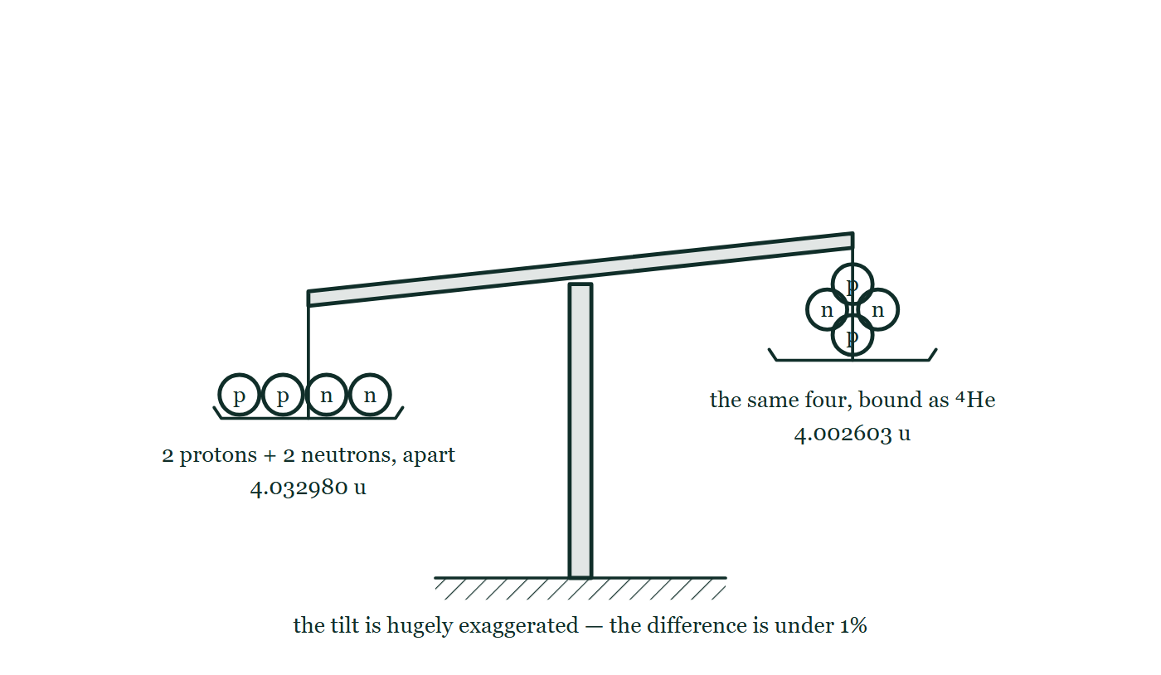
ATOMIC PHYSICS · NUCLEAR REACTIONS & BINDING ENERGY
GIOPHYSICS LESSON
THINK FIRST
Weigh two protons and two neutrons. Now stick them together into a helium nucleus and weigh that. Which is heavier?
Take answers before you click — the point is the commitment
Nothing has been added and nothing has been thrown away — the same four particles, first apart and then joined. Conservation of mass says the two readings must agree.
THE ANSWER
The four loose ones, by 0.030377 u — about three quarters of a per cent. Binding a nucleus costs it mass, and that missing mass times c² is the 28 MeV you would have to spend to pull it back apart. Mass and energy are the same currency, and a bound system is simply a lighter one.
A balance with two protons and two neutrons loose on one pan reading 4.032980 u, the same four bound as a helium-4 nucleus on the other reading 4.002603 u, the loose pan sitting lower, and a note that the tilt is hugely exaggerated.
The live version of this figure — click here
Atomic Physics — Nuclear Reactions & Binding Energy. Built by GioPhysics from the lesson's own copy; nothing on these slides is re-authored.
3 / 35
Notes:
[Phase] Starter: Recall what this lesson stands on (minutes 0–5 of 45)
[Hook] Weigh two protons and two neutrons. Now stick them together into a helium nucleus and weigh that. Which is heavier? Nothing has been added and nothing has been thrown away — the same four particles, first apart and then joined. Conservation of mass says the two readings must agree.
[Answer] The four loose ones, by 0.030377 u — about three quarters of a per cent. Binding a nucleus costs it mass, and that missing mass times c² is the 28 MeV you would have to spend to pull it back apart. Mass and energy are the same currency, and a bound system is simply a lighter one.
[Figure] A balance with two protons and two neutrons loose on one pan reading 4.032980 u, the same four bound as a helium-4 nucleus on the other reading 4.002603 u, the loose pan sitting lower, and a note that the tilt is hugely exaggerated.

Slide 4
ATOMIC PHYSICS · NUCLEAR REACTIONS & BINDING ENERGY
GIOPHYSICS LESSON
EXPLAINED SIMPLY
In one sentence
Introduce the idea — The big idea and the definition
The mass defect is the difference between a nucleus’s mass and the total mass of its separate nucleons; multiplied by c² it gives the binding energy, and binding energy per nucleon (peaking at iron) tells you which nuclear reactions release energy.
Atomic Physics — Nuclear Reactions & Binding Energy. Built by GioPhysics from the lesson's own copy; nothing on these slides is re-authored.
4 / 35
Notes:
[Phase] Introduce the idea: The big idea and the definition (minutes 5–13 of 45)
[Definition] The mass defect is the difference between a nucleus’s mass and the total mass of its separate nucleons; multiplied by c² it gives the binding energy, and binding energy per nucleon (peaking at iron) tells you which nuclear reactions release energy.

Slide 5
ATOMIC PHYSICS · NUCLEAR REACTIONS & BINDING ENERGY
GIOPHYSICS LESSON
EXPLAINED SIMPLY
What that looks like
Introduce the idea — The big idea and the definition
FOR EXAMPLE
The Sun fuses 600 million tonnes of hydrogen every second and comes out about 4 million tonnes light — that missing mass, times c², is the sunshine.
Atomic Physics — Nuclear Reactions & Binding Energy. Built by GioPhysics from the lesson's own copy; nothing on these slides is re-authored.
5 / 35
Notes:
[Phase] Introduce the idea: The big idea and the definition (minutes 5–13 of 45)
[Worked illustration] The Sun fuses 600 million tonnes of hydrogen every second and comes out about 4 million tonnes light — that missing mass, times c², is the sunshine.

Slide 6
ATOMIC PHYSICS · NUCLEAR REACTIONS & BINDING ENERGY
GIOPHYSICS LESSON
THE BIG IDEA
Mass is frozen energy
Introduce the idea — The big idea and the definition
Nuclear masses are tracked in unified atomic mass units, u, defined so carbon-12 is exactly 12 u; usefully, 1 u = 931.5 MeV/c². A nucleus is lighter than its separated nucleons by the mass defect Δm, and E = Δmc² converts that defect into the binding energy — the energy needed to pull the nucleus completely apart. Dividing by A gives binding energy per nucleon, the true measure of stability.
Plotted against A, this curve rises steeply, peaks near iron-56 at about 8.8 MeV per nucleon, then drifts gently down. Reactions that climb the curve release energy: fusion of light nuclei on the left, fission of heavy nuclei on the right. The energy released by any reaction — its Q value — is just the mass difference between reactants and products, cashed in via E = Δmc².
Atomic Physics — Nuclear Reactions & Binding Energy. Built by GioPhysics from the lesson's own copy; nothing on these slides is re-authored.
6 / 35
Notes:
[Phase] Introduce the idea: The big idea and the definition (minutes 5–13 of 45)
[Big idea] Nuclear masses are tracked in unified atomic mass units, u, defined so carbon-12 is exactly 12 u; usefully, 1 u = 931.5 MeV/c². A nucleus is lighter than its separated nucleons by the mass defect Δm, and E = Δmc² converts that defect into the binding energy — the energy needed to pull the nucleus completely apart. Dividing by A gives binding energy per nucleon, the true measure of stability. Plotted against A, this curve rises steeply, peaks near iron-56 at about 8.8 MeV per nucleon, then drifts gently down. Reactions that climb the curve release energy: fusion of light nuclei on the left, fission of heavy nuclei on the right. The energy released by any reaction — its Q value — is just the mass difference between reactants and products, cashed in via E = Δmc².

Slide 7
ATOMIC PHYSICS · NUCLEAR REACTIONS & BINDING ENERGY
GIOPHYSICS LESSON
THE PHYSICS · 1 OF 3
Why iron sits at the top
Build the model — The formulae, one at a time, in plain English
The strong force is short-ranged: each nucleon only binds its neighbours, so binding per nucleon grows quickly in small nuclei as neighbours accumulate. Coulomb repulsion is long-ranged: every proton pushes on every other, a penalty that grows relentlessly with Z.
The two effects balance near A = 56 — iron and nickel — the most tightly bound nuclei in nature. Lighter nuclei gain by merging; heavier ones gain by splitting.
Atomic Physics — Nuclear Reactions & Binding Energy. Built by GioPhysics from the lesson's own copy; nothing on these slides is re-authored.
7 / 35
Notes:
[Phase] Build the model: The formulae, one at a time, in plain English (minutes 13–22 of 45)
[Section] The strong force is short-ranged: each nucleon only binds its neighbours, so binding per nucleon grows quickly in small nuclei as neighbours accumulate. Coulomb repulsion is long-ranged: every proton pushes on every other, a penalty that grows relentlessly with Z. The two effects balance near A = 56 — iron and nickel — the most tightly bound nuclei in nature. Lighter nuclei gain by merging; heavier ones gain by splitting.

Slide 8
ATOMIC PHYSICS · NUCLEAR REACTIONS & BINDING ENERGY
GIOPHYSICS LESSON
THE PHYSICS · 2 OF 3
Fission and the chain reaction
Build the model — The formulae, one at a time, in plain English
A slow neutron absorbed by uranium-235 makes an excited nucleus that splits into two mid-sized fragments plus two or three fresh neutrons, releasing about 200 MeV. Those neutrons can trigger further fissions: kept steady by control rods this is a reactor, allowed to multiply it is a bomb. The fragments land near the top of the curve — that height gained is the energy out.
Atomic Physics — Nuclear Reactions & Binding Energy. Built by GioPhysics from the lesson's own copy; nothing on these slides is re-authored.
8 / 35
Notes:
[Phase] Build the model: The formulae, one at a time, in plain English (minutes 13–22 of 45)
[Section] A slow neutron absorbed by uranium-235 makes an excited nucleus that splits into two mid-sized fragments plus two or three fresh neutrons, releasing about 200 MeV. Those neutrons can trigger further fissions: kept steady by control rods this is a reactor, allowed to multiply it is a bomb. The fragments land near the top of the curve — that height gained is the energy out.

Slide 9
ATOMIC PHYSICS · NUCLEAR REACTIONS & BINDING ENERGY
GIOPHYSICS LESSON
THE PHYSICS · 3 OF 3
Fusion and the stars
Build the model — The formulae, one at a time, in plain English
Fusing nuclei must first overcome their Coulomb repulsion, which takes the temperatures and pressures of a stellar core — the Sun’s gravity does the confining. Stars fuse their way up the curve toward iron, then stall: iron is the summit, with no energy left to release. Elements beyond iron are forged in supernovae and neutron-star mergers, which is why gold is rare.
Atomic Physics — Nuclear Reactions & Binding Energy. Built by GioPhysics from the lesson's own copy; nothing on these slides is re-authored.
9 / 35
Notes:
[Phase] Build the model: The formulae, one at a time, in plain English (minutes 13–22 of 45)
[Section] Fusing nuclei must first overcome their Coulomb repulsion, which takes the temperatures and pressures of a stellar core — the Sun’s gravity does the confining. Stars fuse their way up the curve toward iron, then stall: iron is the summit, with no energy left to release. Elements beyond iron are forged in supernovae and neutron-star mergers, which is why gold is rare.

Slide 10
ATOMIC PHYSICS · NUCLEAR REACTIONS & BINDING ENERGY
GIOPHYSICS LESSON
FORMULA 1 OF 3
Unified mass unit
Build the model — The formulae, one at a time, in plain English
1 u = 1.661 × 10⁻²⁷ kg = 931.5 MeV c⁻²
Carbon-12 defines exactly 12 u
IN PLAIN ENGLISH
Nuclear mass differences are tiny fractions of a kilogram, so we count in u — and the 931.5 conversion turns a mass defect in u straight into MeV of energy.
Atomic Physics — Nuclear Reactions & Binding Energy. Built by GioPhysics from the lesson's own copy; nothing on these slides is re-authored.
10 / 35
Notes:
[Phase] Build the model: The formulae, one at a time, in plain English (minutes 13–22 of 45)
[Formula] Unified mass unit: 1 u = 1.661 × 10⁻²⁷ kg = 931.5 MeV c⁻²
[In plain English] Nuclear mass differences are tiny fractions of a kilogram, so we count in u — and the 931.5 conversion turns a mass defect in u straight into MeV of energy.
[Note] Carbon-12 defines exactly 12 u

Slide 11
ATOMIC PHYSICS · NUCLEAR REACTIONS & BINDING ENERGY
GIOPHYSICS LESSON
FORMULA 2 OF 3
Mass–energy equivalence
Build the model — The formulae, one at a time, in plain English
E = Δm c²
c² = 9.00 × 10¹⁶ J kg⁻¹ — a huge exchange rate
IN PLAIN ENGLISH
Mass and energy are one currency. A single gram, fully converted, is 9 × 10¹³ J — the output of a large power station running for a day.
Atomic Physics — Nuclear Reactions & Binding Energy. Built by GioPhysics from the lesson's own copy; nothing on these slides is re-authored.
11 / 35
Notes:
[Phase] Build the model: The formulae, one at a time, in plain English (minutes 13–22 of 45)
[Formula] Mass–energy equivalence: E = Δm c²
[In plain English] Mass and energy are one currency. A single gram, fully converted, is 9 × 10¹³ J — the output of a large power station running for a day.
[Note] c² = 9.00 × 10¹⁶ J kg⁻¹ — a huge exchange rate

Slide 12
ATOMIC PHYSICS · NUCLEAR REACTIONS & BINDING ENERGY
GIOPHYSICS LESSON
FORMULA 3 OF 3
Binding energy per nucleon
Build the model — The formulae, one at a time, in plain English
E(b)/A · peak ≈ 8.8 MeV at ⁵⁶Fe
Higher on the curve = more stable
IN PLAIN ENGLISH
E(b)/A measures how tightly each nucleon is held. Any reaction whose products sit higher on the curve than its reactants releases the difference — that single graph explains both fusion and fission.
Atomic Physics — Nuclear Reactions & Binding Energy. Built by GioPhysics from the lesson's own copy; nothing on these slides is re-authored.
12 / 35
Notes:
[Phase] Build the model: The formulae, one at a time, in plain English (minutes 13–22 of 45)
[Formula] Binding energy per nucleon: E(b)/A · peak ≈ 8.8 MeV at ⁵⁶Fe
[In plain English] E(b)/A measures how tightly each nucleon is held. Any reaction whose products sit higher on the curve than its reactants releases the difference — that single graph explains both fusion and fission.
[Note] Higher on the curve = more stable

Slide 13
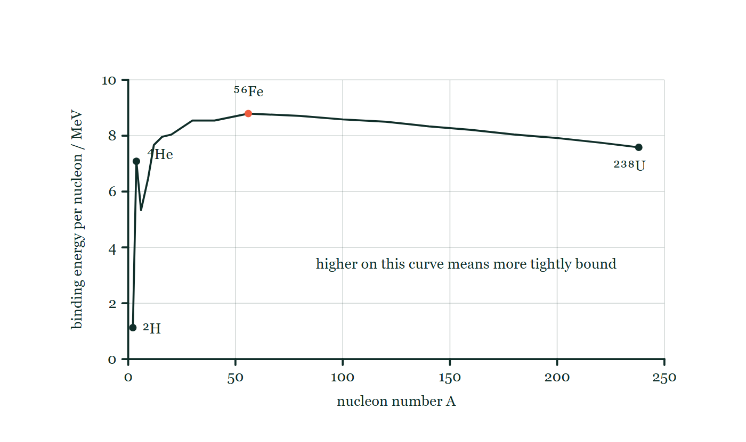
ATOMIC PHYSICS · NUCLEAR REACTIONS & BINDING ENERGY
GIOPHYSICS LESSON
THE PICTURE
The curve everything climbs
Drawn for this lesson
Binding energy per nucleon against nucleon number, drawn as straight segments so the zigzag at the light end shows, rising steeply past ²H and ⁴He to a peak of about 8.8 MeV near ⁵⁶Fe and drifting slowly down to ²³⁸U.
The live version of this figure — click here
Atomic Physics — Nuclear Reactions & Binding Energy. Built by GioPhysics from the lesson's own copy; nothing on these slides is re-authored.
13 / 35
Notes:
[Phase] Build the model: The formulae, one at a time, in plain English (minutes 13–22 of 45)
[Figure] Binding energy per nucleon against nucleon number, drawn as straight segments so the zigzag at the light end shows, rising steeply past ²H and ⁴He to a peak of about 8.8 MeV near ⁵⁶Fe and drifting slowly down to ²³⁸U.

Slide 14
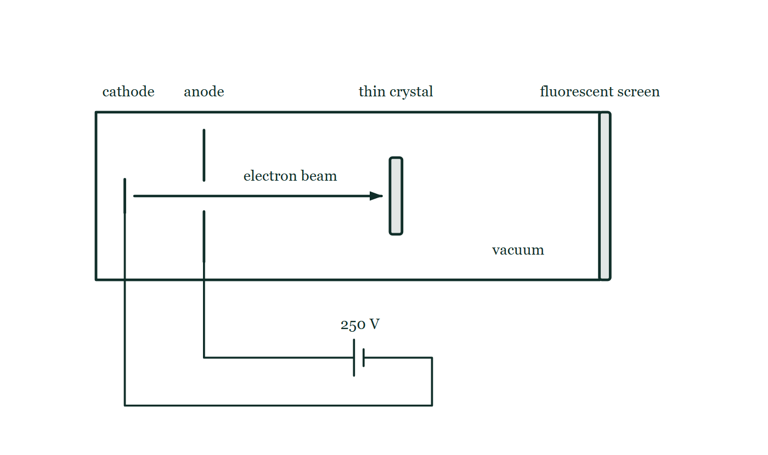
ATOMIC PHYSICS · NUCLEAR REACTIONS & BINDING ENERGY
GIOPHYSICS LESSON
FIGURE 1 OF 3
Fig. 11.1 — A Level · Topics 12–25
Drawn for question 11 of that paper · syllabus 22, 23
An evacuated tube is drawn as a long horizontal rectangle, closed at its right-hand end by a bar labelled fluorescent screen. Near the left-hand end is a short vertical cathode, and beyond it a vertical anode plate with a gap at its centre; leads from both pass out of the tube to a cell labelled 250 V, whose positive terminal is joined to the anode. An arrow along the axis shows a beam of electrons passing through the gap in the anode and travelling to a thin crystal mounted upright across the middle of the tube. The screen is drawn blank.
See the question this was drawn for — click here
Atomic Physics — Nuclear Reactions & Binding Energy. Built by GioPhysics from the lesson's own copy; nothing on these slides is re-authored.
14 / 35
Notes:
[Phase] Build the model: The formulae, one at a time, in plain English (minutes 13–22 of 45)
[Figure] Fig. 11.1. An evacuated tube is drawn as a long horizontal rectangle, closed at its right-hand end by a bar labelled fluorescent screen. Near the left-hand end is a short vertical cathode, and beyond it a vertical anode plate with a gap at its centre; leads from both pass out of the tube to a cell labelled 250 V, whose positive terminal is joined to the anode. An arrow along the axis shows a beam of electrons passing through the gap in the anode and travelling to a thin crystal mounted upright across the middle of the tube. The screen is drawn blank.
[Where it came from] A Level · Topics 12–25, question 11; syllabus 22, 23.

Slide 15
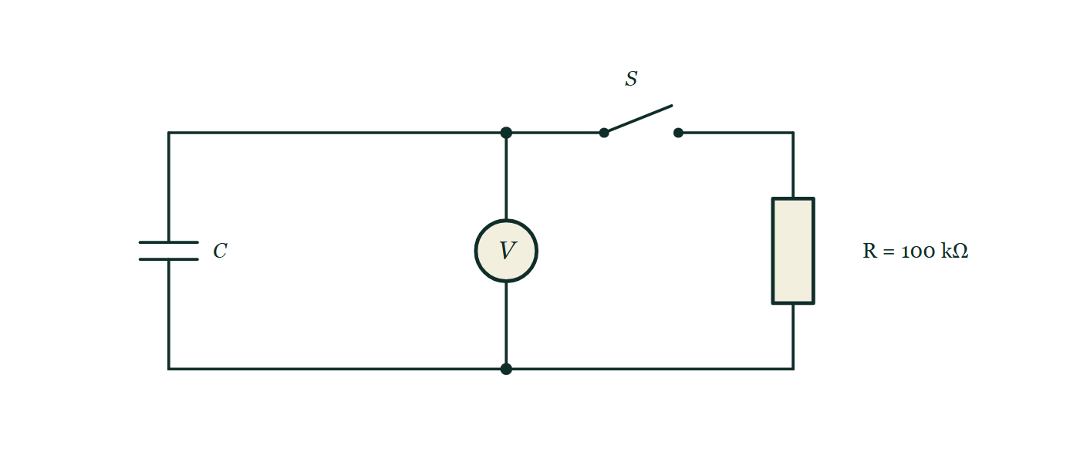
ATOMIC PHYSICS · NUCLEAR REACTIONS & BINDING ENERGY
GIOPHYSICS LESSON
FIGURE 2 OF 3
Fig. 12.1 — A Level · Topics 12–25
Drawn for question 12 of that paper · syllabus 19, 23
A circuit with three branches between an upper and a lower horizontal wire. On the left is a capacitor labelled C; in the middle is a voltmeter connected permanently across it, with junction dots where its branch joins each of the two wires; on the right is a resistor labelled R = 100 kΩ. An open switch S lies in the upper wire between the voltmeter branch and the resistor branch, so that closing it connects the resistor across the capacitor.
See the question this was drawn for — click here
Atomic Physics — Nuclear Reactions & Binding Energy. Built by GioPhysics from the lesson's own copy; nothing on these slides is re-authored.
15 / 35
Notes:
[Phase] Build the model: The formulae, one at a time, in plain English (minutes 13–22 of 45)
[Figure] Fig. 12.1. A circuit with three branches between an upper and a lower horizontal wire. On the left is a capacitor labelled C; in the middle is a voltmeter connected permanently across it, with junction dots where its branch joins each of the two wires; on the right is a resistor labelled R = 100 kΩ. An open switch S lies in the upper wire between the voltmeter branch and the resistor branch, so that closing it connects the resistor across the capacitor.
[Where it came from] A Level · Topics 12–25, question 12; syllabus 19, 23.

Slide 16
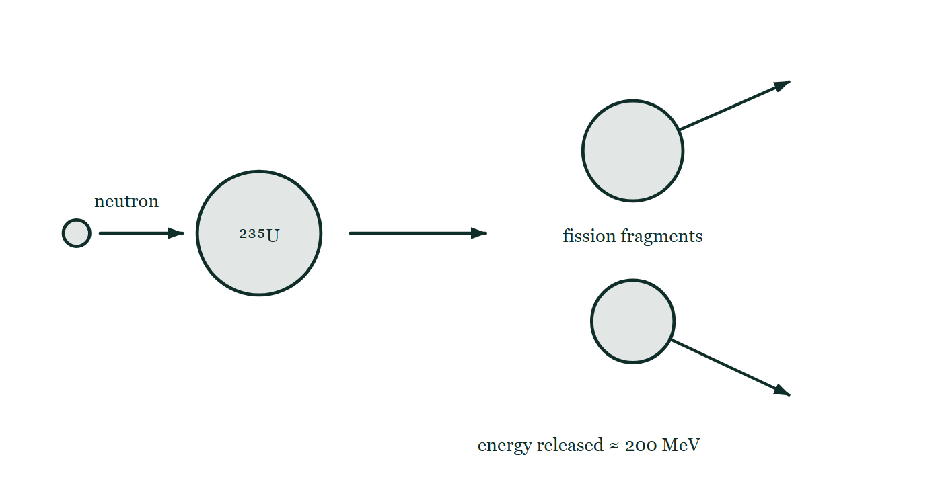
ATOMIC PHYSICS · NUCLEAR REACTIONS & BINDING ENERGY
GIOPHYSICS LESSON
FIGURE 3 OF 3
Fig. 9.1 — IB Theme E · Nuclear and quantum physics
Drawn for question 9 of that paper · syllabus E.4, E.5
A schematic of a single induced fission event, read from left to right. A small neutron on the left travels to the right towards a large circle labelled ²³⁵U. An arrow from that nucleus leads to the products: two unequal fission fragments drawn as circles one above the other, each with its own arrow showing it moving away from the other. Printed below the fragments is the energy released in the event, about 200 MeV.
See the question this was drawn for — click here
Atomic Physics — Nuclear Reactions & Binding Energy. Built by GioPhysics from the lesson's own copy; nothing on these slides is re-authored.
16 / 35
Notes:
[Phase] Build the model: The formulae, one at a time, in plain English (minutes 13–22 of 45)
[Figure] Fig. 9.1. A schematic of a single induced fission event, read from left to right. A small neutron on the left travels to the right towards a large circle labelled ²³⁵U. An arrow from that nucleus leads to the products: two unequal fission fragments drawn as circles one above the other, each with its own arrow showing it moving away from the other. Printed below the fragments is the energy released in the event, about 200 MeV.
[Where it came from] IB Theme E · Nuclear and quantum physics, question 9; syllabus E.4, E.5.

Slide 17
ATOMIC PHYSICS · NUCLEAR REACTIONS & BINDING ENERGY
GIOPHYSICS LESSON
WATCH OUT
The common trap
Check and misconception — The quick check and the trap
Binding energy is not energy stored in the nucleus waiting to escape — it is energy that is missing. A bound nucleus sits in an energy hole Δmc² deep, and you must pay that much to dig the nucleons out. Nuclear reactions release energy only by moving to a deeper hole — a higher point on the E(b)/A curve — never by ‘unlocking’ the binding energy itself.
Atomic Physics — Nuclear Reactions & Binding Energy. Built by GioPhysics from the lesson's own copy; nothing on these slides is re-authored.
17 / 35
Notes:
[Phase] Check and misconception: The quick check and the trap (minutes 35–41 of 45)
[Misconception] Binding energy is not energy stored in the nucleus waiting to escape — it is energy that is missing. A bound nucleus sits in an energy hole Δmc² deep, and you must pay that much to dig the nucleons out. Nuclear reactions release energy only by moving to a deeper hole — a higher point on the E(b)/A curve — never by ‘unlocking’ the binding energy itself.

Slide 18
ATOMIC PHYSICS · NUCLEAR REACTIONS & BINDING ENERGY
GIOPHYSICS LESSON
WORKED EXAMPLE 1 OF 2 · EASY
The question
Easy
Worked examples — I do, we do — one step revealed at a time
Helium-4 has mass 4.002603 u; a ¹H atom is 1.007825 u and a neutron 1.008665 u. Find the mass defect and binding energy of ⁴He.
Atomic Physics — Nuclear Reactions & Binding Energy. Built by GioPhysics from the lesson's own copy; nothing on these slides is re-authored.
18 / 35
Notes:
[Phase] Worked examples: I do, we do — one step revealed at a time (minutes 22–35 of 45)
[Question] Helium-4 has mass 4.002603 u; a ¹H atom is 1.007825 u and a neutron 1.008665 u. Find the mass defect and binding energy of ⁴He.
[Answer] Δm = 0.0304 u; E(b) ≈ 28.3 MeV

Slide 19
ATOMIC PHYSICS · NUCLEAR REACTIONS & BINDING ENERGY
GIOPHYSICS LESSON
WORKED EXAMPLE 1 OF 2 · EASY · THE WORKING
How to solve it
Easy
Worked examples — I do, we do — one step revealed at a time
Helium-4 has mass 4.002603 u; a ¹H atom is 1.007825 u and a neutron 1.008665 u. Find the mass defect and binding energy of ⁴He.
1.
Constituents: 2(1.007825) + 2(1.008665) = 4.032980 u.
2.
Δm = 4.032980 − 4.002603 = 0.030377 u.
3.
E(b) = 0.030377 × 931.5 ≈ 28.3 MeV — about 7.1 MeV per nucleon.
Atomic Physics — Nuclear Reactions & Binding Energy. Built by GioPhysics from the lesson's own copy; nothing on these slides is re-authored.
19 / 35
Notes:
[Phase] Worked examples: I do, we do — one step revealed at a time (minutes 22–35 of 45)
[Reveal] One click per step. The class works each line before the next appears.
[Step 1] Constituents: 2(1.007825) + 2(1.008665) = 4.032980 u.
[Step 2] Δm = 4.032980 − 4.002603 = 0.030377 u.
[Step 3] E(b) = 0.030377 × 931.5 ≈ 28.3 MeV — about 7.1 MeV per nucleon.

Slide 20
ATOMIC PHYSICS · NUCLEAR REACTIONS & BINDING ENERGY
GIOPHYSICS LESSON
WORKED EXAMPLE 1 OF 2 · EASY
Answer
Easy
Worked examples — I do, we do — one step revealed at a time
Δm = 0.0304 u; E(b) ≈ 28.3 MeV
Atomic Physics — Nuclear Reactions & Binding Energy. Built by GioPhysics from the lesson's own copy; nothing on these slides is re-authored.
20 / 35
Notes:
[Phase] Worked examples: I do, we do — one step revealed at a time (minutes 22–35 of 45)
[Answer] Δm = 0.0304 u; E(b) ≈ 28.3 MeV

Slide 21
ATOMIC PHYSICS · NUCLEAR REACTIONS & BINDING ENERGY
GIOPHYSICS LESSON
WORKED EXAMPLE 2 OF 2 · MEDIUM
The question
Medium
Worked examples — I do, we do — one step revealed at a time
Uranium-238 has a binding energy per nucleon of about 7.6 MeV. Estimate its total binding energy and the equivalent mass defect in kilograms.
Atomic Physics — Nuclear Reactions & Binding Energy. Built by GioPhysics from the lesson's own copy; nothing on these slides is re-authored.
21 / 35
Notes:
[Phase] Worked examples: I do, we do — one step revealed at a time (minutes 22–35 of 45)
[Question] Uranium-238 has a binding energy per nucleon of about 7.6 MeV. Estimate its total binding energy and the equivalent mass defect in kilograms.
[Answer] ≈ 1800 MeV ≈ 3.2 × 10⁻²⁷ kg

Slide 22
ATOMIC PHYSICS · NUCLEAR REACTIONS & BINDING ENERGY
GIOPHYSICS LESSON
WORKED EXAMPLE 2 OF 2 · MEDIUM · THE WORKING
How to solve it
Medium
Worked examples — I do, we do — one step revealed at a time
Uranium-238 has a binding energy per nucleon of about 7.6 MeV. Estimate its total binding energy and the equivalent mass defect in kilograms.
1.
E(b) = 238 × 7.6 ≈ 1800 MeV.
2.
Convert: Δm = 1800 MeV × (1.661 × 10⁻²⁷ kg ÷ 931.5 MeV).
3.
Δm ≈ 3.2 × 10⁻²⁷ kg — nearly two whole nucleon masses of pure binding.
Atomic Physics — Nuclear Reactions & Binding Energy. Built by GioPhysics from the lesson's own copy; nothing on these slides is re-authored.
22 / 35
Notes:
[Phase] Worked examples: I do, we do — one step revealed at a time (minutes 22–35 of 45)
[Reveal] One click per step. The class works each line before the next appears.
[Step 1] E(b) = 238 × 7.6 ≈ 1800 MeV.
[Step 2] Convert: Δm = 1800 MeV × (1.661 × 10⁻²⁷ kg ÷ 931.5 MeV).
[Step 3] Δm ≈ 3.2 × 10⁻²⁷ kg — nearly two whole nucleon masses of pure binding.

Slide 23
ATOMIC PHYSICS · NUCLEAR REACTIONS & BINDING ENERGY
GIOPHYSICS LESSON
WORKED EXAMPLE 2 OF 2 · MEDIUM
Answer
Medium
Worked examples — I do, we do — one step revealed at a time
≈ 1800 MeV ≈ 3.2 × 10⁻²⁷ kg
Atomic Physics — Nuclear Reactions & Binding Energy. Built by GioPhysics from the lesson's own copy; nothing on these slides is re-authored.
23 / 35
Notes:
[Phase] Worked examples: I do, we do — one step revealed at a time (minutes 22–35 of 45)
[Answer] ≈ 1800 MeV ≈ 3.2 × 10⁻²⁷ kg

Slide 24
ATOMIC PHYSICS · NUCLEAR REACTIONS & BINDING ENERGY
GIOPHYSICS LESSON
SPOT THE MISTAKE
One line here is wrong
The whole working is up — find the bad line before you click
1.
Radium-226 (226.0254 u) alpha-decays to radon-222 (222.0176 u) plus helium-4 (4.0026 u). Find the energy released.
2.
Products: 222.0176 + 4.0026 = 226.0202 u
3.
Δm = 226.0254 − 226.0202 = 0.0052 u
4.
Q = 0.0052 × 1.661 × 10⁻²⁷ = 8.6 × 10⁻³⁰ MeV
5.
So about 10⁻²⁹ MeV is released.
LINE 4 IS WRONG
Two conversions have been run into one. 1.661 × 10⁻²⁷ turns u into kilograms; 931.5 turns u straight into MeV. Multiplying by the first and then writing MeV after it gives a number that is neither. Either take 0.0052 u × 931.5 MeV/u, or convert to kilograms and then multiply by c² — the two routes agree, and 10⁻²⁹ MeV would be an alpha decay nothing could ever detect.
IT SHOULD SAY
Q = 0.0052 × 931.5 = 4.8 MeV
Atomic Physics — Nuclear Reactions & Binding Energy. Built by GioPhysics from the lesson's own copy; nothing on these slides is re-authored.
24 / 35
Notes:
[Phase] Worked examples: I do, we do — one step revealed at a time (minutes 22–35 of 45)
[Spot the mistake] The working is complete and one line of it is wrong. Let the room hunt: one click names the line, a second shows it done correctly.
[Line 4 is wrong] Two conversions have been run into one. 1.661 × 10⁻²⁷ turns u into kilograms; 931.5 turns u straight into MeV. Multiplying by the first and then writing MeV after it gives a number that is neither. Either take 0.0052 u × 931.5 MeV/u, or convert to kilograms and then multiply by c² — the two routes agree, and 10⁻²⁹ MeV would be an alpha decay nothing could ever detect.
[It should say] Q = 0.0052 × 931.5 = 4.8 MeV

Slide 25
ATOMIC PHYSICS · NUCLEAR REACTIONS & BINDING ENERGY
GIOPHYSICS LESSON
PREDICT · TAKE THE VOTE
Commit before you are told
Hands up for each option, then click
The bound helium nucleus is the lighter side. What would you have to do to make the pans balance?
A Put 28 MeV into the helium nucleus, tearing it back into four separate nucleons
B Take 28 MeV out of the helium nucleus, releasing its binding energy
C Nothing — three quarters of a per cent is measurement error at this precision
A balance with two protons and two neutrons loose on one pan reading 4.032980 u, the same four bound as a helium-4 nucleus on the other reading 4.002603 u, the loose pan sitting lower, and a note that the tilt is hugely exaggerated.
The live version of this figure — click here
Atomic Physics — Nuclear Reactions & Binding Energy. Built by GioPhysics from the lesson's own copy; nothing on these slides is re-authored.
25 / 35
Notes:
[Phase] Build the model: The formulae, one at a time, in plain English (minutes 13–22 of 45)
[Predict] The bound helium nucleus is the lighter side. What would you have to do to make the pans balance?
[Options] A Put 28 MeV into the helium nucleus, tearing it back into four separate nucleons B Take 28 MeV out of the helium nucleus, releasing its binding energy C Nothing — three quarters of a per cent is measurement error at this precision
[Figure] A balance with two protons and two neutrons loose on one pan reading 4.032980 u, the same four bound as a helium-4 nucleus on the other reading 4.002603 u, the loose pan sitting lower, and a note that the tilt is hugely exaggerated.

Slide 26
ATOMIC PHYSICS · NUCLEAR REACTIONS & BINDING ENERGY
GIOPHYSICS LESSON
PREDICT · THE OUTCOME
What actually happens
Ask the room who changed their mind, and why
A Put 28 MeV into the helium nucleus, tearing it back into four separate nucleons
WHY
Binding energy is not a store the nucleus is holding; it is a hole the nucleus is sitting in. Helium-4 is 28 MeV below the four loose nucleons, so climbing back out costs 28 MeV, and paying it is exactly what restores the missing mass. Nothing can be taken out of a bound nucleus by 'unlocking' it. Fission and fusion release energy only by moving nucleons to a deeper hole — a higher point on the binding-energy-per-nucleon curve.
Atomic Physics — Nuclear Reactions & Binding Energy. Built by GioPhysics from the lesson's own copy; nothing on these slides is re-authored.
26 / 35
Notes:
[Phase] Build the model: The formulae, one at a time, in plain English (minutes 13–22 of 45)
[Answer] A — Put 28 MeV into the helium nucleus, tearing it back into four separate nucleons. Binding energy is not a store the nucleus is holding; it is a hole the nucleus is sitting in. Helium-4 is 28 MeV below the four loose nucleons, so climbing back out costs 28 MeV, and paying it is exactly what restores the missing mass. Nothing can be taken out of a bound nucleus by 'unlocking' it. Fission and fusion release energy only by moving nucleons to a deeper hole — a higher point on the binding-energy-per-nucleon curve.

Slide 27
ATOMIC PHYSICS · NUCLEAR REACTIONS & BINDING ENERGY
GIOPHYSICS LESSON
QUICK CHECK
Decide before the answer goes up
Check and misconception — The quick check and the trap
Iron-56 has the highest binding energy per nucleon. This means…
A
Iron releases energy whether it is fused or split
B
Neither fusing nor splitting iron releases energy
C
Iron has the most binding energy of any nucleus
Atomic Physics — Nuclear Reactions & Binding Energy. Built by GioPhysics from the lesson's own copy; nothing on these slides is re-authored.
27 / 35
Notes:
[Phase] Check and misconception: The quick check and the trap (minutes 35–41 of 45)
[Question] Iron-56 has the highest binding energy per nucleon. This means…
[Options] A Iron releases energy whether it is fused or split B Neither fusing nor splitting iron releases energy C Iron has the most binding energy of any nucleus

Slide 28
ATOMIC PHYSICS · NUCLEAR REACTIONS & BINDING ENERGY
GIOPHYSICS LESSON
QUICK CHECK · THE ANSWER
The answer, and why
Check and misconception — The quick check and the trap
B Neither fusing nor splitting iron releases energy
HOW TO GET THERE
Iron is the summit of the curve: any change moves its nucleons to a less tightly bound state and costs energy. (Total binding energy keeps growing with A — it is the per-nucleon value that peaks.)
WHY THE OTHERS TEMPT
A This reads the curve upside down. Standing at the summit means every move is downhill in binding per nucleon, so fusing iron and splitting iron both cost energy rather than releasing it. It is why a massive star's core stalls at iron and then collapses: there is nothing left to burn.
B Correct. Iron sits at the top of the curve, so any change moves its nucleons to a less tightly bound state and has to be paid for.
C Total binding energy keeps climbing with A — uranium-238's is about 1800 MeV against iron-56's 490 MeV. It is the per-nucleon figure that peaks at iron, and that is the one that decides which direction releases energy.
Atomic Physics — Nuclear Reactions & Binding Energy. Built by GioPhysics from the lesson's own copy; nothing on these slides is re-authored.
28 / 35
Notes:
[Phase] Check and misconception: The quick check and the trap (minutes 35–41 of 45)
[Question] Iron-56 has the highest binding energy per nucleon. This means…
[Option by option] A: This reads the curve upside down. Standing at the summit means every move is downhill in binding per nucleon, so fusing iron and splitting iron both cost energy rather than releasing it. It is why a massive star's core stalls at iron and then collapses: there is nothing left to burn. B: Correct. Iron sits at the top of the curve, so any change moves its nucleons to a less tightly bound state and has to be paid for. C: Total binding energy keeps climbing with A — uranium-238's is about 1800 MeV against iron-56's 490 MeV. It is the per-nucleon figure that peaks at iron, and that is the one that decides which direction releases energy.
[Answer] B — Neither fusing nor splitting iron releases energy
[Why] Iron is the summit of the curve: any change moves its nucleons to a less tightly bound state and costs energy. (Total binding energy keeps growing with A — it is the per-nucleon value that peaks.)
[Reveal] One click for the answer, then one for the reason.

Slide 29
ATOMIC PHYSICS · NUCLEAR REACTIONS & BINDING ENERGY
GIOPHYSICS LESSON
EXTENSION 1 OF 2 · HARD
The question
Hard
Worked examples — I do, we do — one step revealed at a time
Radium-226 (226.0254 u) alpha-decays to radon-222 (222.0176 u) plus helium-4 (4.0026 u). Find the energy released (the Q value).
Atomic Physics — Nuclear Reactions & Binding Energy. Built by GioPhysics from the lesson's own copy; nothing on these slides is re-authored.
29 / 35
Notes:
[Phase] Worked examples: I do, we do — one step revealed at a time (minutes 22–35 of 45)
[Question] Radium-226 (226.0254 u) alpha-decays to radon-222 (222.0176 u) plus helium-4 (4.0026 u). Find the energy released (the Q value).
[Answer] Q ≈ 4.8 MeV (≈ 7.8 × 10⁻¹³ J)

Slide 30
ATOMIC PHYSICS · NUCLEAR REACTIONS & BINDING ENERGY
GIOPHYSICS LESSON
EXTENSION 1 OF 2 · HARD · THE WORKING
How to solve it
Hard
Worked examples — I do, we do — one step revealed at a time
Radium-226 (226.0254 u) alpha-decays to radon-222 (222.0176 u) plus helium-4 (4.0026 u). Find the energy released (the Q value).
1.
Products: 222.0176 + 4.0026 = 226.0202 u.
2.
Δm = 226.0254 − 226.0202 = 0.0052 u.
3.
Q = 0.0052 × 931.5 ≈ 4.8 MeV = 7.8 × 10⁻¹³ J, carried off almost entirely by the light alpha particle.
Atomic Physics — Nuclear Reactions & Binding Energy. Built by GioPhysics from the lesson's own copy; nothing on these slides is re-authored.
30 / 35
Notes:
[Phase] Worked examples: I do, we do — one step revealed at a time (minutes 22–35 of 45)
[Reveal] One click per step. The class works each line before the next appears.
[Step 1] Products: 222.0176 + 4.0026 = 226.0202 u.
[Step 2] Δm = 226.0254 − 226.0202 = 0.0052 u.
[Step 3] Q = 0.0052 × 931.5 ≈ 4.8 MeV = 7.8 × 10⁻¹³ J, carried off almost entirely by the light alpha particle.

Slide 31
ATOMIC PHYSICS · NUCLEAR REACTIONS & BINDING ENERGY
GIOPHYSICS LESSON
EXTENSION 1 OF 2 · HARD
Answer
Hard
Worked examples — I do, we do — one step revealed at a time
Q ≈ 4.8 MeV (≈ 7.8 × 10⁻¹³ J)
Atomic Physics — Nuclear Reactions & Binding Energy. Built by GioPhysics from the lesson's own copy; nothing on these slides is re-authored.
31 / 35
Notes:
[Phase] Worked examples: I do, we do — one step revealed at a time (minutes 22–35 of 45)
[Answer] Q ≈ 4.8 MeV (≈ 7.8 × 10⁻¹³ J)

Slide 32
ATOMIC PHYSICS · NUCLEAR REACTIONS & BINDING ENERGY
GIOPHYSICS LESSON
EXTENSION 2 OF 2 · CHALLENGING
The question
Challenging
Worked examples — I do, we do — one step revealed at a time
Use the curve (E(b)/A ≈ 7.6 MeV at A ≈ 236; ≈ 8.4 MeV for the fragments) to estimate the energy released when ²³⁵U + n fissions, and compare it with a chemical reaction.
Atomic Physics — Nuclear Reactions & Binding Energy. Built by GioPhysics from the lesson's own copy; nothing on these slides is re-authored.
32 / 35
Notes:
[Phase] Worked examples: I do, we do — one step revealed at a time (minutes 22–35 of 45)
[Question] Use the curve (E(b)/A ≈ 7.6 MeV at A ≈ 236; ≈ 8.4 MeV for the fragments) to estimate the energy released when ²³⁵U + n fissions, and compare it with a chemical reaction.
[Answer] ≈ 190 MeV per fission — roughly a hundred million times any chemical step

Slide 33
ATOMIC PHYSICS · NUCLEAR REACTIONS & BINDING ENERGY
GIOPHYSICS LESSON
EXTENSION 2 OF 2 · CHALLENGING · THE WORKING
How to solve it
Challenging
Worked examples — I do, we do — one step revealed at a time
Use the curve (E(b)/A ≈ 7.6 MeV at A ≈ 236; ≈ 8.4 MeV for the fragments) to estimate the energy released when ²³⁵U + n fissions, and compare it with a chemical reaction.
1.
Before: 236 nucleons × 7.6 ≈ 1794 MeV of binding. After: 236 × 8.4 ≈ 1982 MeV.
2.
Q ≈ 1982 − 1794 ≈ 190 MeV ≈ 3 × 10⁻¹¹ J per fission.
3.
A chemical bond rearrangement releases a few eV — a few 10⁻¹⁹ J. Fission wins by a factor of about 10⁸, which is why a pellet of uranium matches train-loads of coal.
Atomic Physics — Nuclear Reactions & Binding Energy. Built by GioPhysics from the lesson's own copy; nothing on these slides is re-authored.
33 / 35
Notes:
[Phase] Worked examples: I do, we do — one step revealed at a time (minutes 22–35 of 45)
[Reveal] One click per step. The class works each line before the next appears.
[Step 1] Before: 236 nucleons × 7.6 ≈ 1794 MeV of binding. After: 236 × 8.4 ≈ 1982 MeV.
[Step 2] Q ≈ 1982 − 1794 ≈ 190 MeV ≈ 3 × 10⁻¹¹ J per fission.
[Step 3] A chemical bond rearrangement releases a few eV — a few 10⁻¹⁹ J. Fission wins by a factor of about 10⁸, which is why a pellet of uranium matches train-loads of coal.

Slide 34
ATOMIC PHYSICS · NUCLEAR REACTIONS & BINDING ENERGY
GIOPHYSICS LESSON
EXTENSION 2 OF 2 · CHALLENGING
Answer
Challenging
Worked examples — I do, we do — one step revealed at a time
≈ 190 MeV per fission — roughly a hundred million times any chemical step
Atomic Physics — Nuclear Reactions & Binding Energy. Built by GioPhysics from the lesson's own copy; nothing on these slides is re-authored.
34 / 35
Notes:
[Phase] Worked examples: I do, we do — one step revealed at a time (minutes 22–35 of 45)
[Answer] ≈ 190 MeV per fission — roughly a hundred million times any chemical step

Slide 35
ATOMIC PHYSICS · NUCLEAR REACTIONS & BINDING ENERGY
GIOPHYSICS LESSON
ATOMIC PHYSICS
Where to go next
Plenary — What to take away, what to practise next
Next
24.5 The Structure of Matter
https://giophysics.com/chapter-46/standard-model/
Lesson
This lesson on giophysics.com
https://giophysics.com/chapter-46/nuclear-reactions/
Live
The live, interactive version of these slides
https://giophysics.com/chapter-46/presentation/?lesson=reactions
Chapter
All Atomic Physics lessons
https://giophysics.com/chapter-46/
PDF
Download the lesson PDF
https://giophysics.com/downloads/46-4-nuclear-reactions.pdf
Atomic Physics — Nuclear Reactions & Binding Energy. Built by GioPhysics from the lesson's own copy; nothing on these slides is re-authored.
35 / 35
Notes:
[Phase] Plenary: What to take away, what to practise next (minutes 41–45 of 45)
[Interactive] The graphs and the circuit topology on these slides are frozen. The live version at https://giophysics.com/chapter-46/presentation/?lesson=reactions moves them.

