Slide 1
QUANTUM · THE PHOTOELECTRIC EFFECT
GIOPHYSICS LESSON
25 · Quantum
Light arrives in packets
The Photoelectric Effect
Shine ultraviolet light on zinc and electrons fly out instantly — even when the light is absurdly dim. Shine red light on the same plate and nothing happens, no matter how bright. Classical wave theory cannot explain either fact. Einstein could, by making light grainy.
POSITION
Lesson 1 of 6 in Quantum
PLAN
15 slides in the 45-minute core run, about 44 minutes of it
LESSON PAGE
https://giophysics.com/chapter-47/photoelectric-effect/
Built by GioPhysics from the lesson's own page. Every word on these slides is the lesson's; nothing here is re-authored. Teaching material, not an awarding body's document.
Quantum — The Photoelectric Effect. Built by GioPhysics from the lesson's own copy; nothing on these slides is re-authored.
1 / 40
Notes:
[Lesson] Quantum — The Photoelectric Effect. Lesson 1 of 6.
[Intro] Shine ultraviolet light on zinc and electrons fly out instantly — even when the light is absurdly dim. Shine red light on the same plate and nothing happens, no matter how bright. Classical wave theory cannot explain either fact. Einstein could, by making light grainy.
[Source] https://giophysics.com/chapter-47/photoelectric-effect/
[Disclaimer] Built by GioPhysics from the lesson's own page. Every word on these slides is the lesson's; nothing here is re-authored. Teaching material, not an awarding body's document.

Slide 2
QUANTUM · THE PHOTOELECTRIC EFFECT
GIOPHYSICS LESSON
WHAT THIS NEEDS
What you already know
Starter — Recall what this lesson stands on
Recall
Electromagnetic waves
https://giophysics.com/chapter-24/electromagnetic-waves/
Recall
Electric potential & the volt
https://giophysics.com/chapter-21/electric-potential-voltage/
Quantum — The Photoelectric Effect. Built by GioPhysics from the lesson's own copy; nothing on these slides is re-authored.
2 / 40
Notes:
[Phase] Starter: Recall what this lesson stands on (minutes 0–5 of 45)
[Starter] Recall: Electromagnetic waves; Electric potential & the volt

Slide 3
QUANTUM · THE PHOTOELECTRIC EFFECT
GIOPHYSICS LESSON
THINK FIRST
A dim ultraviolet lamp frees electrons from zinc the instant it is switched on. A blinding red floodlight, left on all afternoon, frees none. Why doesn't the red light win on brightness alone?
Take answers before you click — the point is the commitment
The floodlight is delivering thousands of times more energy per second onto the same plate. On any wave picture, energy arriving continuously must eventually add up to enough.
THE ANSWER
Because one electron absorbs one photon, and cannot save up. Each red photon offers about 1.9 eV against zinc's 4.3 eV entry fee, so every one of them is refused, however many arrive. Brightness counts photons; frequency sets what each one is worth. And the electron cannot bank two of them and try again.
Quantum — The Photoelectric Effect. Built by GioPhysics from the lesson's own copy; nothing on these slides is re-authored.
3 / 40
Notes:
[Phase] Starter: Recall what this lesson stands on (minutes 0–5 of 45)
[Hook] A dim ultraviolet lamp frees electrons from zinc the instant it is switched on. A blinding red floodlight, left on all afternoon, frees none. Why doesn't the red light win on brightness alone? The floodlight is delivering thousands of times more energy per second onto the same plate. On any wave picture, energy arriving continuously must eventually add up to enough.
[Answer] Because one electron absorbs one photon, and cannot save up. Each red photon offers about 1.9 eV against zinc's 4.3 eV entry fee, so every one of them is refused, however many arrive. Brightness counts photons; frequency sets what each one is worth. And the electron cannot bank two of them and try again.

Slide 4
QUANTUM · THE PHOTOELECTRIC EFFECT
GIOPHYSICS LESSON
EXPLAINED SIMPLY
In one sentence
Introduce the idea — The big idea and the definition
Light of frequency f is a stream of photons of energy E = hf; one photon can eject one electron from a metal if hf exceeds the work function φ, and the fastest electrons carry away E(max) = hf − φ.
Quantum — The Photoelectric Effect. Built by GioPhysics from the lesson's own copy; nothing on these slides is re-authored.
4 / 40
Notes:
[Phase] Introduce the idea: The big idea and the definition (minutes 5–13 of 45)
[Definition] Light of frequency f is a stream of photons of energy E = hf; one photon can eject one electron from a metal if hf exceeds the work function φ, and the fastest electrons carry away E(max) = hf − φ.

Slide 5
QUANTUM · THE PHOTOELECTRIC EFFECT
GIOPHYSICS LESSON
EXPLAINED SIMPLY
What that looks like
Introduce the idea — The big idea and the definition
FOR EXAMPLE
A photographer’s darkroom uses a red safelight because red photons (about 1.9 eV each) cannot trigger the chemistry that blue photons (about 2.8 eV) trigger easily — brightness is irrelevant, the packet size is everything.
Quantum — The Photoelectric Effect. Built by GioPhysics from the lesson's own copy; nothing on these slides is re-authored.
5 / 40
Notes:
[Phase] Introduce the idea: The big idea and the definition (minutes 5–13 of 45)
[Worked illustration] A photographer’s darkroom uses a red safelight because red photons (about 1.9 eV each) cannot trigger the chemistry that blue photons (about 2.8 eV) trigger easily — brightness is irrelevant, the packet size is everything.

Slide 6
QUANTUM · THE PHOTOELECTRIC EFFECT
GIOPHYSICS LESSON
THE BIG IDEA
Light arrives in packets
Introduce the idea — The big idea and the definition
A beam of light of frequency f delivers its energy in indivisible packets — photons — each carrying E = hf. An electron in a metal absorbs one photon or none; it cannot save up several. Escaping the metal costs a fixed entry fee called the work function φ, so the fastest electrons leave with E(max) = hf − φ.
Below the threshold frequency f₀ = φ/h a photon simply cannot pay the fee, so no electrons appear at any intensity. Intensity only sets how many photons arrive per second — the current, never the electron energy. Reversing the collecting voltage until the current dies measures E(max) directly: eV(s) = E(max).
Quantum — The Photoelectric Effect. Built by GioPhysics from the lesson's own copy; nothing on these slides is re-authored.
6 / 40
Notes:
[Phase] Introduce the idea: The big idea and the definition (minutes 5–13 of 45)
[Big idea] A beam of light of frequency f delivers its energy in indivisible packets — photons — each carrying E = hf. An electron in a metal absorbs one photon or none; it cannot save up several. Escaping the metal costs a fixed entry fee called the work function φ, so the fastest electrons leave with E(max) = hf − φ. Below the threshold frequency f₀ = φ/h a photon simply cannot pay the fee, so no electrons appear at any intensity. Intensity only sets how many photons arrive per second — the current, never the electron energy. Reversing the collecting voltage until the current dies measures E(max) directly: eV(s) = E(max).

Slide 7
QUANTUM · THE PHOTOELECTRIC EFFECT
GIOPHYSICS LESSON
THE PHYSICS · 1 OF 5
What the wave picture predicted — and got wrong
Build the model — The formulae, one at a time, in plain English
A wave delivers energy continuously, so any frequency should eject electrons if you wait long enough or turn the intensity up, and brighter light should make faster electrons. Experiment says the opposite: below f₀ nothing happens at any brightness, above f₀ emission is instantaneous even in the dimmest light, and only frequency changes the electron energy.
Quantum — The Photoelectric Effect. Built by GioPhysics from the lesson's own copy; nothing on these slides is re-authored.
7 / 40
Notes:
[Phase] Build the model: The formulae, one at a time, in plain English (minutes 13–22 of 45)
[Section] A wave delivers energy continuously, so any frequency should eject electrons if you wait long enough or turn the intensity up, and brighter light should make faster electrons. Experiment says the opposite: below f₀ nothing happens at any brightness, above f₀ emission is instantaneous even in the dimmest light, and only frequency changes the electron energy.

Slide 8
QUANTUM · THE PHOTOELECTRIC EFFECT
GIOPHYSICS LESSON
THE PHYSICS · 2 OF 5
What each dial does
Build the model — The formulae, one at a time, in plain English
Frequency sets the energy of each photon, so it sets E(max) and the stopping potential. Intensity sets the number of photons per second, so it sets the photocurrent — the count of ejected electrons — and nothing else. The two roles never mix, which is the clearest fingerprint of the photon model.
Quantum — The Photoelectric Effect. Built by GioPhysics from the lesson's own copy; nothing on these slides is re-authored.
8 / 40
Notes:
[Phase] Build the model: The formulae, one at a time, in plain English (minutes 13–22 of 45)
[Section] Frequency sets the energy of each photon, so it sets E(max) and the stopping potential. Intensity sets the number of photons per second, so it sets the photocurrent — the count of ejected electrons — and nothing else. The two roles never mix, which is the clearest fingerprint of the photon model.

Slide 9
QUANTUM · THE PHOTOELECTRIC EFFECT
GIOPHYSICS LESSON
THE PHYSICS · 3 OF 5
Millikan’s reluctant confirmation
Build the model — The formulae, one at a time, in plain English
Robert Millikan spent a decade trying to disprove Einstein’s equation. Plotting stopping energy against frequency for different metals, he found perfectly straight lines, every one with slope h — the same constant Planck had extracted from glowing objects.
The intercepts gave each metal’s work function. Einstein received the 1921 Nobel Prize for this equation, not for relativity.
Quantum — The Photoelectric Effect. Built by GioPhysics from the lesson's own copy; nothing on these slides is re-authored.
9 / 40
Notes:
[Phase] Build the model: The formulae, one at a time, in plain English (minutes 13–22 of 45)
[Section] Robert Millikan spent a decade trying to disprove Einstein’s equation. Plotting stopping energy against frequency for different metals, he found perfectly straight lines, every one with slope h — the same constant Planck had extracted from glowing objects. The intercepts gave each metal’s work function. Einstein received the 1921 Nobel Prize for this equation, not for relativity.

Slide 10
QUANTUM · THE PHOTOELECTRIC EFFECT
GIOPHYSICS LESSON
THE PHYSICS · 4 OF 5
Light pushes
Build the model — The formulae, one at a time, in plain English
p = mv is a rule for slow matter, not for light, so a massless photon is not a momentum-less one: it carries p = E/c = h/λ, and a surface that absorbs it feels the recoil. Absorb a beam of power P for one second and it delivers P/c of momentum; reflect it instead and the momentum change doubles, which is why a mirrored solar sail feels twice the push of a black one. The numbers are small — full sunlight on a square metre of mirror pushes with about 9 μN — but they act continuously and for free, which is enough to sail on.
Quantum — The Photoelectric Effect. Built by GioPhysics from the lesson's own copy; nothing on these slides is re-authored.
10 / 40
Notes:
[Phase] Build the model: The formulae, one at a time, in plain English (minutes 13–22 of 45)
[Section] p = mv is a rule for slow matter, not for light, so a massless photon is not a momentum-less one: it carries p = E/c = h/λ, and a surface that absorbs it feels the recoil. Absorb a beam of power P for one second and it delivers P/c of momentum; reflect it instead and the momentum change doubles, which is why a mirrored solar sail feels twice the push of a black one. The numbers are small — full sunlight on a square metre of mirror pushes with about 9 μN — but they act continuously and for free, which is enough to sail on.

Slide 11
QUANTUM · THE PHOTOELECTRIC EFFECT
GIOPHYSICS LESSON
THE PHYSICS · 5 OF 5
Compton: billiards with light
Build the model — The formulae, one at a time, in plain English
Fire X-rays into graphite and some emerge with a longer wavelength than they went in with, by an amount that depends only on the angle you look from. A wave cannot do that: an electron shaken by a wave re-radiates at the frequency that shook it. A particle can.
Treat the photon as a projectile carrying energy hf and momentum h/λ, collide it elastically with a free electron, and conserving both gives λf − λi = (h/mₑc)(1 − cos θ). The photon hands over some energy, so its wavelength grows; the electron recoils with the rest. The shift is independent of the incoming wavelength and of the target material, which is exactly why it settled the argument.
Quantum — The Photoelectric Effect. Built by GioPhysics from the lesson's own copy; nothing on these slides is re-authored.
11 / 40
Notes:
[Phase] Build the model: The formulae, one at a time, in plain English (minutes 13–22 of 45)
[Section] Fire X-rays into graphite and some emerge with a longer wavelength than they went in with, by an amount that depends only on the angle you look from. A wave cannot do that: an electron shaken by a wave re-radiates at the frequency that shook it. A particle can. Treat the photon as a projectile carrying energy hf and momentum h/λ, collide it elastically with a free electron, and conserving both gives λf − λi = (h/mₑc)(1 − cos θ). The photon hands over some energy, so its wavelength grows; the electron recoils with the rest. The shift is independent of the incoming wavelength and of the target material, which is exactly why it settled the argument.

Slide 12
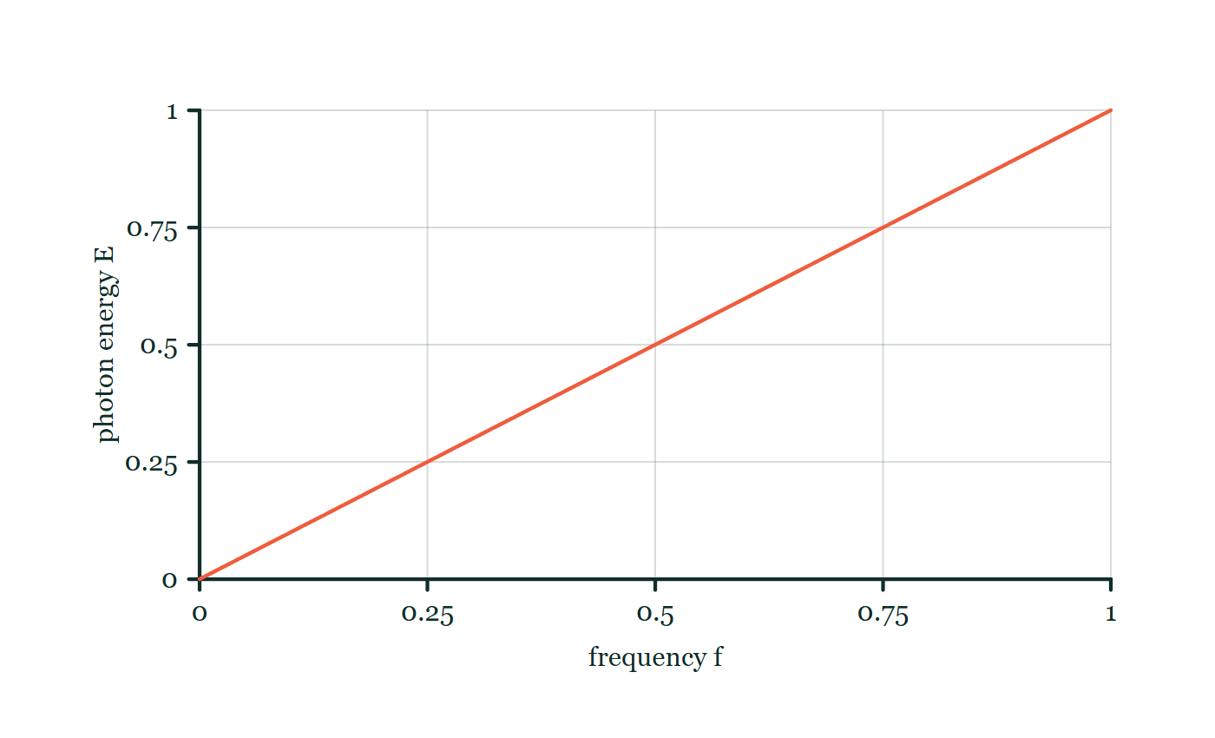
QUANTUM · THE PHOTOELECTRIC EFFECT
GIOPHYSICS LESSON
FORMULA 1 OF 6
Photon energy
Build the model — The formulae, one at a time, in plain English
E = hf = hc/λ
h = 6.63 × 10⁻³⁴ J s
IN PLAIN ENGLISH
Light of one frequency comes in identical energy packets. Doubling the brightness doubles the number of packets per second — it never makes any single packet bigger.
Photon energy–frequency explorer
Move this graph on the live version — click here
Quantum — The Photoelectric Effect. Built by GioPhysics from the lesson's own copy; nothing on these slides is re-authored.
12 / 40
Notes:
[Phase] Build the model: The formulae, one at a time, in plain English (minutes 13–22 of 45)
[Formula] Photon energy: E = hf = hc/λ
[In plain English] Light of one frequency comes in identical energy packets. Doubling the brightness doubles the number of packets per second — it never makes any single packet bigger.
[Note] h = 6.63 × 10⁻³⁴ J s
[Graph] Photon energy–frequency explorer. Planck's constant h is fixed, so photon energy is directly proportional to frequency.
[Axes] Horizontal: frequency f. Vertical: photon energy E. Values are normalised — the graph teaches the shape, not a measurement.

Slide 13
QUANTUM · THE PHOTOELECTRIC EFFECT
GIOPHYSICS LESSON
FORMULA 2 OF 6
Work function & threshold
Build the model — The formulae, one at a time, in plain English
φ = hf₀
φ in eV varies metal to metal
IN PLAIN ENGLISH
The work function is the minimum energy to pull one electron out of the metal surface. It fixes a threshold frequency f₀ below which no photon can free an electron.
Quantum — The Photoelectric Effect. Built by GioPhysics from the lesson's own copy; nothing on these slides is re-authored.
13 / 40
Notes:
[Phase] Build the model: The formulae, one at a time, in plain English (minutes 13–22 of 45)
[Formula] Work function & threshold: φ = hf₀
[In plain English] The work function is the minimum energy to pull one electron out of the metal surface. It fixes a threshold frequency f₀ below which no photon can free an electron.
[Note] φ in eV varies metal to metal

Slide 14
QUANTUM · THE PHOTOELECTRIC EFFECT
GIOPHYSICS LESSON
FORMULA 3 OF 6
Einstein’s equation
Build the model — The formulae, one at a time, in plain English
E(max) = hf − φ
Energy bookkeeping for one photon, one electron
IN PLAIN ENGLISH
One photon hands hf to one electron; φ is spent escaping; the remainder is kinetic energy. Electrons from deeper in the metal lose more, which is why E(max) is a maximum.
Quantum — The Photoelectric Effect. Built by GioPhysics from the lesson's own copy; nothing on these slides is re-authored.
14 / 40
Notes:
[Phase] Build the model: The formulae, one at a time, in plain English (minutes 13–22 of 45)
[Formula] Einstein’s equation: E(max) = hf − φ
[In plain English] One photon hands hf to one electron; φ is spent escaping; the remainder is kinetic energy. Electrons from deeper in the metal lose more, which is why E(max) is a maximum.
[Note] Energy bookkeeping for one photon, one electron

Slide 15
QUANTUM · THE PHOTOELECTRIC EFFECT
GIOPHYSICS LESSON
FORMULA 4 OF 6
Stopping potential
Build the model — The formulae, one at a time, in plain English
eV(s) = E(max)
The reverse voltage that just kills the current
IN PLAIN ENGLISH
Make the collector negative and it repels photoelectrons. The voltage that stops even the fastest ones converts straight into their kinetic energy in electronvolts.
Quantum — The Photoelectric Effect. Built by GioPhysics from the lesson's own copy; nothing on these slides is re-authored.
15 / 40
Notes:
[Phase] Build the model: The formulae, one at a time, in plain English (minutes 13–22 of 45)
[Formula] Stopping potential: eV(s) = E(max)
[In plain English] Make the collector negative and it repels photoelectrons. The voltage that stops even the fastest ones converts straight into their kinetic energy in electronvolts.
[Note] The reverse voltage that just kills the current

Slide 16
QUANTUM · THE PHOTOELECTRIC EFFECT
GIOPHYSICS LESSON
FORMULA 5 OF 6
Photon momentum
Build the model — The formulae, one at a time, in plain English
p = E/c = h/λ
Massless, but never momentum-less
IN PLAIN ENGLISH
A photon has no mass and still carries momentum: divide its energy by c, or divide h by its wavelength. Short wavelength, bigger kick.
Quantum — The Photoelectric Effect. Built by GioPhysics from the lesson's own copy; nothing on these slides is re-authored.
16 / 40
Notes:
[Phase] Build the model: The formulae, one at a time, in plain English (minutes 13–22 of 45)
[Formula] Photon momentum: p = E/c = h/λ
[In plain English] A photon has no mass and still carries momentum: divide its energy by c, or divide h by its wavelength. Short wavelength, bigger kick.
[Note] Massless, but never momentum-less

Slide 17
QUANTUM · THE PHOTOELECTRIC EFFECT
GIOPHYSICS LESSON
FORMULA 6 OF 6
Compton shift
Build the model — The formulae, one at a time, in plain English
Δλ = (h/mₑc)(1 − cos θ)
h/mₑc = 2.43 pm; largest shift 4.86 pm, straight back
IN PLAIN ENGLISH
The wavelength a photon gains scattering off a free electron. It depends on the viewing angle and nothing else — not the starting wavelength, not the target, not the intensity.
Quantum — The Photoelectric Effect. Built by GioPhysics from the lesson's own copy; nothing on these slides is re-authored.
17 / 40
Notes:
[Phase] Build the model: The formulae, one at a time, in plain English (minutes 13–22 of 45)
[Formula] Compton shift: Δλ = (h/mₑc)(1 − cos θ)
[In plain English] The wavelength a photon gains scattering off a free electron. It depends on the viewing angle and nothing else — not the starting wavelength, not the target, not the intensity.
[Note] h/mₑc = 2.43 pm; largest shift 4.86 pm, straight back

Slide 18
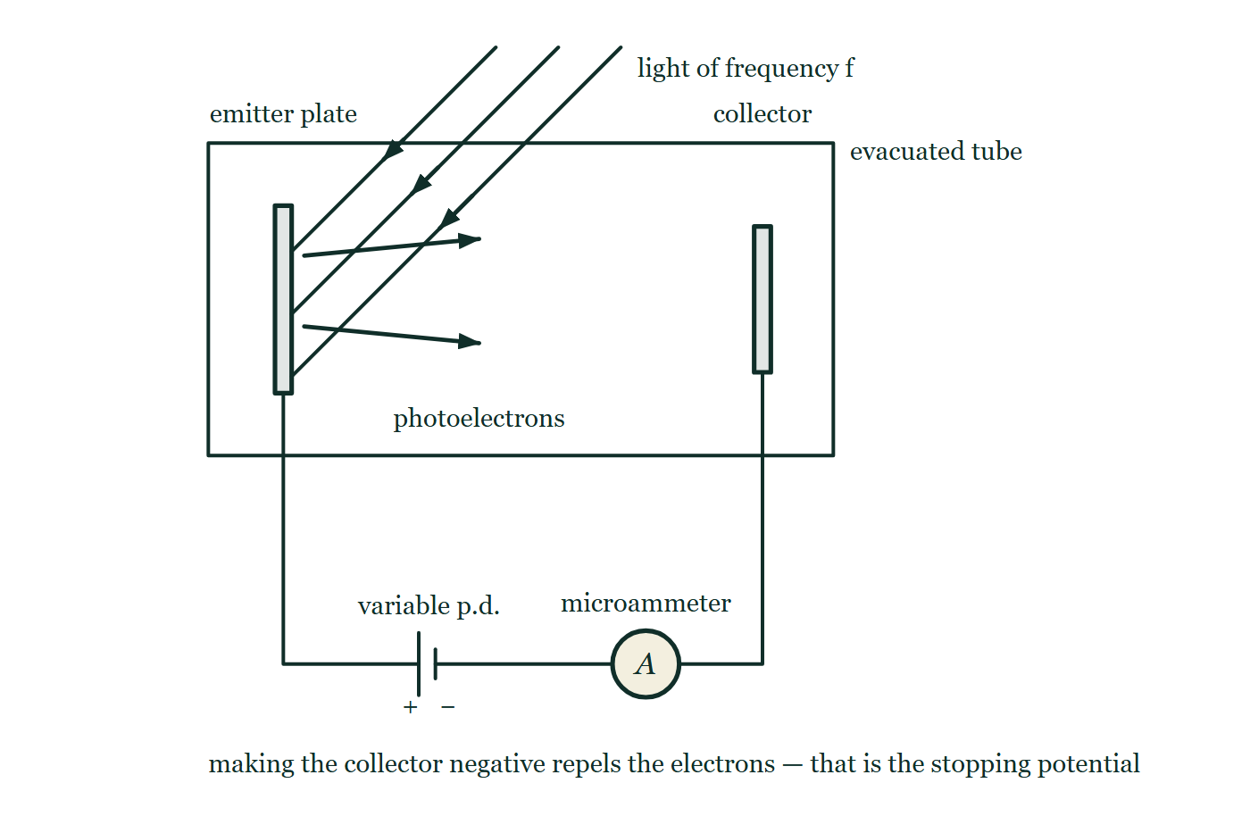
QUANTUM · THE PHOTOELECTRIC EFFECT
GIOPHYSICS LESSON
THE PICTURE
The circuit that measures an electron's energy
Drawn for this lesson
An evacuated tube with light of frequency f falling on the emitter plate and photoelectrons crossing to the collector, wired to a cell whose negative terminal faces the collector so the field between the plates opposes them, with a microammeter reading the current.
The live version of this figure — click here
Quantum — The Photoelectric Effect. Built by GioPhysics from the lesson's own copy; nothing on these slides is re-authored.
18 / 40
Notes:
[Phase] Build the model: The formulae, one at a time, in plain English (minutes 13–22 of 45)
[Figure] An evacuated tube with light of frequency f falling on the emitter plate and photoelectrons crossing to the collector, wired to a cell whose negative terminal faces the collector so the field between the plates opposes them, with a microammeter reading the current.

Slide 19
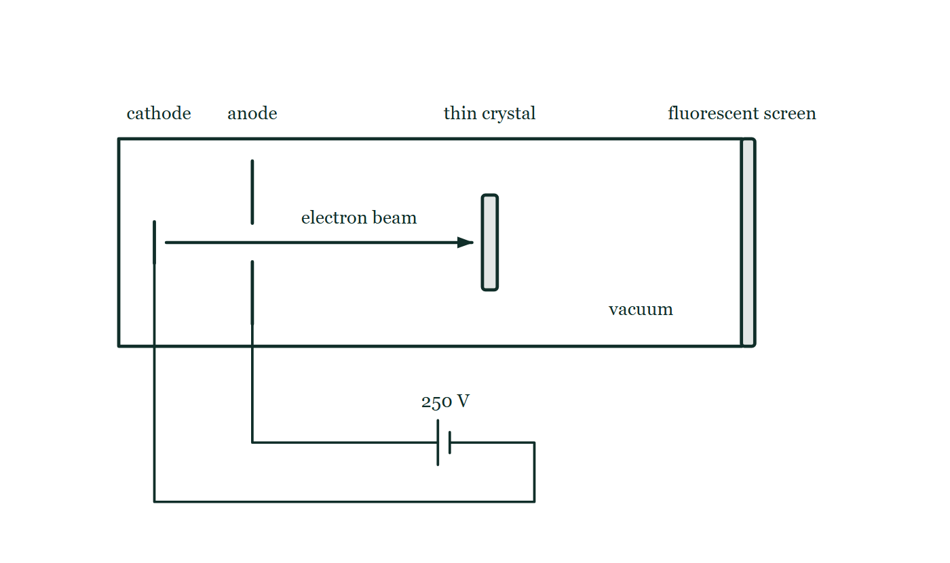
QUANTUM · THE PHOTOELECTRIC EFFECT
GIOPHYSICS LESSON
FIGURE 1 OF 3
Fig. 11.1 — A Level · Topics 12–25
Drawn for question 11 of that paper · syllabus 22, 23
An evacuated tube is drawn as a long horizontal rectangle, closed at its right-hand end by a bar labelled fluorescent screen. Near the left-hand end is a short vertical cathode, and beyond it a vertical anode plate with a gap at its centre; leads from both pass out of the tube to a cell labelled 250 V, whose positive terminal is joined to the anode. An arrow along the axis shows a beam of electrons passing through the gap in the anode and travelling to a thin crystal mounted upright across the middle of the tube. The screen is drawn blank.
See the question this was drawn for — click here
Quantum — The Photoelectric Effect. Built by GioPhysics from the lesson's own copy; nothing on these slides is re-authored.
19 / 40
Notes:
[Phase] Build the model: The formulae, one at a time, in plain English (minutes 13–22 of 45)
[Figure] Fig. 11.1. An evacuated tube is drawn as a long horizontal rectangle, closed at its right-hand end by a bar labelled fluorescent screen. Near the left-hand end is a short vertical cathode, and beyond it a vertical anode plate with a gap at its centre; leads from both pass out of the tube to a cell labelled 250 V, whose positive terminal is joined to the anode. An arrow along the axis shows a beam of electrons passing through the gap in the anode and travelling to a thin crystal mounted upright across the middle of the tube. The screen is drawn blank.
[Where it came from] A Level · Topics 12–25, question 11; syllabus 22, 23.

Slide 20
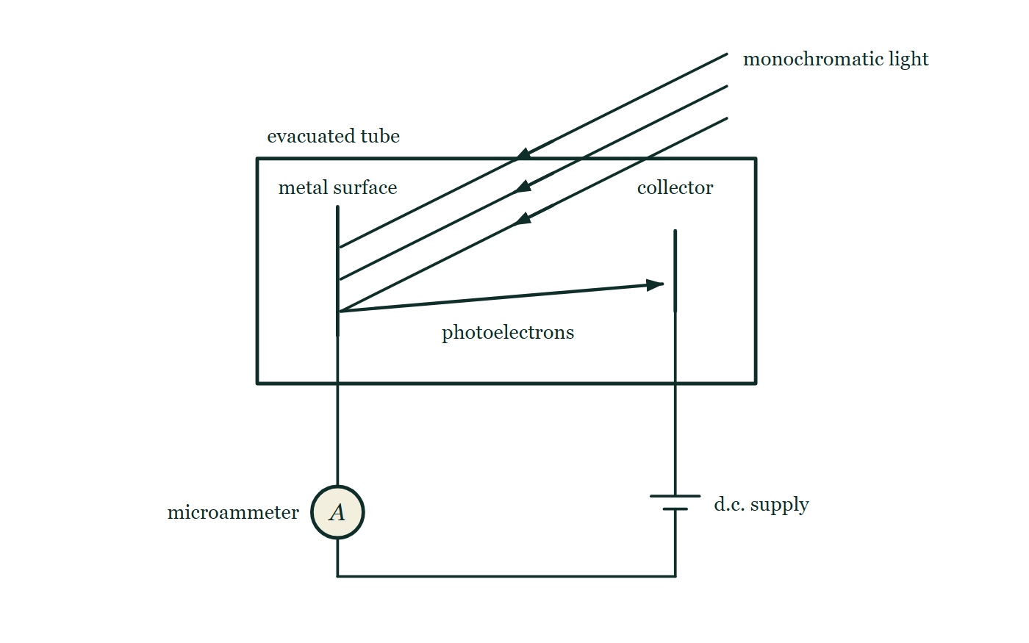
QUANTUM · THE PHOTOELECTRIC EFFECT
GIOPHYSICS LESSON
FIGURE 2 OF 3
Fig. 6.1 — IB Theme E · Nuclear and quantum physics
Drawn for question 6 of that paper · syllabus E.2
A photoelectric cell drawn as an evacuated tube. Inside it a flat metal plate stands on the left and a smaller collecting electrode on the right. A beam of monochromatic light enters through the top of the tube and falls on the face of the plate that faces the collector, and an arrow across the vacuum shows photoelectrons travelling from the plate to the collector. Outside the tube the plate is connected through a microammeter and along a wire to a d.c. supply, the positive terminal of which is the one joined back to the collector.
See the question this was drawn for — click here
Quantum — The Photoelectric Effect. Built by GioPhysics from the lesson's own copy; nothing on these slides is re-authored.
20 / 40
Notes:
[Phase] Build the model: The formulae, one at a time, in plain English (minutes 13–22 of 45)
[Figure] Fig. 6.1. A photoelectric cell drawn as an evacuated tube. Inside it a flat metal plate stands on the left and a smaller collecting electrode on the right. A beam of monochromatic light enters through the top of the tube and falls on the face of the plate that faces the collector, and an arrow across the vacuum shows photoelectrons travelling from the plate to the collector. Outside the tube the plate is connected through a microammeter and along a wire to a d.c. supply, the positive terminal of which is the one joined back to the collector.
[Where it came from] IB Theme E · Nuclear and quantum physics, question 6; syllabus E.2.

Slide 21
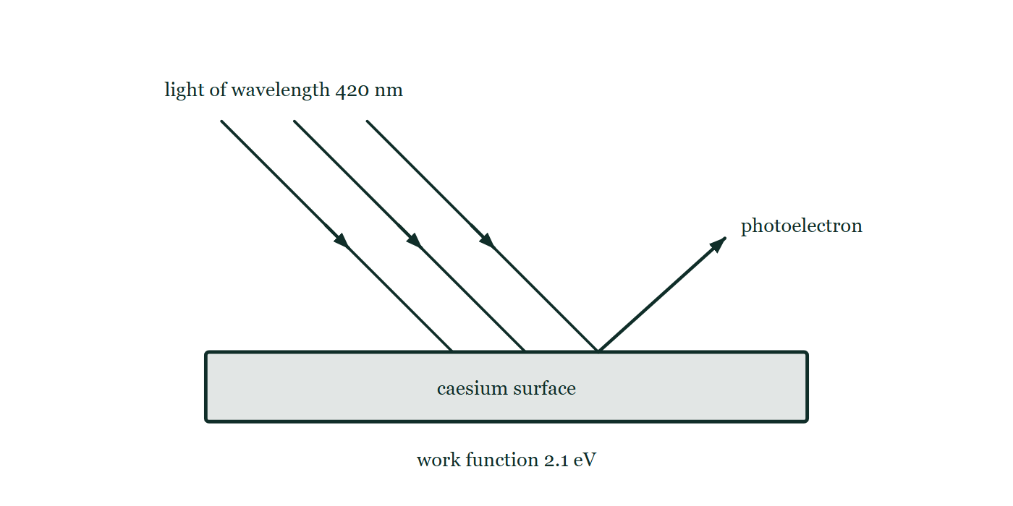
QUANTUM · THE PHOTOELECTRIC EFFECT
GIOPHYSICS LESSON
FIGURE 3 OF 3
Fig. 10.1 — IB Theme E · Nuclear and quantum physics
Drawn for question 10 of that paper · syllabus E.2
Three parallel rays of light of wavelength 420 nm slant down to the right and meet the flat upper face of a block labelled as a caesium surface with a work function of 2.1 eV. From a point on that same face, further to the right of where the light lands, a single arrow slants up and to the right, marking one photoelectron leaving the metal.
See the question this was drawn for — click here
Quantum — The Photoelectric Effect. Built by GioPhysics from the lesson's own copy; nothing on these slides is re-authored.
21 / 40
Notes:
[Phase] Build the model: The formulae, one at a time, in plain English (minutes 13–22 of 45)
[Figure] Fig. 10.1. Three parallel rays of light of wavelength 420 nm slant down to the right and meet the flat upper face of a block labelled as a caesium surface with a work function of 2.1 eV. From a point on that same face, further to the right of where the light lands, a single arrow slants up and to the right, marking one photoelectron leaving the metal.
[Where it came from] IB Theme E · Nuclear and quantum physics, question 10; syllabus E.2.

Slide 22
QUANTUM · THE PHOTOELECTRIC EFFECT
GIOPHYSICS LESSON
WATCH OUT
The common trap
Check and misconception — The quick check and the trap
Brighter does not mean more energetic. Intensity counts photons per second; frequency sets the energy of each photon.
Sub-threshold light ejects nothing at any brightness because no single photon can pay the work function — and electrons cannot pool the energy of two photons. Meanwhile the dimmest above-threshold beam ejects electrons immediately.
Quantum — The Photoelectric Effect. Built by GioPhysics from the lesson's own copy; nothing on these slides is re-authored.
22 / 40
Notes:
[Phase] Check and misconception: The quick check and the trap (minutes 35–41 of 45)
[Misconception] Brighter does not mean more energetic. Intensity counts photons per second; frequency sets the energy of each photon. Sub-threshold light ejects nothing at any brightness because no single photon can pay the work function — and electrons cannot pool the energy of two photons. Meanwhile the dimmest above-threshold beam ejects electrons immediately.

Slide 23
QUANTUM · THE PHOTOELECTRIC EFFECT
GIOPHYSICS LESSON
WORKED EXAMPLE 1 OF 2 · EASY
The question
Easy
Worked examples — I do, we do — one step revealed at a time
Find the energy of one photon of 500 nm green light, in joules and electronvolts.
Quantum — The Photoelectric Effect. Built by GioPhysics from the lesson's own copy; nothing on these slides is re-authored.
23 / 40
Notes:
[Phase] Worked examples: I do, we do — one step revealed at a time (minutes 22–35 of 45)
[Question] Find the energy of one photon of 500 nm green light, in joules and electronvolts.
[Answer] 3.98 × 10⁻¹⁹ J ≈ 2.5 eV

Slide 24
QUANTUM · THE PHOTOELECTRIC EFFECT
GIOPHYSICS LESSON
WORKED EXAMPLE 1 OF 2 · EASY · THE WORKING
How to solve it
Easy
Worked examples — I do, we do — one step revealed at a time
Find the energy of one photon of 500 nm green light, in joules and electronvolts.
1.
E = hc/λ = (6.63 × 10⁻³⁴ × 3.00 × 10⁸) ÷ (500 × 10⁻⁹).
2.
E = 3.98 × 10⁻¹⁹ J.
3.
Divide by 1.6 × 10⁻¹⁹ J/eV: E ≈ 2.5 eV.
Quantum — The Photoelectric Effect. Built by GioPhysics from the lesson's own copy; nothing on these slides is re-authored.
24 / 40
Notes:
[Phase] Worked examples: I do, we do — one step revealed at a time (minutes 22–35 of 45)
[Reveal] One click per step. The class works each line before the next appears.
[Step 1] E = hc/λ = (6.63 × 10⁻³⁴ × 3.00 × 10⁸) ÷ (500 × 10⁻⁹).
[Step 2] E = 3.98 × 10⁻¹⁹ J.
[Step 3] Divide by 1.6 × 10⁻¹⁹ J/eV: E ≈ 2.5 eV.

Slide 25
QUANTUM · THE PHOTOELECTRIC EFFECT
GIOPHYSICS LESSON
WORKED EXAMPLE 1 OF 2 · EASY
Answer
Easy
Worked examples — I do, we do — one step revealed at a time
3.98 × 10⁻¹⁹ J ≈ 2.5 eV
Quantum — The Photoelectric Effect. Built by GioPhysics from the lesson's own copy; nothing on these slides is re-authored.
25 / 40
Notes:
[Phase] Worked examples: I do, we do — one step revealed at a time (minutes 22–35 of 45)
[Answer] 3.98 × 10⁻¹⁹ J ≈ 2.5 eV

Slide 26
QUANTUM · THE PHOTOELECTRIC EFFECT
GIOPHYSICS LESSON
WORKED EXAMPLE 2 OF 2 · MEDIUM
The question
Medium
Worked examples — I do, we do — one step revealed at a time
A photosensitive metal has a work function of 5.5 eV. Find the minimum (threshold) frequency of light that can free an electron.
Quantum — The Photoelectric Effect. Built by GioPhysics from the lesson's own copy; nothing on these slides is re-authored.
26 / 40
Notes:
[Phase] Worked examples: I do, we do — one step revealed at a time (minutes 22–35 of 45)
[Question] A photosensitive metal has a work function of 5.5 eV. Find the minimum (threshold) frequency of light that can free an electron.
[Answer] f₀ ≈ 1.3 × 10¹⁵ Hz

Slide 27
QUANTUM · THE PHOTOELECTRIC EFFECT
GIOPHYSICS LESSON
WORKED EXAMPLE 2 OF 2 · MEDIUM · THE WORKING
How to solve it
Medium
Worked examples — I do, we do — one step revealed at a time
A photosensitive metal has a work function of 5.5 eV. Find the minimum (threshold) frequency of light that can free an electron.
1.
At threshold the photon exactly pays the work function: hf₀ = φ.
2.
φ = 5.5 × 1.6 × 10⁻¹⁹ = 8.8 × 10⁻¹⁹ J.
3.
f₀ = 8.8 × 10⁻¹⁹ ÷ 6.63 × 10⁻³⁴ ≈ 1.3 × 10¹⁵ Hz — ultraviolet.
Quantum — The Photoelectric Effect. Built by GioPhysics from the lesson's own copy; nothing on these slides is re-authored.
27 / 40
Notes:
[Phase] Worked examples: I do, we do — one step revealed at a time (minutes 22–35 of 45)
[Reveal] One click per step. The class works each line before the next appears.
[Step 1] At threshold the photon exactly pays the work function: hf₀ = φ.
[Step 2] φ = 5.5 × 1.6 × 10⁻¹⁹ = 8.8 × 10⁻¹⁹ J.
[Step 3] f₀ = 8.8 × 10⁻¹⁹ ÷ 6.63 × 10⁻³⁴ ≈ 1.3 × 10¹⁵ Hz — ultraviolet.

Slide 28
QUANTUM · THE PHOTOELECTRIC EFFECT
GIOPHYSICS LESSON
WORKED EXAMPLE 2 OF 2 · MEDIUM
Answer
Medium
Worked examples — I do, we do — one step revealed at a time
f₀ ≈ 1.3 × 10¹⁵ Hz
Quantum — The Photoelectric Effect. Built by GioPhysics from the lesson's own copy; nothing on these slides is re-authored.
28 / 40
Notes:
[Phase] Worked examples: I do, we do — one step revealed at a time (minutes 22–35 of 45)
[Answer] f₀ ≈ 1.3 × 10¹⁵ Hz

Slide 29
QUANTUM · THE PHOTOELECTRIC EFFECT
GIOPHYSICS LESSON
SPOT THE MISTAKE
One line here is wrong
The whole working is up — find the bad line before you click
1.
Light of wavelength 540 nm ejects electrons of maximum kinetic energy 1.9 eV from a metal. Find its work function.
2.
Photon energy: E = hc/λ = (6.63 × 10⁻³⁴ × 3.00 × 10⁸) ÷ (540 × 10⁻⁹) = 3.7 × 10⁻¹⁹ J ≈ 2.3 eV
3.
Einstein's equation: E(max) = hf − φ
4.
φ = E(max) − hf = 1.9 − 2.3 = −0.4 eV
5.
The metal has a work function of −0.4 eV.
LINE 4 IS WRONG
The rearrangement is inside out: E(max) = hf − φ gives φ = hf − E(max), not the other way round. The answer announces the mistake if you read it — a negative work function would mean the metal pays electrons to leave, and every surface in the room would be spraying them off in the dark.
IT SHOULD SAY
φ = hf − E(max) = 2.3 − 1.9 = 0.4 eV
Quantum — The Photoelectric Effect. Built by GioPhysics from the lesson's own copy; nothing on these slides is re-authored.
29 / 40
Notes:
[Phase] Worked examples: I do, we do — one step revealed at a time (minutes 22–35 of 45)
[Spot the mistake] The working is complete and one line of it is wrong. Let the room hunt: one click names the line, a second shows it done correctly.
[Line 4 is wrong] The rearrangement is inside out: E(max) = hf − φ gives φ = hf − E(max), not the other way round. The answer announces the mistake if you read it — a negative work function would mean the metal pays electrons to leave, and every surface in the room would be spraying them off in the dark.
[It should say] φ = hf − E(max) = 2.3 − 1.9 = 0.4 eV

Slide 30
QUANTUM · THE PHOTOELECTRIC EFFECT
GIOPHYSICS LESSON
PREDICT · TAKE THE VOTE
Commit before you are told
Hands up for each option, then click
The lamp is made ten times brighter, at exactly the same frequency. What happens to the microammeter reading, and to the reverse voltage needed to stop the current?
A Both rise ten-fold
B The current rises ten-fold; the stopping voltage does not move
C The stopping voltage rises ten-fold; the current does not move
An evacuated tube with light of frequency f falling on the emitter plate and photoelectrons crossing to the collector, wired to a cell whose negative terminal faces the collector so the field between the plates opposes them, with a microammeter reading the current.
The live version of this figure — click here
Quantum — The Photoelectric Effect. Built by GioPhysics from the lesson's own copy; nothing on these slides is re-authored.
30 / 40
Notes:
[Phase] Build the model: The formulae, one at a time, in plain English (minutes 13–22 of 45)
[Predict] The lamp is made ten times brighter, at exactly the same frequency. What happens to the microammeter reading, and to the reverse voltage needed to stop the current?
[Options] A Both rise ten-fold B The current rises ten-fold; the stopping voltage does not move C The stopping voltage rises ten-fold; the current does not move
[Figure] An evacuated tube with light of frequency f falling on the emitter plate and photoelectrons crossing to the collector, wired to a cell whose negative terminal faces the collector so the field between the plates opposes them, with a microammeter reading the current.

Slide 31
QUANTUM · THE PHOTOELECTRIC EFFECT
GIOPHYSICS LESSON
PREDICT · THE OUTCOME
What actually happens
Ask the room who changed their mind, and why
B The current rises ten-fold; the stopping voltage does not move
WHY
The two dials do entirely separate jobs and never swap. Intensity is a count of photons per second, so it sets how many electrons are ejected per second — the current. Frequency sets the energy of each photon, so it alone sets E(max) = hf − φ, and therefore the stopping voltage eV(s) = E(max). Ten times as many photons of exactly the same size eject ten times as many electrons, each carrying the same maximum energy as before.
Quantum — The Photoelectric Effect. Built by GioPhysics from the lesson's own copy; nothing on these slides is re-authored.
31 / 40
Notes:
[Phase] Build the model: The formulae, one at a time, in plain English (minutes 13–22 of 45)
[Answer] B — The current rises ten-fold; the stopping voltage does not move. The two dials do entirely separate jobs and never swap. Intensity is a count of photons per second, so it sets how many electrons are ejected per second — the current. Frequency sets the energy of each photon, so it alone sets E(max) = hf − φ, and therefore the stopping voltage eV(s) = E(max). Ten times as many photons of exactly the same size eject ten times as many electrons, each carrying the same maximum energy as before.

Slide 32
QUANTUM · THE PHOTOELECTRIC EFFECT
GIOPHYSICS LESSON
QUICK CHECK
Decide before the answer goes up
Check and misconception — The quick check and the trap
Zinc has φ = 4.3 eV. Which beam ejects photoelectrons from it?
A
A very bright red beam (photon energy 1.9 eV)
B
A very dim UV beam (photon energy 4.9 eV)
C
Both — enough red photons together can free an electron
Quantum — The Photoelectric Effect. Built by GioPhysics from the lesson's own copy; nothing on these slides is re-authored.
32 / 40
Notes:
[Phase] Check and misconception: The quick check and the trap (minutes 35–41 of 45)
[Question] Zinc has φ = 4.3 eV. Which beam ejects photoelectrons from it?
[Options] A A very bright red beam (photon energy 1.9 eV) B A very dim UV beam (photon energy 4.9 eV) C Both — enough red photons together can free an electron

Slide 33
QUANTUM · THE PHOTOELECTRIC EFFECT
GIOPHYSICS LESSON
QUICK CHECK · THE ANSWER
The answer, and why
Check and misconception — The quick check and the trap
B A very dim UV beam (photon energy 4.9 eV)
HOW TO GET THERE
One electron absorbs one photon. A 1.9 eV photon can never pay a 4.3 eV work function, however many arrive; a 4.9 eV photon always can.
WHY THE OTHERS TEMPT
A Brightness is a count, not a size. Each red photon still offers 1.9 eV against a 4.3 eV fee, and the electron takes one photon or none — so a thousand times more of them just means a thousand times more refusals per second. Nothing about the beam's intensity changes what any single photon is worth.
B Correct. 4.9 eV clears zinc's 4.3 eV work function with 0.6 eV to spare, and it does it on the first photon that arrives, however dim the beam.
C This is exactly the wave picture, and it is exactly what the experiment rules out. An electron does not accumulate energy from photon after photon: it absorbs one, or it absorbs none. If pooling were possible, dim light would work after a measurable delay — and no such delay has ever been found.
Quantum — The Photoelectric Effect. Built by GioPhysics from the lesson's own copy; nothing on these slides is re-authored.
33 / 40
Notes:
[Phase] Check and misconception: The quick check and the trap (minutes 35–41 of 45)
[Question] Zinc has φ = 4.3 eV. Which beam ejects photoelectrons from it?
[Option by option] A: Brightness is a count, not a size. Each red photon still offers 1.9 eV against a 4.3 eV fee, and the electron takes one photon or none — so a thousand times more of them just means a thousand times more refusals per second. Nothing about the beam's intensity changes what any single photon is worth. B: Correct. 4.9 eV clears zinc's 4.3 eV work function with 0.6 eV to spare, and it does it on the first photon that arrives, however dim the beam. C: This is exactly the wave picture, and it is exactly what the experiment rules out. An electron does not accumulate energy from photon after photon: it absorbs one, or it absorbs none. If pooling were possible, dim light would work after a measurable delay — and no such delay has ever been found.
[Answer] B — A very dim UV beam (photon energy 4.9 eV)
[Why] One electron absorbs one photon. A 1.9 eV photon can never pay a 4.3 eV work function, however many arrive; a 4.9 eV photon always can.
[Reveal] One click for the answer, then one for the reason.

Slide 34
QUANTUM · THE PHOTOELECTRIC EFFECT
GIOPHYSICS LESSON
EXTENSION 1 OF 2 · HARD
The question
Hard
Worked examples — I do, we do — one step revealed at a time
Light of frequency 2.5 × 10¹⁵ Hz strikes the same φ = 5.5 eV metal. Find E(max) and the stopping potential.
Quantum — The Photoelectric Effect. Built by GioPhysics from the lesson's own copy; nothing on these slides is re-authored.
34 / 40
Notes:
[Phase] Worked examples: I do, we do — one step revealed at a time (minutes 22–35 of 45)
[Question] Light of frequency 2.5 × 10¹⁵ Hz strikes the same φ = 5.5 eV metal. Find E(max) and the stopping potential.
[Answer] E(max) ≈ 7.8 × 10⁻¹⁹ J (4.9 eV); V(s) ≈ 4.9 V

Slide 35
QUANTUM · THE PHOTOELECTRIC EFFECT
GIOPHYSICS LESSON
EXTENSION 1 OF 2 · HARD · THE WORKING
How to solve it
Hard
Worked examples — I do, we do — one step revealed at a time
Light of frequency 2.5 × 10¹⁵ Hz strikes the same φ = 5.5 eV metal. Find E(max) and the stopping potential.
1.
Photon energy: hf = 6.63 × 10⁻³⁴ × 2.5 × 10¹⁵ = 1.66 × 10⁻¹⁸ J.
2.
E(max) = hf − φ = 1.66 × 10⁻¹⁸ − 8.8 × 10⁻¹⁹ = 7.8 × 10⁻¹⁹ J ≈ 4.9 eV.
3.
eV(s) = E(max), so V(s) ≈ 4.9 V — the reverse voltage that just zeroes the current.
Quantum — The Photoelectric Effect. Built by GioPhysics from the lesson's own copy; nothing on these slides is re-authored.
35 / 40
Notes:
[Phase] Worked examples: I do, we do — one step revealed at a time (minutes 22–35 of 45)
[Reveal] One click per step. The class works each line before the next appears.
[Step 1] Photon energy: hf = 6.63 × 10⁻³⁴ × 2.5 × 10¹⁵ = 1.66 × 10⁻¹⁸ J.
[Step 2] E(max) = hf − φ = 1.66 × 10⁻¹⁸ − 8.8 × 10⁻¹⁹ = 7.8 × 10⁻¹⁹ J ≈ 4.9 eV.
[Step 3] eV(s) = E(max), so V(s) ≈ 4.9 V — the reverse voltage that just zeroes the current.

Slide 36
QUANTUM · THE PHOTOELECTRIC EFFECT
GIOPHYSICS LESSON
EXTENSION 1 OF 2 · HARD
Answer
Hard
Worked examples — I do, we do — one step revealed at a time
E(max) ≈ 7.8 × 10⁻¹⁹ J (4.9 eV); V(s) ≈ 4.9 V
Quantum — The Photoelectric Effect. Built by GioPhysics from the lesson's own copy; nothing on these slides is re-authored.
36 / 40
Notes:
[Phase] Worked examples: I do, we do — one step revealed at a time (minutes 22–35 of 45)
[Answer] E(max) ≈ 7.8 × 10⁻¹⁹ J (4.9 eV); V(s) ≈ 4.9 V

Slide 37
QUANTUM · THE PHOTOELECTRIC EFFECT
GIOPHYSICS LESSON
EXTENSION 2 OF 2 · CHALLENGING
The question
Challenging
Worked examples — I do, we do — one step revealed at a time
540 nm light ejects electrons of maximum kinetic energy 1.9 eV from an unknown metal. Find its work function, and describe the E(max)–f graph for this metal.
Quantum — The Photoelectric Effect. Built by GioPhysics from the lesson's own copy; nothing on these slides is re-authored.
37 / 40
Notes:
[Phase] Worked examples: I do, we do — one step revealed at a time (minutes 22–35 of 45)
[Question] 540 nm light ejects electrons of maximum kinetic energy 1.9 eV from an unknown metal. Find its work function, and describe the E(max)–f graph for this metal.
[Answer] φ ≈ 0.4 eV; straight line of universal slope h with intercept −φ

Slide 38
QUANTUM · THE PHOTOELECTRIC EFFECT
GIOPHYSICS LESSON
EXTENSION 2 OF 2 · CHALLENGING · THE WORKING
How to solve it
Challenging
Worked examples — I do, we do — one step revealed at a time
540 nm light ejects electrons of maximum kinetic energy 1.9 eV from an unknown metal. Find its work function, and describe the E(max)–f graph for this metal.
1.
Photon energy: E = hc/λ = (6.63 × 10⁻³⁴ × 3.00 × 10⁸) ÷ (540 × 10⁻⁹) = 3.7 × 10⁻¹⁹ J ≈ 2.3 eV.
2.
φ = hf − E(max) = 2.3 − 1.9 = 0.4 eV — an unusually easy metal to strip, like caesium coatings in photocells.
3.
The graph of E(max) against f is a straight line: slope h (identical for every metal), x-intercept f₀ = φ/h, y-intercept −φ. Only the intercepts move between metals.
Quantum — The Photoelectric Effect. Built by GioPhysics from the lesson's own copy; nothing on these slides is re-authored.
38 / 40
Notes:
[Phase] Worked examples: I do, we do — one step revealed at a time (minutes 22–35 of 45)
[Reveal] One click per step. The class works each line before the next appears.
[Step 1] Photon energy: E = hc/λ = (6.63 × 10⁻³⁴ × 3.00 × 10⁸) ÷ (540 × 10⁻⁹) = 3.7 × 10⁻¹⁹ J ≈ 2.3 eV.
[Step 2] φ = hf − E(max) = 2.3 − 1.9 = 0.4 eV — an unusually easy metal to strip, like caesium coatings in photocells.
[Step 3] The graph of E(max) against f is a straight line: slope h (identical for every metal), x-intercept f₀ = φ/h, y-intercept −φ. Only the intercepts move between metals.

Slide 39
QUANTUM · THE PHOTOELECTRIC EFFECT
GIOPHYSICS LESSON
EXTENSION 2 OF 2 · CHALLENGING
Answer
Challenging
Worked examples — I do, we do — one step revealed at a time
φ ≈ 0.4 eV; straight line of universal slope h with intercept −φ
Quantum — The Photoelectric Effect. Built by GioPhysics from the lesson's own copy; nothing on these slides is re-authored.
39 / 40
Notes:
[Phase] Worked examples: I do, we do — one step revealed at a time (minutes 22–35 of 45)
[Answer] φ ≈ 0.4 eV; straight line of universal slope h with intercept −φ

Slide 40
QUANTUM · THE PHOTOELECTRIC EFFECT
GIOPHYSICS LESSON
QUANTUM
Where to go next
Plenary — What to take away, what to practise next
Next
25.2 Matter Waves
https://giophysics.com/chapter-47/matter-waves/
Lesson
This lesson on giophysics.com
https://giophysics.com/chapter-47/photoelectric-effect/
Live
The live, interactive version of these slides
https://giophysics.com/chapter-47/presentation/?lesson=photoelectric
Chapter
All Quantum lessons
https://giophysics.com/chapter-47/
PDF
Download the lesson PDF
https://giophysics.com/downloads/47-1-photoelectric-effect.pdf
Quantum — The Photoelectric Effect. Built by GioPhysics from the lesson's own copy; nothing on these slides is re-authored.
40 / 40
Notes:
[Phase] Plenary: What to take away, what to practise next (minutes 41–45 of 45)
[Interactive] The graphs and the circuit topology on these slides are frozen. The live version at https://giophysics.com/chapter-47/presentation/?lesson=photoelectric moves them.

