Slide 1
WORK · FORCE–DISPLACEMENT GRAPHS
GIOPHYSICS LESSON
03 · Work
Area measures transferred energy
Force–Displacement Graphs
When force changes with position, add many narrow strips of force × displacement. The signed area is the work.
POSITION
Lesson 2 of 5 in Work
PLAN
15 slides in the 45-minute core run, about 43 minutes of it
LESSON PAGE
https://giophysics.com/chapter-5/force-displacement-graphs/
Built by GioPhysics from the lesson's own page. Every word on these slides is the lesson's; nothing here is re-authored. Teaching material, not an awarding body's document.
Work — Force–Displacement Graphs. Built by GioPhysics from the lesson's own copy; nothing on these slides is re-authored.
1 / 29
Notes:
[Lesson] Work — Force–Displacement Graphs. Lesson 2 of 5.
[Intro] When force changes with position, add many narrow strips of force × displacement. The signed area is the work.
[Source] https://giophysics.com/chapter-5/force-displacement-graphs/
[Disclaimer] Built by GioPhysics from the lesson's own page. Every word on these slides is the lesson's; nothing here is re-authored. Teaching material, not an awarding body's document.

Slide 2
WORK · FORCE–DISPLACEMENT GRAPHS
GIOPHYSICS LESSON
THINK FIRST
A spring is already stretched by 10 cm. Does the next 10 cm cost the same energy as the first?
Take answers before you click — the point is the commitment
Pulling a chest expander, the first few centimetres come easily and the last few are a real fight.
THE ANSWER
No — the second 10 cm costs three times as much. The force grows as you pull, so the strip of area under the F–x graph between 10 cm and 20 cm is three times the triangle between 0 and 10 cm. Same distance, three times the energy.
Work — Force–Displacement Graphs. Built by GioPhysics from the lesson's own copy; nothing on these slides is re-authored.
2 / 29
Notes:
[Phase] Starter: Recall what this lesson stands on (minutes 0–5 of 45)
[Hook] A spring is already stretched by 10 cm. Does the next 10 cm cost the same energy as the first? Pulling a chest expander, the first few centimetres come easily and the last few are a real fight.
[Answer] No — the second 10 cm costs three times as much. The force grows as you pull, so the strip of area under the F–x graph between 10 cm and 20 cm is three times the triangle between 0 and 10 cm. Same distance, three times the energy.

Slide 3
WORK · FORCE–DISPLACEMENT GRAPHS
GIOPHYSICS LESSON
EXPLAINED SIMPLY
In one sentence
Introduce the idea — The big idea and the definition
The signed area under a force-displacement graph equals the work done by that force.
Work — Force–Displacement Graphs. Built by GioPhysics from the lesson's own copy; nothing on these slides is re-authored.
3 / 29
Notes:
[Phase] Introduce the idea: The big idea and the definition (minutes 5–13 of 45)
[Definition] The signed area under a force-displacement graph equals the work done by that force.

Slide 4
WORK · FORCE–DISPLACEMENT GRAPHS
GIOPHYSICS LESSON
EXPLAINED SIMPLY
What that looks like
Introduce the idea — The big idea and the definition
FOR EXAMPLE
A constant 10 N force from 0 m to 3 m makes a rectangular area of 30 J.
Work — Force–Displacement Graphs. Built by GioPhysics from the lesson's own copy; nothing on these slides is re-authored.
4 / 29
Notes:
[Phase] Introduce the idea: The big idea and the definition (minutes 5–13 of 45)
[Worked illustration] A constant 10 N force from 0 m to 3 m makes a rectangular area of 30 J.

Slide 5
WORK · FORCE–DISPLACEMENT GRAPHS
GIOPHYSICS LESSON
THE PHYSICS · 1 OF 2
How it works · 1
Build the model — The formulae, one at a time, in plain English
On an Fₓ–x graph, area above the displacement axis is positive work and area below it is negative work.
Work — Force–Displacement Graphs. Built by GioPhysics from the lesson's own copy; nothing on these slides is re-authored.
5 / 29
Notes:
[Phase] Build the model: The formulae, one at a time, in plain English (minutes 13–22 of 45)
[Section] On an Fₓ–x graph, area above the displacement axis is positive work and area below it is negative work.

Slide 6
WORK · FORCE–DISPLACEMENT GRAPHS
GIOPHYSICS LESSON
THE PHYSICS · 2 OF 2
How it works · 2
Build the model — The formulae, one at a time, in plain English
For a straight-line change in force, the trapezium area gives the exact result. Calculus extends the same idea to any smooth force curve.
Work — Force–Displacement Graphs. Built by GioPhysics from the lesson's own copy; nothing on these slides is re-authored.
6 / 29
Notes:
[Phase] Build the model: The formulae, one at a time, in plain English (minutes 13–22 of 45)
[Section] For a straight-line change in force, the trapezium area gives the exact result. Calculus extends the same idea to any smooth force curve.

Slide 7
WORK · FORCE–DISPLACEMENT GRAPHS
GIOPHYSICS LESSON
THE PHYSICS
What to remember
Build the model — The formulae, one at a time, in plain English
Work is signed area under an Fₓ–x graph.
A straight ramp in force gives a triangular or trapezoidal area.
State whether you mean work on a spring or work done by the spring.
Work — Force–Displacement Graphs. Built by GioPhysics from the lesson's own copy; nothing on these slides is re-authored.
7 / 29
Notes:
[Phase] Build the model: The formulae, one at a time, in plain English (minutes 13–22 of 45)
[Takeaways] Work is signed area under an Fₓ–x graph. · A straight ramp in force gives a triangular or trapezoidal area. · State whether you mean work on a spring or work done by the spring.

Slide 8
WORK · FORCE–DISPLACEMENT GRAPHS
GIOPHYSICS LESSON
FORMULA 1 OF 3
Changing force
Build the model — The formulae, one at a time, in plain English
W = ∫ Fₓ dx
Signed area under the Fₓ–x graph.
IN PLAIN ENGLISH
When the force keeps changing, add up force × tiny distance for every step of the way — that running total is the area under the force–distance graph.
Work — Force–Displacement Graphs. Built by GioPhysics from the lesson's own copy; nothing on these slides is re-authored.
8 / 29
Notes:
[Phase] Build the model: The formulae, one at a time, in plain English (minutes 13–22 of 45)
[Formula] Changing force: W = ∫ Fₓ dx
[In plain English] When the force keeps changing, add up force × tiny distance for every step of the way — that running total is the area under the force–distance graph.
[Note] Signed area under the Fₓ–x graph.

Slide 9
WORK · FORCE–DISPLACEMENT GRAPHS
GIOPHYSICS LESSON
FORMULA 2 OF 3
Linear graph
Build the model — The formulae, one at a time, in plain English
W = ½(F₀ + F₁)Δx
The area of a trapezium.
IN PLAIN ENGLISH
If the force changes steadily, use its average — start force plus end force, halved — times the distance.
Work — Force–Displacement Graphs. Built by GioPhysics from the lesson's own copy; nothing on these slides is re-authored.
9 / 29
Notes:
[Phase] Build the model: The formulae, one at a time, in plain English (minutes 13–22 of 45)
[Formula] Linear graph: W = ½(F₀ + F₁)Δx
[In plain English] If the force changes steadily, use its average — start force plus end force, halved — times the distance.
[Note] The area of a trapezium.

Slide 10
WORK · FORCE–DISPLACEMENT GRAPHS
GIOPHYSICS LESSON
FORMULA 3 OF 3
Spring signs
Build the model — The formulae, one at a time, in plain English
Wext = +½kx² · Wspring = −½kx²
Stretching work in versus restoring work by the spring.
IN PLAIN ENGLISH
The energy you put in to stretch a spring is exactly the energy the spring pulls back with — same size, opposite sign.
Work — Force–Displacement Graphs. Built by GioPhysics from the lesson's own copy; nothing on these slides is re-authored.
10 / 29
Notes:
[Phase] Build the model: The formulae, one at a time, in plain English (minutes 13–22 of 45)
[Formula] Spring signs: Wext = +½kx² · Wspring = −½kx²
[In plain English] The energy you put in to stretch a spring is exactly the energy the spring pulls back with — same size, opposite sign.
[Note] Stretching work in versus restoring work by the spring.

Slide 11
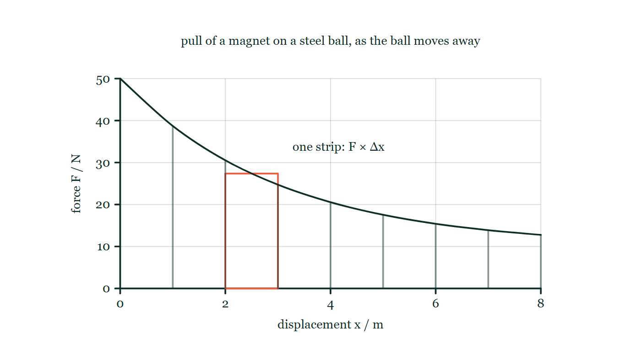
WORK · FORCE–DISPLACEMENT GRAPHS
GIOPHYSICS LESSON
THE PICTURE
Work is the area, strip by strip
Drawn for this lesson
A force–displacement graph for a magnet pulling on a steel ball as the ball moves away: the force starts at 50 N and dies away to about 13 N by 8 m. The area beneath the curve is cut into narrow strips of equal width, with one strip picked out to show its height and its width.
The live version of this figure — click here
Work — Force–Displacement Graphs. Built by GioPhysics from the lesson's own copy; nothing on these slides is re-authored.
11 / 29
Notes:
[Phase] Build the model: The formulae, one at a time, in plain English (minutes 13–22 of 45)
[Figure] A force–displacement graph for a magnet pulling on a steel ball as the ball moves away: the force starts at 50 N and dies away to about 13 N by 8 m. The area beneath the curve is cut into narrow strips of equal width, with one strip picked out to show its height and its width.

Slide 12
WORK · FORCE–DISPLACEMENT GRAPHS
GIOPHYSICS LESSON
WORKED EXAMPLE 1 OF 2 · EASY
The question
Easy
Worked examples — I do, we do — one step revealed at a time
A force–displacement graph shows a constant 12 N force from x = 0 to x = 5.0 m. How much work does the force do?
Work — Force–Displacement Graphs. Built by GioPhysics from the lesson's own copy; nothing on these slides is re-authored.
12 / 29
Notes:
[Phase] Worked examples: I do, we do — one step revealed at a time (minutes 22–35 of 45)
[Question] A force–displacement graph shows a constant 12 N force from x = 0 to x = 5.0 m. How much work does the force do?
[Answer] W = 60 J

Slide 13
WORK · FORCE–DISPLACEMENT GRAPHS
GIOPHYSICS LESSON
WORKED EXAMPLE 1 OF 2 · EASY · THE WORKING
How to solve it
Easy
Worked examples — I do, we do — one step revealed at a time
A force–displacement graph shows a constant 12 N force from x = 0 to x = 5.0 m. How much work does the force do?
1.
Work is the area under the F–x graph.
2.
Rectangle: W = 12 × 5.0 = 60 J.
Work — Force–Displacement Graphs. Built by GioPhysics from the lesson's own copy; nothing on these slides is re-authored.
13 / 29
Notes:
[Phase] Worked examples: I do, we do — one step revealed at a time (minutes 22–35 of 45)
[Reveal] One click per step. The class works each line before the next appears.
[Step 1] Work is the area under the F–x graph.
[Step 2] Rectangle: W = 12 × 5.0 = 60 J.

Slide 14
WORK · FORCE–DISPLACEMENT GRAPHS
GIOPHYSICS LESSON
WORKED EXAMPLE 1 OF 2 · EASY
Answer
Easy
Worked examples — I do, we do — one step revealed at a time
W = 60 J
Work — Force–Displacement Graphs. Built by GioPhysics from the lesson's own copy; nothing on these slides is re-authored.
14 / 29
Notes:
[Phase] Worked examples: I do, we do — one step revealed at a time (minutes 22–35 of 45)
[Answer] W = 60 J

Slide 15
WORK · FORCE–DISPLACEMENT GRAPHS
GIOPHYSICS LESSON
WORKED EXAMPLE 2 OF 2 · MEDIUM
The question
Medium
Worked examples — I do, we do — one step revealed at a time
A force rises uniformly from 4 N to 10 N while an object moves from x = 0 to x = 6 m. Find the work.
Work — Force–Displacement Graphs. Built by GioPhysics from the lesson's own copy; nothing on these slides is re-authored.
15 / 29
Notes:
[Phase] Worked examples: I do, we do — one step revealed at a time (minutes 22–35 of 45)
[Question] A force rises uniformly from 4 N to 10 N while an object moves from x = 0 to x = 6 m. Find the work.
[Answer] W = 42 J.

Slide 16
WORK · FORCE–DISPLACEMENT GRAPHS
GIOPHYSICS LESSON
WORKED EXAMPLE 2 OF 2 · MEDIUM · THE WORKING
How to solve it
Medium
Worked examples — I do, we do — one step revealed at a time
A force rises uniformly from 4 N to 10 N while an object moves from x = 0 to x = 6 m. Find the work.
1.
The Fₓ–x graph is a trapezium.
2.
Average force = ½(4 + 10) = 7 N.
3.
W = average force × displacement = (7 N)(6 m).
Work — Force–Displacement Graphs. Built by GioPhysics from the lesson's own copy; nothing on these slides is re-authored.
16 / 29
Notes:
[Phase] Worked examples: I do, we do — one step revealed at a time (minutes 22–35 of 45)
[Reveal] One click per step. The class works each line before the next appears.
[Step 1] The Fₓ–x graph is a trapezium.
[Step 2] Average force = ½(4 + 10) = 7 N.
[Step 3] W = average force × displacement = (7 N)(6 m).

Slide 17
WORK · FORCE–DISPLACEMENT GRAPHS
GIOPHYSICS LESSON
WORKED EXAMPLE 2 OF 2 · MEDIUM
Answer
Medium
Worked examples — I do, we do — one step revealed at a time
W = 42 J.
Work — Force–Displacement Graphs. Built by GioPhysics from the lesson's own copy; nothing on these slides is re-authored.
17 / 29
Notes:
[Phase] Worked examples: I do, we do — one step revealed at a time (minutes 22–35 of 45)
[Answer] W = 42 J.

Slide 18
WORK · FORCE–DISPLACEMENT GRAPHS
GIOPHYSICS LESSON
SPOT THE MISTAKE
One line here is wrong
The whole working is up — find the bad line before you click
1.
Spring constant k = 400 N/m, stretched from 0.10 m to 0.30 m
2.
Extra stretch Δx = 0.30 − 0.10 = 0.20 m
3.
Extra work = ½kΔx² = ½ × 400 × 0.20² = 8.0 J
LINE 3 IS WRONG
½kx² is the area of the triangle measured from the spring's natural length, not from wherever the spring happens to be sitting already. The extra work is the difference of two such triangles, so the two areas have to be subtracted rather than a single triangle drawn over the 0.20 m actually moved — which is the tempting move, because 0.20 m is the distance the hand really travels.
IT SHOULD SAY
Extra work = ½k(0.30² − 0.10²) = ½ × 400 × (0.090 − 0.010) = 16 J
Work — Force–Displacement Graphs. Built by GioPhysics from the lesson's own copy; nothing on these slides is re-authored.
18 / 29
Notes:
[Phase] Worked examples: I do, we do — one step revealed at a time (minutes 22–35 of 45)
[Spot the mistake] The working is complete and one line of it is wrong. Let the room hunt: one click names the line, a second shows it done correctly.
[Line 3 is wrong] ½kx² is the area of the triangle measured from the spring's natural length, not from wherever the spring happens to be sitting already. The extra work is the difference of two such triangles, so the two areas have to be subtracted rather than a single triangle drawn over the 0.20 m actually moved — which is the tempting move, because 0.20 m is the distance the hand really travels.
[It should say] Extra work = ½k(0.30² − 0.10²) = ½ × 400 × (0.090 − 0.010) = 16 J

Slide 19
WORK · FORCE–DISPLACEMENT GRAPHS
GIOPHYSICS LESSON
PREDICT · TAKE THE VOTE
Commit before you are told
Hands up for each option, then click
Compare the work done over the first 2 m of the ball's journey with the work done over the last 2 m, from 6 m to 8 m.
A Much more over the first 2 m
B Much more over the last 2 m, because the force has been acting for longer by then
C The same, because the ball moves 2 m in each case
D Nothing over the last 2 m, since the force has dropped below its starting value
A force–displacement graph for a magnet pulling on a steel ball as the ball moves away: the force starts at 50 N and dies away to about 13 N by 8 m. The area beneath the curve is cut into narrow strips of equal width, with one strip picked out to show its height and its width.
The live version of this figure — click here
Work — Force–Displacement Graphs. Built by GioPhysics from the lesson's own copy; nothing on these slides is re-authored.
19 / 29
Notes:
[Phase] Build the model: The formulae, one at a time, in plain English (minutes 13–22 of 45)
[Predict] Compare the work done over the first 2 m of the ball's journey with the work done over the last 2 m, from 6 m to 8 m.
[Options] A Much more over the first 2 m B Much more over the last 2 m, because the force has been acting for longer by then C The same, because the ball moves 2 m in each case D Nothing over the last 2 m, since the force has dropped below its starting value
[Figure] A force–displacement graph for a magnet pulling on a steel ball as the ball moves away: the force starts at 50 N and dies away to about 13 N by 8 m. The area beneath the curve is cut into narrow strips of equal width, with one strip picked out to show its height and its width.

Slide 20
WORK · FORCE–DISPLACEMENT GRAPHS
GIOPHYSICS LESSON
PREDICT · THE OUTCOME
What actually happens
Ask the room who changed their mind, and why
A Much more over the first 2 m
WHY
Work is the area of the strips, and the strips over the first 2 m stand between 50 N and about 30 N tall while those over the last 2 m are barely 13 N. Same width, far greater height, so far more area: about 78 J against about 28 J.
Work — Force–Displacement Graphs. Built by GioPhysics from the lesson's own copy; nothing on these slides is re-authored.
20 / 29
Notes:
[Phase] Build the model: The formulae, one at a time, in plain English (minutes 13–22 of 45)
[Answer] A — Much more over the first 2 m. Work is the area of the strips, and the strips over the first 2 m stand between 50 N and about 30 N tall while those over the last 2 m are barely 13 N. Same width, far greater height, so far more area: about 78 J against about 28 J.

Slide 21
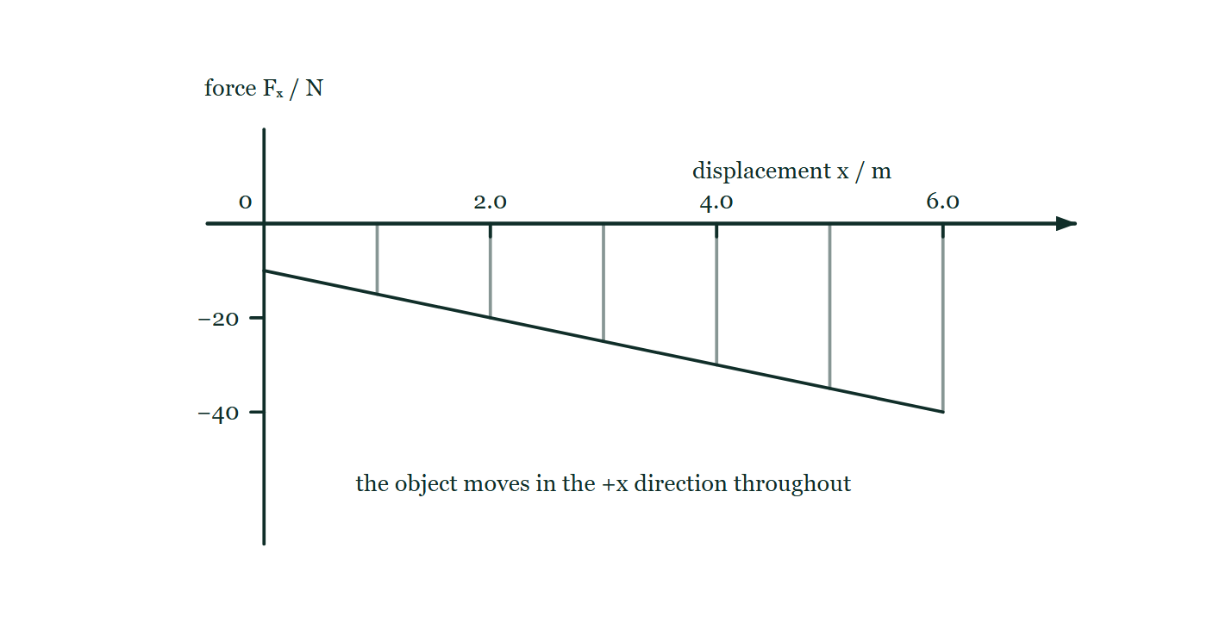
WORK · FORCE–DISPLACEMENT GRAPHS
GIOPHYSICS LESSON
QUICK CHECK
Decide before the answer goes up
Check and misconception — The quick check and the trap
A force–displacement graph lies entirely below the x-axis. What is the sign of the work done by that force?
A
Negative
B
Positive because area cannot be negative
A force–displacement graph whose line runs from −10 N at the start to −40 N at 6.0 m, so it lies wholly below the displacement axis. The object is stated to move in the +x direction throughout, and thin lines drop from the axis to the graph to mark out the region between them.
The live version of this figure — click here
Work — Force–Displacement Graphs. Built by GioPhysics from the lesson's own copy; nothing on these slides is re-authored.
21 / 29
Notes:
[Phase] Check and misconception: The quick check and the trap (minutes 35–41 of 45)
[Question] A force–displacement graph lies entirely below the x-axis. What is the sign of the work done by that force?
[Figure] A force–displacement graph whose line runs from −10 N at the start to −40 N at 6.0 m, so it lies wholly below the displacement axis. The object is stated to move in the +x direction throughout, and thin lines drop from the axis to the graph to mark out the region between them.
[Options] A Negative B Positive because area cannot be negative

Slide 22
WORK · FORCE–DISPLACEMENT GRAPHS
GIOPHYSICS LESSON
QUICK CHECK · THE ANSWER
The answer, and why
Check and misconception — The quick check and the trap
A Negative
HOW TO GET THERE
Correct. Graphical area is signed: below the axis means the force opposes positive displacement.
WHY THE OTHERS TEMPT
A Right. The height of every strip is a force with a direction, and here it points backwards while the object moves forwards — so each strip is a negative force times a positive step, and the total comes out negative. The force is removing energy.
B Geometric area is never negative, but this is not geometry. Below the axis means the force opposes the positive displacement, and that is exactly the case in which W = Fs cos 180° = −Fs. The graph is telling you the sign.
Work — Force–Displacement Graphs. Built by GioPhysics from the lesson's own copy; nothing on these slides is re-authored.
22 / 29
Notes:
[Phase] Check and misconception: The quick check and the trap (minutes 35–41 of 45)
[Question] A force–displacement graph lies entirely below the x-axis. What is the sign of the work done by that force?
[Option by option] A: Right. The height of every strip is a force with a direction, and here it points backwards while the object moves forwards — so each strip is a negative force times a positive step, and the total comes out negative. The force is removing energy. B: Geometric area is never negative, but this is not geometry. Below the axis means the force opposes the positive displacement, and that is exactly the case in which W = Fs cos 180° = −Fs. The graph is telling you the sign.
[Answer] A — Negative
[Why] Correct. Graphical area is signed: below the axis means the force opposes positive displacement.
[Reveal] One click for the answer, then one for the reason.

Slide 23
WORK · FORCE–DISPLACEMENT GRAPHS
GIOPHYSICS LESSON
EXTENSION 1 OF 2 · HARD
The question
Hard
Worked examples — I do, we do — one step revealed at a time
A force falls linearly from 80 N at x = 0 to 20 N at x = 6.0 m. Find the work done over the 6.0 m.
Work — Force–Displacement Graphs. Built by GioPhysics from the lesson's own copy; nothing on these slides is re-authored.
23 / 29
Notes:
[Phase] Worked examples: I do, we do — one step revealed at a time (minutes 22–35 of 45)
[Question] A force falls linearly from 80 N at x = 0 to 20 N at x = 6.0 m. Find the work done over the 6.0 m.
[Answer] W = 300 J

Slide 24
WORK · FORCE–DISPLACEMENT GRAPHS
GIOPHYSICS LESSON
EXTENSION 1 OF 2 · HARD · THE WORKING
How to solve it
Hard
Worked examples — I do, we do — one step revealed at a time
A force falls linearly from 80 N at x = 0 to 20 N at x = 6.0 m. Find the work done over the 6.0 m.
1.
The area under the line is a trapezium.
2.
W = ½(F₀ + F₁)Δx = ½(80 + 20) × 6.0.
3.
W = 50 × 6.0 = 300 J.
Work — Force–Displacement Graphs. Built by GioPhysics from the lesson's own copy; nothing on these slides is re-authored.
24 / 29
Notes:
[Phase] Worked examples: I do, we do — one step revealed at a time (minutes 22–35 of 45)
[Reveal] One click per step. The class works each line before the next appears.
[Step 1] The area under the line is a trapezium.
[Step 2] W = ½(F₀ + F₁)Δx = ½(80 + 20) × 6.0.
[Step 3] W = 50 × 6.0 = 300 J.

Slide 25
WORK · FORCE–DISPLACEMENT GRAPHS
GIOPHYSICS LESSON
EXTENSION 1 OF 2 · HARD
Answer
Hard
Worked examples — I do, we do — one step revealed at a time
W = 300 J
Work — Force–Displacement Graphs. Built by GioPhysics from the lesson's own copy; nothing on these slides is re-authored.
25 / 29
Notes:
[Phase] Worked examples: I do, we do — one step revealed at a time (minutes 22–35 of 45)
[Answer] W = 300 J

Slide 26
WORK · FORCE–DISPLACEMENT GRAPHS
GIOPHYSICS LESSON
EXTENSION 2 OF 2 · CHALLENGING
The question
Challenging
Worked examples — I do, we do — one step revealed at a time
A spring (k = 400 N/m) is already stretched 0.10 m. How much extra work is needed to stretch it to 0.30 m, and why is it more than the first 0.10 m cost?
Work — Force–Displacement Graphs. Built by GioPhysics from the lesson's own copy; nothing on these slides is re-authored.
26 / 29
Notes:
[Phase] Worked examples: I do, we do — one step revealed at a time (minutes 22–35 of 45)
[Question] A spring (k = 400 N/m) is already stretched 0.10 m. How much extra work is needed to stretch it to 0.30 m, and why is it more than the first 0.10 m cost?
[Answer] 16 J, versus 2 J for the first 0.10 m — the F–x area grows quadratically

Slide 27
WORK · FORCE–DISPLACEMENT GRAPHS
GIOPHYSICS LESSON
EXTENSION 2 OF 2 · CHALLENGING · THE WORKING
How to solve it
Challenging
Worked examples — I do, we do — one step revealed at a time
A spring (k = 400 N/m) is already stretched 0.10 m. How much extra work is needed to stretch it to 0.30 m, and why is it more than the first 0.10 m cost?
1.
Stored energy: U = ½kx². At 0.10 m: U₁ = ½ × 400 × 0.01 = 2.0 J.
2.
At 0.30 m: U₂ = ½ × 400 × 0.09 = 18 J.
3.
Extra work = 18 − 2.0 = 16 J — the force grows with x, so later centimetres of stretch cost more than early ones.
Work — Force–Displacement Graphs. Built by GioPhysics from the lesson's own copy; nothing on these slides is re-authored.
27 / 29
Notes:
[Phase] Worked examples: I do, we do — one step revealed at a time (minutes 22–35 of 45)
[Reveal] One click per step. The class works each line before the next appears.
[Step 1] Stored energy: U = ½kx². At 0.10 m: U₁ = ½ × 400 × 0.01 = 2.0 J.
[Step 2] At 0.30 m: U₂ = ½ × 400 × 0.09 = 18 J.
[Step 3] Extra work = 18 − 2.0 = 16 J — the force grows with x, so later centimetres of stretch cost more than early ones.

Slide 28
WORK · FORCE–DISPLACEMENT GRAPHS
GIOPHYSICS LESSON
EXTENSION 2 OF 2 · CHALLENGING
Answer
Challenging
Worked examples — I do, we do — one step revealed at a time
16 J, versus 2 J for the first 0.10 m — the F–x area grows quadratically
Work — Force–Displacement Graphs. Built by GioPhysics from the lesson's own copy; nothing on these slides is re-authored.
28 / 29
Notes:
[Phase] Worked examples: I do, we do — one step revealed at a time (minutes 22–35 of 45)
[Answer] 16 J, versus 2 J for the first 0.10 m — the F–x area grows quadratically

Slide 29
WORK · FORCE–DISPLACEMENT GRAPHS
GIOPHYSICS LESSON
WORK
Where to go next
Plenary — What to take away, what to practise next
Next
3.3 Work–Energy Theorem
https://giophysics.com/chapter-5/work-energy-theorem/
Lesson
This lesson on giophysics.com
https://giophysics.com/chapter-5/force-displacement-graphs/
Live
The live, interactive version of these slides
https://giophysics.com/chapter-5/presentation/?lesson=graphs
Chapter
All Work lessons
https://giophysics.com/chapter-5/
PDF
Download the lesson PDF
https://giophysics.com/downloads/5-2-force-displacement-graphs.pdf
Work — Force–Displacement Graphs. Built by GioPhysics from the lesson's own copy; nothing on these slides is re-authored.
29 / 29
Notes:
[Phase] Plenary: What to take away, what to practise next (minutes 41–45 of 45)
[Interactive] The graphs and the circuit topology on these slides are frozen. The live version at https://giophysics.com/chapter-5/presentation/?lesson=graphs moves them.

