Slide 1
WORK · POWER AND EFFICIENCY
GIOPHYSICS LESSON
03 · Work
Rate and useful output
Power and Efficiency
Power tells how quickly energy is transferred. Efficiency compares the useful output with the total input.
POSITION
Lesson 4 of 5 in Work
PLAN
15 slides in the 45-minute core run, about 43 minutes of it
LESSON PAGE
https://giophysics.com/chapter-5/power-efficiency/
Built by GioPhysics from the lesson's own page. Every word on these slides is the lesson's; nothing here is re-authored. Teaching material, not an awarding body's document.
Work — Power and Efficiency. Built by GioPhysics from the lesson's own copy; nothing on these slides is re-authored.
1 / 29
Notes:
[Lesson] Work — Power and Efficiency. Lesson 4 of 5.
[Intro] Power tells how quickly energy is transferred. Efficiency compares the useful output with the total input.
[Source] https://giophysics.com/chapter-5/power-efficiency/
[Disclaimer] Built by GioPhysics from the lesson's own page. Every word on these slides is the lesson's; nothing here is re-authored. Teaching material, not an awarding body's document.

Slide 2
WORK · POWER AND EFFICIENCY
GIOPHYSICS LESSON
THINK FIRST
Two hikers of the same mass reach the same summit, one in three hours and one in five. Which did more work against gravity?
Take answers before you click — the point is the commitment
The fast one arrives exhausted; the slow one strolls in and says the climb was easy.
THE ANSWER
Neither — they did exactly the same work, mgh, because work against gravity depends only on weight and height gained. What the fast hiker had was more power: the same joules delivered in less time.
Work — Power and Efficiency. Built by GioPhysics from the lesson's own copy; nothing on these slides is re-authored.
2 / 29
Notes:
[Phase] Starter: Recall what this lesson stands on (minutes 0–5 of 45)
[Hook] Two hikers of the same mass reach the same summit, one in three hours and one in five. Which did more work against gravity? The fast one arrives exhausted; the slow one strolls in and says the climb was easy.
[Answer] Neither — they did exactly the same work, mgh, because work against gravity depends only on weight and height gained. What the fast hiker had was more power: the same joules delivered in less time.

Slide 3
WORK · POWER AND EFFICIENCY
GIOPHYSICS LESSON
EXPLAINED SIMPLY
In one sentence
Introduce the idea — The big idea and the definition
Power is the rate of energy transfer, while efficiency is the fraction of input that becomes useful output.
Work — Power and Efficiency. Built by GioPhysics from the lesson's own copy; nothing on these slides is re-authored.
3 / 29
Notes:
[Phase] Introduce the idea: The big idea and the definition (minutes 5–13 of 45)
[Definition] Power is the rate of energy transfer, while efficiency is the fraction of input that becomes useful output.

Slide 4
WORK · POWER AND EFFICIENCY
GIOPHYSICS LESSON
EXPLAINED SIMPLY
What that looks like
Introduce the idea — The big idea and the definition
FOR EXAMPLE
A machine transferring 600 J in 3 s has 200 W power; if 480 J is useful, its efficiency is 80%.
Work — Power and Efficiency. Built by GioPhysics from the lesson's own copy; nothing on these slides is re-authored.
4 / 29
Notes:
[Phase] Introduce the idea: The big idea and the definition (minutes 5–13 of 45)
[Worked illustration] A machine transferring 600 J in 3 s has 200 W power; if 480 J is useful, its efficiency is 80%.

Slide 5
WORK · POWER AND EFFICIENCY
GIOPHYSICS LESSON
THE PHYSICS · 1 OF 2
How it works · 1
Build the model — The formulae, one at a time, in plain English
Two machines can do the same work but have different powers if one completes it sooner. Power measures a rate, not a total amount of energy.
Work — Power and Efficiency. Built by GioPhysics from the lesson's own copy; nothing on these slides is re-authored.
5 / 29
Notes:
[Phase] Build the model: The formulae, one at a time, in plain English (minutes 13–22 of 45)
[Section] Two machines can do the same work but have different powers if one completes it sooner. Power measures a rate, not a total amount of energy.

Slide 6
WORK · POWER AND EFFICIENCY
GIOPHYSICS LESSON
THE PHYSICS · 2 OF 2
How it works · 2
Build the model — The formulae, one at a time, in plain English
No real machine converts every joule into its intended output. Track useful and dissipated transfers while remembering that total energy is conserved.
Work — Power and Efficiency. Built by GioPhysics from the lesson's own copy; nothing on these slides is re-authored.
6 / 29
Notes:
[Phase] Build the model: The formulae, one at a time, in plain English (minutes 13–22 of 45)
[Section] No real machine converts every joule into its intended output. Track useful and dissipated transfers while remembering that total energy is conserved.

Slide 7
WORK · POWER AND EFFICIENCY
GIOPHYSICS LESSON
THE PHYSICS
What to remember
Build the model — The formulae, one at a time, in plain English
Power is a rate measured in watts: 1 W = 1 J/s.
Only the velocity component parallel to the force contributes to Fv cos θ.
Efficiency is useful output divided by total input and cannot exceed 100%.
Work — Power and Efficiency. Built by GioPhysics from the lesson's own copy; nothing on these slides is re-authored.
7 / 29
Notes:
[Phase] Build the model: The formulae, one at a time, in plain English (minutes 13–22 of 45)
[Takeaways] Power is a rate measured in watts: 1 W = 1 J/s. · Only the velocity component parallel to the force contributes to Fv cos θ. · Efficiency is useful output divided by total input and cannot exceed 100%.

Slide 8
WORK · POWER AND EFFICIENCY
GIOPHYSICS LESSON
FORMULA 1 OF 3
Average power
Build the model — The formulae, one at a time, in plain English
P = W / t
Energy transferred per unit time.
IN PLAIN ENGLISH
Power is how fast energy is transferred: the work done divided by the time it took.
Work — Power and Efficiency. Built by GioPhysics from the lesson's own copy; nothing on these slides is re-authored.
8 / 29
Notes:
[Phase] Build the model: The formulae, one at a time, in plain English (minutes 13–22 of 45)
[Formula] Average power: P = W / t
[In plain English] Power is how fast energy is transferred: the work done divided by the time it took.
[Note] Energy transferred per unit time.

Slide 9
WORK · POWER AND EFFICIENCY
GIOPHYSICS LESSON
FORMULA 2 OF 3
Moving force
Build the model — The formulae, one at a time, in plain English
P = Fv cos θ
Instantaneous transfer by a force at angle θ.
IN PLAIN ENGLISH
At any instant, power is force times how fast the object moves in the force's direction.
Work — Power and Efficiency. Built by GioPhysics from the lesson's own copy; nothing on these slides is re-authored.
9 / 29
Notes:
[Phase] Build the model: The formulae, one at a time, in plain English (minutes 13–22 of 45)
[Formula] Moving force: P = Fv cos θ
[In plain English] At any instant, power is force times how fast the object moves in the force's direction.
[Note] Instantaneous transfer by a force at angle θ.

Slide 10
WORK · POWER AND EFFICIENCY
GIOPHYSICS LESSON
FORMULA 3 OF 3
Efficiency
Build the model — The formulae, one at a time, in plain English
η = useful output / total input
Use energies or powers consistently; ×100% for percent.
IN PLAIN ENGLISH
What fraction of the energy you put in actually does the job you want — the rest is lost, usually as heat.
Work — Power and Efficiency. Built by GioPhysics from the lesson's own copy; nothing on these slides is re-authored.
10 / 29
Notes:
[Phase] Build the model: The formulae, one at a time, in plain English (minutes 13–22 of 45)
[Formula] Efficiency: η = useful output / total input
[In plain English] What fraction of the energy you put in actually does the job you want — the rest is lost, usually as heat.
[Note] Use energies or powers consistently; ×100% for percent.

Slide 11
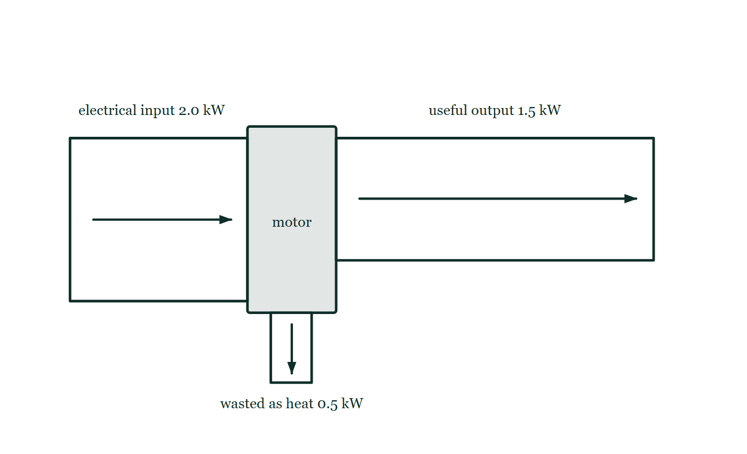
WORK · POWER AND EFFICIENCY
GIOPHYSICS LESSON
THE PICTURE
Where the input goes
Drawn for this lesson
An energy flow diagram for a motor: a band 2.0 kW wide enters from the left, and leaves as a band 1.5 kW wide for the useful mechanical output and a narrower 0.5 kW band dropping away below as heat. The band widths are drawn to the same scale, so the two outputs together are exactly as wide as the input.
The live version of this figure — click here
Work — Power and Efficiency. Built by GioPhysics from the lesson's own copy; nothing on these slides is re-authored.
11 / 29
Notes:
[Phase] Build the model: The formulae, one at a time, in plain English (minutes 13–22 of 45)
[Figure] An energy flow diagram for a motor: a band 2.0 kW wide enters from the left, and leaves as a band 1.5 kW wide for the useful mechanical output and a narrower 0.5 kW band dropping away below as heat. The band widths are drawn to the same scale, so the two outputs together are exactly as wide as the input.

Slide 12
WORK · POWER AND EFFICIENCY
GIOPHYSICS LESSON
WORKED EXAMPLE 1 OF 2 · EASY
The question
Easy
Worked examples — I do, we do — one step revealed at a time
A motor does 3000 J of work in 60 s. What is its average power?
Work — Power and Efficiency. Built by GioPhysics from the lesson's own copy; nothing on these slides is re-authored.
12 / 29
Notes:
[Phase] Worked examples: I do, we do — one step revealed at a time (minutes 22–35 of 45)
[Question] A motor does 3000 J of work in 60 s. What is its average power?
[Answer] P = 50 W

Slide 13
WORK · POWER AND EFFICIENCY
GIOPHYSICS LESSON
WORKED EXAMPLE 1 OF 2 · EASY · THE WORKING
How to solve it
Easy
Worked examples — I do, we do — one step revealed at a time
A motor does 3000 J of work in 60 s. What is its average power?
1.
P = W/t = 3000 ÷ 60.
2.
P = 50 W.
Work — Power and Efficiency. Built by GioPhysics from the lesson's own copy; nothing on these slides is re-authored.
13 / 29
Notes:
[Phase] Worked examples: I do, we do — one step revealed at a time (minutes 22–35 of 45)
[Reveal] One click per step. The class works each line before the next appears.
[Step 1] P = W/t = 3000 ÷ 60.
[Step 2] P = 50 W.

Slide 14
WORK · POWER AND EFFICIENCY
GIOPHYSICS LESSON
WORKED EXAMPLE 1 OF 2 · EASY
Answer
Easy
Worked examples — I do, we do — one step revealed at a time
P = 50 W
Work — Power and Efficiency. Built by GioPhysics from the lesson's own copy; nothing on these slides is re-authored.
14 / 29
Notes:
[Phase] Worked examples: I do, we do — one step revealed at a time (minutes 22–35 of 45)
[Answer] P = 50 W

Slide 15
WORK · POWER AND EFFICIENCY
GIOPHYSICS LESSON
WORKED EXAMPLE 2 OF 2 · MEDIUM
The question
Medium
Worked examples — I do, we do — one step revealed at a time
A motor takes 2.0 kW of electrical power and delivers 1.5 kW of useful mechanical power. Find its efficiency and wasted power.
Work — Power and Efficiency. Built by GioPhysics from the lesson's own copy; nothing on these slides is re-authored.
15 / 29
Notes:
[Phase] Worked examples: I do, we do — one step revealed at a time (minutes 22–35 of 45)
[Question] A motor takes 2.0 kW of electrical power and delivers 1.5 kW of useful mechanical power. Find its efficiency and wasted power.
[Answer] Efficiency = 75%; wasted power = 0.50 kW.

Slide 16
WORK · POWER AND EFFICIENCY
GIOPHYSICS LESSON
WORKED EXAMPLE 2 OF 2 · MEDIUM · THE WORKING
How to solve it
Medium
Worked examples — I do, we do — one step revealed at a time
A motor takes 2.0 kW of electrical power and delivers 1.5 kW of useful mechanical power. Find its efficiency and wasted power.
1.
η = useful output power / input power.
2.
η = 1.5 kW / 2.0 kW = 0.75.
3.
Wasted power = 2.0 kW − 1.5 kW.
Work — Power and Efficiency. Built by GioPhysics from the lesson's own copy; nothing on these slides is re-authored.
16 / 29
Notes:
[Phase] Worked examples: I do, we do — one step revealed at a time (minutes 22–35 of 45)
[Reveal] One click per step. The class works each line before the next appears.
[Step 1] η = useful output power / input power.
[Step 2] η = 1.5 kW / 2.0 kW = 0.75.
[Step 3] Wasted power = 2.0 kW − 1.5 kW.

Slide 17
WORK · POWER AND EFFICIENCY
GIOPHYSICS LESSON
WORKED EXAMPLE 2 OF 2 · MEDIUM
Answer
Medium
Worked examples — I do, we do — one step revealed at a time
Efficiency = 75%; wasted power = 0.50 kW.
Work — Power and Efficiency. Built by GioPhysics from the lesson's own copy; nothing on these slides is re-authored.
17 / 29
Notes:
[Phase] Worked examples: I do, we do — one step revealed at a time (minutes 22–35 of 45)
[Answer] Efficiency = 75%; wasted power = 0.50 kW.

Slide 18
WORK · POWER AND EFFICIENCY
GIOPHYSICS LESSON
SPOT THE MISTAKE
One line here is wrong
The whole working is up — find the bad line before you click
1.
Useful work = mgh = 65 × 9.81 × 4.2 ≈ 2678 J
2.
Useful power = 2678 ÷ 3.5 ≈ 765 W
3.
The body is 25% efficient, so input power = 765 × 0.25 ≈ 191 W
LINE 3 IS WRONG
Efficiency is useful output ÷ total input, so the input must be the bigger of the two numbers: divide by 0.25 rather than multiply by it. Multiplying is tempting because '25% of' almost always means multiply — but here the 765 W is the 25%, not the whole. The answer gives itself away: no machine takes in less power than it usefully delivers.
IT SHOULD SAY
Input power = 765 ÷ 0.25 ≈ 3.1 kW
Work — Power and Efficiency. Built by GioPhysics from the lesson's own copy; nothing on these slides is re-authored.
18 / 29
Notes:
[Phase] Worked examples: I do, we do — one step revealed at a time (minutes 22–35 of 45)
[Spot the mistake] The working is complete and one line of it is wrong. Let the room hunt: one click names the line, a second shows it done correctly.
[Line 3 is wrong] Efficiency is useful output ÷ total input, so the input must be the bigger of the two numbers: divide by 0.25 rather than multiply by it. Multiplying is tempting because '25% of' almost always means multiply — but here the 765 W is the 25%, not the whole. The answer gives itself away: no machine takes in less power than it usefully delivers.
[It should say] Input power = 765 ÷ 0.25 ≈ 3.1 kW

Slide 19
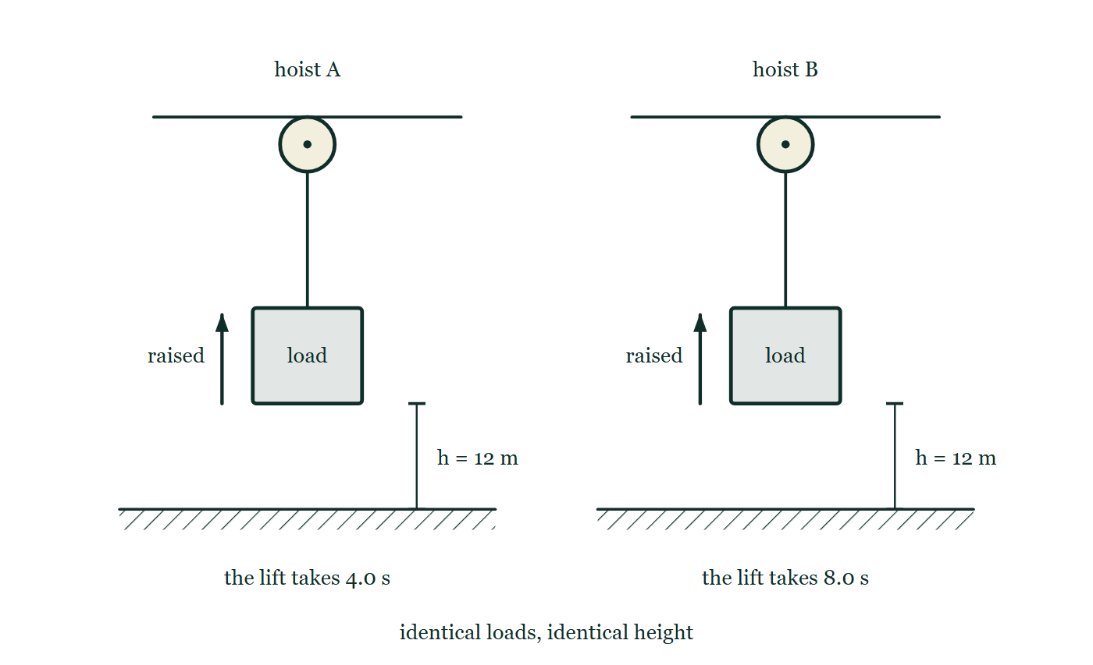
WORK · POWER AND EFFICIENCY
GIOPHYSICS LESSON
PREDICT · TAKE THE VOTE
Commit before you are told
Hands up for each option, then click
Compare the two hoists in the drawing on both counts — work done on the load, and average power.
A A does more work, because it moves the load faster
B A and B do the same work; A's average power is twice B's
C B has the greater power, because its motor runs for longer
D A does twice the work and delivers twice the power
Two identical hoists side by side, each raising an equal load through the same 12 m with the same pulley and cable. The only difference is written underneath: the left-hand lift takes 4.0 s and the right-hand lift takes 8.0 s.
The live version of this figure — click here
Work — Power and Efficiency. Built by GioPhysics from the lesson's own copy; nothing on these slides is re-authored.
19 / 29
Notes:
[Phase] Build the model: The formulae, one at a time, in plain English (minutes 13–22 of 45)
[Predict] Compare the two hoists in the drawing on both counts — work done on the load, and average power.
[Options] A A does more work, because it moves the load faster B A and B do the same work; A's average power is twice B's C B has the greater power, because its motor runs for longer D A does twice the work and delivers twice the power
[Figure] Two identical hoists side by side, each raising an equal load through the same 12 m with the same pulley and cable. The only difference is written underneath: the left-hand lift takes 4.0 s and the right-hand lift takes 8.0 s.

Slide 20
WORK · POWER AND EFFICIENCY
GIOPHYSICS LESSON
PREDICT · THE OUTCOME
What actually happens
Ask the room who changed their mind, and why
B A and B do the same work; A's average power is twice B's
WHY
Both loads end 12 m higher and both loads are equal, so the drawing marks the same mgh on each side — identical joules. Power is joules per second, and A delivers its joules in half the time, so A's average power is twice B's.
Work — Power and Efficiency. Built by GioPhysics from the lesson's own copy; nothing on these slides is re-authored.
20 / 29
Notes:
[Phase] Build the model: The formulae, one at a time, in plain English (minutes 13–22 of 45)
[Answer] B — A and B do the same work; A's average power is twice B's. Both loads end 12 m higher and both loads are equal, so the drawing marks the same mgh on each side — identical joules. Power is joules per second, and A delivers its joules in half the time, so A's average power is twice B's.

Slide 21
WORK · POWER AND EFFICIENCY
GIOPHYSICS LESSON
QUICK CHECK
Decide before the answer goes up
Check and misconception — The quick check and the trap
Two lifts raise identical loads through the same height. Lift A takes half as long as lift B. Which has greater average power?
A
Lift A
B
They have the same power because the work is equal
Two identical hoists side by side, each raising an equal load through the same 12 m with the same pulley and cable. The only difference is written underneath: the left-hand lift takes 4.0 s and the right-hand lift takes 8.0 s.
The live version of this figure — click here
Work — Power and Efficiency. Built by GioPhysics from the lesson's own copy; nothing on these slides is re-authored.
21 / 29
Notes:
[Phase] Check and misconception: The quick check and the trap (minutes 35–41 of 45)
[Question] Two lifts raise identical loads through the same height. Lift A takes half as long as lift B. Which has greater average power?
[Figure] Two identical hoists side by side, each raising an equal load through the same 12 m with the same pulley and cable. The only difference is written underneath: the left-hand lift takes 4.0 s and the right-hand lift takes 8.0 s.
[Options] A Lift A B They have the same power because the work is equal

Slide 22
WORK · POWER AND EFFICIENCY
GIOPHYSICS LESSON
QUICK CHECK · THE ANSWER
The answer, and why
Check and misconception — The quick check and the trap
A Lift A
HOW TO GET THERE
Correct. Both do the same work, but A transfers that energy in half the time, so its average power is twice as large.
WHY THE OTHERS TEMPT
A Right. Both lifts transfer the same energy, mgh, but A does it in half the time — and power is energy per second, so A's average power is twice B's.
B The work really is equal, and that is worth holding on to. But power is not the work: it is the work divided by the time taken, so equal work done in unequal times gives unequal power.
Work — Power and Efficiency. Built by GioPhysics from the lesson's own copy; nothing on these slides is re-authored.
22 / 29
Notes:
[Phase] Check and misconception: The quick check and the trap (minutes 35–41 of 45)
[Question] Two lifts raise identical loads through the same height. Lift A takes half as long as lift B. Which has greater average power?
[Option by option] A: Right. Both lifts transfer the same energy, mgh, but A does it in half the time — and power is energy per second, so A's average power is twice B's. B: The work really is equal, and that is worth holding on to. But power is not the work: it is the work divided by the time taken, so equal work done in unequal times gives unequal power.
[Answer] A — Lift A
[Why] Correct. Both do the same work, but A transfers that energy in half the time, so its average power is twice as large.
[Reveal] One click for the answer, then one for the reason.

Slide 23
WORK · POWER AND EFFICIENCY
GIOPHYSICS LESSON
EXTENSION 1 OF 2 · HARD
The question
Hard
Worked examples — I do, we do — one step revealed at a time
A 65 kg sprinter runs up stairs 4.2 m high in 3.5 s. Find the useful power, and the input power if the body is 25% efficient.
Work — Power and Efficiency. Built by GioPhysics from the lesson's own copy; nothing on these slides is re-authored.
23 / 29
Notes:
[Phase] Worked examples: I do, we do — one step revealed at a time (minutes 22–35 of 45)
[Question] A 65 kg sprinter runs up stairs 4.2 m high in 3.5 s. Find the useful power, and the input power if the body is 25% efficient.
[Answer] ≈ 0.77 kW useful; ≈ 3.1 kW input

Slide 24
WORK · POWER AND EFFICIENCY
GIOPHYSICS LESSON
EXTENSION 1 OF 2 · HARD · THE WORKING
How to solve it
Hard
Worked examples — I do, we do — one step revealed at a time
A 65 kg sprinter runs up stairs 4.2 m high in 3.5 s. Find the useful power, and the input power if the body is 25% efficient.
1.
Useful work = mgh = 65 × 9.81 × 4.2 ≈ 2678 J.
2.
P(useful) = 2678 ÷ 3.5 ≈ 765 W.
3.
P(input) = 765 ÷ 0.25 ≈ 3.1 kW.
Work — Power and Efficiency. Built by GioPhysics from the lesson's own copy; nothing on these slides is re-authored.
24 / 29
Notes:
[Phase] Worked examples: I do, we do — one step revealed at a time (minutes 22–35 of 45)
[Reveal] One click per step. The class works each line before the next appears.
[Step 1] Useful work = mgh = 65 × 9.81 × 4.2 ≈ 2678 J.
[Step 2] P(useful) = 2678 ÷ 3.5 ≈ 765 W.
[Step 3] P(input) = 765 ÷ 0.25 ≈ 3.1 kW.

Slide 25
WORK · POWER AND EFFICIENCY
GIOPHYSICS LESSON
EXTENSION 1 OF 2 · HARD
Answer
Hard
Worked examples — I do, we do — one step revealed at a time
≈ 0.77 kW useful; ≈ 3.1 kW input
Work — Power and Efficiency. Built by GioPhysics from the lesson's own copy; nothing on these slides is re-authored.
25 / 29
Notes:
[Phase] Worked examples: I do, we do — one step revealed at a time (minutes 22–35 of 45)
[Answer] ≈ 0.77 kW useful; ≈ 3.1 kW input

Slide 26
WORK · POWER AND EFFICIENCY
GIOPHYSICS LESSON
EXTENSION 2 OF 2 · CHALLENGING
The question
Challenging
Worked examples — I do, we do — one step revealed at a time
A car needs 20 kW to cruise at 25 m/s on the flat. What total power does it need to climb a 5.0% grade at the same speed, if its mass is 1400 kg and drag is unchanged?
Work — Power and Efficiency. Built by GioPhysics from the lesson's own copy; nothing on these slides is re-authored.
26 / 29
Notes:
[Phase] Worked examples: I do, we do — one step revealed at a time (minutes 22–35 of 45)
[Question] A car needs 20 kW to cruise at 25 m/s on the flat. What total power does it need to climb a 5.0% grade at the same speed, if its mass is 1400 kg and drag is unchanged?
[Answer] ≈ 37 kW

Slide 27
WORK · POWER AND EFFICIENCY
GIOPHYSICS LESSON
EXTENSION 2 OF 2 · CHALLENGING · THE WORKING
How to solve it
Challenging
Worked examples — I do, we do — one step revealed at a time
A car needs 20 kW to cruise at 25 m/s on the flat. What total power does it need to climb a 5.0% grade at the same speed, if its mass is 1400 kg and drag is unchanged?
1.
Climbing adds rate of gain of Ug: P(climb) = mgv sinθ ≈ 1400 × 9.81 × 25 × 0.05.
2.
P(climb) ≈ 17.2 kW.
3.
Total ≈ 20 + 17.2 ≈ 37 kW.
Work — Power and Efficiency. Built by GioPhysics from the lesson's own copy; nothing on these slides is re-authored.
27 / 29
Notes:
[Phase] Worked examples: I do, we do — one step revealed at a time (minutes 22–35 of 45)
[Reveal] One click per step. The class works each line before the next appears.
[Step 1] Climbing adds rate of gain of Ug: P(climb) = mgv sinθ ≈ 1400 × 9.81 × 25 × 0.05.
[Step 2] P(climb) ≈ 17.2 kW.
[Step 3] Total ≈ 20 + 17.2 ≈ 37 kW.

Slide 28
WORK · POWER AND EFFICIENCY
GIOPHYSICS LESSON
EXTENSION 2 OF 2 · CHALLENGING
Answer
Challenging
Worked examples — I do, we do — one step revealed at a time
≈ 37 kW
Work — Power and Efficiency. Built by GioPhysics from the lesson's own copy; nothing on these slides is re-authored.
28 / 29
Notes:
[Phase] Worked examples: I do, we do — one step revealed at a time (minutes 22–35 of 45)
[Answer] ≈ 37 kW

Slide 29
WORK · POWER AND EFFICIENCY
GIOPHYSICS LESSON
WORK
Where to go next
Plenary — What to take away, what to practise next
Next
3.5 Work Calculus
https://giophysics.com/chapter-5/work-calculus/
Lesson
This lesson on giophysics.com
https://giophysics.com/chapter-5/power-efficiency/
Live
The live, interactive version of these slides
https://giophysics.com/chapter-5/presentation/?lesson=power
Chapter
All Work lessons
https://giophysics.com/chapter-5/
PDF
Download the lesson PDF
https://giophysics.com/downloads/5-4-power-efficiency.pdf
Work — Power and Efficiency. Built by GioPhysics from the lesson's own copy; nothing on these slides is re-authored.
29 / 29
Notes:
[Phase] Plenary: What to take away, what to practise next (minutes 41–45 of 45)
[Interactive] The graphs and the circuit topology on these slides are frozen. The live version at https://giophysics.com/chapter-5/presentation/?lesson=power moves them.

