Slide 1
WORK · WORK–ENERGY THEOREM
GIOPHYSICS LESSON
03 · Work
The net work changes kinetic energy
Work–Energy Theorem
Combine the work done by every external force. The total tells you exactly how the object's kinetic energy changes.
POSITION
Lesson 3 of 5 in Work
PLAN
15 slides in the 45-minute core run, about 44.5 minutes of it
LESSON PAGE
https://giophysics.com/chapter-5/work-energy-theorem/
Built by GioPhysics from the lesson's own page. Every word on these slides is the lesson's; nothing here is re-authored. Teaching material, not an awarding body's document.
Work — Work–Energy Theorem. Built by GioPhysics from the lesson's own copy; nothing on these slides is re-authored.
1 / 28
Notes:
[Lesson] Work — Work–Energy Theorem. Lesson 3 of 5.
[Intro] Combine the work done by every external force. The total tells you exactly how the object's kinetic energy changes.
[Source] https://giophysics.com/chapter-5/work-energy-theorem/
[Disclaimer] Built by GioPhysics from the lesson's own page. Every word on these slides is the lesson's; nothing here is re-authored. Teaching material, not an awarding body's document.

Slide 2
WORK · WORK–ENERGY THEOREM
GIOPHYSICS LESSON
THINK FIRST
A cyclist pedals hard for 200 m and does not speed up at all. Where has her work gone?
Take answers before you click — the point is the commitment
She is working — she can feel it in her legs and the chain is under tension the whole way.
THE ANSWER
Into drag and rolling resistance, which did an equal and opposite amount of negative work on her. The net work is zero, so ΔK is zero and the speed is unchanged. Individual forces can do plenty of work while the net work is nothing at all.
Work — Work–Energy Theorem. Built by GioPhysics from the lesson's own copy; nothing on these slides is re-authored.
2 / 28
Notes:
[Phase] Starter: Recall what this lesson stands on (minutes 0–5 of 45)
[Hook] A cyclist pedals hard for 200 m and does not speed up at all. Where has her work gone? She is working — she can feel it in her legs and the chain is under tension the whole way.
[Answer] Into drag and rolling resistance, which did an equal and opposite amount of negative work on her. The net work is zero, so ΔK is zero and the speed is unchanged. Individual forces can do plenty of work while the net work is nothing at all.

Slide 3
WORK · WORK–ENERGY THEOREM
GIOPHYSICS LESSON
EXPLAINED SIMPLY
In one sentence
Introduce the idea — The big idea and the definition
The work-energy theorem says that net work on an object equals its change in kinetic energy.
Work — Work–Energy Theorem. Built by GioPhysics from the lesson's own copy; nothing on these slides is re-authored.
3 / 28
Notes:
[Phase] Introduce the idea: The big idea and the definition (minutes 5–13 of 45)
[Definition] The work-energy theorem says that net work on an object equals its change in kinetic energy.

Slide 4
WORK · WORK–ENERGY THEOREM
GIOPHYSICS LESSON
EXPLAINED SIMPLY
What that looks like
Introduce the idea — The big idea and the definition
FOR EXAMPLE
If 20 J of net work is done on a cart with 10 J of kinetic energy, it finishes with 30 J.
Work — Work–Energy Theorem. Built by GioPhysics from the lesson's own copy; nothing on these slides is re-authored.
4 / 28
Notes:
[Phase] Introduce the idea: The big idea and the definition (minutes 5–13 of 45)
[Worked illustration] If 20 J of net work is done on a cart with 10 J of kinetic energy, it finishes with 30 J.

Slide 5
WORK · WORK–ENERGY THEOREM
GIOPHYSICS LESSON
THE PHYSICS · 1 OF 2
How it works · 1
Build the model — The formulae, one at a time, in plain English
Positive net work increases kinetic energy; negative net work decreases it. Zero net work means kinetic energy is unchanged, even if individual forces do work.
Work — Work–Energy Theorem. Built by GioPhysics from the lesson's own copy; nothing on these slides is re-authored.
5 / 28
Notes:
[Phase] Build the model: The formulae, one at a time, in plain English (minutes 13–22 of 45)
[Section] Positive net work increases kinetic energy; negative net work decreases it. Zero net work means kinetic energy is unchanged, even if individual forces do work.

Slide 6
WORK · WORK–ENERGY THEOREM
GIOPHYSICS LESSON
THE PHYSICS · 2 OF 2
How it works · 2
Build the model — The formulae, one at a time, in plain English
This method is especially useful when acceleration is not constant or when a direct force-by-force time calculation would be awkward.
Work — Work–Energy Theorem. Built by GioPhysics from the lesson's own copy; nothing on these slides is re-authored.
6 / 28
Notes:
[Phase] Build the model: The formulae, one at a time, in plain English (minutes 13–22 of 45)
[Section] This method is especially useful when acceleration is not constant or when a direct force-by-force time calculation would be awkward.

Slide 7
WORK · WORK–ENERGY THEOREM
GIOPHYSICS LESSON
THE PHYSICS
What to remember
Build the model — The formulae, one at a time, in plain English
Use net work, not the work of only one force, in Wnet = ΔK.
Kinetic energy cannot be negative.
The theorem predicts speed without requiring the travel time.
Work — Work–Energy Theorem. Built by GioPhysics from the lesson's own copy; nothing on these slides is re-authored.
7 / 28
Notes:
[Phase] Build the model: The formulae, one at a time, in plain English (minutes 13–22 of 45)
[Takeaways] Use net work, not the work of only one force, in Wnet = ΔK. · Kinetic energy cannot be negative. · The theorem predicts speed without requiring the travel time.

Slide 8
WORK · WORK–ENERGY THEOREM
GIOPHYSICS LESSON
FORMULA 1 OF 3
The theorem
Build the model — The formulae, one at a time, in plain English
Wnet = ΔK = Kf − Ki
Add the work from all external forces.
IN PLAIN ENGLISH
The total work done on an object equals how much its energy of motion changed — speed up and it gained, slow down and it lost.
Work — Work–Energy Theorem. Built by GioPhysics from the lesson's own copy; nothing on these slides is re-authored.
8 / 28
Notes:
[Phase] Build the model: The formulae, one at a time, in plain English (minutes 13–22 of 45)
[Formula] The theorem: Wnet = ΔK = Kf − Ki
[In plain English] The total work done on an object equals how much its energy of motion changed — speed up and it gained, slow down and it lost.
[Note] Add the work from all external forces.

Slide 9
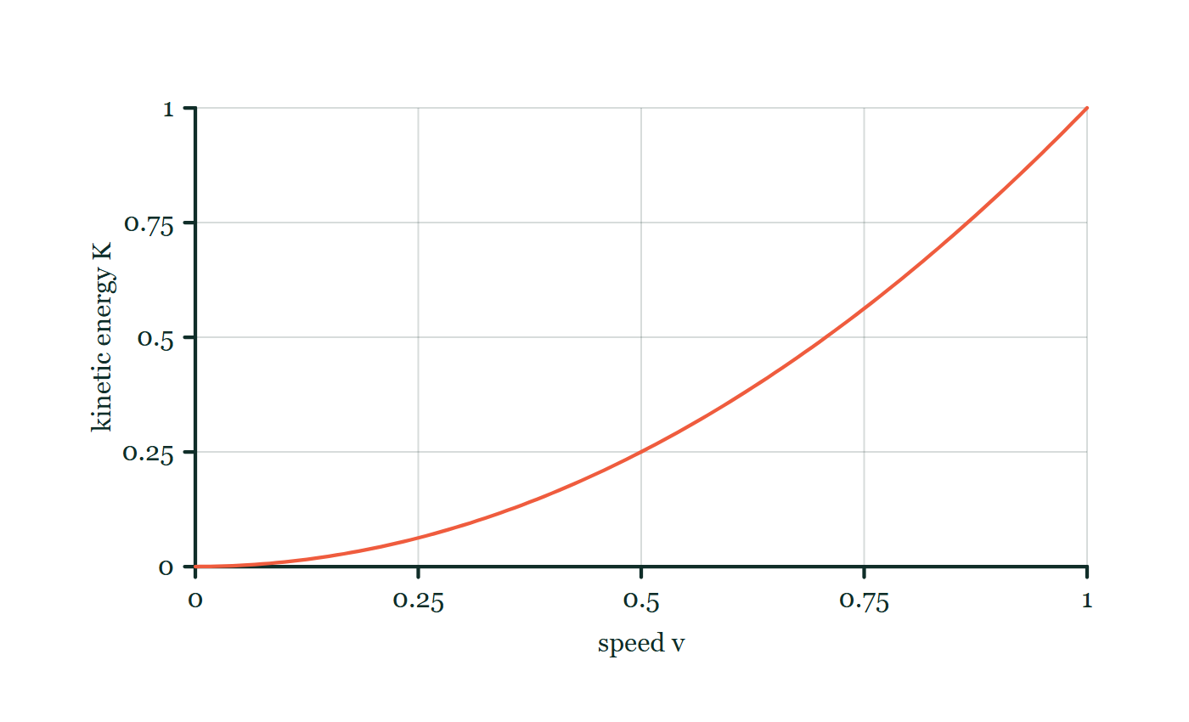
WORK · WORK–ENERGY THEOREM
GIOPHYSICS LESSON
FORMULA 2 OF 3
Kinetic energy
Build the model — The formulae, one at a time, in plain English
K = ½mv²
A scalar that depends on speed, not direction.
IN PLAIN ENGLISH
Energy of motion: it grows with mass, and with the square of speed — twice as fast means four times the energy.
Kinetic energy–speed explorer
Move this graph on the live version — click here
Work — Work–Energy Theorem. Built by GioPhysics from the lesson's own copy; nothing on these slides is re-authored.
9 / 28
Notes:
[Phase] Build the model: The formulae, one at a time, in plain English (minutes 13–22 of 45)
[Formula] Kinetic energy: K = ½mv²
[In plain English] Energy of motion: it grows with mass, and with the square of speed — twice as fast means four times the energy.
[Note] A scalar that depends on speed, not direction.
[Graph] Kinetic energy–speed explorer. For a fixed mass, kinetic energy follows a square law: doubling speed makes four times the energy.
[Axes] Horizontal: speed v. Vertical: kinetic energy K. Values are normalised — the graph teaches the shape, not a measurement.

Slide 10
WORK · WORK–ENERGY THEOREM
GIOPHYSICS LESSON
FORMULA 3 OF 3
Stopping work
Build the model — The formulae, one at a time, in plain English
Wnet = −½mv₀²
The exact work needed to reach rest.
IN PLAIN ENGLISH
To bring something to rest you must take away all its energy of motion — no more, no less.
Work — Work–Energy Theorem. Built by GioPhysics from the lesson's own copy; nothing on these slides is re-authored.
10 / 28
Notes:
[Phase] Build the model: The formulae, one at a time, in plain English (minutes 13–22 of 45)
[Formula] Stopping work: Wnet = −½mv₀²
[In plain English] To bring something to rest you must take away all its energy of motion — no more, no less.
[Note] The exact work needed to reach rest.

Slide 11
WORK · WORK–ENERGY THEOREM
GIOPHYSICS LESSON
WORKED EXAMPLE 1 OF 2 · EASY
The question
Easy
Worked examples — I do, we do — one step revealed at a time
A net work of 150 J is done on a stationary 3.0 kg trolley. Find its final speed.
Work — Work–Energy Theorem. Built by GioPhysics from the lesson's own copy; nothing on these slides is re-authored.
11 / 28
Notes:
[Phase] Worked examples: I do, we do — one step revealed at a time (minutes 22–35 of 45)
[Question] A net work of 150 J is done on a stationary 3.0 kg trolley. Find its final speed.
[Answer] v = 10 m/s

Slide 12
WORK · WORK–ENERGY THEOREM
GIOPHYSICS LESSON
WORKED EXAMPLE 1 OF 2 · EASY · THE WORKING
How to solve it
Easy
Worked examples — I do, we do — one step revealed at a time
A net work of 150 J is done on a stationary 3.0 kg trolley. Find its final speed.
1.
Wnet = ΔK = ½mv² − 0.
2.
v = √(2W/m) = √(2 × 150 / 3.0) = √100.
3.
v = 10 m/s.
Work — Work–Energy Theorem. Built by GioPhysics from the lesson's own copy; nothing on these slides is re-authored.
12 / 28
Notes:
[Phase] Worked examples: I do, we do — one step revealed at a time (minutes 22–35 of 45)
[Reveal] One click per step. The class works each line before the next appears.
[Step 1] Wnet = ΔK = ½mv² − 0.
[Step 2] v = √(2W/m) = √(2 × 150 / 3.0) = √100.
[Step 3] v = 10 m/s.

Slide 13
WORK · WORK–ENERGY THEOREM
GIOPHYSICS LESSON
WORKED EXAMPLE 1 OF 2 · EASY
Answer
Easy
Worked examples — I do, we do — one step revealed at a time
v = 10 m/s
Work — Work–Energy Theorem. Built by GioPhysics from the lesson's own copy; nothing on these slides is re-authored.
13 / 28
Notes:
[Phase] Worked examples: I do, we do — one step revealed at a time (minutes 22–35 of 45)
[Answer] v = 10 m/s

Slide 14
WORK · WORK–ENERGY THEOREM
GIOPHYSICS LESSON
WORKED EXAMPLE 2 OF 2 · MEDIUM
The question
Medium
Worked examples — I do, we do — one step revealed at a time
A 3.0 kg block moving at 4.0 m/s slides to rest under a constant 3.0 N friction force. How far does it travel?
Work — Work–Energy Theorem. Built by GioPhysics from the lesson's own copy; nothing on these slides is re-authored.
14 / 28
Notes:
[Phase] Worked examples: I do, we do — one step revealed at a time (minutes 22–35 of 45)
[Question] A 3.0 kg block moving at 4.0 m/s slides to rest under a constant 3.0 N friction force. How far does it travel?
[Answer] s = 8.0 m.

Slide 15
WORK · WORK–ENERGY THEOREM
GIOPHYSICS LESSON
WORKED EXAMPLE 2 OF 2 · MEDIUM · THE WORKING
How to solve it
Medium
Worked examples — I do, we do — one step revealed at a time
A 3.0 kg block moving at 4.0 m/s slides to rest under a constant 3.0 N friction force. How far does it travel?
1.
Ki = ½(3.0 kg)(4.0 m/s)² = 24 J and Kf = 0.
2.
Wnet = ΔK = −24 J.
3.
Friction does W = −fs, so −(3.0 N)s = −24 J.
Work — Work–Energy Theorem. Built by GioPhysics from the lesson's own copy; nothing on these slides is re-authored.
15 / 28
Notes:
[Phase] Worked examples: I do, we do — one step revealed at a time (minutes 22–35 of 45)
[Reveal] One click per step. The class works each line before the next appears.
[Step 1] Ki = ½(3.0 kg)(4.0 m/s)² = 24 J and Kf = 0.
[Step 2] Wnet = ΔK = −24 J.
[Step 3] Friction does W = −fs, so −(3.0 N)s = −24 J.

Slide 16
WORK · WORK–ENERGY THEOREM
GIOPHYSICS LESSON
WORKED EXAMPLE 2 OF 2 · MEDIUM
Answer
Medium
Worked examples — I do, we do — one step revealed at a time
s = 8.0 m.
Work — Work–Energy Theorem. Built by GioPhysics from the lesson's own copy; nothing on these slides is re-authored.
16 / 28
Notes:
[Phase] Worked examples: I do, we do — one step revealed at a time (minutes 22–35 of 45)
[Answer] s = 8.0 m.

Slide 17
WORK · WORK–ENERGY THEOREM
GIOPHYSICS LESSON
SPOT THE MISTAKE
One line here is wrong
The whole working is up — find the bad line before you click
1.
Kᵢ = ½mv² = ½ × 3.0 × 4.0 = 6.0 J
2.
Wnet = ΔK = 0 − 6.0 = −6.0 J
3.
Friction does W = −fs, so −3.0s = −6.0 and s = 2.0 m
LINE 1 IS WRONG
The speed has to be squared before it is halved: ½ × 3.0 × 4.0² = 24 J, not 6.0 J. Writing the formula correctly and then keying in v instead of v² is the commonest slip in the whole topic, and it hides well — every line after it is arithmetically perfect.
IT SHOULD SAY
Kᵢ = ½mv² = ½ × 3.0 × 4.0² = 24 J
Work — Work–Energy Theorem. Built by GioPhysics from the lesson's own copy; nothing on these slides is re-authored.
17 / 28
Notes:
[Phase] Worked examples: I do, we do — one step revealed at a time (minutes 22–35 of 45)
[Spot the mistake] The working is complete and one line of it is wrong. Let the room hunt: one click names the line, a second shows it done correctly.
[Line 1 is wrong] The speed has to be squared before it is halved: ½ × 3.0 × 4.0² = 24 J, not 6.0 J. Writing the formula correctly and then keying in v instead of v² is the commonest slip in the whole topic, and it hides well — every line after it is arithmetically perfect.
[It should say] Kᵢ = ½mv² = ½ × 3.0 × 4.0² = 24 J

Slide 18
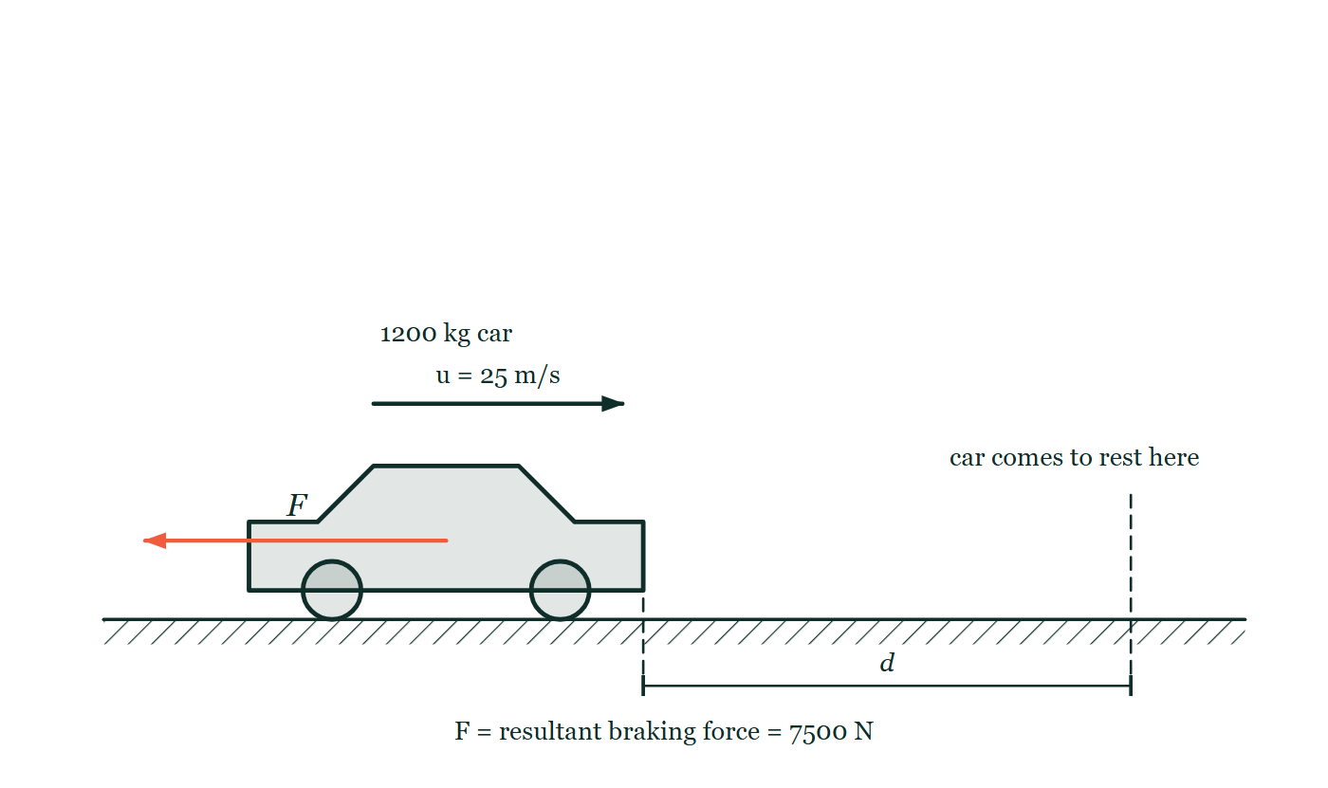
WORK · WORK–ENERGY THEOREM
GIOPHYSICS LESSON
PREDICT · TAKE THE VOTE
Commit before you are told
Hands up for each option, then click
The same car brakes with the same 7500 N resultant, but starts at twice the speed shown. What happens to the distance marked d?
A It doubles, because the speed has doubled
B It becomes four times as long
C It is unchanged, because the braking force is the same
D It grows a little, but by less than double, because a faster car brakes harder
A 1200 kg car travelling at 25 m/s along a level road, with a single arrow on the car for the 7500 N resultant braking force pointing back against the motion. Dashed lines mark the point where the car comes to rest, and the distance between them is labelled d.
The live version of this figure — click here
Work — Work–Energy Theorem. Built by GioPhysics from the lesson's own copy; nothing on these slides is re-authored.
18 / 28
Notes:
[Phase] Build the model: The formulae, one at a time, in plain English (minutes 13–22 of 45)
[Predict] The same car brakes with the same 7500 N resultant, but starts at twice the speed shown. What happens to the distance marked d?
[Options] A It doubles, because the speed has doubled B It becomes four times as long C It is unchanged, because the braking force is the same D It grows a little, but by less than double, because a faster car brakes harder
[Figure] A 1200 kg car travelling at 25 m/s along a level road, with a single arrow on the car for the 7500 N resultant braking force pointing back against the motion. Dashed lines mark the point where the car comes to rest, and the distance between them is labelled d.

Slide 19
WORK · WORK–ENERGY THEOREM
GIOPHYSICS LESSON
PREDICT · THE OUTCOME
What actually happens
Ask the room who changed their mind, and why
B It becomes four times as long
WHY
The braking force is fixed, so the distance is set entirely by how much kinetic energy has to be removed: Fd = ½mv². Replace v by 2v and ½mv² quadruples, so d must quadruple — the arrow marked d on the drawing stretches to four times its length, not two.
Work — Work–Energy Theorem. Built by GioPhysics from the lesson's own copy; nothing on these slides is re-authored.
19 / 28
Notes:
[Phase] Build the model: The formulae, one at a time, in plain English (minutes 13–22 of 45)
[Answer] B — It becomes four times as long. The braking force is fixed, so the distance is set entirely by how much kinetic energy has to be removed: Fd = ½mv². Replace v by 2v and ½mv² quadruples, so d must quadruple — the arrow marked d on the drawing stretches to four times its length, not two.

Slide 20
WORK · WORK–ENERGY THEOREM
GIOPHYSICS LESSON
QUICK CHECK
Decide before the answer goes up
Check and misconception — The quick check and the trap
A car doubles its speed while its mass stays constant. By what factor does its kinetic energy change?
A
It doubles
B
It becomes four times as large
Work — Work–Energy Theorem. Built by GioPhysics from the lesson's own copy; nothing on these slides is re-authored.
20 / 28
Notes:
[Phase] Check and misconception: The quick check and the trap (minutes 35–41 of 45)
[Question] A car doubles its speed while its mass stays constant. By what factor does its kinetic energy change?
[Options] A It doubles B It becomes four times as large

Slide 21
WORK · WORK–ENERGY THEOREM
GIOPHYSICS LESSON
QUICK CHECK · THE ANSWER
The answer, and why
Check and misconception — The quick check and the trap
B It becomes four times as large
HOW TO GET THERE
Correct. K ∝ v², so doubling speed multiplies kinetic energy by 2² = 4.
WHY THE OTHERS TEMPT
A This would be right if kinetic energy were proportional to speed — but the formula is ½mv², not ½mv. It is momentum, mv, that simply doubles when the speed doubles.
B Right. K = ½mv², so replacing v by 2v gives ½m(2v)² = 4 × ½mv². That factor of four is why stopping distances lengthen so alarmingly with speed.
Work — Work–Energy Theorem. Built by GioPhysics from the lesson's own copy; nothing on these slides is re-authored.
21 / 28
Notes:
[Phase] Check and misconception: The quick check and the trap (minutes 35–41 of 45)
[Question] A car doubles its speed while its mass stays constant. By what factor does its kinetic energy change?
[Option by option] A: This would be right if kinetic energy were proportional to speed — but the formula is ½mv², not ½mv. It is momentum, mv, that simply doubles when the speed doubles. B: Right. K = ½mv², so replacing v by 2v gives ½m(2v)² = 4 × ½mv². That factor of four is why stopping distances lengthen so alarmingly with speed.
[Answer] B — It becomes four times as large
[Why] Correct. K ∝ v², so doubling speed multiplies kinetic energy by 2² = 4.
[Reveal] One click for the answer, then one for the reason.

Slide 22
WORK · WORK–ENERGY THEOREM
GIOPHYSICS LESSON
EXTENSION 1 OF 2 · HARD
The question
Hard
Worked examples — I do, we do — one step revealed at a time
A 1200 kg car at 25 m/s brakes with a 7500 N resultant force. How far does it travel before stopping?
Work — Work–Energy Theorem. Built by GioPhysics from the lesson's own copy; nothing on these slides is re-authored.
22 / 28
Notes:
[Phase] Worked examples: I do, we do — one step revealed at a time (minutes 22–35 of 45)
[Question] A 1200 kg car at 25 m/s brakes with a 7500 N resultant force. How far does it travel before stopping?
[Answer] d = 50 m

Slide 23
WORK · WORK–ENERGY THEOREM
GIOPHYSICS LESSON
EXTENSION 1 OF 2 · HARD · THE WORKING
How to solve it
Hard
Worked examples — I do, we do — one step revealed at a time
A 1200 kg car at 25 m/s brakes with a 7500 N resultant force. How far does it travel before stopping?
1.
Work–energy theorem: −Fd = 0 − ½mv².
2.
d = mv²/(2F) = 1200 × 625 / (2 × 7500).
3.
d = 750000 / 15000 = 50 m.
Work — Work–Energy Theorem. Built by GioPhysics from the lesson's own copy; nothing on these slides is re-authored.
23 / 28
Notes:
[Phase] Worked examples: I do, we do — one step revealed at a time (minutes 22–35 of 45)
[Reveal] One click per step. The class works each line before the next appears.
[Step 1] Work–energy theorem: −Fd = 0 − ½mv².
[Step 2] d = mv²/(2F) = 1200 × 625 / (2 × 7500).
[Step 3] d = 750000 / 15000 = 50 m.

Slide 24
WORK · WORK–ENERGY THEOREM
GIOPHYSICS LESSON
EXTENSION 1 OF 2 · HARD
Answer
Hard
Worked examples — I do, we do — one step revealed at a time
d = 50 m
Work — Work–Energy Theorem. Built by GioPhysics from the lesson's own copy; nothing on these slides is re-authored.
24 / 28
Notes:
[Phase] Worked examples: I do, we do — one step revealed at a time (minutes 22–35 of 45)
[Answer] d = 50 m

Slide 25
WORK · WORK–ENERGY THEOREM
GIOPHYSICS LESSON
EXTENSION 2 OF 2 · CHALLENGING
The question
Challenging
Worked examples — I do, we do — one step revealed at a time
A 0.50 kg ball is thrown straight down at 8.0 m/s from 12 m. Air resistance removes 6.0 J on the way down. Use energy methods to find its landing speed.
Work — Work–Energy Theorem. Built by GioPhysics from the lesson's own copy; nothing on these slides is re-authored.
25 / 28
Notes:
[Phase] Worked examples: I do, we do — one step revealed at a time (minutes 22–35 of 45)
[Question] A 0.50 kg ball is thrown straight down at 8.0 m/s from 12 m. Air resistance removes 6.0 J on the way down. Use energy methods to find its landing speed.
[Answer] v ≈ 17 m/s

Slide 26
WORK · WORK–ENERGY THEOREM
GIOPHYSICS LESSON
EXTENSION 2 OF 2 · CHALLENGING · THE WORKING
How to solve it
Challenging
Worked examples — I do, we do — one step revealed at a time
A 0.50 kg ball is thrown straight down at 8.0 m/s from 12 m. Air resistance removes 6.0 J on the way down. Use energy methods to find its landing speed.
1.
Initial energy: K = ½ × 0.5 × 64 = 16 J; Ug = 0.5 × 9.81 × 12 ≈ 58.9 J; total ≈ 74.9 J.
2.
Landing kinetic energy = 74.9 − 6.0 ≈ 68.9 J.
3.
v = √(2K/m) = √(2 × 68.9 / 0.5) ≈ √275.4 ≈ 16.6 m/s.
Work — Work–Energy Theorem. Built by GioPhysics from the lesson's own copy; nothing on these slides is re-authored.
26 / 28
Notes:
[Phase] Worked examples: I do, we do — one step revealed at a time (minutes 22–35 of 45)
[Reveal] One click per step. The class works each line before the next appears.
[Step 1] Initial energy: K = ½ × 0.5 × 64 = 16 J; Ug = 0.5 × 9.81 × 12 ≈ 58.9 J; total ≈ 74.9 J.
[Step 2] Landing kinetic energy = 74.9 − 6.0 ≈ 68.9 J.
[Step 3] v = √(2K/m) = √(2 × 68.9 / 0.5) ≈ √275.4 ≈ 16.6 m/s.

Slide 27
WORK · WORK–ENERGY THEOREM
GIOPHYSICS LESSON
EXTENSION 2 OF 2 · CHALLENGING
Answer
Challenging
Worked examples — I do, we do — one step revealed at a time
v ≈ 17 m/s
Work — Work–Energy Theorem. Built by GioPhysics from the lesson's own copy; nothing on these slides is re-authored.
27 / 28
Notes:
[Phase] Worked examples: I do, we do — one step revealed at a time (minutes 22–35 of 45)
[Answer] v ≈ 17 m/s

Slide 28
WORK · WORK–ENERGY THEOREM
GIOPHYSICS LESSON
WORK
Where to go next
Plenary — What to take away, what to practise next
Next
3.4 Power and Efficiency
https://giophysics.com/chapter-5/power-efficiency/
Lesson
This lesson on giophysics.com
https://giophysics.com/chapter-5/work-energy-theorem/
Live
The live, interactive version of these slides
https://giophysics.com/chapter-5/presentation/?lesson=theorem
Chapter
All Work lessons
https://giophysics.com/chapter-5/
PDF
Download the lesson PDF
https://giophysics.com/downloads/5-3-work-energy-theorem.pdf
Work — Work–Energy Theorem. Built by GioPhysics from the lesson's own copy; nothing on these slides is re-authored.
28 / 28
Notes:
[Phase] Plenary: What to take away, what to practise next (minutes 41–45 of 45)
[Interactive] The graphs and the circuit topology on these slides are frozen. The live version at https://giophysics.com/chapter-5/presentation/?lesson=theorem moves them.

