Slide 1
WORK · WORK DONE
GIOPHYSICS LESSON
03 · Work
Energy crosses the system boundary
Work Done
A force does work only through the part of the displacement parallel to that force. Direction decides the sign.
POSITION
Lesson 1 of 5 in Work
PLAN
15 slides in the 45-minute core run, about 43 minutes of it
LESSON PAGE
https://giophysics.com/chapter-5/work/
Built by GioPhysics from the lesson's own page. Every word on these slides is the lesson's; nothing here is re-authored. Teaching material, not an awarding body's document.
Work — Work Done. Built by GioPhysics from the lesson's own copy; nothing on these slides is re-authored.
1 / 31
Notes:
[Lesson] Work — Work Done. Lesson 1 of 5.
[Intro] A force does work only through the part of the displacement parallel to that force. Direction decides the sign.
[Source] https://giophysics.com/chapter-5/work/
[Disclaimer] Built by GioPhysics from the lesson's own page. Every word on these slides is the lesson's; nothing here is re-authored. Teaching material, not an awarding body's document.

Slide 2
WORK · WORK DONE
GIOPHYSICS LESSON
THINK FIRST
You carry a heavy suitcase along a level platform. How much work do you do on the suitcase?
Take answers before you click — the point is the commitment
It certainly feels like work — your arm aches and you are breathing harder by the far end of the platform.
THE ANSWER
None at all. Your hand pushes upwards on the case while the case moves horizontally, so θ = 90°, cos θ = 0 and no energy is transferred to the case. The ache is your own muscle fibres contracting and releasing, which costs your body energy without transferring any to the luggage.
Work — Work Done. Built by GioPhysics from the lesson's own copy; nothing on these slides is re-authored.
2 / 31
Notes:
[Phase] Starter: Recall what this lesson stands on (minutes 0–5 of 45)
[Hook] You carry a heavy suitcase along a level platform. How much work do you do on the suitcase? It certainly feels like work — your arm aches and you are breathing harder by the far end of the platform.
[Answer] None at all. Your hand pushes upwards on the case while the case moves horizontally, so θ = 90°, cos θ = 0 and no energy is transferred to the case. The ache is your own muscle fibres contracting and releasing, which costs your body energy without transferring any to the luggage.

Slide 3
WORK · WORK DONE
GIOPHYSICS LESSON
EXPLAINED SIMPLY
In one sentence
Introduce the idea — The big idea and the definition
Work is energy transferred when a force acts through a displacement.
Work — Work Done. Built by GioPhysics from the lesson's own copy; nothing on these slides is re-authored.
3 / 31
Notes:
[Phase] Introduce the idea: The big idea and the definition (minutes 5–13 of 45)
[Definition] Work is energy transferred when a force acts through a displacement.

Slide 4
WORK · WORK DONE
GIOPHYSICS LESSON
EXPLAINED SIMPLY
What that looks like
Introduce the idea — The big idea and the definition
FOR EXAMPLE
A 10 N force moving a box 3 m in the same direction does 30 J of work.
Work — Work Done. Built by GioPhysics from the lesson's own copy; nothing on these slides is re-authored.
4 / 31
Notes:
[Phase] Introduce the idea: The big idea and the definition (minutes 5–13 of 45)
[Worked illustration] A 10 N force moving a box 3 m in the same direction does 30 J of work.

Slide 5
WORK · WORK DONE
GIOPHYSICS LESSON
THE PHYSICS · 1 OF 2
How it works · 1
Build the model — The formulae, one at a time, in plain English
Work is an energy transfer, not a stored substance. A push can add energy, a resistive force can remove it, and a perpendicular force can transfer none.
Work — Work Done. Built by GioPhysics from the lesson's own copy; nothing on these slides is re-authored.
5 / 31
Notes:
[Phase] Build the model: The formulae, one at a time, in plain English (minutes 13–22 of 45)
[Section] Work is an energy transfer, not a stored substance. A push can add energy, a resistive force can remove it, and a perpendicular force can transfer none.

Slide 6
WORK · WORK DONE
GIOPHYSICS LESSON
THE PHYSICS · 2 OF 2
How it works · 2
Build the model — The formulae, one at a time, in plain English
Choose the object or system first. Then compare each force direction with the displacement of that same object.
Work — Work Done. Built by GioPhysics from the lesson's own copy; nothing on these slides is re-authored.
6 / 31
Notes:
[Phase] Build the model: The formulae, one at a time, in plain English (minutes 13–22 of 45)
[Section] Choose the object or system first. Then compare each force direction with the displacement of that same object.

Slide 7
WORK · WORK DONE
GIOPHYSICS LESSON
THE PHYSICS
What to remember
Build the model — The formulae, one at a time, in plain English
Work is energy transferred by a force through displacement.
The angle is measured between the force and displacement vectors.
Resistive forces usually do negative work on the moving object.
Work — Work Done. Built by GioPhysics from the lesson's own copy; nothing on these slides is re-authored.
7 / 31
Notes:
[Phase] Build the model: The formulae, one at a time, in plain English (minutes 13–22 of 45)
[Takeaways] Work is energy transferred by a force through displacement. · The angle is measured between the force and displacement vectors. · Resistive forces usually do negative work on the moving object.

Slide 8
WORK · WORK DONE
GIOPHYSICS LESSON
FORMULA 1 OF 3
Constant force
Build the model — The formulae, one at a time, in plain English
W = F s cos θ
θ is the angle between force and displacement.
IN PLAIN ENGLISH
Work is the push (F) times the distance moved (s), counting only the part of the push that points along the motion — that is what cos θ does.
Work — Work Done. Built by GioPhysics from the lesson's own copy; nothing on these slides is re-authored.
8 / 31
Notes:
[Phase] Build the model: The formulae, one at a time, in plain English (minutes 13–22 of 45)
[Formula] Constant force: W = F s cos θ
[In plain English] Work is the push (F) times the distance moved (s), counting only the part of the push that points along the motion — that is what cos θ does.
[Note] θ is the angle between force and displacement.

Slide 9
WORK · WORK DONE
GIOPHYSICS LESSON
FORMULA 2 OF 3
Sign
Build the model — The formulae, one at a time, in plain English
W > 0 · W = 0 · W < 0
With motion · perpendicular · against motion.
IN PLAIN ENGLISH
Pushing along the motion adds energy (positive), pushing at right angles adds nothing (zero), and pushing against the motion takes energy away (negative).
Work — Work Done. Built by GioPhysics from the lesson's own copy; nothing on these slides is re-authored.
9 / 31
Notes:
[Phase] Build the model: The formulae, one at a time, in plain English (minutes 13–22 of 45)
[Formula] Sign: W > 0 · W = 0 · W < 0
[In plain English] Pushing along the motion adds energy (positive), pushing at right angles adds nothing (zero), and pushing against the motion takes energy away (negative).
[Note] With motion · perpendicular · against motion.

Slide 10
WORK · WORK DONE
GIOPHYSICS LESSON
FORMULA 3 OF 3
Unit
Build the model — The formulae, one at a time, in plain English
1 J = 1 N·m
Work and energy use joules, J.
IN PLAIN ENGLISH
One joule is the energy used when a force of one newton moves something one metre.
Work — Work Done. Built by GioPhysics from the lesson's own copy; nothing on these slides is re-authored.
10 / 31
Notes:
[Phase] Build the model: The formulae, one at a time, in plain English (minutes 13–22 of 45)
[Formula] Unit: 1 J = 1 N·m
[In plain English] One joule is the energy used when a force of one newton moves something one metre.
[Note] Work and energy use joules, J.

Slide 11
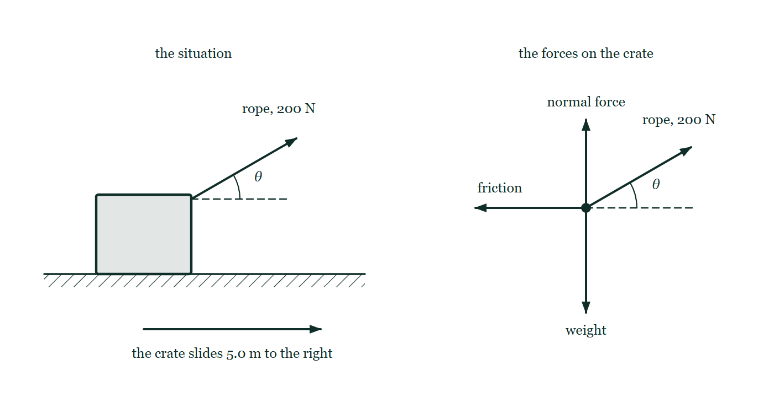
WORK · WORK DONE
GIOPHYSICS LESSON
THE PICTURE
Which forces actually transfer energy?
Drawn for this lesson
On the left, a crate on a level floor is pulled by a rope at 30° above the horizontal while it slides 5.0 m to the right. On the right the same four forces are drawn again from a single point: the rope tension at 30°, friction backwards along the floor, the normal force straight up and the weight straight down.
The live version of this figure — click here
Work — Work Done. Built by GioPhysics from the lesson's own copy; nothing on these slides is re-authored.
11 / 31
Notes:
[Phase] Build the model: The formulae, one at a time, in plain English (minutes 13–22 of 45)
[Figure] On the left, a crate on a level floor is pulled by a rope at 30° above the horizontal while it slides 5.0 m to the right. On the right the same four forces are drawn again from a single point: the rope tension at 30°, friction backwards along the floor, the normal force straight up and the weight straight down.

Slide 12
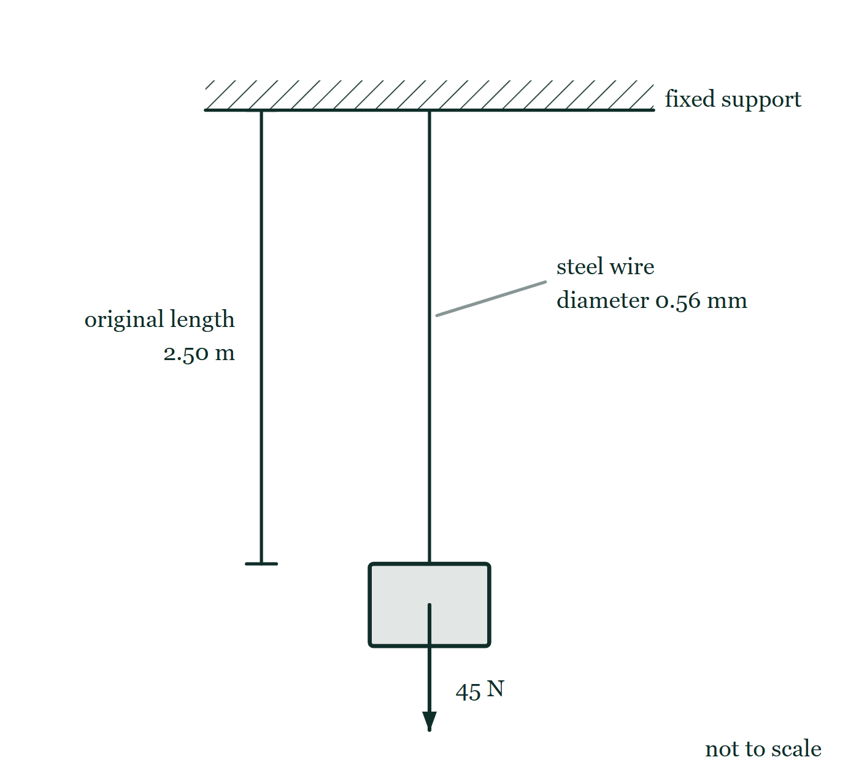
WORK · WORK DONE
GIOPHYSICS LESSON
FIGURE 1 OF 2
Fig. 8.1 — A Level AS · Topics 1–11
Drawn for question 8 of that paper · syllabus 5, 6
A steel wire hangs vertically from a rigid support drawn as a hatched ceiling, and a block is attached to its lower end. An arrow starting at the centre of that block points vertically downwards and is labelled 45 N. A dimension line to the left of the wire marks its original length as 2.50 m, and a leader line to the wire labels it as a steel wire of diameter 0.56 mm. The figure is not to scale.
See the question this was drawn for — click here
Work — Work Done. Built by GioPhysics from the lesson's own copy; nothing on these slides is re-authored.
12 / 31
Notes:
[Phase] Build the model: The formulae, one at a time, in plain English (minutes 13–22 of 45)
[Figure] Fig. 8.1. A steel wire hangs vertically from a rigid support drawn as a hatched ceiling, and a block is attached to its lower end. An arrow starting at the centre of that block points vertically downwards and is labelled 45 N. A dimension line to the left of the wire marks its original length as 2.50 m, and a leader line to the wire labels it as a steel wire of diameter 0.56 mm. The figure is not to scale.
[Where it came from] A Level AS · Topics 1–11, question 8; syllabus 5, 6.

Slide 13
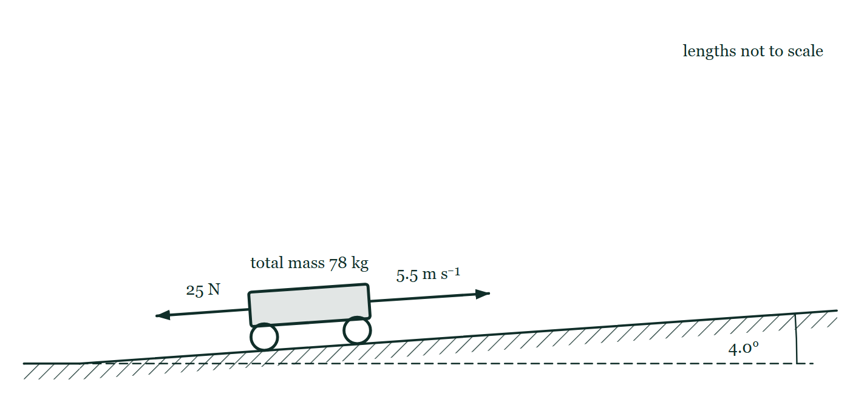
WORK · WORK DONE
GIOPHYSICS LESSON
FIGURE 2 OF 2
Figure 4 — IB Theme A · Space, time and motion
Drawn for question 9 of that paper · syllabus A.3
Side view, drawn not to scale. A road climbs to the right from level ground, and the angle between the road and a dashed horizontal line drawn from the foot of the slope is marked 4.0°. The cyclist and bicycle are drawn as one wheeled body on the road, labelled total mass 78 kg. An arrow from the front of the body points up the slope and is labelled 5.5 m s⁻¹; a second arrow from the rear points down the slope and is labelled 25 N.
See the question this was drawn for — click here
Work — Work Done. Built by GioPhysics from the lesson's own copy; nothing on these slides is re-authored.
13 / 31
Notes:
[Phase] Build the model: The formulae, one at a time, in plain English (minutes 13–22 of 45)
[Figure] Figure 4. Side view, drawn not to scale. A road climbs to the right from level ground, and the angle between the road and a dashed horizontal line drawn from the foot of the slope is marked 4.0°. The cyclist and bicycle are drawn as one wheeled body on the road, labelled total mass 78 kg. An arrow from the front of the body points up the slope and is labelled 5.5 m s⁻¹; a second arrow from the rear points down the slope and is labelled 25 N.
[Where it came from] IB Theme A · Space, time and motion, question 9; syllabus A.3.

Slide 14
WORK · WORK DONE
GIOPHYSICS LESSON
WORKED EXAMPLE 1 OF 2 · EASY
The question
Easy
Worked examples — I do, we do — one step revealed at a time
A 50 N horizontal force pushes a box 4.0 m along a floor in the direction of the force. How much work is done?
Work — Work Done. Built by GioPhysics from the lesson's own copy; nothing on these slides is re-authored.
14 / 31
Notes:
[Phase] Worked examples: I do, we do — one step revealed at a time (minutes 22–35 of 45)
[Question] A 50 N horizontal force pushes a box 4.0 m along a floor in the direction of the force. How much work is done?
[Answer] W = 200 J

Slide 15
WORK · WORK DONE
GIOPHYSICS LESSON
WORKED EXAMPLE 1 OF 2 · EASY · THE WORKING
How to solve it
Easy
Worked examples — I do, we do — one step revealed at a time
A 50 N horizontal force pushes a box 4.0 m along a floor in the direction of the force. How much work is done?
1.
W = Fs cosθ with θ = 0°, so cosθ = 1.
2.
W = 50 × 4.0 = 200 J.
Work — Work Done. Built by GioPhysics from the lesson's own copy; nothing on these slides is re-authored.
15 / 31
Notes:
[Phase] Worked examples: I do, we do — one step revealed at a time (minutes 22–35 of 45)
[Reveal] One click per step. The class works each line before the next appears.
[Step 1] W = Fs cosθ with θ = 0°, so cosθ = 1.
[Step 2] W = 50 × 4.0 = 200 J.

Slide 16
WORK · WORK DONE
GIOPHYSICS LESSON
WORKED EXAMPLE 1 OF 2 · EASY
Answer
Easy
Worked examples — I do, we do — one step revealed at a time
W = 200 J
Work — Work Done. Built by GioPhysics from the lesson's own copy; nothing on these slides is re-authored.
16 / 31
Notes:
[Phase] Worked examples: I do, we do — one step revealed at a time (minutes 22–35 of 45)
[Answer] W = 200 J

Slide 17
WORK · WORK DONE
GIOPHYSICS LESSON
WORKED EXAMPLE 2 OF 2 · MEDIUM
The question
Medium
Worked examples — I do, we do — one step revealed at a time
A rope pulls a crate 5.0 m with a force of 200 N at 30° above the horizontal. Find the work done by the rope.
Work — Work Done. Built by GioPhysics from the lesson's own copy; nothing on these slides is re-authored.
17 / 31
Notes:
[Phase] Worked examples: I do, we do — one step revealed at a time (minutes 22–35 of 45)
[Question] A rope pulls a crate 5.0 m with a force of 200 N at 30° above the horizontal. Find the work done by the rope.
[Answer] W = 866 J (3 s.f.), positive because the rope helps the motion.

Slide 18
WORK · WORK DONE
GIOPHYSICS LESSON
WORKED EXAMPLE 2 OF 2 · MEDIUM · THE WORKING
How to solve it
Medium
Worked examples — I do, we do — one step revealed at a time
A rope pulls a crate 5.0 m with a force of 200 N at 30° above the horizontal. Find the work done by the rope.
1.
The crate moves horizontally, so θ = 30°.
2.
Use the force component parallel to the motion: F cos θ.
3.
W = (200 N)(5.0 m) cos 30°.
Work — Work Done. Built by GioPhysics from the lesson's own copy; nothing on these slides is re-authored.
18 / 31
Notes:
[Phase] Worked examples: I do, we do — one step revealed at a time (minutes 22–35 of 45)
[Reveal] One click per step. The class works each line before the next appears.
[Step 1] The crate moves horizontally, so θ = 30°.
[Step 2] Use the force component parallel to the motion: F cos θ.
[Step 3] W = (200 N)(5.0 m) cos 30°.

Slide 19
WORK · WORK DONE
GIOPHYSICS LESSON
WORKED EXAMPLE 2 OF 2 · MEDIUM
Answer
Medium
Worked examples — I do, we do — one step revealed at a time
W = 866 J (3 s.f.), positive because the rope helps the motion.
Work — Work Done. Built by GioPhysics from the lesson's own copy; nothing on these slides is re-authored.
19 / 31
Notes:
[Phase] Worked examples: I do, we do — one step revealed at a time (minutes 22–35 of 45)
[Answer] W = 866 J (3 s.f.), positive because the rope helps the motion.

Slide 20
WORK · WORK DONE
GIOPHYSICS LESSON
SPOT THE MISTAKE
One line here is wrong
The whole working is up — find the bad line before you click
1.
Rope: W = Fs cos θ = 90 × 25 × cos 35° ≈ 1843 J
2.
Friction: W = fs = 40 × 25 = +1000 J
3.
Weight and normal force: θ = 90°, so each does W = 0
4.
Net work = 1843 + 1000 ≈ 2843 J
LINE 2 IS WRONG
Friction points backwards along a forward displacement, so θ = 180° and cos θ = −1. The arithmetic 40 × 25 is the same whichever way round you think about it, which is precisely why the minus sign goes missing — and the sign is the only part of that line carrying the physics that friction takes energy out of the sledge.
IT SHOULD SAY
Friction: W = fs cos 180° = −40 × 25 = −1000 J
Work — Work Done. Built by GioPhysics from the lesson's own copy; nothing on these slides is re-authored.
20 / 31
Notes:
[Phase] Worked examples: I do, we do — one step revealed at a time (minutes 22–35 of 45)
[Spot the mistake] The working is complete and one line of it is wrong. Let the room hunt: one click names the line, a second shows it done correctly.
[Line 2 is wrong] Friction points backwards along a forward displacement, so θ = 180° and cos θ = −1. The arithmetic 40 × 25 is the same whichever way round you think about it, which is precisely why the minus sign goes missing — and the sign is the only part of that line carrying the physics that friction takes energy out of the sledge.
[It should say] Friction: W = fs cos 180° = −40 × 25 = −1000 J

Slide 21
WORK · WORK DONE
GIOPHYSICS LESSON
PREDICT · TAKE THE VOTE
Commit before you are told
Hands up for each option, then click
The crate slides 5.0 m to the right. Which of the four forces transfer no energy to it at all?
A Friction, because a resistive force cannot transfer energy
B The normal force and the weight, because both are perpendicular to the displacement
C The weight only, because the crate does not change height
D None of them — every force that acts must do some work
On the left, a crate on a level floor is pulled by a rope at 30° above the horizontal while it slides 5.0 m to the right. On the right the same four forces are drawn again from a single point: the rope tension at 30°, friction backwards along the floor, the normal force straight up and the weight straight down.
The live version of this figure — click here
Work — Work Done. Built by GioPhysics from the lesson's own copy; nothing on these slides is re-authored.
21 / 31
Notes:
[Phase] Build the model: The formulae, one at a time, in plain English (minutes 13–22 of 45)
[Predict] The crate slides 5.0 m to the right. Which of the four forces transfer no energy to it at all?
[Options] A Friction, because a resistive force cannot transfer energy B The normal force and the weight, because both are perpendicular to the displacement C The weight only, because the crate does not change height D None of them — every force that acts must do some work
[Figure] On the left, a crate on a level floor is pulled by a rope at 30° above the horizontal while it slides 5.0 m to the right. On the right the same four forces are drawn again from a single point: the rope tension at 30°, friction backwards along the floor, the normal force straight up and the weight straight down.

Slide 22
WORK · WORK DONE
GIOPHYSICS LESSON
PREDICT · THE OUTCOME
What actually happens
Ask the room who changed their mind, and why
B The normal force and the weight, because both are perpendicular to the displacement
WHY
Read the angles off the free body. The normal force points straight up and the weight straight down while the crate moves horizontally, so for both of them θ = 90° and cos θ = 0. Friction is a different case: it is antiparallel to the displacement, θ = 180°, so it does negative work — it takes energy out rather than transferring none.
Work — Work Done. Built by GioPhysics from the lesson's own copy; nothing on these slides is re-authored.
22 / 31
Notes:
[Phase] Build the model: The formulae, one at a time, in plain English (minutes 13–22 of 45)
[Answer] B — The normal force and the weight, because both are perpendicular to the displacement. Read the angles off the free body. The normal force points straight up and the weight straight down while the crate moves horizontally, so for both of them θ = 90° and cos θ = 0. Friction is a different case: it is antiparallel to the displacement, θ = 180°, so it does negative work — it takes energy out rather than transferring none.

Slide 23
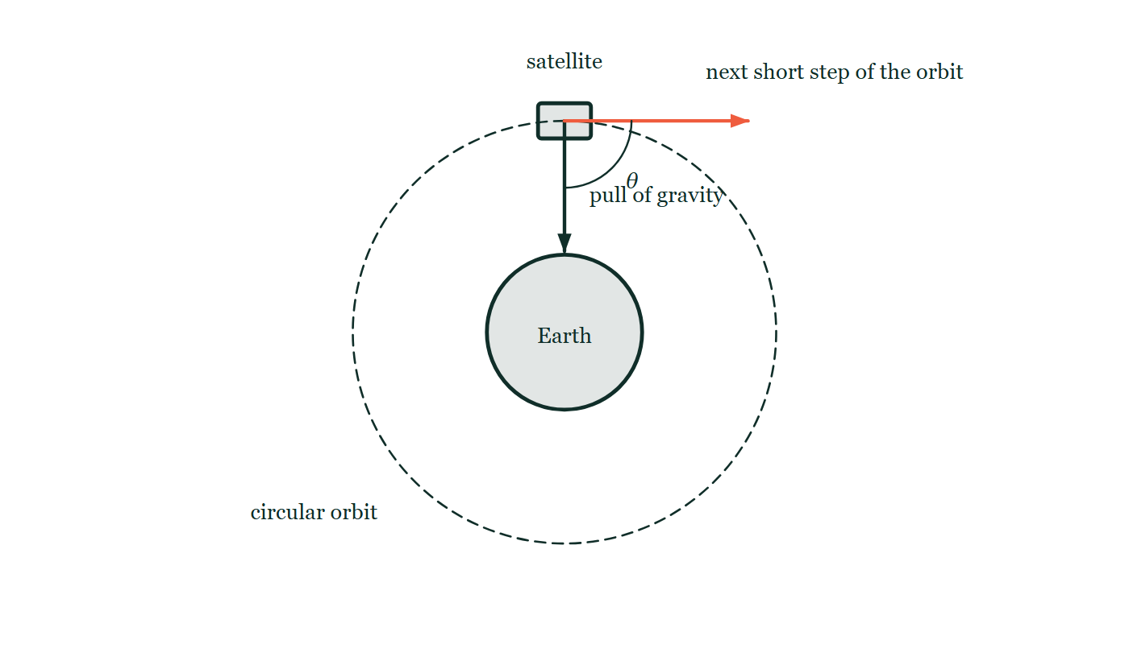
WORK · WORK DONE
GIOPHYSICS LESSON
QUICK CHECK
Decide before the answer goes up
Check and misconception — The quick check and the trap
A satellite moves in a circular orbit while gravity points toward the centre. Does gravity do work during a short tangential displacement?
A
Yes — gravity is large
B
No — force and displacement are perpendicular
A satellite on a circular orbit, drawn as a dashed circle round the Earth. One arrow runs from the satellite to the Earth's centre for the pull of gravity; a second runs along the orbit for the satellite's next short step of travel, with the angle between them marked θ.
The live version of this figure — click here
Work — Work Done. Built by GioPhysics from the lesson's own copy; nothing on these slides is re-authored.
23 / 31
Notes:
[Phase] Check and misconception: The quick check and the trap (minutes 35–41 of 45)
[Question] A satellite moves in a circular orbit while gravity points toward the centre. Does gravity do work during a short tangential displacement?
[Figure] A satellite on a circular orbit, drawn as a dashed circle round the Earth. One arrow runs from the satellite to the Earth's centre for the pull of gravity; a second runs along the orbit for the satellite's next short step of travel, with the angle between them marked θ.
[Options] A Yes — gravity is large B No — force and displacement are perpendicular

Slide 24
WORK · WORK DONE
GIOPHYSICS LESSON
QUICK CHECK · THE ANSWER
The answer, and why
Check and misconception — The quick check and the trap
B No — force and displacement are perpendicular
HOW TO GET THERE
Correct. θ = 90°, so cos θ = 0 and gravity does no work during that tangential step.
WHY THE OTHERS TEMPT
A Gravity is indeed the largest force acting on the satellite, but size is not what decides work. W = Fs cos θ, and a force at right angles to the step scores cos 90° = 0 however strong it is.
B Right. Over that short step the satellite moves along its orbit while gravity points at the Earth's centre, so θ = 90°, cos θ = 0 and no energy is transferred — which is exactly why a satellite in a circular orbit keeps the same speed for years.
Work — Work Done. Built by GioPhysics from the lesson's own copy; nothing on these slides is re-authored.
24 / 31
Notes:
[Phase] Check and misconception: The quick check and the trap (minutes 35–41 of 45)
[Question] A satellite moves in a circular orbit while gravity points toward the centre. Does gravity do work during a short tangential displacement?
[Option by option] A: Gravity is indeed the largest force acting on the satellite, but size is not what decides work. W = Fs cos θ, and a force at right angles to the step scores cos 90° = 0 however strong it is. B: Right. Over that short step the satellite moves along its orbit while gravity points at the Earth's centre, so θ = 90°, cos θ = 0 and no energy is transferred — which is exactly why a satellite in a circular orbit keeps the same speed for years.
[Answer] B — No — force and displacement are perpendicular
[Why] Correct. θ = 90°, so cos θ = 0 and gravity does no work during that tangential step.
[Reveal] One click for the answer, then one for the reason.

Slide 25
WORK · WORK DONE
GIOPHYSICS LESSON
EXTENSION 1 OF 2 · HARD
The question
Hard
Worked examples — I do, we do — one step revealed at a time
A sledge is pulled 25 m by a 90 N rope at 35° above the horizontal while friction exerts 40 N backwards. Find the work done by the rope, by friction, and the net work.
Work — Work Done. Built by GioPhysics from the lesson's own copy; nothing on these slides is re-authored.
25 / 31
Notes:
[Phase] Worked examples: I do, we do — one step revealed at a time (minutes 22–35 of 45)
[Question] A sledge is pulled 25 m by a 90 N rope at 35° above the horizontal while friction exerts 40 N backwards. Find the work done by the rope, by friction, and the net work.
[Answer] W(rope) ≈ 1.8 kJ, W(friction) = −1.0 kJ, net ≈ +0.84 kJ

Slide 26
WORK · WORK DONE
GIOPHYSICS LESSON
EXTENSION 1 OF 2 · HARD · THE WORKING
How to solve it
Hard
Worked examples — I do, we do — one step revealed at a time
A sledge is pulled 25 m by a 90 N rope at 35° above the horizontal while friction exerts 40 N backwards. Find the work done by the rope, by friction, and the net work.
1.
Rope: W = Fs cosθ = 90 × 25 × cos35° ≈ 1843 J.
2.
Friction acts opposite the motion: W = −40 × 25 = −1000 J.
3.
The vertical forces do no work; net W ≈ 1843 − 1000 ≈ 843 J.
Work — Work Done. Built by GioPhysics from the lesson's own copy; nothing on these slides is re-authored.
26 / 31
Notes:
[Phase] Worked examples: I do, we do — one step revealed at a time (minutes 22–35 of 45)
[Reveal] One click per step. The class works each line before the next appears.
[Step 1] Rope: W = Fs cosθ = 90 × 25 × cos35° ≈ 1843 J.
[Step 2] Friction acts opposite the motion: W = −40 × 25 = −1000 J.
[Step 3] The vertical forces do no work; net W ≈ 1843 − 1000 ≈ 843 J.

Slide 27
WORK · WORK DONE
GIOPHYSICS LESSON
EXTENSION 1 OF 2 · HARD
Answer
Hard
Worked examples — I do, we do — one step revealed at a time
W(rope) ≈ 1.8 kJ, W(friction) = −1.0 kJ, net ≈ +0.84 kJ
Work — Work Done. Built by GioPhysics from the lesson's own copy; nothing on these slides is re-authored.
27 / 31
Notes:
[Phase] Worked examples: I do, we do — one step revealed at a time (minutes 22–35 of 45)
[Answer] W(rope) ≈ 1.8 kJ, W(friction) = −1.0 kJ, net ≈ +0.84 kJ

Slide 28
WORK · WORK DONE
GIOPHYSICS LESSON
EXTENSION 2 OF 2 · CHALLENGING
The question
Challenging
Worked examples — I do, we do — one step revealed at a time
A 2.0 kg block is pushed up a frictionless 30° incline at constant speed for 3.0 m along the slope. Show that the pushing force's work equals the gain in gravitational potential energy.
Work — Work Done. Built by GioPhysics from the lesson's own copy; nothing on these slides is re-authored.
28 / 31
Notes:
[Phase] Worked examples: I do, we do — one step revealed at a time (minutes 22–35 of 45)
[Question] A 2.0 kg block is pushed up a frictionless 30° incline at constant speed for 3.0 m along the slope. Show that the pushing force's work equals the gain in gravitational potential energy.
[Answer] Both equal ≈ 29 J: with ΔK = 0, every joule of pushing work becomes potential energy

Slide 29
WORK · WORK DONE
GIOPHYSICS LESSON
EXTENSION 2 OF 2 · CHALLENGING · THE WORKING
How to solve it
Challenging
Worked examples — I do, we do — one step revealed at a time
A 2.0 kg block is pushed up a frictionless 30° incline at constant speed for 3.0 m along the slope. Show that the pushing force's work equals the gain in gravitational potential energy.
1.
Constant speed on a frictionless slope: push F = mg sin30° = 2.0 × 9.81 × 0.5 ≈ 9.8 N along the slope.
2.
W(push) = 9.8 × 3.0 ≈ 29 J.
3.
Height gained h = 3.0 sin30° = 1.5 m, so ΔUg = mgh = 2.0 × 9.81 × 1.5 ≈ 29 J — they match because kinetic energy never changes.
Work — Work Done. Built by GioPhysics from the lesson's own copy; nothing on these slides is re-authored.
29 / 31
Notes:
[Phase] Worked examples: I do, we do — one step revealed at a time (minutes 22–35 of 45)
[Reveal] One click per step. The class works each line before the next appears.
[Step 1] Constant speed on a frictionless slope: push F = mg sin30° = 2.0 × 9.81 × 0.5 ≈ 9.8 N along the slope.
[Step 2] W(push) = 9.8 × 3.0 ≈ 29 J.
[Step 3] Height gained h = 3.0 sin30° = 1.5 m, so ΔUg = mgh = 2.0 × 9.81 × 1.5 ≈ 29 J — they match because kinetic energy never changes.

Slide 30
WORK · WORK DONE
GIOPHYSICS LESSON
EXTENSION 2 OF 2 · CHALLENGING
Answer
Challenging
Worked examples — I do, we do — one step revealed at a time
Both equal ≈ 29 J: with ΔK = 0, every joule of pushing work becomes potential energy
Work — Work Done. Built by GioPhysics from the lesson's own copy; nothing on these slides is re-authored.
30 / 31
Notes:
[Phase] Worked examples: I do, we do — one step revealed at a time (minutes 22–35 of 45)
[Answer] Both equal ≈ 29 J: with ΔK = 0, every joule of pushing work becomes potential energy

Slide 31
WORK · WORK DONE
GIOPHYSICS LESSON
WORK
Where to go next
Plenary — What to take away, what to practise next
Next
3.2 Force–Displacement Graphs
https://giophysics.com/chapter-5/force-displacement-graphs/
Lesson
This lesson on giophysics.com
https://giophysics.com/chapter-5/work/
Live
The live, interactive version of these slides
https://giophysics.com/chapter-5/presentation/?lesson=work
Chapter
All Work lessons
https://giophysics.com/chapter-5/
PDF
Download the lesson PDF
https://giophysics.com/downloads/5-1-work.pdf
Work — Work Done. Built by GioPhysics from the lesson's own copy; nothing on these slides is re-authored.
31 / 31
Notes:
[Phase] Plenary: What to take away, what to practise next (minutes 41–45 of 45)
[Interactive] The graphs and the circuit topology on these slides are frozen. The live version at https://giophysics.com/chapter-5/presentation/?lesson=work moves them.

