Slide 1
GALILEAN & SPECIAL RELATIVITY · FRAMES & GALILEAN RELATIVITY
GIOPHYSICS LESSON
27 · Galilean & Special Relativity
No experiment names the moving frame
Frames & Galilean Relativity
Pour coffee on a smoothly cruising train and it falls straight into the cup, exactly as it would at home. Galileo noticed this on ships four centuries ago: below deck, with the sea calm, no experiment can tell you whether the ship is moving. That innocent observation is the first relativity principle.
POSITION
Lesson 1 of 6 in Galilean & Special Relativity
PLAN
15 slides in the 45-minute core run, about 41.5 minutes of it
LESSON PAGE
https://giophysics.com/chapter-52/galilean-relativity/
Built by GioPhysics from the lesson's own page. Every word on these slides is the lesson's; nothing here is re-authored. Teaching material, not an awarding body's document.
Galilean & Special Relativity — Frames & Galilean Relativity. Built by GioPhysics from the lesson's own copy; nothing on these slides is re-authored.
1 / 33
Notes:
[Lesson] Galilean & Special Relativity — Frames & Galilean Relativity. Lesson 1 of 6.
[Intro] Pour coffee on a smoothly cruising train and it falls straight into the cup, exactly as it would at home. Galileo noticed this on ships four centuries ago: below deck, with the sea calm, no experiment can tell you whether the ship is moving. That innocent observation is the first relativity principle.
[Source] https://giophysics.com/chapter-52/galilean-relativity/
[Disclaimer] Built by GioPhysics from the lesson's own page. Every word on these slides is the lesson's; nothing here is re-authored. Teaching material, not an awarding body's document.

Slide 2
GALILEAN & SPECIAL RELATIVITY · FRAMES & GALILEAN RELATIVITY
GIOPHYSICS LESSON
WHAT THIS NEEDS
What you already know
Starter — Recall what this lesson stands on
Recall
2D kinematics & relative motion
https://giophysics.com/chapter-1/kinematics-2d-advanced/
Recall
Newton’s laws of motion
https://giophysics.com/chapter-3/newtons-laws-of-motion/
Galilean & Special Relativity — Frames & Galilean Relativity. Built by GioPhysics from the lesson's own copy; nothing on these slides is re-authored.
2 / 33
Notes:
[Phase] Starter: Recall what this lesson stands on (minutes 0–5 of 45)
[Starter] Recall: 2D kinematics & relative motion; Newton’s laws of motion

Slide 3
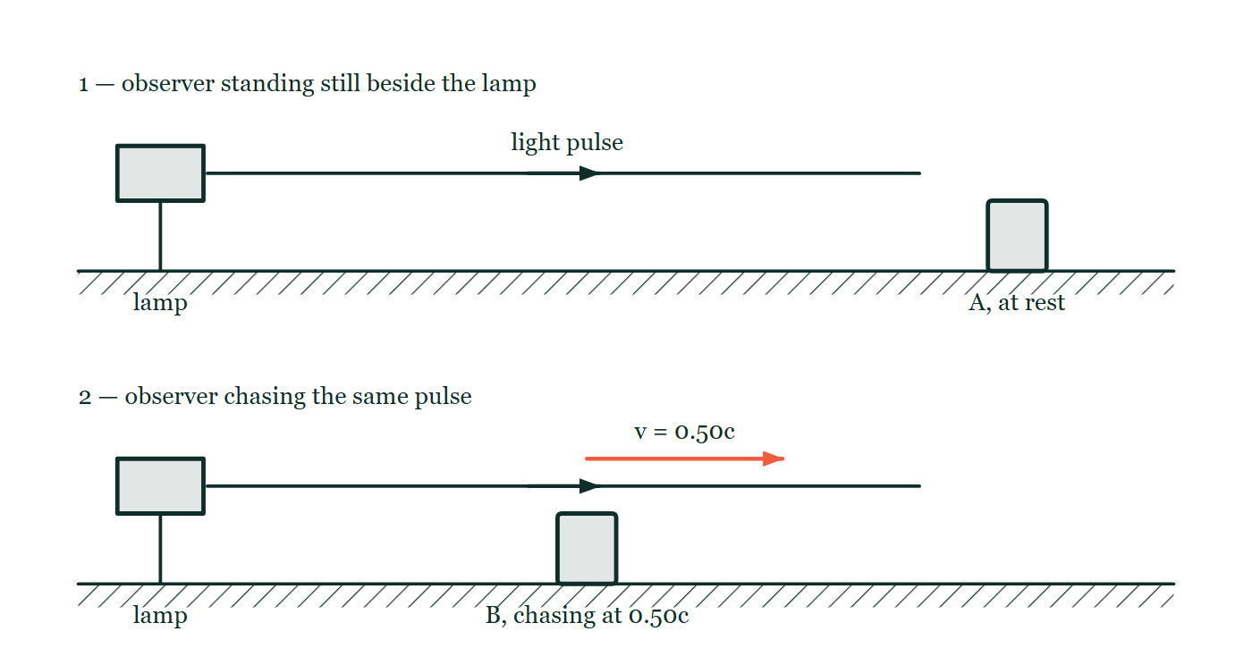
GALILEAN & SPECIAL RELATIVITY · FRAMES & GALILEAN RELATIVITY
GIOPHYSICS LESSON
THINK FIRST
You jump straight up in the aisle of a train doing 300 km/h. Why does the back of the carriage not slam into you?
Take answers before you click — the point is the commitment
For the half-second you are airborne, nothing is touching you and the train covers over forty metres of track. You land on the same floor tile you left.
THE ANSWER
Because you left the floor already moving at 300 km/h horizontally, and nothing horizontal acts on you in flight. It is not the air: seal the carriage and pump it out and the jump comes out identical. That is the Galilean principle — uniform velocity leaves no mechanical fingerprint.
The same lamp emitting one light pulse, drawn twice: in the upper panel an observer stands still beside the lamp, in the lower panel an observer chases the same pulse at 0.50c, and neither measured speed is written down.
The live version of this figure — click here
Galilean & Special Relativity — Frames & Galilean Relativity. Built by GioPhysics from the lesson's own copy; nothing on these slides is re-authored.
3 / 33
Notes:
[Phase] Starter: Recall what this lesson stands on (minutes 0–5 of 45)
[Hook] You jump straight up in the aisle of a train doing 300 km/h. Why does the back of the carriage not slam into you? For the half-second you are airborne, nothing is touching you and the train covers over forty metres of track. You land on the same floor tile you left.
[Answer] Because you left the floor already moving at 300 km/h horizontally, and nothing horizontal acts on you in flight. It is not the air: seal the carriage and pump it out and the jump comes out identical. That is the Galilean principle — uniform velocity leaves no mechanical fingerprint.
[Figure] The same lamp emitting one light pulse, drawn twice: in the upper panel an observer stands still beside the lamp, in the lower panel an observer chases the same pulse at 0.50c, and neither measured speed is written down.

Slide 4
GALILEAN & SPECIAL RELATIVITY · FRAMES & GALILEAN RELATIVITY
GIOPHYSICS LESSON
EXPLAINED SIMPLY
In one sentence
Introduce the idea — The big idea and the definition
An inertial frame is one moving at constant velocity in which Newton’s laws hold; Galilean relativity says mechanics is identical in all of them, with frames related by x′ = x − vt, t′ = t and velocities by u′ = u − v.
Galilean & Special Relativity — Frames & Galilean Relativity. Built by GioPhysics from the lesson's own copy; nothing on these slides is re-authored.
4 / 33
Notes:
[Phase] Introduce the idea: The big idea and the definition (minutes 5–13 of 45)
[Definition] An inertial frame is one moving at constant velocity in which Newton’s laws hold; Galilean relativity says mechanics is identical in all of them, with frames related by x′ = x − vt, t′ = t and velocities by u′ = u − v.

Slide 5
GALILEAN & SPECIAL RELATIVITY · FRAMES & GALILEAN RELATIVITY
GIOPHYSICS LESSON
EXPLAINED SIMPLY
What that looks like
Introduce the idea — The big idea and the definition
FOR EXAMPLE
A flight attendant walks forward at 1 m/s in a plane cruising at 250 m/s: the ground measures 251 m/s, the plane measures 1 m/s — and the coffee pours identically for both observers.
Galilean & Special Relativity — Frames & Galilean Relativity. Built by GioPhysics from the lesson's own copy; nothing on these slides is re-authored.
5 / 33
Notes:
[Phase] Introduce the idea: The big idea and the definition (minutes 5–13 of 45)
[Worked illustration] A flight attendant walks forward at 1 m/s in a plane cruising at 250 m/s: the ground measures 251 m/s, the plane measures 1 m/s — and the coffee pours identically for both observers.

Slide 6
GALILEAN & SPECIAL RELATIVITY · FRAMES & GALILEAN RELATIVITY
GIOPHYSICS LESSON
THE BIG IDEA
No experiment names the moving frame
Introduce the idea — The big idea and the definition
A reference frame is a coordinate grid plus a clock; an inertial frame is one in which Newton’s first law holds — no fictitious pushes appear. The Galilean principle of relativity says the laws of mechanics are identical in every inertial frame: uniform velocity is undetectable from inside. Translating between frames is bookkeeping — the Galilean transformations x′ = x − vt, t′ = t — and differentiating gives velocity addition u′ = u − v, then a′ = a: both frames agree on accelerations, hence on forces, hence on all of mechanics.
The picture cracked when Maxwell’s equations predicted a definite speed for light, c = 3.00 × 10⁸ m s⁻¹, with no frame attached. Galileo insists a moving observer must measure c − v; Maxwell’s equations contain no v. One of them had to give.
Galilean & Special Relativity — Frames & Galilean Relativity. Built by GioPhysics from the lesson's own copy; nothing on these slides is re-authored.
6 / 33
Notes:
[Phase] Introduce the idea: The big idea and the definition (minutes 5–13 of 45)
[Big idea] A reference frame is a coordinate grid plus a clock; an inertial frame is one in which Newton’s first law holds — no fictitious pushes appear. The Galilean principle of relativity says the laws of mechanics are identical in every inertial frame: uniform velocity is undetectable from inside. Translating between frames is bookkeeping — the Galilean transformations x′ = x − vt, t′ = t — and differentiating gives velocity addition u′ = u − v, then a′ = a: both frames agree on accelerations, hence on forces, hence on all of mechanics. The picture cracked when Maxwell’s equations predicted a definite speed for light, c = 3.00 × 10⁸ m s⁻¹, with no frame attached. Galileo insists a moving observer must measure c − v; Maxwell’s equations contain no v. One of them had to give.

Slide 7
GALILEAN & SPECIAL RELATIVITY · FRAMES & GALILEAN RELATIVITY
GIOPHYSICS LESSON
THE PHYSICS · 1 OF 3
What counts as inertial
Build the model — The formulae, one at a time, in plain English
A frame gliding at constant velocity is inertial: a puck released at rest stays put. A braking car or a rotating carousel is not — loose objects accelerate with no force in sight, and you must invent fictitious forces to patch Newton up. The Earth’s surface spins and orbits, but the accelerations are so small that it passes as inertial for laboratory physics.
Galilean & Special Relativity — Frames & Galilean Relativity. Built by GioPhysics from the lesson's own copy; nothing on these slides is re-authored.
7 / 33
Notes:
[Phase] Build the model: The formulae, one at a time, in plain English (minutes 13–22 of 45)
[Section] A frame gliding at constant velocity is inertial: a puck released at rest stays put. A braking car or a rotating carousel is not — loose objects accelerate with no force in sight, and you must invent fictitious forces to patch Newton up. The Earth’s surface spins and orbits, but the accelerations are so small that it passes as inertial for laboratory physics.

Slide 8
GALILEAN & SPECIAL RELATIVITY · FRAMES & GALILEAN RELATIVITY
GIOPHYSICS LESSON
THE PHYSICS · 2 OF 3
Relativity is about symmetry, not motion
Build the model — The formulae, one at a time, in plain English
The deep claim is not that things move — it is that the laws cannot tell inertial frames apart. Drop a ball on the train and it lands at your feet, because it shares the train’s velocity and gains none horizontally.
Every mechanics experiment comes out identical, so the question ‘are we really moving?’ has no mechanical answer. Only relative velocity between frames is measurable.
Galilean & Special Relativity — Frames & Galilean Relativity. Built by GioPhysics from the lesson's own copy; nothing on these slides is re-authored.
8 / 33
Notes:
[Phase] Build the model: The formulae, one at a time, in plain English (minutes 13–22 of 45)
[Section] The deep claim is not that things move — it is that the laws cannot tell inertial frames apart. Drop a ball on the train and it lands at your feet, because it shares the train’s velocity and gains none horizontally. Every mechanics experiment comes out identical, so the question ‘are we really moving?’ has no mechanical answer. Only relative velocity between frames is measurable.

Slide 9
GALILEAN & SPECIAL RELATIVITY · FRAMES & GALILEAN RELATIVITY
GIOPHYSICS LESSON
THE PHYSICS · 3 OF 3
The crack Maxwell opened
Build the model — The formulae, one at a time, in plain English
By 1865 light was an electromagnetic wave with speed c set by μ₀ and ε₀. Waves usually have a medium — sound needs air — so physicists invented the ‘aether’ and expected light’s measured speed to vary with the observer’s motion through it, by u′ = c − v.
The Earth orbits at 30 km/s, so the effect had to be there at 1 part in 10⁴. The next lesson is the experiment that went looking — and found nothing.
Galilean & Special Relativity — Frames & Galilean Relativity. Built by GioPhysics from the lesson's own copy; nothing on these slides is re-authored.
9 / 33
Notes:
[Phase] Build the model: The formulae, one at a time, in plain English (minutes 13–22 of 45)
[Section] By 1865 light was an electromagnetic wave with speed c set by μ₀ and ε₀. Waves usually have a medium — sound needs air — so physicists invented the ‘aether’ and expected light’s measured speed to vary with the observer’s motion through it, by u′ = c − v. The Earth orbits at 30 km/s, so the effect had to be there at 1 part in 10⁴. The next lesson is the experiment that went looking — and found nothing.

Slide 10
GALILEAN & SPECIAL RELATIVITY · FRAMES & GALILEAN RELATIVITY
GIOPHYSICS LESSON
FORMULA 1 OF 4
Galilean transformation
Build the model — The formulae, one at a time, in plain English
x′ = x − vt · t′ = t
v = relative speed of the frames along x
IN PLAIN ENGLISH
The moving observer’s origin has slid a distance vt away, so subtract it. The second equation is the hidden assumption of all pre-1905 physics: one universal clock for everybody.
Galilean & Special Relativity — Frames & Galilean Relativity. Built by GioPhysics from the lesson's own copy; nothing on these slides is re-authored.
10 / 33
Notes:
[Phase] Build the model: The formulae, one at a time, in plain English (minutes 13–22 of 45)
[Formula] Galilean transformation: x′ = x − vt · t′ = t
[In plain English] The moving observer’s origin has slid a distance vt away, so subtract it. The second equation is the hidden assumption of all pre-1905 physics: one universal clock for everybody.
[Note] v = relative speed of the frames along x

Slide 11
GALILEAN & SPECIAL RELATIVITY · FRAMES & GALILEAN RELATIVITY
GIOPHYSICS LESSON
FORMULA 2 OF 4
Velocity addition
Build the model — The formulae, one at a time, in plain English
u′ = u − v
Differentiate x′ = x − vt with t′ = t
IN PLAIN ENGLISH
Speeds simply add and subtract: a ball thrown at 8 m/s inside a 30 m/s train does 38 m/s past the platform. Utterly reliable at everyday speeds — and, it turns out, only approximately true.
Galilean & Special Relativity — Frames & Galilean Relativity. Built by GioPhysics from the lesson's own copy; nothing on these slides is re-authored.
11 / 33
Notes:
[Phase] Build the model: The formulae, one at a time, in plain English (minutes 13–22 of 45)
[Formula] Velocity addition: u′ = u − v
[In plain English] Speeds simply add and subtract: a ball thrown at 8 m/s inside a 30 m/s train does 38 m/s past the platform. Utterly reliable at everyday speeds — and, it turns out, only approximately true.
[Note] Differentiate x′ = x − vt with t′ = t

Slide 12
GALILEAN & SPECIAL RELATIVITY · FRAMES & GALILEAN RELATIVITY
GIOPHYSICS LESSON
FORMULA 3 OF 4
Acceleration is invariant
Build the model — The formulae, one at a time, in plain English
a′ = a, so F = ma in both frames
v is constant, so it dies under d/dt
IN PLAIN ENGLISH
Differentiating u′ = u − v kills the constant v. Both frames agree on every acceleration and every force — which is exactly why no mechanics experiment can reveal uniform motion.
Galilean & Special Relativity — Frames & Galilean Relativity. Built by GioPhysics from the lesson's own copy; nothing on these slides is re-authored.
12 / 33
Notes:
[Phase] Build the model: The formulae, one at a time, in plain English (minutes 13–22 of 45)
[Formula] Acceleration is invariant: a′ = a, so F = ma in both frames
[In plain English] Differentiating u′ = u − v kills the constant v. Both frames agree on every acceleration and every force — which is exactly why no mechanics experiment can reveal uniform motion.
[Note] v is constant, so it dies under d/dt

Slide 13
GALILEAN & SPECIAL RELATIVITY · FRAMES & GALILEAN RELATIVITY
GIOPHYSICS LESSON
FORMULA 4 OF 4
The problem with light
Build the model — The formulae, one at a time, in plain English
Galileo: c′ = c − v · Maxwell: c′ = c
c = 1/√(μ₀ε₀) — no frame appears
IN PLAIN ENGLISH
Maxwell’s equations fix the speed of light from constants of electricity and magnetism, without asking who is measuring. Galilean addition says different observers must disagree. Both cannot be right.
Galilean & Special Relativity — Frames & Galilean Relativity. Built by GioPhysics from the lesson's own copy; nothing on these slides is re-authored.
13 / 33
Notes:
[Phase] Build the model: The formulae, one at a time, in plain English (minutes 13–22 of 45)
[Formula] The problem with light: Galileo: c′ = c − v · Maxwell: c′ = c
[In plain English] Maxwell’s equations fix the speed of light from constants of electricity and magnetism, without asking who is measuring. Galilean addition says different observers must disagree. Both cannot be right.
[Note] c = 1/√(μ₀ε₀) — no frame appears

Slide 14
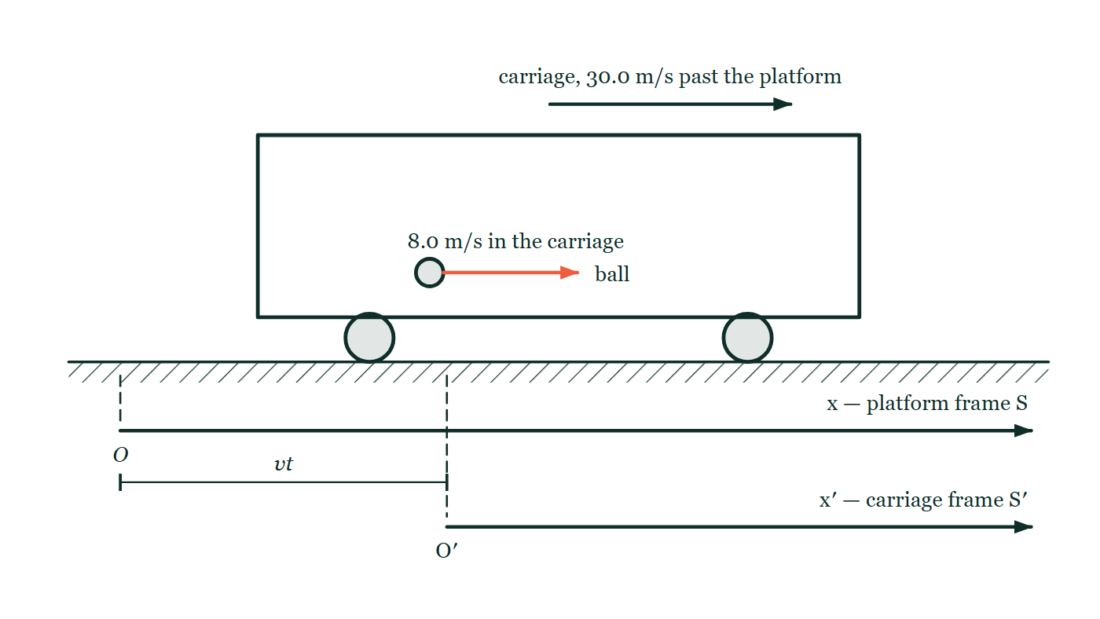
GALILEAN & SPECIAL RELATIVITY · FRAMES & GALILEAN RELATIVITY
GIOPHYSICS LESSON
THE PICTURE
One ball, two frames
Drawn for this lesson
A ball thrown at 8.0 m/s inside a carriage that is passing the platform at 30.0 m/s, with two parallel position axes drawn below it: x for the platform frame S with origin O, and x′ for the carriage frame S′ with origin O′, the gap between the two origins dimensioned.
The live version of this figure — click here
Galilean & Special Relativity — Frames & Galilean Relativity. Built by GioPhysics from the lesson's own copy; nothing on these slides is re-authored.
14 / 33
Notes:
[Phase] Build the model: The formulae, one at a time, in plain English (minutes 13–22 of 45)
[Figure] A ball thrown at 8.0 m/s inside a carriage that is passing the platform at 30.0 m/s, with two parallel position axes drawn below it: x for the platform frame S with origin O, and x′ for the carriage frame S′ with origin O′, the gap between the two origins dimensioned.

Slide 15
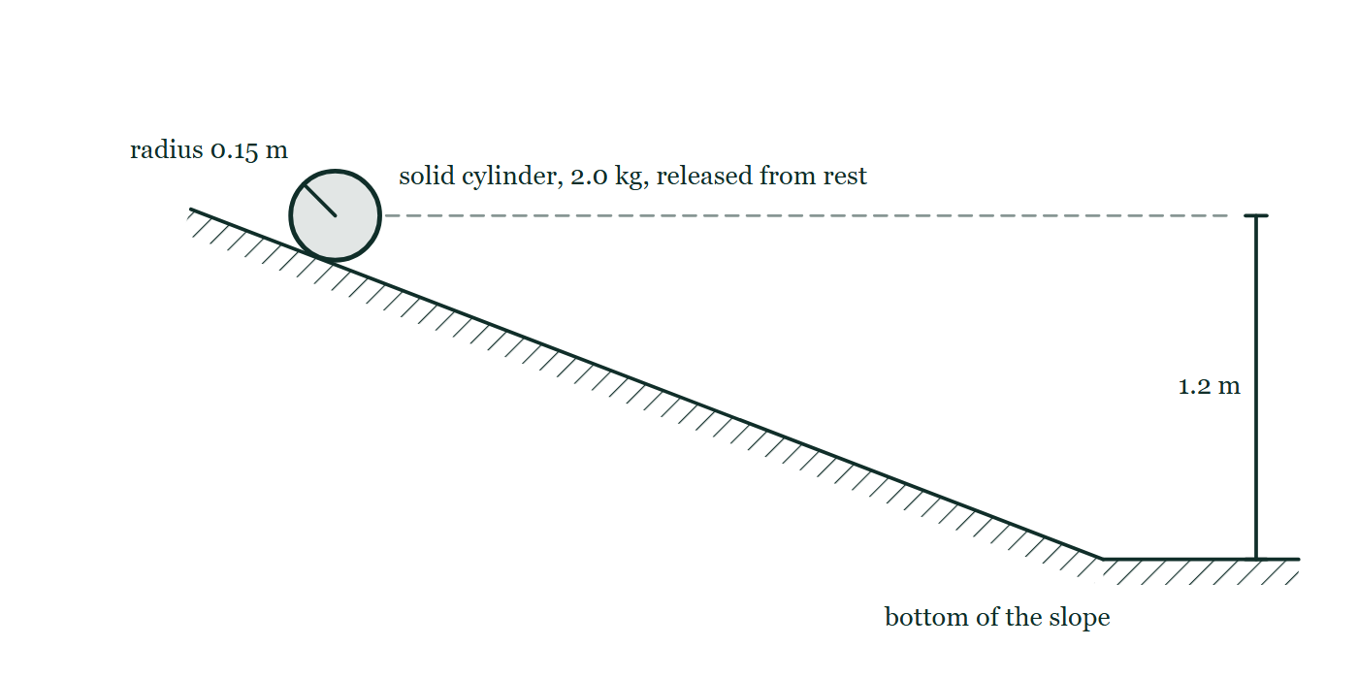
GALILEAN & SPECIAL RELATIVITY · FRAMES & GALILEAN RELATIVITY
GIOPHYSICS LESSON
FIGURE
Figure 5 — IB Theme A · Space, time and motion
Drawn for question 10 of that paper · syllabus A.4, A.5
Side view. A straight hatched slope runs down from the upper left to a horizontal surface at the lower right. A cylinder is drawn end-on resting on the slope near the top, labelled solid cylinder, 2.0 kg, released from rest, with a line from its centre to the rim labelled radius 0.15 m. A dashed horizontal line runs to the right from the level of the cylinder's centre, and a dimension line marks 1.2 m between that level and the horizontal surface at the bottom of the slope.
See the question this was drawn for — click here
Galilean & Special Relativity — Frames & Galilean Relativity. Built by GioPhysics from the lesson's own copy; nothing on these slides is re-authored.
15 / 33
Notes:
[Phase] Build the model: The formulae, one at a time, in plain English (minutes 13–22 of 45)
[Figure] Figure 5. Side view. A straight hatched slope runs down from the upper left to a horizontal surface at the lower right. A cylinder is drawn end-on resting on the slope near the top, labelled solid cylinder, 2.0 kg, released from rest, with a line from its centre to the rim labelled radius 0.15 m. A dashed horizontal line runs to the right from the level of the cylinder's centre, and a dimension line marks 1.2 m between that level and the horizontal surface at the bottom of the slope.
[Where it came from] IB Theme A · Space, time and motion, question 10; syllabus A.4, A.5.

Slide 16
GALILEAN & SPECIAL RELATIVITY · FRAMES & GALILEAN RELATIVITY
GIOPHYSICS LESSON
WATCH OUT
The common trap
Check and misconception — The quick check and the trap
Galilean relativity does not say ‘everything is relative’. Uniform velocity is relative and undetectable — but acceleration is absolute.
Slam the brakes and the standing passengers stagger; spin the frame and loose objects drift outward: no symmetry hides that. Relativity, Galilean or special, is a statement about constant-velocity frames only.
Galilean & Special Relativity — Frames & Galilean Relativity. Built by GioPhysics from the lesson's own copy; nothing on these slides is re-authored.
16 / 33
Notes:
[Phase] Check and misconception: The quick check and the trap (minutes 35–41 of 45)
[Misconception] Galilean relativity does not say ‘everything is relative’. Uniform velocity is relative and undetectable — but acceleration is absolute. Slam the brakes and the standing passengers stagger; spin the frame and loose objects drift outward: no symmetry hides that. Relativity, Galilean or special, is a statement about constant-velocity frames only.

Slide 17
GALILEAN & SPECIAL RELATIVITY · FRAMES & GALILEAN RELATIVITY
GIOPHYSICS LESSON
WORKED EXAMPLE 1 OF 2 · EASY
The question
Easy
Worked examples — I do, we do — one step revealed at a time
A passenger walks forward at 2.0 m/s along a train moving at 30.0 m/s. Find her velocity in the ground frame, and her velocity if she walks toward the rear instead.
Galilean & Special Relativity — Frames & Galilean Relativity. Built by GioPhysics from the lesson's own copy; nothing on these slides is re-authored.
17 / 33
Notes:
[Phase] Worked examples: I do, we do — one step revealed at a time (minutes 22–35 of 45)
[Question] A passenger walks forward at 2.0 m/s along a train moving at 30.0 m/s. Find her velocity in the ground frame, and her velocity if she walks toward the rear instead.
[Answer] 32.0 m/s forward; 28.0 m/s walking rearward

Slide 18
GALILEAN & SPECIAL RELATIVITY · FRAMES & GALILEAN RELATIVITY
GIOPHYSICS LESSON
WORKED EXAMPLE 1 OF 2 · EASY · THE WORKING
How to solve it
Easy
Worked examples — I do, we do — one step revealed at a time
A passenger walks forward at 2.0 m/s along a train moving at 30.0 m/s. Find her velocity in the ground frame, and her velocity if she walks toward the rear instead.
1.
Ground frame: u = u′ + v = 2.0 + 30.0 = 32.0 m/s.
2.
Walking rearward, u′ = −2.0 m/s, so u = −2.0 + 30.0 = 28.0 m/s.
3.
Both answers come from the same rule u′ = u − v, rearranged — velocities add like ordinary vectors in Galilean physics.
Galilean & Special Relativity — Frames & Galilean Relativity. Built by GioPhysics from the lesson's own copy; nothing on these slides is re-authored.
18 / 33
Notes:
[Phase] Worked examples: I do, we do — one step revealed at a time (minutes 22–35 of 45)
[Reveal] One click per step. The class works each line before the next appears.
[Step 1] Ground frame: u = u′ + v = 2.0 + 30.0 = 32.0 m/s.
[Step 2] Walking rearward, u′ = −2.0 m/s, so u = −2.0 + 30.0 = 28.0 m/s.
[Step 3] Both answers come from the same rule u′ = u − v, rearranged — velocities add like ordinary vectors in Galilean physics.

Slide 19
GALILEAN & SPECIAL RELATIVITY · FRAMES & GALILEAN RELATIVITY
GIOPHYSICS LESSON
WORKED EXAMPLE 1 OF 2 · EASY
Answer
Easy
Worked examples — I do, we do — one step revealed at a time
32.0 m/s forward; 28.0 m/s walking rearward
Galilean & Special Relativity — Frames & Galilean Relativity. Built by GioPhysics from the lesson's own copy; nothing on these slides is re-authored.
19 / 33
Notes:
[Phase] Worked examples: I do, we do — one step revealed at a time (minutes 22–35 of 45)
[Answer] 32.0 m/s forward; 28.0 m/s walking rearward

Slide 20
GALILEAN & SPECIAL RELATIVITY · FRAMES & GALILEAN RELATIVITY
GIOPHYSICS LESSON
WORKED EXAMPLE 2 OF 2 · MEDIUM
The question
Medium
Worked examples — I do, we do — one step revealed at a time
A ball is thrown at 8.0 m/s (train frame) inside a carriage doing 30.0 m/s. Where is the ball after 3.0 s in each frame? Verify the Galilean transformation connects the answers.
Galilean & Special Relativity — Frames & Galilean Relativity. Built by GioPhysics from the lesson's own copy; nothing on these slides is re-authored.
20 / 33
Notes:
[Phase] Worked examples: I do, we do — one step revealed at a time (minutes 22–35 of 45)
[Question] A ball is thrown at 8.0 m/s (train frame) inside a carriage doing 30.0 m/s. Where is the ball after 3.0 s in each frame? Verify the Galilean transformation connects the answers.
[Answer] 24.0 m (train frame), 114.0 m (ground frame), linked by x′ = x − vt

Slide 21
GALILEAN & SPECIAL RELATIVITY · FRAMES & GALILEAN RELATIVITY
GIOPHYSICS LESSON
WORKED EXAMPLE 2 OF 2 · MEDIUM · THE WORKING
How to solve it
Medium
Worked examples — I do, we do — one step revealed at a time
A ball is thrown at 8.0 m/s (train frame) inside a carriage doing 30.0 m/s. Where is the ball after 3.0 s in each frame? Verify the Galilean transformation connects the answers.
1.
Train frame: x′ = u′t = 8.0 × 3.0 = 24.0 m from the thrower.
2.
Ground frame: u = 38.0 m/s, so x = 38.0 × 3.0 = 114.0 m.
3.
Check: x′ = x − vt = 114.0 − 30.0 × 3.0 = 24.0 m ✓ — same event, two coordinate grids.
Galilean & Special Relativity — Frames & Galilean Relativity. Built by GioPhysics from the lesson's own copy; nothing on these slides is re-authored.
21 / 33
Notes:
[Phase] Worked examples: I do, we do — one step revealed at a time (minutes 22–35 of 45)
[Reveal] One click per step. The class works each line before the next appears.
[Step 1] Train frame: x′ = u′t = 8.0 × 3.0 = 24.0 m from the thrower.
[Step 2] Ground frame: u = 38.0 m/s, so x = 38.0 × 3.0 = 114.0 m.
[Step 3] Check: x′ = x − vt = 114.0 − 30.0 × 3.0 = 24.0 m ✓ — same event, two coordinate grids.

Slide 22
GALILEAN & SPECIAL RELATIVITY · FRAMES & GALILEAN RELATIVITY
GIOPHYSICS LESSON
WORKED EXAMPLE 2 OF 2 · MEDIUM
Answer
Medium
Worked examples — I do, we do — one step revealed at a time
24.0 m (train frame), 114.0 m (ground frame), linked by x′ = x − vt
Galilean & Special Relativity — Frames & Galilean Relativity. Built by GioPhysics from the lesson's own copy; nothing on these slides is re-authored.
22 / 33
Notes:
[Phase] Worked examples: I do, we do — one step revealed at a time (minutes 22–35 of 45)
[Answer] 24.0 m (train frame), 114.0 m (ground frame), linked by x′ = x − vt

Slide 23
GALILEAN & SPECIAL RELATIVITY · FRAMES & GALILEAN RELATIVITY
GIOPHYSICS LESSON
PREDICT · TAKE THE VOTE
Commit before you are told
Hands up for each option, then click
The carriage now brakes hard. The ball, touched by nobody, rolls forward along the floor. What does that tell you about frame S′?
A Nothing — mechanics is the same in every frame, so a rolling ball is allowed
B S′ has stopped being inertial, and unlike uniform velocity, acceleration is detectable from inside
C The ball was pushed by the air moving forward in the carriage
A ball thrown at 8.0 m/s inside a carriage that is passing the platform at 30.0 m/s, with two parallel position axes drawn below it: x for the platform frame S with origin O, and x′ for the carriage frame S′ with origin O′, the gap between the two origins dimensioned.
The live version of this figure — click here
Galilean & Special Relativity — Frames & Galilean Relativity. Built by GioPhysics from the lesson's own copy; nothing on these slides is re-authored.
23 / 33
Notes:
[Phase] Build the model: The formulae, one at a time, in plain English (minutes 13–22 of 45)
[Predict] The carriage now brakes hard. The ball, touched by nobody, rolls forward along the floor. What does that tell you about frame S′?
[Options] A Nothing — mechanics is the same in every frame, so a rolling ball is allowed B S′ has stopped being inertial, and unlike uniform velocity, acceleration is detectable from inside C The ball was pushed by the air moving forward in the carriage
[Figure] A ball thrown at 8.0 m/s inside a carriage that is passing the platform at 30.0 m/s, with two parallel position axes drawn below it: x for the platform frame S with origin O, and x′ for the carriage frame S′ with origin O′, the gap between the two origins dimensioned.

Slide 24
GALILEAN & SPECIAL RELATIVITY · FRAMES & GALILEAN RELATIVITY
GIOPHYSICS LESSON
PREDICT · THE OUTCOME
What actually happens
Ask the room who changed their mind, and why
B S′ has stopped being inertial, and unlike uniform velocity, acceleration is detectable from inside
WHY
While the carriage held 30.0 m/s, x′ = x − vt with v constant gave a′ = a, and the ball obeyed Newton's laws in both frames. Braking breaks that: v is no longer constant, the transformation acquires an acceleration, and a ball with no force on it changes velocity in S′. Galilean relativity is a statement about constant-velocity frames only — uniform motion is relative, acceleration is absolute, and the staggering passengers prove it.
Galilean & Special Relativity — Frames & Galilean Relativity. Built by GioPhysics from the lesson's own copy; nothing on these slides is re-authored.
24 / 33
Notes:
[Phase] Build the model: The formulae, one at a time, in plain English (minutes 13–22 of 45)
[Answer] B — S′ has stopped being inertial, and unlike uniform velocity, acceleration is detectable from inside. While the carriage held 30.0 m/s, x′ = x − vt with v constant gave a′ = a, and the ball obeyed Newton's laws in both frames. Braking breaks that: v is no longer constant, the transformation acquires an acceleration, and a ball with no force on it changes velocity in S′. Galilean relativity is a statement about constant-velocity frames only — uniform motion is relative, acceleration is absolute, and the staggering passengers prove it.

Slide 25
GALILEAN & SPECIAL RELATIVITY · FRAMES & GALILEAN RELATIVITY
GIOPHYSICS LESSON
QUICK CHECK
Decide before the answer goes up
Check and misconception — The quick check and the trap
You are sealed in a windowless cabin moving at constant velocity. Which experiment can reveal your speed?
A
Timing a pendulum very precisely
B
Dropping a ball and watching where it lands
C
None — every mechanics experiment comes out the same
Galilean & Special Relativity — Frames & Galilean Relativity. Built by GioPhysics from the lesson's own copy; nothing on these slides is re-authored.
25 / 33
Notes:
[Phase] Check and misconception: The quick check and the trap (minutes 35–41 of 45)
[Question] You are sealed in a windowless cabin moving at constant velocity. Which experiment can reveal your speed?
[Options] A Timing a pendulum very precisely B Dropping a ball and watching where it lands C None — every mechanics experiment comes out the same

Slide 26
GALILEAN & SPECIAL RELATIVITY · FRAMES & GALILEAN RELATIVITY
GIOPHYSICS LESSON
QUICK CHECK · THE ANSWER
The answer, and why
Check and misconception — The quick check and the trap
C None — every mechanics experiment comes out the same
HOW TO GET THERE
a′ = a means both frames agree on every force and every trajectory. Uniform motion leaves no mechanical fingerprint — that is the Galilean principle of relativity.
WHY THE OTHERS TEMPT
A The pendulum's period is 2π√(L/g), and both L and g are exactly what they were on the ground — the precision does not help, because there is no small effect hiding under it. Adding "very precisely" to an experiment cannot create a quantity that the physics does not contain.
B This is the experiment Galileo actually described, and it comes out the same as on the platform: the ball shares the cabin's velocity and lands at your feet. It is the demonstration of the principle rather than a test that could break it.
C Correct. Since a′ = a, every frame agrees on every force and every trajectory, so no mechanics experiment can single out one frame as the one at rest.
Galilean & Special Relativity — Frames & Galilean Relativity. Built by GioPhysics from the lesson's own copy; nothing on these slides is re-authored.
26 / 33
Notes:
[Phase] Check and misconception: The quick check and the trap (minutes 35–41 of 45)
[Question] You are sealed in a windowless cabin moving at constant velocity. Which experiment can reveal your speed?
[Option by option] A: The pendulum's period is 2π√(L/g), and both L and g are exactly what they were on the ground — the precision does not help, because there is no small effect hiding under it. Adding "very precisely" to an experiment cannot create a quantity that the physics does not contain. B: This is the experiment Galileo actually described, and it comes out the same as on the platform: the ball shares the cabin's velocity and lands at your feet. It is the demonstration of the principle rather than a test that could break it. C: Correct. Since a′ = a, every frame agrees on every force and every trajectory, so no mechanics experiment can single out one frame as the one at rest.
[Answer] C — None — every mechanics experiment comes out the same
[Why] a′ = a means both frames agree on every force and every trajectory. Uniform motion leaves no mechanical fingerprint — that is the Galilean principle of relativity.
[Reveal] One click for the answer, then one for the reason.

Slide 27
GALILEAN & SPECIAL RELATIVITY · FRAMES & GALILEAN RELATIVITY
GIOPHYSICS LESSON
EXTENSION 1 OF 2 · HARD
The question
Hard
Worked examples — I do, we do — one step revealed at a time
Maxwell’s equations give c = 1/√(μ₀ε₀) = 3.00 × 10⁸ m/s with no reference frame specified. The Earth orbits the Sun at 30 km/s. What fractional change in the measured speed of light did Galilean physics predict across the year, and why was that a crisis?
Galilean & Special Relativity — Frames & Galilean Relativity. Built by GioPhysics from the lesson's own copy; nothing on these slides is re-authored.
27 / 33
Notes:
[Phase] Worked examples: I do, we do — one step revealed at a time (minutes 22–35 of 45)
[Question] Maxwell’s equations give c = 1/√(μ₀ε₀) = 3.00 × 10⁸ m/s with no reference frame specified. The Earth orbits the Sun at 30 km/s. What fractional change in the measured speed of light did Galilean physics predict across the year, and why was that a crisis?
[Answer] A ±1 × 10⁻⁴ seasonal shift was predicted; Maxwell’s frame-free c said there should be none

Slide 28
GALILEAN & SPECIAL RELATIVITY · FRAMES & GALILEAN RELATIVITY
GIOPHYSICS LESSON
EXTENSION 1 OF 2 · HARD · THE WORKING
How to solve it
Hard
Worked examples — I do, we do — one step revealed at a time
Maxwell’s equations give c = 1/√(μ₀ε₀) = 3.00 × 10⁸ m/s with no reference frame specified. The Earth orbits the Sun at 30 km/s. What fractional change in the measured speed of light did Galilean physics predict across the year, and why was that a crisis?
1.
Galilean addition: measured speed should be c ± v depending on the direction of travel through the supposed aether.
2.
Fractional shift: v/c = 3.0 × 10⁴ ÷ 3.0 × 10⁸ = 1.0 × 10⁻⁴ — one part in ten thousand, reversing over six months.
3.
But Maxwell’s c is built only from μ₀ and ε₀, constants with no v in them. Either Maxwell’s equations were wrong in moving frames, or the Galilean transformation was. Interferometers were precise enough to referee — see 27.2.
Galilean & Special Relativity — Frames & Galilean Relativity. Built by GioPhysics from the lesson's own copy; nothing on these slides is re-authored.
28 / 33
Notes:
[Phase] Worked examples: I do, we do — one step revealed at a time (minutes 22–35 of 45)
[Reveal] One click per step. The class works each line before the next appears.
[Step 1] Galilean addition: measured speed should be c ± v depending on the direction of travel through the supposed aether.
[Step 2] Fractional shift: v/c = 3.0 × 10⁴ ÷ 3.0 × 10⁸ = 1.0 × 10⁻⁴ — one part in ten thousand, reversing over six months.
[Step 3] But Maxwell’s c is built only from μ₀ and ε₀, constants with no v in them. Either Maxwell’s equations were wrong in moving frames, or the Galilean transformation was. Interferometers were precise enough to referee — see 27.2.

Slide 29
GALILEAN & SPECIAL RELATIVITY · FRAMES & GALILEAN RELATIVITY
GIOPHYSICS LESSON
EXTENSION 1 OF 2 · HARD
Answer
Hard
Worked examples — I do, we do — one step revealed at a time
A ±1 × 10⁻⁴ seasonal shift was predicted; Maxwell’s frame-free c said there should be none
Galilean & Special Relativity — Frames & Galilean Relativity. Built by GioPhysics from the lesson's own copy; nothing on these slides is re-authored.
29 / 33
Notes:
[Phase] Worked examples: I do, we do — one step revealed at a time (minutes 22–35 of 45)
[Answer] A ±1 × 10⁻⁴ seasonal shift was predicted; Maxwell’s frame-free c said there should be none

Slide 30
GALILEAN & SPECIAL RELATIVITY · FRAMES & GALILEAN RELATIVITY
GIOPHYSICS LESSON
EXTENSION 2 OF 2 · CHALLENGING
The question
Challenging
Worked examples — I do, we do — one step revealed at a time
Starting from u′ = u − v with v constant, show that both frames agree on accelerations and hence on Newton’s second law — and identify the single assumption that special relativity will later abandon.
Galilean & Special Relativity — Frames & Galilean Relativity. Built by GioPhysics from the lesson's own copy; nothing on these slides is re-authored.
30 / 33
Notes:
[Phase] Worked examples: I do, we do — one step revealed at a time (minutes 22–35 of 45)
[Question] Starting from u′ = u − v with v constant, show that both frames agree on accelerations and hence on Newton’s second law — and identify the single assumption that special relativity will later abandon.
[Answer] a′ = a follows, so mechanics is frame-blind; the buried assumption is universal time t′ = t

Slide 31
GALILEAN & SPECIAL RELATIVITY · FRAMES & GALILEAN RELATIVITY
GIOPHYSICS LESSON
EXTENSION 2 OF 2 · CHALLENGING · THE WORKING
How to solve it
Challenging
Worked examples — I do, we do — one step revealed at a time
Starting from u′ = u − v with v constant, show that both frames agree on accelerations and hence on Newton’s second law — and identify the single assumption that special relativity will later abandon.
1.
Differentiate with respect to time: du′/dt = du/dt − 0, so a′ = a — the constant v vanishes.
2.
With identical masses and forces, F = ma holds in both frames: no mechanics experiment can distinguish them. Galilean relativity is proved, not assumed, for mechanics.
3.
The derivation silently used t′ = t — the same clock for all observers, which let us differentiate both sides ‘with respect to time’ as if time were shared. That is the assumption Einstein drops: once simultaneity is frame-dependent, u′ = u − v must be rebuilt (27.4).
Galilean & Special Relativity — Frames & Galilean Relativity. Built by GioPhysics from the lesson's own copy; nothing on these slides is re-authored.
31 / 33
Notes:
[Phase] Worked examples: I do, we do — one step revealed at a time (minutes 22–35 of 45)
[Reveal] One click per step. The class works each line before the next appears.
[Step 1] Differentiate with respect to time: du′/dt = du/dt − 0, so a′ = a — the constant v vanishes.
[Step 2] With identical masses and forces, F = ma holds in both frames: no mechanics experiment can distinguish them. Galilean relativity is proved, not assumed, for mechanics.
[Step 3] The derivation silently used t′ = t — the same clock for all observers, which let us differentiate both sides ‘with respect to time’ as if time were shared. That is the assumption Einstein drops: once simultaneity is frame-dependent, u′ = u − v must be rebuilt (27.4).

Slide 32
GALILEAN & SPECIAL RELATIVITY · FRAMES & GALILEAN RELATIVITY
GIOPHYSICS LESSON
EXTENSION 2 OF 2 · CHALLENGING
Answer
Challenging
Worked examples — I do, we do — one step revealed at a time
a′ = a follows, so mechanics is frame-blind; the buried assumption is universal time t′ = t
Galilean & Special Relativity — Frames & Galilean Relativity. Built by GioPhysics from the lesson's own copy; nothing on these slides is re-authored.
32 / 33
Notes:
[Phase] Worked examples: I do, we do — one step revealed at a time (minutes 22–35 of 45)
[Answer] a′ = a follows, so mechanics is frame-blind; the buried assumption is universal time t′ = t

Slide 33
GALILEAN & SPECIAL RELATIVITY · FRAMES & GALILEAN RELATIVITY
GIOPHYSICS LESSON
GALILEAN & SPECIAL RELATIVITY
Where to go next
Plenary — What to take away, what to practise next
Next
27.2 The Postulates of Special Relativity
https://giophysics.com/chapter-52/relativity-postulates/
Lesson
This lesson on giophysics.com
https://giophysics.com/chapter-52/galilean-relativity/
Live
The live, interactive version of these slides
https://giophysics.com/chapter-52/presentation/?lesson=galilean
Chapter
All Galilean & Special Relativity lessons
https://giophysics.com/chapter-52/
PDF
Download the lesson PDF
https://giophysics.com/downloads/52-1-galilean-relativity.pdf
Galilean & Special Relativity — Frames & Galilean Relativity. Built by GioPhysics from the lesson's own copy; nothing on these slides is re-authored.
33 / 33
Notes:
[Phase] Plenary: What to take away, what to practise next (minutes 41–45 of 45)
[Interactive] The graphs and the circuit topology on these slides are frozen. The live version at https://giophysics.com/chapter-52/presentation/?lesson=galilean moves them.

