Slide 1
SPACE & STARS PHYSICS · MEASURING THE UNIVERSE
GIOPHYSICS LESSON
28 · Space & Stars Physics
A ladder built one rung at a time
Measuring the Universe
No tape measure reaches the stars, so astronomers built a ladder. Rung one: geometry — watch a nearby star shift against the background as the Earth swings around its orbit. Rung two: physics — find objects whose true brightness is known, and let the inverse square law read off the distance. Each rung stands on the one below it, all the way to the edge of the observable universe.
POSITION
Lesson 4 of 6 in Space & Stars Physics
PLAN
16 slides in the 45-minute core run, about 45 minutes of it
LESSON PAGE
https://giophysics.com/chapter-53/cosmic-distances/
Built by GioPhysics from the lesson's own page. Every word on these slides is the lesson's; nothing here is re-authored. Teaching material, not an awarding body's document.
Space & Stars Physics — Measuring the Universe. Built by GioPhysics from the lesson's own copy; nothing on these slides is re-authored.
1 / 32
Notes:
[Lesson] Space & Stars Physics — Measuring the Universe. Lesson 4 of 6.
[Intro] No tape measure reaches the stars, so astronomers built a ladder. Rung one: geometry — watch a nearby star shift against the background as the Earth swings around its orbit. Rung two: physics — find objects whose true brightness is known, and let the inverse square law read off the distance. Each rung stands on the one below it, all the way to the edge of the observable universe.
[Source] https://giophysics.com/chapter-53/cosmic-distances/
[Disclaimer] Built by GioPhysics from the lesson's own page. Every word on these slides is the lesson's; nothing here is re-authored. Teaching material, not an awarding body's document.

Slide 2
SPACE & STARS PHYSICS · MEASURING THE UNIVERSE
GIOPHYSICS LESSON
WHAT THIS NEEDS
What you already know
Starter — Recall what this lesson stands on
Recall
The HR diagram (luminosity)
https://giophysics.com/chapter-53/hr-diagram/
Recall
Electromagnetic waves
https://giophysics.com/chapter-24/electromagnetic-waves/
Space & Stars Physics — Measuring the Universe. Built by GioPhysics from the lesson's own copy; nothing on these slides is re-authored.
2 / 32
Notes:
[Phase] Starter: Recall what this lesson stands on (minutes 0–5 of 45)
[Starter] Recall: The HR diagram (luminosity); Electromagnetic waves

Slide 3
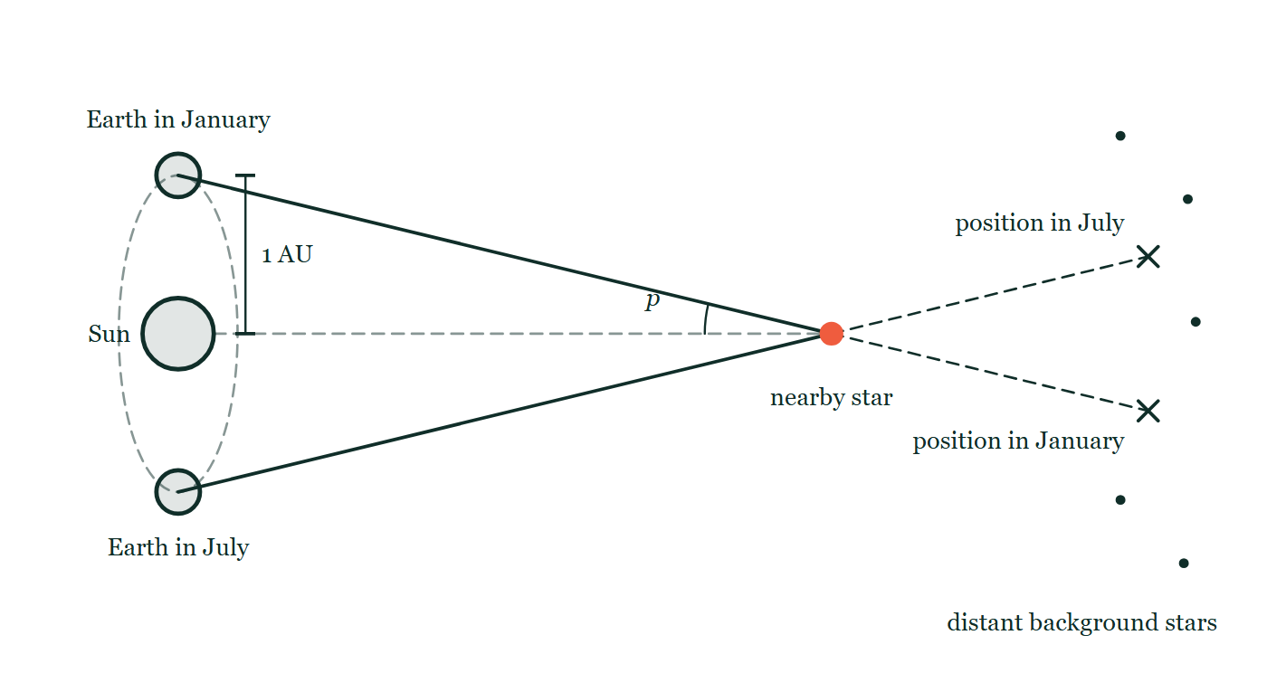
SPACE & STARS PHYSICS · MEASURING THE UNIVERSE
GIOPHYSICS LESSON
THINK FIRST
How would you measure the distance to a star without leaving your chair — using only a camera in January and the same camera in July?
Take answers before you click — the point is the commitment
You cannot send anything there, you cannot bounce anything off it, and light from it has been travelling for years before it arrives. All you will ever have is two photographs.
THE ANSWER
By parallax. Between January and July the Earth moves to the far side of its orbit, giving you a baseline of 2 AU — the biggest pair of eyes anyone has — and a nearby star shifts against the distant background. Half that shift is the parallax angle p, and d = 1/p gives the distance in parsecs straight away.
The Earth drawn at its January and July positions on opposite sides of the Sun, 1 AU marked from the Sun to one of them, and two sight lines from those positions to a nearby star carried on past it to a field of distant background stars, with the parallax angle p marked at the star where it is subtended.
The live version of this figure — click here
Space & Stars Physics — Measuring the Universe. Built by GioPhysics from the lesson's own copy; nothing on these slides is re-authored.
3 / 32
Notes:
[Phase] Starter: Recall what this lesson stands on (minutes 0–5 of 45)
[Hook] How would you measure the distance to a star without leaving your chair — using only a camera in January and the same camera in July? You cannot send anything there, you cannot bounce anything off it, and light from it has been travelling for years before it arrives. All you will ever have is two photographs.
[Answer] By parallax. Between January and July the Earth moves to the far side of its orbit, giving you a baseline of 2 AU — the biggest pair of eyes anyone has — and a nearby star shifts against the distant background. Half that shift is the parallax angle p, and d = 1/p gives the distance in parsecs straight away.
[Figure] The Earth drawn at its January and July positions on opposite sides of the Sun, 1 AU marked from the Sun to one of them, and two sight lines from those positions to a nearby star carried on past it to a field of distant background stars, with the parallax angle p marked at the star where it is subtended.

Slide 4
SPACE & STARS PHYSICS · MEASURING THE UNIVERSE
GIOPHYSICS LESSON
EXPLAINED SIMPLY
In one sentence
Introduce the idea — The big idea and the definition
Stellar distances come from parallax — d = 1/p, with d in parsecs and p in arcseconds — for nearby stars, and from standard candles plus the inverse square law b = L/4πd² for everything beyond.
Space & Stars Physics — Measuring the Universe. Built by GioPhysics from the lesson's own copy; nothing on these slides is re-authored.
4 / 32
Notes:
[Phase] Introduce the idea: The big idea and the definition (minutes 5–13 of 45)
[Definition] Stellar distances come from parallax — d = 1/p, with d in parsecs and p in arcseconds — for nearby stars, and from standard candles plus the inverse square law b = L/4πd² for everything beyond.

Slide 5
SPACE & STARS PHYSICS · MEASURING THE UNIVERSE
GIOPHYSICS LESSON
EXPLAINED SIMPLY
What that looks like
Introduce the idea — The big idea and the definition
FOR EXAMPLE
Proxima Centauri shows a parallax of 0.768 arcseconds, so d = 1/0.768 = 1.30 pc = 4.25 light-years — the nearest star, and the ladder’s first firmly measured rung.
Space & Stars Physics — Measuring the Universe. Built by GioPhysics from the lesson's own copy; nothing on these slides is re-authored.
5 / 32
Notes:
[Phase] Introduce the idea: The big idea and the definition (minutes 5–13 of 45)
[Worked illustration] Proxima Centauri shows a parallax of 0.768 arcseconds, so d = 1/0.768 = 1.30 pc = 4.25 light-years — the nearest star, and the ladder’s first firmly measured rung.

Slide 6
SPACE & STARS PHYSICS · MEASURING THE UNIVERSE
GIOPHYSICS LESSON
THE BIG IDEA
A ladder built one rung at a time
Introduce the idea — The big idea and the definition
Astronomy needs its own units: the astronomical unit (1 AU = 1.5 × 10¹¹ m, the Earth–Sun distance), the light-year (9.5 × 10¹⁵ m, the distance light travels in a year), and the parsec (3.26 ly), defined by parallax itself. Stellar parallax is the apparent shift of a nearby star against distant background stars as the Earth moves from one side of its orbit to the other; half the total angular shift is the parallax angle p, and d = 1/p gives the distance in parsecs when p is in arcseconds. Parallax fades below measurability beyond a few thousand parsecs, so the ladder continues with standard candles — objects of known luminosity.
Measure apparent brightness b, and the inverse square law b = L/4πd² returns the distance. Cepheid variables (whose pulsation period reveals their luminosity) reach nearby galaxies; Type Ia supernovae (exploding white dwarfs with a near-uniform peak luminosity) reach billions of light-years. Every rung is calibrated by the rung below — and inherits its uncertainties.
Space & Stars Physics — Measuring the Universe. Built by GioPhysics from the lesson's own copy; nothing on these slides is re-authored.
6 / 32
Notes:
[Phase] Introduce the idea: The big idea and the definition (minutes 5–13 of 45)
[Big idea] Astronomy needs its own units: the astronomical unit (1 AU = 1.5 × 10¹¹ m, the Earth–Sun distance), the light-year (9.5 × 10¹⁵ m, the distance light travels in a year), and the parsec (3.26 ly), defined by parallax itself. Stellar parallax is the apparent shift of a nearby star against distant background stars as the Earth moves from one side of its orbit to the other; half the total angular shift is the parallax angle p, and d = 1/p gives the distance in parsecs when p is in arcseconds. Parallax fades below measurability beyond a few thousand parsecs, so the ladder continues with standard candles — objects of known luminosity. Measure apparent brightness b, and the inverse square law b = L/4πd² returns the distance. Cepheid variables (whose pulsation period reveals their luminosity) reach nearby galaxies; Type Ia supernovae (exploding white dwarfs with a near-uniform peak luminosity) reach billions of light-years. Every rung is calibrated by the rung below — and inherits its uncertainties.

Slide 7
SPACE & STARS PHYSICS · MEASURING THE UNIVERSE
GIOPHYSICS LESSON
THE PHYSICS · 1 OF 3
Parallax: distance from pure geometry
Build the model — The formulae, one at a time, in plain English
Hold up a thumb and blink one eye then the other — it jumps against the background. The Earth’s orbit gives astronomy a 2 AU ‘eye separation’: photograph a star field in January and July and the nearby stars shift slightly against the distant ones. The angles are tiny — under one arcsecond, a coin seen from kilometres away — which is why space telescopes matter: Gaia measures microarcseconds, extending the geometric rung to a good slice of the galaxy.
Space & Stars Physics — Measuring the Universe. Built by GioPhysics from the lesson's own copy; nothing on these slides is re-authored.
7 / 32
Notes:
[Phase] Build the model: The formulae, one at a time, in plain English (minutes 13–22 of 45)
[Section] Hold up a thumb and blink one eye then the other — it jumps against the background. The Earth’s orbit gives astronomy a 2 AU ‘eye separation’: photograph a star field in January and July and the nearby stars shift slightly against the distant ones. The angles are tiny — under one arcsecond, a coin seen from kilometres away — which is why space telescopes matter: Gaia measures microarcseconds, extending the geometric rung to a good slice of the galaxy.

Slide 8
SPACE & STARS PHYSICS · MEASURING THE UNIVERSE
GIOPHYSICS LESSON
THE PHYSICS · 2 OF 3
Standard candles: distance from physics
Build the model — The formulae, one at a time, in plain English
If you know a bulb is 100 W, its apparent dimness tells you how far away it is. Cepheid variables are the classic astronomical bulb: their brightness pulses with a period locked to their luminosity (discovered by Henrietta Leavitt in 1912), so timing the pulse reveals L, and b = L/4πd² does the rest. Type Ia supernovae go further: a white dwarf pushed past 1.4 solar masses detonates with nearly the same peak luminosity every time — a candle bright enough to be seen across billions of light-years.
Space & Stars Physics — Measuring the Universe. Built by GioPhysics from the lesson's own copy; nothing on these slides is re-authored.
8 / 32
Notes:
[Phase] Build the model: The formulae, one at a time, in plain English (minutes 13–22 of 45)
[Section] If you know a bulb is 100 W, its apparent dimness tells you how far away it is. Cepheid variables are the classic astronomical bulb: their brightness pulses with a period locked to their luminosity (discovered by Henrietta Leavitt in 1912), so timing the pulse reveals L, and b = L/4πd² does the rest. Type Ia supernovae go further: a white dwarf pushed past 1.4 solar masses detonates with nearly the same peak luminosity every time — a candle bright enough to be seen across billions of light-years.

Slide 9
SPACE & STARS PHYSICS · MEASURING THE UNIVERSE
GIOPHYSICS LESSON
THE PHYSICS · 3 OF 3
The ladder, rung by rung
Build the model — The formulae, one at a time, in plain English
Radar ranging fixes the AU. Parallax, calibrated in AU, fixes distances to nearby Cepheids.
Those Cepheids calibrate the period–luminosity law, which fixes distances to galaxies containing both Cepheids and Type Ia supernovae — which then calibrate the supernovae for the deep universe. Each rung inherits the errors of every rung beneath it, which is why astronomers obsess over the low rungs: a 1% shift in parallax calibration moves the measured size of the entire universe by 1%.
Space & Stars Physics — Measuring the Universe. Built by GioPhysics from the lesson's own copy; nothing on these slides is re-authored.
9 / 32
Notes:
[Phase] Build the model: The formulae, one at a time, in plain English (minutes 13–22 of 45)
[Section] Radar ranging fixes the AU. Parallax, calibrated in AU, fixes distances to nearby Cepheids. Those Cepheids calibrate the period–luminosity law, which fixes distances to galaxies containing both Cepheids and Type Ia supernovae — which then calibrate the supernovae for the deep universe. Each rung inherits the errors of every rung beneath it, which is why astronomers obsess over the low rungs: a 1% shift in parallax calibration moves the measured size of the entire universe by 1%.

Slide 10
SPACE & STARS PHYSICS · MEASURING THE UNIVERSE
GIOPHYSICS LESSON
FORMULA 1 OF 3
Parallax distance
Build the model — The formulae, one at a time, in plain English
d = 1/p
d in parsecs when p is in arcseconds
IN PLAIN ENGLISH
A parsec is defined as the distance at which the Earth–Sun radius subtends one arcsecond. Halve the parallax and you double the distance — nearby stars wobble more.
Space & Stars Physics — Measuring the Universe. Built by GioPhysics from the lesson's own copy; nothing on these slides is re-authored.
10 / 32
Notes:
[Phase] Build the model: The formulae, one at a time, in plain English (minutes 13–22 of 45)
[Formula] Parallax distance: d = 1/p
[In plain English] A parsec is defined as the distance at which the Earth–Sun radius subtends one arcsecond. Halve the parallax and you double the distance — nearby stars wobble more.
[Note] d in parsecs when p is in arcseconds

Slide 11
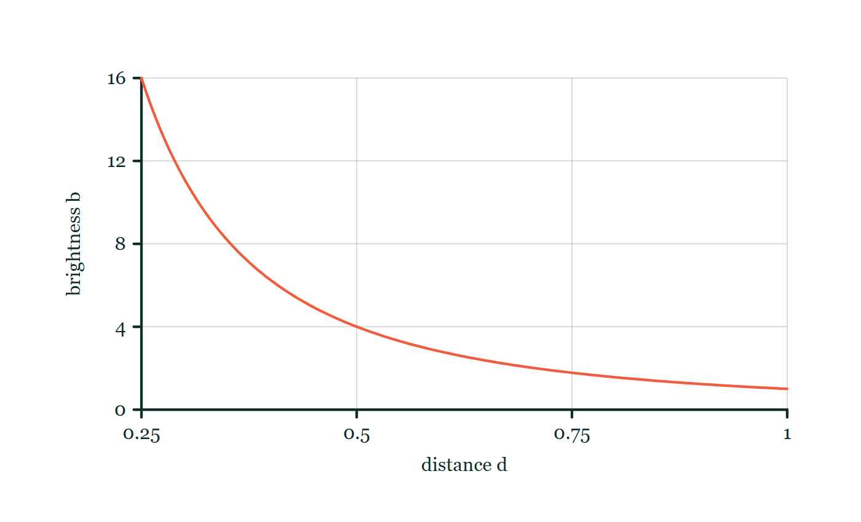
SPACE & STARS PHYSICS · MEASURING THE UNIVERSE
GIOPHYSICS LESSON
FORMULA 2 OF 3
Inverse square law
Build the model — The formulae, one at a time, in plain English
b = L/4πd²
b = apparent brightness, W/m²
IN PLAIN ENGLISH
A star’s light spreads over a sphere of area 4πd². Know the true luminosity L and measure b, and the distance falls out — the engine of every standard candle.
Brightness with distance
Move this graph on the live version — click here
Space & Stars Physics — Measuring the Universe. Built by GioPhysics from the lesson's own copy; nothing on these slides is re-authored.
11 / 32
Notes:
[Phase] Build the model: The formulae, one at a time, in plain English (minutes 13–22 of 45)
[Formula] Inverse square law: b = L/4πd²
[In plain English] A star’s light spreads over a sphere of area 4πd². Know the true luminosity L and measure b, and the distance falls out — the engine of every standard candle.
[Note] b = apparent brightness, W/m²
[Graph] Brightness with distance. For fixed luminosity, doubling distance reduces observed brightness to one quarter.
[Axes] Horizontal: distance d. Vertical: brightness b. Values are normalised — the graph teaches the shape, not a measurement.

Slide 12
SPACE & STARS PHYSICS · MEASURING THE UNIVERSE
GIOPHYSICS LESSON
FORMULA 3 OF 3
The units
Build the model — The formulae, one at a time, in plain English
1 pc = 3.26 ly = 3.09 × 10¹⁶ m
1 ly = 9.5 × 10¹⁵ m, 1 AU = 1.5 × 10¹¹ m
IN PLAIN ENGLISH
A light-year is a distance, not a time. The AU rules the Solar System, the light-year rules headlines, and the parsec rules the research papers.
Space & Stars Physics — Measuring the Universe. Built by GioPhysics from the lesson's own copy; nothing on these slides is re-authored.
12 / 32
Notes:
[Phase] Build the model: The formulae, one at a time, in plain English (minutes 13–22 of 45)
[Formula] The units: 1 pc = 3.26 ly = 3.09 × 10¹⁶ m
[In plain English] A light-year is a distance, not a time. The AU rules the Solar System, the light-year rules headlines, and the parsec rules the research papers.
[Note] 1 ly = 9.5 × 10¹⁵ m, 1 AU = 1.5 × 10¹¹ m

Slide 13
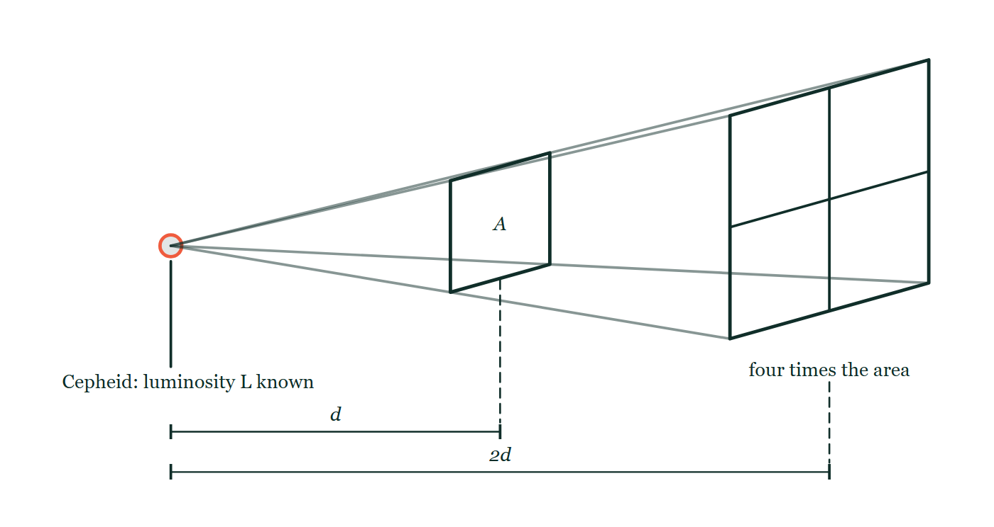
SPACE & STARS PHYSICS · MEASURING THE UNIVERSE
GIOPHYSICS LESSON
THE PICTURE
Spreading over four times the area
Drawn for this lesson
A Cepheid of known luminosity L at the apex of a cone of light, four rays drawn from it through the corners of a square of area A at distance d and continuing to a square at distance 2d that is four times the area, with no brightness written on either square.
The live version of this figure — click here
Space & Stars Physics — Measuring the Universe. Built by GioPhysics from the lesson's own copy; nothing on these slides is re-authored.
13 / 32
Notes:
[Phase] Build the model: The formulae, one at a time, in plain English (minutes 13–22 of 45)
[Figure] A Cepheid of known luminosity L at the apex of a cone of light, four rays drawn from it through the corners of a square of area A at distance d and continuing to a square at distance 2d that is four times the area, with no brightness written on either square.

Slide 14
SPACE & STARS PHYSICS · MEASURING THE UNIVERSE
GIOPHYSICS LESSON
WATCH OUT
The common trap
Check and misconception — The quick check and the trap
A light-year measures distance, not time — it is how far light travels in a year, about 9.5 × 10¹⁵ m. And a larger parallax means a CLOSER star, not a farther one: d = 1/p is a reciprocal, so the nearest stars wobble the most. Distant stars barely shift at all — which is exactly why they can serve as the fixed background.
Space & Stars Physics — Measuring the Universe. Built by GioPhysics from the lesson's own copy; nothing on these slides is re-authored.
14 / 32
Notes:
[Phase] Check and misconception: The quick check and the trap (minutes 35–41 of 45)
[Misconception] A light-year measures distance, not time — it is how far light travels in a year, about 9.5 × 10¹⁵ m. And a larger parallax means a CLOSER star, not a farther one: d = 1/p is a reciprocal, so the nearest stars wobble the most. Distant stars barely shift at all — which is exactly why they can serve as the fixed background.

Slide 15
SPACE & STARS PHYSICS · MEASURING THE UNIVERSE
GIOPHYSICS LESSON
WORKED EXAMPLE 1 OF 2 · EASY
The question
Easy
Worked examples — I do, we do — one step revealed at a time
Proxima Centauri has a parallax of 0.768 arcseconds. Find its distance in parsecs and light-years.
Space & Stars Physics — Measuring the Universe. Built by GioPhysics from the lesson's own copy; nothing on these slides is re-authored.
15 / 32
Notes:
[Phase] Worked examples: I do, we do — one step revealed at a time (minutes 22–35 of 45)
[Question] Proxima Centauri has a parallax of 0.768 arcseconds. Find its distance in parsecs and light-years.
[Answer] 1.30 pc = 4.25 light-years

Slide 16
SPACE & STARS PHYSICS · MEASURING THE UNIVERSE
GIOPHYSICS LESSON
WORKED EXAMPLE 1 OF 2 · EASY · THE WORKING
How to solve it
Easy
Worked examples — I do, we do — one step revealed at a time
Proxima Centauri has a parallax of 0.768 arcseconds. Find its distance in parsecs and light-years.
1.
d = 1/p = 1 ÷ 0.768 = 1.30 pc.
2.
In light-years: 1.30 × 3.26 = 4.25 ly.
3.
The nearest star beyond the Sun — and its parallax is still under a thousandth of a degree.
Space & Stars Physics — Measuring the Universe. Built by GioPhysics from the lesson's own copy; nothing on these slides is re-authored.
16 / 32
Notes:
[Phase] Worked examples: I do, we do — one step revealed at a time (minutes 22–35 of 45)
[Reveal] One click per step. The class works each line before the next appears.
[Step 1] d = 1/p = 1 ÷ 0.768 = 1.30 pc.
[Step 2] In light-years: 1.30 × 3.26 = 4.25 ly.
[Step 3] The nearest star beyond the Sun — and its parallax is still under a thousandth of a degree.

Slide 17
SPACE & STARS PHYSICS · MEASURING THE UNIVERSE
GIOPHYSICS LESSON
WORKED EXAMPLE 1 OF 2 · EASY
Answer
Easy
Worked examples — I do, we do — one step revealed at a time
1.30 pc = 4.25 light-years
Space & Stars Physics — Measuring the Universe. Built by GioPhysics from the lesson's own copy; nothing on these slides is re-authored.
17 / 32
Notes:
[Phase] Worked examples: I do, we do — one step revealed at a time (minutes 22–35 of 45)
[Answer] 1.30 pc = 4.25 light-years

Slide 18
SPACE & STARS PHYSICS · MEASURING THE UNIVERSE
GIOPHYSICS LESSON
WORKED EXAMPLE 2 OF 2 · MEDIUM
The question
Medium
Worked examples — I do, we do — one step revealed at a time
The Sun’s luminosity is 3.8 × 10²⁶ W and the Earth sits 1.5 × 10¹¹ m away. Use the inverse square law to find the apparent brightness of sunlight at the Earth.
Space & Stars Physics — Measuring the Universe. Built by GioPhysics from the lesson's own copy; nothing on these slides is re-authored.
18 / 32
Notes:
[Phase] Worked examples: I do, we do — one step revealed at a time (minutes 22–35 of 45)
[Question] The Sun’s luminosity is 3.8 × 10²⁶ W and the Earth sits 1.5 × 10¹¹ m away. Use the inverse square law to find the apparent brightness of sunlight at the Earth.
[Answer] ≈ 1300 W/m² — the measured solar constant confirms the law

Slide 19
SPACE & STARS PHYSICS · MEASURING THE UNIVERSE
GIOPHYSICS LESSON
WORKED EXAMPLE 2 OF 2 · MEDIUM · THE WORKING
How to solve it
Medium
Worked examples — I do, we do — one step revealed at a time
The Sun’s luminosity is 3.8 × 10²⁶ W and the Earth sits 1.5 × 10¹¹ m away. Use the inverse square law to find the apparent brightness of sunlight at the Earth.
1.
b = L/4πd² = 3.8 × 10²⁶ ÷ (4π × (1.5 × 10¹¹)²).
2.
b = 3.8 × 10²⁶ ÷ 2.8 × 10²³ ≈ 1.3 × 10³ W/m².
3.
About 1.3 kW per square metre — the solar constant, and the reason a square metre of solar panel is worth having.
Space & Stars Physics — Measuring the Universe. Built by GioPhysics from the lesson's own copy; nothing on these slides is re-authored.
19 / 32
Notes:
[Phase] Worked examples: I do, we do — one step revealed at a time (minutes 22–35 of 45)
[Reveal] One click per step. The class works each line before the next appears.
[Step 1] b = L/4πd² = 3.8 × 10²⁶ ÷ (4π × (1.5 × 10¹¹)²).
[Step 2] b = 3.8 × 10²⁶ ÷ 2.8 × 10²³ ≈ 1.3 × 10³ W/m².
[Step 3] About 1.3 kW per square metre — the solar constant, and the reason a square metre of solar panel is worth having.

Slide 20
SPACE & STARS PHYSICS · MEASURING THE UNIVERSE
GIOPHYSICS LESSON
WORKED EXAMPLE 2 OF 2 · MEDIUM
Answer
Medium
Worked examples — I do, we do — one step revealed at a time
≈ 1300 W/m² — the measured solar constant confirms the law
Space & Stars Physics — Measuring the Universe. Built by GioPhysics from the lesson's own copy; nothing on these slides is re-authored.
20 / 32
Notes:
[Phase] Worked examples: I do, we do — one step revealed at a time (minutes 22–35 of 45)
[Answer] ≈ 1300 W/m² — the measured solar constant confirms the law

Slide 21
SPACE & STARS PHYSICS · MEASURING THE UNIVERSE
GIOPHYSICS LESSON
SPOT THE MISTAKE
One line here is wrong
The whole working is up — find the bad line before you click
1.
A Cepheid's period reveals a luminosity of 1.0 × 10⁴ L☉ = 3.8 × 10³⁰ W. Its apparent brightness is 1.0 × 10⁻¹² W/m². Find its distance.
2.
The inverse square law is b = L/4πd².
3.
Rearranging: d = L/4πb
4.
d = 3.8 × 10³⁰ / (4π × 1.0 × 10⁻¹²) = 3.0 × 10⁴¹ m
5.
So the Cepheid is 3.0 × 10⁴¹ m away.
LINE 3 IS WRONG
The square root has been skipped in the rearrangement. Rearranging b = L/4πd² gives d² = L/4πb and then d = √(L/4πb) = 5.5 × 10²⁰ m — about 18 kpc, a plausible distance inside our own galaxy. The 3.0 × 10⁴¹ m of the unrooted answer is roughly 10²⁵ light-years, which is a trillion times the size of the observable universe; an astronomical answer that absurd is almost always a missing root or a missing square.
IT SHOULD SAY
d = √(L/4πb) = √(3.0 × 10⁴¹) = 5.5 × 10²⁰ m
Space & Stars Physics — Measuring the Universe. Built by GioPhysics from the lesson's own copy; nothing on these slides is re-authored.
21 / 32
Notes:
[Phase] Worked examples: I do, we do — one step revealed at a time (minutes 22–35 of 45)
[Spot the mistake] The working is complete and one line of it is wrong. Let the room hunt: one click names the line, a second shows it done correctly.
[Line 3 is wrong] The square root has been skipped in the rearrangement. Rearranging b = L/4πd² gives d² = L/4πb and then d = √(L/4πb) = 5.5 × 10²⁰ m — about 18 kpc, a plausible distance inside our own galaxy. The 3.0 × 10⁴¹ m of the unrooted answer is roughly 10²⁵ light-years, which is a trillion times the size of the observable universe; an astronomical answer that absurd is almost always a missing root or a missing square.
[It should say] d = √(L/4πb) = √(3.0 × 10⁴¹) = 5.5 × 10²⁰ m

Slide 22
SPACE & STARS PHYSICS · MEASURING THE UNIVERSE
GIOPHYSICS LESSON
PREDICT · TAKE THE VOTE
Commit before you are told
Hands up for each option, then click
Star X shifts twice as far across the sky between January and July as star Y does. Which of them is farther away?
A Star X — a bigger shift means a bigger distance
B Star Y — d = 1/p, so the bigger the wobble, the closer the star
C They are the same distance; the size of the shift depends on how bright the star is
The Earth drawn at its January and July positions on opposite sides of the Sun, 1 AU marked from the Sun to one of them, and two sight lines from those positions to a nearby star carried on past it to a field of distant background stars, with the parallax angle p marked at the star where it is subtended.
The live version of this figure — click here
Space & Stars Physics — Measuring the Universe. Built by GioPhysics from the lesson's own copy; nothing on these slides is re-authored.
22 / 32
Notes:
[Phase] Build the model: The formulae, one at a time, in plain English (minutes 13–22 of 45)
[Predict] Star X shifts twice as far across the sky between January and July as star Y does. Which of them is farther away?
[Options] A Star X — a bigger shift means a bigger distance B Star Y — d = 1/p, so the bigger the wobble, the closer the star C They are the same distance; the size of the shift depends on how bright the star is
[Figure] The Earth drawn at its January and July positions on opposite sides of the Sun, 1 AU marked from the Sun to one of them, and two sight lines from those positions to a nearby star carried on past it to a field of distant background stars, with the parallax angle p marked at the star where it is subtended.

Slide 23
SPACE & STARS PHYSICS · MEASURING THE UNIVERSE
GIOPHYSICS LESSON
PREDICT · THE OUTCOME
What actually happens
Ask the room who changed their mind, and why
B Star Y — d = 1/p, so the bigger the wobble, the closer the star
WHY
Look at where the angle is drawn: it is subtended at the star, by the Earth's orbit. Push the star further away and the same 1 AU baseline covers a smaller angle, which is why the background stars in the figure do not appear to move at all — they are so remote that their parallax is unmeasurable, and that is exactly what qualifies them to be the fixed background. The relation is a reciprocal, d = 1/p, so nearest means most wobble. Brightness does not enter it: parallax is geometry, and it works on a faint star as well as a brilliant one.
Space & Stars Physics — Measuring the Universe. Built by GioPhysics from the lesson's own copy; nothing on these slides is re-authored.
23 / 32
Notes:
[Phase] Build the model: The formulae, one at a time, in plain English (minutes 13–22 of 45)
[Answer] B — Star Y — d = 1/p, so the bigger the wobble, the closer the star. Look at where the angle is drawn: it is subtended at the star, by the Earth's orbit. Push the star further away and the same 1 AU baseline covers a smaller angle, which is why the background stars in the figure do not appear to move at all — they are so remote that their parallax is unmeasurable, and that is exactly what qualifies them to be the fixed background. The relation is a reciprocal, d = 1/p, so nearest means most wobble. Brightness does not enter it: parallax is geometry, and it works on a faint star as well as a brilliant one.

Slide 24
SPACE & STARS PHYSICS · MEASURING THE UNIVERSE
GIOPHYSICS LESSON
QUICK CHECK
Decide before the answer goes up
Check and misconception — The quick check and the trap
A star’s parallax angle is measured as 0.1 arcseconds. How far away is it?
A
1 parsec
B
10 parsecs
C
100 parsecs
Space & Stars Physics — Measuring the Universe. Built by GioPhysics from the lesson's own copy; nothing on these slides is re-authored.
24 / 32
Notes:
[Phase] Check and misconception: The quick check and the trap (minutes 35–41 of 45)
[Question] A star’s parallax angle is measured as 0.1 arcseconds. How far away is it?
[Options] A 1 parsec B 10 parsecs C 100 parsecs

Slide 25
SPACE & STARS PHYSICS · MEASURING THE UNIVERSE
GIOPHYSICS LESSON
QUICK CHECK · THE ANSWER
The answer, and why
Check and misconception — The quick check and the trap
B 10 parsecs
HOW TO GET THERE
d = 1/p = 1/0.1 = 10 pc (about 33 light-years). The reciprocal is the whole formula — small wobble, large distance.
WHY THE OTHERS TEMPT
A 1 pc would need p = 1 arcsecond, which is ten times the measured angle — and no star in the sky has a parallax that large. Proxima Centauri, the nearest of all, manages 0.768 arcseconds.
B Correct. d = 1/p = 1/0.1 = 10 pc, about 33 light-years.
C 100 pc comes from 1/0.01 — the parallax read as 0.01 arcseconds rather than 0.1, a decimal place lost. It is worth keeping a feel for the scale: 0.1 arcsecond is a fairly typical measurable parallax, and it puts the star at tens of parsecs, not hundreds.
Space & Stars Physics — Measuring the Universe. Built by GioPhysics from the lesson's own copy; nothing on these slides is re-authored.
25 / 32
Notes:
[Phase] Check and misconception: The quick check and the trap (minutes 35–41 of 45)
[Question] A star’s parallax angle is measured as 0.1 arcseconds. How far away is it?
[Option by option] A: 1 pc would need p = 1 arcsecond, which is ten times the measured angle — and no star in the sky has a parallax that large. Proxima Centauri, the nearest of all, manages 0.768 arcseconds. B: Correct. d = 1/p = 1/0.1 = 10 pc, about 33 light-years. C: 100 pc comes from 1/0.01 — the parallax read as 0.01 arcseconds rather than 0.1, a decimal place lost. It is worth keeping a feel for the scale: 0.1 arcsecond is a fairly typical measurable parallax, and it puts the star at tens of parsecs, not hundreds.
[Answer] B — 10 parsecs
[Why] d = 1/p = 1/0.1 = 10 pc (about 33 light-years). The reciprocal is the whole formula — small wobble, large distance.
[Reveal] One click for the answer, then one for the reason.

Slide 26
SPACE & STARS PHYSICS · MEASURING THE UNIVERSE
GIOPHYSICS LESSON
EXTENSION 1 OF 2 · HARD
The question
Hard
Worked examples — I do, we do — one step revealed at a time
A Cepheid’s pulsation period reveals its luminosity to be 1.0 × 10⁴ L☉ (L☉ = 3.8 × 10²⁶ W). Its apparent brightness is 1.0 × 10⁻¹² W/m². How far away is it?
Space & Stars Physics — Measuring the Universe. Built by GioPhysics from the lesson's own copy; nothing on these slides is re-authored.
26 / 32
Notes:
[Phase] Worked examples: I do, we do — one step revealed at a time (minutes 22–35 of 45)
[Question] A Cepheid’s pulsation period reveals its luminosity to be 1.0 × 10⁴ L☉ (L☉ = 3.8 × 10²⁶ W). Its apparent brightness is 1.0 × 10⁻¹² W/m². How far away is it?
[Answer] ≈ 5.5 × 10²⁰ m ≈ 18 kpc

Slide 27
SPACE & STARS PHYSICS · MEASURING THE UNIVERSE
GIOPHYSICS LESSON
EXTENSION 1 OF 2 · HARD · THE WORKING
How to solve it
Hard
Worked examples — I do, we do — one step revealed at a time
A Cepheid’s pulsation period reveals its luminosity to be 1.0 × 10⁴ L☉ (L☉ = 3.8 × 10²⁶ W). Its apparent brightness is 1.0 × 10⁻¹² W/m². How far away is it?
1.
L = 10⁴ × 3.8 × 10²⁶ = 3.8 × 10³⁰ W.
2.
Rearrange b = L/4πd²: d = √(L/4πb) = √(3.8 × 10³⁰ ÷ (4π × 10⁻¹²)).
3.
d = √(3.0 × 10⁴¹) = 5.5 × 10²⁰ m ≈ 18 000 pc ≈ 58 000 ly — across the galaxy, measured with a stopwatch and a light meter.
Space & Stars Physics — Measuring the Universe. Built by GioPhysics from the lesson's own copy; nothing on these slides is re-authored.
27 / 32
Notes:
[Phase] Worked examples: I do, we do — one step revealed at a time (minutes 22–35 of 45)
[Reveal] One click per step. The class works each line before the next appears.
[Step 1] L = 10⁴ × 3.8 × 10²⁶ = 3.8 × 10³⁰ W.
[Step 2] Rearrange b = L/4πd²: d = √(L/4πb) = √(3.8 × 10³⁰ ÷ (4π × 10⁻¹²)).
[Step 3] d = √(3.0 × 10⁴¹) = 5.5 × 10²⁰ m ≈ 18 000 pc ≈ 58 000 ly — across the galaxy, measured with a stopwatch and a light meter.

Slide 28
SPACE & STARS PHYSICS · MEASURING THE UNIVERSE
GIOPHYSICS LESSON
EXTENSION 1 OF 2 · HARD
Answer
Hard
Worked examples — I do, we do — one step revealed at a time
≈ 5.5 × 10²⁰ m ≈ 18 kpc
Space & Stars Physics — Measuring the Universe. Built by GioPhysics from the lesson's own copy; nothing on these slides is re-authored.
28 / 32
Notes:
[Phase] Worked examples: I do, we do — one step revealed at a time (minutes 22–35 of 45)
[Answer] ≈ 5.5 × 10²⁰ m ≈ 18 kpc

Slide 29
SPACE & STARS PHYSICS · MEASURING THE UNIVERSE
GIOPHYSICS LESSON
EXTENSION 2 OF 2 · CHALLENGING
The question
Challenging
Worked examples — I do, we do — one step revealed at a time
Explain why the cosmic distance ladder needs multiple rungs at all, and why an error in the parallax rung matters for the age of the universe.
Space & Stars Physics — Measuring the Universe. Built by GioPhysics from the lesson's own copy; nothing on these slides is re-authored.
29 / 32
Notes:
[Phase] Worked examples: I do, we do — one step revealed at a time (minutes 22–35 of 45)
[Question] Explain why the cosmic distance ladder needs multiple rungs at all, and why an error in the parallax rung matters for the age of the universe.
[Answer] Ranges force a ladder; calibration chains the rungs, so low-rung errors propagate all the way to 1/H₀

Slide 30
SPACE & STARS PHYSICS · MEASURING THE UNIVERSE
GIOPHYSICS LESSON
EXTENSION 2 OF 2 · CHALLENGING · THE WORKING
How to solve it
Challenging
Worked examples — I do, we do — one step revealed at a time
Explain why the cosmic distance ladder needs multiple rungs at all, and why an error in the parallax rung matters for the age of the universe.
1.
Each method has a range. Parallax dies beyond a few kpc (the angles drown in measurement noise); Cepheids are too dim to resolve beyond ~30 Mpc; only Type Ia supernovae reach the Gpc distances where cosmic expansion dominates.
2.
Each rung is calibrated by the one below: parallax fixes Cepheid luminosities, Cepheids fix the supernova peak luminosity. An error low on the ladder silently rescales every rung above — the errors multiply, not cancel.
3.
Hubble’s law (next lesson) turns supernova distances into the expansion rate H₀, and the age of the universe is roughly 1/H₀. So a 2% miscalibration of parallax becomes a 2% error in H₀ and therefore in the age of the universe — the current ‘Hubble tension’ is exactly such a rung-by-rung accounting argument, made at the percent level.
Space & Stars Physics — Measuring the Universe. Built by GioPhysics from the lesson's own copy; nothing on these slides is re-authored.
30 / 32
Notes:
[Phase] Worked examples: I do, we do — one step revealed at a time (minutes 22–35 of 45)
[Reveal] One click per step. The class works each line before the next appears.
[Step 1] Each method has a range. Parallax dies beyond a few kpc (the angles drown in measurement noise); Cepheids are too dim to resolve beyond ~30 Mpc; only Type Ia supernovae reach the Gpc distances where cosmic expansion dominates.
[Step 2] Each rung is calibrated by the one below: parallax fixes Cepheid luminosities, Cepheids fix the supernova peak luminosity. An error low on the ladder silently rescales every rung above — the errors multiply, not cancel.
[Step 3] Hubble’s law (next lesson) turns supernova distances into the expansion rate H₀, and the age of the universe is roughly 1/H₀. So a 2% miscalibration of parallax becomes a 2% error in H₀ and therefore in the age of the universe — the current ‘Hubble tension’ is exactly such a rung-by-rung accounting argument, made at the percent level.

Slide 31
SPACE & STARS PHYSICS · MEASURING THE UNIVERSE
GIOPHYSICS LESSON
EXTENSION 2 OF 2 · CHALLENGING
Answer
Challenging
Worked examples — I do, we do — one step revealed at a time
Ranges force a ladder; calibration chains the rungs, so low-rung errors propagate all the way to 1/H₀
Space & Stars Physics — Measuring the Universe. Built by GioPhysics from the lesson's own copy; nothing on these slides is re-authored.
31 / 32
Notes:
[Phase] Worked examples: I do, we do — one step revealed at a time (minutes 22–35 of 45)
[Answer] Ranges force a ladder; calibration chains the rungs, so low-rung errors propagate all the way to 1/H₀

Slide 32
SPACE & STARS PHYSICS · MEASURING THE UNIVERSE
GIOPHYSICS LESSON
SPACE & STARS PHYSICS
Where to go next
Plenary — What to take away, what to practise next
Next
28.5 Redshift & the Big Bang
https://giophysics.com/chapter-53/redshift-big-bang/
Lesson
This lesson on giophysics.com
https://giophysics.com/chapter-53/cosmic-distances/
Live
The live, interactive version of these slides
https://giophysics.com/chapter-53/presentation/?lesson=distances
Chapter
All Space & Stars Physics lessons
https://giophysics.com/chapter-53/
PDF
Download the lesson PDF
https://giophysics.com/downloads/53-4-cosmic-distances.pdf
Space & Stars Physics — Measuring the Universe. Built by GioPhysics from the lesson's own copy; nothing on these slides is re-authored.
32 / 32
Notes:
[Phase] Plenary: What to take away, what to practise next (minutes 41–45 of 45)
[Interactive] The graphs and the circuit topology on these slides are frozen. The live version at https://giophysics.com/chapter-53/presentation/?lesson=distances moves them.

