Slide 1
SPACE & STARS PHYSICS · STAR BIRTH & LIFE CYCLES
GIOPHYSICS LESSON
28 · Space & Stars Physics
Gravity versus pressure, refereed by mass
Star Birth & Life Cycles
Every star is a tug of war: gravity pulling inward forever, pressure pushing back for as long as the fuel lasts. The mass a star is born with decides everything — how bright it burns, how long it lives, and whether it dies as a fading ember, a city-sized ball of neutrons, or a black hole.
POSITION
Lesson 2 of 6 in Space & Stars Physics
PLAN
15 slides in the 45-minute core run, about 44.5 minutes of it
LESSON PAGE
https://giophysics.com/chapter-53/stellar-lifecycles/
Built by GioPhysics from the lesson's own page. Every word on these slides is the lesson's; nothing here is re-authored. Teaching material, not an awarding body's document.
Space & Stars Physics — Star Birth & Life Cycles. Built by GioPhysics from the lesson's own copy; nothing on these slides is re-authored.
1 / 37
Notes:
[Lesson] Space & Stars Physics — Star Birth & Life Cycles. Lesson 2 of 6.
[Intro] Every star is a tug of war: gravity pulling inward forever, pressure pushing back for as long as the fuel lasts. The mass a star is born with decides everything — how bright it burns, how long it lives, and whether it dies as a fading ember, a city-sized ball of neutrons, or a black hole.
[Source] https://giophysics.com/chapter-53/stellar-lifecycles/
[Disclaimer] Built by GioPhysics from the lesson's own page. Every word on these slides is the lesson's; nothing here is re-authored. Teaching material, not an awarding body's document.

Slide 2
SPACE & STARS PHYSICS · STAR BIRTH & LIFE CYCLES
GIOPHYSICS LESSON
WHAT THIS NEEDS
What you already know
Starter — Recall what this lesson stands on
Recall
Nuclear reactions & binding energy
https://giophysics.com/chapter-46/nuclear-reactions/
Recall
Gravitational potential energy
https://giophysics.com/chapter-6/gravitational-potential-energy/
Space & Stars Physics — Star Birth & Life Cycles. Built by GioPhysics from the lesson's own copy; nothing on these slides is re-authored.
2 / 37
Notes:
[Phase] Starter: Recall what this lesson stands on (minutes 0–5 of 45)
[Starter] Recall: Nuclear reactions & binding energy; Gravitational potential energy

Slide 3
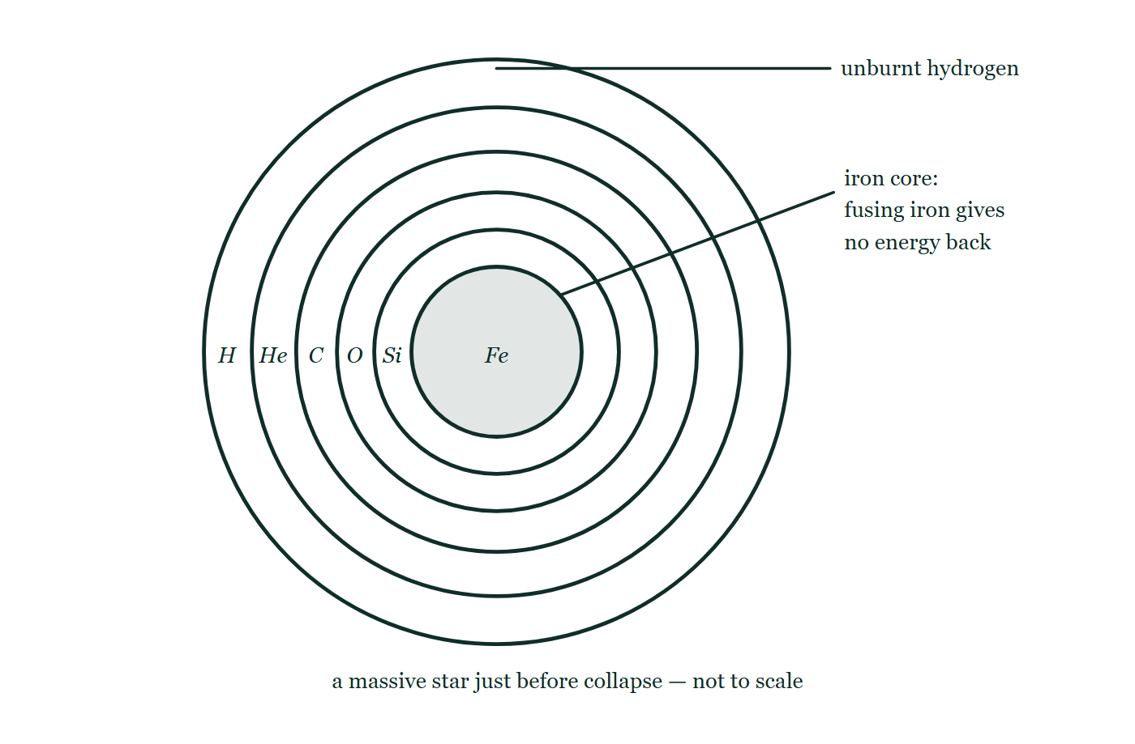
SPACE & STARS PHYSICS · STAR BIRTH & LIFE CYCLES
GIOPHYSICS LESSON
THINK FIRST
A star ten times the Sun's mass has ten times the fuel. Does it live ten times as long?
Take answers before you click — the point is the commitment
It is the same hydrogen, fusing by the same reactions, into the same helium. There is simply a great deal more of it.
THE ANSWER
No — it lives about three hundred times less long: roughly 30 million years against the Sun's 10 billion. Luminosity climbs as L ∝ M³·⁵, so ten times the fuel is spent more than three thousand times faster. In stars, being rich is no help if you are also extravagant.
A massive star drawn in cross-section just before collapse: six nested shells labelled from an unburnt hydrogen envelope inward through helium, carbon, oxygen and silicon to a solid iron core, with the shell radii shrinking sharply toward the centre and a note that fusing iron gives no energy back.
The live version of this figure — click here
Space & Stars Physics — Star Birth & Life Cycles. Built by GioPhysics from the lesson's own copy; nothing on these slides is re-authored.
3 / 37
Notes:
[Phase] Starter: Recall what this lesson stands on (minutes 0–5 of 45)
[Hook] A star ten times the Sun's mass has ten times the fuel. Does it live ten times as long? It is the same hydrogen, fusing by the same reactions, into the same helium. There is simply a great deal more of it.
[Answer] No — it lives about three hundred times less long: roughly 30 million years against the Sun's 10 billion. Luminosity climbs as L ∝ M³·⁵, so ten times the fuel is spent more than three thousand times faster. In stars, being rich is no help if you are also extravagant.
[Figure] A massive star drawn in cross-section just before collapse: six nested shells labelled from an unburnt hydrogen envelope inward through helium, carbon, oxygen and silicon to a solid iron core, with the shell radii shrinking sharply toward the centre and a note that fusing iron gives no energy back.

Slide 4
SPACE & STARS PHYSICS · STAR BIRTH & LIFE CYCLES
GIOPHYSICS LESSON
EXPLAINED SIMPLY
In one sentence
Introduce the idea — The big idea and the definition
A star forms when gravity collapses a nebula until core fusion ignites; it then holds a balance between gravity and pressure until the fuel fails, ending as a white dwarf (Sun-like mass), a neutron star (above about 8 solar masses), or a black hole (above about 20).
Space & Stars Physics — Star Birth & Life Cycles. Built by GioPhysics from the lesson's own copy; nothing on these slides is re-authored.
4 / 37
Notes:
[Phase] Introduce the idea: The big idea and the definition (minutes 5–13 of 45)
[Definition] A star forms when gravity collapses a nebula until core fusion ignites; it then holds a balance between gravity and pressure until the fuel fails, ending as a white dwarf (Sun-like mass), a neutron star (above about 8 solar masses), or a black hole (above about 20).

Slide 5
SPACE & STARS PHYSICS · STAR BIRTH & LIFE CYCLES
GIOPHYSICS LESSON
EXPLAINED SIMPLY
What that looks like
Introduce the idea — The big idea and the definition
FOR EXAMPLE
The Sun, at 1 M☉, has about 10 billion years on the main sequence and will end as a white dwarf. Betelgeuse, at roughly 18 M☉, will live only about 10 million years before exploding as a supernova.
Space & Stars Physics — Star Birth & Life Cycles. Built by GioPhysics from the lesson's own copy; nothing on these slides is re-authored.
5 / 37
Notes:
[Phase] Introduce the idea: The big idea and the definition (minutes 5–13 of 45)
[Worked illustration] The Sun, at 1 M☉, has about 10 billion years on the main sequence and will end as a white dwarf. Betelgeuse, at roughly 18 M☉, will live only about 10 million years before exploding as a supernova.

Slide 6
SPACE & STARS PHYSICS · STAR BIRTH & LIFE CYCLES
GIOPHYSICS LESSON
THE BIG IDEA
Gravity versus pressure, refereed by mass
Introduce the idea — The big idea and the definition
Stars condense from nebulae — vast clouds of hydrogen, helium, and dust. Gravity pulls a clump together into a protostar, compression heats the core, and at about 15 million K hydrogen begins fusing into helium: a star is born. On the main sequence the star sits in hydrostatic equilibrium — inward gravity balanced by outward gas and radiation pressure — and stays there for most of its life.
Luminosity climbs steeply with mass (roughly L ∝ M³·⁵) while the fuel grows only as M, so massive stars are gluttons: lifetime ∝ M/L ∝ M⁻²·⁵. When the core’s hydrogen runs out, the balance breaks and mass decides the ending. A Sun-like star swells into a red giant, sheds its envelope as a planetary nebula, and leaves a white dwarf that slowly cools.
A star above about 8 solar masses becomes a red supergiant, fuses its way up to iron, then collapses and rebounds as a supernova — leaving a neutron star, or, above roughly 20 solar masses, a black hole. Supernovae also forge the elements heavier than iron and blast them into space, seeding the next generation of stars and planets.
Space & Stars Physics — Star Birth & Life Cycles. Built by GioPhysics from the lesson's own copy; nothing on these slides is re-authored.
6 / 37
Notes:
[Phase] Introduce the idea: The big idea and the definition (minutes 5–13 of 45)
[Big idea] Stars condense from nebulae — vast clouds of hydrogen, helium, and dust. Gravity pulls a clump together into a protostar, compression heats the core, and at about 15 million K hydrogen begins fusing into helium: a star is born. On the main sequence the star sits in hydrostatic equilibrium — inward gravity balanced by outward gas and radiation pressure — and stays there for most of its life. Luminosity climbs steeply with mass (roughly L ∝ M³·⁵) while the fuel grows only as M, so massive stars are gluttons: lifetime ∝ M/L ∝ M⁻²·⁵. When the core’s hydrogen runs out, the balance breaks and mass decides the ending. A Sun-like star swells into a red giant, sheds its envelope as a planetary nebula, and leaves a white dwarf that slowly cools. A star above about 8 solar masses becomes a red supergiant, fuses its way up to iron, then collapses and rebounds as a supernova — leaving a neutron star, or, above roughly 20 solar masses, a black hole. Supernovae also forge the elements heavier than iron and blast them into space, seeding the next generation of stars and planets.

Slide 7
SPACE & STARS PHYSICS · STAR BIRTH & LIFE CYCLES
GIOPHYSICS LESSON
THE PHYSICS · 1 OF 4
From cloud to main sequence
Build the model — The formulae, one at a time, in plain English
A nebula clump collapses under its own gravity, converting gravitational potential energy to heat — the glowing protostar phase. When the core reaches ignition temperature, fusion switches on and the outward pressure finally holds gravity to a draw: the star settles onto the main sequence. There it spends about 90% of its life quietly turning hydrogen into helium — which is why 90% of the stars we see are main-sequence stars.
Space & Stars Physics — Star Birth & Life Cycles. Built by GioPhysics from the lesson's own copy; nothing on these slides is re-authored.
7 / 37
Notes:
[Phase] Build the model: The formulae, one at a time, in plain English (minutes 13–22 of 45)
[Section] A nebula clump collapses under its own gravity, converting gravitational potential energy to heat — the glowing protostar phase. When the core reaches ignition temperature, fusion switches on and the outward pressure finally holds gravity to a draw: the star settles onto the main sequence. There it spends about 90% of its life quietly turning hydrogen into helium — which is why 90% of the stars we see are main-sequence stars.

Slide 8
SPACE & STARS PHYSICS · STAR BIRTH & LIFE CYCLES
GIOPHYSICS LESSON
THE PHYSICS · 2 OF 4
The Sun-like ending
Build the model — The formulae, one at a time, in plain English
When the core hydrogen is spent, the core contracts and heats while fusion moves to a shell around it — the envelope inflates enormously and cools at the surface: a red giant. The core ignites helium, building carbon and oxygen, but a Sun-like star can go no further. The bloated envelope drifts off as a planetary nebula, unveiling the dead core: a white dwarf — about a solar mass squeezed into an Earth-sized ball, held up not by fusion but by electron degeneracy pressure, cooling forever.
Space & Stars Physics — Star Birth & Life Cycles. Built by GioPhysics from the lesson's own copy; nothing on these slides is re-authored.
8 / 37
Notes:
[Phase] Build the model: The formulae, one at a time, in plain English (minutes 13–22 of 45)
[Section] When the core hydrogen is spent, the core contracts and heats while fusion moves to a shell around it — the envelope inflates enormously and cools at the surface: a red giant. The core ignites helium, building carbon and oxygen, but a Sun-like star can go no further. The bloated envelope drifts off as a planetary nebula, unveiling the dead core: a white dwarf — about a solar mass squeezed into an Earth-sized ball, held up not by fusion but by electron degeneracy pressure, cooling forever.

Slide 9
SPACE & STARS PHYSICS · STAR BIRTH & LIFE CYCLES
GIOPHYSICS LESSON
THE PHYSICS · 3 OF 4
The massive ending
Build the model — The formulae, one at a time, in plain English
A star above ~8 M☉ keeps fusing: carbon, neon, oxygen, silicon — an onion of shells — until the core is iron, the one ash that releases no energy by fusing. Pressure support fails, the core collapses in under a second, and the rebound plus a flood of neutrinos blows the star apart: a supernova that briefly outshines its galaxy.
The collapse forges elements beyond iron and hurls the whole periodic table into space. The remnant core is a neutron star — or, above roughly 20 M☉ at birth, nothing can halt the collapse and a black hole forms.
Space & Stars Physics — Star Birth & Life Cycles. Built by GioPhysics from the lesson's own copy; nothing on these slides is re-authored.
9 / 37
Notes:
[Phase] Build the model: The formulae, one at a time, in plain English (minutes 13–22 of 45)
[Section] A star above ~8 M☉ keeps fusing: carbon, neon, oxygen, silicon — an onion of shells — until the core is iron, the one ash that releases no energy by fusing. Pressure support fails, the core collapses in under a second, and the rebound plus a flood of neutrinos blows the star apart: a supernova that briefly outshines its galaxy. The collapse forges elements beyond iron and hurls the whole periodic table into space. The remnant core is a neutron star — or, above roughly 20 M☉ at birth, nothing can halt the collapse and a black hole forms.

Slide 10
SPACE & STARS PHYSICS · STAR BIRTH & LIFE CYCLES
GIOPHYSICS LESSON
THE PHYSICS · 4 OF 4
What sets the ceilings
Build the model — The formulae, one at a time, in plain English
What holds a dead star up is degeneracy pressure: electrons in a white dwarf, neutrons in a neutron star, packed so tightly that quantum mechanics forbids them being packed closer. Unlike gas pressure it cannot be turned up by heating, so it is a fixed ceiling and there is a maximum mass it can carry. Above about 1.4 solar masses of remnant — the Chandrasekhar limit — electron degeneracy pressure loses to gravity and the core keeps falling until electrons are crushed into protons, p + e⁻ → n + νₑ, leaving a ball of neutrons.
Neutron degeneracy pressure has its own ceiling, the Oppenheimer–Volkoff limit at roughly 2–3 M☉, and beyond that nothing known can stop the collapse. Those two numbers are why the endings come in exactly three kinds rather than shading into one another.
Space & Stars Physics — Star Birth & Life Cycles. Built by GioPhysics from the lesson's own copy; nothing on these slides is re-authored.
10 / 37
Notes:
[Phase] Build the model: The formulae, one at a time, in plain English (minutes 13–22 of 45)
[Section] What holds a dead star up is degeneracy pressure: electrons in a white dwarf, neutrons in a neutron star, packed so tightly that quantum mechanics forbids them being packed closer. Unlike gas pressure it cannot be turned up by heating, so it is a fixed ceiling and there is a maximum mass it can carry. Above about 1.4 solar masses of remnant — the Chandrasekhar limit — electron degeneracy pressure loses to gravity and the core keeps falling until electrons are crushed into protons, p + e⁻ → n + νₑ, leaving a ball of neutrons. Neutron degeneracy pressure has its own ceiling, the Oppenheimer–Volkoff limit at roughly 2–3 M☉, and beyond that nothing known can stop the collapse. Those two numbers are why the endings come in exactly three kinds rather than shading into one another.

Slide 11
SPACE & STARS PHYSICS · STAR BIRTH & LIFE CYCLES
GIOPHYSICS LESSON
FORMULA 1 OF 4
Hydrostatic balance
Build the model — The formulae, one at a time, in plain English
gravity (in) = gas + radiation pressure (out)
Holds at every layer of a stable star
IN PLAIN ENGLISH
Squeeze a star and its core gets hotter, fusion quickens, pressure rises, and it re-inflates. That self-correcting balance is why stars are so stable for so long.
Space & Stars Physics — Star Birth & Life Cycles. Built by GioPhysics from the lesson's own copy; nothing on these slides is re-authored.
11 / 37
Notes:
[Phase] Build the model: The formulae, one at a time, in plain English (minutes 13–22 of 45)
[Formula] Hydrostatic balance: gravity (in) = gas + radiation pressure (out)
[In plain English] Squeeze a star and its core gets hotter, fusion quickens, pressure rises, and it re-inflates. That self-correcting balance is why stars are so stable for so long.
[Note] Holds at every layer of a stable star

Slide 12
SPACE & STARS PHYSICS · STAR BIRTH & LIFE CYCLES
GIOPHYSICS LESSON
FORMULA 2 OF 4
The power source
Build the model — The formulae, one at a time, in plain English
4 ¹H → ⁴He + energy
≈ 0.7% of the mass becomes energy, E = Δmc²
IN PLAIN ENGLISH
Four protons fuse (via the pp chain) into one helium nucleus that is slightly lighter than its ingredients. The missing 0.7% of mass, times c², is the starlight.
Space & Stars Physics — Star Birth & Life Cycles. Built by GioPhysics from the lesson's own copy; nothing on these slides is re-authored.
12 / 37
Notes:
[Phase] Build the model: The formulae, one at a time, in plain English (minutes 13–22 of 45)
[Formula] The power source: 4 ¹H → ⁴He + energy
[In plain English] Four protons fuse (via the pp chain) into one helium nucleus that is slightly lighter than its ingredients. The missing 0.7% of mass, times c², is the starlight.
[Note] ≈ 0.7% of the mass becomes energy, E = Δmc²

Slide 13
SPACE & STARS PHYSICS · STAR BIRTH & LIFE CYCLES
GIOPHYSICS LESSON
FORMULA 3 OF 4
Mass–luminosity
Build the model — The formulae, one at a time, in plain English
L ∝ M³·⁵
Main-sequence stars only
IN PLAIN ENGLISH
Double the mass and the luminosity rises about elevenfold. Heavier cores are hotter and denser, and fusion rates are savagely sensitive to temperature.
Space & Stars Physics — Star Birth & Life Cycles. Built by GioPhysics from the lesson's own copy; nothing on these slides is re-authored.
13 / 37
Notes:
[Phase] Build the model: The formulae, one at a time, in plain English (minutes 13–22 of 45)
[Formula] Mass–luminosity: L ∝ M³·⁵
[In plain English] Double the mass and the luminosity rises about elevenfold. Heavier cores are hotter and denser, and fusion rates are savagely sensitive to temperature.
[Note] Main-sequence stars only

Slide 14
SPACE & STARS PHYSICS · STAR BIRTH & LIFE CYCLES
GIOPHYSICS LESSON
FORMULA 4 OF 4
Lifetime
Build the model — The formulae, one at a time, in plain English
t ∝ M/L ∝ M⁻²·⁵
Fuel over spending rate
IN PLAIN ENGLISH
Fuel grows like M but spending like M³·⁵ — so the biggest stars die first. A 10 M☉ star lives about 30 million years; a red dwarf will outlast the current age of the universe.
Space & Stars Physics — Star Birth & Life Cycles. Built by GioPhysics from the lesson's own copy; nothing on these slides is re-authored.
14 / 37
Notes:
[Phase] Build the model: The formulae, one at a time, in plain English (minutes 13–22 of 45)
[Formula] Lifetime: t ∝ M/L ∝ M⁻²·⁵
[In plain English] Fuel grows like M but spending like M³·⁵ — so the biggest stars die first. A 10 M☉ star lives about 30 million years; a red dwarf will outlast the current age of the universe.
[Note] Fuel over spending rate

Slide 15
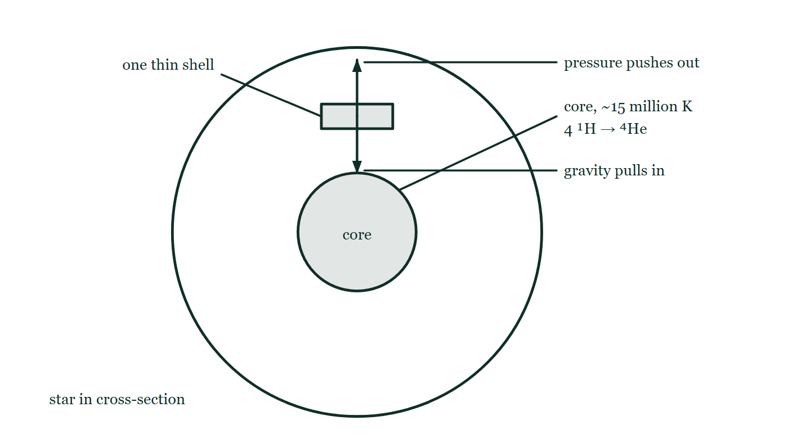
SPACE & STARS PHYSICS · STAR BIRTH & LIFE CYCLES
GIOPHYSICS LESSON
THE PICTURE
The balance that is a star
Drawn for this lesson
A star in cross-section with one thin shell picked out, carrying two arrows of equal length that both start at that shell: gravity pulling inward and gas and radiation pressure pushing outward, around a core marked at about 15 million K where four hydrogen nuclei become one helium.
The live version of this figure — click here
Space & Stars Physics — Star Birth & Life Cycles. Built by GioPhysics from the lesson's own copy; nothing on these slides is re-authored.
15 / 37
Notes:
[Phase] Build the model: The formulae, one at a time, in plain English (minutes 13–22 of 45)
[Figure] A star in cross-section with one thin shell picked out, carrying two arrows of equal length that both start at that shell: gravity pulling inward and gas and radiation pressure pushing outward, around a core marked at about 15 million K where four hydrogen nuclei become one helium.

Slide 16
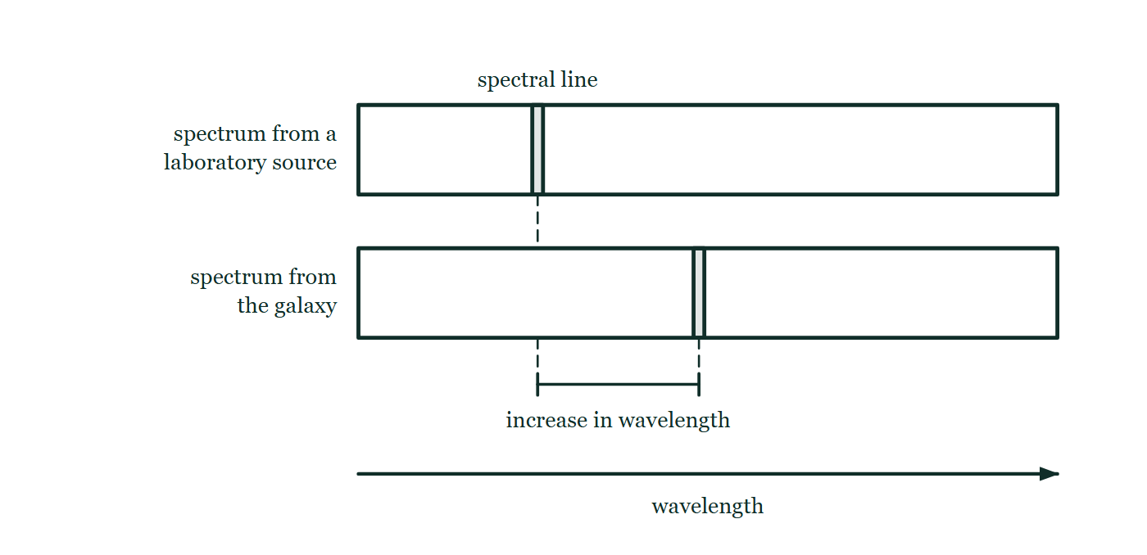
SPACE & STARS PHYSICS · STAR BIRTH & LIFE CYCLES
GIOPHYSICS LESSON
FIGURE 1 OF 3
Fig. 6.1 — IGCSE Topic 6 · Space physics
Drawn for question 6 of that paper · syllabus 6.2
Two spectra drawn one above the other against a common horizontal wavelength scale that increases to the right. The upper strip is the spectrum of a source in the laboratory on Earth, with one spectral line marked in it. The lower strip is the spectrum of light received from the distant galaxy, in which the same line appears further to the right. A dashed line dropped from each line marks its position on the scale, and the gap between the two positions is labelled as the increase in wavelength.
See the question this was drawn for — click here
Space & Stars Physics — Star Birth & Life Cycles. Built by GioPhysics from the lesson's own copy; nothing on these slides is re-authored.
16 / 37
Notes:
[Phase] Build the model: The formulae, one at a time, in plain English (minutes 13–22 of 45)
[Figure] Fig. 6.1. Two spectra drawn one above the other against a common horizontal wavelength scale that increases to the right. The upper strip is the spectrum of a source in the laboratory on Earth, with one spectral line marked in it. The lower strip is the spectrum of light received from the distant galaxy, in which the same line appears further to the right. A dashed line dropped from each line marks its position on the scale, and the gap between the two positions is labelled as the increase in wavelength.
[Where it came from] IGCSE Topic 6 · Space physics, question 6; syllabus 6.2.

Slide 17
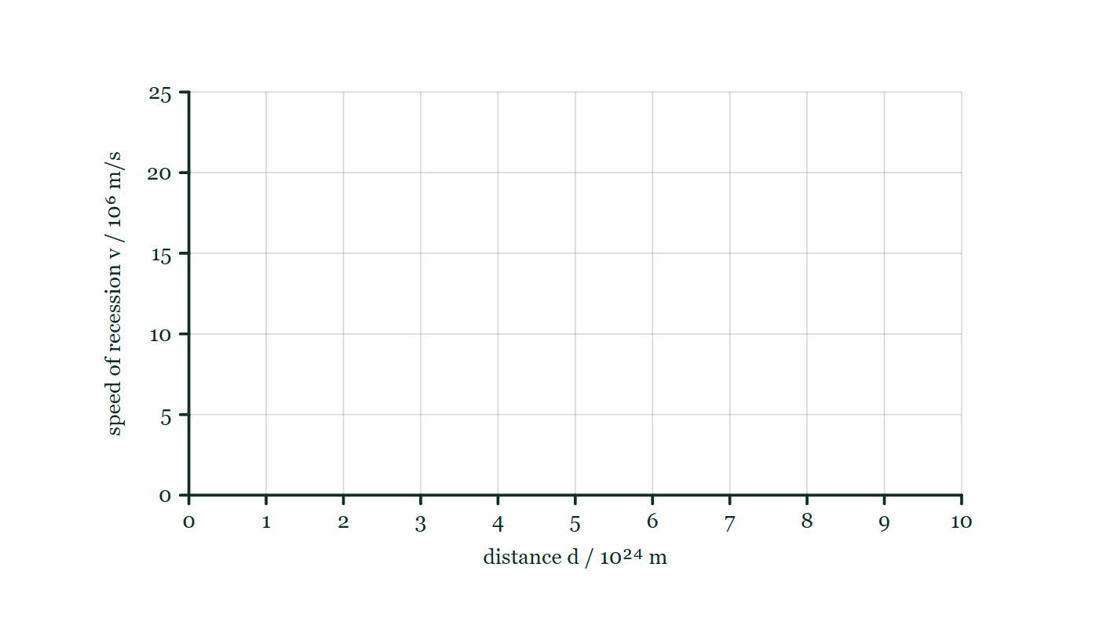
SPACE & STARS PHYSICS · STAR BIRTH & LIFE CYCLES
GIOPHYSICS LESSON
FIGURE 2 OF 3
Fig. 10.1 — IGCSE Topic 6 · Space physics
Drawn for question 10 of that paper · syllabus 6.2
An empty graph grid on which the readings in the table can be plotted. The horizontal axis is labelled distance d / 10²⁴ m and runs from 0 to 10 with a numbered gridline at every unit; the vertical axis is labelled speed of recession v / 10⁶ m/s and runs from 0 to 25 with a numbered gridline every 5. No points are plotted on the grid.
See the question this was drawn for — click here
Space & Stars Physics — Star Birth & Life Cycles. Built by GioPhysics from the lesson's own copy; nothing on these slides is re-authored.
17 / 37
Notes:
[Phase] Build the model: The formulae, one at a time, in plain English (minutes 13–22 of 45)
[Figure] Fig. 10.1. An empty graph grid on which the readings in the table can be plotted. The horizontal axis is labelled distance d / 10²⁴ m and runs from 0 to 10 with a numbered gridline at every unit; the vertical axis is labelled speed of recession v / 10⁶ m/s and runs from 0 to 25 with a numbered gridline every 5. No points are plotted on the grid.
[Where it came from] IGCSE Topic 6 · Space physics, question 10; syllabus 6.2.

Slide 18
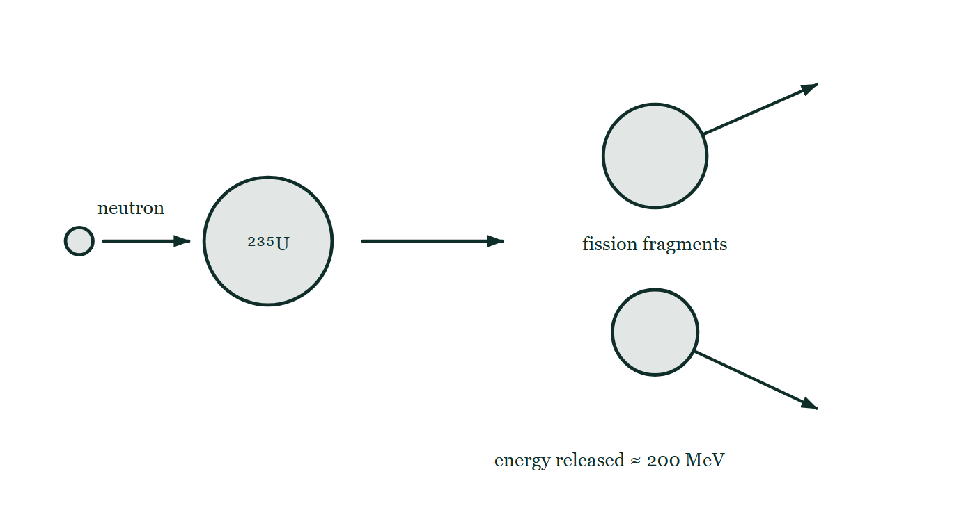
SPACE & STARS PHYSICS · STAR BIRTH & LIFE CYCLES
GIOPHYSICS LESSON
FIGURE 3 OF 3
Fig. 9.1 — IB Theme E · Nuclear and quantum physics
Drawn for question 9 of that paper · syllabus E.4, E.5
A schematic of a single induced fission event, read from left to right. A small neutron on the left travels to the right towards a large circle labelled ²³⁵U. An arrow from that nucleus leads to the products: two unequal fission fragments drawn as circles one above the other, each with its own arrow showing it moving away from the other. Printed below the fragments is the energy released in the event, about 200 MeV.
See the question this was drawn for — click here
Space & Stars Physics — Star Birth & Life Cycles. Built by GioPhysics from the lesson's own copy; nothing on these slides is re-authored.
18 / 37
Notes:
[Phase] Build the model: The formulae, one at a time, in plain English (minutes 13–22 of 45)
[Figure] Fig. 9.1. A schematic of a single induced fission event, read from left to right. A small neutron on the left travels to the right towards a large circle labelled ²³⁵U. An arrow from that nucleus leads to the products: two unequal fission fragments drawn as circles one above the other, each with its own arrow showing it moving away from the other. Printed below the fragments is the energy released in the event, about 200 MeV.
[Where it came from] IB Theme E · Nuclear and quantum physics, question 9; syllabus E.4, E.5.

Slide 19
SPACE & STARS PHYSICS · STAR BIRTH & LIFE CYCLES
GIOPHYSICS LESSON
WATCH OUT
The common trap
Check and misconception — The quick check and the trap
The Sun will not explode as a supernova — it is about eight times too light. Supernovae are reserved for massive stars whose cores reach iron and collapse.
The Sun’s fate is quieter: red giant, planetary nebula, then a white dwarf that cools for the rest of time. Nor do stars ‘burn’ in the chemical sense — no oxygen, no flames — fusion converts mass itself to energy, a million times more potent per kilogram than any fire.
Space & Stars Physics — Star Birth & Life Cycles. Built by GioPhysics from the lesson's own copy; nothing on these slides is re-authored.
19 / 37
Notes:
[Phase] Check and misconception: The quick check and the trap (minutes 35–41 of 45)
[Misconception] The Sun will not explode as a supernova — it is about eight times too light. Supernovae are reserved for massive stars whose cores reach iron and collapse. The Sun’s fate is quieter: red giant, planetary nebula, then a white dwarf that cools for the rest of time. Nor do stars ‘burn’ in the chemical sense — no oxygen, no flames — fusion converts mass itself to energy, a million times more potent per kilogram than any fire.

Slide 20
SPACE & STARS PHYSICS · STAR BIRTH & LIFE CYCLES
GIOPHYSICS LESSON
WORKED EXAMPLE 1 OF 2 · EASY
The question
Easy
Worked examples — I do, we do — one step revealed at a time
In the pp chain, four hydrogen-1 atoms (each 1.007825 u) become one helium-4 (4.002603 u). Find the mass defect and the energy released per helium nucleus made.
Space & Stars Physics — Star Birth & Life Cycles. Built by GioPhysics from the lesson's own copy; nothing on these slides is re-authored.
20 / 37
Notes:
[Phase] Worked examples: I do, we do — one step revealed at a time (minutes 22–35 of 45)
[Question] In the pp chain, four hydrogen-1 atoms (each 1.007825 u) become one helium-4 (4.002603 u). Find the mass defect and the energy released per helium nucleus made.
[Answer] Δm ≈ 0.0287 u, releasing ≈ 27 MeV

Slide 21
SPACE & STARS PHYSICS · STAR BIRTH & LIFE CYCLES
GIOPHYSICS LESSON
WORKED EXAMPLE 1 OF 2 · EASY · THE WORKING
How to solve it
Easy
Worked examples — I do, we do — one step revealed at a time
In the pp chain, four hydrogen-1 atoms (each 1.007825 u) become one helium-4 (4.002603 u). Find the mass defect and the energy released per helium nucleus made.
1.
Ingredients: 4 × 1.007825 = 4.031300 u. Product: 4.002603 u.
2.
Δm = 4.031300 − 4.002603 = 0.028697 u — about 0.7% of the mass.
3.
E = 0.0287 × 931.5 ≈ 26.7 MeV per helium nucleus — the Sun’s entire output, one nucleus at a time.
Space & Stars Physics — Star Birth & Life Cycles. Built by GioPhysics from the lesson's own copy; nothing on these slides is re-authored.
21 / 37
Notes:
[Phase] Worked examples: I do, we do — one step revealed at a time (minutes 22–35 of 45)
[Reveal] One click per step. The class works each line before the next appears.
[Step 1] Ingredients: 4 × 1.007825 = 4.031300 u. Product: 4.002603 u.
[Step 2] Δm = 4.031300 − 4.002603 = 0.028697 u — about 0.7% of the mass.
[Step 3] E = 0.0287 × 931.5 ≈ 26.7 MeV per helium nucleus — the Sun’s entire output, one nucleus at a time.

Slide 22
SPACE & STARS PHYSICS · STAR BIRTH & LIFE CYCLES
GIOPHYSICS LESSON
WORKED EXAMPLE 1 OF 2 · EASY
Answer
Easy
Worked examples — I do, we do — one step revealed at a time
Δm ≈ 0.0287 u, releasing ≈ 27 MeV
Space & Stars Physics — Star Birth & Life Cycles. Built by GioPhysics from the lesson's own copy; nothing on these slides is re-authored.
22 / 37
Notes:
[Phase] Worked examples: I do, we do — one step revealed at a time (minutes 22–35 of 45)
[Answer] Δm ≈ 0.0287 u, releasing ≈ 27 MeV

Slide 23
SPACE & STARS PHYSICS · STAR BIRTH & LIFE CYCLES
GIOPHYSICS LESSON
WORKED EXAMPLE 2 OF 2 · MEDIUM
The question
Medium
Worked examples — I do, we do — one step revealed at a time
Estimate the Sun’s main-sequence lifetime, given M = 2.0 × 10³⁰ kg, L = 3.8 × 10²⁶ W, that ~10% of the hydrogen is available to the core, and that fusion converts 0.7% of fuel mass to energy.
Space & Stars Physics — Star Birth & Life Cycles. Built by GioPhysics from the lesson's own copy; nothing on these slides is re-authored.
23 / 37
Notes:
[Phase] Worked examples: I do, we do — one step revealed at a time (minutes 22–35 of 45)
[Question] Estimate the Sun’s main-sequence lifetime, given M = 2.0 × 10³⁰ kg, L = 3.8 × 10²⁶ W, that ~10% of the hydrogen is available to the core, and that fusion converts 0.7% of fuel mass to energy.
[Answer] ≈ 10 billion years

Slide 24
SPACE & STARS PHYSICS · STAR BIRTH & LIFE CYCLES
GIOPHYSICS LESSON
WORKED EXAMPLE 2 OF 2 · MEDIUM · THE WORKING
How to solve it
Medium
Worked examples — I do, we do — one step revealed at a time
Estimate the Sun’s main-sequence lifetime, given M = 2.0 × 10³⁰ kg, L = 3.8 × 10²⁶ W, that ~10% of the hydrogen is available to the core, and that fusion converts 0.7% of fuel mass to energy.
1.
Usable energy: E = 0.10 × 0.007 × Mc² = 7 × 10⁻⁴ × 2.0 × 10³⁰ × 9.0 × 10¹⁶ ≈ 1.3 × 10⁴⁴ J.
2.
Lifetime: t = E/L = 1.3 × 10⁴⁴ ÷ 3.8 × 10²⁶ ≈ 3.3 × 10¹⁷ s.
3.
In years: 3.3 × 10¹⁷ ÷ 3.15 × 10⁷ ≈ 1.0 × 10¹⁰ — about ten billion years, of which nearly five billion are already spent.
Space & Stars Physics — Star Birth & Life Cycles. Built by GioPhysics from the lesson's own copy; nothing on these slides is re-authored.
24 / 37
Notes:
[Phase] Worked examples: I do, we do — one step revealed at a time (minutes 22–35 of 45)
[Reveal] One click per step. The class works each line before the next appears.
[Step 1] Usable energy: E = 0.10 × 0.007 × Mc² = 7 × 10⁻⁴ × 2.0 × 10³⁰ × 9.0 × 10¹⁶ ≈ 1.3 × 10⁴⁴ J.
[Step 2] Lifetime: t = E/L = 1.3 × 10⁴⁴ ÷ 3.8 × 10²⁶ ≈ 3.3 × 10¹⁷ s.
[Step 3] In years: 3.3 × 10¹⁷ ÷ 3.15 × 10⁷ ≈ 1.0 × 10¹⁰ — about ten billion years, of which nearly five billion are already spent.

Slide 25
SPACE & STARS PHYSICS · STAR BIRTH & LIFE CYCLES
GIOPHYSICS LESSON
WORKED EXAMPLE 2 OF 2 · MEDIUM
Answer
Medium
Worked examples — I do, we do — one step revealed at a time
≈ 10 billion years
Space & Stars Physics — Star Birth & Life Cycles. Built by GioPhysics from the lesson's own copy; nothing on these slides is re-authored.
25 / 37
Notes:
[Phase] Worked examples: I do, we do — one step revealed at a time (minutes 22–35 of 45)
[Answer] ≈ 10 billion years

Slide 26
SPACE & STARS PHYSICS · STAR BIRTH & LIFE CYCLES
GIOPHYSICS LESSON
SPOT THE MISTAKE
One line here is wrong
The whole working is up — find the bad line before you click
1.
A star has 10 times the Sun's mass. Estimate its main-sequence lifetime.
2.
Luminosity goes as L ∝ M³·⁵, so L = 10³·⁵ = 3200 times the Sun's.
3.
Lifetime goes as fuel divided by burn rate: t ∝ M/L.
4.
t ∝ 10 × 3200 = 32 000, so it lives 32 000 × 10 billion years.
5.
That is about 3 × 10¹⁴ years.
LINE 4 IS WRONG
M/L has been multiplied instead of divided. The slip survives a first reading because the answer still sounds like a long time, and stellar lifetimes are long — but the sanity check is the direction: a star three thousand times more luminous cannot possibly last longer than the Sun. t ∝ M/L = 10/3200 = 1/320, so about 30 million years, and the whole point of the lesson is how brief that is.
IT SHOULD SAY
t ∝ 10/3200 = 3.1 × 10⁻³, so it lives about 0.003 × 10 billion years ≈ 30 million years.
Space & Stars Physics — Star Birth & Life Cycles. Built by GioPhysics from the lesson's own copy; nothing on these slides is re-authored.
26 / 37
Notes:
[Phase] Worked examples: I do, we do — one step revealed at a time (minutes 22–35 of 45)
[Spot the mistake] The working is complete and one line of it is wrong. Let the room hunt: one click names the line, a second shows it done correctly.
[Line 4 is wrong] M/L has been multiplied instead of divided. The slip survives a first reading because the answer still sounds like a long time, and stellar lifetimes are long — but the sanity check is the direction: a star three thousand times more luminous cannot possibly last longer than the Sun. t ∝ M/L = 10/3200 = 1/320, so about 30 million years, and the whole point of the lesson is how brief that is.
[It should say] t ∝ 10/3200 = 3.1 × 10⁻³, so it lives about 0.003 × 10 billion years ≈ 30 million years.

Slide 27
SPACE & STARS PHYSICS · STAR BIRTH & LIFE CYCLES
GIOPHYSICS LESSON
PREDICT · TAKE THE VOTE
Commit before you are told
Hands up for each option, then click
Will the Sun ever look like this?
A Yes — every star eventually works its way up to an iron core and then collapses
B No — the Sun is about eight times too light to fuse past carbon and oxygen
C Yes, but only after it has spent a while as a white dwarf first
A massive star drawn in cross-section just before collapse: six nested shells labelled from an unburnt hydrogen envelope inward through helium, carbon, oxygen and silicon to a solid iron core, with the shell radii shrinking sharply toward the centre and a note that fusing iron gives no energy back.
The live version of this figure — click here
Space & Stars Physics — Star Birth & Life Cycles. Built by GioPhysics from the lesson's own copy; nothing on these slides is re-authored.
27 / 37
Notes:
[Phase] Build the model: The formulae, one at a time, in plain English (minutes 13–22 of 45)
[Predict] Will the Sun ever look like this?
[Options] A Yes — every star eventually works its way up to an iron core and then collapses B No — the Sun is about eight times too light to fuse past carbon and oxygen C Yes, but only after it has spent a while as a white dwarf first
[Figure] A massive star drawn in cross-section just before collapse: six nested shells labelled from an unburnt hydrogen envelope inward through helium, carbon, oxygen and silicon to a solid iron core, with the shell radii shrinking sharply toward the centre and a note that fusing iron gives no energy back.

Slide 28
SPACE & STARS PHYSICS · STAR BIRTH & LIFE CYCLES
GIOPHYSICS LESSON
PREDICT · THE OUTCOME
What actually happens
Ask the room who changed their mind, and why
B No — the Sun is about eight times too light to fuse past carbon and oxygen
WHY
Each shell in the picture needs a hotter, denser core than the one outside it, and only gravity can supply that — so how far up the onion a star gets is decided by its mass. Below about 8 solar masses the core never reaches the temperature to fuse carbon in bulk, and the story ends quietly: red giant, planetary nebula, then a white dwarf cooling for the rest of time. The Sun will not explode. It is also worth saying that nothing here is burning in the chemical sense: no oxygen, no flames, just mass converted to energy at about a million times the yield of any fire.
Space & Stars Physics — Star Birth & Life Cycles. Built by GioPhysics from the lesson's own copy; nothing on these slides is re-authored.
28 / 37
Notes:
[Phase] Build the model: The formulae, one at a time, in plain English (minutes 13–22 of 45)
[Answer] B — No — the Sun is about eight times too light to fuse past carbon and oxygen. Each shell in the picture needs a hotter, denser core than the one outside it, and only gravity can supply that — so how far up the onion a star gets is decided by its mass. Below about 8 solar masses the core never reaches the temperature to fuse carbon in bulk, and the story ends quietly: red giant, planetary nebula, then a white dwarf cooling for the rest of time. The Sun will not explode. It is also worth saying that nothing here is burning in the chemical sense: no oxygen, no flames, just mass converted to energy at about a million times the yield of any fire.

Slide 29
SPACE & STARS PHYSICS · STAR BIRTH & LIFE CYCLES
GIOPHYSICS LESSON
QUICK CHECK
Decide before the answer goes up
Check and misconception — The quick check and the trap
What single property decides whether a star ends as a white dwarf, a neutron star, or a black hole?
A
Its temperature
B
Its mass
C
Its distance from other stars
Space & Stars Physics — Star Birth & Life Cycles. Built by GioPhysics from the lesson's own copy; nothing on these slides is re-authored.
29 / 37
Notes:
[Phase] Check and misconception: The quick check and the trap (minutes 35–41 of 45)
[Question] What single property decides whether a star ends as a white dwarf, a neutron star, or a black hole?
[Options] A Its temperature B Its mass C Its distance from other stars

Slide 30
SPACE & STARS PHYSICS · STAR BIRTH & LIFE CYCLES
GIOPHYSICS LESSON
QUICK CHECK · THE ANSWER
The answer, and why
Check and misconception — The quick check and the trap
B Its mass
HOW TO GET THERE
Mass sets the core’s fate: below about 8 M☉ the collapse stops at a white dwarf; above it, a supernova leaves a neutron star; above roughly 20 M☉, not even neutron pressure can resist and a black hole forms.
WHY THE OTHERS TEMPT
A Temperature is a symptom rather than a cause — a massive star is hot because it is massive, and the same mass decides the ending. Two stars can share a surface temperature and die completely differently.
B Correct. Mass sets the core's fate: below about 8 M☉ the collapse halts at a white dwarf, above it a supernova leaves a neutron star, and above roughly 20 M☉ not even neutron degeneracy holds and a black hole forms.
C Stars in crowded clusters really do interact, and a close binary can change a star's fate by stealing its envelope — but that is an exception being offered as the rule. A lone star with no neighbour at all still dies in exactly the way its mass dictates.
Space & Stars Physics — Star Birth & Life Cycles. Built by GioPhysics from the lesson's own copy; nothing on these slides is re-authored.
30 / 37
Notes:
[Phase] Check and misconception: The quick check and the trap (minutes 35–41 of 45)
[Question] What single property decides whether a star ends as a white dwarf, a neutron star, or a black hole?
[Option by option] A: Temperature is a symptom rather than a cause — a massive star is hot because it is massive, and the same mass decides the ending. Two stars can share a surface temperature and die completely differently. B: Correct. Mass sets the core's fate: below about 8 M☉ the collapse halts at a white dwarf, above it a supernova leaves a neutron star, and above roughly 20 M☉ not even neutron degeneracy holds and a black hole forms. C: Stars in crowded clusters really do interact, and a close binary can change a star's fate by stealing its envelope — but that is an exception being offered as the rule. A lone star with no neighbour at all still dies in exactly the way its mass dictates.
[Answer] B — Its mass
[Why] Mass sets the core’s fate: below about 8 M☉ the collapse stops at a white dwarf; above it, a supernova leaves a neutron star; above roughly 20 M☉, not even neutron pressure can resist and a black hole forms.
[Reveal] One click for the answer, then one for the reason.

Slide 31
SPACE & STARS PHYSICS · STAR BIRTH & LIFE CYCLES
GIOPHYSICS LESSON
EXTENSION 1 OF 2 · HARD
The question
Hard
Worked examples — I do, we do — one step revealed at a time
A star has 10 times the Sun’s mass. Using L ∝ M³·⁵ and t ∝ M/L, find its luminosity and main-sequence lifetime, and state how it will die.
Space & Stars Physics — Star Birth & Life Cycles. Built by GioPhysics from the lesson's own copy; nothing on these slides is re-authored.
31 / 37
Notes:
[Phase] Worked examples: I do, we do — one step revealed at a time (minutes 22–35 of 45)
[Question] A star has 10 times the Sun’s mass. Using L ∝ M³·⁵ and t ∝ M/L, find its luminosity and main-sequence lifetime, and state how it will die.
[Answer] ≈ 3200 L☉, ≈ 30 Myr, ending in a supernova → neutron star

Slide 32
SPACE & STARS PHYSICS · STAR BIRTH & LIFE CYCLES
GIOPHYSICS LESSON
EXTENSION 1 OF 2 · HARD · THE WORKING
How to solve it
Hard
Worked examples — I do, we do — one step revealed at a time
A star has 10 times the Sun’s mass. Using L ∝ M³·⁵ and t ∝ M/L, find its luminosity and main-sequence lifetime, and state how it will die.
1.
L = 10³·⁵ ≈ 3200 L☉ — a 10× heavier star spends over 3000 times faster.
2.
t = t☉ × M/L = 10¹⁰ × 10 ÷ 3200 ≈ 3 × 10⁷ years — thirty million years, a thousandth of the Sun’s span.
3.
At 10 M☉ it is above the ~8 M☉ line: red supergiant, iron core, supernova — leaving a neutron star.
Space & Stars Physics — Star Birth & Life Cycles. Built by GioPhysics from the lesson's own copy; nothing on these slides is re-authored.
32 / 37
Notes:
[Phase] Worked examples: I do, we do — one step revealed at a time (minutes 22–35 of 45)
[Reveal] One click per step. The class works each line before the next appears.
[Step 1] L = 10³·⁵ ≈ 3200 L☉ — a 10× heavier star spends over 3000 times faster.
[Step 2] t = t☉ × M/L = 10¹⁰ × 10 ÷ 3200 ≈ 3 × 10⁷ years — thirty million years, a thousandth of the Sun’s span.
[Step 3] At 10 M☉ it is above the ~8 M☉ line: red supergiant, iron core, supernova — leaving a neutron star.

Slide 33
SPACE & STARS PHYSICS · STAR BIRTH & LIFE CYCLES
GIOPHYSICS LESSON
EXTENSION 1 OF 2 · HARD
Answer
Hard
Worked examples — I do, we do — one step revealed at a time
≈ 3200 L☉, ≈ 30 Myr, ending in a supernova → neutron star
Space & Stars Physics — Star Birth & Life Cycles. Built by GioPhysics from the lesson's own copy; nothing on these slides is re-authored.
33 / 37
Notes:
[Phase] Worked examples: I do, we do — one step revealed at a time (minutes 22–35 of 45)
[Answer] ≈ 3200 L☉, ≈ 30 Myr, ending in a supernova → neutron star

Slide 34
SPACE & STARS PHYSICS · STAR BIRTH & LIFE CYCLES
GIOPHYSICS LESSON
EXTENSION 2 OF 2 · CHALLENGING
The question
Challenging
Worked examples — I do, we do — one step revealed at a time
A supernova leaves a 1.4 M☉ neutron star of radius 10 km. Find its density, compare it with nuclear density, and explain why supernovae matter for the existence of planets like ours.
Space & Stars Physics — Star Birth & Life Cycles. Built by GioPhysics from the lesson's own copy; nothing on these slides is re-authored.
34 / 37
Notes:
[Phase] Worked examples: I do, we do — one step revealed at a time (minutes 22–35 of 45)
[Question] A supernova leaves a 1.4 M☉ neutron star of radius 10 km. Find its density, compare it with nuclear density, and explain why supernovae matter for the existence of planets like ours.
[Answer] ρ ≈ 7 × 10¹⁷ kg/m³ — nuclear matter; supernovae make and deliver the heavy elements

Slide 35
SPACE & STARS PHYSICS · STAR BIRTH & LIFE CYCLES
GIOPHYSICS LESSON
EXTENSION 2 OF 2 · CHALLENGING · THE WORKING
How to solve it
Challenging
Worked examples — I do, we do — one step revealed at a time
A supernova leaves a 1.4 M☉ neutron star of radius 10 km. Find its density, compare it with nuclear density, and explain why supernovae matter for the existence of planets like ours.
1.
ρ = M/V = (1.4 × 2.0 × 10³⁰) ÷ (4/3 × π × (10⁴)³) = 2.8 × 10³⁰ ÷ 4.2 × 10¹² ≈ 6.7 × 10¹⁷ kg/m³.
2.
That is nuclear density — the star is effectively one giant nucleus; a sugar-cube of it would have the mass of a mountain range (≈ 7 × 10¹¹ kg).
3.
Fusion in stars stops at iron, the most tightly bound nucleus. Everything heavier — gold, iodine, uranium — is forged in the supernova itself and scattered into space, enriching the clouds that build the next stars and their planets. The calcium in your bones went through at least one supernova.
Space & Stars Physics — Star Birth & Life Cycles. Built by GioPhysics from the lesson's own copy; nothing on these slides is re-authored.
35 / 37
Notes:
[Phase] Worked examples: I do, we do — one step revealed at a time (minutes 22–35 of 45)
[Reveal] One click per step. The class works each line before the next appears.
[Step 1] ρ = M/V = (1.4 × 2.0 × 10³⁰) ÷ (4/3 × π × (10⁴)³) = 2.8 × 10³⁰ ÷ 4.2 × 10¹² ≈ 6.7 × 10¹⁷ kg/m³.
[Step 2] That is nuclear density — the star is effectively one giant nucleus; a sugar-cube of it would have the mass of a mountain range (≈ 7 × 10¹¹ kg).
[Step 3] Fusion in stars stops at iron, the most tightly bound nucleus. Everything heavier — gold, iodine, uranium — is forged in the supernova itself and scattered into space, enriching the clouds that build the next stars and their planets. The calcium in your bones went through at least one supernova.

Slide 36
SPACE & STARS PHYSICS · STAR BIRTH & LIFE CYCLES
GIOPHYSICS LESSON
EXTENSION 2 OF 2 · CHALLENGING
Answer
Challenging
Worked examples — I do, we do — one step revealed at a time
ρ ≈ 7 × 10¹⁷ kg/m³ — nuclear matter; supernovae make and deliver the heavy elements
Space & Stars Physics — Star Birth & Life Cycles. Built by GioPhysics from the lesson's own copy; nothing on these slides is re-authored.
36 / 37
Notes:
[Phase] Worked examples: I do, we do — one step revealed at a time (minutes 22–35 of 45)
[Answer] ρ ≈ 7 × 10¹⁷ kg/m³ — nuclear matter; supernovae make and deliver the heavy elements

Slide 37
SPACE & STARS PHYSICS · STAR BIRTH & LIFE CYCLES
GIOPHYSICS LESSON
SPACE & STARS PHYSICS
Where to go next
Plenary — What to take away, what to practise next
Next
28.3 The Hertzsprung–Russell Diagram
https://giophysics.com/chapter-53/hr-diagram/
Lesson
This lesson on giophysics.com
https://giophysics.com/chapter-53/stellar-lifecycles/
Live
The live, interactive version of these slides
https://giophysics.com/chapter-53/presentation/?lesson=lifecycle
Chapter
All Space & Stars Physics lessons
https://giophysics.com/chapter-53/
PDF
Download the lesson PDF
https://giophysics.com/downloads/53-2-stellar-lifecycles.pdf
Space & Stars Physics — Star Birth & Life Cycles. Built by GioPhysics from the lesson's own copy; nothing on these slides is re-authored.
37 / 37
Notes:
[Phase] Plenary: What to take away, what to practise next (minutes 41–45 of 45)
[Interactive] The graphs and the circuit topology on these slides are frozen. The live version at https://giophysics.com/chapter-53/presentation/?lesson=lifecycle moves them.

