Slide 1
SPACE & STARS PHYSICS · THE EARTH & THE SOLAR SYSTEM
GIOPHYSICS LESSON
28 · Space & Stars Physics
One force runs the clockwork
The Earth & the Solar System
The Sun rises because the Earth spins; summer comes because the spin axis leans; the Moon changes shape because we watch its sunlit half from different angles. None of it is mysterious — it is one tilted, spinning planet riding a gravitational clockwork that Newton could wind forward or back for centuries.
POSITION
Lesson 1 of 6 in Space & Stars Physics
PLAN
15 slides in the 45-minute core run, about 41 minutes of it
LESSON PAGE
https://giophysics.com/chapter-53/solar-system/
Built by GioPhysics from the lesson's own page. Every word on these slides is the lesson's; nothing here is re-authored. Teaching material, not an awarding body's document.
Space & Stars Physics — The Earth & the Solar System. Built by GioPhysics from the lesson's own copy; nothing on these slides is re-authored.
1 / 33
Notes:
[Lesson] Space & Stars Physics — The Earth & the Solar System. Lesson 1 of 6.
[Intro] The Sun rises because the Earth spins; summer comes because the spin axis leans; the Moon changes shape because we watch its sunlit half from different angles. None of it is mysterious — it is one tilted, spinning planet riding a gravitational clockwork that Newton could wind forward or back for centuries.
[Source] https://giophysics.com/chapter-53/solar-system/
[Disclaimer] Built by GioPhysics from the lesson's own page. Every word on these slides is the lesson's; nothing here is re-authored. Teaching material, not an awarding body's document.

Slide 2
SPACE & STARS PHYSICS · THE EARTH & THE SOLAR SYSTEM
GIOPHYSICS LESSON
WHAT THIS NEEDS
What you already know
Starter — Recall what this lesson stands on
Recall
Universal gravitation
https://giophysics.com/chapter-3/universal-gravitation/
Recall
Uniform circular motion
https://giophysics.com/chapter-10/uniform-circular-motion/
Space & Stars Physics — The Earth & the Solar System. Built by GioPhysics from the lesson's own copy; nothing on these slides is re-authored.
2 / 33
Notes:
[Phase] Starter: Recall what this lesson stands on (minutes 0–5 of 45)
[Starter] Recall: Universal gravitation; Uniform circular motion

Slide 3
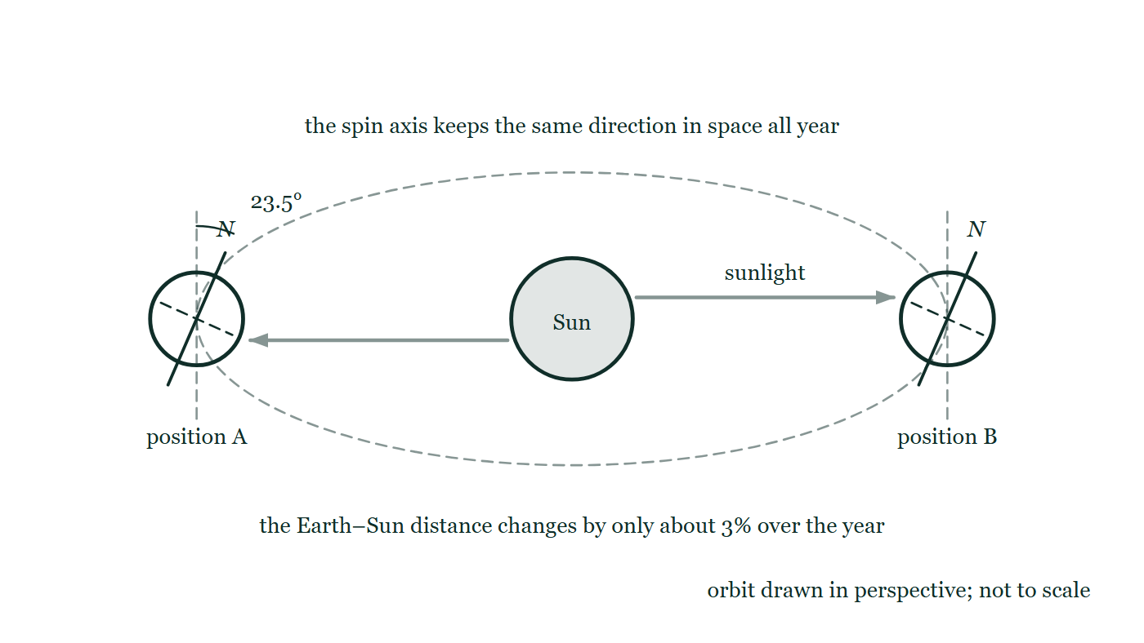
SPACE & STARS PHYSICS · THE EARTH & THE SOLAR SYSTEM
GIOPHYSICS LESSON
THINK FIRST
The Earth is closest to the Sun in the first week of January. So why is January the middle of winter?
Take answers before you click — the point is the commitment
The orbit is very nearly circular, but not exactly — and the small difference goes the wrong way for the story most people carry. While the northern hemisphere shivers, Australia is at the beach.
THE ANSWER
Because distance is not what makes the seasons. The 23.5° tilt is: the hemisphere leaning toward the Sun gets longer days and steeper, more concentrated sunlight. The clinching evidence is that the two hemispheres have opposite seasons at the same instant, which nothing about distance could ever produce.
The Earth drawn at two positions of its orbit round the Sun, its spin axis tilted 23.5° from the vertical and pointing the same way in space at both, with sunlight arrowed in and a note that the Earth–Sun distance changes by only about 3% over the year.
The live version of this figure — click here
Space & Stars Physics — The Earth & the Solar System. Built by GioPhysics from the lesson's own copy; nothing on these slides is re-authored.
3 / 33
Notes:
[Phase] Starter: Recall what this lesson stands on (minutes 0–5 of 45)
[Hook] The Earth is closest to the Sun in the first week of January. So why is January the middle of winter? The orbit is very nearly circular, but not exactly — and the small difference goes the wrong way for the story most people carry. While the northern hemisphere shivers, Australia is at the beach.
[Answer] Because distance is not what makes the seasons. The 23.5° tilt is: the hemisphere leaning toward the Sun gets longer days and steeper, more concentrated sunlight. The clinching evidence is that the two hemispheres have opposite seasons at the same instant, which nothing about distance could ever produce.
[Figure] The Earth drawn at two positions of its orbit round the Sun, its spin axis tilted 23.5° from the vertical and pointing the same way in space at both, with sunlight arrowed in and a note that the Earth–Sun distance changes by only about 3% over the year.

Slide 4
SPACE & STARS PHYSICS · THE EARTH & THE SOLAR SYSTEM
GIOPHYSICS LESSON
EXPLAINED SIMPLY
In one sentence
Introduce the idea — The big idea and the definition
The Solar System is the Sun plus everything its gravity holds — eight planets, moons, asteroids, and comets — with each body’s orbital speed set by v = 2πr/T, faster close to the Sun where gravity is stronger and slower far out.
Space & Stars Physics — The Earth & the Solar System. Built by GioPhysics from the lesson's own copy; nothing on these slides is re-authored.
4 / 33
Notes:
[Phase] Introduce the idea: The big idea and the definition (minutes 5–13 of 45)
[Definition] The Solar System is the Sun plus everything its gravity holds — eight planets, moons, asteroids, and comets — with each body’s orbital speed set by v = 2πr/T, faster close to the Sun where gravity is stronger and slower far out.

Slide 5
SPACE & STARS PHYSICS · THE EARTH & THE SOLAR SYSTEM
GIOPHYSICS LESSON
EXPLAINED SIMPLY
What that looks like
Introduce the idea — The big idea and the definition
FOR EXAMPLE
Mercury (r = 0.39 AU) completes an orbit in 88 days at about 48 km/s; Neptune (r = 30 AU) needs 165 years at 5.4 km/s — thirty times farther, nine times slower.
Space & Stars Physics — The Earth & the Solar System. Built by GioPhysics from the lesson's own copy; nothing on these slides is re-authored.
5 / 33
Notes:
[Phase] Introduce the idea: The big idea and the definition (minutes 5–13 of 45)
[Worked illustration] Mercury (r = 0.39 AU) completes an orbit in 88 days at about 48 km/s; Neptune (r = 30 AU) needs 165 years at 5.4 km/s — thirty times farther, nine times slower.

Slide 6
SPACE & STARS PHYSICS · THE EARTH & THE SOLAR SYSTEM
GIOPHYSICS LESSON
THE BIG IDEA
One force runs the clockwork
Introduce the idea — The big idea and the definition
The Earth turns once on its axis every 24 hours, giving day and night, and orbits the Sun once every 365¼ days. Seasons come from the 23.5° tilt of the spin axis — in June the northern hemisphere leans toward the Sun, catching steeper, longer sunlight — not from any change in distance. The Moon orbits the Earth in about a month, and its phases are simply the fraction of its sunlit half we can see.
The Sun is an ordinary star, a ball of mostly hydrogen and helium containing 99.8% of the Solar System’s mass, and its gravity is the glue: g = GM/r² weakens with distance, so each planet moves on a near-circular orbit with speed v = 2πr/T. Because gravity is stronger closer in, the inner planets must move faster — Mercury tears round at 48 km/s while Neptune drifts at 5.4 km/s — and comets on stretched elliptical orbits obey the same rule moment by moment, sprinting at perihelion and crawling at aphelion.
Space & Stars Physics — The Earth & the Solar System. Built by GioPhysics from the lesson's own copy; nothing on these slides is re-authored.
6 / 33
Notes:
[Phase] Introduce the idea: The big idea and the definition (minutes 5–13 of 45)
[Big idea] The Earth turns once on its axis every 24 hours, giving day and night, and orbits the Sun once every 365¼ days. Seasons come from the 23.5° tilt of the spin axis — in June the northern hemisphere leans toward the Sun, catching steeper, longer sunlight — not from any change in distance. The Moon orbits the Earth in about a month, and its phases are simply the fraction of its sunlit half we can see. The Sun is an ordinary star, a ball of mostly hydrogen and helium containing 99.8% of the Solar System’s mass, and its gravity is the glue: g = GM/r² weakens with distance, so each planet moves on a near-circular orbit with speed v = 2πr/T. Because gravity is stronger closer in, the inner planets must move faster — Mercury tears round at 48 km/s while Neptune drifts at 5.4 km/s — and comets on stretched elliptical orbits obey the same rule moment by moment, sprinting at perihelion and crawling at aphelion.

Slide 7
SPACE & STARS PHYSICS · THE EARTH & THE SOLAR SYSTEM
GIOPHYSICS LESSON
THE PHYSICS · 1 OF 3
Days, years, and seasons
Build the model — The formulae, one at a time, in plain English
Day and night come from the Earth’s rotation, the year from its orbit. Seasons come from the 23.5° axial tilt: the hemisphere leaning toward the Sun gets longer days and steeper, more concentrated sunlight. The proof that distance is not the cause: the Earth is actually closest to the Sun in early January, in the middle of the northern winter — and the two hemispheres always have opposite seasons at the same distance.
Space & Stars Physics — The Earth & the Solar System. Built by GioPhysics from the lesson's own copy; nothing on these slides is re-authored.
7 / 33
Notes:
[Phase] Build the model: The formulae, one at a time, in plain English (minutes 13–22 of 45)
[Section] Day and night come from the Earth’s rotation, the year from its orbit. Seasons come from the 23.5° axial tilt: the hemisphere leaning toward the Sun gets longer days and steeper, more concentrated sunlight. The proof that distance is not the cause: the Earth is actually closest to the Sun in early January, in the middle of the northern winter — and the two hemispheres always have opposite seasons at the same distance.

Slide 8
SPACE & STARS PHYSICS · THE EARTH & THE SOLAR SYSTEM
GIOPHYSICS LESSON
THE PHYSICS · 2 OF 3
The Sun’s family
Build the model — The formulae, one at a time, in plain English
Four small rocky planets orbit close in — Mercury, Venus, Earth, Mars — then the asteroid belt, then four large, cold gas and ice giants: Jupiter, Saturn, Uranus, Neptune. The split is a fossil of formation: near the young Sun it was too hot for ices to condense, so only rock and metal remained, while beyond the frost line ice-rich cores grew massive enough to capture thick hydrogen envelopes. Moons orbit planets; the whole ensemble orbits the Sun.
Space & Stars Physics — The Earth & the Solar System. Built by GioPhysics from the lesson's own copy; nothing on these slides is re-authored.
8 / 33
Notes:
[Phase] Build the model: The formulae, one at a time, in plain English (minutes 13–22 of 45)
[Section] Four small rocky planets orbit close in — Mercury, Venus, Earth, Mars — then the asteroid belt, then four large, cold gas and ice giants: Jupiter, Saturn, Uranus, Neptune. The split is a fossil of formation: near the young Sun it was too hot for ices to condense, so only rock and metal remained, while beyond the frost line ice-rich cores grew massive enough to capture thick hydrogen envelopes. Moons orbit planets; the whole ensemble orbits the Sun.

Slide 9
SPACE & STARS PHYSICS · THE EARTH & THE SOLAR SYSTEM
GIOPHYSICS LESSON
THE PHYSICS · 3 OF 3
Comets: the eccentric relatives
Build the model — The formulae, one at a time, in plain English
A comet rides a highly elliptical orbit with the Sun at one focus. Far out it is a dormant lump of ice and dust moving slowly; falling inward it trades gravitational potential energy for kinetic energy, so it moves fastest at perihelion — exactly where solar heating boils off gas and dust into the tail, which always streams away from the Sun. Then it climbs back out, slowing all the way, and the loop repeats: Halley’s comet has done so every 76 years for millennia.
Space & Stars Physics — The Earth & the Solar System. Built by GioPhysics from the lesson's own copy; nothing on these slides is re-authored.
9 / 33
Notes:
[Phase] Build the model: The formulae, one at a time, in plain English (minutes 13–22 of 45)
[Section] A comet rides a highly elliptical orbit with the Sun at one focus. Far out it is a dormant lump of ice and dust moving slowly; falling inward it trades gravitational potential energy for kinetic energy, so it moves fastest at perihelion — exactly where solar heating boils off gas and dust into the tail, which always streams away from the Sun. Then it climbs back out, slowing all the way, and the loop repeats: Halley’s comet has done so every 76 years for millennia.

Slide 10
SPACE & STARS PHYSICS · THE EARTH & THE SOLAR SYSTEM
GIOPHYSICS LESSON
FORMULA 1 OF 3
Orbital speed
Build the model — The formulae, one at a time, in plain English
v = 2πr/T
Circumference of the orbit divided by the period
IN PLAIN ENGLISH
A near-circular orbit is just a circle traversed once per period. Know any two of r, T, and v and the third follows — this one equation handles planets, moons, and satellites alike.
Space & Stars Physics — The Earth & the Solar System. Built by GioPhysics from the lesson's own copy; nothing on these slides is re-authored.
10 / 33
Notes:
[Phase] Build the model: The formulae, one at a time, in plain English (minutes 13–22 of 45)
[Formula] Orbital speed: v = 2πr/T
[In plain English] A near-circular orbit is just a circle traversed once per period. Know any two of r, T, and v and the third follows — this one equation handles planets, moons, and satellites alike.
[Note] Circumference of the orbit divided by the period

Slide 11
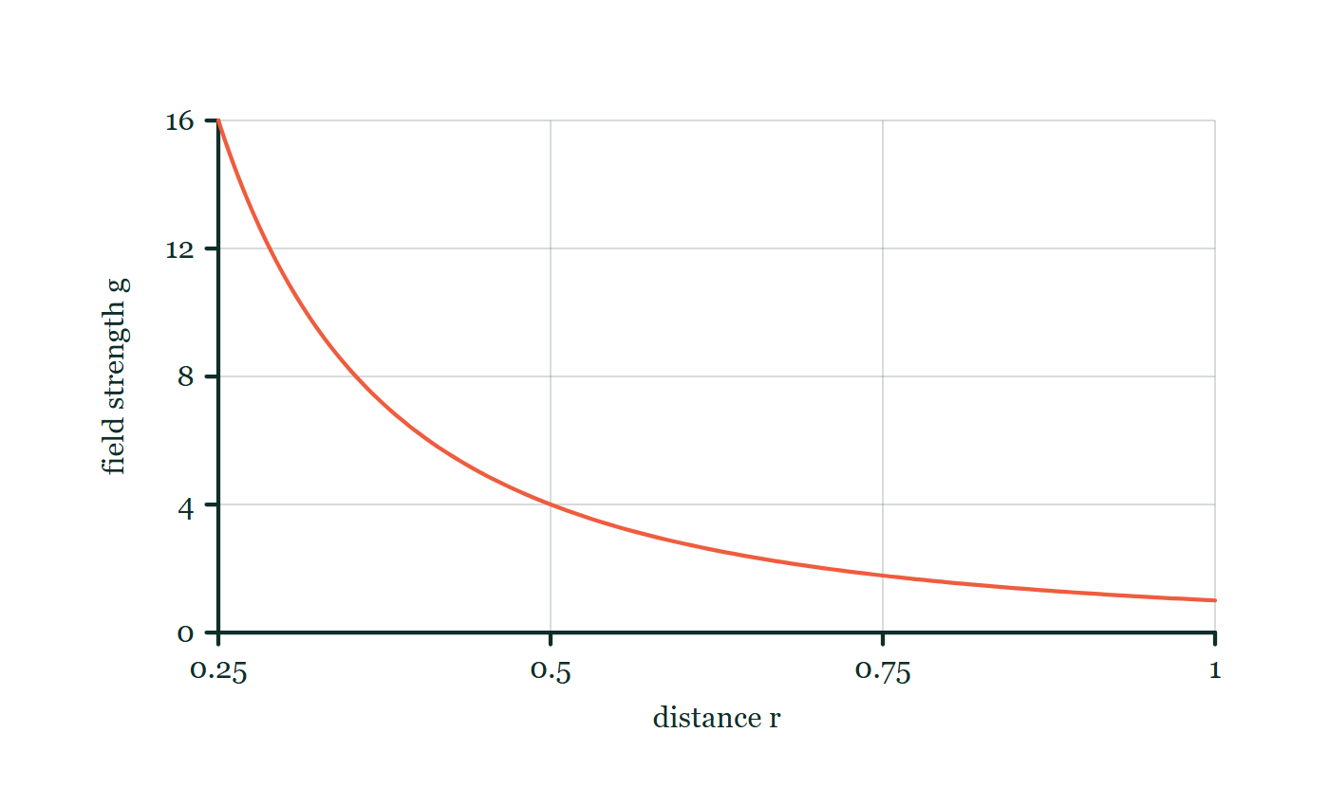
SPACE & STARS PHYSICS · THE EARTH & THE SOLAR SYSTEM
GIOPHYSICS LESSON
FORMULA 2 OF 3
Gravity as the glue
Build the model — The formulae, one at a time, in plain English
g = GM/r²
G = 6.67 × 10⁻¹¹ N m² kg⁻²
IN PLAIN ENGLISH
The Sun’s gravitational field weakens with the square of distance. That inverse square is why inner planets must orbit fast to keep falling around the Sun rather than into it.
Field strength with distance
Move this graph on the live version — click here
Space & Stars Physics — The Earth & the Solar System. Built by GioPhysics from the lesson's own copy; nothing on these slides is re-authored.
11 / 33
Notes:
[Phase] Build the model: The formulae, one at a time, in plain English (minutes 13–22 of 45)
[Formula] Gravity as the glue: g = GM/r²
[In plain English] The Sun’s gravitational field weakens with the square of distance. That inverse square is why inner planets must orbit fast to keep falling around the Sun rather than into it.
[Note] G = 6.67 × 10⁻¹¹ N m² kg⁻²
[Graph] Field strength with distance. Outside a spherical mass, doubling distance from its centre reduces field strength to one quarter.
[Axes] Horizontal: distance r. Vertical: field strength g. Values are normalised — the graph teaches the shape, not a measurement.

Slide 12
SPACE & STARS PHYSICS · THE EARTH & THE SOLAR SYSTEM
GIOPHYSICS LESSON
FORMULA 3 OF 3
Kepler’s pattern
Build the model — The formulae, one at a time, in plain English
T² ∝ r³
In AU and years: T² = r³ for the Sun
IN PLAIN ENGLISH
Farther orbits are both longer and slower, so the period grows faster than the radius. Jupiter at 5.2 AU takes not 5.2 years but √(5.2³) ≈ 12 years.
Space & Stars Physics — The Earth & the Solar System. Built by GioPhysics from the lesson's own copy; nothing on these slides is re-authored.
12 / 33
Notes:
[Phase] Build the model: The formulae, one at a time, in plain English (minutes 13–22 of 45)
[Formula] Kepler’s pattern: T² ∝ r³
[In plain English] Farther orbits are both longer and slower, so the period grows faster than the radius. Jupiter at 5.2 AU takes not 5.2 years but √(5.2³) ≈ 12 years.
[Note] In AU and years: T² = r³ for the Sun

Slide 13
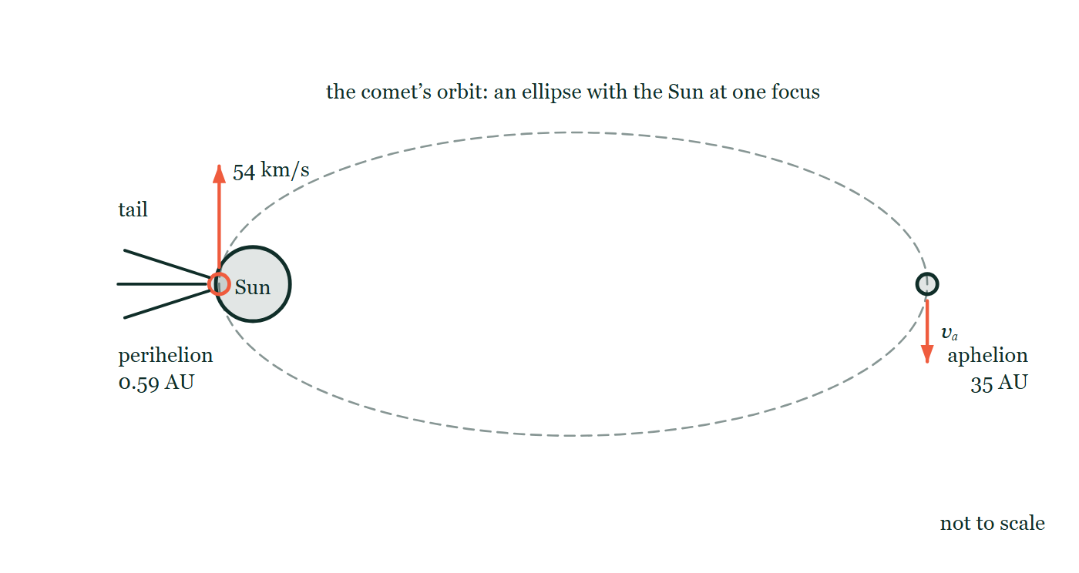
SPACE & STARS PHYSICS · THE EARTH & THE SOLAR SYSTEM
GIOPHYSICS LESSON
THE PICTURE
One comet, two ends of an ellipse
Drawn for this lesson
A comet's highly elliptical orbit with the Sun at one focus and the other focus left empty: perihelion at 0.59 AU where the speed is marked 54 km/s, aphelion at 35 AU where the speed carries only the symbol vₐ, and the tail drawn pointing radially away from the Sun rather than trailing the motion.
The live version of this figure — click here
Space & Stars Physics — The Earth & the Solar System. Built by GioPhysics from the lesson's own copy; nothing on these slides is re-authored.
13 / 33
Notes:
[Phase] Build the model: The formulae, one at a time, in plain English (minutes 13–22 of 45)
[Figure] A comet's highly elliptical orbit with the Sun at one focus and the other focus left empty: perihelion at 0.59 AU where the speed is marked 54 km/s, aphelion at 35 AU where the speed carries only the symbol vₐ, and the tail drawn pointing radially away from the Sun rather than trailing the motion.

Slide 14
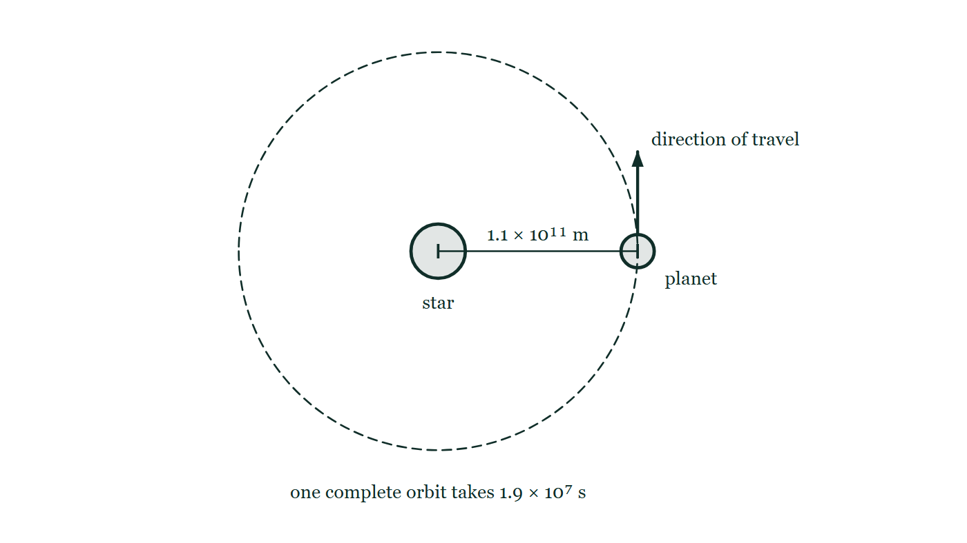
SPACE & STARS PHYSICS · THE EARTH & THE SOLAR SYSTEM
GIOPHYSICS LESSON
FIGURE 1 OF 2
Fig. 3.1 — IGCSE Topic 6 · Space physics
Drawn for question 3 of that paper · syllabus 6.1
A planet moving on a nearly circular orbit around its star. The star is a disc at the centre of a dashed circle and the planet is a smaller disc on that circle, level with the star and to its right. The distance from the centre of the star out to the planet is marked 1.1 × 10¹¹ m, an arrow at the planet points along the orbit to show the direction in which it travels, and a note beneath states that one complete orbit takes 1.9 × 10⁷ s.
See the question this was drawn for — click here
Space & Stars Physics — The Earth & the Solar System. Built by GioPhysics from the lesson's own copy; nothing on these slides is re-authored.
14 / 33
Notes:
[Phase] Build the model: The formulae, one at a time, in plain English (minutes 13–22 of 45)
[Figure] Fig. 3.1. A planet moving on a nearly circular orbit around its star. The star is a disc at the centre of a dashed circle and the planet is a smaller disc on that circle, level with the star and to its right. The distance from the centre of the star out to the planet is marked 1.1 × 10¹¹ m, an arrow at the planet points along the orbit to show the direction in which it travels, and a note beneath states that one complete orbit takes 1.9 × 10⁷ s.
[Where it came from] IGCSE Topic 6 · Space physics, question 3; syllabus 6.1.

Slide 15
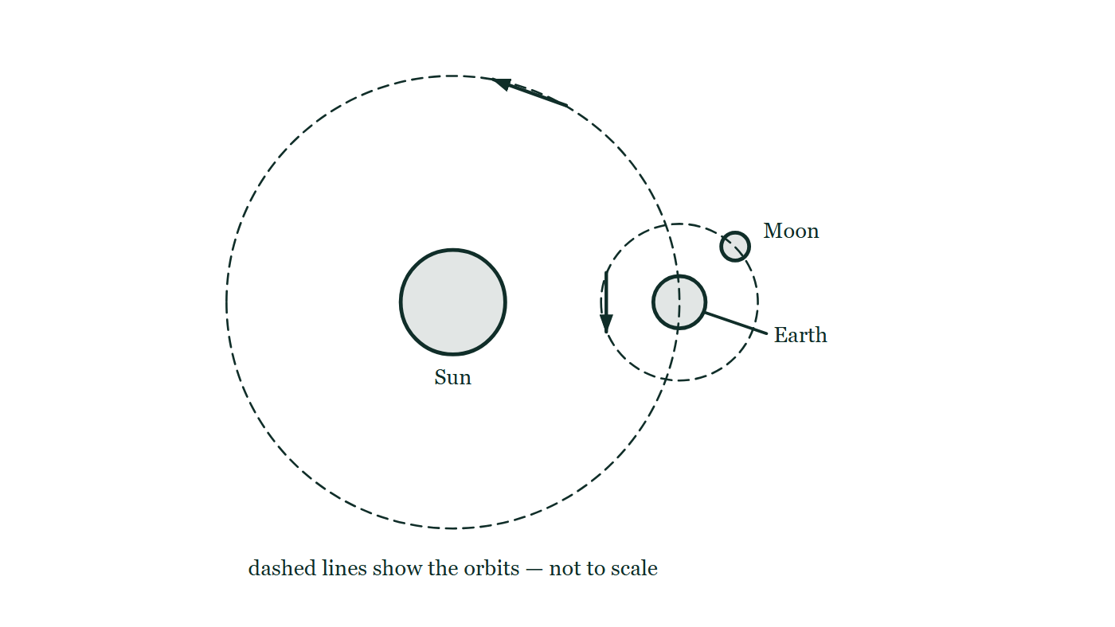
SPACE & STARS PHYSICS · THE EARTH & THE SOLAR SYSTEM
GIOPHYSICS LESSON
FIGURE 2 OF 2
Fig. 7.1 — IGCSE Topic 6 · Space physics
Drawn for question 7 of that paper · syllabus 6.1
A not-to-scale plan view of the Sun, the Earth and the Moon. The Sun is a disc at the centre of a large dashed circle, and the Earth is a smaller disc sitting on that circle to the right of the Sun. A second, much smaller dashed circle is drawn around the Earth with the Moon on it, up and to the right of the Earth. A short arrow on each dashed circle shows the direction in which the Earth travels around the Sun and the Moon around the Earth.
See the question this was drawn for — click here
Space & Stars Physics — The Earth & the Solar System. Built by GioPhysics from the lesson's own copy; nothing on these slides is re-authored.
15 / 33
Notes:
[Phase] Build the model: The formulae, one at a time, in plain English (minutes 13–22 of 45)
[Figure] Fig. 7.1. A not-to-scale plan view of the Sun, the Earth and the Moon. The Sun is a disc at the centre of a large dashed circle, and the Earth is a smaller disc sitting on that circle to the right of the Sun. A second, much smaller dashed circle is drawn around the Earth with the Moon on it, up and to the right of the Earth. A short arrow on each dashed circle shows the direction in which the Earth travels around the Sun and the Moon around the Earth.
[Where it came from] IGCSE Topic 6 · Space physics, question 7; syllabus 6.1.

Slide 16
SPACE & STARS PHYSICS · THE EARTH & THE SOLAR SYSTEM
GIOPHYSICS LESSON
WATCH OUT
The common trap
Check and misconception — The quick check and the trap
Seasons are not caused by the Earth being nearer the Sun in summer. The orbit is nearly circular, the Earth is closest in January, and the hemispheres have opposite seasons simultaneously — impossible if distance were the cause. It is the tilt: leaning toward the Sun means steeper rays and longer days, and that is the whole story.
Space & Stars Physics — The Earth & the Solar System. Built by GioPhysics from the lesson's own copy; nothing on these slides is re-authored.
16 / 33
Notes:
[Phase] Check and misconception: The quick check and the trap (minutes 35–41 of 45)
[Misconception] Seasons are not caused by the Earth being nearer the Sun in summer. The orbit is nearly circular, the Earth is closest in January, and the hemispheres have opposite seasons simultaneously — impossible if distance were the cause. It is the tilt: leaning toward the Sun means steeper rays and longer days, and that is the whole story.

Slide 17
SPACE & STARS PHYSICS · THE EARTH & THE SOLAR SYSTEM
GIOPHYSICS LESSON
WORKED EXAMPLE 1 OF 2 · EASY
The question
Easy
Worked examples — I do, we do — one step revealed at a time
The Earth orbits the Sun at radius 1.5 × 10¹¹ m with a period of 1 year (3.15 × 10⁷ s). Find its orbital speed.
Space & Stars Physics — The Earth & the Solar System. Built by GioPhysics from the lesson's own copy; nothing on these slides is re-authored.
17 / 33
Notes:
[Phase] Worked examples: I do, we do — one step revealed at a time (minutes 22–35 of 45)
[Question] The Earth orbits the Sun at radius 1.5 × 10¹¹ m with a period of 1 year (3.15 × 10⁷ s). Find its orbital speed.
[Answer] ≈ 3.0 × 10⁴ m/s (30 km/s)

Slide 18
SPACE & STARS PHYSICS · THE EARTH & THE SOLAR SYSTEM
GIOPHYSICS LESSON
WORKED EXAMPLE 1 OF 2 · EASY · THE WORKING
How to solve it
Easy
Worked examples — I do, we do — one step revealed at a time
The Earth orbits the Sun at radius 1.5 × 10¹¹ m with a period of 1 year (3.15 × 10⁷ s). Find its orbital speed.
1.
v = 2πr/T = (2π × 1.5 × 10¹¹) ÷ 3.15 × 10⁷.
2.
v = 9.42 × 10¹¹ ÷ 3.15 × 10⁷ = 2.99 × 10⁴ m/s.
3.
About 30 km/s — the Earth covers its own diameter every seven minutes.
Space & Stars Physics — The Earth & the Solar System. Built by GioPhysics from the lesson's own copy; nothing on these slides is re-authored.
18 / 33
Notes:
[Phase] Worked examples: I do, we do — one step revealed at a time (minutes 22–35 of 45)
[Reveal] One click per step. The class works each line before the next appears.
[Step 1] v = 2πr/T = (2π × 1.5 × 10¹¹) ÷ 3.15 × 10⁷.
[Step 2] v = 9.42 × 10¹¹ ÷ 3.15 × 10⁷ = 2.99 × 10⁴ m/s.
[Step 3] About 30 km/s — the Earth covers its own diameter every seven minutes.

Slide 19
SPACE & STARS PHYSICS · THE EARTH & THE SOLAR SYSTEM
GIOPHYSICS LESSON
WORKED EXAMPLE 1 OF 2 · EASY
Answer
Easy
Worked examples — I do, we do — one step revealed at a time
≈ 3.0 × 10⁴ m/s (30 km/s)
Space & Stars Physics — The Earth & the Solar System. Built by GioPhysics from the lesson's own copy; nothing on these slides is re-authored.
19 / 33
Notes:
[Phase] Worked examples: I do, we do — one step revealed at a time (minutes 22–35 of 45)
[Answer] ≈ 3.0 × 10⁴ m/s (30 km/s)

Slide 20
SPACE & STARS PHYSICS · THE EARTH & THE SOLAR SYSTEM
GIOPHYSICS LESSON
WORKED EXAMPLE 2 OF 2 · MEDIUM
The question
Medium
Worked examples — I do, we do — one step revealed at a time
Jupiter orbits at r = 7.8 × 10¹¹ m with a period of 11.9 years. Find its orbital speed and compare it with the Earth’s.
Space & Stars Physics — The Earth & the Solar System. Built by GioPhysics from the lesson's own copy; nothing on these slides is re-authored.
20 / 33
Notes:
[Phase] Worked examples: I do, we do — one step revealed at a time (minutes 22–35 of 45)
[Question] Jupiter orbits at r = 7.8 × 10¹¹ m with a period of 11.9 years. Find its orbital speed and compare it with the Earth’s.
[Answer] ≈ 13 km/s — farther is slower

Slide 21
SPACE & STARS PHYSICS · THE EARTH & THE SOLAR SYSTEM
GIOPHYSICS LESSON
WORKED EXAMPLE 2 OF 2 · MEDIUM · THE WORKING
How to solve it
Medium
Worked examples — I do, we do — one step revealed at a time
Jupiter orbits at r = 7.8 × 10¹¹ m with a period of 11.9 years. Find its orbital speed and compare it with the Earth’s.
1.
T = 11.9 × 3.15 × 10⁷ = 3.75 × 10⁸ s.
2.
v = 2πr/T = (2π × 7.8 × 10¹¹) ÷ 3.75 × 10⁸ = 1.3 × 10⁴ m/s.
3.
Five times farther out than the Earth, Jupiter moves at less than half the speed — v = 2πr/T rises with r far more slowly than T does, because gravity out there is 27 times weaker.
Space & Stars Physics — The Earth & the Solar System. Built by GioPhysics from the lesson's own copy; nothing on these slides is re-authored.
21 / 33
Notes:
[Phase] Worked examples: I do, we do — one step revealed at a time (minutes 22–35 of 45)
[Reveal] One click per step. The class works each line before the next appears.
[Step 1] T = 11.9 × 3.15 × 10⁷ = 3.75 × 10⁸ s.
[Step 2] v = 2πr/T = (2π × 7.8 × 10¹¹) ÷ 3.75 × 10⁸ = 1.3 × 10⁴ m/s.
[Step 3] Five times farther out than the Earth, Jupiter moves at less than half the speed — v = 2πr/T rises with r far more slowly than T does, because gravity out there is 27 times weaker.

Slide 22
SPACE & STARS PHYSICS · THE EARTH & THE SOLAR SYSTEM
GIOPHYSICS LESSON
WORKED EXAMPLE 2 OF 2 · MEDIUM
Answer
Medium
Worked examples — I do, we do — one step revealed at a time
≈ 13 km/s — farther is slower
Space & Stars Physics — The Earth & the Solar System. Built by GioPhysics from the lesson's own copy; nothing on these slides is re-authored.
22 / 33
Notes:
[Phase] Worked examples: I do, we do — one step revealed at a time (minutes 22–35 of 45)
[Answer] ≈ 13 km/s — farther is slower

Slide 23
SPACE & STARS PHYSICS · THE EARTH & THE SOLAR SYSTEM
GIOPHYSICS LESSON
PREDICT · TAKE THE VOTE
Commit before you are told
Hands up for each option, then click
At one of the two drawn positions the Earth is about 3% nearer the Sun. Which position is northern summer?
A The nearer one — more sunlight arrives from closer in
B The one where the north pole leans toward the Sun, whichever of the two that happens to be
C Both, because the Earth is always nearest the Sun when the north pole leans toward it
The Earth drawn at two positions of its orbit round the Sun, its spin axis tilted 23.5° from the vertical and pointing the same way in space at both, with sunlight arrowed in and a note that the Earth–Sun distance changes by only about 3% over the year.
The live version of this figure — click here
Space & Stars Physics — The Earth & the Solar System. Built by GioPhysics from the lesson's own copy; nothing on these slides is re-authored.
23 / 33
Notes:
[Phase] Build the model: The formulae, one at a time, in plain English (minutes 13–22 of 45)
[Predict] At one of the two drawn positions the Earth is about 3% nearer the Sun. Which position is northern summer?
[Options] A The nearer one — more sunlight arrives from closer in B The one where the north pole leans toward the Sun, whichever of the two that happens to be C Both, because the Earth is always nearest the Sun when the north pole leans toward it
[Figure] The Earth drawn at two positions of its orbit round the Sun, its spin axis tilted 23.5° from the vertical and pointing the same way in space at both, with sunlight arrowed in and a note that the Earth–Sun distance changes by only about 3% over the year.

Slide 24
SPACE & STARS PHYSICS · THE EARTH & THE SOLAR SYSTEM
GIOPHYSICS LESSON
PREDICT · THE OUTCOME
What actually happens
Ask the room who changed their mind, and why
B The one where the north pole leans toward the Sun, whichever of the two that happens to be
WHY
The axis keeps pointing the same way in space all year, so as the Earth goes round, first one hemisphere and then the other leans sunward — and that is the whole of the seasons. The 3% is real but it is the wrong size and, as it happens, the wrong sign: the Earth is nearest the Sun in January, in the middle of the northern winter. And whatever the distance is doing, it is doing it to both hemispheres at once, which is why option 3 could never account for Australia's summer happening at the same time.
Space & Stars Physics — The Earth & the Solar System. Built by GioPhysics from the lesson's own copy; nothing on these slides is re-authored.
24 / 33
Notes:
[Phase] Build the model: The formulae, one at a time, in plain English (minutes 13–22 of 45)
[Answer] B — The one where the north pole leans toward the Sun, whichever of the two that happens to be. The axis keeps pointing the same way in space all year, so as the Earth goes round, first one hemisphere and then the other leans sunward — and that is the whole of the seasons. The 3% is real but it is the wrong size and, as it happens, the wrong sign: the Earth is nearest the Sun in January, in the middle of the northern winter. And whatever the distance is doing, it is doing it to both hemispheres at once, which is why option 3 could never account for Australia's summer happening at the same time.

Slide 25
SPACE & STARS PHYSICS · THE EARTH & THE SOLAR SYSTEM
GIOPHYSICS LESSON
QUICK CHECK
Decide before the answer goes up
Check and misconception — The quick check and the trap
Why does Mercury orbit the Sun faster than Neptune?
A
Mercury is smaller, so it is easier to move
B
Closer in, the Sun’s gravity is stronger, so a faster speed is needed to stay in orbit
C
Mercury is hotter, and hot objects move faster
Space & Stars Physics — The Earth & the Solar System. Built by GioPhysics from the lesson's own copy; nothing on these slides is re-authored.
25 / 33
Notes:
[Phase] Check and misconception: The quick check and the trap (minutes 35–41 of 45)
[Question] Why does Mercury orbit the Sun faster than Neptune?
[Options] A Mercury is smaller, so it is easier to move B Closer in, the Sun’s gravity is stronger, so a faster speed is needed to stay in orbit C Mercury is hotter, and hot objects move faster

Slide 26
SPACE & STARS PHYSICS · THE EARTH & THE SOLAR SYSTEM
GIOPHYSICS LESSON
QUICK CHECK · THE ANSWER
The answer, and why
Check and misconception — The quick check and the trap
B Closer in, the Sun’s gravity is stronger, so a faster speed is needed to stay in orbit
HOW TO GET THERE
The pull g = GM/r² is fiercest close in, and the centripetal acceleration v²/r must match it. Mass cancels out of the orbit equation entirely — a pebble at Mercury’s distance would orbit at Mercury’s speed.
WHY THE OTHERS TEMPT
A Mass drops out of the orbit equation entirely: set GMm/r² = mv²/r and the m cancels. A pebble placed at Mercury's distance would orbit at Mercury's speed, and so would a planet the size of Jupiter — being small buys a planet nothing.
B Correct. The pull g = GM/r² is fiercest close in, and the centripetal acceleration v²/r has to match it, which needs a larger v at a smaller r.
C Mercury is hot because it is close to the Sun, so the two facts do travel together — but the heat is a consequence of the distance, not a cause of the speed. Temperature is about how fast the atoms of a surface jiggle; it has no bearing on how fast the planet as a whole is carried round its orbit.
Space & Stars Physics — The Earth & the Solar System. Built by GioPhysics from the lesson's own copy; nothing on these slides is re-authored.
26 / 33
Notes:
[Phase] Check and misconception: The quick check and the trap (minutes 35–41 of 45)
[Question] Why does Mercury orbit the Sun faster than Neptune?
[Option by option] A: Mass drops out of the orbit equation entirely: set GMm/r² = mv²/r and the m cancels. A pebble placed at Mercury's distance would orbit at Mercury's speed, and so would a planet the size of Jupiter — being small buys a planet nothing. B: Correct. The pull g = GM/r² is fiercest close in, and the centripetal acceleration v²/r has to match it, which needs a larger v at a smaller r. C: Mercury is hot because it is close to the Sun, so the two facts do travel together — but the heat is a consequence of the distance, not a cause of the speed. Temperature is about how fast the atoms of a surface jiggle; it has no bearing on how fast the planet as a whole is carried round its orbit.
[Answer] B — Closer in, the Sun’s gravity is stronger, so a faster speed is needed to stay in orbit
[Why] The pull g = GM/r² is fiercest close in, and the centripetal acceleration v²/r must match it. Mass cancels out of the orbit equation entirely — a pebble at Mercury’s distance would orbit at Mercury’s speed.
[Reveal] One click for the answer, then one for the reason.

Slide 27
SPACE & STARS PHYSICS · THE EARTH & THE SOLAR SYSTEM
GIOPHYSICS LESSON
EXTENSION 1 OF 2 · HARD
The question
Hard
Worked examples — I do, we do — one step revealed at a time
Use the Earth’s orbit (r = 1.5 × 10¹¹ m, T = 3.15 × 10⁷ s) to find the mass of the Sun.
Space & Stars Physics — The Earth & the Solar System. Built by GioPhysics from the lesson's own copy; nothing on these slides is re-authored.
27 / 33
Notes:
[Phase] Worked examples: I do, we do — one step revealed at a time (minutes 22–35 of 45)
[Question] Use the Earth’s orbit (r = 1.5 × 10¹¹ m, T = 3.15 × 10⁷ s) to find the mass of the Sun.
[Answer] M ≈ 2.0 × 10³⁰ kg

Slide 28
SPACE & STARS PHYSICS · THE EARTH & THE SOLAR SYSTEM
GIOPHYSICS LESSON
EXTENSION 1 OF 2 · HARD · THE WORKING
How to solve it
Hard
Worked examples — I do, we do — one step revealed at a time
Use the Earth’s orbit (r = 1.5 × 10¹¹ m, T = 3.15 × 10⁷ s) to find the mass of the Sun.
1.
Gravity supplies the centripetal force: GMm/r² = mv²/r with v = 2πr/T, giving M = 4π²r³/(GT²).
2.
M = (4π² × (1.5 × 10¹¹)³) ÷ (6.67 × 10⁻¹¹ × (3.15 × 10⁷)²).
3.
M = 1.33 × 10³⁵ ÷ 6.62 × 10⁴ ≈ 2.0 × 10³⁰ kg — weighing the Sun with a calendar and a ruler.
Space & Stars Physics — The Earth & the Solar System. Built by GioPhysics from the lesson's own copy; nothing on these slides is re-authored.
28 / 33
Notes:
[Phase] Worked examples: I do, we do — one step revealed at a time (minutes 22–35 of 45)
[Reveal] One click per step. The class works each line before the next appears.
[Step 1] Gravity supplies the centripetal force: GMm/r² = mv²/r with v = 2πr/T, giving M = 4π²r³/(GT²).
[Step 2] M = (4π² × (1.5 × 10¹¹)³) ÷ (6.67 × 10⁻¹¹ × (3.15 × 10⁷)²).
[Step 3] M = 1.33 × 10³⁵ ÷ 6.62 × 10⁴ ≈ 2.0 × 10³⁰ kg — weighing the Sun with a calendar and a ruler.

Slide 29
SPACE & STARS PHYSICS · THE EARTH & THE SOLAR SYSTEM
GIOPHYSICS LESSON
EXTENSION 1 OF 2 · HARD
Answer
Hard
Worked examples — I do, we do — one step revealed at a time
M ≈ 2.0 × 10³⁰ kg
Space & Stars Physics — The Earth & the Solar System. Built by GioPhysics from the lesson's own copy; nothing on these slides is re-authored.
29 / 33
Notes:
[Phase] Worked examples: I do, we do — one step revealed at a time (minutes 22–35 of 45)
[Answer] M ≈ 2.0 × 10³⁰ kg

Slide 30
SPACE & STARS PHYSICS · THE EARTH & THE SOLAR SYSTEM
GIOPHYSICS LESSON
EXTENSION 2 OF 2 · CHALLENGING
The question
Challenging
Worked examples — I do, we do — one step revealed at a time
Halley’s comet moves at 54 km/s at perihelion (0.59 AU) and climbs out to aphelion at 35 AU. Estimate its aphelion speed and explain the energy story of one full orbit.
Space & Stars Physics — The Earth & the Solar System. Built by GioPhysics from the lesson's own copy; nothing on these slides is re-authored.
30 / 33
Notes:
[Phase] Worked examples: I do, we do — one step revealed at a time (minutes 22–35 of 45)
[Question] Halley’s comet moves at 54 km/s at perihelion (0.59 AU) and climbs out to aphelion at 35 AU. Estimate its aphelion speed and explain the energy story of one full orbit.
[Answer] ≈ 0.9 km/s at aphelion — fast and hot near the Sun, slow and frozen far away

Slide 31
SPACE & STARS PHYSICS · THE EARTH & THE SOLAR SYSTEM
GIOPHYSICS LESSON
EXTENSION 2 OF 2 · CHALLENGING · THE WORKING
How to solve it
Challenging
Worked examples — I do, we do — one step revealed at a time
Halley’s comet moves at 54 km/s at perihelion (0.59 AU) and climbs out to aphelion at 35 AU. Estimate its aphelion speed and explain the energy story of one full orbit.
1.
For an orbit, angular momentum about the Sun is conserved: m v r is the same at the two extremes (velocity is perpendicular to the radius there), so vₐ = vₚ rₚ/rₐ.
2.
vₐ = 54 × 0.59 ÷ 35 ≈ 0.91 km/s — sixty times slower than at perihelion.
3.
Energy bookkeeping: falling inward, gravitational potential energy converts to kinetic energy, peaking at perihelion; climbing out, the trade reverses. Total energy never changes — the comet is a frictionless pendulum swinging in the Sun’s field, which is why its 76-year returns are so predictable.
Space & Stars Physics — The Earth & the Solar System. Built by GioPhysics from the lesson's own copy; nothing on these slides is re-authored.
31 / 33
Notes:
[Phase] Worked examples: I do, we do — one step revealed at a time (minutes 22–35 of 45)
[Reveal] One click per step. The class works each line before the next appears.
[Step 1] For an orbit, angular momentum about the Sun is conserved: m v r is the same at the two extremes (velocity is perpendicular to the radius there), so vₐ = vₚ rₚ/rₐ.
[Step 2] vₐ = 54 × 0.59 ÷ 35 ≈ 0.91 km/s — sixty times slower than at perihelion.
[Step 3] Energy bookkeeping: falling inward, gravitational potential energy converts to kinetic energy, peaking at perihelion; climbing out, the trade reverses. Total energy never changes — the comet is a frictionless pendulum swinging in the Sun’s field, which is why its 76-year returns are so predictable.

Slide 32
SPACE & STARS PHYSICS · THE EARTH & THE SOLAR SYSTEM
GIOPHYSICS LESSON
EXTENSION 2 OF 2 · CHALLENGING
Answer
Challenging
Worked examples — I do, we do — one step revealed at a time
≈ 0.9 km/s at aphelion — fast and hot near the Sun, slow and frozen far away
Space & Stars Physics — The Earth & the Solar System. Built by GioPhysics from the lesson's own copy; nothing on these slides is re-authored.
32 / 33
Notes:
[Phase] Worked examples: I do, we do — one step revealed at a time (minutes 22–35 of 45)
[Answer] ≈ 0.9 km/s at aphelion — fast and hot near the Sun, slow and frozen far away

Slide 33
SPACE & STARS PHYSICS · THE EARTH & THE SOLAR SYSTEM
GIOPHYSICS LESSON
SPACE & STARS PHYSICS
Where to go next
Plenary — What to take away, what to practise next
Next
28.2 Star Birth & Life Cycles
https://giophysics.com/chapter-53/stellar-lifecycles/
Lesson
This lesson on giophysics.com
https://giophysics.com/chapter-53/solar-system/
Live
The live, interactive version of these slides
https://giophysics.com/chapter-53/presentation/?lesson=solar
Chapter
All Space & Stars Physics lessons
https://giophysics.com/chapter-53/
PDF
Download the lesson PDF
https://giophysics.com/downloads/53-1-solar-system.pdf
Space & Stars Physics — The Earth & the Solar System. Built by GioPhysics from the lesson's own copy; nothing on these slides is re-authored.
33 / 33
Notes:
[Phase] Plenary: What to take away, what to practise next (minutes 41–45 of 45)
[Interactive] The graphs and the circuit topology on these slides are frozen. The live version at https://giophysics.com/chapter-53/presentation/?lesson=solar moves them.

