Slide 1
MEDICAL PHYSICS · X-RAY IMAGING
GIOPHYSICS LESSON
29 · Medical Physics
Shadows the body casts
X-Ray Imaging
Slam a beam of fast electrons into a tungsten block and about one percent of their energy re-emerges as X-ray photons — the other ninety-nine percent is heat. Aim those photons through a patient at a detector, and the shadow the skeleton casts becomes the oldest medical image of all.
POSITION
Lesson 1 of 6 in Medical Physics
PLAN
16 slides in the 45-minute core run, about 45 minutes of it
LESSON PAGE
https://giophysics.com/chapter-57/x-ray-imaging/
Built by GioPhysics from the lesson's own page. Every word on these slides is the lesson's; nothing here is re-authored. Teaching material, not an awarding body's document.
Medical Physics — X-Ray Imaging. Built by GioPhysics from the lesson's own copy; nothing on these slides is re-authored.
1 / 33
Notes:
[Lesson] Medical Physics — X-Ray Imaging. Lesson 1 of 6.
[Intro] Slam a beam of fast electrons into a tungsten block and about one percent of their energy re-emerges as X-ray photons — the other ninety-nine percent is heat. Aim those photons through a patient at a detector, and the shadow the skeleton casts becomes the oldest medical image of all.
[Source] https://giophysics.com/chapter-57/x-ray-imaging/
[Disclaimer] Built by GioPhysics from the lesson's own page. Every word on these slides is the lesson's; nothing here is re-authored. Teaching material, not an awarding body's document.

Slide 2
MEDICAL PHYSICS · X-RAY IMAGING
GIOPHYSICS LESSON
WHAT THIS NEEDS
What you already know
Starter — Recall what this lesson stands on
Recall
Photons & energy levels
https://giophysics.com/chapter-46/energy-levels/
Recall
Electromagnetic waves
https://giophysics.com/chapter-24/electromagnetic-waves/
Medical Physics — X-Ray Imaging. Built by GioPhysics from the lesson's own copy; nothing on these slides is re-authored.
2 / 33
Notes:
[Phase] Starter: Recall what this lesson stands on (minutes 0–5 of 45)
[Starter] Recall: Photons & energy levels; Electromagnetic waves

Slide 3
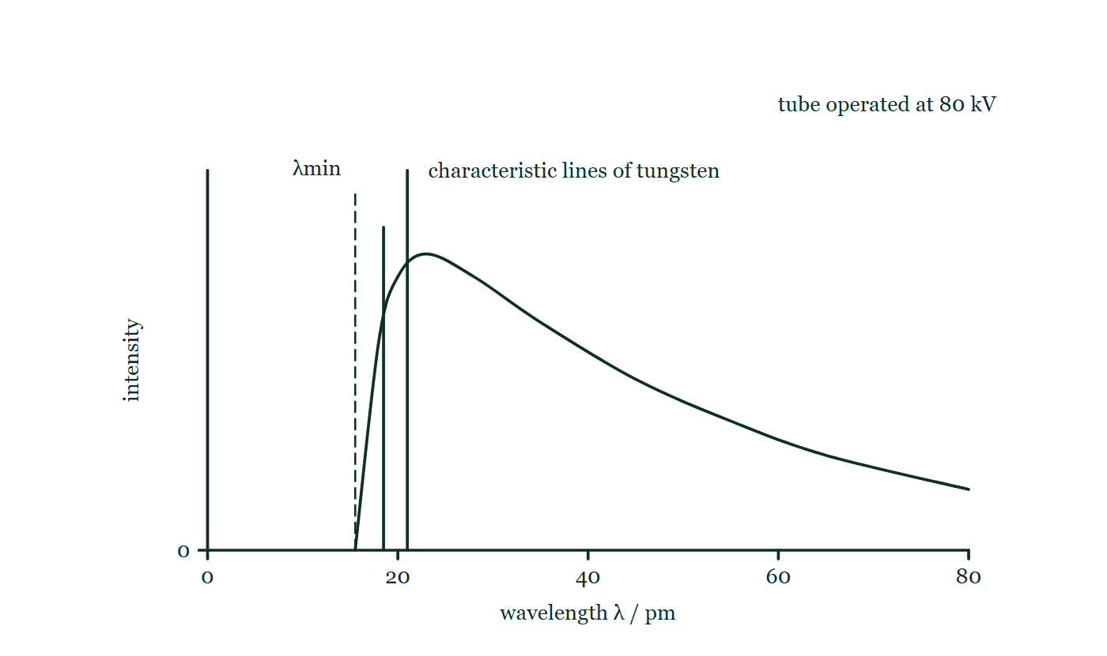
MEDICAL PHYSICS · X-RAY IMAGING
GIOPHYSICS LESSON
THINK FIRST
An X-ray shows bone brilliantly and a tumour in soft tissue almost not at all. Both are made of atoms. What is bone doing that the tumour is not?
Take answers before you click — the point is the commitment
Bone is denser than soft tissue, but only by about a factor of two — and two neighbouring soft tissues can differ in density by as much as that without showing any difference on the film at all.
THE ANSWER
Absorbing far more per gram, because the attenuation coefficient μ climbs steeply with atomic number. Bone carries calcium at Z = 20 among tissue's carbon, oxygen and hydrogen, and that is what makes the shadow. It also explains barium, at Z = 56, which a patient swallows precisely so that a gut made of the wrong elements can be made to cast a shadow at all.
Intensity against wavelength for a tube at 80 kV: a continuous braking hump that stops dead at a sharp cutoff marked λmin, with two narrow characteristic lines of tungsten standing above the hump at shorter wavelengths than its peak.
The live version of this figure — click here
Medical Physics — X-Ray Imaging. Built by GioPhysics from the lesson's own copy; nothing on these slides is re-authored.
3 / 33
Notes:
[Phase] Starter: Recall what this lesson stands on (minutes 0–5 of 45)
[Hook] An X-ray shows bone brilliantly and a tumour in soft tissue almost not at all. Both are made of atoms. What is bone doing that the tumour is not? Bone is denser than soft tissue, but only by about a factor of two — and two neighbouring soft tissues can differ in density by as much as that without showing any difference on the film at all.
[Answer] Absorbing far more per gram, because the attenuation coefficient μ climbs steeply with atomic number. Bone carries calcium at Z = 20 among tissue's carbon, oxygen and hydrogen, and that is what makes the shadow. It also explains barium, at Z = 56, which a patient swallows precisely so that a gut made of the wrong elements can be made to cast a shadow at all.
[Figure] Intensity against wavelength for a tube at 80 kV: a continuous braking hump that stops dead at a sharp cutoff marked λmin, with two narrow characteristic lines of tungsten standing above the hump at shorter wavelengths than its peak.

Slide 4
MEDICAL PHYSICS · X-RAY IMAGING
GIOPHYSICS LESSON
EXPLAINED SIMPLY
In one sentence
Introduce the idea — The big idea and the definition
An X-ray tube converts the kinetic energy of electrons accelerated through a p.d. V into X-ray photons — maximum photon energy eV, so λmin = hc/eV. The body attenuates the beam as I = I₀e^(−μx), and differences in μ between tissues create the image contrast.
Medical Physics — X-Ray Imaging. Built by GioPhysics from the lesson's own copy; nothing on these slides is re-authored.
4 / 33
Notes:
[Phase] Introduce the idea: The big idea and the definition (minutes 5–13 of 45)
[Definition] An X-ray tube converts the kinetic energy of electrons accelerated through a p.d. V into X-ray photons — maximum photon energy eV, so λmin = hc/eV. The body attenuates the beam as I = I₀e^(−μx), and differences in μ between tissues create the image contrast.

Slide 5
MEDICAL PHYSICS · X-RAY IMAGING
GIOPHYSICS LESSON
EXPLAINED SIMPLY
What that looks like
Introduce the idea — The big idea and the definition
FOR EXAMPLE
At 100 kV no photon can carry more than 100 keV, so λmin = hc/eV ≈ 12.4 pm. Raising the voltage shifts the whole spectrum to shorter, more penetrating wavelengths; raising the current only makes more of the same photons.
Medical Physics — X-Ray Imaging. Built by GioPhysics from the lesson's own copy; nothing on these slides is re-authored.
5 / 33
Notes:
[Phase] Introduce the idea: The big idea and the definition (minutes 5–13 of 45)
[Worked illustration] At 100 kV no photon can carry more than 100 keV, so λmin = hc/eV ≈ 12.4 pm. Raising the voltage shifts the whole spectrum to shorter, more penetrating wavelengths; raising the current only makes more of the same photons.

Slide 6
MEDICAL PHYSICS · X-RAY IMAGING
GIOPHYSICS LESSON
THE BIG IDEA
Shadows the body casts
Introduce the idea — The big idea and the definition
An X-ray tube boils electrons off a hot cathode by thermionic emission, accelerates them through a p.d. of tens of kilovolts in vacuum, and crashes them into a tungsten anode. The violent deceleration radiates a continuous braking spectrum whose sharp short-wavelength cutoff comes from an electron converting its entire kinetic energy into one photon: eV = hc/λmin. Electrons that knock out inner tungsten electrons add characteristic spike lines at fixed wavelengths on top of the continuum.
Only about 1% of the beam power becomes X-rays, so the anode spins to spread the heat. Inside the body the beam attenuates exponentially, I = I₀e^(−μx), and the attenuation coefficient μ rises steeply with atomic number and falls with photon energy: calcium-rich bone absorbs far more than soft tissue, so the transmitted beam prints a shadowgraph. Soft structures that barely differ in μ are made visible by filling them with a high-Z contrast medium such as a barium meal.
Medical Physics — X-Ray Imaging. Built by GioPhysics from the lesson's own copy; nothing on these slides is re-authored.
6 / 33
Notes:
[Phase] Introduce the idea: The big idea and the definition (minutes 5–13 of 45)
[Big idea] An X-ray tube boils electrons off a hot cathode by thermionic emission, accelerates them through a p.d. of tens of kilovolts in vacuum, and crashes them into a tungsten anode. The violent deceleration radiates a continuous braking spectrum whose sharp short-wavelength cutoff comes from an electron converting its entire kinetic energy into one photon: eV = hc/λmin. Electrons that knock out inner tungsten electrons add characteristic spike lines at fixed wavelengths on top of the continuum. Only about 1% of the beam power becomes X-rays, so the anode spins to spread the heat. Inside the body the beam attenuates exponentially, I = I₀e^(−μx), and the attenuation coefficient μ rises steeply with atomic number and falls with photon energy: calcium-rich bone absorbs far more than soft tissue, so the transmitted beam prints a shadowgraph. Soft structures that barely differ in μ are made visible by filling them with a high-Z contrast medium such as a barium meal.

Slide 7
MEDICAL PHYSICS · X-RAY IMAGING
GIOPHYSICS LESSON
THE PHYSICS · 1 OF 3
Inside the tube
Build the model — The formulae, one at a time, in plain English
A heated filament releases electrons (thermionic emission); a p.d. of 30–150 kV accelerates them across an evacuated gap; a tungsten anode stops them. The tube current sets how many electrons arrive per second and hence the beam intensity; the tube voltage sets each photon's energy budget. Because ~99% of the power becomes heat, the anode is a spinning disc, presenting fresh metal to the beam thousands of times a second.
Medical Physics — X-Ray Imaging. Built by GioPhysics from the lesson's own copy; nothing on these slides is re-authored.
7 / 33
Notes:
[Phase] Build the model: The formulae, one at a time, in plain English (minutes 13–22 of 45)
[Section] A heated filament releases electrons (thermionic emission); a p.d. of 30–150 kV accelerates them across an evacuated gap; a tungsten anode stops them. The tube current sets how many electrons arrive per second and hence the beam intensity; the tube voltage sets each photon's energy budget. Because ~99% of the power becomes heat, the anode is a spinning disc, presenting fresh metal to the beam thousands of times a second.

Slide 8
MEDICAL PHYSICS · X-RAY IMAGING
GIOPHYSICS LESSON
THE PHYSICS · 2 OF 3
Two spectra in one beam
Build the model — The formulae, one at a time, in plain English
The continuous spectrum comes from braking radiation: electrons decelerating in the target radiate every wavelength down to the λmin cutoff. The line spectrum comes from tungsten itself: a beam electron ejects an inner-shell electron, an outer electron falls into the hole, and a photon of fixed, element-specific energy leaves. The lines only appear once the tube voltage exceeds the inner-shell binding energy — about 70 kV for tungsten's K lines.
Medical Physics — X-Ray Imaging. Built by GioPhysics from the lesson's own copy; nothing on these slides is re-authored.
8 / 33
Notes:
[Phase] Build the model: The formulae, one at a time, in plain English (minutes 13–22 of 45)
[Section] The continuous spectrum comes from braking radiation: electrons decelerating in the target radiate every wavelength down to the λmin cutoff. The line spectrum comes from tungsten itself: a beam electron ejects an inner-shell electron, an outer electron falls into the hole, and a photon of fixed, element-specific energy leaves. The lines only appear once the tube voltage exceeds the inner-shell binding energy — about 70 kV for tungsten's K lines.

Slide 9
MEDICAL PHYSICS · X-RAY IMAGING
GIOPHYSICS LESSON
THE PHYSICS · 3 OF 3
From shadow to image
Build the model — The formulae, one at a time, in plain English
Sharpness demands a small focal spot and a patient close to the detector, so each point casts a crisp shadow instead of a blurred penumbra. Contrast demands tissues of different μ in the path — given for bone, engineered with barium for the gut. An aluminium filter hardens the beam by absorbing the long-wavelength photons that would only dose the skin without ever reaching the detector, and digital flat-panel detectors have replaced film, trading grains of silver for pixels and slashing the dose needed.
Medical Physics — X-Ray Imaging. Built by GioPhysics from the lesson's own copy; nothing on these slides is re-authored.
9 / 33
Notes:
[Phase] Build the model: The formulae, one at a time, in plain English (minutes 13–22 of 45)
[Section] Sharpness demands a small focal spot and a patient close to the detector, so each point casts a crisp shadow instead of a blurred penumbra. Contrast demands tissues of different μ in the path — given for bone, engineered with barium for the gut. An aluminium filter hardens the beam by absorbing the long-wavelength photons that would only dose the skin without ever reaching the detector, and digital flat-panel detectors have replaced film, trading grains of silver for pixels and slashing the dose needed.

Slide 10
MEDICAL PHYSICS · X-RAY IMAGING
GIOPHYSICS LESSON
FORMULA 1 OF 4
Minimum wavelength
Build the model — The formulae, one at a time, in plain English
eV = hc/λmin
λmin = hc/eV — set by the tube p.d. alone
IN PLAIN ENGLISH
The most extreme electron gives everything to a single photon. Nothing in the tube can beat that, so the spectrum stops dead at λmin — a cutoff you can move with the voltage knob.
Medical Physics — X-Ray Imaging. Built by GioPhysics from the lesson's own copy; nothing on these slides is re-authored.
10 / 33
Notes:
[Phase] Build the model: The formulae, one at a time, in plain English (minutes 13–22 of 45)
[Formula] Minimum wavelength: eV = hc/λmin
[In plain English] The most extreme electron gives everything to a single photon. Nothing in the tube can beat that, so the spectrum stops dead at λmin — a cutoff you can move with the voltage knob.
[Note] λmin = hc/eV — set by the tube p.d. alone

Slide 11
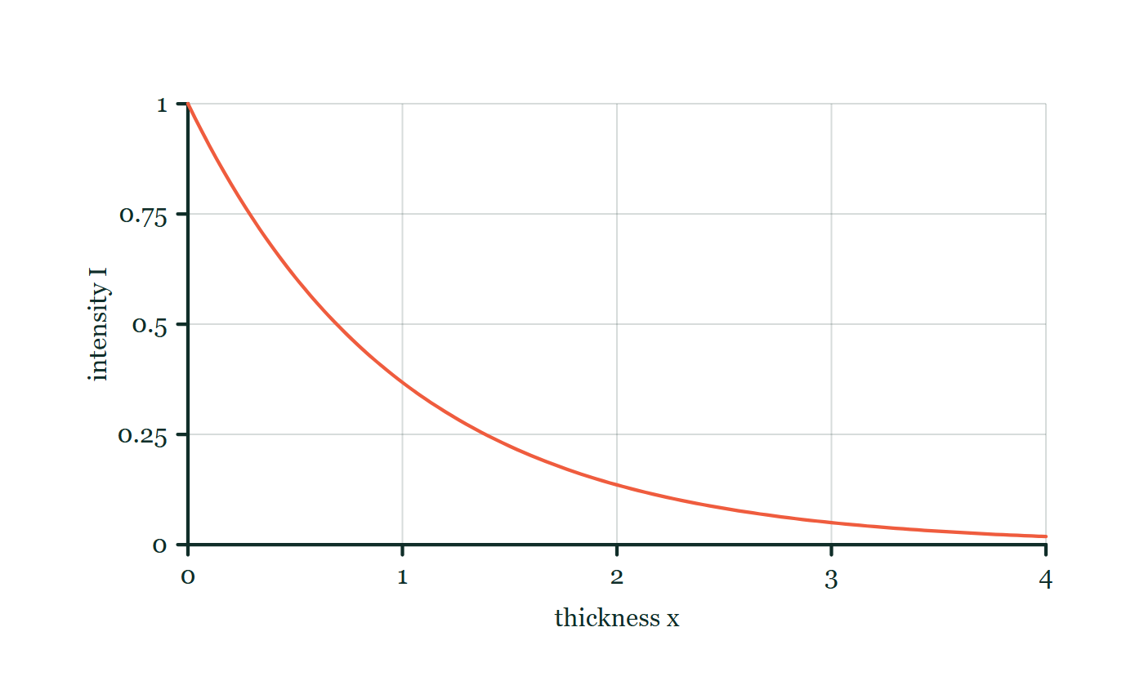
MEDICAL PHYSICS · X-RAY IMAGING
GIOPHYSICS LESSON
FORMULA 2 OF 4
Exponential attenuation
Build the model — The formulae, one at a time, in plain English
I = I₀e^(−μx)
μ is the linear attenuation coefficient
IN PLAIN ENGLISH
Each layer of tissue removes the same fraction of whatever intensity reaches it — so intensity falls exponentially, never to zero, exactly like radioactive decay with depth playing the role of time.
Attenuation explorer
Move this graph on the live version — click here
Medical Physics — X-Ray Imaging. Built by GioPhysics from the lesson's own copy; nothing on these slides is re-authored.
11 / 33
Notes:
[Phase] Build the model: The formulae, one at a time, in plain English (minutes 13–22 of 45)
[Formula] Exponential attenuation: I = I₀e^(−μx)
[In plain English] Each layer of tissue removes the same fraction of whatever intensity reaches it — so intensity falls exponentially, never to zero, exactly like radioactive decay with depth playing the role of time.
[Note] μ is the linear attenuation coefficient
[Graph] Attenuation explorer. Equal added thicknesses remove the same fraction of the remaining intensity.
[Axes] Horizontal: thickness x. Vertical: intensity I. Values are normalised — the graph teaches the shape, not a measurement.

Slide 12
MEDICAL PHYSICS · X-RAY IMAGING
GIOPHYSICS LESSON
FORMULA 3 OF 4
Electron energy
Build the model — The formulae, one at a time, in plain English
Eₖ = eV
≈ 99% ends as heat in the tungsten target
IN PLAIN ENGLISH
A 100 kV tube gives each electron 100 keV. Tungsten is chosen for its high Z (efficient X-ray production) and high melting point (it must survive the other 99%).
Medical Physics — X-Ray Imaging. Built by GioPhysics from the lesson's own copy; nothing on these slides is re-authored.
12 / 33
Notes:
[Phase] Build the model: The formulae, one at a time, in plain English (minutes 13–22 of 45)
[Formula] Electron energy: Eₖ = eV
[In plain English] A 100 kV tube gives each electron 100 keV. Tungsten is chosen for its high Z (efficient X-ray production) and high melting point (it must survive the other 99%).
[Note] ≈ 99% ends as heat in the tungsten target

Slide 13
MEDICAL PHYSICS · X-RAY IMAGING
GIOPHYSICS LESSON
FORMULA 4 OF 4
Contrast
Build the model — The formulae, one at a time, in plain English
μ rises steeply with Z
roughly as Z³ at diagnostic energies
IN PLAIN ENGLISH
Bone is rich in calcium (Z = 20) while soft tissue averages Z ≈ 7 — that Z³ gap is the whole radiograph. Barium (Z = 56) borrows the same trick to paint the gut visible.
Medical Physics — X-Ray Imaging. Built by GioPhysics from the lesson's own copy; nothing on these slides is re-authored.
13 / 33
Notes:
[Phase] Build the model: The formulae, one at a time, in plain English (minutes 13–22 of 45)
[Formula] Contrast: μ rises steeply with Z
[In plain English] Bone is rich in calcium (Z = 20) while soft tissue averages Z ≈ 7 — that Z³ gap is the whole radiograph. Barium (Z = 56) borrows the same trick to paint the gut visible.
[Note] roughly as Z³ at diagnostic energies

Slide 14
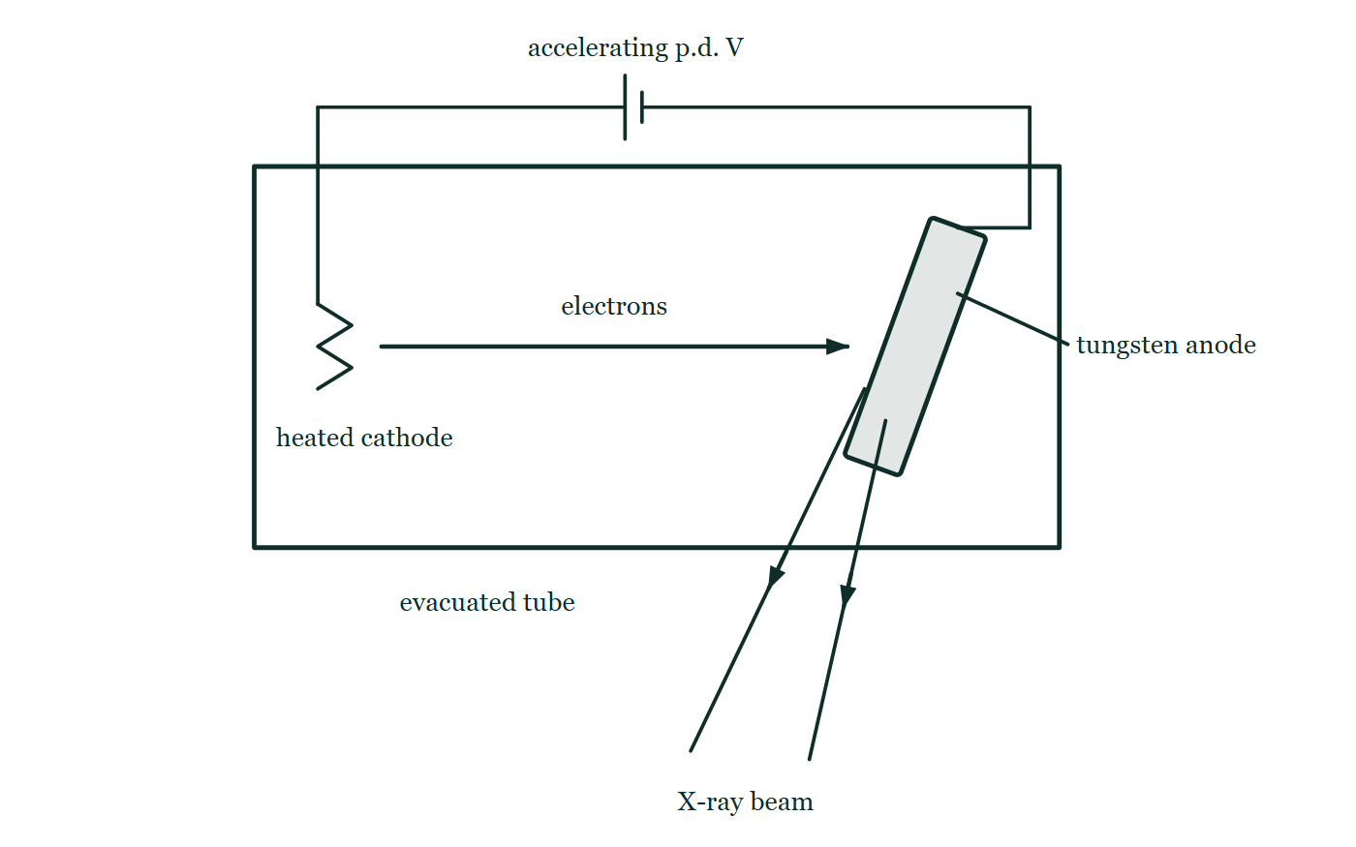
MEDICAL PHYSICS · X-RAY IMAGING
GIOPHYSICS LESSON
THE PICTURE
Inside the tube
Drawn for this lesson
An evacuated X-ray tube with a heated cathode filament at one end and a tungsten anode set at an angle at the other, electrons arrowed across the gap between them, an X-ray beam leaving the angled face downward, and the accelerating p.d. supplied by a cell wired to both electrodes outside the envelope.
The live version of this figure — click here
Medical Physics — X-Ray Imaging. Built by GioPhysics from the lesson's own copy; nothing on these slides is re-authored.
14 / 33
Notes:
[Phase] Build the model: The formulae, one at a time, in plain English (minutes 13–22 of 45)
[Figure] An evacuated X-ray tube with a heated cathode filament at one end and a tungsten anode set at an angle at the other, electrons arrowed across the gap between them, an X-ray beam leaving the angled face downward, and the accelerating p.d. supplied by a cell wired to both electrodes outside the envelope.

Slide 15
MEDICAL PHYSICS · X-RAY IMAGING
GIOPHYSICS LESSON
WATCH OUT
The common trap
Check and misconception — The quick check and the trap
Turning up the tube current does not make the X-rays more penetrating. Current sets how many electrons arrive per second — more photons, brighter image, larger dose — but every photon is still capped at energy eV. Only raising the accelerating p.d. shortens λmin and hardens the beam.
Medical Physics — X-Ray Imaging. Built by GioPhysics from the lesson's own copy; nothing on these slides is re-authored.
15 / 33
Notes:
[Phase] Check and misconception: The quick check and the trap (minutes 35–41 of 45)
[Misconception] Turning up the tube current does not make the X-rays more penetrating. Current sets how many electrons arrive per second — more photons, brighter image, larger dose — but every photon is still capped at energy eV. Only raising the accelerating p.d. shortens λmin and hardens the beam.

Slide 16
MEDICAL PHYSICS · X-RAY IMAGING
GIOPHYSICS LESSON
WORKED EXAMPLE 1 OF 2 · EASY
The question
Easy
Worked examples — I do, we do — one step revealed at a time
Find the minimum X-ray wavelength produced by a tube operating at 80 kV.
Medical Physics — X-Ray Imaging. Built by GioPhysics from the lesson's own copy; nothing on these slides is re-authored.
16 / 33
Notes:
[Phase] Worked examples: I do, we do — one step revealed at a time (minutes 22–35 of 45)
[Question] Find the minimum X-ray wavelength produced by a tube operating at 80 kV.
[Answer] λmin ≈ 1.6 × 10⁻¹¹ m (16 pm)

Slide 17
MEDICAL PHYSICS · X-RAY IMAGING
GIOPHYSICS LESSON
WORKED EXAMPLE 1 OF 2 · EASY · THE WORKING
How to solve it
Easy
Worked examples — I do, we do — one step revealed at a time
Find the minimum X-ray wavelength produced by a tube operating at 80 kV.
1.
The most energetic photon carries the whole electron energy: eV = hc/λmin.
2.
λmin = hc/eV = (6.63 × 10⁻³⁴ × 3.00 × 10⁸) ÷ (1.60 × 10⁻¹⁹ × 8.0 × 10⁴).
3.
λmin = 1.55 × 10⁻¹¹ m ≈ 16 pm — deep in the X-ray band.
Medical Physics — X-Ray Imaging. Built by GioPhysics from the lesson's own copy; nothing on these slides is re-authored.
17 / 33
Notes:
[Phase] Worked examples: I do, we do — one step revealed at a time (minutes 22–35 of 45)
[Reveal] One click per step. The class works each line before the next appears.
[Step 1] The most energetic photon carries the whole electron energy: eV = hc/λmin.
[Step 2] λmin = hc/eV = (6.63 × 10⁻³⁴ × 3.00 × 10⁸) ÷ (1.60 × 10⁻¹⁹ × 8.0 × 10⁴).
[Step 3] λmin = 1.55 × 10⁻¹¹ m ≈ 16 pm — deep in the X-ray band.

Slide 18
MEDICAL PHYSICS · X-RAY IMAGING
GIOPHYSICS LESSON
WORKED EXAMPLE 1 OF 2 · EASY
Answer
Easy
Worked examples — I do, we do — one step revealed at a time
λmin ≈ 1.6 × 10⁻¹¹ m (16 pm)
Medical Physics — X-Ray Imaging. Built by GioPhysics from the lesson's own copy; nothing on these slides is re-authored.
18 / 33
Notes:
[Phase] Worked examples: I do, we do — one step revealed at a time (minutes 22–35 of 45)
[Answer] λmin ≈ 1.6 × 10⁻¹¹ m (16 pm)

Slide 19
MEDICAL PHYSICS · X-RAY IMAGING
GIOPHYSICS LESSON
WORKED EXAMPLE 2 OF 2 · MEDIUM
The question
Medium
Worked examples — I do, we do — one step revealed at a time
A beam passes through 5.0 cm of muscle with μ = 0.20 cm⁻¹. What fraction of the intensity emerges?
Medical Physics — X-Ray Imaging. Built by GioPhysics from the lesson's own copy; nothing on these slides is re-authored.
19 / 33
Notes:
[Phase] Worked examples: I do, we do — one step revealed at a time (minutes 22–35 of 45)
[Question] A beam passes through 5.0 cm of muscle with μ = 0.20 cm⁻¹. What fraction of the intensity emerges?
[Answer] ≈ 37% transmitted

Slide 20
MEDICAL PHYSICS · X-RAY IMAGING
GIOPHYSICS LESSON
WORKED EXAMPLE 2 OF 2 · MEDIUM · THE WORKING
How to solve it
Medium
Worked examples — I do, we do — one step revealed at a time
A beam passes through 5.0 cm of muscle with μ = 0.20 cm⁻¹. What fraction of the intensity emerges?
1.
I/I₀ = e^(−μx) = e^(−0.20 × 5.0) = e^(−1.0).
2.
e^(−1.0) = 0.37.
3.
About 37% of the intensity survives — attenuation removes a fixed fraction per centimetre, so the answer would be 0.37² ≈ 14% for 10 cm.
Medical Physics — X-Ray Imaging. Built by GioPhysics from the lesson's own copy; nothing on these slides is re-authored.
20 / 33
Notes:
[Phase] Worked examples: I do, we do — one step revealed at a time (minutes 22–35 of 45)
[Reveal] One click per step. The class works each line before the next appears.
[Step 1] I/I₀ = e^(−μx) = e^(−0.20 × 5.0) = e^(−1.0).
[Step 2] e^(−1.0) = 0.37.
[Step 3] About 37% of the intensity survives — attenuation removes a fixed fraction per centimetre, so the answer would be 0.37² ≈ 14% for 10 cm.

Slide 21
MEDICAL PHYSICS · X-RAY IMAGING
GIOPHYSICS LESSON
WORKED EXAMPLE 2 OF 2 · MEDIUM
Answer
Medium
Worked examples — I do, we do — one step revealed at a time
≈ 37% transmitted
Medical Physics — X-Ray Imaging. Built by GioPhysics from the lesson's own copy; nothing on these slides is re-authored.
21 / 33
Notes:
[Phase] Worked examples: I do, we do — one step revealed at a time (minutes 22–35 of 45)
[Answer] ≈ 37% transmitted

Slide 22
MEDICAL PHYSICS · X-RAY IMAGING
GIOPHYSICS LESSON
SPOT THE MISTAKE
One line here is wrong
The whole working is up — find the bad line before you click
1.
A beam passes through 5.0 cm of muscle with μ = 0.20 cm⁻¹. Find the fraction transmitted.
2.
Attenuation is I = I₀e^(−μx).
3.
Converting the thickness to SI: x = 5.0 cm = 0.050 m
4.
μx = 0.20 × 0.050 = 0.010
5.
I/I₀ = e^(−0.010) = 0.99, so 99% is transmitted.
LINE 3 IS WRONG
The thickness has been converted and the coefficient has not. μ is quoted in cm⁻¹, so it is already committed to a length unit, and the exponent μx is only dimensionless if x is in centimetres too. Converting one and not the other is the classic slip here, and its answer always looks reassuring — hardly anything absorbed — which is why it survives. Keep both in centimetres: μx = 0.20 × 5.0 = 1.0, so I/I₀ = e⁻¹ = 0.37.
IT SHOULD SAY
Keeping both in centimetres: μx = 0.20 × 5.0 = 1.0
Medical Physics — X-Ray Imaging. Built by GioPhysics from the lesson's own copy; nothing on these slides is re-authored.
22 / 33
Notes:
[Phase] Worked examples: I do, we do — one step revealed at a time (minutes 22–35 of 45)
[Spot the mistake] The working is complete and one line of it is wrong. Let the room hunt: one click names the line, a second shows it done correctly.
[Line 3 is wrong] The thickness has been converted and the coefficient has not. μ is quoted in cm⁻¹, so it is already committed to a length unit, and the exponent μx is only dimensionless if x is in centimetres too. Converting one and not the other is the classic slip here, and its answer always looks reassuring — hardly anything absorbed — which is why it survives. Keep both in centimetres: μx = 0.20 × 5.0 = 1.0, so I/I₀ = e⁻¹ = 0.37.
[It should say] Keeping both in centimetres: μx = 0.20 × 5.0 = 1.0

Slide 23
MEDICAL PHYSICS · X-RAY IMAGING
GIOPHYSICS LESSON
PREDICT · TAKE THE VOTE
Commit before you are told
Hands up for each option, then click
The radiographer doubles the tube CURRENT and leaves the p.d. alone. What happens to the cutoff λmin on this spectrum?
A It halves — twice the current means twice the energy per photon
B It moves to longer wavelengths — the beam is softer
C It does not move at all; the whole curve simply gets taller
Intensity against wavelength for a tube at 80 kV: a continuous braking hump that stops dead at a sharp cutoff marked λmin, with two narrow characteristic lines of tungsten standing above the hump at shorter wavelengths than its peak.
The live version of this figure — click here
Medical Physics — X-Ray Imaging. Built by GioPhysics from the lesson's own copy; nothing on these slides is re-authored.
23 / 33
Notes:
[Phase] Build the model: The formulae, one at a time, in plain English (minutes 13–22 of 45)
[Predict] The radiographer doubles the tube CURRENT and leaves the p.d. alone. What happens to the cutoff λmin on this spectrum?
[Options] A It halves — twice the current means twice the energy per photon B It moves to longer wavelengths — the beam is softer C It does not move at all; the whole curve simply gets taller
[Figure] Intensity against wavelength for a tube at 80 kV: a continuous braking hump that stops dead at a sharp cutoff marked λmin, with two narrow characteristic lines of tungsten standing above the hump at shorter wavelengths than its peak.

Slide 24
MEDICAL PHYSICS · X-RAY IMAGING
GIOPHYSICS LESSON
PREDICT · THE OUTCOME
What actually happens
Ask the room who changed their mind, and why
C It does not move at all; the whole curve simply gets taller
WHY
The current says how many electrons arrive per second, and nothing else. Each one still crosses the same p.d., so each still arrives with the same eV of kinetic energy, and the very best any of them can do is give the lot to a single photon: eV = hc/λmin, unchanged. What doubles is the number of photons — a brighter image, and twice the dose to the patient, at exactly the same penetrating power. Only raising the accelerating p.d. shortens λmin and hardens the beam.
Medical Physics — X-Ray Imaging. Built by GioPhysics from the lesson's own copy; nothing on these slides is re-authored.
24 / 33
Notes:
[Phase] Build the model: The formulae, one at a time, in plain English (minutes 13–22 of 45)
[Answer] C — It does not move at all; the whole curve simply gets taller. The current says how many electrons arrive per second, and nothing else. Each one still crosses the same p.d., so each still arrives with the same eV of kinetic energy, and the very best any of them can do is give the lot to a single photon: eV = hc/λmin, unchanged. What doubles is the number of photons — a brighter image, and twice the dose to the patient, at exactly the same penetrating power. Only raising the accelerating p.d. shortens λmin and hardens the beam.

Slide 25
MEDICAL PHYSICS · X-RAY IMAGING
GIOPHYSICS LESSON
QUICK CHECK
Decide before the answer goes up
Check and misconception — The quick check and the trap
Doubling an X-ray tube's accelerating p.d. does what to the minimum wavelength λmin?
A
Halves it — λmin = hc/eV
B
Doubles it — longer waves carry more energy
C
Nothing — λmin is set by the tube current
Medical Physics — X-Ray Imaging. Built by GioPhysics from the lesson's own copy; nothing on these slides is re-authored.
25 / 33
Notes:
[Phase] Check and misconception: The quick check and the trap (minutes 35–41 of 45)
[Question] Doubling an X-ray tube's accelerating p.d. does what to the minimum wavelength λmin?
[Options] A Halves it — λmin = hc/eV B Doubles it — longer waves carry more energy C Nothing — λmin is set by the tube current

Slide 26
MEDICAL PHYSICS · X-RAY IMAGING
GIOPHYSICS LESSON
QUICK CHECK · THE ANSWER
The answer, and why
Check and misconception — The quick check and the trap
A Halves it — λmin = hc/eV
HOW TO GET THERE
λmin = hc/eV: the cutoff wavelength is inversely proportional to the accelerating p.d. Doubling V doubles the maximum photon energy and halves λmin.
WHY THE OTHERS TEMPT
A Correct. λmin = hc/eV, so the cutoff wavelength is inversely proportional to the p.d.: doubling V doubles the maximum photon energy and halves λmin.
B This is energy and wavelength read the wrong way round. E = hc/λ puts them in inverse proportion — long waves are the low-energy ones, which is why radio is harmless and X-rays are not — so a more energetic beam must reach shorter wavelengths, not longer.
C The current does control the beam, which is what makes this tempting: it sets how many electrons strike the target each second, and therefore the intensity and the dose. But it has no say in how much energy any one of them arrives with, and λmin is a statement about a single electron spending everything it has.
Medical Physics — X-Ray Imaging. Built by GioPhysics from the lesson's own copy; nothing on these slides is re-authored.
26 / 33
Notes:
[Phase] Check and misconception: The quick check and the trap (minutes 35–41 of 45)
[Question] Doubling an X-ray tube's accelerating p.d. does what to the minimum wavelength λmin?
[Option by option] A: Correct. λmin = hc/eV, so the cutoff wavelength is inversely proportional to the p.d.: doubling V doubles the maximum photon energy and halves λmin. B: This is energy and wavelength read the wrong way round. E = hc/λ puts them in inverse proportion — long waves are the low-energy ones, which is why radio is harmless and X-rays are not — so a more energetic beam must reach shorter wavelengths, not longer. C: The current does control the beam, which is what makes this tempting: it sets how many electrons strike the target each second, and therefore the intensity and the dose. But it has no say in how much energy any one of them arrives with, and λmin is a statement about a single electron spending everything it has.
[Answer] A — Halves it — λmin = hc/eV
[Why] λmin = hc/eV: the cutoff wavelength is inversely proportional to the accelerating p.d. Doubling V doubles the maximum photon energy and halves λmin.
[Reveal] One click for the answer, then one for the reason.

Slide 27
MEDICAL PHYSICS · X-RAY IMAGING
GIOPHYSICS LESSON
EXTENSION 1 OF 2 · HARD
The question
Hard
Worked examples — I do, we do — one step revealed at a time
One ray crosses 4.0 cm of soft tissue (μ = 0.22 cm⁻¹). A neighbouring ray crosses 3.0 cm of tissue plus 1.0 cm of bone (μ = 0.60 cm⁻¹). Find the intensity ratio between the two rays — the contrast in the image.
Medical Physics — X-Ray Imaging. Built by GioPhysics from the lesson's own copy; nothing on these slides is re-authored.
27 / 33
Notes:
[Phase] Worked examples: I do, we do — one step revealed at a time (minutes 22–35 of 45)
[Question] One ray crosses 4.0 cm of soft tissue (μ = 0.22 cm⁻¹). A neighbouring ray crosses 3.0 cm of tissue plus 1.0 cm of bone (μ = 0.60 cm⁻¹). Find the intensity ratio between the two rays — the contrast in the image.
[Answer] I₂/I₁ ≈ 0.68 — one centimetre of bone dims the ray by about a third

Slide 28
MEDICAL PHYSICS · X-RAY IMAGING
GIOPHYSICS LESSON
EXTENSION 1 OF 2 · HARD · THE WORKING
How to solve it
Hard
Worked examples — I do, we do — one step revealed at a time
One ray crosses 4.0 cm of soft tissue (μ = 0.22 cm⁻¹). A neighbouring ray crosses 3.0 cm of tissue plus 1.0 cm of bone (μ = 0.60 cm⁻¹). Find the intensity ratio between the two rays — the contrast in the image.
1.
Tissue-only ray: I₁/I₀ = e^(−0.22 × 4.0) = e^(−0.88) = 0.415.
2.
Tissue + bone ray: exponents add along the path: I₂/I₀ = e^(−0.22 × 3.0 − 0.60 × 1.0) = e^(−1.26) = 0.284.
3.
Ratio I₂/I₁ = 0.284 ÷ 0.415 = 0.68 — the bone path arrives about 32% dimmer, and that difference is the shadow the radiologist reads.
Medical Physics — X-Ray Imaging. Built by GioPhysics from the lesson's own copy; nothing on these slides is re-authored.
28 / 33
Notes:
[Phase] Worked examples: I do, we do — one step revealed at a time (minutes 22–35 of 45)
[Reveal] One click per step. The class works each line before the next appears.
[Step 1] Tissue-only ray: I₁/I₀ = e^(−0.22 × 4.0) = e^(−0.88) = 0.415.
[Step 2] Tissue + bone ray: exponents add along the path: I₂/I₀ = e^(−0.22 × 3.0 − 0.60 × 1.0) = e^(−1.26) = 0.284.
[Step 3] Ratio I₂/I₁ = 0.284 ÷ 0.415 = 0.68 — the bone path arrives about 32% dimmer, and that difference is the shadow the radiologist reads.

Slide 29
MEDICAL PHYSICS · X-RAY IMAGING
GIOPHYSICS LESSON
EXTENSION 1 OF 2 · HARD
Answer
Hard
Worked examples — I do, we do — one step revealed at a time
I₂/I₁ ≈ 0.68 — one centimetre of bone dims the ray by about a third
Medical Physics — X-Ray Imaging. Built by GioPhysics from the lesson's own copy; nothing on these slides is re-authored.
29 / 33
Notes:
[Phase] Worked examples: I do, we do — one step revealed at a time (minutes 22–35 of 45)
[Answer] I₂/I₁ ≈ 0.68 — one centimetre of bone dims the ray by about a third

Slide 30
MEDICAL PHYSICS · X-RAY IMAGING
GIOPHYSICS LESSON
EXTENSION 2 OF 2 · CHALLENGING
The question
Challenging
Worked examples — I do, we do — one step revealed at a time
A tube runs at 90 kV and 250 mA. Find the electrical power, the approximate X-ray output, the number of electrons striking the target per second — and explain the rotating anode.
Medical Physics — X-Ray Imaging. Built by GioPhysics from the lesson's own copy; nothing on these slides is re-authored.
30 / 33
Notes:
[Phase] Worked examples: I do, we do — one step revealed at a time (minutes 22–35 of 45)
[Question] A tube runs at 90 kV and 250 mA. Find the electrical power, the approximate X-ray output, the number of electrons striking the target per second — and explain the rotating anode.
[Answer] 22.5 kW in, ≈ 225 W of X-rays out, 1.6 × 10¹⁸ electrons per second — hence the spinning anode

Slide 31
MEDICAL PHYSICS · X-RAY IMAGING
GIOPHYSICS LESSON
EXTENSION 2 OF 2 · CHALLENGING · THE WORKING
How to solve it
Challenging
Worked examples — I do, we do — one step revealed at a time
A tube runs at 90 kV and 250 mA. Find the electrical power, the approximate X-ray output, the number of electrons striking the target per second — and explain the rotating anode.
1.
P = VI = 9.0 × 10⁴ × 0.250 = 22.5 kW of electron beam power.
2.
At ~1% efficiency, only ≈ 225 W leaves as X-rays; ≈ 22.3 kW becomes heat in a focal spot barely a millimetre across.
3.
Electrons per second = I/e = 0.250 ÷ 1.60 × 10⁻¹⁹ = 1.6 × 10¹⁸ s⁻¹.
4.
No stationary target survives 22 kW on a millimetre: the anode is a disc spinning at thousands of rpm, so each part of the rim is heated only briefly and radiates its heat between passes.
Medical Physics — X-Ray Imaging. Built by GioPhysics from the lesson's own copy; nothing on these slides is re-authored.
31 / 33
Notes:
[Phase] Worked examples: I do, we do — one step revealed at a time (minutes 22–35 of 45)
[Reveal] One click per step. The class works each line before the next appears.
[Step 1] P = VI = 9.0 × 10⁴ × 0.250 = 22.5 kW of electron beam power.
[Step 2] At ~1% efficiency, only ≈ 225 W leaves as X-rays; ≈ 22.3 kW becomes heat in a focal spot barely a millimetre across.
[Step 3] Electrons per second = I/e = 0.250 ÷ 1.60 × 10⁻¹⁹ = 1.6 × 10¹⁸ s⁻¹.
[Step 4] No stationary target survives 22 kW on a millimetre: the anode is a disc spinning at thousands of rpm, so each part of the rim is heated only briefly and radiates its heat between passes.

Slide 32
MEDICAL PHYSICS · X-RAY IMAGING
GIOPHYSICS LESSON
EXTENSION 2 OF 2 · CHALLENGING
Answer
Challenging
Worked examples — I do, we do — one step revealed at a time
22.5 kW in, ≈ 225 W of X-rays out, 1.6 × 10¹⁸ electrons per second — hence the spinning anode
Medical Physics — X-Ray Imaging. Built by GioPhysics from the lesson's own copy; nothing on these slides is re-authored.
32 / 33
Notes:
[Phase] Worked examples: I do, we do — one step revealed at a time (minutes 22–35 of 45)
[Answer] 22.5 kW in, ≈ 225 W of X-rays out, 1.6 × 10¹⁸ electrons per second — hence the spinning anode

Slide 33
MEDICAL PHYSICS · X-RAY IMAGING
GIOPHYSICS LESSON
MEDICAL PHYSICS
Where to go next
Plenary — What to take away, what to practise next
Next
29.2 CT Scanning
https://giophysics.com/chapter-57/ct-scanning/
Lesson
This lesson on giophysics.com
https://giophysics.com/chapter-57/x-ray-imaging/
Live
The live, interactive version of these slides
https://giophysics.com/chapter-57/presentation/?lesson=xray
Chapter
All Medical Physics lessons
https://giophysics.com/chapter-57/
PDF
Download the lesson PDF
https://giophysics.com/downloads/57-1-x-ray-imaging.pdf
Medical Physics — X-Ray Imaging. Built by GioPhysics from the lesson's own copy; nothing on these slides is re-authored.
33 / 33
Notes:
[Phase] Plenary: What to take away, what to practise next (minutes 41–45 of 45)
[Interactive] The graphs and the circuit topology on these slides are frozen. The live version at https://giophysics.com/chapter-57/presentation/?lesson=xray moves them.

