Slide 1
ENERGY · ENERGY CALCULUS INTEGRATION
GIOPHYSICS LESSON
04 · Energy
From force curves to energy landscapes
Energy Calculus Integration
Integrate force to find work. Differentiate potential energy to recover force.
POSITION
Lesson 5 of 6 in Energy
PLAN
16 slides in the 45-minute core run, about 45 minutes of it
LESSON PAGE
https://giophysics.com/chapter-6/energy-calculus/
Built by GioPhysics from the lesson's own page. Every word on these slides is the lesson's; nothing here is re-authored. Teaching material, not an awarding body's document.
Energy — Energy Calculus Integration. Built by GioPhysics from the lesson's own copy; nothing on these slides is re-authored.
1 / 30
Notes:
[Lesson] Energy — Energy Calculus Integration. Lesson 5 of 6.
[Intro] Integrate force to find work. Differentiate potential energy to recover force.
[Source] https://giophysics.com/chapter-6/energy-calculus/
[Disclaimer] Built by GioPhysics from the lesson's own page. Every word on these slides is the lesson's; nothing here is re-authored. Teaching material, not an awarding body's document.

Slide 2
ENERGY · ENERGY CALCULUS INTEGRATION
GIOPHYSICS LESSON
THINK FIRST
A hiker walks to the top of a hill and back down to the same spot. Gravity pulled on her the whole way. How much work did gravity do on her, in total?
Take answers before you click — the point is the commitment
Several hundred metres of climbing, several hundred of descent, and gravity acting on every step of it.
THE ANSWER
Exactly zero. Going up, gravity opposes the motion and its work is negative; coming down it does the same magnitude positively, and the two cancel to the joule. That cancellation is the definition of a conservative force: its work depends on where you started and where you finished, never on the route, which is why it can be written as −ΔU at all.
Energy — Energy Calculus Integration. Built by GioPhysics from the lesson's own copy; nothing on these slides is re-authored.
2 / 30
Notes:
[Phase] Starter: Recall what this lesson stands on (minutes 0–5 of 45)
[Hook] A hiker walks to the top of a hill and back down to the same spot. Gravity pulled on her the whole way. How much work did gravity do on her, in total? Several hundred metres of climbing, several hundred of descent, and gravity acting on every step of it.
[Answer] Exactly zero. Going up, gravity opposes the motion and its work is negative; coming down it does the same magnitude positively, and the two cancel to the joule. That cancellation is the definition of a conservative force: its work depends on where you started and where you finished, never on the route, which is why it can be written as −ΔU at all.

Slide 3
ENERGY · ENERGY CALCULUS INTEGRATION
GIOPHYSICS LESSON
EXPLAINED SIMPLY
In one sentence
Introduce the idea — The big idea and the definition
Energy calculus uses integration to find work from a changing force and differentiation to find force from potential energy.
Energy — Energy Calculus Integration. Built by GioPhysics from the lesson's own copy; nothing on these slides is re-authored.
3 / 30
Notes:
[Phase] Introduce the idea: The big idea and the definition (minutes 5–13 of 45)
[Definition] Energy calculus uses integration to find work from a changing force and differentiation to find force from potential energy.

Slide 4
ENERGY · ENERGY CALCULUS INTEGRATION
GIOPHYSICS LESSON
EXPLAINED SIMPLY
What that looks like
Introduce the idea — The big idea and the definition
FOR EXAMPLE
For F = 2x, integrating from x = 0 m to 3 m gives 9 J of work.
Energy — Energy Calculus Integration. Built by GioPhysics from the lesson's own copy; nothing on these slides is re-authored.
4 / 30
Notes:
[Phase] Introduce the idea: The big idea and the definition (minutes 5–13 of 45)
[Worked illustration] For F = 2x, integrating from x = 0 m to 3 m gives 9 J of work.

Slide 5
ENERGY · ENERGY CALCULUS INTEGRATION
GIOPHYSICS LESSON
THE BIG IDEA
From force curves to energy landscapes
Introduce the idea — The big idea and the definition
For a variable force, work is signed area along the path. Conservative-force work is the negative change in potential energy; slow external loading has the opposite sign.
Energy — Energy Calculus Integration. Built by GioPhysics from the lesson's own copy; nothing on these slides is re-authored.
5 / 30
Notes:
[Phase] Introduce the idea: The big idea and the definition (minutes 5–13 of 45)
[Big idea] For a variable force, work is signed area along the path. Conservative-force work is the negative change in potential energy; slow external loading has the opposite sign.

Slide 6
ENERGY · ENERGY CALCULUS INTEGRATION
GIOPHYSICS LESSON
THE PHYSICS · 1 OF 3
Signed area
Build the model — The formulae, one at a time, in plain English
Area above the displacement axis adds work; area below it subtracts work.
Energy — Energy Calculus Integration. Built by GioPhysics from the lesson's own copy; nothing on these slides is re-authored.
6 / 30
Notes:
[Phase] Build the model: The formulae, one at a time, in plain English (minutes 13–22 of 45)
[Section] Area above the displacement axis adds work; area below it subtracts work.

Slide 7
ENERGY · ENERGY CALCULUS INTEGRATION
GIOPHYSICS LESSON
THE PHYSICS · 2 OF 3
Do not mix the signs
Build the model — The formulae, one at a time, in plain English
For slow, loss-free motion, Wexternal = +ΔU while Wconservative = -ΔU.
Energy — Energy Calculus Integration. Built by GioPhysics from the lesson's own copy; nothing on these slides is re-authored.
7 / 30
Notes:
[Phase] Build the model: The formulae, one at a time, in plain English (minutes 13–22 of 45)
[Section] For slow, loss-free motion, Wexternal = +ΔU while Wconservative = -ΔU.

Slide 8
ENERGY · ENERGY CALCULUS INTEGRATION
GIOPHYSICS LESSON
THE PHYSICS · 3 OF 3
Read a landscape
Build the model — The formulae, one at a time, in plain English
A particle is pushed toward lower U. Steeper potential means a larger force magnitude.
Energy — Energy Calculus Integration. Built by GioPhysics from the lesson's own copy; nothing on these slides is re-authored.
8 / 30
Notes:
[Phase] Build the model: The formulae, one at a time, in plain English (minutes 13–22 of 45)
[Section] A particle is pushed toward lower U. Steeper potential means a larger force magnitude.

Slide 9
ENERGY · ENERGY CALCULUS INTEGRATION
GIOPHYSICS LESSON
FORMULA 1 OF 3
Variable-force work
Build the model — The formulae, one at a time, in plain English
W = ∫ F·dr
Use the component of force along each displacement
IN PLAIN ENGLISH
When force changes along the path, add up force × tiny step for the whole journey, keeping only the part of the force along each step.
Energy — Energy Calculus Integration. Built by GioPhysics from the lesson's own copy; nothing on these slides is re-authored.
9 / 30
Notes:
[Phase] Build the model: The formulae, one at a time, in plain English (minutes 13–22 of 45)
[Formula] Variable-force work: W = ∫ F·dr
[In plain English] When force changes along the path, add up force × tiny step for the whole journey, keeping only the part of the force along each step.
[Note] Use the component of force along each displacement

Slide 10
ENERGY · ENERGY CALCULUS INTEGRATION
GIOPHYSICS LESSON
FORMULA 2 OF 3
Conservative force
Build the model — The formulae, one at a time, in plain English
Wconservative = -ΔU
The energy store falls when the force does positive work
IN PLAIN ENGLISH
For forces like gravity and springs, positive work by the force means the stored energy dropped by the same amount.
Energy — Energy Calculus Integration. Built by GioPhysics from the lesson's own copy; nothing on these slides is re-authored.
10 / 30
Notes:
[Phase] Build the model: The formulae, one at a time, in plain English (minutes 13–22 of 45)
[Formula] Conservative force: Wconservative = -ΔU
[In plain English] For forces like gravity and springs, positive work by the force means the stored energy dropped by the same amount.
[Note] The energy store falls when the force does positive work

Slide 11
ENERGY · ENERGY CALCULUS INTEGRATION
GIOPHYSICS LESSON
FORMULA 3 OF 3
Potential slope
Build the model — The formulae, one at a time, in plain English
F = -dU/dx
In 3D, F = -∇U
IN PLAIN ENGLISH
The force always points 'downhill' on an energy graph — from high stored energy toward low.
Energy — Energy Calculus Integration. Built by GioPhysics from the lesson's own copy; nothing on these slides is re-authored.
11 / 30
Notes:
[Phase] Build the model: The formulae, one at a time, in plain English (minutes 13–22 of 45)
[Formula] Potential slope: F = -dU/dx
[In plain English] The force always points 'downhill' on an energy graph — from high stored energy toward low.
[Note] In 3D, F = -∇U

Slide 12
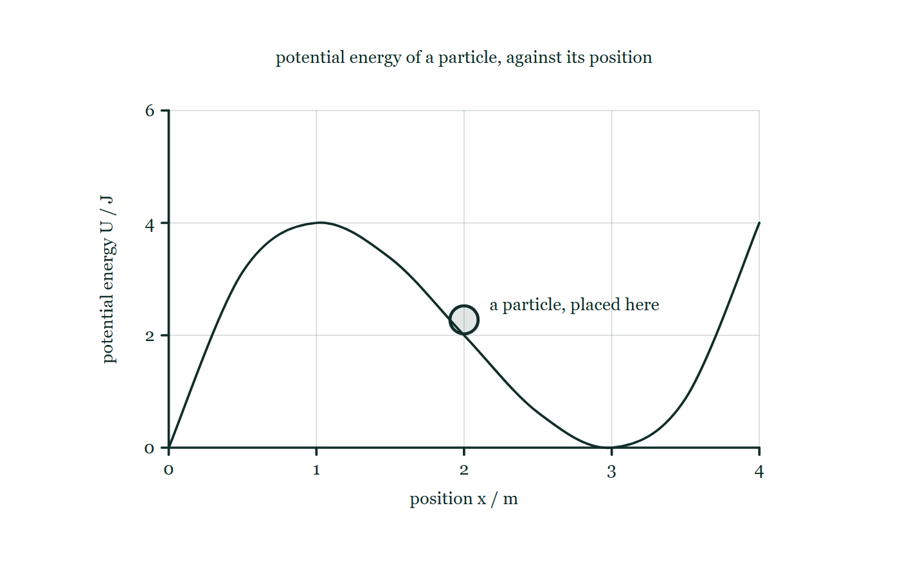
ENERGY · ENERGY CALCULUS INTEGRATION
GIOPHYSICS LESSON
THE PICTURE
An energy landscape
Drawn for this lesson
Potential energy plotted against position with a hill and a valley in it, and one particle drawn resting partway down the side of the hill with no arrow on it.
The live version of this figure — click here
Energy — Energy Calculus Integration. Built by GioPhysics from the lesson's own copy; nothing on these slides is re-authored.
12 / 30
Notes:
[Phase] Build the model: The formulae, one at a time, in plain English (minutes 13–22 of 45)
[Figure] Potential energy plotted against position with a hill and a valley in it, and one particle drawn resting partway down the side of the hill with no arrow on it.

Slide 13
ENERGY · ENERGY CALCULUS INTEGRATION
GIOPHYSICS LESSON
WATCH OUT
The common trap
Check and misconception — The quick check and the trap
The area under an F-x graph is signed. Treating every region as positive gives distance-like area, not net work.
Energy — Energy Calculus Integration. Built by GioPhysics from the lesson's own copy; nothing on these slides is re-authored.
13 / 30
Notes:
[Phase] Check and misconception: The quick check and the trap (minutes 35–41 of 45)
[Misconception] The area under an F-x graph is signed. Treating every region as positive gives distance-like area, not net work.

Slide 14
ENERGY · ENERGY CALCULUS INTEGRATION
GIOPHYSICS LESSON
WORKED EXAMPLE 1 OF 2 · EASY
The question
Easy
Worked examples — I do, we do — one step revealed at a time
A potential energy function is U(x) = 5x² J. What is the force at x = 1.0 m?
Energy — Energy Calculus Integration. Built by GioPhysics from the lesson's own copy; nothing on these slides is re-authored.
14 / 30
Notes:
[Phase] Worked examples: I do, we do — one step revealed at a time (minutes 22–35 of 45)
[Question] A potential energy function is U(x) = 5x² J. What is the force at x = 1.0 m?
[Answer] F = −10 N

Slide 15
ENERGY · ENERGY CALCULUS INTEGRATION
GIOPHYSICS LESSON
WORKED EXAMPLE 1 OF 2 · EASY · THE WORKING
How to solve it
Easy
Worked examples — I do, we do — one step revealed at a time
A potential energy function is U(x) = 5x² J. What is the force at x = 1.0 m?
1.
F = −dU/dx = −10x.
2.
At x = 1.0: F = −10 N (toward the origin).
Energy — Energy Calculus Integration. Built by GioPhysics from the lesson's own copy; nothing on these slides is re-authored.
15 / 30
Notes:
[Phase] Worked examples: I do, we do — one step revealed at a time (minutes 22–35 of 45)
[Reveal] One click per step. The class works each line before the next appears.
[Step 1] F = −dU/dx = −10x.
[Step 2] At x = 1.0: F = −10 N (toward the origin).

Slide 16
ENERGY · ENERGY CALCULUS INTEGRATION
GIOPHYSICS LESSON
WORKED EXAMPLE 1 OF 2 · EASY
Answer
Easy
Worked examples — I do, we do — one step revealed at a time
F = −10 N
Energy — Energy Calculus Integration. Built by GioPhysics from the lesson's own copy; nothing on these slides is re-authored.
16 / 30
Notes:
[Phase] Worked examples: I do, we do — one step revealed at a time (minutes 22–35 of 45)
[Answer] F = −10 N

Slide 17
ENERGY · ENERGY CALCULUS INTEGRATION
GIOPHYSICS LESSON
WORKED EXAMPLE 2 OF 2 · MEDIUM
The question
Medium
Worked examples — I do, we do — one step revealed at a time
A particle has U(x) = 3x² - 4x joules. Find F at x = 2 m and the conservative work from x = 1 m to x = 2 m.
Energy — Energy Calculus Integration. Built by GioPhysics from the lesson's own copy; nothing on these slides is re-authored.
17 / 30
Notes:
[Phase] Worked examples: I do, we do — one step revealed at a time (minutes 22–35 of 45)
[Question] A particle has U(x) = 3x² - 4x joules. Find F at x = 2 m and the conservative work from x = 1 m to x = 2 m.
[Answer] F(2) = -8 N and Wconservative = -5 J

Slide 18
ENERGY · ENERGY CALCULUS INTEGRATION
GIOPHYSICS LESSON
WORKED EXAMPLE 2 OF 2 · MEDIUM · THE WORKING
How to solve it
Medium
Worked examples — I do, we do — one step revealed at a time
A particle has U(x) = 3x² - 4x joules. Find F at x = 2 m and the conservative work from x = 1 m to x = 2 m.
1.
F = -dU/dx = -(6x - 4), so F(2) = -8 N.
2.
U(1) = -1 J and U(2) = 4 J, so ΔU = +5 J.
3.
Wconservative = -ΔU.
Energy — Energy Calculus Integration. Built by GioPhysics from the lesson's own copy; nothing on these slides is re-authored.
18 / 30
Notes:
[Phase] Worked examples: I do, we do — one step revealed at a time (minutes 22–35 of 45)
[Reveal] One click per step. The class works each line before the next appears.
[Step 1] F = -dU/dx = -(6x - 4), so F(2) = -8 N.
[Step 2] U(1) = -1 J and U(2) = 4 J, so ΔU = +5 J.
[Step 3] Wconservative = -ΔU.

Slide 19
ENERGY · ENERGY CALCULUS INTEGRATION
GIOPHYSICS LESSON
WORKED EXAMPLE 2 OF 2 · MEDIUM
Answer
Medium
Worked examples — I do, we do — one step revealed at a time
F(2) = -8 N and Wconservative = -5 J
Energy — Energy Calculus Integration. Built by GioPhysics from the lesson's own copy; nothing on these slides is re-authored.
19 / 30
Notes:
[Phase] Worked examples: I do, we do — one step revealed at a time (minutes 22–35 of 45)
[Answer] F(2) = -8 N and Wconservative = -5 J

Slide 20
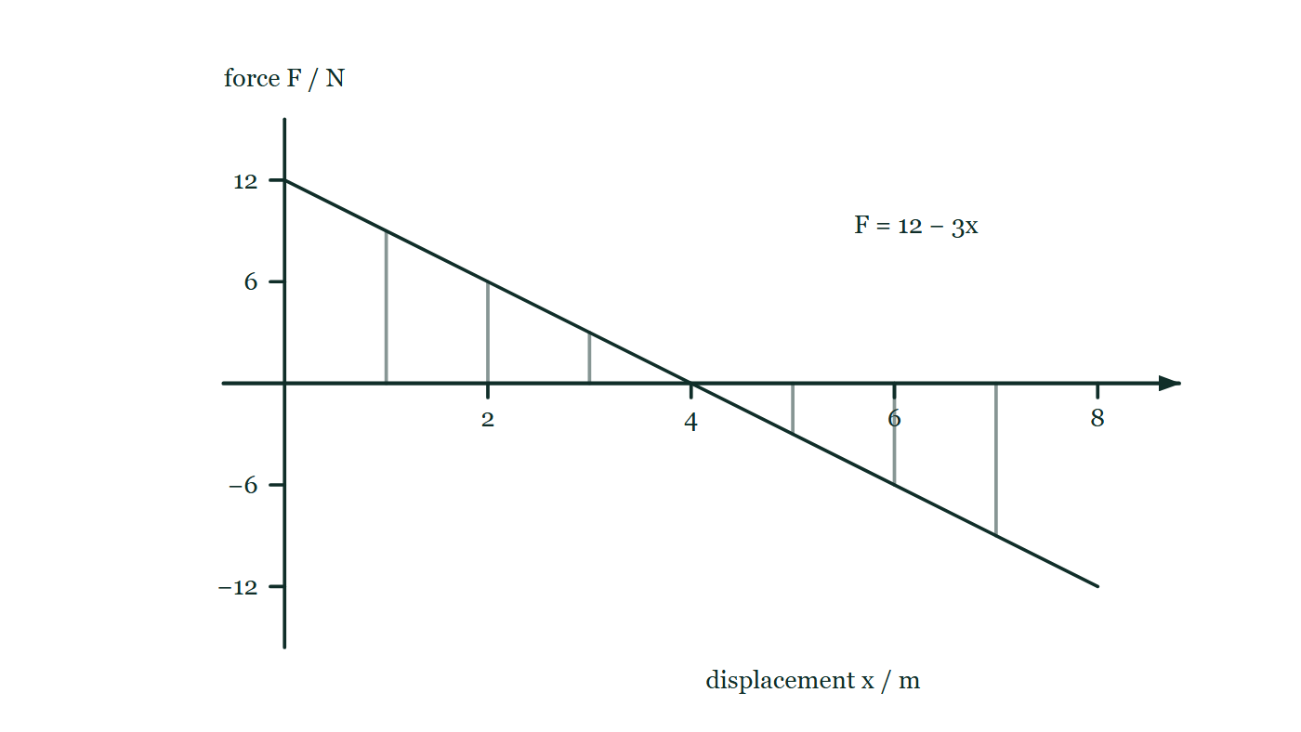
ENERGY · ENERGY CALCULUS INTEGRATION
GIOPHYSICS LESSON
PREDICT · TAKE THE VOTE
Commit before you are told
Hands up for each option, then click
F = 12 − 3x newtons acts along x. The graph is a triangle above the axis from 0 to 4.0 m and an equal triangle below it from 4.0 to 8.0 m. What work is done over the whole 8.0 m?
A 48 J
B 24 J
C 0 J
The line F = 12 − 3x drawn from +12 N down through the axis at 4.0 m to −12 N at 8.0 m, with the two regions between the line and the axis cut into strips and neither given a value.
The live version of this figure — click here
Energy — Energy Calculus Integration. Built by GioPhysics from the lesson's own copy; nothing on these slides is re-authored.
20 / 30
Notes:
[Phase] Build the model: The formulae, one at a time, in plain English (minutes 13–22 of 45)
[Predict] F = 12 − 3x newtons acts along x. The graph is a triangle above the axis from 0 to 4.0 m and an equal triangle below it from 4.0 to 8.0 m. What work is done over the whole 8.0 m?
[Options] A 48 J B 24 J C 0 J
[Figure] The line F = 12 − 3x drawn from +12 N down through the axis at 4.0 m to −12 N at 8.0 m, with the two regions between the line and the axis cut into strips and neither given a value.

Slide 21
ENERGY · ENERGY CALCULUS INTEGRATION
GIOPHYSICS LESSON
PREDICT · THE OUTCOME
What actually happens
Ask the room who changed their mind, and why
C 0 J
WHY
Work is signed area, and the second triangle is below the axis: the force has reversed, so it takes back exactly what the first one gave. 24 J out and 24 J back is 0 J net. 48 J is what you get by measuring both triangles and adding them as areas, which is the misconception this lesson names — that is a distance-like total, not work. 24 J is the first half on its own, correct only as far as x = 4.0 m, which is where F passes through zero.
Energy — Energy Calculus Integration. Built by GioPhysics from the lesson's own copy; nothing on these slides is re-authored.
21 / 30
Notes:
[Phase] Build the model: The formulae, one at a time, in plain English (minutes 13–22 of 45)
[Answer] C — 0 J. Work is signed area, and the second triangle is below the axis: the force has reversed, so it takes back exactly what the first one gave. 24 J out and 24 J back is 0 J net. 48 J is what you get by measuring both triangles and adding them as areas, which is the misconception this lesson names — that is a distance-like total, not work. 24 J is the first half on its own, correct only as far as x = 4.0 m, which is where F passes through zero.

Slide 22
ENERGY · ENERGY CALCULUS INTEGRATION
GIOPHYSICS LESSON
QUICK CHECK
Decide before the answer goes up
Check and misconception — The quick check and the trap
U(x) slopes upward as x increases. Which way does the conservative force point?
A
Toward +x
B
Toward -x
C
There is no force
Energy — Energy Calculus Integration. Built by GioPhysics from the lesson's own copy; nothing on these slides is re-authored.
22 / 30
Notes:
[Phase] Check and misconception: The quick check and the trap (minutes 35–41 of 45)
[Question] U(x) slopes upward as x increases. Which way does the conservative force point?
[Options] A Toward +x B Toward -x C There is no force

Slide 23
ENERGY · ENERGY CALCULUS INTEGRATION
GIOPHYSICS LESSON
QUICK CHECK · THE ANSWER
The answer, and why
Check and misconception — The quick check and the trap
B Toward -x
HOW TO GET THERE
F = -dU/dx. A positive slope gives a negative force.
WHY THE OTHERS TEMPT
A This is the answer for F = +dU/dx, and the missing minus sign is the whole of the difference. Things are pushed towards lower potential energy, not up towards higher — put a ball on a slope and see which way it goes.
B Correct. F = −dU/dx, so a positive slope gives a negative force: the particle is pushed back towards smaller x, where the potential energy is lower.
C A sloping graph is precisely where a force exists. Zero force needs a flat U — the region of neutral equilibrium — and this one is not flat.
Energy — Energy Calculus Integration. Built by GioPhysics from the lesson's own copy; nothing on these slides is re-authored.
23 / 30
Notes:
[Phase] Check and misconception: The quick check and the trap (minutes 35–41 of 45)
[Question] U(x) slopes upward as x increases. Which way does the conservative force point?
[Option by option] A: This is the answer for F = +dU/dx, and the missing minus sign is the whole of the difference. Things are pushed towards lower potential energy, not up towards higher — put a ball on a slope and see which way it goes. B: Correct. F = −dU/dx, so a positive slope gives a negative force: the particle is pushed back towards smaller x, where the potential energy is lower. C: A sloping graph is precisely where a force exists. Zero force needs a flat U — the region of neutral equilibrium — and this one is not flat.
[Answer] B — Toward -x
[Why] F = -dU/dx. A positive slope gives a negative force.
[Reveal] One click for the answer, then one for the reason.

Slide 24
ENERGY · ENERGY CALCULUS INTEGRATION
GIOPHYSICS LESSON
EXTENSION 1 OF 2 · HARD
The question
Hard
Worked examples — I do, we do — one step revealed at a time
A force F(x) = 12 − 3x N acts along x. Find the work done from x = 0 to x = 4.0 m and the position where the force reverses.
Energy — Energy Calculus Integration. Built by GioPhysics from the lesson's own copy; nothing on these slides is re-authored.
24 / 30
Notes:
[Phase] Worked examples: I do, we do — one step revealed at a time (minutes 22–35 of 45)
[Question] A force F(x) = 12 − 3x N acts along x. Find the work done from x = 0 to x = 4.0 m and the position where the force reverses.
[Answer] W = 24 J; F = 0 at x = 4.0 m

Slide 25
ENERGY · ENERGY CALCULUS INTEGRATION
GIOPHYSICS LESSON
EXTENSION 1 OF 2 · HARD · THE WORKING
How to solve it
Hard
Worked examples — I do, we do — one step revealed at a time
A force F(x) = 12 − 3x N acts along x. Find the work done from x = 0 to x = 4.0 m and the position where the force reverses.
1.
W = ∫(12 − 3x)dx from 0 to 4 = [12x − 1.5x²]₀⁴ = 48 − 24 = 24 J.
2.
Force reverses where F = 0: 12 − 3x = 0.
3.
x = 4.0 m — exactly at the end of the interval.
Energy — Energy Calculus Integration. Built by GioPhysics from the lesson's own copy; nothing on these slides is re-authored.
25 / 30
Notes:
[Phase] Worked examples: I do, we do — one step revealed at a time (minutes 22–35 of 45)
[Reveal] One click per step. The class works each line before the next appears.
[Step 1] W = ∫(12 − 3x)dx from 0 to 4 = [12x − 1.5x²]₀⁴ = 48 − 24 = 24 J.
[Step 2] Force reverses where F = 0: 12 − 3x = 0.
[Step 3] x = 4.0 m — exactly at the end of the interval.

Slide 26
ENERGY · ENERGY CALCULUS INTEGRATION
GIOPHYSICS LESSON
EXTENSION 1 OF 2 · HARD
Answer
Hard
Worked examples — I do, we do — one step revealed at a time
W = 24 J; F = 0 at x = 4.0 m
Energy — Energy Calculus Integration. Built by GioPhysics from the lesson's own copy; nothing on these slides is re-authored.
26 / 30
Notes:
[Phase] Worked examples: I do, we do — one step revealed at a time (minutes 22–35 of 45)
[Answer] W = 24 J; F = 0 at x = 4.0 m

Slide 27
ENERGY · ENERGY CALCULUS INTEGRATION
GIOPHYSICS LESSON
EXTENSION 2 OF 2 · CHALLENGING
The question
Challenging
Worked examples — I do, we do — one step revealed at a time
For U(x) = x³ − 6x² + 9x (joules, x in metres), locate the equilibria and classify their stability.
Energy — Energy Calculus Integration. Built by GioPhysics from the lesson's own copy; nothing on these slides is re-authored.
27 / 30
Notes:
[Phase] Worked examples: I do, we do — one step revealed at a time (minutes 22–35 of 45)
[Question] For U(x) = x³ − 6x² + 9x (joules, x in metres), locate the equilibria and classify their stability.
[Answer] x = 1 m unstable, x = 3 m stable

Slide 28
ENERGY · ENERGY CALCULUS INTEGRATION
GIOPHYSICS LESSON
EXTENSION 2 OF 2 · CHALLENGING · THE WORKING
How to solve it
Challenging
Worked examples — I do, we do — one step revealed at a time
For U(x) = x³ − 6x² + 9x (joules, x in metres), locate the equilibria and classify their stability.
1.
F = −dU/dx = −(3x² − 12x + 9) = −3(x − 1)(x − 3); equilibria at x = 1 and x = 3.
2.
d²U/dx² = 6x − 12: at x = 1 it is −6 (maximum of U → unstable).
3.
At x = 3 it is +6 (minimum of U → stable).
Energy — Energy Calculus Integration. Built by GioPhysics from the lesson's own copy; nothing on these slides is re-authored.
28 / 30
Notes:
[Phase] Worked examples: I do, we do — one step revealed at a time (minutes 22–35 of 45)
[Reveal] One click per step. The class works each line before the next appears.
[Step 1] F = −dU/dx = −(3x² − 12x + 9) = −3(x − 1)(x − 3); equilibria at x = 1 and x = 3.
[Step 2] d²U/dx² = 6x − 12: at x = 1 it is −6 (maximum of U → unstable).
[Step 3] At x = 3 it is +6 (minimum of U → stable).

Slide 29
ENERGY · ENERGY CALCULUS INTEGRATION
GIOPHYSICS LESSON
EXTENSION 2 OF 2 · CHALLENGING
Answer
Challenging
Worked examples — I do, we do — one step revealed at a time
x = 1 m unstable, x = 3 m stable
Energy — Energy Calculus Integration. Built by GioPhysics from the lesson's own copy; nothing on these slides is re-authored.
29 / 30
Notes:
[Phase] Worked examples: I do, we do — one step revealed at a time (minutes 22–35 of 45)
[Answer] x = 1 m unstable, x = 3 m stable

Slide 30
ENERGY · ENERGY CALCULUS INTEGRATION
GIOPHYSICS LESSON
ENERGY
Where to go next
Plenary — What to take away, what to practise next
Next
4.6 Energy Model for Gaming
https://giophysics.com/chapter-6/energy-model-for-gaming/
Lesson
This lesson on giophysics.com
https://giophysics.com/chapter-6/energy-calculus/
Live
The live, interactive version of these slides
https://giophysics.com/chapter-6/presentation/?lesson=calculus
Chapter
All Energy lessons
https://giophysics.com/chapter-6/
PDF
Download the lesson PDF
https://giophysics.com/downloads/6-5-energy-calculus-integration.pdf
Energy — Energy Calculus Integration. Built by GioPhysics from the lesson's own copy; nothing on these slides is re-authored.
30 / 30
Notes:
[Phase] Plenary: What to take away, what to practise next (minutes 41–45 of 45)
[Interactive] The graphs and the circuit topology on these slides are frozen. The live version at https://giophysics.com/chapter-6/presentation/?lesson=calculus moves them.

