Slide 1
ENERGY · ENERGY CONVERSION & CONSERVATION
GIOPHYSICS LESSON
04 · Energy
Track every store
Energy Conversion & Conservation
Energy can move and change form. A complete system account keeps the total constant.
POSITION
Lesson 4 of 6 in Energy
PLAN
16 slides in the 45-minute core run, about 45 minutes of it
LESSON PAGE
https://giophysics.com/chapter-6/energy-conversion-conservation/
Built by GioPhysics from the lesson's own page. Every word on these slides is the lesson's; nothing here is re-authored. Teaching material, not an awarding body's document.
Energy — Energy Conversion & Conservation. Built by GioPhysics from the lesson's own copy; nothing on these slides is re-authored.
1 / 29
Notes:
[Lesson] Energy — Energy Conversion & Conservation. Lesson 4 of 6.
[Intro] Energy can move and change form. A complete system account keeps the total constant.
[Source] https://giophysics.com/chapter-6/energy-conversion-conservation/
[Disclaimer] Built by GioPhysics from the lesson's own page. Every word on these slides is the lesson's; nothing here is re-authored. Teaching material, not an awarding body's document.

Slide 2
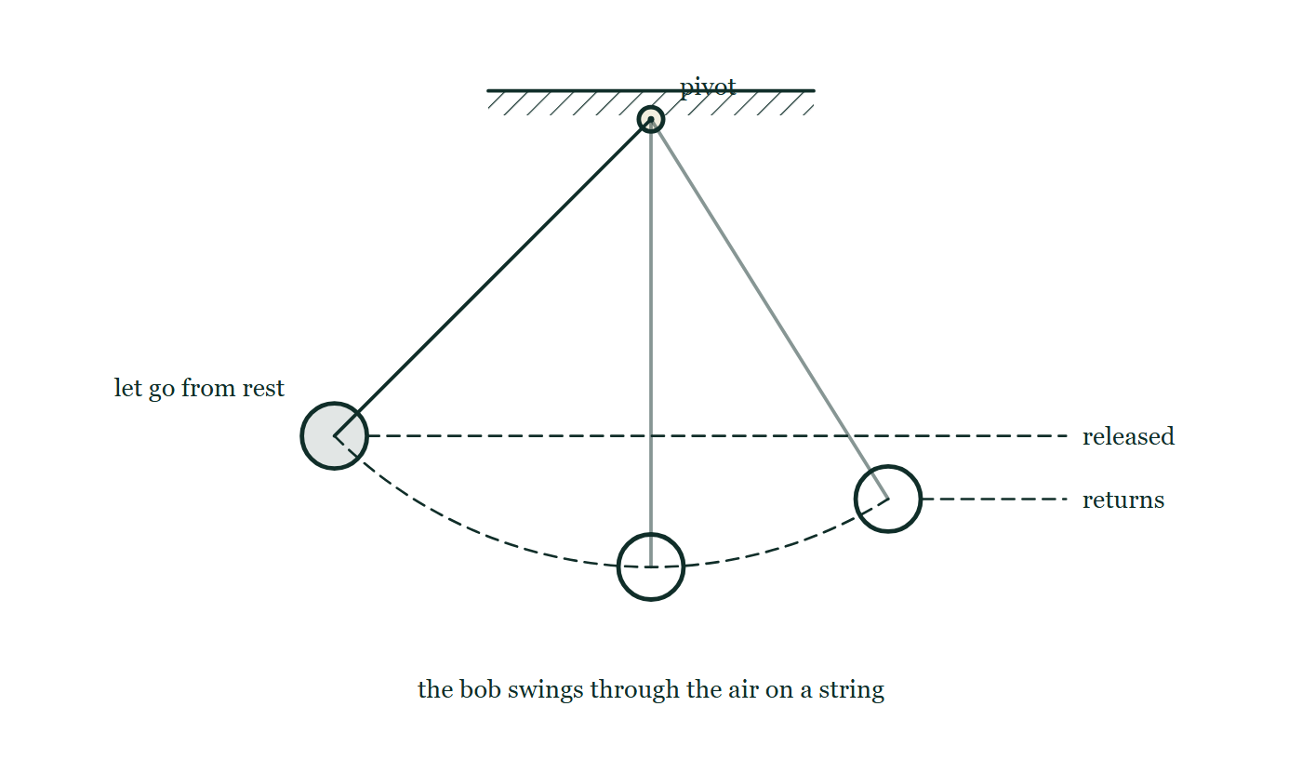
ENERGY · ENERGY CONVERSION & CONSERVATION
GIOPHYSICS LESSON
THINK FIRST
A heavy pendulum bob is held against the end of your nose and released. It swings away and comes back. Do you flinch?
Take answers before you click — the point is the commitment
It is a bowling ball on a wire. You may not push it — you must let it go from rest, exactly where it is touching you, and then stand perfectly still.
THE ANSWER
You are safe, and everyone flinches anyway. It was released from rest at that height, so it has no energy beyond what that height gave it, and it cannot climb back past the height it started from. It arrives a little short every time, because some of the store has gone to the air and the pivot. It can only ever come back lower.
A pendulum drawn at both extremes of one swing, with a dashed horizontal line carried across from the height it was released at and a second, lower line from the height it returns to.
The live version of this figure — click here
Energy — Energy Conversion & Conservation. Built by GioPhysics from the lesson's own copy; nothing on these slides is re-authored.
2 / 29
Notes:
[Phase] Starter: Recall what this lesson stands on (minutes 0–5 of 45)
[Hook] A heavy pendulum bob is held against the end of your nose and released. It swings away and comes back. Do you flinch? It is a bowling ball on a wire. You may not push it — you must let it go from rest, exactly where it is touching you, and then stand perfectly still.
[Answer] You are safe, and everyone flinches anyway. It was released from rest at that height, so it has no energy beyond what that height gave it, and it cannot climb back past the height it started from. It arrives a little short every time, because some of the store has gone to the air and the pivot. It can only ever come back lower.
[Figure] A pendulum drawn at both extremes of one swing, with a dashed horizontal line carried across from the height it was released at and a second, lower line from the height it returns to.

Slide 3
ENERGY · ENERGY CONVERSION & CONSERVATION
GIOPHYSICS LESSON
EXPLAINED SIMPLY
In one sentence
Introduce the idea — The big idea and the definition
Energy conservation means energy can be transferred or transformed, but the total in a closed system stays constant.
Energy — Energy Conversion & Conservation. Built by GioPhysics from the lesson's own copy; nothing on these slides is re-authored.
3 / 29
Notes:
[Phase] Introduce the idea: The big idea and the definition (minutes 5–13 of 45)
[Definition] Energy conservation means energy can be transferred or transformed, but the total in a closed system stays constant.

Slide 4
ENERGY · ENERGY CONVERSION & CONSERVATION
GIOPHYSICS LESSON
EXPLAINED SIMPLY
What that looks like
Introduce the idea — The big idea and the definition
FOR EXAMPLE
As a roller coaster descends, gravitational potential energy becomes kinetic and thermal energy without disappearing.
Energy — Energy Conversion & Conservation. Built by GioPhysics from the lesson's own copy; nothing on these slides is re-authored.
4 / 29
Notes:
[Phase] Introduce the idea: The big idea and the definition (minutes 5–13 of 45)
[Worked illustration] As a roller coaster descends, gravitational potential energy becomes kinetic and thermal energy without disappearing.

Slide 5
ENERGY · ENERGY CONVERSION & CONSERVATION
GIOPHYSICS LESSON
THE BIG IDEA
Track every store
Introduce the idea — The big idea and the definition
Mechanical energy can decrease when friction or drag transfers energy into internal and thermal stores. Total energy is still conserved when the system boundary includes those stores.
Energy — Energy Conversion & Conservation. Built by GioPhysics from the lesson's own copy; nothing on these slides is re-authored.
5 / 29
Notes:
[Phase] Introduce the idea: The big idea and the definition (minutes 5–13 of 45)
[Big idea] Mechanical energy can decrease when friction or drag transfers energy into internal and thermal stores. Total energy is still conserved when the system boundary includes those stores.

Slide 6
ENERGY · ENERGY CONVERSION & CONSERVATION
GIOPHYSICS LESSON
THE PHYSICS · 1 OF 3
Define the system
Build the model — The formulae, one at a time, in plain English
Name what is inside the boundary before deciding whether energy enters or leaves.
Energy — Energy Conversion & Conservation. Built by GioPhysics from the lesson's own copy; nothing on these slides is re-authored.
6 / 29
Notes:
[Phase] Build the model: The formulae, one at a time, in plain English (minutes 13–22 of 45)
[Section] Name what is inside the boundary before deciding whether energy enters or leaves.

Slide 7
ENERGY · ENERGY CONVERSION & CONSERVATION
GIOPHYSICS LESSON
THE PHYSICS · 2 OF 3
Follow transfers
Build the model — The formulae, one at a time, in plain English
Forces transfer energy by work; heating, radiation, and electrical transfer can also move energy.
Energy — Energy Conversion & Conservation. Built by GioPhysics from the lesson's own copy; nothing on these slides is re-authored.
7 / 29
Notes:
[Phase] Build the model: The formulae, one at a time, in plain English (minutes 13–22 of 45)
[Section] Forces transfer energy by work; heating, radiation, and electrical transfer can also move energy.

Slide 8
ENERGY · ENERGY CONVERSION & CONSERVATION
GIOPHYSICS LESSON
THE PHYSICS · 3 OF 3
Friction changes the store
Build the model — The formulae, one at a time, in plain English
Lost mechanical energy usually appears as internal energy of surfaces and surroundings.
Energy — Energy Conversion & Conservation. Built by GioPhysics from the lesson's own copy; nothing on these slides is re-authored.
8 / 29
Notes:
[Phase] Build the model: The formulae, one at a time, in plain English (minutes 13–22 of 45)
[Section] Lost mechanical energy usually appears as internal energy of surfaces and surroundings.

Slide 9
ENERGY · ENERGY CONVERSION & CONSERVATION
GIOPHYSICS LESSON
FORMULA 1 OF 3
Complete account
Build the model — The formulae, one at a time, in plain English
Einitial = Efinal
Include every relevant store and transfer
IN PLAIN ENGLISH
Energy is never created or destroyed — count every store before and after, and the totals must match.
Energy — Energy Conversion & Conservation. Built by GioPhysics from the lesson's own copy; nothing on these slides is re-authored.
9 / 29
Notes:
[Phase] Build the model: The formulae, one at a time, in plain English (minutes 13–22 of 45)
[Formula] Complete account: Einitial = Efinal
[In plain English] Energy is never created or destroyed — count every store before and after, and the totals must match.
[Note] Include every relevant store and transfer

Slide 10
ENERGY · ENERGY CONVERSION & CONSERVATION
GIOPHYSICS LESSON
FORMULA 2 OF 3
Mechanical energy
Build the model — The formulae, one at a time, in plain English
Emech = K + Ug + Us
Mechanical energy need not stay constant
IN PLAIN ENGLISH
The moving, height, and spring stores added together; friction can drain this total into heat.
Energy — Energy Conversion & Conservation. Built by GioPhysics from the lesson's own copy; nothing on these slides is re-authored.
10 / 29
Notes:
[Phase] Build the model: The formulae, one at a time, in plain English (minutes 13–22 of 45)
[Formula] Mechanical energy: Emech = K + Ug + Us
[In plain English] The moving, height, and spring stores added together; friction can drain this total into heat.
[Note] Mechanical energy need not stay constant

Slide 11
ENERGY · ENERGY CONVERSION & CONSERVATION
GIOPHYSICS LESSON
FORMULA 3 OF 3
Efficiency
Build the model — The formulae, one at a time, in plain English
η = Euseful / Einput
Multiply by 100% for percentage efficiency
IN PLAIN ENGLISH
What fraction of the energy you put in actually does the job you want — the rest is lost, usually as heat.
Energy — Energy Conversion & Conservation. Built by GioPhysics from the lesson's own copy; nothing on these slides is re-authored.
11 / 29
Notes:
[Phase] Build the model: The formulae, one at a time, in plain English (minutes 13–22 of 45)
[Formula] Efficiency: η = Euseful / Einput
[In plain English] What fraction of the energy you put in actually does the job you want — the rest is lost, usually as heat.
[Note] Multiply by 100% for percentage efficiency

Slide 12
ENERGY · ENERGY CONVERSION & CONSERVATION
GIOPHYSICS LESSON
WATCH OUT
The common trap
Check and misconception — The quick check and the trap
Friction does not destroy energy. It makes organized mechanical energy less available by transferring it into internal and thermal stores.
Energy — Energy Conversion & Conservation. Built by GioPhysics from the lesson's own copy; nothing on these slides is re-authored.
12 / 29
Notes:
[Phase] Check and misconception: The quick check and the trap (minutes 35–41 of 45)
[Misconception] Friction does not destroy energy. It makes organized mechanical energy less available by transferring it into internal and thermal stores.

Slide 13
ENERGY · ENERGY CONVERSION & CONSERVATION
GIOPHYSICS LESSON
WORKED EXAMPLE 1 OF 2 · EASY
The question
Easy
Worked examples — I do, we do — one step revealed at a time
A 1.0 kg ball is dropped from 4.0 m. Ignoring air resistance, how fast is it moving just before landing?
Energy — Energy Conversion & Conservation. Built by GioPhysics from the lesson's own copy; nothing on these slides is re-authored.
13 / 29
Notes:
[Phase] Worked examples: I do, we do — one step revealed at a time (minutes 22–35 of 45)
[Question] A 1.0 kg ball is dropped from 4.0 m. Ignoring air resistance, how fast is it moving just before landing?
[Answer] v ≈ 8.9 m/s

Slide 14
ENERGY · ENERGY CONVERSION & CONSERVATION
GIOPHYSICS LESSON
WORKED EXAMPLE 1 OF 2 · EASY · THE WORKING
How to solve it
Easy
Worked examples — I do, we do — one step revealed at a time
A 1.0 kg ball is dropped from 4.0 m. Ignoring air resistance, how fast is it moving just before landing?
1.
mgh = ½mv², so v = √(2gh).
2.
v = √(2 × 9.81 × 4.0) ≈ 8.9 m/s.
Energy — Energy Conversion & Conservation. Built by GioPhysics from the lesson's own copy; nothing on these slides is re-authored.
14 / 29
Notes:
[Phase] Worked examples: I do, we do — one step revealed at a time (minutes 22–35 of 45)
[Reveal] One click per step. The class works each line before the next appears.
[Step 1] mgh = ½mv², so v = √(2gh).
[Step 2] v = √(2 × 9.81 × 4.0) ≈ 8.9 m/s.

Slide 15
ENERGY · ENERGY CONVERSION & CONSERVATION
GIOPHYSICS LESSON
WORKED EXAMPLE 1 OF 2 · EASY
Answer
Easy
Worked examples — I do, we do — one step revealed at a time
v ≈ 8.9 m/s
Energy — Energy Conversion & Conservation. Built by GioPhysics from the lesson's own copy; nothing on these slides is re-authored.
15 / 29
Notes:
[Phase] Worked examples: I do, we do — one step revealed at a time (minutes 22–35 of 45)
[Answer] v ≈ 8.9 m/s

Slide 16
ENERGY · ENERGY CONVERSION & CONSERVATION
GIOPHYSICS LESSON
WORKED EXAMPLE 2 OF 2 · MEDIUM
The question
Medium
Worked examples — I do, we do — one step revealed at a time
A 2.0 kg cart descends from 5.0 m to 2.0 m. Twenty percent of the lost Ug becomes thermal energy. Find K and speed if it starts from rest.
Energy — Energy Conversion & Conservation. Built by GioPhysics from the lesson's own copy; nothing on these slides is re-authored.
16 / 29
Notes:
[Phase] Worked examples: I do, we do — one step revealed at a time (minutes 22–35 of 45)
[Question] A 2.0 kg cart descends from 5.0 m to 2.0 m. Twenty percent of the lost Ug becomes thermal energy. Find K and speed if it starts from rest.
[Answer] K = 47.0 J and v = 6.86 m/s

Slide 17
ENERGY · ENERGY CONVERSION & CONSERVATION
GIOPHYSICS LESSON
WORKED EXAMPLE 2 OF 2 · MEDIUM · THE WORKING
How to solve it
Medium
Worked examples — I do, we do — one step revealed at a time
A 2.0 kg cart descends from 5.0 m to 2.0 m. Twenty percent of the lost Ug becomes thermal energy. Find K and speed if it starts from rest.
1.
Lost Ug = mg(5.0 - 2.0) = (2.0)(9.8)(3.0) = 58.8 J.
2.
Thermal transfer = 0.20(58.8) = 11.76 J, so K = 47.04 J.
3.
From K = 1/2 mv², v = √(2K/m).
Energy — Energy Conversion & Conservation. Built by GioPhysics from the lesson's own copy; nothing on these slides is re-authored.
17 / 29
Notes:
[Phase] Worked examples: I do, we do — one step revealed at a time (minutes 22–35 of 45)
[Reveal] One click per step. The class works each line before the next appears.
[Step 1] Lost Ug = mg(5.0 - 2.0) = (2.0)(9.8)(3.0) = 58.8 J.
[Step 2] Thermal transfer = 0.20(58.8) = 11.76 J, so K = 47.04 J.
[Step 3] From K = 1/2 mv², v = √(2K/m).

Slide 18
ENERGY · ENERGY CONVERSION & CONSERVATION
GIOPHYSICS LESSON
WORKED EXAMPLE 2 OF 2 · MEDIUM
Answer
Medium
Worked examples — I do, we do — one step revealed at a time
K = 47.0 J and v = 6.86 m/s
Energy — Energy Conversion & Conservation. Built by GioPhysics from the lesson's own copy; nothing on these slides is re-authored.
18 / 29
Notes:
[Phase] Worked examples: I do, we do — one step revealed at a time (minutes 22–35 of 45)
[Answer] K = 47.0 J and v = 6.86 m/s

Slide 19
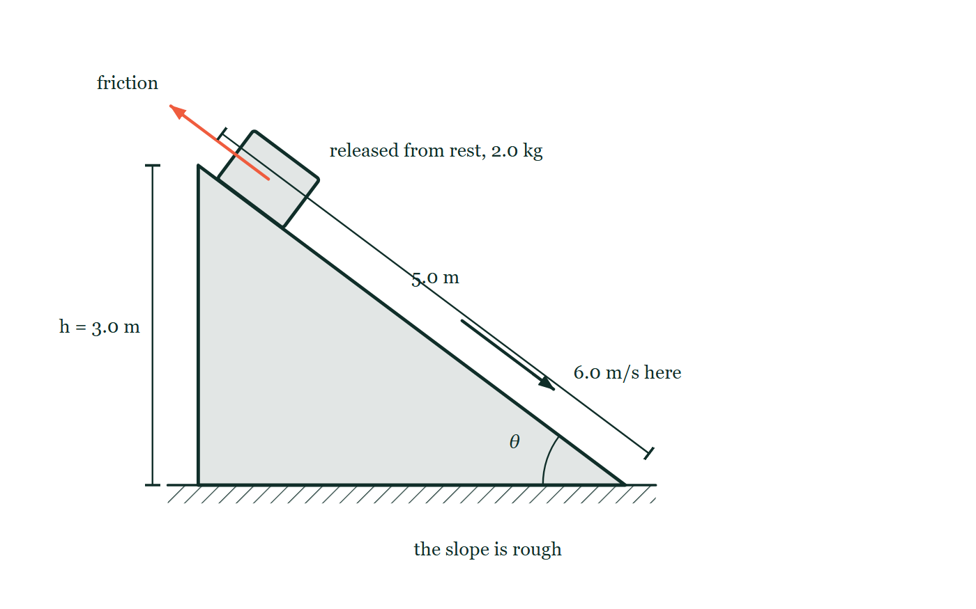
ENERGY · ENERGY CONVERSION & CONSERVATION
GIOPHYSICS LESSON
PREDICT · TAKE THE VOTE
Commit before you are told
Hands up for each option, then click
The block starts 3.0 m up and arrives at the bottom at 6.0 m/s. The height gave it 58.9 J; it arrives with 36 J. Where are the other 23 J?
A Destroyed — that is what friction does to energy
B In the block and the slope, as internal energy: they are both slightly warmer
C Still in the block as potential energy it did not manage to convert
A 2.0 kg block released from rest at the top of a slope drawn as a true 3–4–5 triangle, 3.0 m high and 5.0 m along, with friction acting up the slope and 6.0 m/s marked at the bottom.
The live version of this figure — click here
Energy — Energy Conversion & Conservation. Built by GioPhysics from the lesson's own copy; nothing on these slides is re-authored.
19 / 29
Notes:
[Phase] Build the model: The formulae, one at a time, in plain English (minutes 13–22 of 45)
[Predict] The block starts 3.0 m up and arrives at the bottom at 6.0 m/s. The height gave it 58.9 J; it arrives with 36 J. Where are the other 23 J?
[Options] A Destroyed — that is what friction does to energy B In the block and the slope, as internal energy: they are both slightly warmer C Still in the block as potential energy it did not manage to convert
[Figure] A 2.0 kg block released from rest at the top of a slope drawn as a true 3–4–5 triangle, 3.0 m high and 5.0 m along, with friction acting up the slope and 6.0 m/s marked at the bottom.

Slide 20
ENERGY · ENERGY CONVERSION & CONSERVATION
GIOPHYSICS LESSON
PREDICT · THE OUTCOME
What actually happens
Ask the room who changed their mind, and why
B In the block and the slope, as internal energy: they are both slightly warmer
WHY
Friction is a transfer, not a leak. The two surfaces have been rubbing for the whole 5.0 m, and the missing 23 J is now in the random motion of the particles in both of them — a temperature rise too small to feel and far too small to get back. Mechanical energy fell; total energy did not move at all. And it is not still potential energy: the block is at the bottom, so there is no height left for it to be in.
Energy — Energy Conversion & Conservation. Built by GioPhysics from the lesson's own copy; nothing on these slides is re-authored.
20 / 29
Notes:
[Phase] Build the model: The formulae, one at a time, in plain English (minutes 13–22 of 45)
[Answer] B — In the block and the slope, as internal energy: they are both slightly warmer. Friction is a transfer, not a leak. The two surfaces have been rubbing for the whole 5.0 m, and the missing 23 J is now in the random motion of the particles in both of them — a temperature rise too small to feel and far too small to get back. Mechanical energy fell; total energy did not move at all. And it is not still potential energy: the block is at the bottom, so there is no height left for it to be in.

Slide 21
ENERGY · ENERGY CONVERSION & CONSERVATION
GIOPHYSICS LESSON
QUICK CHECK
Decide before the answer goes up
Check and misconception — The quick check and the trap
A coaster slows on a rough track. Which statement is correct for coaster + track + surroundings?
A
Total energy decreases
B
Mechanical energy decreases but total energy is conserved
C
Both total and mechanical energy stay constant
Energy — Energy Conversion & Conservation. Built by GioPhysics from the lesson's own copy; nothing on these slides is re-authored.
21 / 29
Notes:
[Phase] Check and misconception: The quick check and the trap (minutes 35–41 of 45)
[Question] A coaster slows on a rough track. Which statement is correct for coaster + track + surroundings?
[Options] A Total energy decreases B Mechanical energy decreases but total energy is conserved C Both total and mechanical energy stay constant

Slide 22
ENERGY · ENERGY CONVERSION & CONSERVATION
GIOPHYSICS LESSON
QUICK CHECK · THE ANSWER
The answer, and why
Check and misconception — The quick check and the trap
B Mechanical energy decreases but total energy is conserved
HOW TO GET THERE
Friction transfers mechanical energy into internal energy; the complete total remains constant.
WHY THE OTHERS TEMPT
A This is what it looks like from inside the mechanical account, where 23 J really has gone missing. Widen the boundary to include the track and the air and the total is exactly where it started — the energy is not gone, it is just no longer organised.
B Correct. Friction moves energy out of the mechanical stores and into internal ones. That transfer is one-way in practice, which is why the coaster never climbs as high again.
C This would need energy to arrive from somewhere and there is nowhere for it to come from. The mechanical stores demonstrably fell, and the whole point of the account is that they did.
Energy — Energy Conversion & Conservation. Built by GioPhysics from the lesson's own copy; nothing on these slides is re-authored.
22 / 29
Notes:
[Phase] Check and misconception: The quick check and the trap (minutes 35–41 of 45)
[Question] A coaster slows on a rough track. Which statement is correct for coaster + track + surroundings?
[Option by option] A: This is what it looks like from inside the mechanical account, where 23 J really has gone missing. Widen the boundary to include the track and the air and the total is exactly where it started — the energy is not gone, it is just no longer organised. B: Correct. Friction moves energy out of the mechanical stores and into internal ones. That transfer is one-way in practice, which is why the coaster never climbs as high again. C: This would need energy to arrive from somewhere and there is nowhere for it to come from. The mechanical stores demonstrably fell, and the whole point of the account is that they did.
[Answer] B — Mechanical energy decreases but total energy is conserved
[Why] Friction transfers mechanical energy into internal energy; the complete total remains constant.
[Reveal] One click for the answer, then one for the reason.

Slide 23
ENERGY · ENERGY CONVERSION & CONSERVATION
GIOPHYSICS LESSON
EXTENSION 1 OF 2 · HARD
The question
Hard
Worked examples — I do, we do — one step revealed at a time
A pendulum bob of mass 0.30 kg is released from 25° with a 2.0 m string. Find its speed at the lowest point.
Energy — Energy Conversion & Conservation. Built by GioPhysics from the lesson's own copy; nothing on these slides is re-authored.
23 / 29
Notes:
[Phase] Worked examples: I do, we do — one step revealed at a time (minutes 22–35 of 45)
[Question] A pendulum bob of mass 0.30 kg is released from 25° with a 2.0 m string. Find its speed at the lowest point.
[Answer] v ≈ 1.9 m/s

Slide 24
ENERGY · ENERGY CONVERSION & CONSERVATION
GIOPHYSICS LESSON
EXTENSION 1 OF 2 · HARD · THE WORKING
How to solve it
Hard
Worked examples — I do, we do — one step revealed at a time
A pendulum bob of mass 0.30 kg is released from 25° with a 2.0 m string. Find its speed at the lowest point.
1.
Height drop: h = L(1 − cos25°) = 2.0 × (1 − 0.906) ≈ 0.187 m.
2.
v = √(2gh) = √(2 × 9.81 × 0.187).
3.
v ≈ 1.9 m/s — mass cancels.
Energy — Energy Conversion & Conservation. Built by GioPhysics from the lesson's own copy; nothing on these slides is re-authored.
24 / 29
Notes:
[Phase] Worked examples: I do, we do — one step revealed at a time (minutes 22–35 of 45)
[Reveal] One click per step. The class works each line before the next appears.
[Step 1] Height drop: h = L(1 − cos25°) = 2.0 × (1 − 0.906) ≈ 0.187 m.
[Step 2] v = √(2gh) = √(2 × 9.81 × 0.187).
[Step 3] v ≈ 1.9 m/s — mass cancels.

Slide 25
ENERGY · ENERGY CONVERSION & CONSERVATION
GIOPHYSICS LESSON
EXTENSION 1 OF 2 · HARD
Answer
Hard
Worked examples — I do, we do — one step revealed at a time
v ≈ 1.9 m/s
Energy — Energy Conversion & Conservation. Built by GioPhysics from the lesson's own copy; nothing on these slides is re-authored.
25 / 29
Notes:
[Phase] Worked examples: I do, we do — one step revealed at a time (minutes 22–35 of 45)
[Answer] v ≈ 1.9 m/s

Slide 26
ENERGY · ENERGY CONVERSION & CONSERVATION
GIOPHYSICS LESSON
EXTENSION 2 OF 2 · CHALLENGING
The question
Challenging
Worked examples — I do, we do — one step revealed at a time
A 2.0 kg block slides from rest down a 5.0 m slope of height 3.0 m, arriving at 6.0 m/s. Find the average friction force along the slope.
Energy — Energy Conversion & Conservation. Built by GioPhysics from the lesson's own copy; nothing on these slides is re-authored.
26 / 29
Notes:
[Phase] Worked examples: I do, we do — one step revealed at a time (minutes 22–35 of 45)
[Question] A 2.0 kg block slides from rest down a 5.0 m slope of height 3.0 m, arriving at 6.0 m/s. Find the average friction force along the slope.
[Answer] F ≈ 4.6 N

Slide 27
ENERGY · ENERGY CONVERSION & CONSERVATION
GIOPHYSICS LESSON
EXTENSION 2 OF 2 · CHALLENGING · THE WORKING
How to solve it
Challenging
Worked examples — I do, we do — one step revealed at a time
A 2.0 kg block slides from rest down a 5.0 m slope of height 3.0 m, arriving at 6.0 m/s. Find the average friction force along the slope.
1.
Energy account: mgh = ½mv² + F(friction) × d.
2.
2.0 × 9.81 × 3.0 = ½ × 2.0 × 36 + F × 5.0 → 58.9 = 36 + 5F.
3.
F = 22.9 ÷ 5.0 ≈ 4.6 N.
Energy — Energy Conversion & Conservation. Built by GioPhysics from the lesson's own copy; nothing on these slides is re-authored.
27 / 29
Notes:
[Phase] Worked examples: I do, we do — one step revealed at a time (minutes 22–35 of 45)
[Reveal] One click per step. The class works each line before the next appears.
[Step 1] Energy account: mgh = ½mv² + F(friction) × d.
[Step 2] 2.0 × 9.81 × 3.0 = ½ × 2.0 × 36 + F × 5.0 → 58.9 = 36 + 5F.
[Step 3] F = 22.9 ÷ 5.0 ≈ 4.6 N.

Slide 28
ENERGY · ENERGY CONVERSION & CONSERVATION
GIOPHYSICS LESSON
EXTENSION 2 OF 2 · CHALLENGING
Answer
Challenging
Worked examples — I do, we do — one step revealed at a time
F ≈ 4.6 N
Energy — Energy Conversion & Conservation. Built by GioPhysics from the lesson's own copy; nothing on these slides is re-authored.
28 / 29
Notes:
[Phase] Worked examples: I do, we do — one step revealed at a time (minutes 22–35 of 45)
[Answer] F ≈ 4.6 N

Slide 29
ENERGY · ENERGY CONVERSION & CONSERVATION
GIOPHYSICS LESSON
ENERGY
Where to go next
Plenary — What to take away, what to practise next
Next
4.5 Energy Calculus Integration
https://giophysics.com/chapter-6/energy-calculus/
Lesson
This lesson on giophysics.com
https://giophysics.com/chapter-6/energy-conversion-conservation/
Live
The live, interactive version of these slides
https://giophysics.com/chapter-6/presentation/?lesson=conservation
Chapter
All Energy lessons
https://giophysics.com/chapter-6/
PDF
Download the lesson PDF
https://giophysics.com/downloads/6-4-energy-conversion-conservation.pdf
Energy — Energy Conversion & Conservation. Built by GioPhysics from the lesson's own copy; nothing on these slides is re-authored.
29 / 29
Notes:
[Phase] Plenary: What to take away, what to practise next (minutes 41–45 of 45)
[Interactive] The graphs and the circuit topology on these slides are frozen. The live version at https://giophysics.com/chapter-6/presentation/?lesson=conservation moves them.

