Slide 1
ENERGY · ELASTIC POTENTIAL ENERGY
GIOPHYSICS LESSON
04 · Energy
Energy stored by deformation
Elastic Potential Energy
Stretch or compress an ideal spring and work is stored in the spring-object system.
POSITION
Lesson 3 of 6 in Energy
PLAN
16 slides in the 45-minute core run, about 45 minutes of it
LESSON PAGE
https://giophysics.com/chapter-6/elastic-potential-energy/
Built by GioPhysics from the lesson's own page. Every word on these slides is the lesson's; nothing here is re-authored. Teaching material, not an awarding body's document.
Energy — Elastic Potential Energy. Built by GioPhysics from the lesson's own copy; nothing on these slides is re-authored.
1 / 30
Notes:
[Lesson] Energy — Elastic Potential Energy. Lesson 3 of 6.
[Intro] Stretch or compress an ideal spring and work is stored in the spring-object system.
[Source] https://giophysics.com/chapter-6/elastic-potential-energy/
[Disclaimer] Built by GioPhysics from the lesson's own page. Every word on these slides is the lesson's; nothing here is re-authored. Teaching material, not an awarding body's document.

Slide 2
ENERGY · ELASTIC POTENTIAL ENERGY
GIOPHYSICS LESSON
THINK FIRST
Two identical springs are joined end to end and the pair is pulled out by 10 cm. A single one of those springs is pulled out by 10 cm. Which stores more energy?
Take answers before you click — the point is the commitment
Two springs against one, and both stretched by the same amount. Two of anything ought to hold twice as much.
THE ANSWER
The single spring — twice as much. Joined end to end, the pair is half as stiff, so the same 10 cm is shared as 5 cm each and the pair only reaches half the force. Us = ½kx² with k halved gives E/2 against the single spring's E. Put the two side by side instead and you get 2E. The same displacement, and a factor of four between the two arrangements.
Energy — Elastic Potential Energy. Built by GioPhysics from the lesson's own copy; nothing on these slides is re-authored.
2 / 30
Notes:
[Phase] Starter: Recall what this lesson stands on (minutes 0–5 of 45)
[Hook] Two identical springs are joined end to end and the pair is pulled out by 10 cm. A single one of those springs is pulled out by 10 cm. Which stores more energy? Two springs against one, and both stretched by the same amount. Two of anything ought to hold twice as much.
[Answer] The single spring — twice as much. Joined end to end, the pair is half as stiff, so the same 10 cm is shared as 5 cm each and the pair only reaches half the force. Us = ½kx² with k halved gives E/2 against the single spring's E. Put the two side by side instead and you get 2E. The same displacement, and a factor of four between the two arrangements.

Slide 3
ENERGY · ELASTIC POTENTIAL ENERGY
GIOPHYSICS LESSON
EXPLAINED SIMPLY
In one sentence
Introduce the idea — The big idea and the definition
Elastic potential energy is energy stored when an elastic object is stretched or compressed.
Energy — Elastic Potential Energy. Built by GioPhysics from the lesson's own copy; nothing on these slides is re-authored.
3 / 30
Notes:
[Phase] Introduce the idea: The big idea and the definition (minutes 5–13 of 45)
[Definition] Elastic potential energy is energy stored when an elastic object is stretched or compressed.

Slide 4
ENERGY · ELASTIC POTENTIAL ENERGY
GIOPHYSICS LESSON
EXPLAINED SIMPLY
What that looks like
Introduce the idea — The big idea and the definition
FOR EXAMPLE
Pulling back a toy launcher stretches its spring, storing energy that can launch the toy.
Energy — Elastic Potential Energy. Built by GioPhysics from the lesson's own copy; nothing on these slides is re-authored.
4 / 30
Notes:
[Phase] Introduce the idea: The big idea and the definition (minutes 5–13 of 45)
[Worked illustration] Pulling back a toy launcher stretches its spring, storing energy that can launch the toy.

Slide 5
ENERGY · ELASTIC POTENTIAL ENERGY
GIOPHYSICS LESSON
THE BIG IDEA
Energy stored by deformation
Introduce the idea — The big idea and the definition
For a Hooke's-law spring, the force grows linearly with deformation. The stored energy is the area under the force-displacement graph, so it grows with x squared.
Energy — Elastic Potential Energy. Built by GioPhysics from the lesson's own copy; nothing on these slides is re-authored.
5 / 30
Notes:
[Phase] Introduce the idea: The big idea and the definition (minutes 5–13 of 45)
[Big idea] For a Hooke's-law spring, the force grows linearly with deformation. The stored energy is the area under the force-displacement graph, so it grows with x squared.

Slide 6
ENERGY · ELASTIC POTENTIAL ENERGY
GIOPHYSICS LESSON
THE PHYSICS · 1 OF 3
Natural length
Build the model — The formulae, one at a time, in plain English
Measure x from the unstrained equilibrium position, not from the end of the table.
Energy — Elastic Potential Energy. Built by GioPhysics from the lesson's own copy; nothing on these slides is re-authored.
6 / 30
Notes:
[Phase] Build the model: The formulae, one at a time, in plain English (minutes 13–22 of 45)
[Section] Measure x from the unstrained equilibrium position, not from the end of the table.

Slide 7
ENERGY · ELASTIC POTENTIAL ENERGY
GIOPHYSICS LESSON
THE PHYSICS · 2 OF 3
Force reverses
Build the model — The formulae, one at a time, in plain English
A positive extension gives a negative restoring force; compression reverses that direction.
Energy — Elastic Potential Energy. Built by GioPhysics from the lesson's own copy; nothing on these slides is re-authored.
7 / 30
Notes:
[Phase] Build the model: The formulae, one at a time, in plain English (minutes 13–22 of 45)
[Section] A positive extension gives a negative restoring force; compression reverses that direction.

Slide 8
ENERGY · ELASTIC POTENTIAL ENERGY
GIOPHYSICS LESSON
THE PHYSICS · 3 OF 3
Energy does not reverse
Build the model — The formulae, one at a time, in plain English
Because x is squared, equal compression and extension store equal Us.
Energy — Elastic Potential Energy. Built by GioPhysics from the lesson's own copy; nothing on these slides is re-authored.
8 / 30
Notes:
[Phase] Build the model: The formulae, one at a time, in plain English (minutes 13–22 of 45)
[Section] Because x is squared, equal compression and extension store equal Us.

Slide 9
ENERGY · ELASTIC POTENTIAL ENERGY
GIOPHYSICS LESSON
FORMULA 1 OF 3
Restoring force
Build the model — The formulae, one at a time, in plain English
Fspring = -kx
The minus sign points toward equilibrium
IN PLAIN ENGLISH
A spring always pulls or pushes back toward its natural length; the further you displace it (x), the harder it resists.
Energy — Elastic Potential Energy. Built by GioPhysics from the lesson's own copy; nothing on these slides is re-authored.
9 / 30
Notes:
[Phase] Build the model: The formulae, one at a time, in plain English (minutes 13–22 of 45)
[Formula] Restoring force: Fspring = -kx
[In plain English] A spring always pulls or pushes back toward its natural length; the further you displace it (x), the harder it resists.
[Note] The minus sign points toward equilibrium

Slide 10
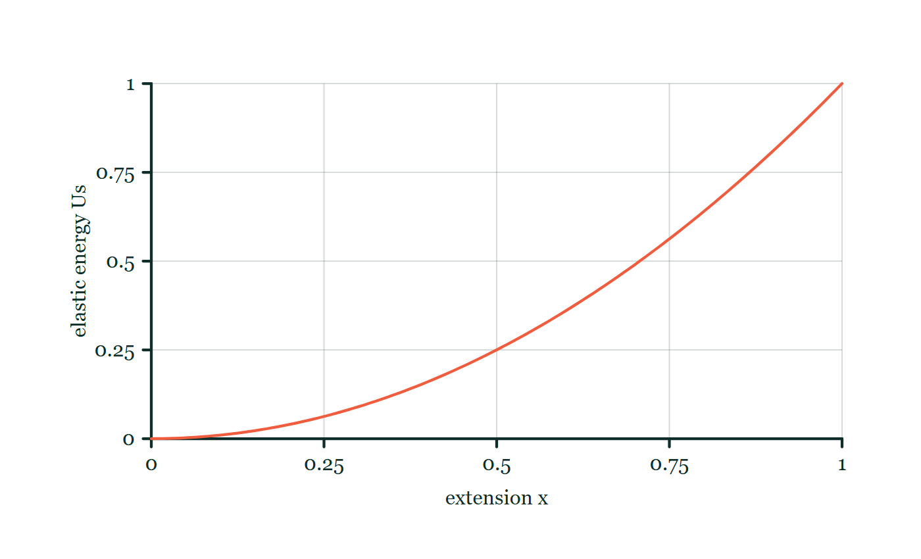
ENERGY · ELASTIC POTENTIAL ENERGY
GIOPHYSICS LESSON
FORMULA 2 OF 3
Elastic store
Build the model — The formulae, one at a time, in plain English
Us = 1/2 kx²
Stretching and compression both store positive energy
IN PLAIN ENGLISH
Energy stored in a stretched or squashed spring — doubling the stretch stores four times the energy.
Elastic energy explorer
Move this graph on the live version — click here
Energy — Elastic Potential Energy. Built by GioPhysics from the lesson's own copy; nothing on these slides is re-authored.
10 / 30
Notes:
[Phase] Build the model: The formulae, one at a time, in plain English (minutes 13–22 of 45)
[Formula] Elastic store: Us = 1/2 kx²
[In plain English] Energy stored in a stretched or squashed spring — doubling the stretch stores four times the energy.
[Note] Stretching and compression both store positive energy
[Graph] Elastic energy explorer. For a Hookean spring with fixed stiffness, stored energy follows the square of extension.
[Axes] Horizontal: extension x. Vertical: elastic energy Us. Values are normalised — the graph teaches the shape, not a measurement.

Slide 11
ENERGY · ELASTIC POTENTIAL ENERGY
GIOPHYSICS LESSON
FORMULA 3 OF 3
Work to load slowly
Build the model — The formulae, one at a time, in plain English
Wexternal = +ΔUs
For quasistatic loading without losses
IN PLAIN ENGLISH
Stretch a spring slowly and every bit of work you do ends up stored in the spring.
Energy — Elastic Potential Energy. Built by GioPhysics from the lesson's own copy; nothing on these slides is re-authored.
11 / 30
Notes:
[Phase] Build the model: The formulae, one at a time, in plain English (minutes 13–22 of 45)
[Formula] Work to load slowly: Wexternal = +ΔUs
[In plain English] Stretch a spring slowly and every bit of work you do ends up stored in the spring.
[Note] For quasistatic loading without losses

Slide 12
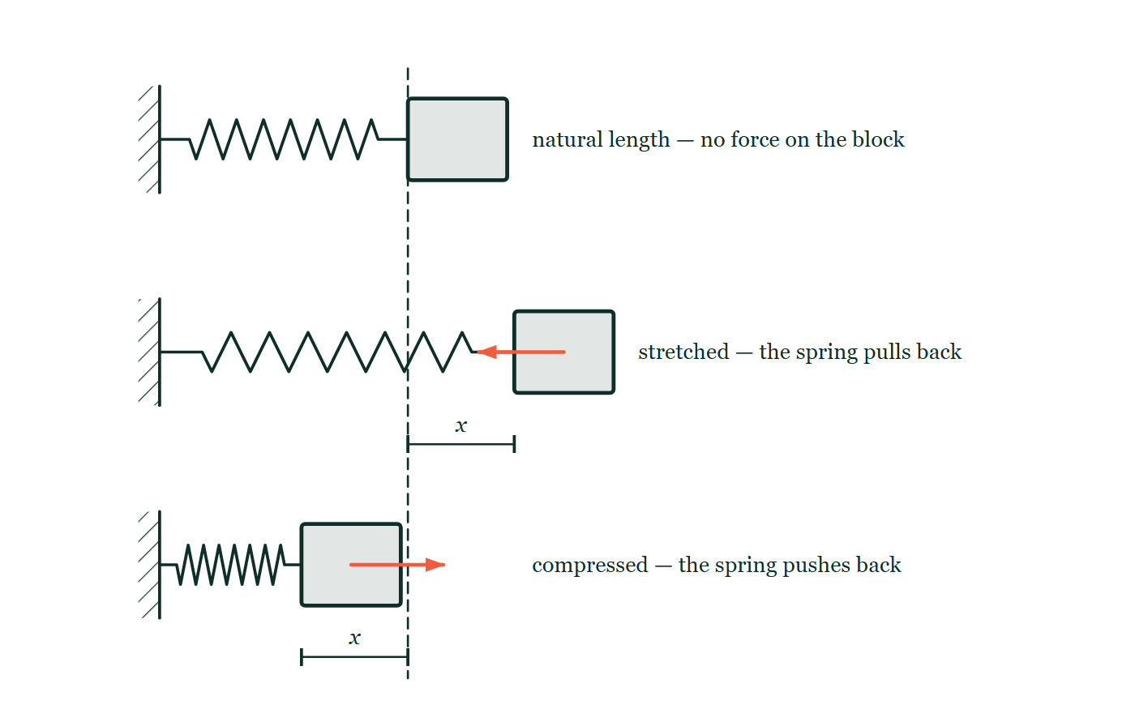
ENERGY · ELASTIC POTENTIAL ENERGY
GIOPHYSICS LESSON
THE PICTURE
Stretched and squashed, side by side
Drawn for this lesson
One spring drawn three times against a single dashed line marking its natural length: relaxed with no arrow, extended by x with the spring's force pointing back, and compressed by the same x with the force pointing the other way.
The live version of this figure — click here
Energy — Elastic Potential Energy. Built by GioPhysics from the lesson's own copy; nothing on these slides is re-authored.
12 / 30
Notes:
[Phase] Build the model: The formulae, one at a time, in plain English (minutes 13–22 of 45)
[Figure] One spring drawn three times against a single dashed line marking its natural length: relaxed with no arrow, extended by x with the spring's force pointing back, and compressed by the same x with the force pointing the other way.

Slide 13
ENERGY · ELASTIC POTENTIAL ENERGY
GIOPHYSICS LESSON
WATCH OUT
The common trap
Check and misconception — The quick check and the trap
F = kx is the magnitude of the slowly applied loading force. The spring's own force is Fspring = -kx.
Energy — Elastic Potential Energy. Built by GioPhysics from the lesson's own copy; nothing on these slides is re-authored.
13 / 30
Notes:
[Phase] Check and misconception: The quick check and the trap (minutes 35–41 of 45)
[Misconception] F = kx is the magnitude of the slowly applied loading force. The spring's own force is Fspring = -kx.

Slide 14
ENERGY · ELASTIC POTENTIAL ENERGY
GIOPHYSICS LESSON
WORKED EXAMPLE 1 OF 2 · EASY
The question
Easy
Worked examples — I do, we do — one step revealed at a time
A spring with k = 100 N/m is compressed 0.20 m. How much energy is stored?
Energy — Elastic Potential Energy. Built by GioPhysics from the lesson's own copy; nothing on these slides is re-authored.
14 / 30
Notes:
[Phase] Worked examples: I do, we do — one step revealed at a time (minutes 22–35 of 45)
[Question] A spring with k = 100 N/m is compressed 0.20 m. How much energy is stored?
[Answer] Us = 2.0 J

Slide 15
ENERGY · ELASTIC POTENTIAL ENERGY
GIOPHYSICS LESSON
WORKED EXAMPLE 1 OF 2 · EASY · THE WORKING
How to solve it
Easy
Worked examples — I do, we do — one step revealed at a time
A spring with k = 100 N/m is compressed 0.20 m. How much energy is stored?
1.
Us = ½kx² = ½ × 100 × 0.04.
2.
Us = 2.0 J.
Energy — Elastic Potential Energy. Built by GioPhysics from the lesson's own copy; nothing on these slides is re-authored.
15 / 30
Notes:
[Phase] Worked examples: I do, we do — one step revealed at a time (minutes 22–35 of 45)
[Reveal] One click per step. The class works each line before the next appears.
[Step 1] Us = ½kx² = ½ × 100 × 0.04.
[Step 2] Us = 2.0 J.

Slide 16
ENERGY · ELASTIC POTENTIAL ENERGY
GIOPHYSICS LESSON
WORKED EXAMPLE 1 OF 2 · EASY
Answer
Easy
Worked examples — I do, we do — one step revealed at a time
Us = 2.0 J
Energy — Elastic Potential Energy. Built by GioPhysics from the lesson's own copy; nothing on these slides is re-authored.
16 / 30
Notes:
[Phase] Worked examples: I do, we do — one step revealed at a time (minutes 22–35 of 45)
[Answer] Us = 2.0 J

Slide 17
ENERGY · ELASTIC POTENTIAL ENERGY
GIOPHYSICS LESSON
WORKED EXAMPLE 2 OF 2 · MEDIUM
The question
Medium
Worked examples — I do, we do — one step revealed at a time
A spring has k = 250 N/m and is stretched 0.12 m. Find the spring force magnitude and stored energy.
Energy — Elastic Potential Energy. Built by GioPhysics from the lesson's own copy; nothing on these slides is re-authored.
17 / 30
Notes:
[Phase] Worked examples: I do, we do — one step revealed at a time (minutes 22–35 of 45)
[Question] A spring has k = 250 N/m and is stretched 0.12 m. Find the spring force magnitude and stored energy.
[Answer] |Fspring| = 30 N and Us = 1.80 J

Slide 18
ENERGY · ELASTIC POTENTIAL ENERGY
GIOPHYSICS LESSON
WORKED EXAMPLE 2 OF 2 · MEDIUM · THE WORKING
How to solve it
Medium
Worked examples — I do, we do — one step revealed at a time
A spring has k = 250 N/m and is stretched 0.12 m. Find the spring force magnitude and stored energy.
1.
Force magnitude = k|x| = (250)(0.12) N.
2.
Us = 1/2 kx² = 1/2(250)(0.12²) J.
3.
The spring force points opposite to the extension.
Energy — Elastic Potential Energy. Built by GioPhysics from the lesson's own copy; nothing on these slides is re-authored.
18 / 30
Notes:
[Phase] Worked examples: I do, we do — one step revealed at a time (minutes 22–35 of 45)
[Reveal] One click per step. The class works each line before the next appears.
[Step 1] Force magnitude = k|x| = (250)(0.12) N.
[Step 2] Us = 1/2 kx² = 1/2(250)(0.12²) J.
[Step 3] The spring force points opposite to the extension.

Slide 19
ENERGY · ELASTIC POTENTIAL ENERGY
GIOPHYSICS LESSON
WORKED EXAMPLE 2 OF 2 · MEDIUM
Answer
Medium
Worked examples — I do, we do — one step revealed at a time
|Fspring| = 30 N and Us = 1.80 J
Energy — Elastic Potential Energy. Built by GioPhysics from the lesson's own copy; nothing on these slides is re-authored.
19 / 30
Notes:
[Phase] Worked examples: I do, we do — one step revealed at a time (minutes 22–35 of 45)
[Answer] |Fspring| = 30 N and Us = 1.80 J

Slide 20
ENERGY · ELASTIC POTENTIAL ENERGY
GIOPHYSICS LESSON
PREDICT · TAKE THE VOTE
Commit before you are told
Hands up for each option, then click
The block is moved 6 cm to the right of the natural length, then 6 cm to the left of it. Compare the spring's force and its stored energy in the two cases.
A Both reverse: the force flips direction and the stored energy goes negative
B The force reverses; the stored energy is exactly the same
C The force is the same; it is the stored energy that reverses
One spring drawn three times against a single dashed line marking its natural length: relaxed with no arrow, extended by x with the spring's force pointing back, and compressed by the same x with the force pointing the other way.
The live version of this figure — click here
Energy — Elastic Potential Energy. Built by GioPhysics from the lesson's own copy; nothing on these slides is re-authored.
20 / 30
Notes:
[Phase] Build the model: The formulae, one at a time, in plain English (minutes 13–22 of 45)
[Predict] The block is moved 6 cm to the right of the natural length, then 6 cm to the left of it. Compare the spring's force and its stored energy in the two cases.
[Options] A Both reverse: the force flips direction and the stored energy goes negative B The force reverses; the stored energy is exactly the same C The force is the same; it is the stored energy that reverses
[Figure] One spring drawn three times against a single dashed line marking its natural length: relaxed with no arrow, extended by x with the spring's force pointing back, and compressed by the same x with the force pointing the other way.

Slide 21
ENERGY · ELASTIC POTENTIAL ENERGY
GIOPHYSICS LESSON
PREDICT · THE OUTCOME
What actually happens
Ask the room who changed their mind, and why
B The force reverses; the stored energy is exactly the same
WHY
Fspring = −kx has one factor of x in it, so changing the sign of x changes the sign of the force — the spring pulls back when stretched and pushes back when compressed, which is what the two arrows in the drawing show. Us = ½kx² has x squared, and squaring destroys the sign. Both displacements store ½k(0.06)², to the joule. There is no such thing as negative stored energy in a spring: you did work either way, and either way it will give it back.
Energy — Elastic Potential Energy. Built by GioPhysics from the lesson's own copy; nothing on these slides is re-authored.
21 / 30
Notes:
[Phase] Build the model: The formulae, one at a time, in plain English (minutes 13–22 of 45)
[Answer] B — The force reverses; the stored energy is exactly the same. Fspring = −kx has one factor of x in it, so changing the sign of x changes the sign of the force — the spring pulls back when stretched and pushes back when compressed, which is what the two arrows in the drawing show. Us = ½kx² has x squared, and squaring destroys the sign. Both displacements store ½k(0.06)², to the joule. There is no such thing as negative stored energy in a spring: you did work either way, and either way it will give it back.

Slide 22
ENERGY · ELASTIC POTENTIAL ENERGY
GIOPHYSICS LESSON
QUICK CHECK
Decide before the answer goes up
Check and misconception — The quick check and the trap
A spring stores 2 J at extension x. How much does it store at extension 2x?
A
2 J
B
4 J
C
8 J
Energy — Elastic Potential Energy. Built by GioPhysics from the lesson's own copy; nothing on these slides is re-authored.
22 / 30
Notes:
[Phase] Check and misconception: The quick check and the trap (minutes 35–41 of 45)
[Question] A spring stores 2 J at extension x. How much does it store at extension 2x?
[Options] A 2 J B 4 J C 8 J

Slide 23
ENERGY · ELASTIC POTENTIAL ENERGY
GIOPHYSICS LESSON
QUICK CHECK · THE ANSWER
The answer, and why
Check and misconception — The quick check and the trap
C 8 J
HOW TO GET THERE
Us is proportional to x², so doubling x multiplies the energy by four: 8 J.
WHY THE OTHERS TEMPT
A 2 J is the energy at x, unchanged — which would be right if the store did not depend on the stretch at all. It depends on it twice over.
B 4 J is 2 × 2 J, the answer for a store that grew in step with the extension. It grows with the square of it, so doubling x is a factor of four, not two.
C Correct. Us = ½kx², so 2x stores 2² = 4 times as much: 4 × 2 J = 8 J. The same reason the force–extension graph's area is a triangle rather than a rectangle.
Energy — Elastic Potential Energy. Built by GioPhysics from the lesson's own copy; nothing on these slides is re-authored.
23 / 30
Notes:
[Phase] Check and misconception: The quick check and the trap (minutes 35–41 of 45)
[Question] A spring stores 2 J at extension x. How much does it store at extension 2x?
[Option by option] A: 2 J is the energy at x, unchanged — which would be right if the store did not depend on the stretch at all. It depends on it twice over. B: 4 J is 2 × 2 J, the answer for a store that grew in step with the extension. It grows with the square of it, so doubling x is a factor of four, not two. C: Correct. Us = ½kx², so 2x stores 2² = 4 times as much: 4 × 2 J = 8 J. The same reason the force–extension graph's area is a triangle rather than a rectangle.
[Answer] C — 8 J
[Why] Us is proportional to x², so doubling x multiplies the energy by four: 8 J.
[Reveal] One click for the answer, then one for the reason.

Slide 24
ENERGY · ELASTIC POTENTIAL ENERGY
GIOPHYSICS LESSON
EXTENSION 1 OF 2 · HARD
The question
Hard
Worked examples — I do, we do — one step revealed at a time
A 0.050 kg dart is fired vertically by a spring (k = 800 N/m) compressed 0.10 m. Ignoring losses, how high does it rise above the release point?
Energy — Elastic Potential Energy. Built by GioPhysics from the lesson's own copy; nothing on these slides is re-authored.
24 / 30
Notes:
[Phase] Worked examples: I do, we do — one step revealed at a time (minutes 22–35 of 45)
[Question] A 0.050 kg dart is fired vertically by a spring (k = 800 N/m) compressed 0.10 m. Ignoring losses, how high does it rise above the release point?
[Answer] h ≈ 8.2 m

Slide 25
ENERGY · ELASTIC POTENTIAL ENERGY
GIOPHYSICS LESSON
EXTENSION 1 OF 2 · HARD · THE WORKING
How to solve it
Hard
Worked examples — I do, we do — one step revealed at a time
A 0.050 kg dart is fired vertically by a spring (k = 800 N/m) compressed 0.10 m. Ignoring losses, how high does it rise above the release point?
1.
Us = ½ × 800 × 0.01 = 4.0 J.
2.
All becomes Ug at the top: mgh = 4.0.
3.
h = 4.0 / (0.050 × 9.81) ≈ 8.2 m.
Energy — Elastic Potential Energy. Built by GioPhysics from the lesson's own copy; nothing on these slides is re-authored.
25 / 30
Notes:
[Phase] Worked examples: I do, we do — one step revealed at a time (minutes 22–35 of 45)
[Reveal] One click per step. The class works each line before the next appears.
[Step 1] Us = ½ × 800 × 0.01 = 4.0 J.
[Step 2] All becomes Ug at the top: mgh = 4.0.
[Step 3] h = 4.0 / (0.050 × 9.81) ≈ 8.2 m.

Slide 26
ENERGY · ELASTIC POTENTIAL ENERGY
GIOPHYSICS LESSON
EXTENSION 1 OF 2 · HARD
Answer
Hard
Worked examples — I do, we do — one step revealed at a time
h ≈ 8.2 m
Energy — Elastic Potential Energy. Built by GioPhysics from the lesson's own copy; nothing on these slides is re-authored.
26 / 30
Notes:
[Phase] Worked examples: I do, we do — one step revealed at a time (minutes 22–35 of 45)
[Answer] h ≈ 8.2 m

Slide 27
ENERGY · ELASTIC POTENTIAL ENERGY
GIOPHYSICS LESSON
EXTENSION 2 OF 2 · CHALLENGING
The question
Challenging
Worked examples — I do, we do — one step revealed at a time
Two identical springs (k each) store energy E when one is stretched by x. Compare the total energy when the pair is stretched x in series and x in parallel.
Energy — Elastic Potential Energy. Built by GioPhysics from the lesson's own copy; nothing on these slides is re-authored.
27 / 30
Notes:
[Phase] Worked examples: I do, we do — one step revealed at a time (minutes 22–35 of 45)
[Question] Two identical springs (k each) store energy E when one is stretched by x. Compare the total energy when the pair is stretched x in series and x in parallel.
[Answer] Series: E/2. Parallel: 2E — a factor of 4 between the arrangements

Slide 28
ENERGY · ELASTIC POTENTIAL ENERGY
GIOPHYSICS LESSON
EXTENSION 2 OF 2 · CHALLENGING · THE WORKING
How to solve it
Challenging
Worked examples — I do, we do — one step revealed at a time
Two identical springs (k each) store energy E when one is stretched by x. Compare the total energy when the pair is stretched x in series and x in parallel.
1.
Series: combined k/2, so U = ½(k/2)x² = E/2 — each spring stretches only x/2.
2.
Parallel: combined 2k, so U = ½(2k)x² = 2E.
3.
The same displacement stores four times more in parallel than in series.
Energy — Elastic Potential Energy. Built by GioPhysics from the lesson's own copy; nothing on these slides is re-authored.
28 / 30
Notes:
[Phase] Worked examples: I do, we do — one step revealed at a time (minutes 22–35 of 45)
[Reveal] One click per step. The class works each line before the next appears.
[Step 1] Series: combined k/2, so U = ½(k/2)x² = E/2 — each spring stretches only x/2.
[Step 2] Parallel: combined 2k, so U = ½(2k)x² = 2E.
[Step 3] The same displacement stores four times more in parallel than in series.

Slide 29
ENERGY · ELASTIC POTENTIAL ENERGY
GIOPHYSICS LESSON
EXTENSION 2 OF 2 · CHALLENGING
Answer
Challenging
Worked examples — I do, we do — one step revealed at a time
Series: E/2. Parallel: 2E — a factor of 4 between the arrangements
Energy — Elastic Potential Energy. Built by GioPhysics from the lesson's own copy; nothing on these slides is re-authored.
29 / 30
Notes:
[Phase] Worked examples: I do, we do — one step revealed at a time (minutes 22–35 of 45)
[Answer] Series: E/2. Parallel: 2E — a factor of 4 between the arrangements

Slide 30
ENERGY · ELASTIC POTENTIAL ENERGY
GIOPHYSICS LESSON
ENERGY
Where to go next
Plenary — What to take away, what to practise next
Next
4.4 Energy Conversion & Conservation
https://giophysics.com/chapter-6/energy-conversion-conservation/
Lesson
This lesson on giophysics.com
https://giophysics.com/chapter-6/elastic-potential-energy/
Live
The live, interactive version of these slides
https://giophysics.com/chapter-6/presentation/?lesson=elastic
Chapter
All Energy lessons
https://giophysics.com/chapter-6/
PDF
Download the lesson PDF
https://giophysics.com/downloads/6-3-elastic-potential-energy.pdf
Energy — Elastic Potential Energy. Built by GioPhysics from the lesson's own copy; nothing on these slides is re-authored.
30 / 30
Notes:
[Phase] Plenary: What to take away, what to practise next (minutes 41–45 of 45)
[Interactive] The graphs and the circuit topology on these slides are frozen. The live version at https://giophysics.com/chapter-6/presentation/?lesson=elastic moves them.

