Slide 1
ENERGY · ENERGY MODEL FOR GAMING
GIOPHYSICS LESSON
04 · Energy
Alpine Relay
Energy Model for Gaming
Pull one spring. The pod stops exactly where its energy runs out — park it on the beacon.
POSITION
Lesson 6 of 6 in Energy
PLAN
16 slides in the 45-minute core run, about 45 minutes of it
LESSON PAGE
https://giophysics.com/chapter-6/energy-model-for-gaming/
Built by GioPhysics from the lesson's own page. Every word on these slides is the lesson's; nothing here is re-authored. Teaching material, not an awarding body's document.
Energy — Energy Model for Gaming. Built by GioPhysics from the lesson's own copy; nothing on these slides is re-authored.
1 / 30
Notes:
[Lesson] Energy — Energy Model for Gaming. Lesson 6 of 6.
[Intro] Pull one spring. The pod stops exactly where its energy runs out — park it on the beacon.
[Source] https://giophysics.com/chapter-6/energy-model-for-gaming/
[Disclaimer] Built by GioPhysics from the lesson's own page. Every word on these slides is the lesson's; nothing here is re-authored. Teaching material, not an awarding body's document.

Slide 2
ENERGY · ENERGY MODEL FOR GAMING
GIOPHYSICS LESSON
THINK FIRST
Two ramps rise to the same height, one short and steep, one long and shallow. The pod has just enough energy for the steep one. Does it make the shallow one?
Take answers before you click — the point is the commitment
The shallow ramp is the gentle option — less climbing per metre, and every push feels easier on it.
THE ANSWER
No, and it is not close. The climb costs mgh either way, because the height is the same. What changes is the friction bill: μmgd cos θ, and the shallow ramp is far longer, so the pod is dragged over much more track for the same gain. Shallower is easier per metre and dearer overall.
Energy — Energy Model for Gaming. Built by GioPhysics from the lesson's own copy; nothing on these slides is re-authored.
2 / 30
Notes:
[Phase] Starter: Recall what this lesson stands on (minutes 0–5 of 45)
[Hook] Two ramps rise to the same height, one short and steep, one long and shallow. The pod has just enough energy for the steep one. Does it make the shallow one? The shallow ramp is the gentle option — less climbing per metre, and every push feels easier on it.
[Answer] No, and it is not close. The climb costs mgh either way, because the height is the same. What changes is the friction bill: μmgd cos θ, and the shallow ramp is far longer, so the pod is dragged over much more track for the same gain. Shallower is easier per metre and dearer overall.

Slide 3
ENERGY · ENERGY MODEL FOR GAMING
GIOPHYSICS LESSON
EXPLAINED SIMPLY
In one sentence
Introduce the idea — The big idea and the definition
An energy game model tracks energy stores and transfers to decide how an object's motion changes.
Energy — Energy Model for Gaming. Built by GioPhysics from the lesson's own copy; nothing on these slides is re-authored.
3 / 30
Notes:
[Phase] Introduce the idea: The big idea and the definition (minutes 5–13 of 45)
[Definition] An energy game model tracks energy stores and transfers to decide how an object's motion changes.

Slide 4
ENERGY · ENERGY MODEL FOR GAMING
GIOPHYSICS LESSON
EXPLAINED SIMPLY
What that looks like
Introduce the idea — The big idea and the definition
FOR EXAMPLE
A game can subtract energy lost to friction from a spring's stored energy before calculating a cart's launch speed.
Energy — Energy Model for Gaming. Built by GioPhysics from the lesson's own copy; nothing on these slides is re-authored.
4 / 30
Notes:
[Phase] Introduce the idea: The big idea and the definition (minutes 5–13 of 45)
[Worked illustration] A game can subtract energy lost to friction from a spring's stored energy before calculating a cart's launch speed.

Slide 5
ENERGY · ENERGY MODEL FOR GAMING
GIOPHYSICS LESSON
THE BIG IDEA
Alpine Relay
Introduce the idea — The big idea and the definition
A useful game model makes every gain and cost visible. One store fills the budget, and the ramp spends it: height takes mgd sin θ per metre and friction takes μmgd cos θ per metre, so the pod halts the instant the budget hits zero.
Energy — Energy Model for Gaming. Built by GioPhysics from the lesson's own copy; nothing on these slides is re-authored.
5 / 30
Notes:
[Phase] Introduce the idea: The big idea and the definition (minutes 5–13 of 45)
[Big idea] A useful game model makes every gain and cost visible. One store fills the budget, and the ramp spends it: height takes mgd sin θ per metre and friction takes μmgd cos θ per metre, so the pod halts the instant the budget hits zero.

Slide 6
ENERGY · ENERGY MODEL FOR GAMING
GIOPHYSICS LESSON
THE PHYSICS · 1 OF 3
State
Build the model — The formulae, one at a time, in plain English
The pod has mass, speed, and a distance travelled up the slope.
Energy — Energy Model for Gaming. Built by GioPhysics from the lesson's own copy; nothing on these slides is re-authored.
6 / 30
Notes:
[Phase] Build the model: The formulae, one at a time, in plain English (minutes 13–22 of 45)
[Section] The pod has mass, speed, and a distance travelled up the slope.

Slide 7
ENERGY · ENERGY MODEL FOR GAMING
GIOPHYSICS LESSON
THE PHYSICS · 2 OF 3
Rules
Build the model — The formulae, one at a time, in plain English
Gravity and friction both bill per metre, so the pod slows at a constant rate until the budget empties.
Energy — Energy Model for Gaming. Built by GioPhysics from the lesson's own copy; nothing on these slides is re-authored.
7 / 30
Notes:
[Phase] Build the model: The formulae, one at a time, in plain English (minutes 13–22 of 45)
[Section] Gravity and friction both bill per metre, so the pod slows at a constant rate until the budget empties.

Slide 8
ENERGY · ENERGY MODEL FOR GAMING
GIOPHYSICS LESSON
THE PHYSICS · 3 OF 3
Feedback
Build the model — The formulae, one at a time, in plain English
The bar splits the same total into motion, height, and heat, so a miss shows you which cost you underpaid.
Energy — Energy Model for Gaming. Built by GioPhysics from the lesson's own copy; nothing on these slides is re-authored.
8 / 30
Notes:
[Phase] Build the model: The formulae, one at a time, in plain English (minutes 13–22 of 45)
[Section] The bar splits the same total into motion, height, and heat, so a miss shows you which cost you underpaid.

Slide 9
ENERGY · ENERGY MODEL FOR GAMING
GIOPHYSICS LESSON
FORMULA 1 OF 3
Supply
Build the model — The formulae, one at a time, in plain English
Ein = 1/2 kx²
x is the spring compression in metres
IN PLAIN ENGLISH
The whole budget: the only energy the pod ever gets is what the spring stored before launch.
Energy — Energy Model for Gaming. Built by GioPhysics from the lesson's own copy; nothing on these slides is re-authored.
9 / 30
Notes:
[Phase] Build the model: The formulae, one at a time, in plain English (minutes 13–22 of 45)
[Formula] Supply: Ein = 1/2 kx²
[In plain English] The whole budget: the only energy the pod ever gets is what the spring stored before launch.
[Note] x is the spring compression in metres

Slide 10
ENERGY · ENERGY MODEL FOR GAMING
GIOPHYSICS LESSON
FORMULA 2 OF 3
Ramp cost
Build the model — The formulae, one at a time, in plain English
Eout = mgd sin θ + μmgd cos θ
Climb plus friction over a slope distance d
IN PLAIN ENGLISH
What the slope charges: lifting the pod, and heating the surface it slides on.
Energy — Energy Model for Gaming. Built by GioPhysics from the lesson's own copy; nothing on these slides is re-authored.
10 / 30
Notes:
[Phase] Build the model: The formulae, one at a time, in plain English (minutes 13–22 of 45)
[Formula] Ramp cost: Eout = mgd sin θ + μmgd cos θ
[In plain English] What the slope charges: lifting the pod, and heating the surface it slides on.
[Note] Climb plus friction over a slope distance d

Slide 11
ENERGY · ENERGY MODEL FOR GAMING
GIOPHYSICS LESSON
FORMULA 3 OF 3
Where it stops
Build the model — The formulae, one at a time, in plain English
d = kx² / (2mg(sin θ + μ cos θ))
Set Ein = Eout and solve for d
IN PLAIN ENGLISH
Balance the two lines above and the stopping point falls out — that is the whole game in one equation.
Energy — Energy Model for Gaming. Built by GioPhysics from the lesson's own copy; nothing on these slides is re-authored.
11 / 30
Notes:
[Phase] Build the model: The formulae, one at a time, in plain English (minutes 13–22 of 45)
[Formula] Where it stops: d = kx² / (2mg(sin θ + μ cos θ))
[In plain English] Balance the two lines above and the stopping point falls out — that is the whole game in one equation.
[Note] Set Ein = Eout and solve for d

Slide 12
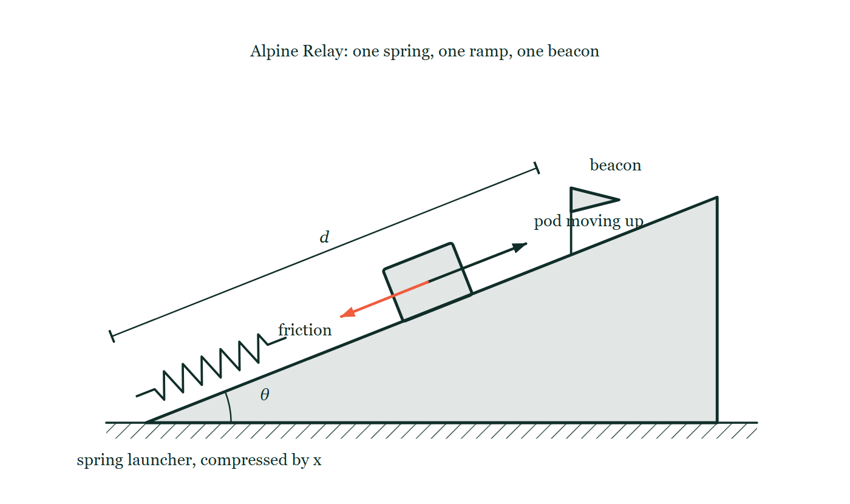
ENERGY · ENERGY MODEL FOR GAMING
GIOPHYSICS LESSON
THE PICTURE
The Alpine Relay board
Drawn for this lesson
A spring launcher at the foot of a ramp of angle θ, a pod partway up it with friction drawn back down the slope against its motion, a beacon standing further up, and the slope distance marked d.
The live version of this figure — click here
Energy — Energy Model for Gaming. Built by GioPhysics from the lesson's own copy; nothing on these slides is re-authored.
12 / 30
Notes:
[Phase] Build the model: The formulae, one at a time, in plain English (minutes 13–22 of 45)
[Figure] A spring launcher at the foot of a ramp of angle θ, a pod partway up it with friction drawn back down the slope against its motion, a beacon standing further up, and the slope distance marked d.

Slide 13
ENERGY · ENERGY MODEL FOR GAMING
GIOPHYSICS LESSON
WATCH OUT
The common trap
Check and misconception — The quick check and the trap
Doubling the pull does not double the distance. Energy goes as x², so twice the compression buys four times the reach.
Energy — Energy Model for Gaming. Built by GioPhysics from the lesson's own copy; nothing on these slides is re-authored.
13 / 30
Notes:
[Phase] Check and misconception: The quick check and the trap (minutes 35–41 of 45)
[Misconception] Doubling the pull does not double the distance. Energy goes as x², so twice the compression buys four times the reach.

Slide 14
ENERGY · ENERGY MODEL FOR GAMING
GIOPHYSICS LESSON
WORKED EXAMPLE 1 OF 2 · EASY
The question
Easy
Worked examples — I do, we do — one step revealed at a time
A game pod needs 500 J to climb a ramp and 200 J to overcome friction. What minimum energy must the launcher supply?
Energy — Energy Model for Gaming. Built by GioPhysics from the lesson's own copy; nothing on these slides is re-authored.
14 / 30
Notes:
[Phase] Worked examples: I do, we do — one step revealed at a time (minutes 22–35 of 45)
[Question] A game pod needs 500 J to climb a ramp and 200 J to overcome friction. What minimum energy must the launcher supply?
[Answer] 700 J

Slide 15
ENERGY · ENERGY MODEL FOR GAMING
GIOPHYSICS LESSON
WORKED EXAMPLE 1 OF 2 · EASY · THE WORKING
How to solve it
Easy
Worked examples — I do, we do — one step revealed at a time
A game pod needs 500 J to climb a ramp and 200 J to overcome friction. What minimum energy must the launcher supply?
1.
Energy needed = climb + friction = 500 + 200.
2.
700 J minimum (finishing with zero speed).
Energy — Energy Model for Gaming. Built by GioPhysics from the lesson's own copy; nothing on these slides is re-authored.
15 / 30
Notes:
[Phase] Worked examples: I do, we do — one step revealed at a time (minutes 22–35 of 45)
[Reveal] One click per step. The class works each line before the next appears.
[Step 1] Energy needed = climb + friction = 500 + 200.
[Step 2] 700 J minimum (finishing with zero speed).

Slide 16
ENERGY · ENERGY MODEL FOR GAMING
GIOPHYSICS LESSON
WORKED EXAMPLE 1 OF 2 · EASY
Answer
Easy
Worked examples — I do, we do — one step revealed at a time
700 J
Energy — Energy Model for Gaming. Built by GioPhysics from the lesson's own copy; nothing on these slides is re-authored.
16 / 30
Notes:
[Phase] Worked examples: I do, we do — one step revealed at a time (minutes 22–35 of 45)
[Answer] 700 J

Slide 17
ENERGY · ENERGY MODEL FOR GAMING
GIOPHYSICS LESSON
WORKED EXAMPLE 2 OF 2 · MEDIUM
The question
Medium
Worked examples — I do, we do — one step revealed at a time
A 60 kg pod climbs 4.0 m, crosses 8.0 m with μ = 0.08, and must finish at 3.0 m/s. Find the minimum energy supply.
Energy — Energy Model for Gaming. Built by GioPhysics from the lesson's own copy; nothing on these slides is re-authored.
17 / 30
Notes:
[Phase] Worked examples: I do, we do — one step revealed at a time (minutes 22–35 of 45)
[Question] A 60 kg pod climbs 4.0 m, crosses 8.0 m with μ = 0.08, and must finish at 3.0 m/s. Find the minimum energy supply.
[Answer] Minimum supply ≈ 3.00 kJ

Slide 18
ENERGY · ENERGY MODEL FOR GAMING
GIOPHYSICS LESSON
WORKED EXAMPLE 2 OF 2 · MEDIUM · THE WORKING
How to solve it
Medium
Worked examples — I do, we do — one step revealed at a time
A 60 kg pod climbs 4.0 m, crosses 8.0 m with μ = 0.08, and must finish at 3.0 m/s. Find the minimum energy supply.
1.
Climb cost = mgh = (60)(9.8)(4.0) = 2,352 J.
2.
Friction cost = μmgd = (0.08)(60)(9.8)(8.0) = 376.3 J.
3.
Target K = 1/2(60)(3.0²) = 270 J; add all three costs.
Energy — Energy Model for Gaming. Built by GioPhysics from the lesson's own copy; nothing on these slides is re-authored.
18 / 30
Notes:
[Phase] Worked examples: I do, we do — one step revealed at a time (minutes 22–35 of 45)
[Reveal] One click per step. The class works each line before the next appears.
[Step 1] Climb cost = mgh = (60)(9.8)(4.0) = 2,352 J.
[Step 2] Friction cost = μmgd = (0.08)(60)(9.8)(8.0) = 376.3 J.
[Step 3] Target K = 1/2(60)(3.0²) = 270 J; add all three costs.

Slide 19
ENERGY · ENERGY MODEL FOR GAMING
GIOPHYSICS LESSON
WORKED EXAMPLE 2 OF 2 · MEDIUM
Answer
Medium
Worked examples — I do, we do — one step revealed at a time
Minimum supply ≈ 3.00 kJ
Energy — Energy Model for Gaming. Built by GioPhysics from the lesson's own copy; nothing on these slides is re-authored.
19 / 30
Notes:
[Phase] Worked examples: I do, we do — one step revealed at a time (minutes 22–35 of 45)
[Answer] Minimum supply ≈ 3.00 kJ

Slide 20
ENERGY · ENERGY MODEL FOR GAMING
GIOPHYSICS LESSON
PREDICT · TAKE THE VOTE
Commit before you are told
Hands up for each option, then click
You halve the pod's mass and pull the spring back exactly as far as before. How far up the ramp does it get?
A The same distance — the spring stored the same energy
B Twice as far
C Four times as far
A spring launcher at the foot of a ramp of angle θ, a pod partway up it with friction drawn back down the slope against its motion, a beacon standing further up, and the slope distance marked d.
The live version of this figure — click here
Energy — Energy Model for Gaming. Built by GioPhysics from the lesson's own copy; nothing on these slides is re-authored.
20 / 30
Notes:
[Phase] Build the model: The formulae, one at a time, in plain English (minutes 13–22 of 45)
[Predict] You halve the pod's mass and pull the spring back exactly as far as before. How far up the ramp does it get?
[Options] A The same distance — the spring stored the same energy B Twice as far C Four times as far
[Figure] A spring launcher at the foot of a ramp of angle θ, a pod partway up it with friction drawn back down the slope against its motion, a beacon standing further up, and the slope distance marked d.

Slide 21
ENERGY · ENERGY MODEL FOR GAMING
GIOPHYSICS LESSON
PREDICT · THE OUTCOME
What actually happens
Ask the room who changed their mind, and why
B Twice as far
WHY
The supply is ½kx², untouched, so the same joules go in. The bill is the part that changed: both the climb and the friction are charged per metre in proportion to mg, so halving m halves the cost of every metre and the same budget buys twice as many. Written out, d = kx²/(2mg(sin θ + μ cos θ)) — mass sits on the bottom, once. Four times as far would need mass squared, and nothing in the ramp's charges is squared.
Energy — Energy Model for Gaming. Built by GioPhysics from the lesson's own copy; nothing on these slides is re-authored.
21 / 30
Notes:
[Phase] Build the model: The formulae, one at a time, in plain English (minutes 13–22 of 45)
[Answer] B — Twice as far. The supply is ½kx², untouched, so the same joules go in. The bill is the part that changed: both the climb and the friction are charged per metre in proportion to mg, so halving m halves the cost of every metre and the same budget buys twice as many. Written out, d = kx²/(2mg(sin θ + μ cos θ)) — mass sits on the bottom, once. Four times as far would need mass squared, and nothing in the ramp's charges is squared.

Slide 22
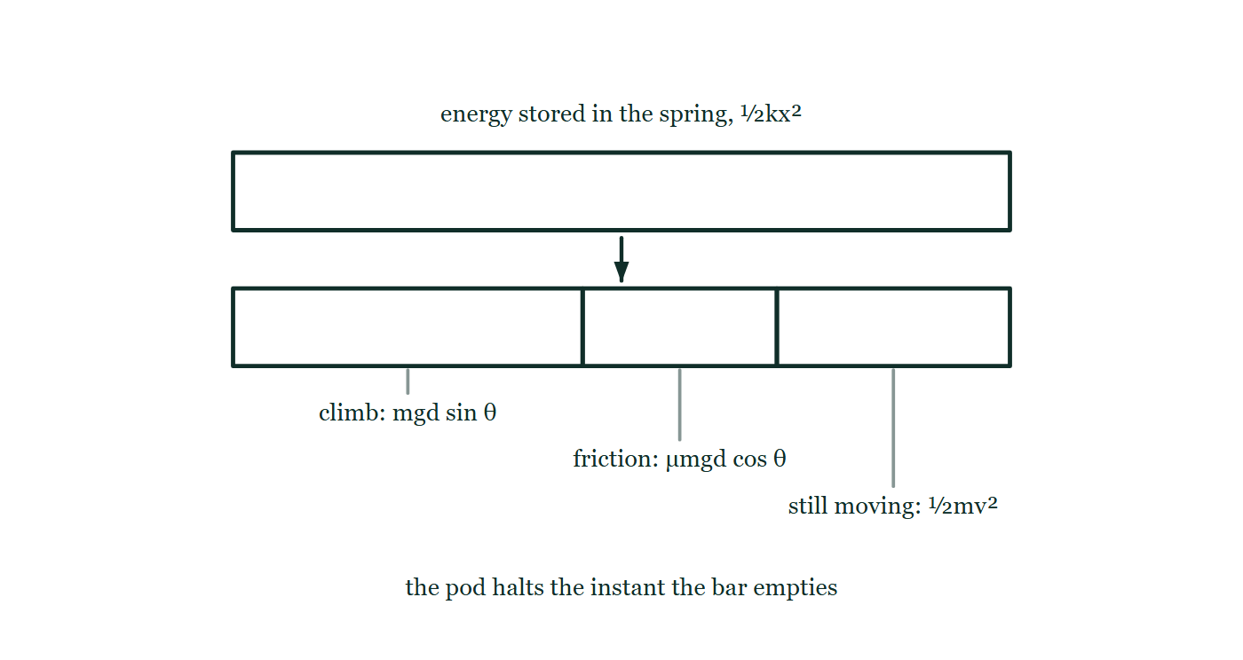
ENERGY · ENERGY MODEL FOR GAMING
GIOPHYSICS LESSON
QUICK CHECK
Decide before the answer goes up
Check and misconception — The quick check and the trap
The pod stops halfway to the beacon. You double the spring compression. What happens to the distance it travels?
A
It doubles, so the pod lands on the beacon
B
It quadruples, so the pod sails past the beacon
C
It stays the same, because mass has not changed
The spring's stored energy drawn as a single bar, with an arrow down to a second bar of the same length cut into three parts labelled climb, friction, and the motion the pod has left.
The live version of this figure — click here
Energy — Energy Model for Gaming. Built by GioPhysics from the lesson's own copy; nothing on these slides is re-authored.
22 / 30
Notes:
[Phase] Check and misconception: The quick check and the trap (minutes 35–41 of 45)
[Question] The pod stops halfway to the beacon. You double the spring compression. What happens to the distance it travels?
[Figure] The spring's stored energy drawn as a single bar, with an arrow down to a second bar of the same length cut into three parts labelled climb, friction, and the motion the pod has left.
[Options] A It doubles, so the pod lands on the beacon B It quadruples, so the pod sails past the beacon C It stays the same, because mass has not changed

Slide 23
ENERGY · ENERGY MODEL FOR GAMING
GIOPHYSICS LESSON
QUICK CHECK · THE ANSWER
The answer, and why
Check and misconception — The quick check and the trap
B It quadruples, so the pod sails past the beacon
HOW TO GET THERE
Stored energy is ½kx², and the ramp charges a fixed cost per metre, so d ∝ x².
WHY THE OTHERS TEMPT
A This is the answer if the reach followed the pull in step, and the launcher does feel that way in the hand. The spring stores ½kx², so the budget doubles twice over while the ramp's price per metre has not moved at all.
B Correct. d ∝ x², so twice the compression is four times the reach — the pod stops well past the beacon. Aim for a beacon at four times the distance, not two.
C Mass has not changed, which is true, and it is why the ramp still charges the same per metre. That is only half the sum: the budget being spent is four times what it was.
Energy — Energy Model for Gaming. Built by GioPhysics from the lesson's own copy; nothing on these slides is re-authored.
23 / 30
Notes:
[Phase] Check and misconception: The quick check and the trap (minutes 35–41 of 45)
[Question] The pod stops halfway to the beacon. You double the spring compression. What happens to the distance it travels?
[Option by option] A: This is the answer if the reach followed the pull in step, and the launcher does feel that way in the hand. The spring stores ½kx², so the budget doubles twice over while the ramp's price per metre has not moved at all. B: Correct. d ∝ x², so twice the compression is four times the reach — the pod stops well past the beacon. Aim for a beacon at four times the distance, not two. C: Mass has not changed, which is true, and it is why the ramp still charges the same per metre. That is only half the sum: the budget being spent is four times what it was.
[Answer] B — It quadruples, so the pod sails past the beacon
[Why] Stored energy is ½kx², and the ramp charges a fixed cost per metre, so d ∝ x².
[Reveal] One click for the answer, then one for the reason.

Slide 24
ENERGY · ENERGY MODEL FOR GAMING
GIOPHYSICS LESSON
EXTENSION 1 OF 2 · HARD
The question
Hard
Worked examples — I do, we do — one step revealed at a time
A 40 kg pod launches at 12 m/s, climbs 3.0 m, and crosses 10 m of track with μ = 0.10. What speed remains at the end?
Energy — Energy Model for Gaming. Built by GioPhysics from the lesson's own copy; nothing on these slides is re-authored.
24 / 30
Notes:
[Phase] Worked examples: I do, we do — one step revealed at a time (minutes 22–35 of 45)
[Question] A 40 kg pod launches at 12 m/s, climbs 3.0 m, and crosses 10 m of track with μ = 0.10. What speed remains at the end?
[Answer] v ≈ 8.1 m/s

Slide 25
ENERGY · ENERGY MODEL FOR GAMING
GIOPHYSICS LESSON
EXTENSION 1 OF 2 · HARD · THE WORKING
How to solve it
Hard
Worked examples — I do, we do — one step revealed at a time
A 40 kg pod launches at 12 m/s, climbs 3.0 m, and crosses 10 m of track with μ = 0.10. What speed remains at the end?
1.
Start: K = ½ × 40 × 144 = 2880 J.
2.
Costs: mgh = 40 × 9.81 × 3.0 ≈ 1177 J; friction = μmgd = 0.10 × 40 × 9.81 × 10 ≈ 392 J.
3.
K(end) = 2880 − 1177 − 392 ≈ 1311 J → v = √(2 × 1311/40) ≈ 8.1 m/s.
Energy — Energy Model for Gaming. Built by GioPhysics from the lesson's own copy; nothing on these slides is re-authored.
25 / 30
Notes:
[Phase] Worked examples: I do, we do — one step revealed at a time (minutes 22–35 of 45)
[Reveal] One click per step. The class works each line before the next appears.
[Step 1] Start: K = ½ × 40 × 144 = 2880 J.
[Step 2] Costs: mgh = 40 × 9.81 × 3.0 ≈ 1177 J; friction = μmgd = 0.10 × 40 × 9.81 × 10 ≈ 392 J.
[Step 3] K(end) = 2880 − 1177 − 392 ≈ 1311 J → v = √(2 × 1311/40) ≈ 8.1 m/s.

Slide 26
ENERGY · ENERGY MODEL FOR GAMING
GIOPHYSICS LESSON
EXTENSION 1 OF 2 · HARD
Answer
Hard
Worked examples — I do, we do — one step revealed at a time
v ≈ 8.1 m/s
Energy — Energy Model for Gaming. Built by GioPhysics from the lesson's own copy; nothing on these slides is re-authored.
26 / 30
Notes:
[Phase] Worked examples: I do, we do — one step revealed at a time (minutes 22–35 of 45)
[Answer] v ≈ 8.1 m/s

Slide 27
ENERGY · ENERGY MODEL FOR GAMING
GIOPHYSICS LESSON
EXTENSION 2 OF 2 · CHALLENGING
The question
Challenging
Worked examples — I do, we do — one step revealed at a time
Design check: a 60 kg pod uses a spring (k = 5000 N/m) compressed 0.80 m, then a motor delivering 400 W for 6.0 s. Can it complete a course needing 4.0 kJ (climb + friction) and arrive at at least 5.0 m/s?
Energy — Energy Model for Gaming. Built by GioPhysics from the lesson's own copy; nothing on these slides is re-authored.
27 / 30
Notes:
[Phase] Worked examples: I do, we do — one step revealed at a time (minutes 22–35 of 45)
[Question] Design check: a 60 kg pod uses a spring (k = 5000 N/m) compressed 0.80 m, then a motor delivering 400 W for 6.0 s. Can it complete a course needing 4.0 kJ (climb + friction) and arrive at at least 5.0 m/s?
[Answer] No — it arrives with 0 J spare; it needs ~750 J more (e.g. compress the spring to ≈ 0.97 m)

Slide 28
ENERGY · ENERGY MODEL FOR GAMING
GIOPHYSICS LESSON
EXTENSION 2 OF 2 · CHALLENGING · THE WORKING
How to solve it
Challenging
Worked examples — I do, we do — one step revealed at a time
Design check: a 60 kg pod uses a spring (k = 5000 N/m) compressed 0.80 m, then a motor delivering 400 W for 6.0 s. Can it complete a course needing 4.0 kJ (climb + friction) and arrive at at least 5.0 m/s?
1.
Spring: ½ × 5000 × 0.64 = 1600 J. Motor: 400 × 6.0 = 2400 J. Supply = 4000 J.
2.
Course cost 4000 J leaves 0 J of kinetic energy — the pod would arrive at rest.
3.
Required arrival K = ½ × 60 × 25 = 750 J → shortfall 750 J; the design fails; raise compression to √(2 × 2350/5000) ≈ 0.97 m.
Energy — Energy Model for Gaming. Built by GioPhysics from the lesson's own copy; nothing on these slides is re-authored.
28 / 30
Notes:
[Phase] Worked examples: I do, we do — one step revealed at a time (minutes 22–35 of 45)
[Reveal] One click per step. The class works each line before the next appears.
[Step 1] Spring: ½ × 5000 × 0.64 = 1600 J. Motor: 400 × 6.0 = 2400 J. Supply = 4000 J.
[Step 2] Course cost 4000 J leaves 0 J of kinetic energy — the pod would arrive at rest.
[Step 3] Required arrival K = ½ × 60 × 25 = 750 J → shortfall 750 J; the design fails; raise compression to √(2 × 2350/5000) ≈ 0.97 m.

Slide 29
ENERGY · ENERGY MODEL FOR GAMING
GIOPHYSICS LESSON
EXTENSION 2 OF 2 · CHALLENGING
Answer
Challenging
Worked examples — I do, we do — one step revealed at a time
No — it arrives with 0 J spare; it needs ~750 J more (e.g. compress the spring to ≈ 0.97 m)
Energy — Energy Model for Gaming. Built by GioPhysics from the lesson's own copy; nothing on these slides is re-authored.
29 / 30
Notes:
[Phase] Worked examples: I do, we do — one step revealed at a time (minutes 22–35 of 45)
[Answer] No — it arrives with 0 J spare; it needs ~750 J more (e.g. compress the spring to ≈ 0.97 m)

Slide 30
ENERGY · ENERGY MODEL FOR GAMING
GIOPHYSICS LESSON
ENERGY
Where to go next
Plenary — What to take away, what to practise next
Lesson
This lesson on giophysics.com
https://giophysics.com/chapter-6/energy-model-for-gaming/
Live
The live, interactive version of these slides
https://giophysics.com/chapter-6/presentation/?lesson=gaming
Chapter
All Energy lessons
https://giophysics.com/chapter-6/
PDF
Download the lesson PDF
https://giophysics.com/downloads/6-6-energy-model-for-gaming.pdf
Energy — Energy Model for Gaming. Built by GioPhysics from the lesson's own copy; nothing on these slides is re-authored.
30 / 30
Notes:
[Phase] Plenary: What to take away, what to practise next (minutes 41–45 of 45)
[Interactive] The graphs and the circuit topology on these slides are frozen. The live version at https://giophysics.com/chapter-6/presentation/?lesson=gaming moves them.

