Slide 1
ENERGY · GRAVITATIONAL POTENTIAL ENERGY
GIOPHYSICS LESSON
04 · Energy
Energy stored by position
Gravitational Potential Energy
Raise an object and the object-Earth system stores energy that gravity can return later.
POSITION
Lesson 2 of 6 in Energy
PLAN
16 slides in the 45-minute core run, about 45 minutes of it
LESSON PAGE
https://giophysics.com/chapter-6/gravitational-potential-energy/
Built by GioPhysics from the lesson's own page. Every word on these slides is the lesson's; nothing here is re-authored. Teaching material, not an awarding body's document.
Energy — Gravitational Potential Energy. Built by GioPhysics from the lesson's own copy; nothing on these slides is re-authored.
1 / 30
Notes:
[Lesson] Energy — Gravitational Potential Energy. Lesson 2 of 6.
[Intro] Raise an object and the object-Earth system stores energy that gravity can return later.
[Source] https://giophysics.com/chapter-6/gravitational-potential-energy/
[Disclaimer] Built by GioPhysics from the lesson's own page. Every word on these slides is the lesson's; nothing here is re-authored. Teaching material, not an awarding body's document.

Slide 2
ENERGY · GRAVITATIONAL POTENTIAL ENERGY
GIOPHYSICS LESSON
THINK FIRST
A 2 kg book is lying on the floor. How much gravitational potential energy has it got?
Take answers before you click — the point is the commitment
It has a mass, it is in the Earth's field, and g is 9.8 N/kg. Everything the formula needs looks as if it is there.
THE ANSWER
The question has no answer until you say where you are measuring from. Measured from that floor, zero. Measured from the pavement three storeys below, about 240 J. Measured from the centre of the Earth, something enormous and negative. Only changes in Ug do anything, so the zero is yours to put wherever makes the arithmetic shortest — and the energy was never in the book alone. It belongs to the book and the Earth together.
Energy — Gravitational Potential Energy. Built by GioPhysics from the lesson's own copy; nothing on these slides is re-authored.
2 / 30
Notes:
[Phase] Starter: Recall what this lesson stands on (minutes 0–5 of 45)
[Hook] A 2 kg book is lying on the floor. How much gravitational potential energy has it got? It has a mass, it is in the Earth's field, and g is 9.8 N/kg. Everything the formula needs looks as if it is there.
[Answer] The question has no answer until you say where you are measuring from. Measured from that floor, zero. Measured from the pavement three storeys below, about 240 J. Measured from the centre of the Earth, something enormous and negative. Only changes in Ug do anything, so the zero is yours to put wherever makes the arithmetic shortest — and the energy was never in the book alone. It belongs to the book and the Earth together.

Slide 3
ENERGY · GRAVITATIONAL POTENTIAL ENERGY
GIOPHYSICS LESSON
EXPLAINED SIMPLY
In one sentence
Introduce the idea — The big idea and the definition
Gravitational potential energy is energy associated with an object's position in a gravitational field.
Energy — Gravitational Potential Energy. Built by GioPhysics from the lesson's own copy; nothing on these slides is re-authored.
3 / 30
Notes:
[Phase] Introduce the idea: The big idea and the definition (minutes 5–13 of 45)
[Definition] Gravitational potential energy is energy associated with an object's position in a gravitational field.

Slide 4
ENERGY · GRAVITATIONAL POTENTIAL ENERGY
GIOPHYSICS LESSON
EXPLAINED SIMPLY
What that looks like
Introduce the idea — The big idea and the definition
FOR EXAMPLE
Lifting a 2 kg book by 1 m near Earth increases its gravitational potential energy by about 19.6 J.
Energy — Gravitational Potential Energy. Built by GioPhysics from the lesson's own copy; nothing on these slides is re-authored.
4 / 30
Notes:
[Phase] Introduce the idea: The big idea and the definition (minutes 5–13 of 45)
[Worked illustration] Lifting a 2 kg book by 1 m near Earth increases its gravitational potential energy by about 19.6 J.

Slide 5
ENERGY · GRAVITATIONAL POTENTIAL ENERGY
GIOPHYSICS LESSON
THE BIG IDEA
Energy stored by position
Introduce the idea — The big idea and the definition
Near a planet's surface, the change in gravitational potential energy depends on mass, field strength, and vertical height change - not on the shape of the path.
Energy — Gravitational Potential Energy. Built by GioPhysics from the lesson's own copy; nothing on these slides is re-authored.
5 / 30
Notes:
[Phase] Introduce the idea: The big idea and the definition (minutes 5–13 of 45)
[Big idea] Near a planet's surface, the change in gravitational potential energy depends on mass, field strength, and vertical height change - not on the shape of the path.

Slide 6
ENERGY · GRAVITATIONAL POTENTIAL ENERGY
GIOPHYSICS LESSON
THE PHYSICS · 1 OF 3
Choose a zero
Build the model — The formulae, one at a time, in plain English
Only changes in Ug affect motion, so choose the most convenient reference height.
Energy — Gravitational Potential Energy. Built by GioPhysics from the lesson's own copy; nothing on these slides is re-authored.
6 / 30
Notes:
[Phase] Build the model: The formulae, one at a time, in plain English (minutes 13–22 of 45)
[Section] Only changes in Ug affect motion, so choose the most convenient reference height.

Slide 7
ENERGY · GRAVITATIONAL POTENTIAL ENERGY
GIOPHYSICS LESSON
THE PHYSICS · 2 OF 3
Height, not path
Build the model — The formulae, one at a time, in plain English
A ramp and a vertical lift give the same ΔUg when they reach the same final height.
Energy — Gravitational Potential Energy. Built by GioPhysics from the lesson's own copy; nothing on these slides is re-authored.
7 / 30
Notes:
[Phase] Build the model: The formulae, one at a time, in plain English (minutes 13–22 of 45)
[Section] A ramp and a vertical lift give the same ΔUg when they reach the same final height.

Slide 8
ENERGY · GRAVITATIONAL POTENTIAL ENERGY
GIOPHYSICS LESSON
THE PHYSICS · 3 OF 3
Know the model
Build the model — The formulae, one at a time, in plain English
Use mgΔh when g is nearly constant; use -GMm/r over planetary-scale distance changes.
Energy — Gravitational Potential Energy. Built by GioPhysics from the lesson's own copy; nothing on these slides is re-authored.
8 / 30
Notes:
[Phase] Build the model: The formulae, one at a time, in plain English (minutes 13–22 of 45)
[Section] Use mgΔh when g is nearly constant; use -GMm/r over planetary-scale distance changes.

Slide 9
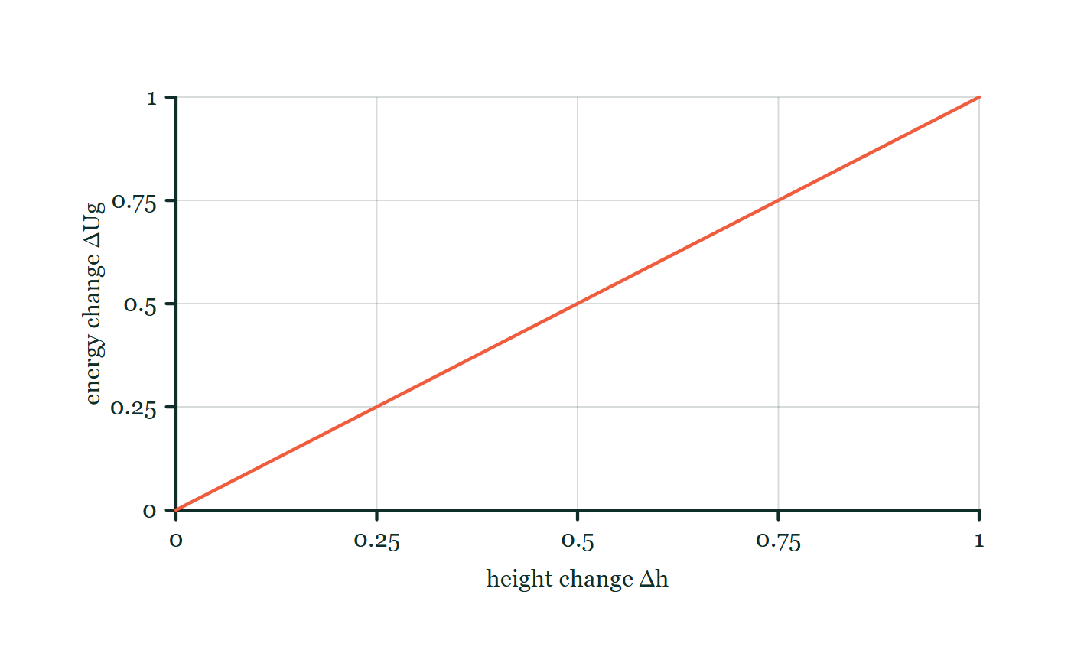
ENERGY · GRAVITATIONAL POTENTIAL ENERGY
GIOPHYSICS LESSON
FORMULA 1 OF 3
Near a surface
Build the model — The formulae, one at a time, in plain English
ΔUg = mgΔh
Use the vertical height change
IN PLAIN ENGLISH
Lifting something stores energy: weight (mass × gravity) times how high it rose.
Gravitational energy explorer
Move this graph on the live version — click here
Energy — Gravitational Potential Energy. Built by GioPhysics from the lesson's own copy; nothing on these slides is re-authored.
9 / 30
Notes:
[Phase] Build the model: The formulae, one at a time, in plain English (minutes 13–22 of 45)
[Formula] Near a surface: ΔUg = mgΔh
[In plain English] Lifting something stores energy: weight (mass × gravity) times how high it rose.
[Note] Use the vertical height change
[Graph] Gravitational energy explorer. Near Earth, fixed mass and g make gravitational energy change directly proportional to height change.
[Axes] Horizontal: height change Δh. Vertical: energy change ΔUg. Values are normalised — the graph teaches the shape, not a measurement.

Slide 10
ENERGY · GRAVITATIONAL POTENTIAL ENERGY
GIOPHYSICS LESSON
FORMULA 2 OF 3
Gravity's work
Build the model — The formulae, one at a time, in plain English
Wgravity = -ΔUg
Gravity removes Ug when it does positive work
IN PLAIN ENGLISH
When something falls, gravity's work turns stored height energy into motion — one goes down as the other goes up.
Energy — Gravitational Potential Energy. Built by GioPhysics from the lesson's own copy; nothing on these slides is re-authored.
10 / 30
Notes:
[Phase] Build the model: The formulae, one at a time, in plain English (minutes 13–22 of 45)
[Formula] Gravity's work: Wgravity = -ΔUg
[In plain English] When something falls, gravity's work turns stored height energy into motion — one goes down as the other goes up.
[Note] Gravity removes Ug when it does positive work

Slide 11
ENERGY · GRAVITATIONAL POTENTIAL ENERGY
GIOPHYSICS LESSON
FORMULA 3 OF 3
Large distances
Build the model — The formulae, one at a time, in plain English
Ug = -GMm/r
Use zero at infinity for inverse-square gravity
IN PLAIN ENGLISH
Far from a planet, stored gravitational energy uses this form; it is negative because you would need to add energy to pull the objects fully apart.
Energy — Gravitational Potential Energy. Built by GioPhysics from the lesson's own copy; nothing on these slides is re-authored.
11 / 30
Notes:
[Phase] Build the model: The formulae, one at a time, in plain English (minutes 13–22 of 45)
[Formula] Large distances: Ug = -GMm/r
[In plain English] Far from a planet, stored gravitational energy uses this form; it is negative because you would need to add energy to pull the objects fully apart.
[Note] Use zero at infinity for inverse-square gravity

Slide 12
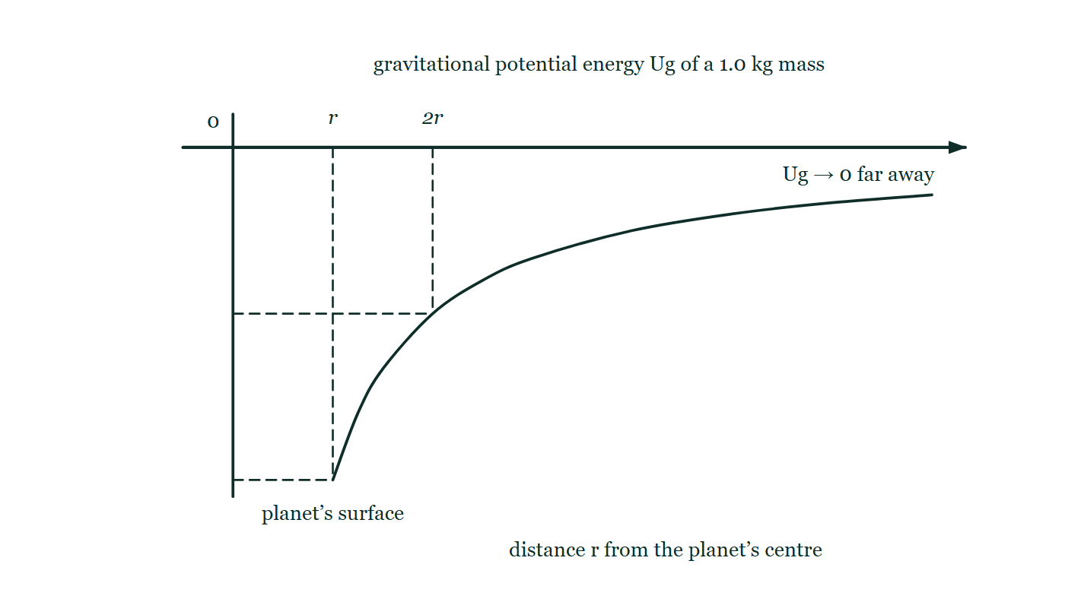
ENERGY · GRAVITATIONAL POTENTIAL ENERGY
GIOPHYSICS LESSON
THE PICTURE
The well, drawn properly
Drawn for this lesson
Gravitational potential energy against distance from a planet's centre: a curve that starts deep below the axis at the surface and climbs steeply, flattening towards zero without ever reaching it.
The live version of this figure — click here
Energy — Gravitational Potential Energy. Built by GioPhysics from the lesson's own copy; nothing on these slides is re-authored.
12 / 30
Notes:
[Phase] Build the model: The formulae, one at a time, in plain English (minutes 13–22 of 45)
[Figure] Gravitational potential energy against distance from a planet's centre: a curve that starts deep below the axis at the surface and climbs steeply, flattening towards zero without ever reaching it.

Slide 13
ENERGY · GRAVITATIONAL POTENTIAL ENERGY
GIOPHYSICS LESSON
WATCH OUT
The common trap
Check and misconception — The quick check and the trap
Potential energy is not stored inside the object alone. It belongs to the interacting object-Earth system and depends on a chosen reference.
Energy — Gravitational Potential Energy. Built by GioPhysics from the lesson's own copy; nothing on these slides is re-authored.
13 / 30
Notes:
[Phase] Check and misconception: The quick check and the trap (minutes 35–41 of 45)
[Misconception] Potential energy is not stored inside the object alone. It belongs to the interacting object-Earth system and depends on a chosen reference.

Slide 14
ENERGY · GRAVITATIONAL POTENTIAL ENERGY
GIOPHYSICS LESSON
WORKED EXAMPLE 1 OF 2 · EASY
The question
Easy
Worked examples — I do, we do — one step revealed at a time
How much gravitational potential energy does a 3.0 kg bag gain when lifted 2.0 m?
Energy — Gravitational Potential Energy. Built by GioPhysics from the lesson's own copy; nothing on these slides is re-authored.
14 / 30
Notes:
[Phase] Worked examples: I do, we do — one step revealed at a time (minutes 22–35 of 45)
[Question] How much gravitational potential energy does a 3.0 kg bag gain when lifted 2.0 m?
[Answer] ΔUg ≈ 59 J

Slide 15
ENERGY · GRAVITATIONAL POTENTIAL ENERGY
GIOPHYSICS LESSON
WORKED EXAMPLE 1 OF 2 · EASY · THE WORKING
How to solve it
Easy
Worked examples — I do, we do — one step revealed at a time
How much gravitational potential energy does a 3.0 kg bag gain when lifted 2.0 m?
1.
ΔUg = mgΔh = 3.0 × 9.81 × 2.0.
2.
ΔUg ≈ 59 J.
Energy — Gravitational Potential Energy. Built by GioPhysics from the lesson's own copy; nothing on these slides is re-authored.
15 / 30
Notes:
[Phase] Worked examples: I do, we do — one step revealed at a time (minutes 22–35 of 45)
[Reveal] One click per step. The class works each line before the next appears.
[Step 1] ΔUg = mgΔh = 3.0 × 9.81 × 2.0.
[Step 2] ΔUg ≈ 59 J.

Slide 16
ENERGY · GRAVITATIONAL POTENTIAL ENERGY
GIOPHYSICS LESSON
WORKED EXAMPLE 1 OF 2 · EASY
Answer
Easy
Worked examples — I do, we do — one step revealed at a time
ΔUg ≈ 59 J
Energy — Gravitational Potential Energy. Built by GioPhysics from the lesson's own copy; nothing on these slides is re-authored.
16 / 30
Notes:
[Phase] Worked examples: I do, we do — one step revealed at a time (minutes 22–35 of 45)
[Answer] ΔUg ≈ 59 J

Slide 17
ENERGY · GRAVITATIONAL POTENTIAL ENERGY
GIOPHYSICS LESSON
WORKED EXAMPLE 2 OF 2 · MEDIUM
The question
Medium
Worked examples — I do, we do — one step revealed at a time
A 12 kg crate is lifted vertically by 2.5 m near Earth. Find its gain in gravitational potential energy.
Energy — Gravitational Potential Energy. Built by GioPhysics from the lesson's own copy; nothing on these slides is re-authored.
17 / 30
Notes:
[Phase] Worked examples: I do, we do — one step revealed at a time (minutes 22–35 of 45)
[Question] A 12 kg crate is lifted vertically by 2.5 m near Earth. Find its gain in gravitational potential energy.
[Answer] ΔUg = +294 J

Slide 18
ENERGY · GRAVITATIONAL POTENTIAL ENERGY
GIOPHYSICS LESSON
WORKED EXAMPLE 2 OF 2 · MEDIUM · THE WORKING
How to solve it
Medium
Worked examples — I do, we do — one step revealed at a time
A 12 kg crate is lifted vertically by 2.5 m near Earth. Find its gain in gravitational potential energy.
1.
Use ΔUg = mgΔh with g = 9.8 N/kg.
2.
ΔUg = (12)(9.8)(2.5) J.
3.
The positive sign means the gravitational store increased.
Energy — Gravitational Potential Energy. Built by GioPhysics from the lesson's own copy; nothing on these slides is re-authored.
18 / 30
Notes:
[Phase] Worked examples: I do, we do — one step revealed at a time (minutes 22–35 of 45)
[Reveal] One click per step. The class works each line before the next appears.
[Step 1] Use ΔUg = mgΔh with g = 9.8 N/kg.
[Step 2] ΔUg = (12)(9.8)(2.5) J.
[Step 3] The positive sign means the gravitational store increased.

Slide 19
ENERGY · GRAVITATIONAL POTENTIAL ENERGY
GIOPHYSICS LESSON
WORKED EXAMPLE 2 OF 2 · MEDIUM
Answer
Medium
Worked examples — I do, we do — one step revealed at a time
ΔUg = +294 J
Energy — Gravitational Potential Energy. Built by GioPhysics from the lesson's own copy; nothing on these slides is re-authored.
19 / 30
Notes:
[Phase] Worked examples: I do, we do — one step revealed at a time (minutes 22–35 of 45)
[Answer] ΔUg = +294 J

Slide 20
ENERGY · GRAVITATIONAL POTENTIAL ENERGY
GIOPHYSICS LESSON
PREDICT · TAKE THE VOTE
Commit before you are told
Hands up for each option, then click
Using Ug = −GMm/r, where is a 1 kg mass's gravitational potential energy greatest?
A At the planet's surface, where gravity is strongest
B Infinitely far away, where it is zero
C Halfway out, where the curve is steepest
Gravitational potential energy against distance from a planet's centre: a curve that starts deep below the axis at the surface and climbs steeply, flattening towards zero without ever reaching it.
The live version of this figure — click here
Energy — Gravitational Potential Energy. Built by GioPhysics from the lesson's own copy; nothing on these slides is re-authored.
20 / 30
Notes:
[Phase] Build the model: The formulae, one at a time, in plain English (minutes 13–22 of 45)
[Predict] Using Ug = −GMm/r, where is a 1 kg mass's gravitational potential energy greatest?
[Options] A At the planet's surface, where gravity is strongest B Infinitely far away, where it is zero C Halfway out, where the curve is steepest
[Figure] Gravitational potential energy against distance from a planet's centre: a curve that starts deep below the axis at the surface and climbs steeply, flattening towards zero without ever reaching it.

Slide 21
ENERGY · GRAVITATIONAL POTENTIAL ENERGY
GIOPHYSICS LESSON
PREDICT · THE OUTCOME
What actually happens
Ask the room who changed their mind, and why
B Infinitely far away, where it is zero
WHY
Follow the curve rather than the words. Every value on it is negative, and negative numbers get larger by getting closer to zero — so the highest point on the graph is the flat end on the right, where r → ∞ and Ug → 0. The deepest point is at the surface, which is where the store is emptiest and where you have to add the most energy to escape. Choosing zero at infinity is what makes every bound orbit come out negative, and that is a feature: it is how you can tell at a glance that something cannot get away.
Energy — Gravitational Potential Energy. Built by GioPhysics from the lesson's own copy; nothing on these slides is re-authored.
21 / 30
Notes:
[Phase] Build the model: The formulae, one at a time, in plain English (minutes 13–22 of 45)
[Answer] B — Infinitely far away, where it is zero. Follow the curve rather than the words. Every value on it is negative, and negative numbers get larger by getting closer to zero — so the highest point on the graph is the flat end on the right, where r → ∞ and Ug → 0. The deepest point is at the surface, which is where the store is emptiest and where you have to add the most energy to escape. Choosing zero at infinity is what makes every bound orbit come out negative, and that is a feature: it is how you can tell at a glance that something cannot get away.

Slide 22
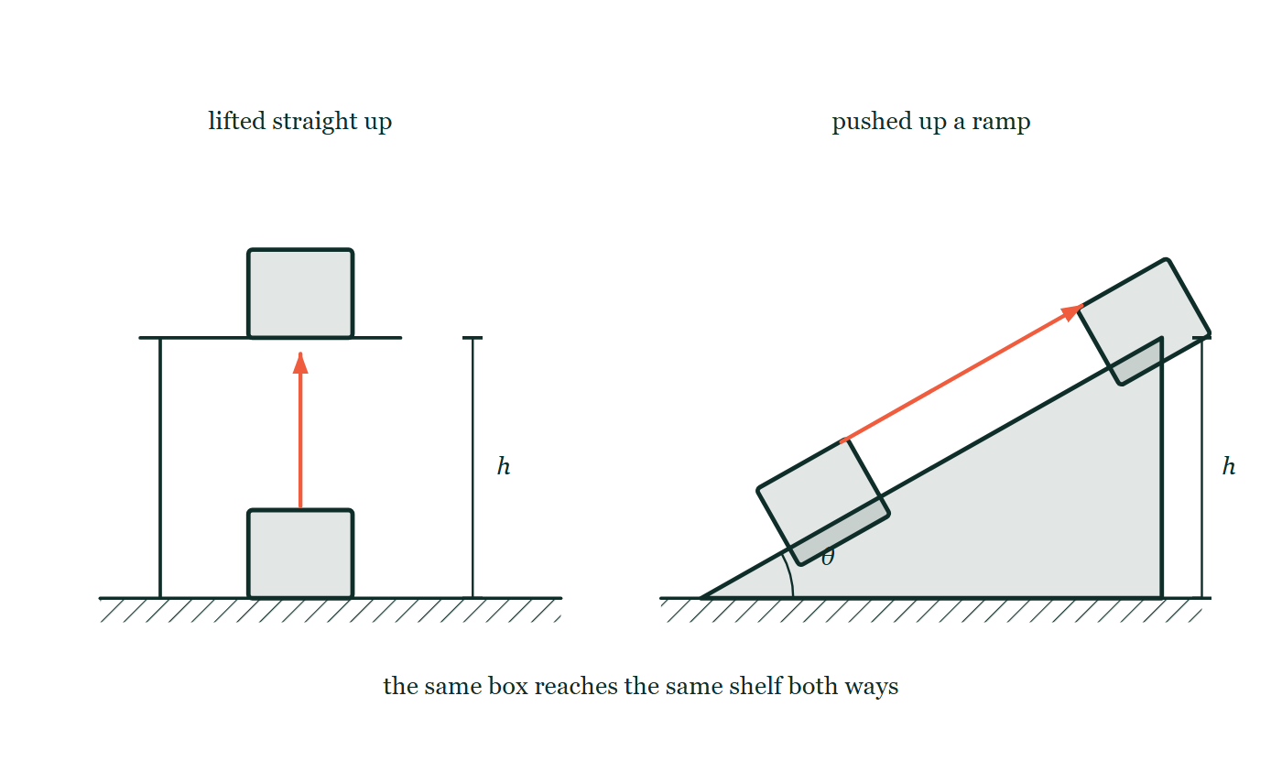
ENERGY · GRAVITATIONAL POTENTIAL ENERGY
GIOPHYSICS LESSON
QUICK CHECK
Decide before the answer goes up
Check and misconception — The quick check and the trap
Two routes lift the same box to the same shelf. One route is longer. Ignoring friction, which gives the larger ΔUg?
A
The longer route
B
The shorter route
C
They are equal
The same box drawn twice on each side: lifted straight up on the left and pushed up a long ramp on the right, with the two height dimensions marked h and drawn the same number of units.
The live version of this figure — click here
Energy — Gravitational Potential Energy. Built by GioPhysics from the lesson's own copy; nothing on these slides is re-authored.
22 / 30
Notes:
[Phase] Check and misconception: The quick check and the trap (minutes 35–41 of 45)
[Question] Two routes lift the same box to the same shelf. One route is longer. Ignoring friction, which gives the larger ΔUg?
[Figure] The same box drawn twice on each side: lifted straight up on the left and pushed up a long ramp on the right, with the two height dimensions marked h and drawn the same number of units.
[Options] A The longer route B The shorter route C They are equal

Slide 23
ENERGY · GRAVITATIONAL POTENTIAL ENERGY
GIOPHYSICS LESSON
QUICK CHECK · THE ANSWER
The answer, and why
Check and misconception — The quick check and the trap
C They are equal
HOW TO GET THERE
ΔUg = mgΔh depends on vertical height change, not route length.
WHY THE OTHERS TEMPT
A The longer route does take more work against friction, and it feels like more effort — which is exactly why this is chosen. But the question says to ignore friction, and once it is gone the only thing ΔUg = mgΔh can respond to is the height, which both routes share.
B A shorter route is a smaller distance, and smaller distances usually mean less of everything — except that Δh is not a distance travelled. It is a difference between two heights, and the two routes start and finish at the same two heights.
C Correct. ΔUg = mgΔh reads the vertical height change and nothing else. A ramp trades a smaller force for a longer push and arrives at the same number, which is what a machine is.
Energy — Gravitational Potential Energy. Built by GioPhysics from the lesson's own copy; nothing on these slides is re-authored.
23 / 30
Notes:
[Phase] Check and misconception: The quick check and the trap (minutes 35–41 of 45)
[Question] Two routes lift the same box to the same shelf. One route is longer. Ignoring friction, which gives the larger ΔUg?
[Option by option] A: The longer route does take more work against friction, and it feels like more effort — which is exactly why this is chosen. But the question says to ignore friction, and once it is gone the only thing ΔUg = mgΔh can respond to is the height, which both routes share. B: A shorter route is a smaller distance, and smaller distances usually mean less of everything — except that Δh is not a distance travelled. It is a difference between two heights, and the two routes start and finish at the same two heights. C: Correct. ΔUg = mgΔh reads the vertical height change and nothing else. A ramp trades a smaller force for a longer push and arrives at the same number, which is what a machine is.
[Answer] C — They are equal
[Why] ΔUg = mgΔh depends on vertical height change, not route length.
[Reveal] One click for the answer, then one for the reason.

Slide 24
ENERGY · GRAVITATIONAL POTENTIAL ENERGY
GIOPHYSICS LESSON
EXTENSION 1 OF 2 · HARD
The question
Hard
Worked examples — I do, we do — one step revealed at a time
A 55 kg hiker climbs 400 m of vertical height. Estimate the food energy used if muscles are 20% efficient, in kJ.
Energy — Gravitational Potential Energy. Built by GioPhysics from the lesson's own copy; nothing on these slides is re-authored.
24 / 30
Notes:
[Phase] Worked examples: I do, we do — one step revealed at a time (minutes 22–35 of 45)
[Question] A 55 kg hiker climbs 400 m of vertical height. Estimate the food energy used if muscles are 20% efficient, in kJ.
[Answer] ≈ 1.1 MJ (about 260 kcal)

Slide 25
ENERGY · GRAVITATIONAL POTENTIAL ENERGY
GIOPHYSICS LESSON
EXTENSION 1 OF 2 · HARD · THE WORKING
How to solve it
Hard
Worked examples — I do, we do — one step revealed at a time
A 55 kg hiker climbs 400 m of vertical height. Estimate the food energy used if muscles are 20% efficient, in kJ.
1.
Useful energy = mgh = 55 × 9.81 × 400 ≈ 2.16 × 10⁵ J.
2.
Input = useful ÷ efficiency = 2.16 × 10⁵ ÷ 0.20.
3.
≈ 1.1 × 10⁶ J ≈ 1100 kJ.
Energy — Gravitational Potential Energy. Built by GioPhysics from the lesson's own copy; nothing on these slides is re-authored.
25 / 30
Notes:
[Phase] Worked examples: I do, we do — one step revealed at a time (minutes 22–35 of 45)
[Reveal] One click per step. The class works each line before the next appears.
[Step 1] Useful energy = mgh = 55 × 9.81 × 400 ≈ 2.16 × 10⁵ J.
[Step 2] Input = useful ÷ efficiency = 2.16 × 10⁵ ÷ 0.20.
[Step 3] ≈ 1.1 × 10⁶ J ≈ 1100 kJ.

Slide 26
ENERGY · GRAVITATIONAL POTENTIAL ENERGY
GIOPHYSICS LESSON
EXTENSION 1 OF 2 · HARD
Answer
Hard
Worked examples — I do, we do — one step revealed at a time
≈ 1.1 MJ (about 260 kcal)
Energy — Gravitational Potential Energy. Built by GioPhysics from the lesson's own copy; nothing on these slides is re-authored.
26 / 30
Notes:
[Phase] Worked examples: I do, we do — one step revealed at a time (minutes 22–35 of 45)
[Answer] ≈ 1.1 MJ (about 260 kcal)

Slide 27
ENERGY · GRAVITATIONAL POTENTIAL ENERGY
GIOPHYSICS LESSON
EXTENSION 2 OF 2 · CHALLENGING
The question
Challenging
Worked examples — I do, we do — one step revealed at a time
Using Ug = −GMm/r, show that lifting 1.0 kg from Earth's surface (r = 6.4 × 10⁶ m) to 2r costs about half of mgr — not mg × r as the flat-Earth formula would guess. (GM = 4.0 × 10¹⁴ m³/s²)
Energy — Gravitational Potential Energy. Built by GioPhysics from the lesson's own copy; nothing on these slides is re-authored.
27 / 30
Notes:
[Phase] Worked examples: I do, we do — one step revealed at a time (minutes 22–35 of 45)
[Question] Using Ug = −GMm/r, show that lifting 1.0 kg from Earth's surface (r = 6.4 × 10⁶ m) to 2r costs about half of mgr — not mg × r as the flat-Earth formula would guess. (GM = 4.0 × 10¹⁴ m³/s²)
[Answer] ΔU = GMm/2r ≈ 3.1 × 10⁷ J, half the naive mgr

Slide 28
ENERGY · GRAVITATIONAL POTENTIAL ENERGY
GIOPHYSICS LESSON
EXTENSION 2 OF 2 · CHALLENGING · THE WORKING
How to solve it
Challenging
Worked examples — I do, we do — one step revealed at a time
Using Ug = −GMm/r, show that lifting 1.0 kg from Earth's surface (r = 6.4 × 10⁶ m) to 2r costs about half of mgr — not mg × r as the flat-Earth formula would guess. (GM = 4.0 × 10¹⁴ m³/s²)
1.
ΔU = −GMm/2r − (−GMm/r) = GMm/2r.
2.
ΔU = 4.0 × 10¹⁴ × 1.0 / (2 × 6.4 × 10⁶) ≈ 3.1 × 10⁷ J.
3.
mgr would give 1.0 × 9.81 × 6.4 × 10⁶ ≈ 6.3 × 10⁷ J — twice as much, because gravity weakens with altitude.
Energy — Gravitational Potential Energy. Built by GioPhysics from the lesson's own copy; nothing on these slides is re-authored.
28 / 30
Notes:
[Phase] Worked examples: I do, we do — one step revealed at a time (minutes 22–35 of 45)
[Reveal] One click per step. The class works each line before the next appears.
[Step 1] ΔU = −GMm/2r − (−GMm/r) = GMm/2r.
[Step 2] ΔU = 4.0 × 10¹⁴ × 1.0 / (2 × 6.4 × 10⁶) ≈ 3.1 × 10⁷ J.
[Step 3] mgr would give 1.0 × 9.81 × 6.4 × 10⁶ ≈ 6.3 × 10⁷ J — twice as much, because gravity weakens with altitude.

Slide 29
ENERGY · GRAVITATIONAL POTENTIAL ENERGY
GIOPHYSICS LESSON
EXTENSION 2 OF 2 · CHALLENGING
Answer
Challenging
Worked examples — I do, we do — one step revealed at a time
ΔU = GMm/2r ≈ 3.1 × 10⁷ J, half the naive mgr
Energy — Gravitational Potential Energy. Built by GioPhysics from the lesson's own copy; nothing on these slides is re-authored.
29 / 30
Notes:
[Phase] Worked examples: I do, we do — one step revealed at a time (minutes 22–35 of 45)
[Answer] ΔU = GMm/2r ≈ 3.1 × 10⁷ J, half the naive mgr

Slide 30
ENERGY · GRAVITATIONAL POTENTIAL ENERGY
GIOPHYSICS LESSON
ENERGY
Where to go next
Plenary — What to take away, what to practise next
Next
4.3 Elastic Potential Energy
https://giophysics.com/chapter-6/elastic-potential-energy/
Lesson
This lesson on giophysics.com
https://giophysics.com/chapter-6/gravitational-potential-energy/
Live
The live, interactive version of these slides
https://giophysics.com/chapter-6/presentation/?lesson=gravity
Chapter
All Energy lessons
https://giophysics.com/chapter-6/
PDF
Download the lesson PDF
https://giophysics.com/downloads/6-2-gravitational-potential-energy.pdf
Energy — Gravitational Potential Energy. Built by GioPhysics from the lesson's own copy; nothing on these slides is re-authored.
30 / 30
Notes:
[Phase] Plenary: What to take away, what to practise next (minutes 41–45 of 45)
[Interactive] The graphs and the circuit topology on these slides are frozen. The live version at https://giophysics.com/chapter-6/presentation/?lesson=gravity moves them.

