Slide 1
ENERGY · KINETIC ENERGY
GIOPHYSICS LESSON
04 · Energy
Energy of motion
Kinetic Energy
A moving object can transfer energy by doing work. Mass matters, but speed matters twice.
POSITION
Lesson 1 of 6 in Energy
PLAN
15 slides in the 45-minute core run, about 43.5 minutes of it
LESSON PAGE
https://giophysics.com/chapter-6/kinetic-energy/
Built by GioPhysics from the lesson's own page. Every word on these slides is the lesson's; nothing here is re-authored. Teaching material, not an awarding body's document.
Energy — Kinetic Energy. Built by GioPhysics from the lesson's own copy; nothing on these slides is re-authored.
1 / 34
Notes:
[Lesson] Energy — Kinetic Energy. Lesson 1 of 6.
[Intro] A moving object can transfer energy by doing work. Mass matters, but speed matters twice.
[Source] https://giophysics.com/chapter-6/kinetic-energy/
[Disclaimer] Built by GioPhysics from the lesson's own page. Every word on these slides is the lesson's; nothing here is re-authored. Teaching material, not an awarding body's document.

Slide 2
ENERGY · KINETIC ENERGY
GIOPHYSICS LESSON
THINK FIRST
Your car needs 45 m to stop from 30 m/s. How much road does it need from 60 m/s?
Take answers before you click — the point is the commitment
Twice the speed. The brakes are the same brakes, the road is the same road, and the driver reacts just as fast.
THE ANSWER
180 m — four times as far, not twice. The brakes remove energy at a fixed rate per metre, and doubling the speed quadruples the energy there is to remove, because K goes as v². This is the single most consequential squared law most people never learn, and it is why the speed limit outside a school is 20 and not 40.
Energy — Kinetic Energy. Built by GioPhysics from the lesson's own copy; nothing on these slides is re-authored.
2 / 34
Notes:
[Phase] Starter: Recall what this lesson stands on (minutes 0–5 of 45)
[Hook] Your car needs 45 m to stop from 30 m/s. How much road does it need from 60 m/s? Twice the speed. The brakes are the same brakes, the road is the same road, and the driver reacts just as fast.
[Answer] 180 m — four times as far, not twice. The brakes remove energy at a fixed rate per metre, and doubling the speed quadruples the energy there is to remove, because K goes as v². This is the single most consequential squared law most people never learn, and it is why the speed limit outside a school is 20 and not 40.

Slide 3
ENERGY · KINETIC ENERGY
GIOPHYSICS LESSON
EXPLAINED SIMPLY
In one sentence
Introduce the idea — The big idea and the definition
Kinetic energy is the energy an object has because it is moving.
Energy — Kinetic Energy. Built by GioPhysics from the lesson's own copy; nothing on these slides is re-authored.
3 / 34
Notes:
[Phase] Introduce the idea: The big idea and the definition (minutes 5–13 of 45)
[Definition] Kinetic energy is the energy an object has because it is moving.

Slide 4
ENERGY · KINETIC ENERGY
GIOPHYSICS LESSON
EXPLAINED SIMPLY
What that looks like
Introduce the idea — The big idea and the definition
FOR EXAMPLE
A moving bicycle has kinetic energy; braking transfers some of it into thermal energy.
Energy — Kinetic Energy. Built by GioPhysics from the lesson's own copy; nothing on these slides is re-authored.
4 / 34
Notes:
[Phase] Introduce the idea: The big idea and the definition (minutes 5–13 of 45)
[Worked illustration] A moving bicycle has kinetic energy; braking transfers some of it into thermal energy.

Slide 5
ENERGY · KINETIC ENERGY
GIOPHYSICS LESSON
THE BIG IDEA
Energy of motion
Introduce the idea — The big idea and the definition
Kinetic energy is a scalar store carried by motion. Direction does not appear in the formula, so two objects moving in opposite directions can have the same kinetic energy.
Energy — Kinetic Energy. Built by GioPhysics from the lesson's own copy; nothing on these slides is re-authored.
5 / 34
Notes:
[Phase] Introduce the idea: The big idea and the definition (minutes 5–13 of 45)
[Big idea] Kinetic energy is a scalar store carried by motion. Direction does not appear in the formula, so two objects moving in opposite directions can have the same kinetic energy.

Slide 6
ENERGY · KINETIC ENERGY
GIOPHYSICS LESSON
THE PHYSICS · 1 OF 5
Mass is linear
Build the model — The formulae, one at a time, in plain English
At one fixed speed, doubling the mass doubles K.
Energy — Kinetic Energy. Built by GioPhysics from the lesson's own copy; nothing on these slides is re-authored.
6 / 34
Notes:
[Phase] Build the model: The formulae, one at a time, in plain English (minutes 13–22 of 45)
[Section] At one fixed speed, doubling the mass doubles K.

Slide 7
ENERGY · KINETIC ENERGY
GIOPHYSICS LESSON
THE PHYSICS · 2 OF 5
Speed is squared
Build the model — The formulae, one at a time, in plain English
Doubling the speed multiplies K by four; tripling it multiplies K by nine.
Energy — Kinetic Energy. Built by GioPhysics from the lesson's own copy; nothing on these slides is re-authored.
7 / 34
Notes:
[Phase] Build the model: The formulae, one at a time, in plain English (minutes 13–22 of 45)
[Section] Doubling the speed multiplies K by four; tripling it multiplies K by nine.

Slide 8
ENERGY · KINETIC ENERGY
GIOPHYSICS LESSON
THE PHYSICS · 3 OF 5
Net work changes K
Build the model — The formulae, one at a time, in plain English
Positive net work speeds an object up. Negative net work removes kinetic energy.
Energy — Kinetic Energy. Built by GioPhysics from the lesson's own copy; nothing on these slides is re-authored.
8 / 34
Notes:
[Phase] Build the model: The formulae, one at a time, in plain English (minutes 13–22 of 45)
[Section] Positive net work speeds an object up. Negative net work removes kinetic energy.

Slide 9
ENERGY · KINETIC ENERGY
GIOPHYSICS LESSON
THE PHYSICS · 4 OF 5
One store among several
Build the model — The formulae, one at a time, in plain English
Kinetic energy is one entry on a list you should be able to give in full: kinetic, in anything moving; gravitational potential, in anything raised in a gravitational field; chemical, in fuel, food or a battery; elastic strain, in anything stretched, squashed or twisted; nuclear, the store emptied by fission and fusion; electrostatic, in charges held apart; and internal or thermal, the random energy of the particles inside an object.
Energy — Kinetic Energy. Built by GioPhysics from the lesson's own copy; nothing on these slides is re-authored.
9 / 34
Notes:
[Phase] Build the model: The formulae, one at a time, in plain English (minutes 13–22 of 45)
[Section] Kinetic energy is one entry on a list you should be able to give in full: kinetic, in anything moving; gravitational potential, in anything raised in a gravitational field; chemical, in fuel, food or a battery; elastic strain, in anything stretched, squashed or twisted; nuclear, the store emptied by fission and fusion; electrostatic, in charges held apart; and internal or thermal, the random energy of the particles inside an object.

Slide 10
ENERGY · KINETIC ENERGY
GIOPHYSICS LESSON
THE PHYSICS · 5 OF 5
Four ways energy moves
Build the model — The formulae, one at a time, in plain English
Energy does not stay put. It is transferred between stores along four pathways: mechanical work done by a force, electrical work done by a current, heating, and waves such as light and sound. A full answer names three things — the store that emptied, the pathway it travelled by, and the store that filled.
Energy — Kinetic Energy. Built by GioPhysics from the lesson's own copy; nothing on these slides is re-authored.
10 / 34
Notes:
[Phase] Build the model: The formulae, one at a time, in plain English (minutes 13–22 of 45)
[Section] Energy does not stay put. It is transferred between stores along four pathways: mechanical work done by a force, electrical work done by a current, heating, and waves such as light and sound. A full answer names three things — the store that emptied, the pathway it travelled by, and the store that filled.

Slide 11
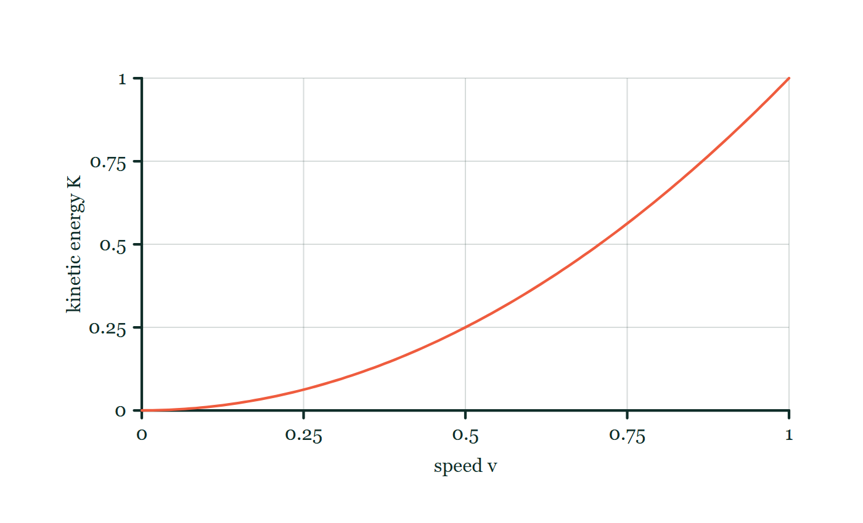
ENERGY · KINETIC ENERGY
GIOPHYSICS LESSON
FORMULA 1 OF 3
Motion store
Build the model — The formulae, one at a time, in plain English
K = 1/2 mv²
m in kilograms, v in metres per second
IN PLAIN ENGLISH
Energy of motion: it grows with mass, and with the square of speed — twice as fast means four times the energy.
Kinetic energy–speed explorer
Move this graph on the live version — click here
Energy — Kinetic Energy. Built by GioPhysics from the lesson's own copy; nothing on these slides is re-authored.
11 / 34
Notes:
[Phase] Build the model: The formulae, one at a time, in plain English (minutes 13–22 of 45)
[Formula] Motion store: K = 1/2 mv²
[In plain English] Energy of motion: it grows with mass, and with the square of speed — twice as fast means four times the energy.
[Note] m in kilograms, v in metres per second
[Graph] Kinetic energy–speed explorer. For a fixed mass, kinetic energy follows a square law: doubling speed makes four times the energy.
[Axes] Horizontal: speed v. Vertical: kinetic energy K. Values are normalised — the graph teaches the shape, not a measurement.

Slide 12
ENERGY · KINETIC ENERGY
GIOPHYSICS LESSON
FORMULA 2 OF 3
Work-energy theorem
Build the model — The formulae, one at a time, in plain English
Wnet = ΔK
Net work changes the kinetic energy
IN PLAIN ENGLISH
The total work done on an object tells you exactly how much its energy of motion changed.
Energy — Kinetic Energy. Built by GioPhysics from the lesson's own copy; nothing on these slides is re-authored.
12 / 34
Notes:
[Phase] Build the model: The formulae, one at a time, in plain English (minutes 13–22 of 45)
[Formula] Work-energy theorem: Wnet = ΔK
[In plain English] The total work done on an object tells you exactly how much its energy of motion changed.
[Note] Net work changes the kinetic energy

Slide 13
ENERGY · KINETIC ENERGY
GIOPHYSICS LESSON
FORMULA 3 OF 3
Energy unit
Build the model — The formulae, one at a time, in plain English
1 J = 1 kg·m²/s²
A joule is a unit of transferred or stored energy
IN PLAIN ENGLISH
The joule, written out in basic units — every energy formula on this page produces this same unit.
Energy — Kinetic Energy. Built by GioPhysics from the lesson's own copy; nothing on these slides is re-authored.
13 / 34
Notes:
[Phase] Build the model: The formulae, one at a time, in plain English (minutes 13–22 of 45)
[Formula] Energy unit: 1 J = 1 kg·m²/s²
[In plain English] The joule, written out in basic units — every energy formula on this page produces this same unit.
[Note] A joule is a unit of transferred or stored energy

Slide 14
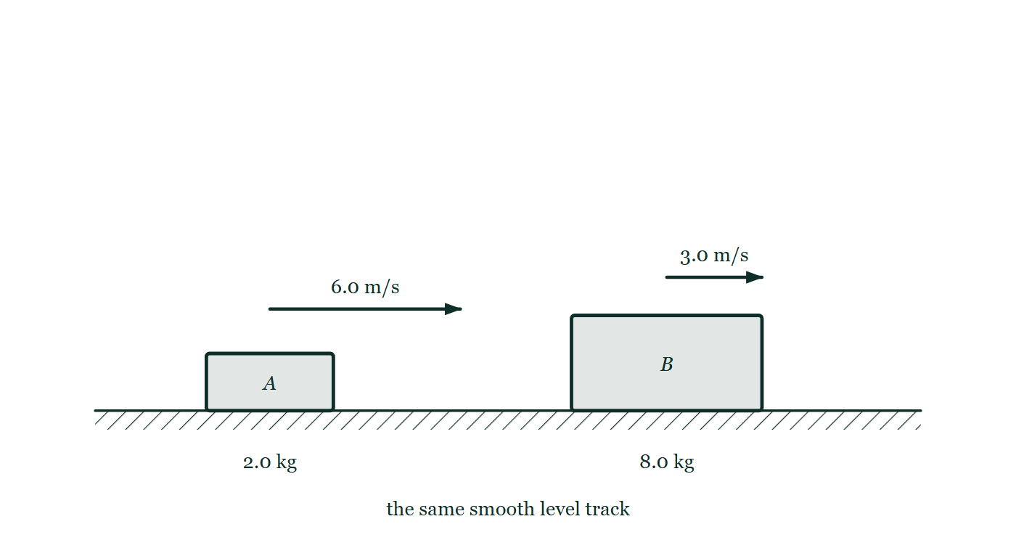
ENERGY · KINETIC ENERGY
GIOPHYSICS LESSON
THE PICTURE
Light and fast, or heavy and slow
Drawn for this lesson
Two trolleys on one level track drawn to scale against each other: a small 2.0 kg one with a long 6.0 m/s arrow, and a larger 8.0 kg one with an arrow half that length marked 3.0 m/s.
The live version of this figure — click here
Energy — Kinetic Energy. Built by GioPhysics from the lesson's own copy; nothing on these slides is re-authored.
14 / 34
Notes:
[Phase] Build the model: The formulae, one at a time, in plain English (minutes 13–22 of 45)
[Figure] Two trolleys on one level track drawn to scale against each other: a small 2.0 kg one with a long 6.0 m/s arrow, and a larger 8.0 kg one with an arrow half that length marked 3.0 m/s.

Slide 15
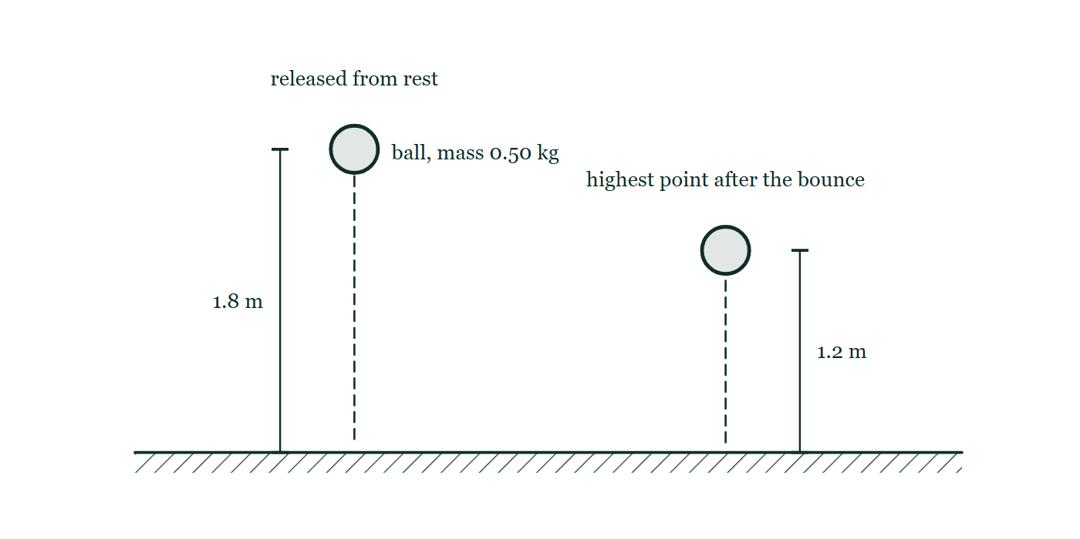
ENERGY · KINETIC ENERGY
GIOPHYSICS LESSON
FIGURE 1 OF 2
Fig. 5.1 — IGCSE Topic 1 · Motion, forces and energy
Drawn for question 5 of that paper · syllabus 1.7.1
A ball of mass 0.50 kg is drawn twice above level ground. On the left it is at the point of release, with a dimension line marking 1.8 m from the ground up to the ball. On the right it is at the highest point reached after the bounce, with 1.2 m marked in the same way. Dashed vertical lines show the path down and the path back up.
See the question this was drawn for — click here
Energy — Kinetic Energy. Built by GioPhysics from the lesson's own copy; nothing on these slides is re-authored.
15 / 34
Notes:
[Phase] Build the model: The formulae, one at a time, in plain English (minutes 13–22 of 45)
[Figure] Fig. 5.1. A ball of mass 0.50 kg is drawn twice above level ground. On the left it is at the point of release, with a dimension line marking 1.8 m from the ground up to the ball. On the right it is at the highest point reached after the bounce, with 1.2 m marked in the same way. Dashed vertical lines show the path down and the path back up.
[Where it came from] IGCSE Topic 1 · Motion, forces and energy, question 5; syllabus 1.7.1.

Slide 16
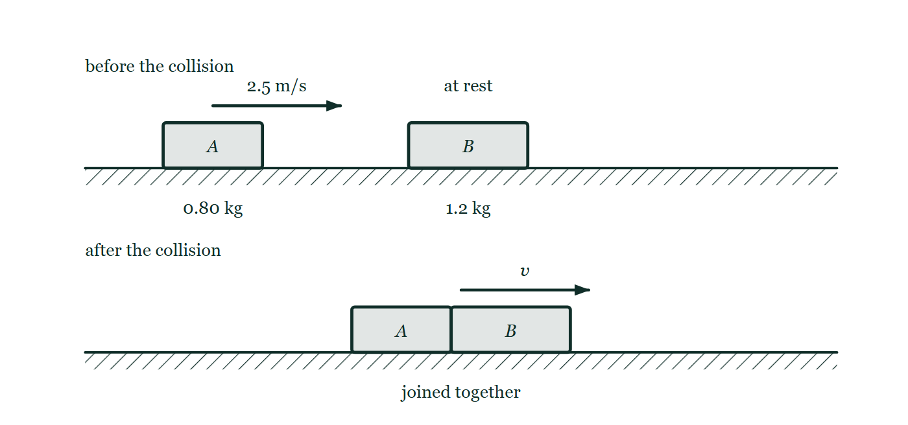
ENERGY · KINETIC ENERGY
GIOPHYSICS LESSON
FIGURE 2 OF 2
Fig. 8.1 — IGCSE Topic 1 · Motion, forces and energy
Drawn for question 8 of that paper · syllabus 1.6, 1.7.1
Two panels, one above the other. In the upper panel, labelled before the collision, trolley A of mass 0.80 kg stands on a level track with an arrow showing it moving to the right at 2.5 m/s towards trolley B of mass 1.2 kg, which is at rest. In the lower panel, labelled after the collision, the two trolleys are drawn joined together and moving to the right with a speed marked v.
See the question this was drawn for — click here
Energy — Kinetic Energy. Built by GioPhysics from the lesson's own copy; nothing on these slides is re-authored.
16 / 34
Notes:
[Phase] Build the model: The formulae, one at a time, in plain English (minutes 13–22 of 45)
[Figure] Fig. 8.1. Two panels, one above the other. In the upper panel, labelled before the collision, trolley A of mass 0.80 kg stands on a level track with an arrow showing it moving to the right at 2.5 m/s towards trolley B of mass 1.2 kg, which is at rest. In the lower panel, labelled after the collision, the two trolleys are drawn joined together and moving to the right with a speed marked v.
[Where it came from] IGCSE Topic 1 · Motion, forces and energy, question 8; syllabus 1.6, 1.7.1.

Slide 17
ENERGY · KINETIC ENERGY
GIOPHYSICS LESSON
WATCH OUT
The common trap
Check and misconception — The quick check and the trap
Kinetic energy is not a vector. Velocity has direction; K depends on speed, so K is always zero or positive.
Energy — Kinetic Energy. Built by GioPhysics from the lesson's own copy; nothing on these slides is re-authored.
17 / 34
Notes:
[Phase] Check and misconception: The quick check and the trap (minutes 35–41 of 45)
[Misconception] Kinetic energy is not a vector. Velocity has direction; K depends on speed, so K is always zero or positive.

Slide 18
ENERGY · KINETIC ENERGY
GIOPHYSICS LESSON
WORKED EXAMPLE 1 OF 2 · EASY
The question
Easy
Worked examples — I do, we do — one step revealed at a time
Find the kinetic energy of a 0.40 kg ball moving at 5.0 m/s.
Energy — Kinetic Energy. Built by GioPhysics from the lesson's own copy; nothing on these slides is re-authored.
18 / 34
Notes:
[Phase] Worked examples: I do, we do — one step revealed at a time (minutes 22–35 of 45)
[Question] Find the kinetic energy of a 0.40 kg ball moving at 5.0 m/s.
[Answer] K = 5.0 J

Slide 19
ENERGY · KINETIC ENERGY
GIOPHYSICS LESSON
WORKED EXAMPLE 1 OF 2 · EASY · THE WORKING
How to solve it
Easy
Worked examples — I do, we do — one step revealed at a time
Find the kinetic energy of a 0.40 kg ball moving at 5.0 m/s.
1.
K = ½mv² = ½ × 0.40 × 25.
2.
K = 5.0 J.
Energy — Kinetic Energy. Built by GioPhysics from the lesson's own copy; nothing on these slides is re-authored.
19 / 34
Notes:
[Phase] Worked examples: I do, we do — one step revealed at a time (minutes 22–35 of 45)
[Reveal] One click per step. The class works each line before the next appears.
[Step 1] K = ½mv² = ½ × 0.40 × 25.
[Step 2] K = 5.0 J.

Slide 20
ENERGY · KINETIC ENERGY
GIOPHYSICS LESSON
WORKED EXAMPLE 1 OF 2 · EASY
Answer
Easy
Worked examples — I do, we do — one step revealed at a time
K = 5.0 J
Energy — Kinetic Energy. Built by GioPhysics from the lesson's own copy; nothing on these slides is re-authored.
20 / 34
Notes:
[Phase] Worked examples: I do, we do — one step revealed at a time (minutes 22–35 of 45)
[Answer] K = 5.0 J

Slide 21
ENERGY · KINETIC ENERGY
GIOPHYSICS LESSON
WORKED EXAMPLE 2 OF 2 · MEDIUM
The question
Medium
Worked examples — I do, we do — one step revealed at a time
A 1,200 kg car speeds up from 10 m/s to 20 m/s. How much net work is done?
Energy — Kinetic Energy. Built by GioPhysics from the lesson's own copy; nothing on these slides is re-authored.
21 / 34
Notes:
[Phase] Worked examples: I do, we do — one step revealed at a time (minutes 22–35 of 45)
[Question] A 1,200 kg car speeds up from 10 m/s to 20 m/s. How much net work is done?
[Answer] Wnet = +180,000 J = 180 kJ

Slide 22
ENERGY · KINETIC ENERGY
GIOPHYSICS LESSON
WORKED EXAMPLE 2 OF 2 · MEDIUM · THE WORKING
How to solve it
Medium
Worked examples — I do, we do — one step revealed at a time
A 1,200 kg car speeds up from 10 m/s to 20 m/s. How much net work is done?
1.
Kinitial = 1/2(1,200)(10²) = 60,000 J.
2.
Kfinal = 1/2(1,200)(20²) = 240,000 J.
3.
Wnet = ΔK = 240,000 - 60,000 J.
Energy — Kinetic Energy. Built by GioPhysics from the lesson's own copy; nothing on these slides is re-authored.
22 / 34
Notes:
[Phase] Worked examples: I do, we do — one step revealed at a time (minutes 22–35 of 45)
[Reveal] One click per step. The class works each line before the next appears.
[Step 1] Kinitial = 1/2(1,200)(10²) = 60,000 J.
[Step 2] Kfinal = 1/2(1,200)(20²) = 240,000 J.
[Step 3] Wnet = ΔK = 240,000 - 60,000 J.

Slide 23
ENERGY · KINETIC ENERGY
GIOPHYSICS LESSON
WORKED EXAMPLE 2 OF 2 · MEDIUM
Answer
Medium
Worked examples — I do, we do — one step revealed at a time
Wnet = +180,000 J = 180 kJ
Energy — Kinetic Energy. Built by GioPhysics from the lesson's own copy; nothing on these slides is re-authored.
23 / 34
Notes:
[Phase] Worked examples: I do, we do — one step revealed at a time (minutes 22–35 of 45)
[Answer] Wnet = +180,000 J = 180 kJ

Slide 24
ENERGY · KINETIC ENERGY
GIOPHYSICS LESSON
PREDICT · TAKE THE VOTE
Commit before you are told
Hands up for each option, then click
Trolley A is 2.0 kg at 6.0 m/s. Trolley B is 8.0 kg at 3.0 m/s. Which carries more kinetic energy?
A A — it is much the faster
B B — it is four times the mass
C Neither: they are equal
Two trolleys on one level track drawn to scale against each other: a small 2.0 kg one with a long 6.0 m/s arrow, and a larger 8.0 kg one with an arrow half that length marked 3.0 m/s.
The live version of this figure — click here
Energy — Kinetic Energy. Built by GioPhysics from the lesson's own copy; nothing on these slides is re-authored.
24 / 34
Notes:
[Phase] Build the model: The formulae, one at a time, in plain English (minutes 13–22 of 45)
[Predict] Trolley A is 2.0 kg at 6.0 m/s. Trolley B is 8.0 kg at 3.0 m/s. Which carries more kinetic energy?
[Options] A A — it is much the faster B B — it is four times the mass C Neither: they are equal
[Figure] Two trolleys on one level track drawn to scale against each other: a small 2.0 kg one with a long 6.0 m/s arrow, and a larger 8.0 kg one with an arrow half that length marked 3.0 m/s.

Slide 25
ENERGY · KINETIC ENERGY
GIOPHYSICS LESSON
PREDICT · THE OUTCOME
What actually happens
Ask the room who changed their mind, and why
C Neither: they are equal
WHY
K(A) = ½ × 2.0 × 6.0² = 36 J and K(B) = ½ × 8.0 × 3.0² = 36 J. Four times the mass exactly pays for half the speed, because mass counts once and speed counts twice: 4 × (½)² = 1. Their momenta are not equal at all — B carries 24 kg·m/s against A's 12 — which is what makes this pair worth staring at. Same energy, double the momentum, one drawing.
Energy — Kinetic Energy. Built by GioPhysics from the lesson's own copy; nothing on these slides is re-authored.
25 / 34
Notes:
[Phase] Build the model: The formulae, one at a time, in plain English (minutes 13–22 of 45)
[Answer] C — Neither: they are equal. K(A) = ½ × 2.0 × 6.0² = 36 J and K(B) = ½ × 8.0 × 3.0² = 36 J. Four times the mass exactly pays for half the speed, because mass counts once and speed counts twice: 4 × (½)² = 1. Their momenta are not equal at all — B carries 24 kg·m/s against A's 12 — which is what makes this pair worth staring at. Same energy, double the momentum, one drawing.

Slide 26
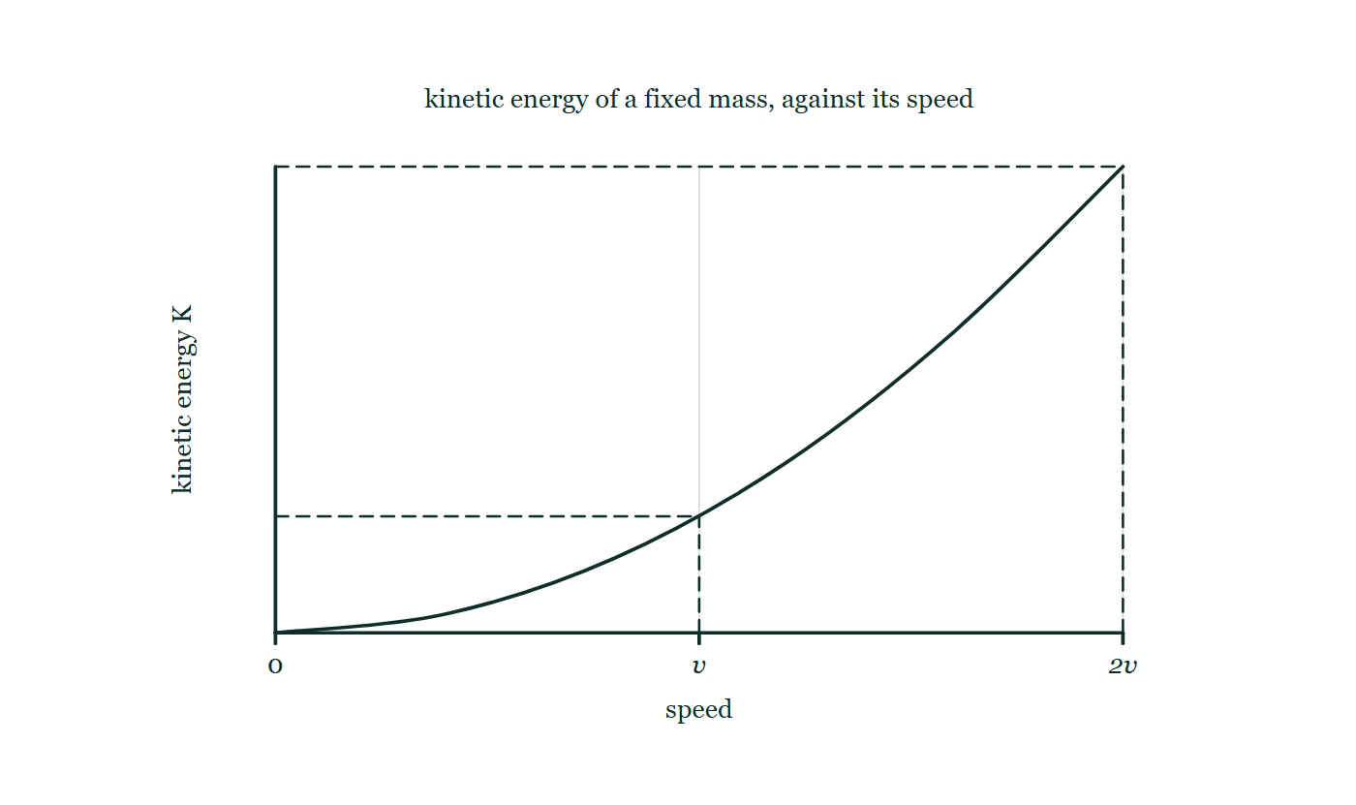
ENERGY · KINETIC ENERGY
GIOPHYSICS LESSON
QUICK CHECK
Decide before the answer goes up
Check and misconception — The quick check and the trap
A cart keeps the same mass but its speed doubles. What happens to its kinetic energy?
A
It stays the same
B
It doubles
C
It becomes four times larger
Kinetic energy plotted against speed for a fixed mass, curving upward, with dashed construction lines dropped at a speed v and at twice that speed and neither height given a value.
The live version of this figure — click here
Energy — Kinetic Energy. Built by GioPhysics from the lesson's own copy; nothing on these slides is re-authored.
26 / 34
Notes:
[Phase] Check and misconception: The quick check and the trap (minutes 35–41 of 45)
[Question] A cart keeps the same mass but its speed doubles. What happens to its kinetic energy?
[Figure] Kinetic energy plotted against speed for a fixed mass, curving upward, with dashed construction lines dropped at a speed v and at twice that speed and neither height given a value.
[Options] A It stays the same B It doubles C It becomes four times larger

Slide 27
ENERGY · KINETIC ENERGY
GIOPHYSICS LESSON
QUICK CHECK · THE ANSWER
The answer, and why
Check and misconception — The quick check and the trap
C It becomes four times larger
HOW TO GET THERE
Because v is squared, (2v)² = 4v².
WHY THE OTHERS TEMPT
A This is what would happen if K depended on mass alone, and mass has not changed. It depends on speed too, and more strongly: it is the only quantity in the formula that gets squared.
B The formula does have v in it, and reading it once gives this answer — the trap is that the v is squared, so it has to be read twice. Doubling something that is squared multiplies by four, not two.
C Correct. (2v)² = 4v², so with m unchanged the kinetic energy is four times larger. It is also why braking distance quadruples, and why a 20 mph zone is not a fussy version of 40.
Energy — Kinetic Energy. Built by GioPhysics from the lesson's own copy; nothing on these slides is re-authored.
27 / 34
Notes:
[Phase] Check and misconception: The quick check and the trap (minutes 35–41 of 45)
[Question] A cart keeps the same mass but its speed doubles. What happens to its kinetic energy?
[Option by option] A: This is what would happen if K depended on mass alone, and mass has not changed. It depends on speed too, and more strongly: it is the only quantity in the formula that gets squared. B: The formula does have v in it, and reading it once gives this answer — the trap is that the v is squared, so it has to be read twice. Doubling something that is squared multiplies by four, not two. C: Correct. (2v)² = 4v², so with m unchanged the kinetic energy is four times larger. It is also why braking distance quadruples, and why a 20 mph zone is not a fussy version of 40.
[Answer] C — It becomes four times larger
[Why] Because v is squared, (2v)² = 4v².
[Reveal] One click for the answer, then one for the reason.

Slide 28
ENERGY · KINETIC ENERGY
GIOPHYSICS LESSON
EXTENSION 1 OF 2 · HARD
The question
Hard
Worked examples — I do, we do — one step revealed at a time
Trolley A (2.0 kg at 6.0 m/s) and trolley B (8.0 kg at 3.0 m/s) are compared. Which has more kinetic energy, and which has more momentum?
Energy — Kinetic Energy. Built by GioPhysics from the lesson's own copy; nothing on these slides is re-authored.
28 / 34
Notes:
[Phase] Worked examples: I do, we do — one step revealed at a time (minutes 22–35 of 45)
[Question] Trolley A (2.0 kg at 6.0 m/s) and trolley B (8.0 kg at 3.0 m/s) are compared. Which has more kinetic energy, and which has more momentum?
[Answer] Equal K (36 J each); B has twice the momentum

Slide 29
ENERGY · KINETIC ENERGY
GIOPHYSICS LESSON
EXTENSION 1 OF 2 · HARD · THE WORKING
How to solve it
Hard
Worked examples — I do, we do — one step revealed at a time
Trolley A (2.0 kg at 6.0 m/s) and trolley B (8.0 kg at 3.0 m/s) are compared. Which has more kinetic energy, and which has more momentum?
1.
K(A) = ½ × 2.0 × 36 = 36 J; K(B) = ½ × 8.0 × 9.0 = 36 J — equal kinetic energies.
2.
p(A) = 2.0 × 6.0 = 12 kg·m/s; p(B) = 8.0 × 3.0 = 24 kg·m/s.
3.
Same energy, but B carries double the momentum — the two quantities scale differently with v.
Energy — Kinetic Energy. Built by GioPhysics from the lesson's own copy; nothing on these slides is re-authored.
29 / 34
Notes:
[Phase] Worked examples: I do, we do — one step revealed at a time (minutes 22–35 of 45)
[Reveal] One click per step. The class works each line before the next appears.
[Step 1] K(A) = ½ × 2.0 × 36 = 36 J; K(B) = ½ × 8.0 × 9.0 = 36 J — equal kinetic energies.
[Step 2] p(A) = 2.0 × 6.0 = 12 kg·m/s; p(B) = 8.0 × 3.0 = 24 kg·m/s.
[Step 3] Same energy, but B carries double the momentum — the two quantities scale differently with v.

Slide 30
ENERGY · KINETIC ENERGY
GIOPHYSICS LESSON
EXTENSION 1 OF 2 · HARD
Answer
Hard
Worked examples — I do, we do — one step revealed at a time
Equal K (36 J each); B has twice the momentum
Energy — Kinetic Energy. Built by GioPhysics from the lesson's own copy; nothing on these slides is re-authored.
30 / 34
Notes:
[Phase] Worked examples: I do, we do — one step revealed at a time (minutes 22–35 of 45)
[Answer] Equal K (36 J each); B has twice the momentum

Slide 31
ENERGY · KINETIC ENERGY
GIOPHYSICS LESSON
EXTENSION 2 OF 2 · CHALLENGING
The question
Challenging
Worked examples — I do, we do — one step revealed at a time
A car's braking distance from 30 m/s is 45 m. Using energy reasoning, predict its braking distance from 60 m/s with the same braking force.
Energy — Kinetic Energy. Built by GioPhysics from the lesson's own copy; nothing on these slides is re-authored.
31 / 34
Notes:
[Phase] Worked examples: I do, we do — one step revealed at a time (minutes 22–35 of 45)
[Question] A car's braking distance from 30 m/s is 45 m. Using energy reasoning, predict its braking distance from 60 m/s with the same braking force.
[Answer] 180 m — double the speed, four times the distance

Slide 32
ENERGY · KINETIC ENERGY
GIOPHYSICS LESSON
EXTENSION 2 OF 2 · CHALLENGING · THE WORKING
How to solve it
Challenging
Worked examples — I do, we do — one step revealed at a time
A car's braking distance from 30 m/s is 45 m. Using energy reasoning, predict its braking distance from 60 m/s with the same braking force.
1.
Braking: Fd = ½mv², so d ∝ v² for fixed force.
2.
Doubling v quadruples the kinetic energy to remove.
3.
d = 4 × 45 = 180 m.
Energy — Kinetic Energy. Built by GioPhysics from the lesson's own copy; nothing on these slides is re-authored.
32 / 34
Notes:
[Phase] Worked examples: I do, we do — one step revealed at a time (minutes 22–35 of 45)
[Reveal] One click per step. The class works each line before the next appears.
[Step 1] Braking: Fd = ½mv², so d ∝ v² for fixed force.
[Step 2] Doubling v quadruples the kinetic energy to remove.
[Step 3] d = 4 × 45 = 180 m.

Slide 33
ENERGY · KINETIC ENERGY
GIOPHYSICS LESSON
EXTENSION 2 OF 2 · CHALLENGING
Answer
Challenging
Worked examples — I do, we do — one step revealed at a time
180 m — double the speed, four times the distance
Energy — Kinetic Energy. Built by GioPhysics from the lesson's own copy; nothing on these slides is re-authored.
33 / 34
Notes:
[Phase] Worked examples: I do, we do — one step revealed at a time (minutes 22–35 of 45)
[Answer] 180 m — double the speed, four times the distance

Slide 34
ENERGY · KINETIC ENERGY
GIOPHYSICS LESSON
ENERGY
Where to go next
Plenary — What to take away, what to practise next
Next
4.2 Gravitational Potential Energy
https://giophysics.com/chapter-6/gravitational-potential-energy/
Lesson
This lesson on giophysics.com
https://giophysics.com/chapter-6/kinetic-energy/
Live
The live, interactive version of these slides
https://giophysics.com/chapter-6/presentation/?lesson=kinetic
Chapter
All Energy lessons
https://giophysics.com/chapter-6/
PDF
Download the lesson PDF
https://giophysics.com/downloads/6-1-kinetic-energy.pdf
Energy — Kinetic Energy. Built by GioPhysics from the lesson's own copy; nothing on these slides is re-authored.
34 / 34
Notes:
[Phase] Plenary: What to take away, what to practise next (minutes 41–45 of 45)
[Interactive] The graphs and the circuit topology on these slides are frozen. The live version at https://giophysics.com/chapter-6/presentation/?lesson=kinetic moves them.

