Slide 1
MOMENTUM · MOMENTUM CALCULUS INTEGRATION
GIOPHYSICS LESSON
05 · Momentum
Rates and accumulated impulse
Momentum Calculus Integration
Force is the rate at which momentum changes. Integrating that rate gives the complete momentum change.
POSITION
Lesson 6 of 7 in Momentum
PLAN
15 slides in the 45-minute core run, about 41.5 minutes of it
LESSON PAGE
https://giophysics.com/chapter-9/momentum-calculus/
Built by GioPhysics from the lesson's own page. Every word on these slides is the lesson's; nothing here is re-authored. Teaching material, not an awarding body's document.
Momentum — Momentum Calculus Integration. Built by GioPhysics from the lesson's own copy; nothing on these slides is re-authored.
1 / 29
Notes:
[Lesson] Momentum — Momentum Calculus Integration. Lesson 6 of 7.
[Intro] Force is the rate at which momentum changes. Integrating that rate gives the complete momentum change.
[Source] https://giophysics.com/chapter-9/momentum-calculus/
[Disclaimer] Built by GioPhysics from the lesson's own page. Every word on these slides is the lesson's; nothing here is re-authored. Teaching material, not an awarding body's document.

Slide 2
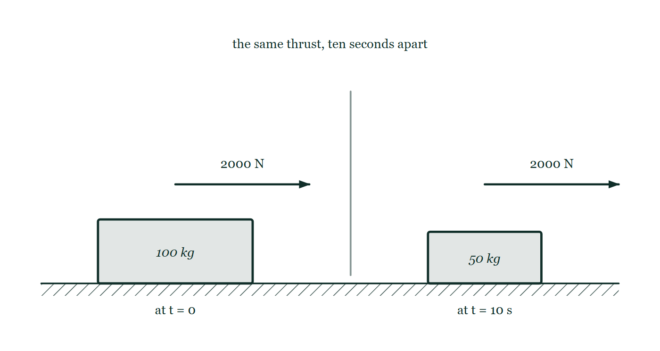
MOMENTUM · MOMENTUM CALCULUS INTEGRATION
GIOPHYSICS LESSON
THINK FIRST
A rocket burns fuel at a steady rate and its engine pushes with a constant thrust. Does it accelerate steadily?
Take answers before you click — the point is the commitment
Constant force, so constant acceleration — that is what F = ma says, and the thrust really is constant all the way through the burn.
THE ANSWER
No. The mass is falling the whole time, so a = F/m climbs: a sled at 100 kg with 2000 N of thrust accelerates at 20 m/s², and ten seconds later at 50 kg the same 2000 N gives 40 m/s². F = ma assumed a fixed m, and this is the case where that assumption breaks. The safe form is F = dp/dt, from which F = ma follows only when the mass is constant — which is why astronauts pull their heaviest g at the very end of a burn.
One rocket sled drawn twice on the same rail, at 100 kilograms when the burn starts and 50 kilograms ten seconds later, with an identical 2000 newton thrust arrow on each and no acceleration marked.
The live version of this figure — click here
Momentum — Momentum Calculus Integration. Built by GioPhysics from the lesson's own copy; nothing on these slides is re-authored.
2 / 29
Notes:
[Phase] Starter: Recall what this lesson stands on (minutes 0–5 of 45)
[Hook] A rocket burns fuel at a steady rate and its engine pushes with a constant thrust. Does it accelerate steadily? Constant force, so constant acceleration — that is what F = ma says, and the thrust really is constant all the way through the burn.
[Answer] No. The mass is falling the whole time, so a = F/m climbs: a sled at 100 kg with 2000 N of thrust accelerates at 20 m/s², and ten seconds later at 50 kg the same 2000 N gives 40 m/s². F = ma assumed a fixed m, and this is the case where that assumption breaks. The safe form is F = dp/dt, from which F = ma follows only when the mass is constant — which is why astronauts pull their heaviest g at the very end of a burn.
[Figure] One rocket sled drawn twice on the same rail, at 100 kilograms when the burn starts and 50 kilograms ten seconds later, with an identical 2000 newton thrust arrow on each and no acceleration marked.

Slide 3
MOMENTUM · MOMENTUM CALCULUS INTEGRATION
GIOPHYSICS LESSON
THE BIG IDEA
Rates and accumulated impulse
Introduce the idea — The big idea and the definition
Newton's second law is most general in momentum form: net external force equals dp/dt. For a force that varies with time, integrate the signed curve instead of multiplying by one arbitrary force value.
Momentum — Momentum Calculus Integration. Built by GioPhysics from the lesson's own copy; nothing on these slides is re-authored.
3 / 29
Notes:
[Phase] Introduce the idea: The big idea and the definition (minutes 5–13 of 45)
[Big idea] Newton's second law is most general in momentum form: net external force equals dp/dt. For a force that varies with time, integrate the signed curve instead of multiplying by one arbitrary force value.

Slide 4
MOMENTUM · MOMENTUM CALCULUS INTEGRATION
GIOPHYSICS LESSON
THE PHYSICS · 1 OF 3
Derivative
Build the model — The formulae, one at a time, in plain English
The slope of a momentum–time graph is net force at that instant.
Momentum — Momentum Calculus Integration. Built by GioPhysics from the lesson's own copy; nothing on these slides is re-authored.
4 / 29
Notes:
[Phase] Build the model: The formulae, one at a time, in plain English (minutes 13–22 of 45)
[Section] The slope of a momentum–time graph is net force at that instant.

Slide 5
MOMENTUM · MOMENTUM CALCULUS INTEGRATION
GIOPHYSICS LESSON
THE PHYSICS · 2 OF 3
Integral
Build the model — The formulae, one at a time, in plain English
The signed area under a net-force–time graph is the momentum change.
Momentum — Momentum Calculus Integration. Built by GioPhysics from the lesson's own copy; nothing on these slides is re-authored.
5 / 29
Notes:
[Phase] Build the model: The formulae, one at a time, in plain English (minutes 13–22 of 45)
[Section] The signed area under a net-force–time graph is the momentum change.

Slide 6
MOMENTUM · MOMENTUM CALCULUS INTEGRATION
GIOPHYSICS LESSON
THE PHYSICS · 3 OF 3
Approximate measured data
Build the model — The formulae, one at a time, in plain English
Rectangles or trapezoids turn sampled forces into a numerical impulse; smaller intervals reduce error.
Momentum — Momentum Calculus Integration. Built by GioPhysics from the lesson's own copy; nothing on these slides is re-authored.
6 / 29
Notes:
[Phase] Build the model: The formulae, one at a time, in plain English (minutes 13–22 of 45)
[Section] Rectangles or trapezoids turn sampled forces into a numerical impulse; smaller intervals reduce error.

Slide 7
MOMENTUM · MOMENTUM CALCULUS INTEGRATION
GIOPHYSICS LESSON
FORMULA 1 OF 3
Rate form
Build the model — The formulae, one at a time, in plain English
Fnet = dp/dt
Valid even when the mass is not constant
IN PLAIN ENGLISH
Force is how quickly momentum changes — Newton's second law in its most general form.
Momentum — Momentum Calculus Integration. Built by GioPhysics from the lesson's own copy; nothing on these slides is re-authored.
7 / 29
Notes:
[Phase] Build the model: The formulae, one at a time, in plain English (minutes 13–22 of 45)
[Formula] Rate form: Fnet = dp/dt
[In plain English] Force is how quickly momentum changes — Newton's second law in its most general form.
[Note] Valid even when the mass is not constant

Slide 8
MOMENTUM · MOMENTUM CALCULUS INTEGRATION
GIOPHYSICS LESSON
FORMULA 2 OF 3
Accumulated change
Build the model — The formulae, one at a time, in plain English
Δp = ∫ Fnet(t) dt
Integrate over the full time interval
IN PLAIN ENGLISH
Add up the force over the whole time it acts and you get the total momentum change.
Momentum — Momentum Calculus Integration. Built by GioPhysics from the lesson's own copy; nothing on these slides is re-authored.
8 / 29
Notes:
[Phase] Build the model: The formulae, one at a time, in plain English (minutes 13–22 of 45)
[Formula] Accumulated change: Δp = ∫ Fnet(t) dt
[In plain English] Add up the force over the whole time it acts and you get the total momentum change.
[Note] Integrate over the full time interval

Slide 9
MOMENTUM · MOMENTUM CALCULUS INTEGRATION
GIOPHYSICS LESSON
FORMULA 3 OF 3
Fixed mass
Build the model — The formulae, one at a time, in plain English
Fnet = ma
Follows from dp/dt when mass is constant
IN PLAIN ENGLISH
The familiar F = ma — it comes from the momentum rate form when the mass stays constant.
Momentum — Momentum Calculus Integration. Built by GioPhysics from the lesson's own copy; nothing on these slides is re-authored.
9 / 29
Notes:
[Phase] Build the model: The formulae, one at a time, in plain English (minutes 13–22 of 45)
[Formula] Fixed mass: Fnet = ma
[In plain English] The familiar F = ma — it comes from the momentum rate form when the mass stays constant.
[Note] Follows from dp/dt when mass is constant

Slide 10
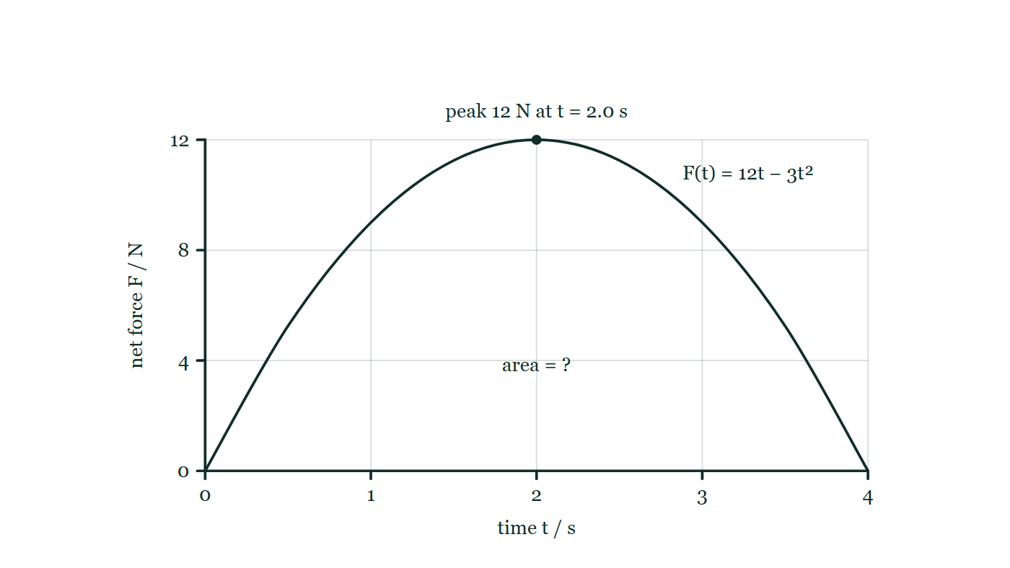
MOMENTUM · MOMENTUM CALCULUS INTEGRATION
GIOPHYSICS LESSON
THE PICTURE
A force that is never the same twice
Drawn for this lesson
A net force rising from zero to a peak of 12 newtons at 2.0 seconds and falling back to zero at 4.0 seconds, with the region between the curve and the time axis left as an unknown area.
The live version of this figure — click here
Momentum — Momentum Calculus Integration. Built by GioPhysics from the lesson's own copy; nothing on these slides is re-authored.
10 / 29
Notes:
[Phase] Build the model: The formulae, one at a time, in plain English (minutes 13–22 of 45)
[Figure] A net force rising from zero to a peak of 12 newtons at 2.0 seconds and falling back to zero at 4.0 seconds, with the region between the curve and the time axis left as an unknown area.

Slide 11
MOMENTUM · MOMENTUM CALCULUS INTEGRATION
GIOPHYSICS LESSON
WATCH OUT
The common trap
Check and misconception — The quick check and the trap
F = ma is not the universal starting point for variable-mass systems. Fexternal = dp/dt is the safer statement.
Momentum — Momentum Calculus Integration. Built by GioPhysics from the lesson's own copy; nothing on these slides is re-authored.
11 / 29
Notes:
[Phase] Check and misconception: The quick check and the trap (minutes 35–41 of 45)
[Misconception] F = ma is not the universal starting point for variable-mass systems. Fexternal = dp/dt is the safer statement.

Slide 12
MOMENTUM · MOMENTUM CALCULUS INTEGRATION
GIOPHYSICS LESSON
WORKED EXAMPLE 1 OF 2 · EASY
The question
Easy
Worked examples — I do, we do — one step revealed at a time
A net force F = 10 N acts on a body for 3.0 s. Use Δp = ∫F dt to find the momentum change.
Momentum — Momentum Calculus Integration. Built by GioPhysics from the lesson's own copy; nothing on these slides is re-authored.
12 / 29
Notes:
[Phase] Worked examples: I do, we do — one step revealed at a time (minutes 22–35 of 45)
[Question] A net force F = 10 N acts on a body for 3.0 s. Use Δp = ∫F dt to find the momentum change.
[Answer] Δp = 30 kg·m/s

Slide 13
MOMENTUM · MOMENTUM CALCULUS INTEGRATION
GIOPHYSICS LESSON
WORKED EXAMPLE 1 OF 2 · EASY · THE WORKING
How to solve it
Easy
Worked examples — I do, we do — one step revealed at a time
A net force F = 10 N acts on a body for 3.0 s. Use Δp = ∫F dt to find the momentum change.
1.
Constant force: Δp = FΔt = 10 × 3.0.
2.
Δp = 30 kg·m/s.
Momentum — Momentum Calculus Integration. Built by GioPhysics from the lesson's own copy; nothing on these slides is re-authored.
13 / 29
Notes:
[Phase] Worked examples: I do, we do — one step revealed at a time (minutes 22–35 of 45)
[Reveal] One click per step. The class works each line before the next appears.
[Step 1] Constant force: Δp = FΔt = 10 × 3.0.
[Step 2] Δp = 30 kg·m/s.

Slide 14
MOMENTUM · MOMENTUM CALCULUS INTEGRATION
GIOPHYSICS LESSON
WORKED EXAMPLE 1 OF 2 · EASY
Answer
Easy
Worked examples — I do, we do — one step revealed at a time
Δp = 30 kg·m/s
Momentum — Momentum Calculus Integration. Built by GioPhysics from the lesson's own copy; nothing on these slides is re-authored.
14 / 29
Notes:
[Phase] Worked examples: I do, we do — one step revealed at a time (minutes 22–35 of 45)
[Answer] Δp = 30 kg·m/s

Slide 15
MOMENTUM · MOMENTUM CALCULUS INTEGRATION
GIOPHYSICS LESSON
WORKED EXAMPLE 2 OF 2 · MEDIUM
The question
Medium
Worked examples — I do, we do — one step revealed at a time
A 3.0 kg cart starts from rest under F(t) = 6t N from t = 0 to 2.0 s. Find its final speed.
Momentum — Momentum Calculus Integration. Built by GioPhysics from the lesson's own copy; nothing on these slides is re-authored.
15 / 29
Notes:
[Phase] Worked examples: I do, we do — one step revealed at a time (minutes 22–35 of 45)
[Question] A 3.0 kg cart starts from rest under F(t) = 6t N from t = 0 to 2.0 s. Find its final speed.
[Answer] v = 4.0 m/s

Slide 16
MOMENTUM · MOMENTUM CALCULUS INTEGRATION
GIOPHYSICS LESSON
WORKED EXAMPLE 2 OF 2 · MEDIUM · THE WORKING
How to solve it
Medium
Worked examples — I do, we do — one step revealed at a time
A 3.0 kg cart starts from rest under F(t) = 6t N from t = 0 to 2.0 s. Find its final speed.
1.
J = ∫₀² 6t dt = [3t²]₀² = 12 N·s.
2.
Δp = J, so final momentum is 12 kg·m/s.
3.
v = p/m = 12/3.0.
Momentum — Momentum Calculus Integration. Built by GioPhysics from the lesson's own copy; nothing on these slides is re-authored.
16 / 29
Notes:
[Phase] Worked examples: I do, we do — one step revealed at a time (minutes 22–35 of 45)
[Reveal] One click per step. The class works each line before the next appears.
[Step 1] J = ∫₀² 6t dt = [3t²]₀² = 12 N·s.
[Step 2] Δp = J, so final momentum is 12 kg·m/s.
[Step 3] v = p/m = 12/3.0.

Slide 17
MOMENTUM · MOMENTUM CALCULUS INTEGRATION
GIOPHYSICS LESSON
WORKED EXAMPLE 2 OF 2 · MEDIUM
Answer
Medium
Worked examples — I do, we do — one step revealed at a time
v = 4.0 m/s
Momentum — Momentum Calculus Integration. Built by GioPhysics from the lesson's own copy; nothing on these slides is re-authored.
17 / 29
Notes:
[Phase] Worked examples: I do, we do — one step revealed at a time (minutes 22–35 of 45)
[Answer] v = 4.0 m/s

Slide 18
MOMENTUM · MOMENTUM CALCULUS INTEGRATION
GIOPHYSICS LESSON
SPOT THE MISTAKE
One line here is wrong
The whole working is up — find the bad line before you click
1.
A rocket sled's thrust is a constant 2000 N and its mass falls as m(t) = 100 − 5t kg. Find its acceleration at t = 10 s.
2.
The thrust is the only horizontal force, so Fnet = 2000 N
3.
F = ma, so a = F/m with m = 100 kg
4.
a = 2000 / 100 = 20 m/s²
5.
The thrust is constant, so this is the acceleration throughout the burn.
LINE 3 IS WRONG
The mass has been read off the problem instead of out of m(t). At t = 10 s the sled is 100 − 5 × 10 = 50 kg, half of what it launched at, and it is a natural slip because 100 kg is the number the question states and t = 10 s looks like it belongs to a different part of the sum. The line beneath it then generalises the error into a claim the whole question was set to disprove.
IT SHOULD SAY
F = ma, so a = F/m with m(10) = 100 − 50 = 50 kg, giving a = 2000 / 50 = 40 m/s²
Momentum — Momentum Calculus Integration. Built by GioPhysics from the lesson's own copy; nothing on these slides is re-authored.
18 / 29
Notes:
[Phase] Worked examples: I do, we do — one step revealed at a time (minutes 22–35 of 45)
[Spot the mistake] The working is complete and one line of it is wrong. Let the room hunt: one click names the line, a second shows it done correctly.
[Line 3 is wrong] The mass has been read off the problem instead of out of m(t). At t = 10 s the sled is 100 − 5 × 10 = 50 kg, half of what it launched at, and it is a natural slip because 100 kg is the number the question states and t = 10 s looks like it belongs to a different part of the sum. The line beneath it then generalises the error into a claim the whole question was set to disprove.
[It should say] F = ma, so a = F/m with m(10) = 100 − 50 = 50 kg, giving a = 2000 / 50 = 40 m/s²

Slide 19
MOMENTUM · MOMENTUM CALCULUS INTEGRATION
GIOPHYSICS LESSON
PREDICT · TAKE THE VOTE
Commit before you are told
Hands up for each option, then click
A net force F(t) = 12t − 3t² N acts on a 2.0 kg body at rest from t = 0 to t = 4.0 s, peaking at 12 N. What is its momentum at 4.0 s?
A 48 kg·m/s — the peak force acting for the whole 4.0 s
B 32 kg·m/s
C 24 kg·m/s — the average of 0 and 12 N, times 4.0 s
A net force rising from zero to a peak of 12 newtons at 2.0 seconds and falling back to zero at 4.0 seconds, with the region between the curve and the time axis left as an unknown area.
The live version of this figure — click here
Momentum — Momentum Calculus Integration. Built by GioPhysics from the lesson's own copy; nothing on these slides is re-authored.
19 / 29
Notes:
[Phase] Build the model: The formulae, one at a time, in plain English (minutes 13–22 of 45)
[Predict] A net force F(t) = 12t − 3t² N acts on a 2.0 kg body at rest from t = 0 to t = 4.0 s, peaking at 12 N. What is its momentum at 4.0 s?
[Options] A 48 kg·m/s — the peak force acting for the whole 4.0 s B 32 kg·m/s C 24 kg·m/s — the average of 0 and 12 N, times 4.0 s
[Figure] A net force rising from zero to a peak of 12 newtons at 2.0 seconds and falling back to zero at 4.0 seconds, with the region between the curve and the time axis left as an unknown area.

Slide 20
MOMENTUM · MOMENTUM CALCULUS INTEGRATION
GIOPHYSICS LESSON
PREDICT · THE OUTCOME
What actually happens
Ask the room who changed their mind, and why
B 32 kg·m/s
WHY
Δp is the area under the curve, and the curve is a parabola rather than a straight line or a rectangle. ∫₀⁴(12t − 3t²)dt = [6t² − t³]₀⁴ = 96 − 64 = 32 kg·m/s, giving 16 m/s. 48 is 12 × 4, the peak force treated as if it acted throughout — the rectangle drawn round the hump. 24 is 6 × 4, the average of the two end values, which would be right if the force ramped linearly; a parabolic hump spends more of its time near the peak than a straight line does, and its mean is two thirds of the peak, not one half.
Momentum — Momentum Calculus Integration. Built by GioPhysics from the lesson's own copy; nothing on these slides is re-authored.
20 / 29
Notes:
[Phase] Build the model: The formulae, one at a time, in plain English (minutes 13–22 of 45)
[Answer] B — 32 kg·m/s. Δp is the area under the curve, and the curve is a parabola rather than a straight line or a rectangle. ∫₀⁴(12t − 3t²)dt = [6t² − t³]₀⁴ = 96 − 64 = 32 kg·m/s, giving 16 m/s. 48 is 12 × 4, the peak force treated as if it acted throughout — the rectangle drawn round the hump. 24 is 6 × 4, the average of the two end values, which would be right if the force ramped linearly; a parabolic hump spends more of its time near the peak than a straight line does, and its mean is two thirds of the peak, not one half.

Slide 21
MOMENTUM · MOMENTUM CALCULUS INTEGRATION
GIOPHYSICS LESSON
QUICK CHECK
Decide before the answer goes up
Check and misconception — The quick check and the trap
What does the signed area under a net-force–time graph represent?
A
Work
B
Change in momentum
C
Change in acceleration
Momentum — Momentum Calculus Integration. Built by GioPhysics from the lesson's own copy; nothing on these slides is re-authored.
21 / 29
Notes:
[Phase] Check and misconception: The quick check and the trap (minutes 35–41 of 45)
[Question] What does the signed area under a net-force–time graph represent?
[Options] A Work B Change in momentum C Change in acceleration

Slide 22
MOMENTUM · MOMENTUM CALCULUS INTEGRATION
GIOPHYSICS LESSON
QUICK CHECK · THE ANSWER
The answer, and why
Check and misconception — The quick check and the trap
B Change in momentum
HOW TO GET THERE
Integrating force over time gives impulse, which equals Δp.
WHY THE OTHERS TEMPT
A Work is the area under a force–distance graph, which is a different graph with a different horizontal axis. Both are areas under a force, and the axis is what decides which quantity you get: force × distance is joules, force × time is kg·m/s.
B Correct. ∫F dt is impulse, and impulse is Δp — that is the momentum form of Newton's second law read backwards.
C Acceleration is what force gives you after dividing by mass, not after multiplying by time, and it is read off the graph's height rather than accumulated under it. A change in acceleration would be a change in the height of this curve.
Momentum — Momentum Calculus Integration. Built by GioPhysics from the lesson's own copy; nothing on these slides is re-authored.
22 / 29
Notes:
[Phase] Check and misconception: The quick check and the trap (minutes 35–41 of 45)
[Question] What does the signed area under a net-force–time graph represent?
[Option by option] A: Work is the area under a force–distance graph, which is a different graph with a different horizontal axis. Both are areas under a force, and the axis is what decides which quantity you get: force × distance is joules, force × time is kg·m/s. B: Correct. ∫F dt is impulse, and impulse is Δp — that is the momentum form of Newton's second law read backwards. C: Acceleration is what force gives you after dividing by mass, not after multiplying by time, and it is read off the graph's height rather than accumulated under it. A change in acceleration would be a change in the height of this curve.
[Answer] B — Change in momentum
[Why] Integrating force over time gives impulse, which equals Δp.
[Reveal] One click for the answer, then one for the reason.

Slide 23
MOMENTUM · MOMENTUM CALCULUS INTEGRATION
GIOPHYSICS LESSON
EXTENSION 1 OF 2 · HARD
The question
Hard
Worked examples — I do, we do — one step revealed at a time
A 2.0 kg body at rest feels F(t) = 12t − 3t² N for 0 ≤ t ≤ 4 s. Find its momentum at t = 4 s.
Momentum — Momentum Calculus Integration. Built by GioPhysics from the lesson's own copy; nothing on these slides is re-authored.
23 / 29
Notes:
[Phase] Worked examples: I do, we do — one step revealed at a time (minutes 22–35 of 45)
[Question] A 2.0 kg body at rest feels F(t) = 12t − 3t² N for 0 ≤ t ≤ 4 s. Find its momentum at t = 4 s.
[Answer] p = 32 kg·m/s (v = 16 m/s)

Slide 24
MOMENTUM · MOMENTUM CALCULUS INTEGRATION
GIOPHYSICS LESSON
EXTENSION 1 OF 2 · HARD · THE WORKING
How to solve it
Hard
Worked examples — I do, we do — one step revealed at a time
A 2.0 kg body at rest feels F(t) = 12t − 3t² N for 0 ≤ t ≤ 4 s. Find its momentum at t = 4 s.
1.
Δp = ∫₀⁴ (12t − 3t²) dt = [6t² − t³]₀⁴.
2.
= 96 − 64 = 32 kg·m/s.
3.
v = 32 ÷ 2.0 = 16 m/s.
Momentum — Momentum Calculus Integration. Built by GioPhysics from the lesson's own copy; nothing on these slides is re-authored.
24 / 29
Notes:
[Phase] Worked examples: I do, we do — one step revealed at a time (minutes 22–35 of 45)
[Reveal] One click per step. The class works each line before the next appears.
[Step 1] Δp = ∫₀⁴ (12t − 3t²) dt = [6t² − t³]₀⁴.
[Step 2] = 96 − 64 = 32 kg·m/s.
[Step 3] v = 32 ÷ 2.0 = 16 m/s.

Slide 25
MOMENTUM · MOMENTUM CALCULUS INTEGRATION
GIOPHYSICS LESSON
EXTENSION 1 OF 2 · HARD
Answer
Hard
Worked examples — I do, we do — one step revealed at a time
p = 32 kg·m/s (v = 16 m/s)
Momentum — Momentum Calculus Integration. Built by GioPhysics from the lesson's own copy; nothing on these slides is re-authored.
25 / 29
Notes:
[Phase] Worked examples: I do, we do — one step revealed at a time (minutes 22–35 of 45)
[Answer] p = 32 kg·m/s (v = 16 m/s)

Slide 26
MOMENTUM · MOMENTUM CALCULUS INTEGRATION
GIOPHYSICS LESSON
EXTENSION 2 OF 2 · CHALLENGING
The question
Challenging
Worked examples — I do, we do — one step revealed at a time
A rocket sled loses mass as it ejects gas: its thrust is constant at 2000 N while its mass falls as m(t) = 100 − 5t kg. Using F = dp/dt thinking, find its acceleration at t = 0 and t = 10 s, and explain the difference.
Momentum — Momentum Calculus Integration. Built by GioPhysics from the lesson's own copy; nothing on these slides is re-authored.
26 / 29
Notes:
[Phase] Worked examples: I do, we do — one step revealed at a time (minutes 22–35 of 45)
[Question] A rocket sled loses mass as it ejects gas: its thrust is constant at 2000 N while its mass falls as m(t) = 100 − 5t kg. Using F = dp/dt thinking, find its acceleration at t = 0 and t = 10 s, and explain the difference.
[Answer] 20 m/s² rising to 40 m/s² as propellant is spent

Slide 27
MOMENTUM · MOMENTUM CALCULUS INTEGRATION
GIOPHYSICS LESSON
EXTENSION 2 OF 2 · CHALLENGING · THE WORKING
How to solve it
Challenging
Worked examples — I do, we do — one step revealed at a time
A rocket sled loses mass as it ejects gas: its thrust is constant at 2000 N while its mass falls as m(t) = 100 − 5t kg. Using F = dp/dt thinking, find its acceleration at t = 0 and t = 10 s, and explain the difference.
1.
a = F/m at each instant (thrust fixed, mass changing).
2.
t = 0: a = 2000/100 = 20 m/s². t = 10: a = 2000/50 = 40 m/s².
3.
Same force on a shrinking mass accelerates it ever harder — why rockets pull more g late in a burn.
Momentum — Momentum Calculus Integration. Built by GioPhysics from the lesson's own copy; nothing on these slides is re-authored.
27 / 29
Notes:
[Phase] Worked examples: I do, we do — one step revealed at a time (minutes 22–35 of 45)
[Reveal] One click per step. The class works each line before the next appears.
[Step 1] a = F/m at each instant (thrust fixed, mass changing).
[Step 2] t = 0: a = 2000/100 = 20 m/s². t = 10: a = 2000/50 = 40 m/s².
[Step 3] Same force on a shrinking mass accelerates it ever harder — why rockets pull more g late in a burn.

Slide 28
MOMENTUM · MOMENTUM CALCULUS INTEGRATION
GIOPHYSICS LESSON
EXTENSION 2 OF 2 · CHALLENGING
Answer
Challenging
Worked examples — I do, we do — one step revealed at a time
20 m/s² rising to 40 m/s² as propellant is spent
Momentum — Momentum Calculus Integration. Built by GioPhysics from the lesson's own copy; nothing on these slides is re-authored.
28 / 29
Notes:
[Phase] Worked examples: I do, we do — one step revealed at a time (minutes 22–35 of 45)
[Answer] 20 m/s² rising to 40 m/s² as propellant is spent

Slide 29
MOMENTUM · MOMENTUM CALCULUS INTEGRATION
GIOPHYSICS LESSON
MOMENTUM
Where to go next
Plenary — What to take away, what to practise next
Next
5.7 Momentum Model for Gaming
https://giophysics.com/chapter-9/momentum-model-for-gaming/
Lesson
This lesson on giophysics.com
https://giophysics.com/chapter-9/momentum-calculus/
Live
The live, interactive version of these slides
https://giophysics.com/chapter-9/presentation/?lesson=calculus
Chapter
All Momentum lessons
https://giophysics.com/chapter-9/
PDF
Download the lesson PDF
https://giophysics.com/downloads/9-6-momentum-calculus-integration.pdf
Momentum — Momentum Calculus Integration. Built by GioPhysics from the lesson's own copy; nothing on these slides is re-authored.
29 / 29
Notes:
[Phase] Plenary: What to take away, what to practise next (minutes 41–45 of 45)
[Interactive] The graphs and the circuit topology on these slides are frozen. The live version at https://giophysics.com/chapter-9/presentation/?lesson=calculus moves them.

