Slide 1
MOMENTUM · CENTRE OF MASS & LINEAR COLLISIONS
GIOPHYSICS LESSON
05 · Momentum
Follow the system, then the outcome
Centre of Mass & Linear Collisions
The centre of mass follows the system momentum. Kinetic energy and restitution then tell you what kind of collision occurred.
POSITION
Lesson 4 of 7 in Momentum
PLAN
15 slides in the 45-minute core run, about 41.5 minutes of it
LESSON PAGE
https://giophysics.com/chapter-9/linear-collisions/
Built by GioPhysics from the lesson's own page. Every word on these slides is the lesson's; nothing here is re-authored. Teaching material, not an awarding body's document.
Momentum — Centre of Mass & Linear Collisions. Built by GioPhysics from the lesson's own copy; nothing on these slides is re-authored.
1 / 28
Notes:
[Lesson] Momentum — Centre of Mass & Linear Collisions. Lesson 4 of 7.
[Intro] The centre of mass follows the system momentum. Kinetic energy and restitution then tell you what kind of collision occurred.
[Source] https://giophysics.com/chapter-9/linear-collisions/
[Disclaimer] Built by GioPhysics from the lesson's own page. Every word on these slides is the lesson's; nothing here is re-authored. Teaching material, not an awarding body's document.

Slide 2
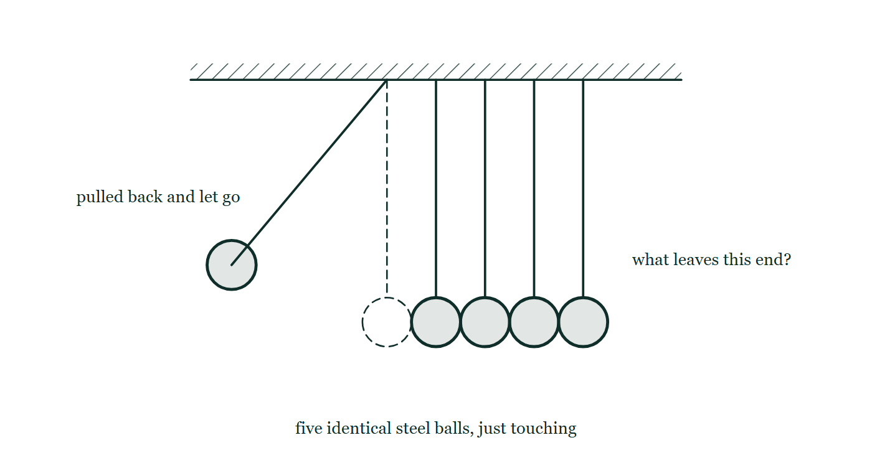
MOMENTUM · CENTRE OF MASS & LINEAR COLLISIONS
GIOPHYSICS LESSON
THINK FIRST
Pull one ball back on a Newton's cradle and one ball flies out. Two at half the speed would carry the same momentum — so why never two?
Take answers before you click — the point is the commitment
One ball of mass m at speed v carries mv. Two balls of mass m at v/2 carry 2m × v/2, which is also mv. The momentum books balance perfectly either way.
THE ANSWER
Because momentum is not the only thing that has to balance. Steel on steel is very nearly elastic, so the kinetic energy has to come out the same too — and two balls at half speed carry ½(2m)(v/2)² = ¼mv², only half of the ½mv² that went in. There is nowhere for the other half to go. One ball at full speed is the only outcome that satisfies both books at once, which is why a collision needs two conservation laws and not one.
A Newton's cradle of five identical steel balls hanging in a touching row from one frame, the end ball pulled back on its string and about to be released, and nothing at all drawn at the far end.
The live version of this figure — click here
Momentum — Centre of Mass & Linear Collisions. Built by GioPhysics from the lesson's own copy; nothing on these slides is re-authored.
2 / 28
Notes:
[Phase] Starter: Recall what this lesson stands on (minutes 0–5 of 45)
[Hook] Pull one ball back on a Newton's cradle and one ball flies out. Two at half the speed would carry the same momentum — so why never two? One ball of mass m at speed v carries mv. Two balls of mass m at v/2 carry 2m × v/2, which is also mv. The momentum books balance perfectly either way.
[Answer] Because momentum is not the only thing that has to balance. Steel on steel is very nearly elastic, so the kinetic energy has to come out the same too — and two balls at half speed carry ½(2m)(v/2)² = ¼mv², only half of the ½mv² that went in. There is nowhere for the other half to go. One ball at full speed is the only outcome that satisfies both books at once, which is why a collision needs two conservation laws and not one.
[Figure] A Newton's cradle of five identical steel balls hanging in a touching row from one frame, the end ball pulled back on its string and about to be released, and nothing at all drawn at the far end.

Slide 3
MOMENTUM · CENTRE OF MASS & LINEAR COLLISIONS
GIOPHYSICS LESSON
THE BIG IDEA
Follow the system, then the outcome
Introduce the idea — The big idea and the definition
For an isolated one-dimensional collision, total momentum and centre-of-mass velocity remain constant. Elasticity is additional information: kinetic energy is conserved only in a perfectly elastic collision.
Momentum — Centre of Mass & Linear Collisions. Built by GioPhysics from the lesson's own copy; nothing on these slides is re-authored.
3 / 28
Notes:
[Phase] Introduce the idea: The big idea and the definition (minutes 5–13 of 45)
[Big idea] For an isolated one-dimensional collision, total momentum and centre-of-mass velocity remain constant. Elasticity is additional information: kinetic energy is conserved only in a perfectly elastic collision.

Slide 4
MOMENTUM · CENTRE OF MASS & LINEAR COLLISIONS
GIOPHYSICS LESSON
THE PHYSICS · 1 OF 3
Centre-of-mass frame
Build the model — The formulae, one at a time, in plain English
When external impulse is negligible, vCM is constant. Subtract it from every velocity to view the collision in the centre-of-mass frame.
Momentum — Centre of Mass & Linear Collisions. Built by GioPhysics from the lesson's own copy; nothing on these slides is re-authored.
4 / 28
Notes:
[Phase] Build the model: The formulae, one at a time, in plain English (minutes 13–22 of 45)
[Section] When external impulse is negligible, vCM is constant. Subtract it from every velocity to view the collision in the centre-of-mass frame.

Slide 5
MOMENTUM · CENTRE OF MASS & LINEAR COLLISIONS
GIOPHYSICS LESSON
THE PHYSICS · 2 OF 3
Elastic
Build the model — The formulae, one at a time, in plain English
Both total momentum and total kinetic energy are conserved; e = 1.
Momentum — Centre of Mass & Linear Collisions. Built by GioPhysics from the lesson's own copy; nothing on these slides is re-authored.
5 / 28
Notes:
[Phase] Build the model: The formulae, one at a time, in plain English (minutes 13–22 of 45)
[Section] Both total momentum and total kinetic energy are conserved; e = 1.

Slide 6
MOMENTUM · CENTRE OF MASS & LINEAR COLLISIONS
GIOPHYSICS LESSON
THE PHYSICS · 3 OF 3
Inelastic
Build the model — The formulae, one at a time, in plain English
Momentum is conserved, but some kinetic energy becomes deformation, sound, or internal energy.
Momentum — Centre of Mass & Linear Collisions. Built by GioPhysics from the lesson's own copy; nothing on these slides is re-authored.
6 / 28
Notes:
[Phase] Build the model: The formulae, one at a time, in plain English (minutes 13–22 of 45)
[Section] Momentum is conserved, but some kinetic energy becomes deformation, sound, or internal energy.

Slide 7
MOMENTUM · CENTRE OF MASS & LINEAR COLLISIONS
GIOPHYSICS LESSON
FORMULA 1 OF 3
Momentum
Build the model — The formulae, one at a time, in plain English
m₁u₁ + m₂u₂ = m₁v₁ + m₂v₂
Required for every isolated collision
IN PLAIN ENGLISH
Momentum before a collision (left side, speeds u) equals momentum after (right side, speeds v), added over both objects with consistent signs.
Momentum — Centre of Mass & Linear Collisions. Built by GioPhysics from the lesson's own copy; nothing on these slides is re-authored.
7 / 28
Notes:
[Phase] Build the model: The formulae, one at a time, in plain English (minutes 13–22 of 45)
[Formula] Momentum: m₁u₁ + m₂u₂ = m₁v₁ + m₂v₂
[In plain English] Momentum before a collision (left side, speeds u) equals momentum after (right side, speeds v), added over both objects with consistent signs.
[Note] Required for every isolated collision

Slide 8
MOMENTUM · CENTRE OF MASS & LINEAR COLLISIONS
GIOPHYSICS LESSON
FORMULA 2 OF 3
Centre-of-mass motion
Build the model — The formulae, one at a time, in plain English
P = MvCM
vCM = (m₁u₁ + m₂u₂)/(m₁ + m₂)
IN PLAIN ENGLISH
The whole system behaves like one object of total mass M moving at the average (centre-of-mass) velocity.
Momentum — Centre of Mass & Linear Collisions. Built by GioPhysics from the lesson's own copy; nothing on these slides is re-authored.
8 / 28
Notes:
[Phase] Build the model: The formulae, one at a time, in plain English (minutes 13–22 of 45)
[Formula] Centre-of-mass motion: P = MvCM
[In plain English] The whole system behaves like one object of total mass M moving at the average (centre-of-mass) velocity.
[Note] vCM = (m₁u₁ + m₂u₂)/(m₁ + m₂)

Slide 9
MOMENTUM · CENTRE OF MASS & LINEAR COLLISIONS
GIOPHYSICS LESSON
FORMULA 3 OF 3
Restitution
Build the model — The formulae, one at a time, in plain English
e = relative speed apart / relative speed together
0 ≤ e ≤ 1 in the usual collision model
IN PLAIN ENGLISH
How bouncy a collision is: 1 means a perfect bounce, 0 means the objects stick together.
Momentum — Centre of Mass & Linear Collisions. Built by GioPhysics from the lesson's own copy; nothing on these slides is re-authored.
9 / 28
Notes:
[Phase] Build the model: The formulae, one at a time, in plain English (minutes 13–22 of 45)
[Formula] Restitution: e = relative speed apart / relative speed together
[In plain English] How bouncy a collision is: 1 means a perfect bounce, 0 means the objects stick together.
[Note] 0 ≤ e ≤ 1 in the usual collision model

Slide 10
MOMENTUM · CENTRE OF MASS & LINEAR COLLISIONS
GIOPHYSICS LESSON
WATCH OUT
The common trap
Check and misconception — The quick check and the trap
Kinetic energy is not generally conserved in a collision. Total energy is conserved, but some may leave the kinetic store.
Momentum — Centre of Mass & Linear Collisions. Built by GioPhysics from the lesson's own copy; nothing on these slides is re-authored.
10 / 28
Notes:
[Phase] Check and misconception: The quick check and the trap (minutes 35–41 of 45)
[Misconception] Kinetic energy is not generally conserved in a collision. Total energy is conserved, but some may leave the kinetic store.

Slide 11
MOMENTUM · CENTRE OF MASS & LINEAR COLLISIONS
GIOPHYSICS LESSON
WORKED EXAMPLE 1 OF 2 · EASY
The question
Easy
Worked examples — I do, we do — one step revealed at a time
A 2.0 kg cart at 3.0 m/s catches and couples to a stationary 4.0 kg cart. Find their common speed.
Momentum — Centre of Mass & Linear Collisions. Built by GioPhysics from the lesson's own copy; nothing on these slides is re-authored.
11 / 28
Notes:
[Phase] Worked examples: I do, we do — one step revealed at a time (minutes 22–35 of 45)
[Question] A 2.0 kg cart at 3.0 m/s catches and couples to a stationary 4.0 kg cart. Find their common speed.
[Answer] v′ = 1.0 m/s

Slide 12
MOMENTUM · CENTRE OF MASS & LINEAR COLLISIONS
GIOPHYSICS LESSON
WORKED EXAMPLE 1 OF 2 · EASY · THE WORKING
How to solve it
Easy
Worked examples — I do, we do — one step revealed at a time
A 2.0 kg cart at 3.0 m/s catches and couples to a stationary 4.0 kg cart. Find their common speed.
1.
mv = (m₁+m₂)v′: 2.0 × 3.0 = 6.0 × v′.
2.
v′ = 1.0 m/s.
Momentum — Centre of Mass & Linear Collisions. Built by GioPhysics from the lesson's own copy; nothing on these slides is re-authored.
12 / 28
Notes:
[Phase] Worked examples: I do, we do — one step revealed at a time (minutes 22–35 of 45)
[Reveal] One click per step. The class works each line before the next appears.
[Step 1] mv = (m₁+m₂)v′: 2.0 × 3.0 = 6.0 × v′.
[Step 2] v′ = 1.0 m/s.

Slide 13
MOMENTUM · CENTRE OF MASS & LINEAR COLLISIONS
GIOPHYSICS LESSON
WORKED EXAMPLE 1 OF 2 · EASY
Answer
Easy
Worked examples — I do, we do — one step revealed at a time
v′ = 1.0 m/s
Momentum — Centre of Mass & Linear Collisions. Built by GioPhysics from the lesson's own copy; nothing on these slides is re-authored.
13 / 28
Notes:
[Phase] Worked examples: I do, we do — one step revealed at a time (minutes 22–35 of 45)
[Answer] v′ = 1.0 m/s

Slide 14
MOMENTUM · CENTRE OF MASS & LINEAR COLLISIONS
GIOPHYSICS LESSON
WORKED EXAMPLE 2 OF 2 · MEDIUM
The question
Medium
Worked examples — I do, we do — one step revealed at a time
A 1.0 kg cart at 4.0 m/s sticks to a stationary 3.0 kg cart. Find their common speed and the kinetic energy converted.
Momentum — Centre of Mass & Linear Collisions. Built by GioPhysics from the lesson's own copy; nothing on these slides is re-authored.
14 / 28
Notes:
[Phase] Worked examples: I do, we do — one step revealed at a time (minutes 22–35 of 45)
[Question] A 1.0 kg cart at 4.0 m/s sticks to a stationary 3.0 kg cart. Find their common speed and the kinetic energy converted.
[Answer] Common velocity = +1.0 m/s; kinetic energy converted = 6.0 J

Slide 15
MOMENTUM · CENTRE OF MASS & LINEAR COLLISIONS
GIOPHYSICS LESSON
WORKED EXAMPLE 2 OF 2 · MEDIUM · THE WORKING
How to solve it
Medium
Worked examples — I do, we do — one step revealed at a time
A 1.0 kg cart at 4.0 m/s sticks to a stationary 3.0 kg cart. Find their common speed and the kinetic energy converted.
1.
v = [(1.0)(4.0) + (3.0)(0)]/(1.0 + 3.0) = 1.0 m/s.
2.
Ki = 1/2(1.0)(4.0²) = 8.0 J.
3.
Kf = 1/2(4.0)(1.0²) = 2.0 J, so 6.0 J leaves the kinetic store.
Momentum — Centre of Mass & Linear Collisions. Built by GioPhysics from the lesson's own copy; nothing on these slides is re-authored.
15 / 28
Notes:
[Phase] Worked examples: I do, we do — one step revealed at a time (minutes 22–35 of 45)
[Reveal] One click per step. The class works each line before the next appears.
[Step 1] v = [(1.0)(4.0) + (3.0)(0)]/(1.0 + 3.0) = 1.0 m/s.
[Step 2] Ki = 1/2(1.0)(4.0²) = 8.0 J.
[Step 3] Kf = 1/2(4.0)(1.0²) = 2.0 J, so 6.0 J leaves the kinetic store.

Slide 16
MOMENTUM · CENTRE OF MASS & LINEAR COLLISIONS
GIOPHYSICS LESSON
WORKED EXAMPLE 2 OF 2 · MEDIUM
Answer
Medium
Worked examples — I do, we do — one step revealed at a time
Common velocity = +1.0 m/s; kinetic energy converted = 6.0 J
Momentum — Centre of Mass & Linear Collisions. Built by GioPhysics from the lesson's own copy; nothing on these slides is re-authored.
16 / 28
Notes:
[Phase] Worked examples: I do, we do — one step revealed at a time (minutes 22–35 of 45)
[Answer] Common velocity = +1.0 m/s; kinetic energy converted = 6.0 J

Slide 17
MOMENTUM · CENTRE OF MASS & LINEAR COLLISIONS
GIOPHYSICS LESSON
SPOT THE MISTAKE
One line here is wrong
The whole working is up — find the bad line before you click
1.
A 10 g bullet at 300 m/s embeds in a 2.0 kg block hanging on strings. How high does the block swing?
2.
Kinetic energy of the bullet: ½ × 0.010 × 300² = 450 J
3.
All of it goes to the block and bullet together: ½ × 2.01 × v′² = 450
4.
v′ = 21.2 m/s
5.
Rise: h = v′² / 2g = 449 / 19.62 ≈ 23 m
LINE 3 IS WRONG
Energy has been carried through the impact, and an embedding collision is the one place it certainly does not go. Momentum does: 0.010 × 300 = 2.01 × v′ gives 1.49 m/s. It is a tempting line because the second half of this problem genuinely is an energy calculation — the swing — and the habit carries backwards into the impact. The answer is the giveaway: a 2 kg block on strings does not rise 23 m.
IT SHOULD SAY
Momentum through the impact: 0.010 × 300 = 2.01 × v′, so v′ = 1.49 m/s and h = 1.49² / 19.62 ≈ 0.11 m
Momentum — Centre of Mass & Linear Collisions. Built by GioPhysics from the lesson's own copy; nothing on these slides is re-authored.
17 / 28
Notes:
[Phase] Worked examples: I do, we do — one step revealed at a time (minutes 22–35 of 45)
[Spot the mistake] The working is complete and one line of it is wrong. Let the room hunt: one click names the line, a second shows it done correctly.
[Line 3 is wrong] Energy has been carried through the impact, and an embedding collision is the one place it certainly does not go. Momentum does: 0.010 × 300 = 2.01 × v′ gives 1.49 m/s. It is a tempting line because the second half of this problem genuinely is an energy calculation — the swing — and the habit carries backwards into the impact. The answer is the giveaway: a 2 kg block on strings does not rise 23 m.
[It should say] Momentum through the impact: 0.010 × 300 = 2.01 × v′, so v′ = 1.49 m/s and h = 1.49² / 19.62 ≈ 0.11 m

Slide 18
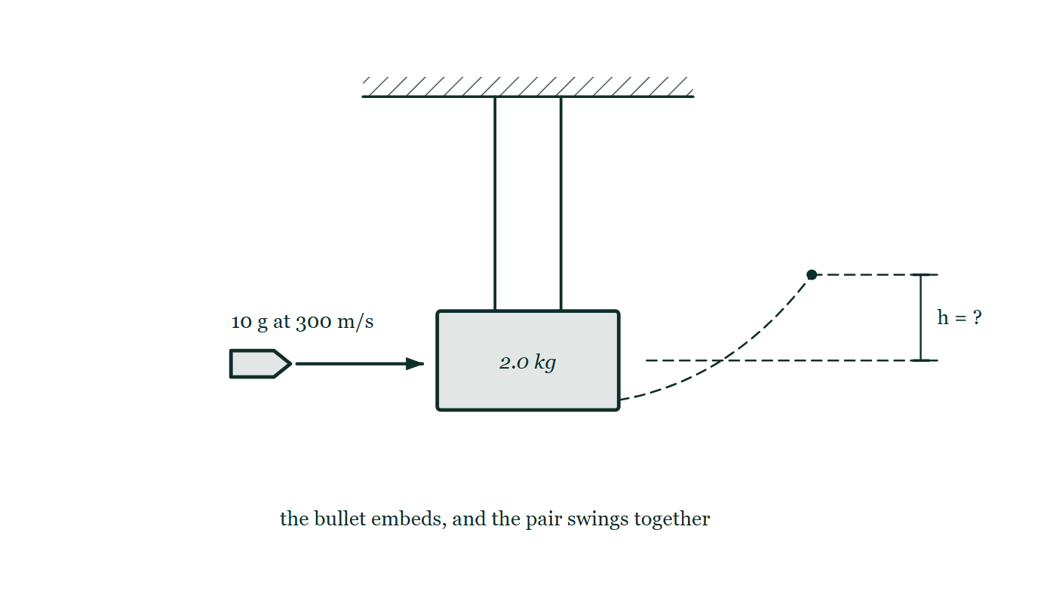
MOMENTUM · CENTRE OF MASS & LINEAR COLLISIONS
GIOPHYSICS LESSON
PREDICT · TAKE THE VOTE
Commit before you are told
Hands up for each option, then click
The 10 g bullet arrives at 300 m/s carrying 450 J and embeds in the 2.0 kg block. How much kinetic energy does the swinging block-and-bullet have?
A About 450 J — energy cannot simply disappear
B About 2 J
C About 225 J — half of it, since the block was at rest
A 2.0 kilogram block hanging from two vertical strings with a 10 gram bullet approaching horizontally at 300 metres per second, and a dashed curve showing the swing to a rise marked only as h.
The live version of this figure — click here
Momentum — Centre of Mass & Linear Collisions. Built by GioPhysics from the lesson's own copy; nothing on these slides is re-authored.
18 / 28
Notes:
[Phase] Build the model: The formulae, one at a time, in plain English (minutes 13–22 of 45)
[Predict] The 10 g bullet arrives at 300 m/s carrying 450 J and embeds in the 2.0 kg block. How much kinetic energy does the swinging block-and-bullet have?
[Options] A About 450 J — energy cannot simply disappear B About 2 J C About 225 J — half of it, since the block was at rest
[Figure] A 2.0 kilogram block hanging from two vertical strings with a 10 gram bullet approaching horizontally at 300 metres per second, and a dashed curve showing the swing to a rise marked only as h.

Slide 19
MOMENTUM · CENTRE OF MASS & LINEAR COLLISIONS
GIOPHYSICS LESSON
PREDICT · THE OUTCOME
What actually happens
Ask the room who changed their mind, and why
B About 2 J
WHY
Momentum carries through the impact intact: 0.010 × 300 = 2.01 × v′, so the pair leaves at 1.49 m/s and its kinetic energy is ½ × 2.01 × 1.49² ≈ 2.2 J. That is half a per cent of what arrived. The other 448 J went into deforming the block and the bullet and heating both — energy is conserved, but almost none of it stays kinetic. This is why the block swings only about 11 cm, and why sharing momentum with a much larger mass is such an effective way to destroy kinetic energy.
Momentum — Centre of Mass & Linear Collisions. Built by GioPhysics from the lesson's own copy; nothing on these slides is re-authored.
19 / 28
Notes:
[Phase] Build the model: The formulae, one at a time, in plain English (minutes 13–22 of 45)
[Answer] B — About 2 J. Momentum carries through the impact intact: 0.010 × 300 = 2.01 × v′, so the pair leaves at 1.49 m/s and its kinetic energy is ½ × 2.01 × 1.49² ≈ 2.2 J. That is half a per cent of what arrived. The other 448 J went into deforming the block and the bullet and heating both — energy is conserved, but almost none of it stays kinetic. This is why the block swings only about 11 cm, and why sharing momentum with a much larger mass is such an effective way to destroy kinetic energy.

Slide 20
MOMENTUM · CENTRE OF MASS & LINEAR COLLISIONS
GIOPHYSICS LESSON
QUICK CHECK
Decide before the answer goes up
Check and misconception — The quick check and the trap
Which quantities are conserved in an isolated perfectly elastic collision?
A
Momentum only
B
Kinetic energy only
C
Momentum and kinetic energy
Momentum — Centre of Mass & Linear Collisions. Built by GioPhysics from the lesson's own copy; nothing on these slides is re-authored.
20 / 28
Notes:
[Phase] Check and misconception: The quick check and the trap (minutes 35–41 of 45)
[Question] Which quantities are conserved in an isolated perfectly elastic collision?
[Options] A Momentum only B Kinetic energy only C Momentum and kinetic energy

Slide 21
MOMENTUM · CENTRE OF MASS & LINEAR COLLISIONS
GIOPHYSICS LESSON
QUICK CHECK · THE ANSWER
The answer, and why
Check and misconception — The quick check and the trap
C Momentum and kinetic energy
HOW TO GET THERE
Elastic collisions conserve the system's total momentum and total kinetic energy.
WHY THE OTHERS TEMPT
A Momentum really is conserved in every isolated collision, so this is never wrong — it is incomplete. Perfectly elastic is a stronger statement than isolated, and it buys you a second equation.
B Kinetic energy is the one that can fail. It survives here only because the collision is stated to be perfectly elastic; in any real collision some of it leaves for deformation, sound and heat.
C Correct. Both, and that is the definition: e = 1, the relative speed of separation equal to the relative speed of approach. Two equations, which is exactly what it takes to solve for two unknown final velocities.
Momentum — Centre of Mass & Linear Collisions. Built by GioPhysics from the lesson's own copy; nothing on these slides is re-authored.
21 / 28
Notes:
[Phase] Check and misconception: The quick check and the trap (minutes 35–41 of 45)
[Question] Which quantities are conserved in an isolated perfectly elastic collision?
[Option by option] A: Momentum really is conserved in every isolated collision, so this is never wrong — it is incomplete. Perfectly elastic is a stronger statement than isolated, and it buys you a second equation. B: Kinetic energy is the one that can fail. It survives here only because the collision is stated to be perfectly elastic; in any real collision some of it leaves for deformation, sound and heat. C: Correct. Both, and that is the definition: e = 1, the relative speed of separation equal to the relative speed of approach. Two equations, which is exactly what it takes to solve for two unknown final velocities.
[Answer] C — Momentum and kinetic energy
[Why] Elastic collisions conserve the system's total momentum and total kinetic energy.
[Reveal] One click for the answer, then one for the reason.

Slide 22
MOMENTUM · CENTRE OF MASS & LINEAR COLLISIONS
GIOPHYSICS LESSON
EXTENSION 1 OF 2 · HARD
The question
Hard
Worked examples — I do, we do — one step revealed at a time
Two 0.50 kg gliders approach each other at 2.0 m/s and 1.0 m/s and collide elastically. Find their velocities afterwards.
Momentum — Centre of Mass & Linear Collisions. Built by GioPhysics from the lesson's own copy; nothing on these slides is re-authored.
22 / 28
Notes:
[Phase] Worked examples: I do, we do — one step revealed at a time (minutes 22–35 of 45)
[Question] Two 0.50 kg gliders approach each other at 2.0 m/s and 1.0 m/s and collide elastically. Find their velocities afterwards.
[Answer] They swap: −1.0 m/s and +2.0 m/s

Slide 23
MOMENTUM · CENTRE OF MASS & LINEAR COLLISIONS
GIOPHYSICS LESSON
EXTENSION 1 OF 2 · HARD · THE WORKING
How to solve it
Hard
Worked examples — I do, we do — one step revealed at a time
Two 0.50 kg gliders approach each other at 2.0 m/s and 1.0 m/s and collide elastically. Find their velocities afterwards.
1.
Equal masses in an elastic collision exchange velocities.
2.
Glider 1 leaves at −1.0 m/s; glider 2 leaves at +2.0 m/s.
3.
Check: momentum 0.5(2 − 1) = 0.5 kg·m/s before and 0.5(−1 + 2) = 0.5 after; K also matches.
Momentum — Centre of Mass & Linear Collisions. Built by GioPhysics from the lesson's own copy; nothing on these slides is re-authored.
23 / 28
Notes:
[Phase] Worked examples: I do, we do — one step revealed at a time (minutes 22–35 of 45)
[Reveal] One click per step. The class works each line before the next appears.
[Step 1] Equal masses in an elastic collision exchange velocities.
[Step 2] Glider 1 leaves at −1.0 m/s; glider 2 leaves at +2.0 m/s.
[Step 3] Check: momentum 0.5(2 − 1) = 0.5 kg·m/s before and 0.5(−1 + 2) = 0.5 after; K also matches.

Slide 24
MOMENTUM · CENTRE OF MASS & LINEAR COLLISIONS
GIOPHYSICS LESSON
EXTENSION 1 OF 2 · HARD
Answer
Hard
Worked examples — I do, we do — one step revealed at a time
They swap: −1.0 m/s and +2.0 m/s
Momentum — Centre of Mass & Linear Collisions. Built by GioPhysics from the lesson's own copy; nothing on these slides is re-authored.
24 / 28
Notes:
[Phase] Worked examples: I do, we do — one step revealed at a time (minutes 22–35 of 45)
[Answer] They swap: −1.0 m/s and +2.0 m/s

Slide 25
MOMENTUM · CENTRE OF MASS & LINEAR COLLISIONS
GIOPHYSICS LESSON
EXTENSION 2 OF 2 · CHALLENGING
The question
Challenging
Worked examples — I do, we do — one step revealed at a time
A 10 g bullet at 300 m/s embeds in a 2.0 kg block hanging on strings (a ballistic pendulum). How high does the block swing?
Momentum — Centre of Mass & Linear Collisions. Built by GioPhysics from the lesson's own copy; nothing on these slides is re-authored.
25 / 28
Notes:
[Phase] Worked examples: I do, we do — one step revealed at a time (minutes 22–35 of 45)
[Question] A 10 g bullet at 300 m/s embeds in a 2.0 kg block hanging on strings (a ballistic pendulum). How high does the block swing?
[Answer] h ≈ 11 cm

Slide 26
MOMENTUM · CENTRE OF MASS & LINEAR COLLISIONS
GIOPHYSICS LESSON
EXTENSION 2 OF 2 · CHALLENGING · THE WORKING
How to solve it
Challenging
Worked examples — I do, we do — one step revealed at a time
A 10 g bullet at 300 m/s embeds in a 2.0 kg block hanging on strings (a ballistic pendulum). How high does the block swing?
1.
Impact (momentum only): v′ = 0.010 × 300 ÷ 2.01 ≈ 1.49 m/s.
2.
Swing (energy only): h = v′²/2g = 2.23 ÷ 19.62.
3.
h ≈ 0.11 m — note 99.5% of the bullet's energy became heat in the impact.
Momentum — Centre of Mass & Linear Collisions. Built by GioPhysics from the lesson's own copy; nothing on these slides is re-authored.
26 / 28
Notes:
[Phase] Worked examples: I do, we do — one step revealed at a time (minutes 22–35 of 45)
[Reveal] One click per step. The class works each line before the next appears.
[Step 1] Impact (momentum only): v′ = 0.010 × 300 ÷ 2.01 ≈ 1.49 m/s.
[Step 2] Swing (energy only): h = v′²/2g = 2.23 ÷ 19.62.
[Step 3] h ≈ 0.11 m — note 99.5% of the bullet's energy became heat in the impact.

Slide 27
MOMENTUM · CENTRE OF MASS & LINEAR COLLISIONS
GIOPHYSICS LESSON
EXTENSION 2 OF 2 · CHALLENGING
Answer
Challenging
Worked examples — I do, we do — one step revealed at a time
h ≈ 11 cm
Momentum — Centre of Mass & Linear Collisions. Built by GioPhysics from the lesson's own copy; nothing on these slides is re-authored.
27 / 28
Notes:
[Phase] Worked examples: I do, we do — one step revealed at a time (minutes 22–35 of 45)
[Answer] h ≈ 11 cm

Slide 28
MOMENTUM · CENTRE OF MASS & LINEAR COLLISIONS
GIOPHYSICS LESSON
MOMENTUM
Where to go next
Plenary — What to take away, what to practise next
Next
5.5 Non-Linear Momentum: Two-Dimensional Collisions
https://giophysics.com/chapter-9/non-linear-momentum/
Lesson
This lesson on giophysics.com
https://giophysics.com/chapter-9/linear-collisions/
Live
The live, interactive version of these slides
https://giophysics.com/chapter-9/presentation/?lesson=collisions
Chapter
All Momentum lessons
https://giophysics.com/chapter-9/
PDF
Download the lesson PDF
https://giophysics.com/downloads/9-4-linear-collisions.pdf
Momentum — Centre of Mass & Linear Collisions. Built by GioPhysics from the lesson's own copy; nothing on these slides is re-authored.
28 / 28
Notes:
[Phase] Plenary: What to take away, what to practise next (minutes 41–45 of 45)
[Interactive] The graphs and the circuit topology on these slides are frozen. The live version at https://giophysics.com/chapter-9/presentation/?lesson=collisions moves them.

