Slide 1
MOMENTUM · CONSERVATION OF MOMENTUM
GIOPHYSICS LESSON
05 · Momentum
Choose the system
Conservation of Momentum
Internal forces exchange momentum between objects. Only external impulse changes the total momentum of the chosen system.
POSITION
Lesson 3 of 7 in Momentum
PLAN
16 slides in the 45-minute core run, about 44 minutes of it
LESSON PAGE
https://giophysics.com/chapter-9/conservation-of-momentum/
Built by GioPhysics from the lesson's own page. Every word on these slides is the lesson's; nothing here is re-authored. Teaching material, not an awarding body's document.
Momentum — Conservation of Momentum. Built by GioPhysics from the lesson's own copy; nothing on these slides is re-authored.
1 / 28
Notes:
[Lesson] Momentum — Conservation of Momentum. Lesson 3 of 7.
[Intro] Internal forces exchange momentum between objects. Only external impulse changes the total momentum of the chosen system.
[Source] https://giophysics.com/chapter-9/conservation-of-momentum/
[Disclaimer] Built by GioPhysics from the lesson's own page. Every word on these slides is the lesson's; nothing here is re-authored. Teaching material, not an awarding body's document.

Slide 2
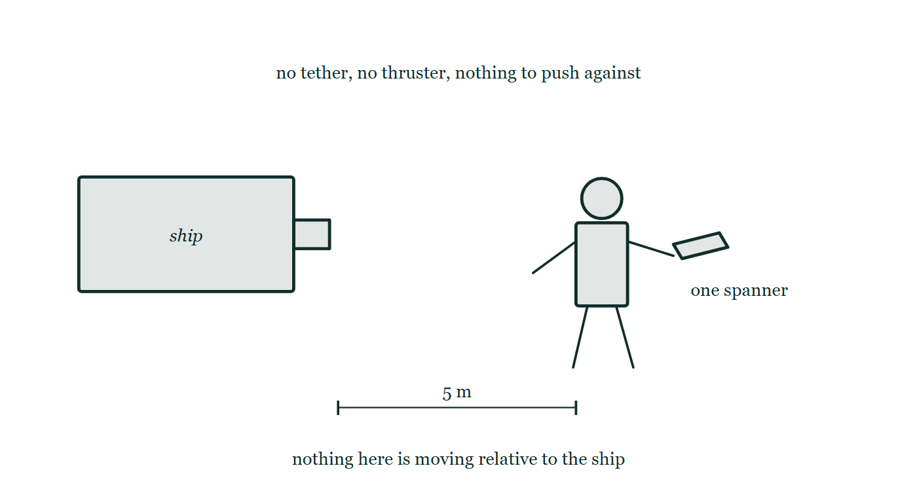
MOMENTUM · CONSERVATION OF MOMENTUM
GIOPHYSICS LESSON
THINK FIRST
An astronaut is drifting five metres from her ship with no tether and nothing but a spanner. How does she get back?
Take answers before you click — the point is the commitment
There is nothing to push against, nothing to grab, and no thruster. Swimming does not work; neither does kicking.
THE ANSWER
She throws the spanner directly away from the ship, as hard as she can. She and the spanner started with zero total momentum and nothing outside is acting on them, so their total has to stay zero: give the spanner momentum one way and she acquires exactly as much the other way. It is a slow way home — a 0.5 kg spanner thrown at 10 m/s moves a 70 kg astronaut at about 7 cm/s — but it is the only one available, and it is precisely how a rocket works.
An astronaut floating five metres from her ship with a spanner in one hand, no tether between them and no arrow anywhere on the drawing, so nothing in it is yet moving.
The live version of this figure — click here
Momentum — Conservation of Momentum. Built by GioPhysics from the lesson's own copy; nothing on these slides is re-authored.
2 / 28
Notes:
[Phase] Starter: Recall what this lesson stands on (minutes 0–5 of 45)
[Hook] An astronaut is drifting five metres from her ship with no tether and nothing but a spanner. How does she get back? There is nothing to push against, nothing to grab, and no thruster. Swimming does not work; neither does kicking.
[Answer] She throws the spanner directly away from the ship, as hard as she can. She and the spanner started with zero total momentum and nothing outside is acting on them, so their total has to stay zero: give the spanner momentum one way and she acquires exactly as much the other way. It is a slow way home — a 0.5 kg spanner thrown at 10 m/s moves a 70 kg astronaut at about 7 cm/s — but it is the only one available, and it is precisely how a rocket works.
[Figure] An astronaut floating five metres from her ship with a spanner in one hand, no tether between them and no arrow anywhere on the drawing, so nothing in it is yet moving.

Slide 3
MOMENTUM · CONSERVATION OF MOMENTUM
GIOPHYSICS LESSON
THE BIG IDEA
Choose the system
Introduce the idea — The big idea and the definition
Momentum is conserved for an isolated system—or approximately conserved during a short interaction when external impulse is negligible. Define the system and time interval before writing an equation.
Momentum — Conservation of Momentum. Built by GioPhysics from the lesson's own copy; nothing on these slides is re-authored.
3 / 28
Notes:
[Phase] Introduce the idea: The big idea and the definition (minutes 5–13 of 45)
[Big idea] Momentum is conserved for an isolated system—or approximately conserved during a short interaction when external impulse is negligible. Define the system and time interval before writing an equation.

Slide 4
MOMENTUM · CONSERVATION OF MOMENTUM
GIOPHYSICS LESSON
THE PHYSICS · 1 OF 3
Draw the boundary
Build the model — The formulae, one at a time, in plain English
Include every interacting object whose momentum exchange you want to treat as internal.
Momentum — Conservation of Momentum. Built by GioPhysics from the lesson's own copy; nothing on these slides is re-authored.
4 / 28
Notes:
[Phase] Build the model: The formulae, one at a time, in plain English (minutes 13–22 of 45)
[Section] Include every interacting object whose momentum exchange you want to treat as internal.

Slide 5
MOMENTUM · CONSERVATION OF MOMENTUM
GIOPHYSICS LESSON
THE PHYSICS · 2 OF 3
Internal forces cancel
Build the model — The formulae, one at a time, in plain English
Newton's third-law forces give equal and opposite impulses inside the system.
Momentum — Conservation of Momentum. Built by GioPhysics from the lesson's own copy; nothing on these slides is re-authored.
5 / 28
Notes:
[Phase] Build the model: The formulae, one at a time, in plain English (minutes 13–22 of 45)
[Section] Newton's third-law forces give equal and opposite impulses inside the system.

Slide 6
MOMENTUM · CONSERVATION OF MOMENTUM
GIOPHYSICS LESSON
THE PHYSICS · 3 OF 3
Short intervals help
Build the model — The formulae, one at a time, in plain English
During a brief collision, gravity or friction may provide much less impulse than the collision forces.
Momentum — Conservation of Momentum. Built by GioPhysics from the lesson's own copy; nothing on these slides is re-authored.
6 / 28
Notes:
[Phase] Build the model: The formulae, one at a time, in plain English (minutes 13–22 of 45)
[Section] During a brief collision, gravity or friction may provide much less impulse than the collision forces.

Slide 7
MOMENTUM · CONSERVATION OF MOMENTUM
GIOPHYSICS LESSON
FORMULA 1 OF 3
Impulse account
Build the model — The formulae, one at a time, in plain English
Σpafter = Σpbefore + Jext
The most general system statement
IN PLAIN ENGLISH
The system's total momentum afterwards is what it had before, plus whatever kick came from outside.
Momentum — Conservation of Momentum. Built by GioPhysics from the lesson's own copy; nothing on these slides is re-authored.
7 / 28
Notes:
[Phase] Build the model: The formulae, one at a time, in plain English (minutes 13–22 of 45)
[Formula] Impulse account: Σpafter = Σpbefore + Jext
[In plain English] The system's total momentum afterwards is what it had before, plus whatever kick came from outside.
[Note] The most general system statement

Slide 8
MOMENTUM · CONSERVATION OF MOMENTUM
GIOPHYSICS LESSON
FORMULA 2 OF 3
Isolated system
Build the model — The formulae, one at a time, in plain English
Σpbefore = Σpafter
Use when external impulse is zero or negligible
IN PLAIN ENGLISH
If nothing outside interferes, the total momentum before equals the total after — the heart of every collision problem.
Momentum — Conservation of Momentum. Built by GioPhysics from the lesson's own copy; nothing on these slides is re-authored.
8 / 28
Notes:
[Phase] Build the model: The formulae, one at a time, in plain English (minutes 13–22 of 45)
[Formula] Isolated system: Σpbefore = Σpafter
[In plain English] If nothing outside interferes, the total momentum before equals the total after — the heart of every collision problem.
[Note] Use when external impulse is zero or negligible

Slide 9
MOMENTUM · CONSERVATION OF MOMENTUM
GIOPHYSICS LESSON
FORMULA 3 OF 3
Two objects in 1D
Build the model — The formulae, one at a time, in plain English
m₁u₁ + m₂u₂ = m₁v₁ + m₂v₂
Keep one consistent sign convention
IN PLAIN ENGLISH
Momentum before a collision (left side, speeds u) equals momentum after (right side, speeds v), added over both objects with consistent signs.
Momentum — Conservation of Momentum. Built by GioPhysics from the lesson's own copy; nothing on these slides is re-authored.
9 / 28
Notes:
[Phase] Build the model: The formulae, one at a time, in plain English (minutes 13–22 of 45)
[Formula] Two objects in 1D: m₁u₁ + m₂u₂ = m₁v₁ + m₂v₂
[In plain English] Momentum before a collision (left side, speeds u) equals momentum after (right side, speeds v), added over both objects with consistent signs.
[Note] Keep one consistent sign convention

Slide 10
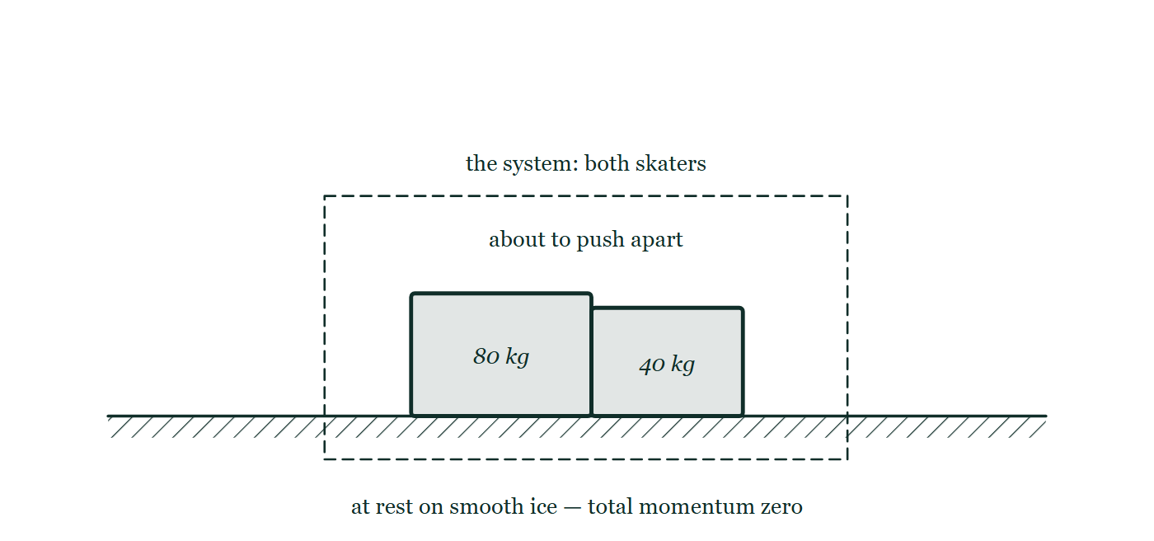
MOMENTUM · CONSERVATION OF MOMENTUM
GIOPHYSICS LESSON
THE PICTURE
Draw the boundary first
Drawn for this lesson
An 80 kilogram and a 40 kilogram skater standing at rest in contact on smooth ice, both enclosed by a dashed rectangle marking the system, with no velocity arrow on either of them.
The live version of this figure — click here
Momentum — Conservation of Momentum. Built by GioPhysics from the lesson's own copy; nothing on these slides is re-authored.
10 / 28
Notes:
[Phase] Build the model: The formulae, one at a time, in plain English (minutes 13–22 of 45)
[Figure] An 80 kilogram and a 40 kilogram skater standing at rest in contact on smooth ice, both enclosed by a dashed rectangle marking the system, with no velocity arrow on either of them.

Slide 11
MOMENTUM · CONSERVATION OF MOMENTUM
GIOPHYSICS LESSON
WATCH OUT
The common trap
Check and misconception — The quick check and the trap
Momentum conservation is not a statement that each object keeps its momentum. Objects can exchange large amounts while the vector total remains fixed.
Momentum — Conservation of Momentum. Built by GioPhysics from the lesson's own copy; nothing on these slides is re-authored.
11 / 28
Notes:
[Phase] Check and misconception: The quick check and the trap (minutes 35–41 of 45)
[Misconception] Momentum conservation is not a statement that each object keeps its momentum. Objects can exchange large amounts while the vector total remains fixed.

Slide 12
MOMENTUM · CONSERVATION OF MOMENTUM
GIOPHYSICS LESSON
WORKED EXAMPLE 1 OF 2 · EASY
The question
Easy
Worked examples — I do, we do — one step revealed at a time
A stationary 80 kg skater pushes a 40 kg skater away at 3.0 m/s. What is the heavier skater's recoil speed?
Momentum — Conservation of Momentum. Built by GioPhysics from the lesson's own copy; nothing on these slides is re-authored.
12 / 28
Notes:
[Phase] Worked examples: I do, we do — one step revealed at a time (minutes 22–35 of 45)
[Question] A stationary 80 kg skater pushes a 40 kg skater away at 3.0 m/s. What is the heavier skater's recoil speed?
[Answer] 1.5 m/s backwards

Slide 13
MOMENTUM · CONSERVATION OF MOMENTUM
GIOPHYSICS LESSON
WORKED EXAMPLE 1 OF 2 · EASY · THE WORKING
How to solve it
Easy
Worked examples — I do, we do — one step revealed at a time
A stationary 80 kg skater pushes a 40 kg skater away at 3.0 m/s. What is the heavier skater's recoil speed?
1.
Total momentum stays zero: 80v = 40 × 3.0.
2.
v = 1.5 m/s in the opposite direction.
Momentum — Conservation of Momentum. Built by GioPhysics from the lesson's own copy; nothing on these slides is re-authored.
13 / 28
Notes:
[Phase] Worked examples: I do, we do — one step revealed at a time (minutes 22–35 of 45)
[Reveal] One click per step. The class works each line before the next appears.
[Step 1] Total momentum stays zero: 80v = 40 × 3.0.
[Step 2] v = 1.5 m/s in the opposite direction.

Slide 14
MOMENTUM · CONSERVATION OF MOMENTUM
GIOPHYSICS LESSON
WORKED EXAMPLE 1 OF 2 · EASY
Answer
Easy
Worked examples — I do, we do — one step revealed at a time
1.5 m/s backwards
Momentum — Conservation of Momentum. Built by GioPhysics from the lesson's own copy; nothing on these slides is re-authored.
14 / 28
Notes:
[Phase] Worked examples: I do, we do — one step revealed at a time (minutes 22–35 of 45)
[Answer] 1.5 m/s backwards

Slide 15
MOMENTUM · CONSERVATION OF MOMENTUM
GIOPHYSICS LESSON
WORKED EXAMPLE 2 OF 2 · MEDIUM
The question
Medium
Worked examples — I do, we do — one step revealed at a time
A 2.0 kg cart at +3.0 m/s and a 1.0 kg cart at −1.0 m/s interact. Afterwards the first cart moves at +1.0 m/s. Find the second cart's velocity.
Momentum — Conservation of Momentum. Built by GioPhysics from the lesson's own copy; nothing on these slides is re-authored.
15 / 28
Notes:
[Phase] Worked examples: I do, we do — one step revealed at a time (minutes 22–35 of 45)
[Question] A 2.0 kg cart at +3.0 m/s and a 1.0 kg cart at −1.0 m/s interact. Afterwards the first cart moves at +1.0 m/s. Find the second cart's velocity.
[Answer] v₂ = +3.0 m/s

Slide 16
MOMENTUM · CONSERVATION OF MOMENTUM
GIOPHYSICS LESSON
WORKED EXAMPLE 2 OF 2 · MEDIUM · THE WORKING
How to solve it
Medium
Worked examples — I do, we do — one step revealed at a time
A 2.0 kg cart at +3.0 m/s and a 1.0 kg cart at −1.0 m/s interact. Afterwards the first cart moves at +1.0 m/s. Find the second cart's velocity.
1.
Before: ptotal = (2.0)(3.0) + (1.0)(−1.0) = +5.0 kg·m/s.
2.
After: +5.0 = (2.0)(1.0) + (1.0)v₂.
3.
Solve 5.0 = 2.0 + v₂.
Momentum — Conservation of Momentum. Built by GioPhysics from the lesson's own copy; nothing on these slides is re-authored.
16 / 28
Notes:
[Phase] Worked examples: I do, we do — one step revealed at a time (minutes 22–35 of 45)
[Reveal] One click per step. The class works each line before the next appears.
[Step 1] Before: ptotal = (2.0)(3.0) + (1.0)(−1.0) = +5.0 kg·m/s.
[Step 2] After: +5.0 = (2.0)(1.0) + (1.0)v₂.
[Step 3] Solve 5.0 = 2.0 + v₂.

Slide 17
MOMENTUM · CONSERVATION OF MOMENTUM
GIOPHYSICS LESSON
WORKED EXAMPLE 2 OF 2 · MEDIUM
Answer
Medium
Worked examples — I do, we do — one step revealed at a time
v₂ = +3.0 m/s
Momentum — Conservation of Momentum. Built by GioPhysics from the lesson's own copy; nothing on these slides is re-authored.
17 / 28
Notes:
[Phase] Worked examples: I do, we do — one step revealed at a time (minutes 22–35 of 45)
[Answer] v₂ = +3.0 m/s

Slide 18
MOMENTUM · CONSERVATION OF MOMENTUM
GIOPHYSICS LESSON
PREDICT · TAKE THE VOTE
Commit before you are told
Hands up for each option, then click
The two skaters push off from rest and the 40 kg one glides away at 3.0 m/s. How fast does the 80 kg one go the other way?
A 3.0 m/s — they pushed each other with equal and opposite forces
B 1.5 m/s
C 6.0 m/s
An 80 kilogram and a 40 kilogram skater standing at rest in contact on smooth ice, both enclosed by a dashed rectangle marking the system, with no velocity arrow on either of them.
The live version of this figure — click here
Momentum — Conservation of Momentum. Built by GioPhysics from the lesson's own copy; nothing on these slides is re-authored.
18 / 28
Notes:
[Phase] Build the model: The formulae, one at a time, in plain English (minutes 13–22 of 45)
[Predict] The two skaters push off from rest and the 40 kg one glides away at 3.0 m/s. How fast does the 80 kg one go the other way?
[Options] A 3.0 m/s — they pushed each other with equal and opposite forces B 1.5 m/s C 6.0 m/s
[Figure] An 80 kilogram and a 40 kilogram skater standing at rest in contact on smooth ice, both enclosed by a dashed rectangle marking the system, with no velocity arrow on either of them.

Slide 19
MOMENTUM · CONSERVATION OF MOMENTUM
GIOPHYSICS LESSON
PREDICT · THE OUTCOME
What actually happens
Ask the room who changed their mind, and why
B 1.5 m/s
WHY
Equal forces, yes — equal speeds, no. The total momentum inside the dashed boundary started at zero and has to end at zero, so 80v = 40 × 3.0 and v = 1.5 m/s. The same push divides by a mass twice as large and produces half the speed. 6.0 m/s is that ratio applied the wrong way round, which would give the heavier skater the larger momentum and leave the system moving off across the ice by itself.
Momentum — Conservation of Momentum. Built by GioPhysics from the lesson's own copy; nothing on these slides is re-authored.
19 / 28
Notes:
[Phase] Build the model: The formulae, one at a time, in plain English (minutes 13–22 of 45)
[Answer] B — 1.5 m/s. Equal forces, yes — equal speeds, no. The total momentum inside the dashed boundary started at zero and has to end at zero, so 80v = 40 × 3.0 and v = 1.5 m/s. The same push divides by a mass twice as large and produces half the speed. 6.0 m/s is that ratio applied the wrong way round, which would give the heavier skater the larger momentum and leave the system moving off across the ice by itself.

Slide 20
MOMENTUM · CONSERVATION OF MOMENTUM
GIOPHYSICS LESSON
QUICK CHECK
Decide before the answer goes up
Check and misconception — The quick check and the trap
During an isolated collision, what must remain constant?
A
Each object's momentum
B
The system's total momentum
C
Each object's speed
Momentum — Conservation of Momentum. Built by GioPhysics from the lesson's own copy; nothing on these slides is re-authored.
20 / 28
Notes:
[Phase] Check and misconception: The quick check and the trap (minutes 35–41 of 45)
[Question] During an isolated collision, what must remain constant?
[Options] A Each object's momentum B The system's total momentum C Each object's speed

Slide 21
MOMENTUM · CONSERVATION OF MOMENTUM
GIOPHYSICS LESSON
QUICK CHECK · THE ANSWER
The answer, and why
Check and misconception — The quick check and the trap
B The system's total momentum
HOW TO GET THERE
Individual momenta change; their vector sum stays constant when external impulse is zero.
WHY THE OTHERS TEMPT
A This is what conservation sounds like when it is read as a promise to each object separately, and objects in a collision would then be unable to affect each other at all. They exchange momentum freely; it is the sum that is protected.
B Correct. Internal forces come in third-law pairs, so they deliver equal and opposite impulses inside the system and cancel exactly. With no external impulse, Σp before equals Σp after.
C Speeds change constantly during a collision — that is what a collision is. Momentum conservation says nothing about them individually, and it says nothing about kinetic energy either unless the collision happens to be elastic.
Momentum — Conservation of Momentum. Built by GioPhysics from the lesson's own copy; nothing on these slides is re-authored.
21 / 28
Notes:
[Phase] Check and misconception: The quick check and the trap (minutes 35–41 of 45)
[Question] During an isolated collision, what must remain constant?
[Option by option] A: This is what conservation sounds like when it is read as a promise to each object separately, and objects in a collision would then be unable to affect each other at all. They exchange momentum freely; it is the sum that is protected. B: Correct. Internal forces come in third-law pairs, so they deliver equal and opposite impulses inside the system and cancel exactly. With no external impulse, Σp before equals Σp after. C: Speeds change constantly during a collision — that is what a collision is. Momentum conservation says nothing about them individually, and it says nothing about kinetic energy either unless the collision happens to be elastic.
[Answer] B — The system's total momentum
[Why] Individual momenta change; their vector sum stays constant when external impulse is zero.
[Reveal] One click for the answer, then one for the reason.

Slide 22
MOMENTUM · CONSERVATION OF MOMENTUM
GIOPHYSICS LESSON
EXTENSION 1 OF 2 · HARD
The question
Hard
Worked examples — I do, we do — one step revealed at a time
A 5.0 kg rifle fires a 10 g bullet at 400 m/s. Find the recoil speed and explain why the shooter's shoulder matters.
Momentum — Conservation of Momentum. Built by GioPhysics from the lesson's own copy; nothing on these slides is re-authored.
22 / 28
Notes:
[Phase] Worked examples: I do, we do — one step revealed at a time (minutes 22–35 of 45)
[Question] A 5.0 kg rifle fires a 10 g bullet at 400 m/s. Find the recoil speed and explain why the shooter's shoulder matters.
[Answer] 0.80 m/s backwards; bracing shares the impulse across a much larger mass

Slide 23
MOMENTUM · CONSERVATION OF MOMENTUM
GIOPHYSICS LESSON
EXTENSION 1 OF 2 · HARD · THE WORKING
How to solve it
Hard
Worked examples — I do, we do — one step revealed at a time
A 5.0 kg rifle fires a 10 g bullet at 400 m/s. Find the recoil speed and explain why the shooter's shoulder matters.
1.
0 = 0.010 × 400 + 5.0 × v → v = −0.80 m/s.
2.
Recoil kinetic energy: ½ × 5.0 × 0.64 = 1.6 J against the bullet's 800 J.
3.
Bracing adds the shooter's mass to the system, cutting recoil speed and spreading the impulse over a longer time.
Momentum — Conservation of Momentum. Built by GioPhysics from the lesson's own copy; nothing on these slides is re-authored.
23 / 28
Notes:
[Phase] Worked examples: I do, we do — one step revealed at a time (minutes 22–35 of 45)
[Reveal] One click per step. The class works each line before the next appears.
[Step 1] 0 = 0.010 × 400 + 5.0 × v → v = −0.80 m/s.
[Step 2] Recoil kinetic energy: ½ × 5.0 × 0.64 = 1.6 J against the bullet's 800 J.
[Step 3] Bracing adds the shooter's mass to the system, cutting recoil speed and spreading the impulse over a longer time.

Slide 24
MOMENTUM · CONSERVATION OF MOMENTUM
GIOPHYSICS LESSON
EXTENSION 1 OF 2 · HARD
Answer
Hard
Worked examples — I do, we do — one step revealed at a time
0.80 m/s backwards; bracing shares the impulse across a much larger mass
Momentum — Conservation of Momentum. Built by GioPhysics from the lesson's own copy; nothing on these slides is re-authored.
24 / 28
Notes:
[Phase] Worked examples: I do, we do — one step revealed at a time (minutes 22–35 of 45)
[Answer] 0.80 m/s backwards; bracing shares the impulse across a much larger mass

Slide 25
MOMENTUM · CONSERVATION OF MOMENTUM
GIOPHYSICS LESSON
EXTENSION 2 OF 2 · CHALLENGING
The question
Challenging
Worked examples — I do, we do — one step revealed at a time
A 3.0 kg cannonball explodes at the top of its flight (moving 12 m/s horizontally) into two 1.5 kg halves. One half stops dead in the air. What happens to the other, and where does the extra energy come from?
Momentum — Conservation of Momentum. Built by GioPhysics from the lesson's own copy; nothing on these slides is re-authored.
25 / 28
Notes:
[Phase] Worked examples: I do, we do — one step revealed at a time (minutes 22–35 of 45)
[Question] A 3.0 kg cannonball explodes at the top of its flight (moving 12 m/s horizontally) into two 1.5 kg halves. One half stops dead in the air. What happens to the other, and where does the extra energy come from?
[Answer] The other half doubles its speed to 24 m/s; the explosion supplies the added 216 J

Slide 26
MOMENTUM · CONSERVATION OF MOMENTUM
GIOPHYSICS LESSON
EXTENSION 2 OF 2 · CHALLENGING · THE WORKING
How to solve it
Challenging
Worked examples — I do, we do — one step revealed at a time
A 3.0 kg cannonball explodes at the top of its flight (moving 12 m/s horizontally) into two 1.5 kg halves. One half stops dead in the air. What happens to the other, and where does the extra energy come from?
1.
Momentum: 3.0 × 12 = 1.5 × 0 + 1.5 × v → v = 24 m/s horizontally.
2.
K before = ½ × 3.0 × 144 = 216 J; after = ½ × 1.5 × 576 = 432 J.
3.
The extra 216 J came from the explosive's chemical energy — momentum conserved, kinetic energy increased.
Momentum — Conservation of Momentum. Built by GioPhysics from the lesson's own copy; nothing on these slides is re-authored.
26 / 28
Notes:
[Phase] Worked examples: I do, we do — one step revealed at a time (minutes 22–35 of 45)
[Reveal] One click per step. The class works each line before the next appears.
[Step 1] Momentum: 3.0 × 12 = 1.5 × 0 + 1.5 × v → v = 24 m/s horizontally.
[Step 2] K before = ½ × 3.0 × 144 = 216 J; after = ½ × 1.5 × 576 = 432 J.
[Step 3] The extra 216 J came from the explosive's chemical energy — momentum conserved, kinetic energy increased.

Slide 27
MOMENTUM · CONSERVATION OF MOMENTUM
GIOPHYSICS LESSON
EXTENSION 2 OF 2 · CHALLENGING
Answer
Challenging
Worked examples — I do, we do — one step revealed at a time
The other half doubles its speed to 24 m/s; the explosion supplies the added 216 J
Momentum — Conservation of Momentum. Built by GioPhysics from the lesson's own copy; nothing on these slides is re-authored.
27 / 28
Notes:
[Phase] Worked examples: I do, we do — one step revealed at a time (minutes 22–35 of 45)
[Answer] The other half doubles its speed to 24 m/s; the explosion supplies the added 216 J

Slide 28
MOMENTUM · CONSERVATION OF MOMENTUM
GIOPHYSICS LESSON
MOMENTUM
Where to go next
Plenary — What to take away, what to practise next
Next
5.4 Centre of Mass & Linear Collisions
https://giophysics.com/chapter-9/linear-collisions/
Lesson
This lesson on giophysics.com
https://giophysics.com/chapter-9/conservation-of-momentum/
Live
The live, interactive version of these slides
https://giophysics.com/chapter-9/presentation/?lesson=conservation
Chapter
All Momentum lessons
https://giophysics.com/chapter-9/
PDF
Download the lesson PDF
https://giophysics.com/downloads/9-3-conservation-of-momentum.pdf
Momentum — Conservation of Momentum. Built by GioPhysics from the lesson's own copy; nothing on these slides is re-authored.
28 / 28
Notes:
[Phase] Plenary: What to take away, what to practise next (minutes 41–45 of 45)
[Interactive] The graphs and the circuit topology on these slides are frozen. The live version at https://giophysics.com/chapter-9/presentation/?lesson=conservation moves them.

