Slide 1
MOMENTUM · IMPULSE & FORCE–TIME GRAPHS
GIOPHYSICS LESSON
05 · Momentum
Force acting through time
Impulse & Force–Time Graphs
A large force for a short time and a smaller force for longer can produce the same momentum change.
POSITION
Lesson 2 of 7 in Momentum
PLAN
15 slides in the 45-minute core run, about 41.5 minutes of it
LESSON PAGE
https://giophysics.com/chapter-9/impulse-force-time-graphs/
Built by GioPhysics from the lesson's own page. Every word on these slides is the lesson's; nothing here is re-authored. Teaching material, not an awarding body's document.
Momentum — Impulse & Force–Time Graphs. Built by GioPhysics from the lesson's own copy; nothing on these slides is re-authored.
1 / 29
Notes:
[Lesson] Momentum — Impulse & Force–Time Graphs. Lesson 2 of 7.
[Intro] A large force for a short time and a smaller force for longer can produce the same momentum change.
[Source] https://giophysics.com/chapter-9/impulse-force-time-graphs/
[Disclaimer] Built by GioPhysics from the lesson's own page. Every word on these slides is the lesson's; nothing here is re-authored. Teaching material, not an awarding body's document.

Slide 2
MOMENTUM · IMPULSE & FORCE–TIME GRAPHS
GIOPHYSICS LESSON
THINK FIRST
You land with exactly the same momentum whether you bend your knees or not. So why does bending them save you?
Take answers before you click — the point is the commitment
Same height, same mass, same speed at the ground. Whether you land stiff-legged or soft, all of that momentum has to be got rid of.
THE ANSWER
Because the impulse is fixed and the force is not. Δp is the same both ways, so J = FavgΔt is the same both ways — but bending your knees stretches Δt from a few hundredths of a second to a few tenths, and the average force drops by exactly that factor. Crumple zones, air bags, crash mats and catching a cricket ball with your hands moving back are all one idea: you cannot change the impulse, so change the time.
Momentum — Impulse & Force–Time Graphs. Built by GioPhysics from the lesson's own copy; nothing on these slides is re-authored.
2 / 29
Notes:
[Phase] Starter: Recall what this lesson stands on (minutes 0–5 of 45)
[Hook] You land with exactly the same momentum whether you bend your knees or not. So why does bending them save you? Same height, same mass, same speed at the ground. Whether you land stiff-legged or soft, all of that momentum has to be got rid of.
[Answer] Because the impulse is fixed and the force is not. Δp is the same both ways, so J = FavgΔt is the same both ways — but bending your knees stretches Δt from a few hundredths of a second to a few tenths, and the average force drops by exactly that factor. Crumple zones, air bags, crash mats and catching a cricket ball with your hands moving back are all one idea: you cannot change the impulse, so change the time.

Slide 3
MOMENTUM · IMPULSE & FORCE–TIME GRAPHS
GIOPHYSICS LESSON
THE BIG IDEA
Force acting through time
Introduce the idea — The big idea and the definition
Impulse is the signed area under a force–time graph. It changes momentum in the force direction, so a rebound usually produces a larger impulse than merely stopping the object.
Momentum — Impulse & Force–Time Graphs. Built by GioPhysics from the lesson's own copy; nothing on these slides is re-authored.
3 / 29
Notes:
[Phase] Introduce the idea: The big idea and the definition (minutes 5–13 of 45)
[Big idea] Impulse is the signed area under a force–time graph. It changes momentum in the force direction, so a rebound usually produces a larger impulse than merely stopping the object.

Slide 4
MOMENTUM · IMPULSE & FORCE–TIME GRAPHS
GIOPHYSICS LESSON
THE PHYSICS · 1 OF 3
Area carries units
Build the model — The formulae, one at a time, in plain English
Force multiplied by time gives N·s, exactly equivalent to kg·m/s.
Momentum — Impulse & Force–Time Graphs. Built by GioPhysics from the lesson's own copy; nothing on these slides is re-authored.
4 / 29
Notes:
[Phase] Build the model: The formulae, one at a time, in plain English (minutes 13–22 of 45)
[Section] Force multiplied by time gives N·s, exactly equivalent to kg·m/s.

Slide 5
MOMENTUM · IMPULSE & FORCE–TIME GRAPHS
GIOPHYSICS LESSON
THE PHYSICS · 2 OF 3
Keep the sign
Build the model — The formulae, one at a time, in plain English
Graph area below the time axis gives negative impulse and subtracts from the chosen positive momentum.
Momentum — Impulse & Force–Time Graphs. Built by GioPhysics from the lesson's own copy; nothing on these slides is re-authored.
5 / 29
Notes:
[Phase] Build the model: The formulae, one at a time, in plain English (minutes 13–22 of 45)
[Section] Graph area below the time axis gives negative impulse and subtracts from the chosen positive momentum.

Slide 6
MOMENTUM · IMPULSE & FORCE–TIME GRAPHS
GIOPHYSICS LESSON
THE PHYSICS · 3 OF 3
Stretch the contact
Build the model — The formulae, one at a time, in plain English
For one fixed Δp, increasing collision time lowers the average force—why padding and crumple zones help.
Momentum — Impulse & Force–Time Graphs. Built by GioPhysics from the lesson's own copy; nothing on these slides is re-authored.
6 / 29
Notes:
[Phase] Build the model: The formulae, one at a time, in plain English (minutes 13–22 of 45)
[Section] For one fixed Δp, increasing collision time lowers the average force—why padding and crumple zones help.

Slide 7
MOMENTUM · IMPULSE & FORCE–TIME GRAPHS
GIOPHYSICS LESSON
FORMULA 1 OF 3
Impulse–momentum theorem
Build the model — The formulae, one at a time, in plain English
J = Δp
Impulse is a vector
IN PLAIN ENGLISH
The total kick something receives (impulse) equals exactly how much its momentum changes.
Momentum — Impulse & Force–Time Graphs. Built by GioPhysics from the lesson's own copy; nothing on these slides is re-authored.
7 / 29
Notes:
[Phase] Build the model: The formulae, one at a time, in plain English (minutes 13–22 of 45)
[Formula] Impulse–momentum theorem: J = Δp
[In plain English] The total kick something receives (impulse) equals exactly how much its momentum changes.
[Note] Impulse is a vector

Slide 8
MOMENTUM · IMPULSE & FORCE–TIME GRAPHS
GIOPHYSICS LESSON
FORMULA 2 OF 3
Average-force model
Build the model — The formulae, one at a time, in plain English
J = Favg Δt
Valid for the average force over the interval
IN PLAIN ENGLISH
A kick's size is the average force times how long it acts — a small force for a long time can match a big force for an instant.
Momentum — Impulse & Force–Time Graphs. Built by GioPhysics from the lesson's own copy; nothing on these slides is re-authored.
8 / 29
Notes:
[Phase] Build the model: The formulae, one at a time, in plain English (minutes 13–22 of 45)
[Formula] Average-force model: J = Favg Δt
[In plain English] A kick's size is the average force times how long it acts — a small force for a long time can match a big force for an instant.
[Note] Valid for the average force over the interval

Slide 9
MOMENTUM · IMPULSE & FORCE–TIME GRAPHS
GIOPHYSICS LESSON
FORMULA 3 OF 3
Variable force
Build the model — The formulae, one at a time, in plain English
J = ∫ F(t) dt
Signed area under the force–time curve
IN PLAIN ENGLISH
When force changes moment to moment, the total kick is the area under the force–time graph.
Momentum — Impulse & Force–Time Graphs. Built by GioPhysics from the lesson's own copy; nothing on these slides is re-authored.
9 / 29
Notes:
[Phase] Build the model: The formulae, one at a time, in plain English (minutes 13–22 of 45)
[Formula] Variable force: J = ∫ F(t) dt
[In plain English] When force changes moment to moment, the total kick is the area under the force–time graph.
[Note] Signed area under the force–time curve

Slide 10
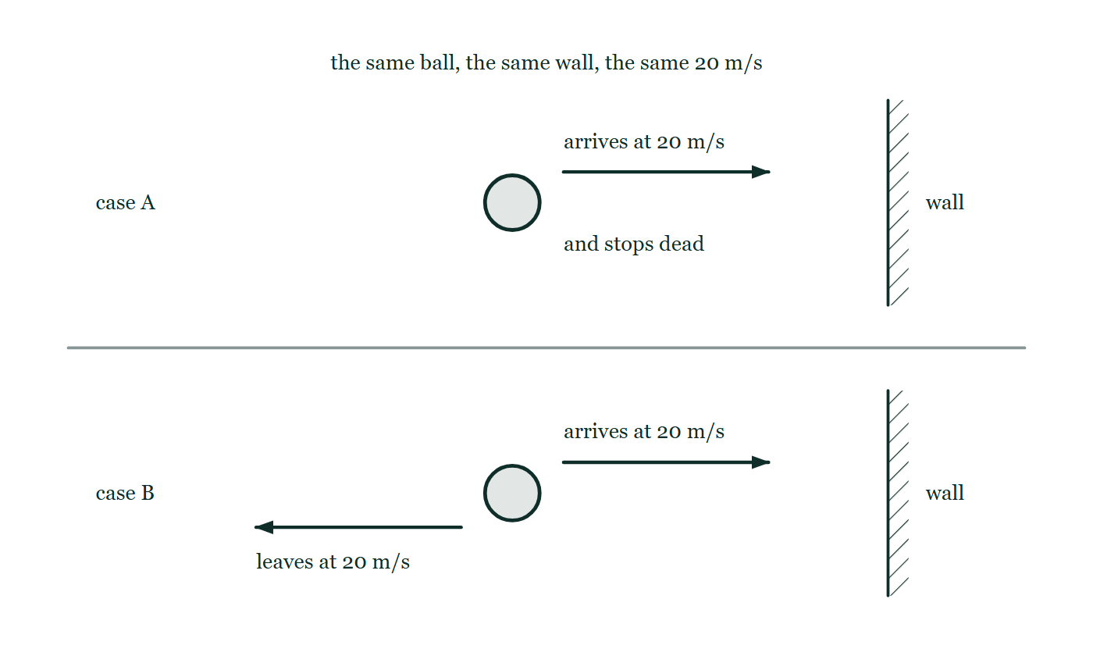
MOMENTUM · IMPULSE & FORCE–TIME GRAPHS
GIOPHYSICS LESSON
THE PICTURE
Stick, or bounce
Drawn for this lesson
The same ball meeting the same wall twice at 20 metres per second: in the upper case it stops dead against the wall, and in the lower it leaves in the opposite direction at the same speed.
The live version of this figure — click here
Momentum — Impulse & Force–Time Graphs. Built by GioPhysics from the lesson's own copy; nothing on these slides is re-authored.
10 / 29
Notes:
[Phase] Build the model: The formulae, one at a time, in plain English (minutes 13–22 of 45)
[Figure] The same ball meeting the same wall twice at 20 metres per second: in the upper case it stops dead against the wall, and in the lower it leaves in the opposite direction at the same speed.

Slide 11
MOMENTUM · IMPULSE & FORCE–TIME GRAPHS
GIOPHYSICS LESSON
WATCH OUT
The common trap
Check and misconception — The quick check and the trap
The graph's peak force is not automatically the average force. For a triangular pulse rising from zero, Favg is half the peak.
Momentum — Impulse & Force–Time Graphs. Built by GioPhysics from the lesson's own copy; nothing on these slides is re-authored.
11 / 29
Notes:
[Phase] Check and misconception: The quick check and the trap (minutes 35–41 of 45)
[Misconception] The graph's peak force is not automatically the average force. For a triangular pulse rising from zero, Favg is half the peak.

Slide 12
MOMENTUM · IMPULSE & FORCE–TIME GRAPHS
GIOPHYSICS LESSON
WORKED EXAMPLE 1 OF 2 · EASY
The question
Easy
Worked examples — I do, we do — one step revealed at a time
A 25 N force acts on a hockey puck for 0.40 s. What impulse does the puck receive?
Momentum — Impulse & Force–Time Graphs. Built by GioPhysics from the lesson's own copy; nothing on these slides is re-authored.
12 / 29
Notes:
[Phase] Worked examples: I do, we do — one step revealed at a time (minutes 22–35 of 45)
[Question] A 25 N force acts on a hockey puck for 0.40 s. What impulse does the puck receive?
[Answer] J = 10 N·s

Slide 13
MOMENTUM · IMPULSE & FORCE–TIME GRAPHS
GIOPHYSICS LESSON
WORKED EXAMPLE 1 OF 2 · EASY · THE WORKING
How to solve it
Easy
Worked examples — I do, we do — one step revealed at a time
A 25 N force acts on a hockey puck for 0.40 s. What impulse does the puck receive?
1.
J = FΔt = 25 × 0.40.
2.
J = 10 N·s in the force's direction.
Momentum — Impulse & Force–Time Graphs. Built by GioPhysics from the lesson's own copy; nothing on these slides is re-authored.
13 / 29
Notes:
[Phase] Worked examples: I do, we do — one step revealed at a time (minutes 22–35 of 45)
[Reveal] One click per step. The class works each line before the next appears.
[Step 1] J = FΔt = 25 × 0.40.
[Step 2] J = 10 N·s in the force's direction.

Slide 14
MOMENTUM · IMPULSE & FORCE–TIME GRAPHS
GIOPHYSICS LESSON
WORKED EXAMPLE 1 OF 2 · EASY
Answer
Easy
Worked examples — I do, we do — one step revealed at a time
J = 10 N·s
Momentum — Impulse & Force–Time Graphs. Built by GioPhysics from the lesson's own copy; nothing on these slides is re-authored.
14 / 29
Notes:
[Phase] Worked examples: I do, we do — one step revealed at a time (minutes 22–35 of 45)
[Answer] J = 10 N·s

Slide 15
MOMENTUM · IMPULSE & FORCE–TIME GRAPHS
GIOPHYSICS LESSON
WORKED EXAMPLE 2 OF 2 · MEDIUM
The question
Medium
Worked examples — I do, we do — one step revealed at a time
A 0.15 kg ball arrives at −20 m/s and rebounds at +30 m/s in 0.012 s. Find the impulse and average force.
Momentum — Impulse & Force–Time Graphs. Built by GioPhysics from the lesson's own copy; nothing on these slides is re-authored.
15 / 29
Notes:
[Phase] Worked examples: I do, we do — one step revealed at a time (minutes 22–35 of 45)
[Question] A 0.15 kg ball arrives at −20 m/s and rebounds at +30 m/s in 0.012 s. Find the impulse and average force.
[Answer] J = +7.5 N·s and Favg = +625 N

Slide 16
MOMENTUM · IMPULSE & FORCE–TIME GRAPHS
GIOPHYSICS LESSON
WORKED EXAMPLE 2 OF 2 · MEDIUM · THE WORKING
How to solve it
Medium
Worked examples — I do, we do — one step revealed at a time
A 0.15 kg ball arrives at −20 m/s and rebounds at +30 m/s in 0.012 s. Find the impulse and average force.
1.
Δp = m(v − u) = 0.15[30 − (−20)].
2.
J = Δp = +7.5 N·s.
3.
Favg = J/Δt = 7.5/0.012.
Momentum — Impulse & Force–Time Graphs. Built by GioPhysics from the lesson's own copy; nothing on these slides is re-authored.
16 / 29
Notes:
[Phase] Worked examples: I do, we do — one step revealed at a time (minutes 22–35 of 45)
[Reveal] One click per step. The class works each line before the next appears.
[Step 1] Δp = m(v − u) = 0.15[30 − (−20)].
[Step 2] J = Δp = +7.5 N·s.
[Step 3] Favg = J/Δt = 7.5/0.012.

Slide 17
MOMENTUM · IMPULSE & FORCE–TIME GRAPHS
GIOPHYSICS LESSON
WORKED EXAMPLE 2 OF 2 · MEDIUM
Answer
Medium
Worked examples — I do, we do — one step revealed at a time
J = +7.5 N·s and Favg = +625 N
Momentum — Impulse & Force–Time Graphs. Built by GioPhysics from the lesson's own copy; nothing on these slides is re-authored.
17 / 29
Notes:
[Phase] Worked examples: I do, we do — one step revealed at a time (minutes 22–35 of 45)
[Answer] J = +7.5 N·s and Favg = +625 N

Slide 18
MOMENTUM · IMPULSE & FORCE–TIME GRAPHS
GIOPHYSICS LESSON
SPOT THE MISTAKE
One line here is wrong
The whole working is up — find the bad line before you click
1.
A 0.15 kg ball arrives at a wall at 20 m/s and rebounds at 30 m/s. Find the impulse it receives.
2.
Taking the direction of the rebound as positive: u = 20 m/s, v = 30 m/s
3.
J = Δp = m(v − u)
4.
J = 0.15 × (30 − 20) = 1.5 N·s
5.
So the wall delivered an impulse of 1.5 N·s to the ball.
LINE 2 IS WRONG
The sign convention was declared and then not used. The ball arrives travelling the other way, so with the rebound taken as positive its initial velocity is −20 m/s, not +20. It is an easy line to lose because both numbers are printed as positive speeds in the question, and nothing in the arithmetic afterwards complains. The size of the answer is the tell: the ball was stopped and then thrown back, and 1.5 N·s is less than it took to stop it.
IT SHOULD SAY
Taking the direction of the rebound as positive: u = −20 m/s, v = +30 m/s, so J = 0.15 × (30 − (−20)) = 7.5 N·s
Momentum — Impulse & Force–Time Graphs. Built by GioPhysics from the lesson's own copy; nothing on these slides is re-authored.
18 / 29
Notes:
[Phase] Worked examples: I do, we do — one step revealed at a time (minutes 22–35 of 45)
[Spot the mistake] The working is complete and one line of it is wrong. Let the room hunt: one click names the line, a second shows it done correctly.
[Line 2 is wrong] The sign convention was declared and then not used. The ball arrives travelling the other way, so with the rebound taken as positive its initial velocity is −20 m/s, not +20. It is an easy line to lose because both numbers are printed as positive speeds in the question, and nothing in the arithmetic afterwards complains. The size of the answer is the tell: the ball was stopped and then thrown back, and 1.5 N·s is less than it took to stop it.
[It should say] Taking the direction of the rebound as positive: u = −20 m/s, v = +30 m/s, so J = 0.15 × (30 − (−20)) = 7.5 N·s

Slide 19
MOMENTUM · IMPULSE & FORCE–TIME GRAPHS
GIOPHYSICS LESSON
PREDICT · TAKE THE VOTE
Commit before you are told
Hands up for each option, then click
The same ball hits the same wall at 20 m/s. In A it sticks; in B it bounces back at 20 m/s. Which case delivers the bigger impulse to the wall?
A A — the ball has to be brought to a dead stop
B B — about twice as big
C The same in both: it arrives at the same speed either way
The same ball meeting the same wall twice at 20 metres per second: in the upper case it stops dead against the wall, and in the lower it leaves in the opposite direction at the same speed.
The live version of this figure — click here
Momentum — Impulse & Force–Time Graphs. Built by GioPhysics from the lesson's own copy; nothing on these slides is re-authored.
19 / 29
Notes:
[Phase] Build the model: The formulae, one at a time, in plain English (minutes 13–22 of 45)
[Predict] The same ball hits the same wall at 20 m/s. In A it sticks; in B it bounces back at 20 m/s. Which case delivers the bigger impulse to the wall?
[Options] A A — the ball has to be brought to a dead stop B B — about twice as big C The same in both: it arrives at the same speed either way
[Figure] The same ball meeting the same wall twice at 20 metres per second: in the upper case it stops dead against the wall, and in the lower it leaves in the opposite direction at the same speed.

Slide 20
MOMENTUM · IMPULSE & FORCE–TIME GRAPHS
GIOPHYSICS LESSON
PREDICT · THE OUTCOME
What actually happens
Ask the room who changed their mind, and why
B B — about twice as big
WHY
Impulse is the change in momentum, not the momentum you started with. Taking the rebound direction as positive: in A the ball goes from −20 to 0, so Δp = +20m. In B it goes from −20 to +20, so Δp = +40m — twice as much, because the wall had to stop it and then send it back. This is why a bouncy ball hurts more than a beanbag of the same mass and speed, and why hail damages a roof more than rain of the same mass.
Momentum — Impulse & Force–Time Graphs. Built by GioPhysics from the lesson's own copy; nothing on these slides is re-authored.
20 / 29
Notes:
[Phase] Build the model: The formulae, one at a time, in plain English (minutes 13–22 of 45)
[Answer] B — B — about twice as big. Impulse is the change in momentum, not the momentum you started with. Taking the rebound direction as positive: in A the ball goes from −20 to 0, so Δp = +20m. In B it goes from −20 to +20, so Δp = +40m — twice as much, because the wall had to stop it and then send it back. This is why a bouncy ball hurts more than a beanbag of the same mass and speed, and why hail damages a roof more than rain of the same mass.

Slide 21
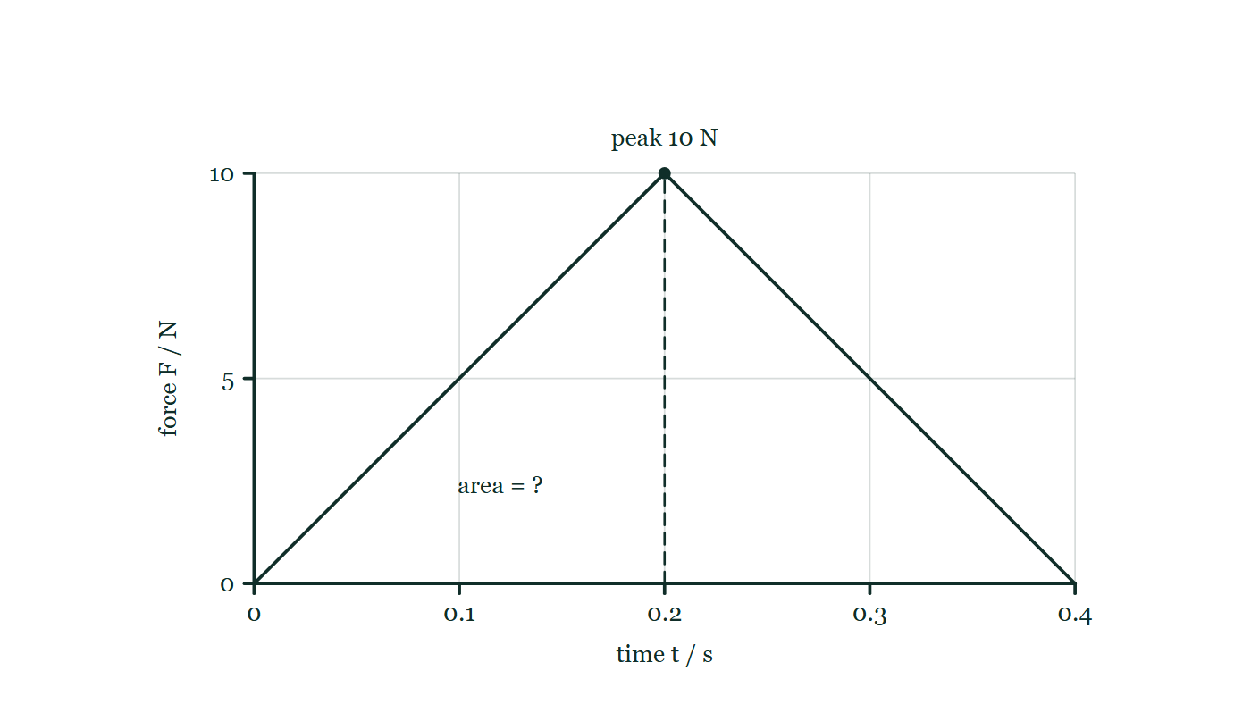
MOMENTUM · IMPULSE & FORCE–TIME GRAPHS
GIOPHYSICS LESSON
QUICK CHECK
Decide before the answer goes up
Check and misconception — The quick check and the trap
A triangular force pulse reaches 10 N and lasts 0.40 s. What impulse does it deliver?
A
2.0 N·s
B
4.0 N·s
C
10 N·s
A force–time graph rising in a straight line to a peak of 10 newtons at 0.20 seconds and falling back to zero at 0.40 seconds, the region under the line marked only as an unknown area.
The live version of this figure — click here
Momentum — Impulse & Force–Time Graphs. Built by GioPhysics from the lesson's own copy; nothing on these slides is re-authored.
21 / 29
Notes:
[Phase] Check and misconception: The quick check and the trap (minutes 35–41 of 45)
[Question] A triangular force pulse reaches 10 N and lasts 0.40 s. What impulse does it deliver?
[Figure] A force–time graph rising in a straight line to a peak of 10 newtons at 0.20 seconds and falling back to zero at 0.40 seconds, the region under the line marked only as an unknown area.
[Options] A 2.0 N·s B 4.0 N·s C 10 N·s

Slide 22
MOMENTUM · IMPULSE & FORCE–TIME GRAPHS
GIOPHYSICS LESSON
QUICK CHECK · THE ANSWER
The answer, and why
Check and misconception — The quick check and the trap
A 2.0 N·s
HOW TO GET THERE
Triangle area = 1/2 × base × height = 1/2(0.40)(10) = 2.0 N·s.
WHY THE OTHERS TEMPT
A Correct. The area of a triangle is ½ × base × height = ½ × 0.40 × 10 = 2.0 N·s. A pulse that rises and falls delivers half of what a steady peak-height force would.
B 4.0 N·s is 10 × 0.40 — the rectangle rather than the triangle, which is what you get by treating the peak force as if it acted for the whole 0.40 s. The force is only at 10 N for one instant.
C 10 N·s is the peak force with the time dropped out of the sum altogether. The units say so: newtons is a force, newton seconds is an impulse, and 10 N does not become 10 N·s by being written down.
Momentum — Impulse & Force–Time Graphs. Built by GioPhysics from the lesson's own copy; nothing on these slides is re-authored.
22 / 29
Notes:
[Phase] Check and misconception: The quick check and the trap (minutes 35–41 of 45)
[Question] A triangular force pulse reaches 10 N and lasts 0.40 s. What impulse does it deliver?
[Option by option] A: Correct. The area of a triangle is ½ × base × height = ½ × 0.40 × 10 = 2.0 N·s. A pulse that rises and falls delivers half of what a steady peak-height force would. B: 4.0 N·s is 10 × 0.40 — the rectangle rather than the triangle, which is what you get by treating the peak force as if it acted for the whole 0.40 s. The force is only at 10 N for one instant. C: 10 N·s is the peak force with the time dropped out of the sum altogether. The units say so: newtons is a force, newton seconds is an impulse, and 10 N does not become 10 N·s by being written down.
[Answer] A — 2.0 N·s
[Why] Triangle area = 1/2 × base × height = 1/2(0.40)(10) = 2.0 N·s.
[Reveal] One click for the answer, then one for the reason.

Slide 23
MOMENTUM · IMPULSE & FORCE–TIME GRAPHS
GIOPHYSICS LESSON
EXTENSION 1 OF 2 · HARD
The question
Hard
Worked examples — I do, we do — one step revealed at a time
An 850 kg car hits a barrier at 14 m/s and stops. Compare the average force with a rigid barrier (0.10 s stop) and a crash cushion (0.80 s stop).
Momentum — Impulse & Force–Time Graphs. Built by GioPhysics from the lesson's own copy; nothing on these slides is re-authored.
23 / 29
Notes:
[Phase] Worked examples: I do, we do — one step revealed at a time (minutes 22–35 of 45)
[Question] An 850 kg car hits a barrier at 14 m/s and stops. Compare the average force with a rigid barrier (0.10 s stop) and a crash cushion (0.80 s stop).
[Answer] ≈ 119 kN vs ≈ 15 kN — longer stopping time, smaller force

Slide 24
MOMENTUM · IMPULSE & FORCE–TIME GRAPHS
GIOPHYSICS LESSON
EXTENSION 1 OF 2 · HARD · THE WORKING
How to solve it
Hard
Worked examples — I do, we do — one step revealed at a time
An 850 kg car hits a barrier at 14 m/s and stops. Compare the average force with a rigid barrier (0.10 s stop) and a crash cushion (0.80 s stop).
1.
Impulse needed: Δp = 850 × 14 = 11900 kg·m/s in both cases.
2.
Rigid: F = 11900 ÷ 0.10 = 119 kN.
3.
Cushion: F = 11900 ÷ 0.80 ≈ 14.9 kN — an eight-fold reduction, same impulse.
Momentum — Impulse & Force–Time Graphs. Built by GioPhysics from the lesson's own copy; nothing on these slides is re-authored.
24 / 29
Notes:
[Phase] Worked examples: I do, we do — one step revealed at a time (minutes 22–35 of 45)
[Reveal] One click per step. The class works each line before the next appears.
[Step 1] Impulse needed: Δp = 850 × 14 = 11900 kg·m/s in both cases.
[Step 2] Rigid: F = 11900 ÷ 0.10 = 119 kN.
[Step 3] Cushion: F = 11900 ÷ 0.80 ≈ 14.9 kN — an eight-fold reduction, same impulse.

Slide 25
MOMENTUM · IMPULSE & FORCE–TIME GRAPHS
GIOPHYSICS LESSON
EXTENSION 1 OF 2 · HARD
Answer
Hard
Worked examples — I do, we do — one step revealed at a time
≈ 119 kN vs ≈ 15 kN — longer stopping time, smaller force
Momentum — Impulse & Force–Time Graphs. Built by GioPhysics from the lesson's own copy; nothing on these slides is re-authored.
25 / 29
Notes:
[Phase] Worked examples: I do, we do — one step revealed at a time (minutes 22–35 of 45)
[Answer] ≈ 119 kN vs ≈ 15 kN — longer stopping time, smaller force

Slide 26
MOMENTUM · IMPULSE & FORCE–TIME GRAPHS
GIOPHYSICS LESSON
EXTENSION 2 OF 2 · CHALLENGING
The question
Challenging
Worked examples — I do, we do — one step revealed at a time
A force–time graph rises linearly from 0 to 600 N in 0.030 s, then drops instantly to zero, acting on a 0.16 kg ball initially at rest. Find the launch speed.
Momentum — Impulse & Force–Time Graphs. Built by GioPhysics from the lesson's own copy; nothing on these slides is re-authored.
26 / 29
Notes:
[Phase] Worked examples: I do, we do — one step revealed at a time (minutes 22–35 of 45)
[Question] A force–time graph rises linearly from 0 to 600 N in 0.030 s, then drops instantly to zero, acting on a 0.16 kg ball initially at rest. Find the launch speed.
[Answer] v ≈ 56 m/s

Slide 27
MOMENTUM · IMPULSE & FORCE–TIME GRAPHS
GIOPHYSICS LESSON
EXTENSION 2 OF 2 · CHALLENGING · THE WORKING
How to solve it
Challenging
Worked examples — I do, we do — one step revealed at a time
A force–time graph rises linearly from 0 to 600 N in 0.030 s, then drops instantly to zero, acting on a 0.16 kg ball initially at rest. Find the launch speed.
1.
Impulse = area under F–t = ½ × 600 × 0.030 = 9.0 N·s.
2.
Δp = J → v = J/m.
3.
v = 9.0 ÷ 0.16 ≈ 56 m/s.
Momentum — Impulse & Force–Time Graphs. Built by GioPhysics from the lesson's own copy; nothing on these slides is re-authored.
27 / 29
Notes:
[Phase] Worked examples: I do, we do — one step revealed at a time (minutes 22–35 of 45)
[Reveal] One click per step. The class works each line before the next appears.
[Step 1] Impulse = area under F–t = ½ × 600 × 0.030 = 9.0 N·s.
[Step 2] Δp = J → v = J/m.
[Step 3] v = 9.0 ÷ 0.16 ≈ 56 m/s.

Slide 28
MOMENTUM · IMPULSE & FORCE–TIME GRAPHS
GIOPHYSICS LESSON
EXTENSION 2 OF 2 · CHALLENGING
Answer
Challenging
Worked examples — I do, we do — one step revealed at a time
v ≈ 56 m/s
Momentum — Impulse & Force–Time Graphs. Built by GioPhysics from the lesson's own copy; nothing on these slides is re-authored.
28 / 29
Notes:
[Phase] Worked examples: I do, we do — one step revealed at a time (minutes 22–35 of 45)
[Answer] v ≈ 56 m/s

Slide 29
MOMENTUM · IMPULSE & FORCE–TIME GRAPHS
GIOPHYSICS LESSON
MOMENTUM
Where to go next
Plenary — What to take away, what to practise next
Next
5.3 Conservation of Momentum
https://giophysics.com/chapter-9/conservation-of-momentum/
Lesson
This lesson on giophysics.com
https://giophysics.com/chapter-9/impulse-force-time-graphs/
Live
The live, interactive version of these slides
https://giophysics.com/chapter-9/presentation/?lesson=impulse
Chapter
All Momentum lessons
https://giophysics.com/chapter-9/
PDF
Download the lesson PDF
https://giophysics.com/downloads/9-2-impulse-force-time-graphs.pdf
Momentum — Impulse & Force–Time Graphs. Built by GioPhysics from the lesson's own copy; nothing on these slides is re-authored.
29 / 29
Notes:
[Phase] Plenary: What to take away, what to practise next (minutes 41–45 of 45)
[Interactive] The graphs and the circuit topology on these slides are frozen. The live version at https://giophysics.com/chapter-9/presentation/?lesson=impulse moves them.

