Slide 1
MOMENTUM · LINEAR MOMENTUM
GIOPHYSICS LESSON
05 · Momentum
Mass in motion
Linear Momentum
Momentum measures how much directed motion an object carries. Mass sets the scale; velocity sets both size and direction.
POSITION
Lesson 1 of 7 in Momentum
PLAN
16 slides in the 45-minute core run, about 44 minutes of it
LESSON PAGE
https://giophysics.com/chapter-9/linear-momentum/
Built by GioPhysics from the lesson's own page. Every word on these slides is the lesson's; nothing here is re-authored. Teaching material, not an awarding body's document.
Momentum — Linear Momentum. Built by GioPhysics from the lesson's own copy; nothing on these slides is re-authored.
1 / 28
Notes:
[Lesson] Momentum — Linear Momentum. Lesson 1 of 7.
[Intro] Momentum measures how much directed motion an object carries. Mass sets the scale; velocity sets both size and direction.
[Source] https://giophysics.com/chapter-9/linear-momentum/
[Disclaimer] Built by GioPhysics from the lesson's own page. Every word on these slides is the lesson's; nothing here is re-authored. Teaching material, not an awarding body's document.

Slide 2
MOMENTUM · LINEAR MOMENTUM
GIOPHYSICS LESSON
THINK FIRST
A tennis ball at 40 m/s and a bowling ball rolling at walking pace carry exactly the same momentum. Which would you rather catch?
Take answers before you click — the point is the commitment
60 g at 40 m/s is 2.4 kg·m/s. A 7.0 kg bowling ball creeping along at 0.34 m/s is 2.4 kg·m/s too. On paper they are the same thing.
THE ANSWER
The bowling ball, easily. Momentum is the same, and kinetic energy is not: 48 J against 0.41 J, a factor of about 117. Momentum goes as v and energy goes as v², so at low speed and high mass a body can be heavy with momentum and carry almost no energy at all. Two quantities, same picture, different physics — and this chapter is the one that keeps them apart.
Momentum — Linear Momentum. Built by GioPhysics from the lesson's own copy; nothing on these slides is re-authored.
2 / 28
Notes:
[Phase] Starter: Recall what this lesson stands on (minutes 0–5 of 45)
[Hook] A tennis ball at 40 m/s and a bowling ball rolling at walking pace carry exactly the same momentum. Which would you rather catch? 60 g at 40 m/s is 2.4 kg·m/s. A 7.0 kg bowling ball creeping along at 0.34 m/s is 2.4 kg·m/s too. On paper they are the same thing.
[Answer] The bowling ball, easily. Momentum is the same, and kinetic energy is not: 48 J against 0.41 J, a factor of about 117. Momentum goes as v and energy goes as v², so at low speed and high mass a body can be heavy with momentum and carry almost no energy at all. Two quantities, same picture, different physics — and this chapter is the one that keeps them apart.

Slide 3
MOMENTUM · LINEAR MOMENTUM
GIOPHYSICS LESSON
THE BIG IDEA
Mass in motion
Introduce the idea — The big idea and the definition
Linear momentum is a vector. Choose a positive direction first, attach a sign to velocity, and the momentum sign follows automatically. A complete answer includes magnitude, direction, and units.
Momentum — Linear Momentum. Built by GioPhysics from the lesson's own copy; nothing on these slides is re-authored.
3 / 28
Notes:
[Phase] Introduce the idea: The big idea and the definition (minutes 5–13 of 45)
[Big idea] Linear momentum is a vector. Choose a positive direction first, attach a sign to velocity, and the momentum sign follows automatically. A complete answer includes magnitude, direction, and units.

Slide 4
MOMENTUM · LINEAR MOMENTUM
GIOPHYSICS LESSON
THE PHYSICS · 1 OF 3
Direction matters
Build the model — The formulae, one at a time, in plain English
Equal speeds in opposite directions give equal momentum magnitudes but opposite momentum vectors.
Momentum — Linear Momentum. Built by GioPhysics from the lesson's own copy; nothing on these slides is re-authored.
4 / 28
Notes:
[Phase] Build the model: The formulae, one at a time, in plain English (minutes 13–22 of 45)
[Section] Equal speeds in opposite directions give equal momentum magnitudes but opposite momentum vectors.

Slide 5
MOMENTUM · LINEAR MOMENTUM
GIOPHYSICS LESSON
THE PHYSICS · 2 OF 3
Choose a frame
Build the model — The formulae, one at a time, in plain English
Velocity—and therefore momentum—depends on the observer's reference frame. State the frame when it matters.
Momentum — Linear Momentum. Built by GioPhysics from the lesson's own copy; nothing on these slides is re-authored.
5 / 28
Notes:
[Phase] Build the model: The formulae, one at a time, in plain English (minutes 13–22 of 45)
[Section] Velocity—and therefore momentum—depends on the observer's reference frame. State the frame when it matters.

Slide 6
MOMENTUM · LINEAR MOMENTUM
GIOPHYSICS LESSON
THE PHYSICS · 3 OF 3
Add vectors
Build the model — The formulae, one at a time, in plain English
System momentum is the vector sum of every object's momentum, not the sum of their magnitudes.
Momentum — Linear Momentum. Built by GioPhysics from the lesson's own copy; nothing on these slides is re-authored.
6 / 28
Notes:
[Phase] Build the model: The formulae, one at a time, in plain English (minutes 13–22 of 45)
[Section] System momentum is the vector sum of every object's momentum, not the sum of their magnitudes.

Slide 7
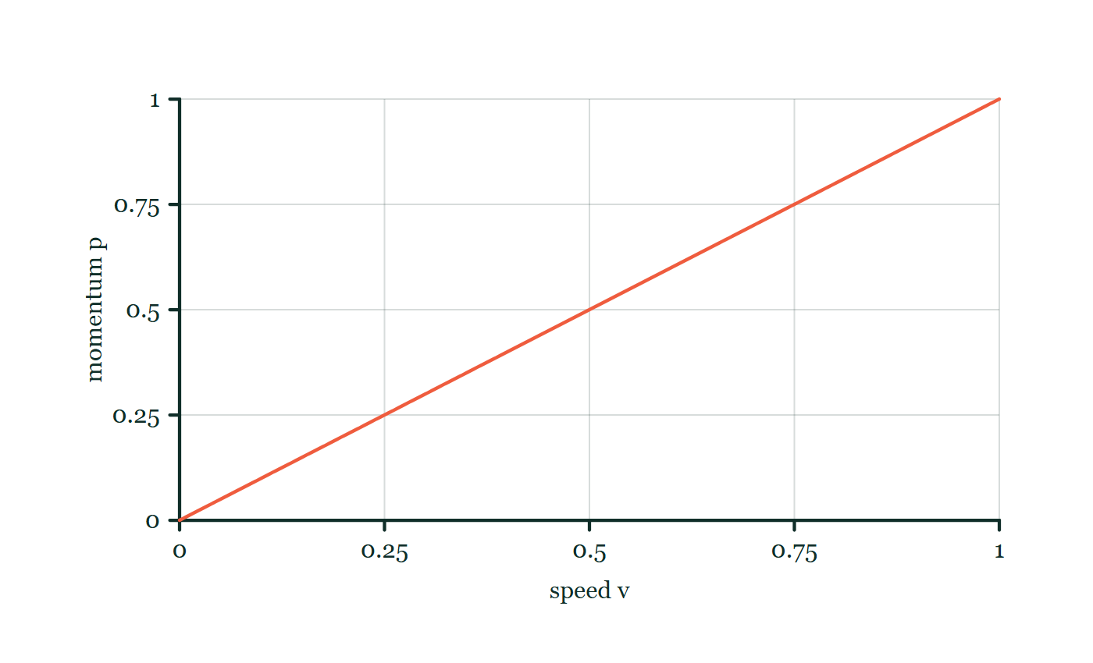
MOMENTUM · LINEAR MOMENTUM
GIOPHYSICS LESSON
FORMULA 1 OF 3
Classical momentum
Build the model — The formulae, one at a time, in plain English
p = mv
Mass in kg, velocity in m/s
IN PLAIN ENGLISH
Momentum is mass times velocity — how much 'moving matter' there is, and in which direction.
Momentum–speed explorer
Move this graph on the live version — click here
Momentum — Linear Momentum. Built by GioPhysics from the lesson's own copy; nothing on these slides is re-authored.
7 / 28
Notes:
[Phase] Build the model: The formulae, one at a time, in plain English (minutes 13–22 of 45)
[Formula] Classical momentum: p = mv
[In plain English] Momentum is mass times velocity — how much 'moving matter' there is, and in which direction.
[Note] Mass in kg, velocity in m/s
[Graph] Momentum–speed explorer. For a fixed mass, momentum rises in direct proportion to speed.
[Axes] Horizontal: speed v. Vertical: momentum p. Values are normalised — the graph teaches the shape, not a measurement.

Slide 8
MOMENTUM · LINEAR MOMENTUM
GIOPHYSICS LESSON
FORMULA 2 OF 3
Fixed-mass change
Build the model — The formulae, one at a time, in plain English
Δp = m(v − u)
Final momentum minus initial momentum
IN PLAIN ENGLISH
How much the momentum changed: mass times the difference between final speed (v) and starting speed (u).
Momentum — Linear Momentum. Built by GioPhysics from the lesson's own copy; nothing on these slides is re-authored.
8 / 28
Notes:
[Phase] Build the model: The formulae, one at a time, in plain English (minutes 13–22 of 45)
[Formula] Fixed-mass change: Δp = m(v − u)
[In plain English] How much the momentum changed: mass times the difference between final speed (v) and starting speed (u).
[Note] Final momentum minus initial momentum

Slide 9
MOMENTUM · LINEAR MOMENTUM
GIOPHYSICS LESSON
FORMULA 3 OF 3
Equivalent unit
Build the model — The formulae, one at a time, in plain English
1 kg·m/s = 1 N·s
Momentum and impulse share equivalent units
IN PLAIN ENGLISH
Momentum's unit equals force × time — a hint that forces acting over time are what change momentum.
Momentum — Linear Momentum. Built by GioPhysics from the lesson's own copy; nothing on these slides is re-authored.
9 / 28
Notes:
[Phase] Build the model: The formulae, one at a time, in plain English (minutes 13–22 of 45)
[Formula] Equivalent unit: 1 kg·m/s = 1 N·s
[In plain English] Momentum's unit equals force × time — a hint that forces acting over time are what change momentum.
[Note] Momentum and impulse share equivalent units

Slide 10
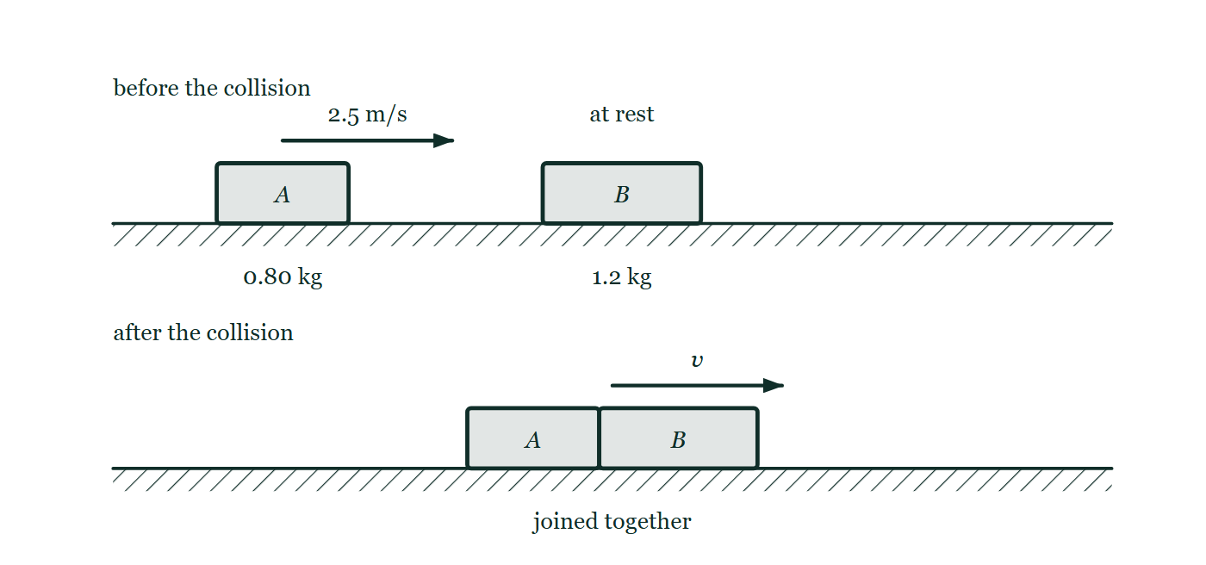
MOMENTUM · LINEAR MOMENTUM
GIOPHYSICS LESSON
FIGURE
Fig. 8.1 — IGCSE Topic 1 · Motion, forces and energy
Drawn for question 8 of that paper · syllabus 1.6, 1.7.1
Two panels, one above the other. In the upper panel, labelled before the collision, trolley A of mass 0.80 kg stands on a level track with an arrow showing it moving to the right at 2.5 m/s towards trolley B of mass 1.2 kg, which is at rest. In the lower panel, labelled after the collision, the two trolleys are drawn joined together and moving to the right with a speed marked v.
See the question this was drawn for — click here
Momentum — Linear Momentum. Built by GioPhysics from the lesson's own copy; nothing on these slides is re-authored.
10 / 28
Notes:
[Phase] Build the model: The formulae, one at a time, in plain English (minutes 13–22 of 45)
[Figure] Fig. 8.1. Two panels, one above the other. In the upper panel, labelled before the collision, trolley A of mass 0.80 kg stands on a level track with an arrow showing it moving to the right at 2.5 m/s towards trolley B of mass 1.2 kg, which is at rest. In the lower panel, labelled after the collision, the two trolleys are drawn joined together and moving to the right with a speed marked v.
[Where it came from] IGCSE Topic 1 · Motion, forces and energy, question 8; syllabus 1.6, 1.7.1.

Slide 11
MOMENTUM · LINEAR MOMENTUM
GIOPHYSICS LESSON
WATCH OUT
The common trap
Check and misconception — The quick check and the trap
Momentum is not the same as kinetic energy. Momentum is a signed vector proportional to v; kinetic energy is a non-negative scalar proportional to v².
Momentum — Linear Momentum. Built by GioPhysics from the lesson's own copy; nothing on these slides is re-authored.
11 / 28
Notes:
[Phase] Check and misconception: The quick check and the trap (minutes 35–41 of 45)
[Misconception] Momentum is not the same as kinetic energy. Momentum is a signed vector proportional to v; kinetic energy is a non-negative scalar proportional to v².

Slide 12
MOMENTUM · LINEAR MOMENTUM
GIOPHYSICS LESSON
WORKED EXAMPLE 1 OF 2 · EASY
The question
Easy
Worked examples — I do, we do — one step revealed at a time
Find the momentum of a 1500 kg car travelling at 20 m/s.
Momentum — Linear Momentum. Built by GioPhysics from the lesson's own copy; nothing on these slides is re-authored.
12 / 28
Notes:
[Phase] Worked examples: I do, we do — one step revealed at a time (minutes 22–35 of 45)
[Question] Find the momentum of a 1500 kg car travelling at 20 m/s.
[Answer] p = 3.0 × 10⁴ kg·m/s

Slide 13
MOMENTUM · LINEAR MOMENTUM
GIOPHYSICS LESSON
WORKED EXAMPLE 1 OF 2 · EASY · THE WORKING
How to solve it
Easy
Worked examples — I do, we do — one step revealed at a time
Find the momentum of a 1500 kg car travelling at 20 m/s.
1.
p = mv = 1500 × 20.
2.
p = 3.0 × 10⁴ kg·m/s in the direction of motion.
Momentum — Linear Momentum. Built by GioPhysics from the lesson's own copy; nothing on these slides is re-authored.
13 / 28
Notes:
[Phase] Worked examples: I do, we do — one step revealed at a time (minutes 22–35 of 45)
[Reveal] One click per step. The class works each line before the next appears.
[Step 1] p = mv = 1500 × 20.
[Step 2] p = 3.0 × 10⁴ kg·m/s in the direction of motion.

Slide 14
MOMENTUM · LINEAR MOMENTUM
GIOPHYSICS LESSON
WORKED EXAMPLE 1 OF 2 · EASY
Answer
Easy
Worked examples — I do, we do — one step revealed at a time
p = 3.0 × 10⁴ kg·m/s
Momentum — Linear Momentum. Built by GioPhysics from the lesson's own copy; nothing on these slides is re-authored.
14 / 28
Notes:
[Phase] Worked examples: I do, we do — one step revealed at a time (minutes 22–35 of 45)
[Answer] p = 3.0 × 10⁴ kg·m/s

Slide 15
MOMENTUM · LINEAR MOMENTUM
GIOPHYSICS LESSON
WORKED EXAMPLE 2 OF 2 · MEDIUM
The question
Medium
Worked examples — I do, we do — one step revealed at a time
A 0.20 kg ball changes velocity from +12 m/s to −8.0 m/s. Find its change in momentum.
Momentum — Linear Momentum. Built by GioPhysics from the lesson's own copy; nothing on these slides is re-authored.
15 / 28
Notes:
[Phase] Worked examples: I do, we do — one step revealed at a time (minutes 22–35 of 45)
[Question] A 0.20 kg ball changes velocity from +12 m/s to −8.0 m/s. Find its change in momentum.
[Answer] Δp = −4.0 kg·m/s, or 4.0 kg·m/s opposite the original motion

Slide 16
MOMENTUM · LINEAR MOMENTUM
GIOPHYSICS LESSON
WORKED EXAMPLE 2 OF 2 · MEDIUM · THE WORKING
How to solve it
Medium
Worked examples — I do, we do — one step revealed at a time
A 0.20 kg ball changes velocity from +12 m/s to −8.0 m/s. Find its change in momentum.
1.
Choose the original direction as positive.
2.
pi = (0.20)(+12) = +2.4 kg·m/s and pf = (0.20)(−8.0) = −1.6 kg·m/s.
3.
Δp = pf − pi = −1.6 − 2.4.
Momentum — Linear Momentum. Built by GioPhysics from the lesson's own copy; nothing on these slides is re-authored.
16 / 28
Notes:
[Phase] Worked examples: I do, we do — one step revealed at a time (minutes 22–35 of 45)
[Reveal] One click per step. The class works each line before the next appears.
[Step 1] Choose the original direction as positive.
[Step 2] pi = (0.20)(+12) = +2.4 kg·m/s and pf = (0.20)(−8.0) = −1.6 kg·m/s.
[Step 3] Δp = pf − pi = −1.6 − 2.4.

Slide 17
MOMENTUM · LINEAR MOMENTUM
GIOPHYSICS LESSON
WORKED EXAMPLE 2 OF 2 · MEDIUM
Answer
Medium
Worked examples — I do, we do — one step revealed at a time
Δp = −4.0 kg·m/s, or 4.0 kg·m/s opposite the original motion
Momentum — Linear Momentum. Built by GioPhysics from the lesson's own copy; nothing on these slides is re-authored.
17 / 28
Notes:
[Phase] Worked examples: I do, we do — one step revealed at a time (minutes 22–35 of 45)
[Answer] Δp = −4.0 kg·m/s, or 4.0 kg·m/s opposite the original motion

Slide 18
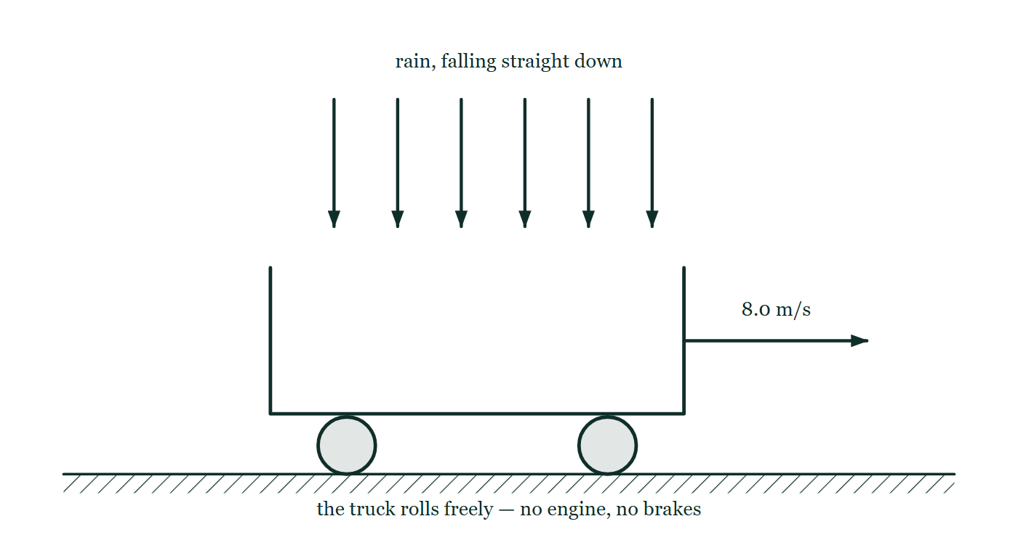
MOMENTUM · LINEAR MOMENTUM
GIOPHYSICS LESSON
PREDICT · TAKE THE VOTE
Commit before you are told
Hands up for each option, then click
Rain falls straight down into the open truck as it rolls freely along at 8.0 m/s. After it has collected 200 kg of water, how fast is the 800 kg truck going?
A Still 8.0 m/s — the rain falls vertically, so it brings no forward momentum with it
B 6.4 m/s
C Faster, since there is now more mass moving along the road
An open-topped truck rolling freely to the right at 8.0 metres per second with six vertical arrows of rain falling into its tray, none of them tilted and nothing driving the truck.
The live version of this figure — click here
Momentum — Linear Momentum. Built by GioPhysics from the lesson's own copy; nothing on these slides is re-authored.
18 / 28
Notes:
[Phase] Build the model: The formulae, one at a time, in plain English (minutes 13–22 of 45)
[Predict] Rain falls straight down into the open truck as it rolls freely along at 8.0 m/s. After it has collected 200 kg of water, how fast is the 800 kg truck going?
[Options] A Still 8.0 m/s — the rain falls vertically, so it brings no forward momentum with it B 6.4 m/s C Faster, since there is now more mass moving along the road
[Figure] An open-topped truck rolling freely to the right at 8.0 metres per second with six vertical arrows of rain falling into its tray, none of them tilted and nothing driving the truck.

Slide 19
MOMENTUM · LINEAR MOMENTUM
GIOPHYSICS LESSON
PREDICT · THE OUTCOME
What actually happens
Ask the room who changed their mind, and why
B 6.4 m/s
WHY
The rain does bring no forward momentum, and that is exactly why the truck slows. Horizontally there is nothing pushing or dragging, so the total forward momentum is fixed at 800 × 8.0 = 6400 kg·m/s — and that same total is now shared among 1000 kg: v = 6.4 m/s. Nothing was taken from the truck; the same momentum was simply spread over more mass. The kinetic energy is not conserved and does not need to be: it goes into the splashes.
Momentum — Linear Momentum. Built by GioPhysics from the lesson's own copy; nothing on these slides is re-authored.
19 / 28
Notes:
[Phase] Build the model: The formulae, one at a time, in plain English (minutes 13–22 of 45)
[Answer] B — 6.4 m/s. The rain does bring no forward momentum, and that is exactly why the truck slows. Horizontally there is nothing pushing or dragging, so the total forward momentum is fixed at 800 × 8.0 = 6400 kg·m/s — and that same total is now shared among 1000 kg: v = 6.4 m/s. Nothing was taken from the truck; the same momentum was simply spread over more mass. The kinetic energy is not conserved and does not need to be: it goes into the splashes.

Slide 20
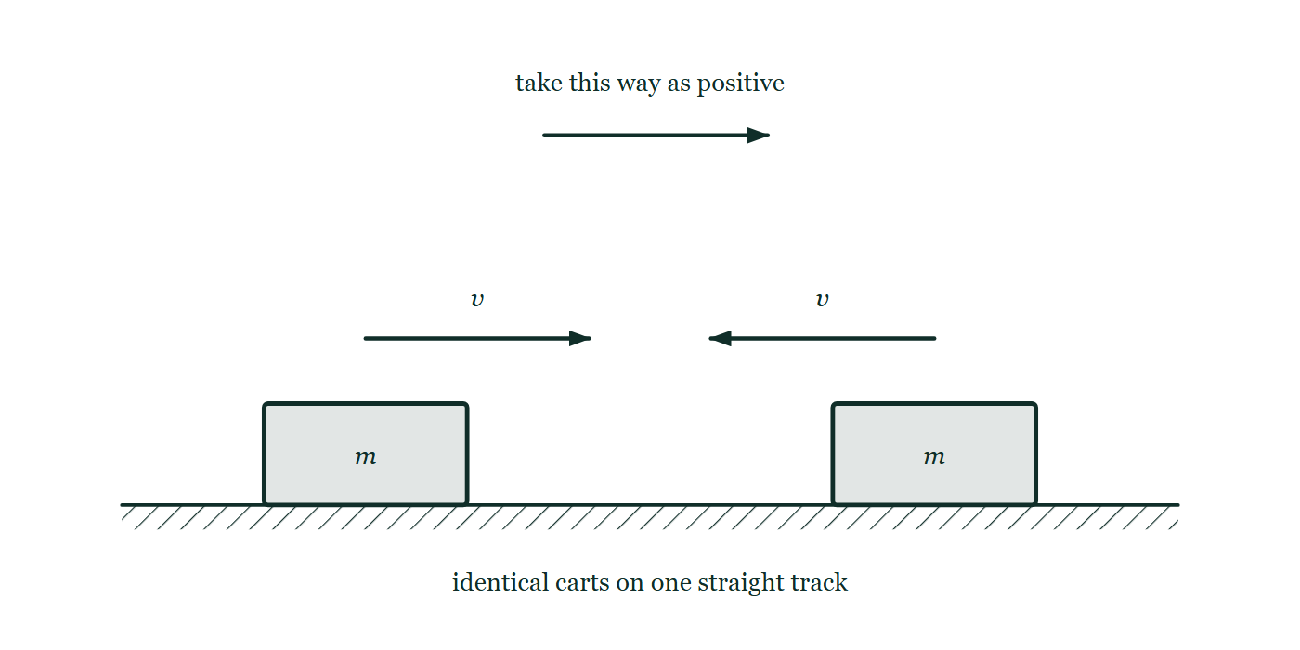
MOMENTUM · LINEAR MOMENTUM
GIOPHYSICS LESSON
QUICK CHECK
Decide before the answer goes up
Check and misconception — The quick check and the trap
Two identical carts move at equal speeds in opposite directions. How do their momenta compare?
A
They have the same momentum
B
They have equal magnitudes but opposite directions
C
Both momenta are zero
Two identical carts on one straight track with velocity arrows of exactly the same length pointing towards each other, and a separate arrow above declaring which direction is being taken as positive.
The live version of this figure — click here
Momentum — Linear Momentum. Built by GioPhysics from the lesson's own copy; nothing on these slides is re-authored.
20 / 28
Notes:
[Phase] Check and misconception: The quick check and the trap (minutes 35–41 of 45)
[Question] Two identical carts move at equal speeds in opposite directions. How do their momenta compare?
[Figure] Two identical carts on one straight track with velocity arrows of exactly the same length pointing towards each other, and a separate arrow above declaring which direction is being taken as positive.
[Options] A They have the same momentum B They have equal magnitudes but opposite directions C Both momenta are zero

Slide 21
MOMENTUM · LINEAR MOMENTUM
GIOPHYSICS LESSON
QUICK CHECK · THE ANSWER
The answer, and why
Check and misconception — The quick check and the trap
B They have equal magnitudes but opposite directions
HOW TO GET THERE
The masses and speeds match, but the velocity vectors point in opposite directions.
WHY THE OTHERS TEMPT
A The masses match and the speeds match, so two of the three things that make up a momentum are identical here — which is why this is the natural answer. The third is direction, and momentum is a vector: reverse the direction and it is a different momentum, even though nothing about the number changed.
B Correct. Same magnitude, opposite sign. Take rightward as positive and one cart has +mv while the other has −mv, so the pair's total is zero even though neither cart is anywhere near stationary.
C Their total is zero, and that is probably what this is remembering. Each cart on its own carries mv of momentum and would flatten anything it hit — the cancelling only happens when you add the two together as vectors.
Momentum — Linear Momentum. Built by GioPhysics from the lesson's own copy; nothing on these slides is re-authored.
21 / 28
Notes:
[Phase] Check and misconception: The quick check and the trap (minutes 35–41 of 45)
[Question] Two identical carts move at equal speeds in opposite directions. How do their momenta compare?
[Option by option] A: The masses match and the speeds match, so two of the three things that make up a momentum are identical here — which is why this is the natural answer. The third is direction, and momentum is a vector: reverse the direction and it is a different momentum, even though nothing about the number changed. B: Correct. Same magnitude, opposite sign. Take rightward as positive and one cart has +mv while the other has −mv, so the pair's total is zero even though neither cart is anywhere near stationary. C: Their total is zero, and that is probably what this is remembering. Each cart on its own carries mv of momentum and would flatten anything it hit — the cancelling only happens when you add the two together as vectors.
[Answer] B — They have equal magnitudes but opposite directions
[Why] The masses and speeds match, but the velocity vectors point in opposite directions.
[Reveal] One click for the answer, then one for the reason.

Slide 22
MOMENTUM · LINEAR MOMENTUM
GIOPHYSICS LESSON
EXTENSION 1 OF 2 · HARD
The question
Hard
Worked examples — I do, we do — one step revealed at a time
A 60 g tennis ball at 40 m/s and a 7.0 kg bowling ball share the same momentum. Find the bowling ball's speed and compare their kinetic energies.
Momentum — Linear Momentum. Built by GioPhysics from the lesson's own copy; nothing on these slides is re-authored.
22 / 28
Notes:
[Phase] Worked examples: I do, we do — one step revealed at a time (minutes 22–35 of 45)
[Question] A 60 g tennis ball at 40 m/s and a 7.0 kg bowling ball share the same momentum. Find the bowling ball's speed and compare their kinetic energies.
[Answer] v ≈ 0.34 m/s; the tennis ball carries ~117× the kinetic energy

Slide 23
MOMENTUM · LINEAR MOMENTUM
GIOPHYSICS LESSON
EXTENSION 1 OF 2 · HARD · THE WORKING
How to solve it
Hard
Worked examples — I do, we do — one step revealed at a time
A 60 g tennis ball at 40 m/s and a 7.0 kg bowling ball share the same momentum. Find the bowling ball's speed and compare their kinetic energies.
1.
p = 0.060 × 40 = 2.4 kg·m/s, so v = 2.4 ÷ 7.0 ≈ 0.343 m/s.
2.
K(tennis) = ½ × 0.060 × 1600 = 48 J.
3.
K(bowling) = ½ × 7.0 × 0.1176 ≈ 0.41 J — same momentum, wildly different energies.
Momentum — Linear Momentum. Built by GioPhysics from the lesson's own copy; nothing on these slides is re-authored.
23 / 28
Notes:
[Phase] Worked examples: I do, we do — one step revealed at a time (minutes 22–35 of 45)
[Reveal] One click per step. The class works each line before the next appears.
[Step 1] p = 0.060 × 40 = 2.4 kg·m/s, so v = 2.4 ÷ 7.0 ≈ 0.343 m/s.
[Step 2] K(tennis) = ½ × 0.060 × 1600 = 48 J.
[Step 3] K(bowling) = ½ × 7.0 × 0.1176 ≈ 0.41 J — same momentum, wildly different energies.

Slide 24
MOMENTUM · LINEAR MOMENTUM
GIOPHYSICS LESSON
EXTENSION 1 OF 2 · HARD
Answer
Hard
Worked examples — I do, we do — one step revealed at a time
v ≈ 0.34 m/s; the tennis ball carries ~117× the kinetic energy
Momentum — Linear Momentum. Built by GioPhysics from the lesson's own copy; nothing on these slides is re-authored.
24 / 28
Notes:
[Phase] Worked examples: I do, we do — one step revealed at a time (minutes 22–35 of 45)
[Answer] v ≈ 0.34 m/s; the tennis ball carries ~117× the kinetic energy

Slide 25
MOMENTUM · LINEAR MOMENTUM
GIOPHYSICS LESSON
EXTENSION 2 OF 2 · CHALLENGING
The question
Challenging
Worked examples — I do, we do — one step revealed at a time
Rain falls vertically into an open truck rolling freely at 8.0 m/s. After collecting 200 kg of water, the 800 kg truck's speed has changed. Find it, and explain what happened to the 'lost' motion.
Momentum — Linear Momentum. Built by GioPhysics from the lesson's own copy; nothing on these slides is re-authored.
25 / 28
Notes:
[Phase] Worked examples: I do, we do — one step revealed at a time (minutes 22–35 of 45)
[Question] Rain falls vertically into an open truck rolling freely at 8.0 m/s. After collecting 200 kg of water, the 800 kg truck's speed has changed. Find it, and explain what happened to the 'lost' motion.
[Answer] v = 6.4 m/s — momentum conserved, kinetic energy not

Slide 26
MOMENTUM · LINEAR MOMENTUM
GIOPHYSICS LESSON
EXTENSION 2 OF 2 · CHALLENGING · THE WORKING
How to solve it
Challenging
Worked examples — I do, we do — one step revealed at a time
Rain falls vertically into an open truck rolling freely at 8.0 m/s. After collecting 200 kg of water, the 800 kg truck's speed has changed. Find it, and explain what happened to the 'lost' motion.
1.
Horizontal momentum is conserved: 800 × 8.0 = (800 + 200) × v.
2.
v = 6400 ÷ 1000 = 6.4 m/s.
3.
The rain had no horizontal momentum; sharing the same total among more mass slows the truck, and the accompanying kinetic-energy drop becomes heat in the splashes.
Momentum — Linear Momentum. Built by GioPhysics from the lesson's own copy; nothing on these slides is re-authored.
26 / 28
Notes:
[Phase] Worked examples: I do, we do — one step revealed at a time (minutes 22–35 of 45)
[Reveal] One click per step. The class works each line before the next appears.
[Step 1] Horizontal momentum is conserved: 800 × 8.0 = (800 + 200) × v.
[Step 2] v = 6400 ÷ 1000 = 6.4 m/s.
[Step 3] The rain had no horizontal momentum; sharing the same total among more mass slows the truck, and the accompanying kinetic-energy drop becomes heat in the splashes.

Slide 27
MOMENTUM · LINEAR MOMENTUM
GIOPHYSICS LESSON
EXTENSION 2 OF 2 · CHALLENGING
Answer
Challenging
Worked examples — I do, we do — one step revealed at a time
v = 6.4 m/s — momentum conserved, kinetic energy not
Momentum — Linear Momentum. Built by GioPhysics from the lesson's own copy; nothing on these slides is re-authored.
27 / 28
Notes:
[Phase] Worked examples: I do, we do — one step revealed at a time (minutes 22–35 of 45)
[Answer] v = 6.4 m/s — momentum conserved, kinetic energy not

Slide 28
MOMENTUM · LINEAR MOMENTUM
GIOPHYSICS LESSON
MOMENTUM
Where to go next
Plenary — What to take away, what to practise next
Next
5.2 Impulse & Force–Time Graphs
https://giophysics.com/chapter-9/impulse-force-time-graphs/
Lesson
This lesson on giophysics.com
https://giophysics.com/chapter-9/linear-momentum/
Live
The live, interactive version of these slides
https://giophysics.com/chapter-9/presentation/?lesson=linear
Chapter
All Momentum lessons
https://giophysics.com/chapter-9/
PDF
Download the lesson PDF
https://giophysics.com/downloads/9-1-linear-momentum.pdf
Momentum — Linear Momentum. Built by GioPhysics from the lesson's own copy; nothing on these slides is re-authored.
28 / 28
Notes:
[Phase] Plenary: What to take away, what to practise next (minutes 41–45 of 45)
[Interactive] The graphs and the circuit topology on these slides are frozen. The live version at https://giophysics.com/chapter-9/presentation/?lesson=linear moves them.

