Slide 1
MOMENTUM · NON-LINEAR MOMENTUM — TWO-DIMENSIONAL & NON-COLLINEAR COLLISIONS
GIOPHYSICS LESSON
05 · Momentum
Non-collinear vector momentum
Non-Linear Momentum — Two-Dimensional & Non-Collinear Collisions
When paths are not on one line, one conservation equation becomes two independent component equations.
POSITION
Lesson 5 of 7 in Momentum
PLAN
16 slides in the 45-minute core run, about 44 minutes of it
LESSON PAGE
https://giophysics.com/chapter-9/non-linear-momentum/
Built by GioPhysics from the lesson's own page. Every word on these slides is the lesson's; nothing here is re-authored. Teaching material, not an awarding body's document.
Momentum — Non-Linear Momentum — Two-Dimensional & Non-Collinear Collisions. Built by GioPhysics from the lesson's own copy; nothing on these slides is re-authored.
1 / 28
Notes:
[Lesson] Momentum — Non-Linear Momentum — Two-Dimensional & Non-Collinear Collisions. Lesson 5 of 7.
[Intro] When paths are not on one line, one conservation equation becomes two independent component equations.
[Source] https://giophysics.com/chapter-9/non-linear-momentum/
[Disclaimer] Built by GioPhysics from the lesson's own page. Every word on these slides is the lesson's; nothing here is re-authored. Teaching material, not an awarding body's document.

Slide 2
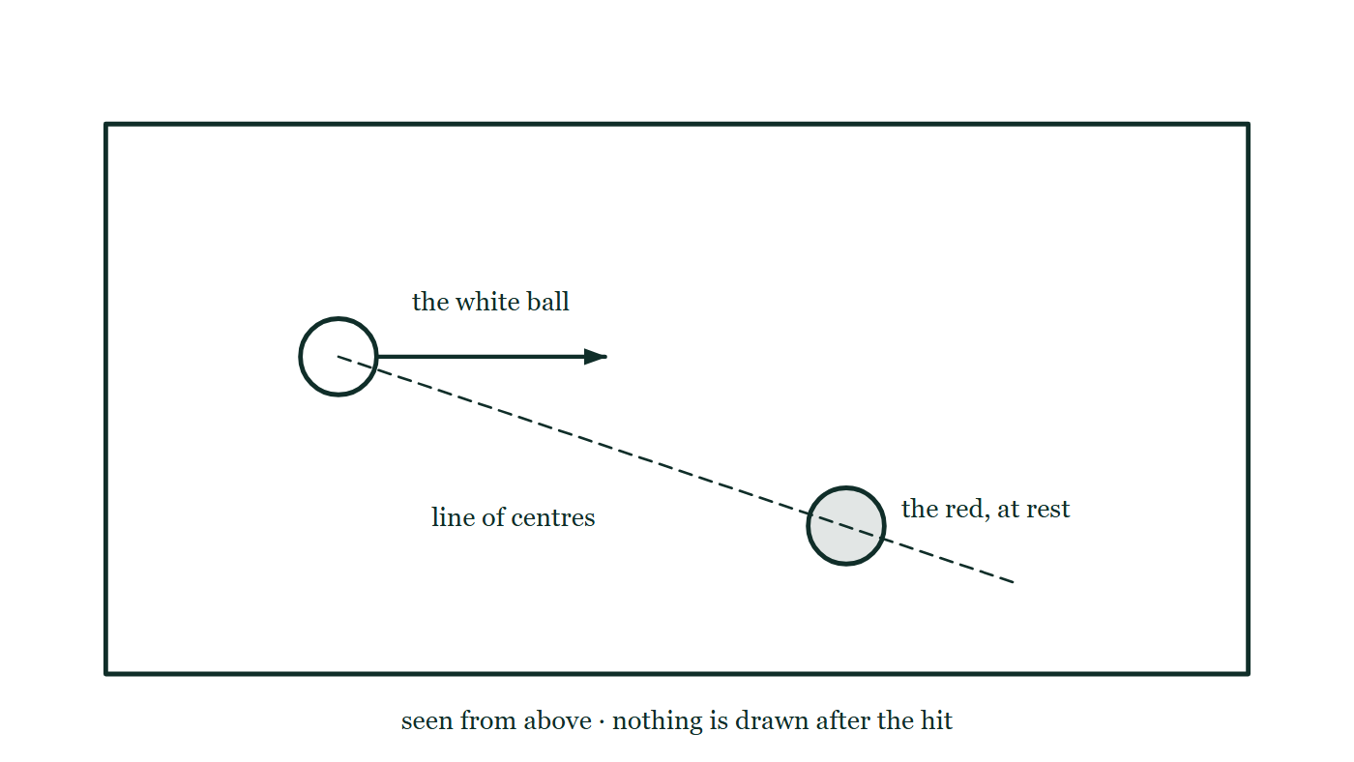
MOMENTUM · NON-LINEAR MOMENTUM — TWO-DIMENSIONAL & NON-COLLINEAR COLLISIONS
GIOPHYSICS LESSON
THINK FIRST
A cue ball hits a stationary ball off-centre. The two roll away at almost exactly 90° to each other. Coincidence?
Take answers before you click — the point is the commitment
It happens on every shot, at every angle, with any pair of balls on the table. Snooker players rely on it without ever having been told why.
THE ANSWER
Not a coincidence — a proof. For two equal masses colliding elastically with one at rest, momentum requires u = v₁ + v₂ and energy requires u² = v₁² + v₂². Put the first into the second and the cross term 2v₁·v₂ must vanish, which for two non-zero velocities means they are perpendicular. The right angle is the collision being elastic, made visible. Where it is not quite 90°, the collision was not quite elastic.
A snooker table seen from above with the white ball travelling right along a marked line and the red at rest a little below it, the line joining their centres dashed and no path drawn after the hit.
The live version of this figure — click here
Momentum — Non-Linear Momentum — Two-Dimensional & Non-Collinear Collisions. Built by GioPhysics from the lesson's own copy; nothing on these slides is re-authored.
2 / 28
Notes:
[Phase] Starter: Recall what this lesson stands on (minutes 0–5 of 45)
[Hook] A cue ball hits a stationary ball off-centre. The two roll away at almost exactly 90° to each other. Coincidence? It happens on every shot, at every angle, with any pair of balls on the table. Snooker players rely on it without ever having been told why.
[Answer] Not a coincidence — a proof. For two equal masses colliding elastically with one at rest, momentum requires u = v₁ + v₂ and energy requires u² = v₁² + v₂². Put the first into the second and the cross term 2v₁·v₂ must vanish, which for two non-zero velocities means they are perpendicular. The right angle is the collision being elastic, made visible. Where it is not quite 90°, the collision was not quite elastic.
[Figure] A snooker table seen from above with the white ball travelling right along a marked line and the red at rest a little below it, the line joining their centres dashed and no path drawn after the hit.

Slide 3
MOMENTUM · NON-LINEAR MOMENTUM — TWO-DIMENSIONAL & NON-COLLINEAR COLLISIONS
GIOPHYSICS LESSON
THE BIG IDEA
Non-collinear vector momentum
Introduce the idea — The big idea and the definition
In standard physics language this is two-dimensional or non-collinear momentum. The classical rule p = mv remains linear at fixed mass; the challenge is balancing x and y components separately.
Momentum — Non-Linear Momentum — Two-Dimensional & Non-Collinear Collisions. Built by GioPhysics from the lesson's own copy; nothing on these slides is re-authored.
3 / 28
Notes:
[Phase] Introduce the idea: The big idea and the definition (minutes 5–13 of 45)
[Big idea] In standard physics language this is two-dimensional or non-collinear momentum. The classical rule p = mv remains linear at fixed mass; the challenge is balancing x and y components separately.

Slide 4
MOMENTUM · NON-LINEAR MOMENTUM — TWO-DIMENSIONAL & NON-COLLINEAR COLLISIONS
GIOPHYSICS LESSON
THE PHYSICS · 1 OF 3
One equation per axis
Build the model — The formulae, one at a time, in plain English
Conservation is a vector statement, so every perpendicular component must balance independently.
Momentum — Non-Linear Momentum — Two-Dimensional & Non-Collinear Collisions. Built by GioPhysics from the lesson's own copy; nothing on these slides is re-authored.
4 / 28
Notes:
[Phase] Build the model: The formulae, one at a time, in plain English (minutes 13–22 of 45)
[Section] Conservation is a vector statement, so every perpendicular component must balance independently.

Slide 5
MOMENTUM · NON-LINEAR MOMENTUM — TWO-DIMENSIONAL & NON-COLLINEAR COLLISIONS
GIOPHYSICS LESSON
THE PHYSICS · 2 OF 3
Signs come from geometry
Build the model — The formulae, one at a time, in plain English
Right/up can be positive and left/down negative. Resolve each vector with that same convention.
Momentum — Non-Linear Momentum — Two-Dimensional & Non-Collinear Collisions. Built by GioPhysics from the lesson's own copy; nothing on these slides is re-authored.
5 / 28
Notes:
[Phase] Build the model: The formulae, one at a time, in plain English (minutes 13–22 of 45)
[Section] Right/up can be positive and left/down negative. Resolve each vector with that same convention.

Slide 6
MOMENTUM · NON-LINEAR MOMENTUM — TWO-DIMENSIONAL & NON-COLLINEAR COLLISIONS
GIOPHYSICS LESSON
THE PHYSICS · 3 OF 3
Recombine last
Build the model — The formulae, one at a time, in plain English
After solving components, use magnitude and atan2 to recover speed and direction.
Momentum — Non-Linear Momentum — Two-Dimensional & Non-Collinear Collisions. Built by GioPhysics from the lesson's own copy; nothing on these slides is re-authored.
6 / 28
Notes:
[Phase] Build the model: The formulae, one at a time, in plain English (minutes 13–22 of 45)
[Section] After solving components, use magnitude and atan2 to recover speed and direction.

Slide 7
MOMENTUM · NON-LINEAR MOMENTUM — TWO-DIMENSIONAL & NON-COLLINEAR COLLISIONS
GIOPHYSICS LESSON
FORMULA 1 OF 3
Components
Build the model — The formulae, one at a time, in plain English
pₓ = mv cosθ, pᵧ = mv sinθ
Choose axes before resolving vectors
IN PLAIN ENGLISH
In two dimensions, split each momentum into a horizontal part and a vertical part before adding anything.
Momentum — Non-Linear Momentum — Two-Dimensional & Non-Collinear Collisions. Built by GioPhysics from the lesson's own copy; nothing on these slides is re-authored.
7 / 28
Notes:
[Phase] Build the model: The formulae, one at a time, in plain English (minutes 13–22 of 45)
[Formula] Components: pₓ = mv cosθ, pᵧ = mv sinθ
[In plain English] In two dimensions, split each momentum into a horizontal part and a vertical part before adding anything.
[Note] Choose axes before resolving vectors

Slide 8
MOMENTUM · NON-LINEAR MOMENTUM — TWO-DIMENSIONAL & NON-COLLINEAR COLLISIONS
GIOPHYSICS LESSON
FORMULA 2 OF 3
Horizontal balance
Build the model — The formulae, one at a time, in plain English
Σpₓ,before = Σpₓ,after
For negligible external x-impulse
IN PLAIN ENGLISH
The horizontal parts of momentum balance on their own, separately from the vertical parts.
Momentum — Non-Linear Momentum — Two-Dimensional & Non-Collinear Collisions. Built by GioPhysics from the lesson's own copy; nothing on these slides is re-authored.
8 / 28
Notes:
[Phase] Build the model: The formulae, one at a time, in plain English (minutes 13–22 of 45)
[Formula] Horizontal balance: Σpₓ,before = Σpₓ,after
[In plain English] The horizontal parts of momentum balance on their own, separately from the vertical parts.
[Note] For negligible external x-impulse

Slide 9
MOMENTUM · NON-LINEAR MOMENTUM — TWO-DIMENSIONAL & NON-COLLINEAR COLLISIONS
GIOPHYSICS LESSON
FORMULA 3 OF 3
Vertical balance
Build the model — The formulae, one at a time, in plain English
Σpᵧ,before = Σpᵧ,after
For negligible external y-impulse
IN PLAIN ENGLISH
The vertical parts of momentum balance on their own, separately from the horizontal parts.
Momentum — Non-Linear Momentum — Two-Dimensional & Non-Collinear Collisions. Built by GioPhysics from the lesson's own copy; nothing on these slides is re-authored.
9 / 28
Notes:
[Phase] Build the model: The formulae, one at a time, in plain English (minutes 13–22 of 45)
[Formula] Vertical balance: Σpᵧ,before = Σpᵧ,after
[In plain English] The vertical parts of momentum balance on their own, separately from the horizontal parts.
[Note] For negligible external y-impulse

Slide 10
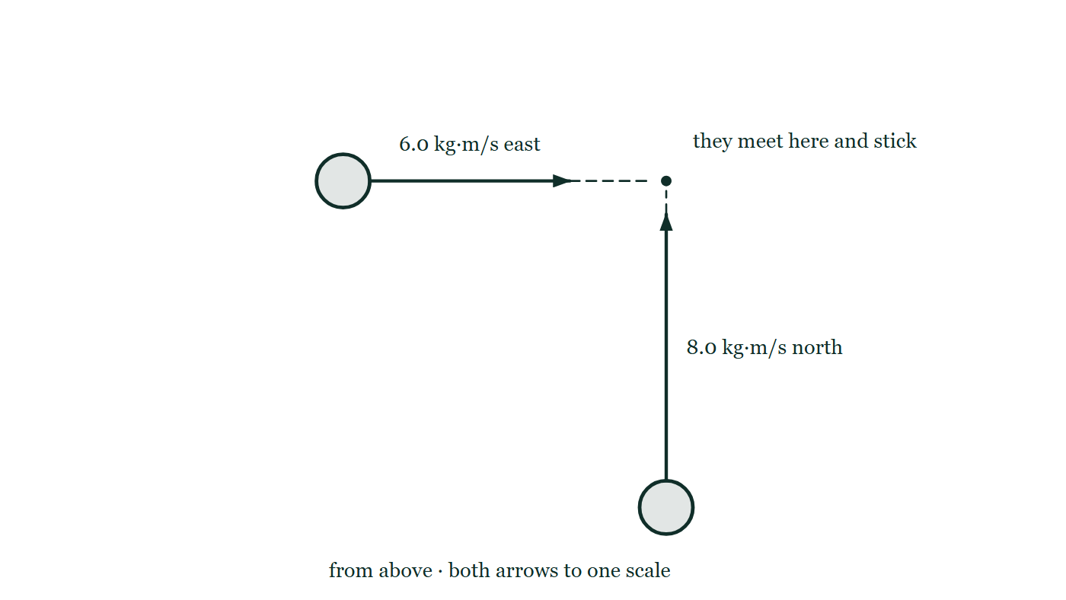
MOMENTUM · NON-LINEAR MOMENTUM — TWO-DIMENSIONAL & NON-COLLINEAR COLLISIONS
GIOPHYSICS LESSON
THE PICTURE
Two momenta at right angles
Drawn for this lesson
Two pucks closing on one point on frictionless ice, one carrying 6.0 kilogram metres per second east and one 8.0 north, drawn to a single scale with a right-angle mark where their directions meet.
The live version of this figure — click here
Momentum — Non-Linear Momentum — Two-Dimensional & Non-Collinear Collisions. Built by GioPhysics from the lesson's own copy; nothing on these slides is re-authored.
10 / 28
Notes:
[Phase] Build the model: The formulae, one at a time, in plain English (minutes 13–22 of 45)
[Figure] Two pucks closing on one point on frictionless ice, one carrying 6.0 kilogram metres per second east and one 8.0 north, drawn to a single scale with a right-angle mark where their directions meet.

Slide 11
MOMENTUM · NON-LINEAR MOMENTUM — TWO-DIMENSIONAL & NON-COLLINEAR COLLISIONS
GIOPHYSICS LESSON
WATCH OUT
The common trap
Check and misconception — The quick check and the trap
Adding momentum magnitudes ignores direction. Two large perpendicular momenta do not cancel, while equal opposite vectors do.
Momentum — Non-Linear Momentum — Two-Dimensional & Non-Collinear Collisions. Built by GioPhysics from the lesson's own copy; nothing on these slides is re-authored.
11 / 28
Notes:
[Phase] Check and misconception: The quick check and the trap (minutes 35–41 of 45)
[Misconception] Adding momentum magnitudes ignores direction. Two large perpendicular momenta do not cancel, while equal opposite vectors do.

Slide 12
MOMENTUM · NON-LINEAR MOMENTUM — TWO-DIMENSIONAL & NON-COLLINEAR COLLISIONS
GIOPHYSICS LESSON
WORKED EXAMPLE 1 OF 2 · EASY
The question
Easy
Worked examples — I do, we do — one step revealed at a time
A momentum vector has components pₓ = 6.0 kg·m/s and pᵧ = 8.0 kg·m/s. Find its magnitude.
Momentum — Non-Linear Momentum — Two-Dimensional & Non-Collinear Collisions. Built by GioPhysics from the lesson's own copy; nothing on these slides is re-authored.
12 / 28
Notes:
[Phase] Worked examples: I do, we do — one step revealed at a time (minutes 22–35 of 45)
[Question] A momentum vector has components pₓ = 6.0 kg·m/s and pᵧ = 8.0 kg·m/s. Find its magnitude.
[Answer] 10 kg·m/s

Slide 13
MOMENTUM · NON-LINEAR MOMENTUM — TWO-DIMENSIONAL & NON-COLLINEAR COLLISIONS
GIOPHYSICS LESSON
WORKED EXAMPLE 1 OF 2 · EASY · THE WORKING
How to solve it
Easy
Worked examples — I do, we do — one step revealed at a time
A momentum vector has components pₓ = 6.0 kg·m/s and pᵧ = 8.0 kg·m/s. Find its magnitude.
1.
|p| = √(6² + 8²) = √100.
2.
|p| = 10 kg·m/s.
Momentum — Non-Linear Momentum — Two-Dimensional & Non-Collinear Collisions. Built by GioPhysics from the lesson's own copy; nothing on these slides is re-authored.
13 / 28
Notes:
[Phase] Worked examples: I do, we do — one step revealed at a time (minutes 22–35 of 45)
[Reveal] One click per step. The class works each line before the next appears.
[Step 1] |p| = √(6² + 8²) = √100.
[Step 2] |p| = 10 kg·m/s.

Slide 14
MOMENTUM · NON-LINEAR MOMENTUM — TWO-DIMENSIONAL & NON-COLLINEAR COLLISIONS
GIOPHYSICS LESSON
WORKED EXAMPLE 1 OF 2 · EASY
Answer
Easy
Worked examples — I do, we do — one step revealed at a time
10 kg·m/s
Momentum — Non-Linear Momentum — Two-Dimensional & Non-Collinear Collisions. Built by GioPhysics from the lesson's own copy; nothing on these slides is re-authored.
14 / 28
Notes:
[Phase] Worked examples: I do, we do — one step revealed at a time (minutes 22–35 of 45)
[Answer] 10 kg·m/s

Slide 15
MOMENTUM · NON-LINEAR MOMENTUM — TWO-DIMENSIONAL & NON-COLLINEAR COLLISIONS
GIOPHYSICS LESSON
WORKED EXAMPLE 2 OF 2 · MEDIUM
The question
Medium
Worked examples — I do, we do — one step revealed at a time
A 2.0 kg puck at 5.0 m/s along +x hits a stationary 1.0 kg puck. Afterwards the first puck moves at 3.0 m/s, 30° above +x. Find the second puck's velocity.
Momentum — Non-Linear Momentum — Two-Dimensional & Non-Collinear Collisions. Built by GioPhysics from the lesson's own copy; nothing on these slides is re-authored.
15 / 28
Notes:
[Phase] Worked examples: I do, we do — one step revealed at a time (minutes 22–35 of 45)
[Question] A 2.0 kg puck at 5.0 m/s along +x hits a stationary 1.0 kg puck. Afterwards the first puck moves at 3.0 m/s, 30° above +x. Find the second puck's velocity.
[Answer] v₂ = (4.80, −3.00) m/s = 5.66 m/s at 32.0° below +x

Slide 16
MOMENTUM · NON-LINEAR MOMENTUM — TWO-DIMENSIONAL & NON-COLLINEAR COLLISIONS
GIOPHYSICS LESSON
WORKED EXAMPLE 2 OF 2 · MEDIUM · THE WORKING
How to solve it
Medium
Worked examples — I do, we do — one step revealed at a time
A 2.0 kg puck at 5.0 m/s along +x hits a stationary 1.0 kg puck. Afterwards the first puck moves at 3.0 m/s, 30° above +x. Find the second puck's velocity.
1.
Initial momentum is (10, 0) kg·m/s.
2.
First puck after: p₁ = 2.0(3.0)(cos30°, sin30°) = (5.20, 3.00) kg·m/s.
3.
Second puck: p₂ = (10, 0) − (5.20, 3.00) = (4.80, −3.00) kg·m/s.
Momentum — Non-Linear Momentum — Two-Dimensional & Non-Collinear Collisions. Built by GioPhysics from the lesson's own copy; nothing on these slides is re-authored.
16 / 28
Notes:
[Phase] Worked examples: I do, we do — one step revealed at a time (minutes 22–35 of 45)
[Reveal] One click per step. The class works each line before the next appears.
[Step 1] Initial momentum is (10, 0) kg·m/s.
[Step 2] First puck after: p₁ = 2.0(3.0)(cos30°, sin30°) = (5.20, 3.00) kg·m/s.
[Step 3] Second puck: p₂ = (10, 0) − (5.20, 3.00) = (4.80, −3.00) kg·m/s.

Slide 17
MOMENTUM · NON-LINEAR MOMENTUM — TWO-DIMENSIONAL & NON-COLLINEAR COLLISIONS
GIOPHYSICS LESSON
WORKED EXAMPLE 2 OF 2 · MEDIUM
Answer
Medium
Worked examples — I do, we do — one step revealed at a time
v₂ = (4.80, −3.00) m/s = 5.66 m/s at 32.0° below +x
Momentum — Non-Linear Momentum — Two-Dimensional & Non-Collinear Collisions. Built by GioPhysics from the lesson's own copy; nothing on these slides is re-authored.
17 / 28
Notes:
[Phase] Worked examples: I do, we do — one step revealed at a time (minutes 22–35 of 45)
[Answer] v₂ = (4.80, −3.00) m/s = 5.66 m/s at 32.0° below +x

Slide 18
MOMENTUM · NON-LINEAR MOMENTUM — TWO-DIMENSIONAL & NON-COLLINEAR COLLISIONS
GIOPHYSICS LESSON
PREDICT · TAKE THE VOTE
Commit before you are told
Hands up for each option, then click
One puck carries 6.0 kg·m/s due east, the other 8.0 kg·m/s due north. They meet and stick together. What momentum does the joined pair carry?
A 14 kg·m/s
B 10 kg·m/s, at 53° north of east
C 2.0 kg·m/s
Two pucks closing on one point on frictionless ice, one carrying 6.0 kilogram metres per second east and one 8.0 north, drawn to a single scale with a right-angle mark where their directions meet.
The live version of this figure — click here
Momentum — Non-Linear Momentum — Two-Dimensional & Non-Collinear Collisions. Built by GioPhysics from the lesson's own copy; nothing on these slides is re-authored.
18 / 28
Notes:
[Phase] Build the model: The formulae, one at a time, in plain English (minutes 13–22 of 45)
[Predict] One puck carries 6.0 kg·m/s due east, the other 8.0 kg·m/s due north. They meet and stick together. What momentum does the joined pair carry?
[Options] A 14 kg·m/s B 10 kg·m/s, at 53° north of east C 2.0 kg·m/s
[Figure] Two pucks closing on one point on frictionless ice, one carrying 6.0 kilogram metres per second east and one 8.0 north, drawn to a single scale with a right-angle mark where their directions meet.

Slide 19
MOMENTUM · NON-LINEAR MOMENTUM — TWO-DIMENSIONAL & NON-COLLINEAR COLLISIONS
GIOPHYSICS LESSON
PREDICT · THE OUTCOME
What actually happens
Ask the room who changed their mind, and why
B 10 kg·m/s, at 53° north of east
WHY
Momentum adds as a vector, and these two are at right angles, so they combine along the hypotenuse: √(6.0² + 8.0²) = 10 kg·m/s, at an angle of arctan(8/6) = 53° north of east. The east component still has to be 6.0 afterwards and the north component still has to be 8.0 — that is what conserving each axis separately means. 14 comes from adding the magnitudes as though the two pointed the same way, and 2.0 from subtracting them as though they pointed opposite ways. Neither is true of a right angle.
Momentum — Non-Linear Momentum — Two-Dimensional & Non-Collinear Collisions. Built by GioPhysics from the lesson's own copy; nothing on these slides is re-authored.
19 / 28
Notes:
[Phase] Build the model: The formulae, one at a time, in plain English (minutes 13–22 of 45)
[Answer] B — 10 kg·m/s, at 53° north of east. Momentum adds as a vector, and these two are at right angles, so they combine along the hypotenuse: √(6.0² + 8.0²) = 10 kg·m/s, at an angle of arctan(8/6) = 53° north of east. The east component still has to be 6.0 afterwards and the north component still has to be 8.0 — that is what conserving each axis separately means. 14 comes from adding the magnitudes as though the two pointed the same way, and 2.0 from subtracting them as though they pointed opposite ways. Neither is true of a right angle.

Slide 20
MOMENTUM · NON-LINEAR MOMENTUM — TWO-DIMENSIONAL & NON-COLLINEAR COLLISIONS
GIOPHYSICS LESSON
QUICK CHECK
Decide before the answer goes up
Check and misconception — The quick check and the trap
A system begins with zero y-momentum. After a two-dimensional collision, one object has positive y-momentum. What must the rest of the system have?
A
Zero y-momentum
B
Equal positive y-momentum
C
Equal total negative y-momentum
Momentum — Non-Linear Momentum — Two-Dimensional & Non-Collinear Collisions. Built by GioPhysics from the lesson's own copy; nothing on these slides is re-authored.
20 / 28
Notes:
[Phase] Check and misconception: The quick check and the trap (minutes 35–41 of 45)
[Question] A system begins with zero y-momentum. After a two-dimensional collision, one object has positive y-momentum. What must the rest of the system have?
[Options] A Zero y-momentum B Equal positive y-momentum C Equal total negative y-momentum

Slide 21
MOMENTUM · NON-LINEAR MOMENTUM — TWO-DIMENSIONAL & NON-COLLINEAR COLLISIONS
GIOPHYSICS LESSON
QUICK CHECK · THE ANSWER
The answer, and why
Check and misconception — The quick check and the trap
C Equal total negative y-momentum
HOW TO GET THERE
The after-collision y-components must add to the original total of zero.
WHY THE OTHERS TEMPT
A It began at zero, so this is the right instinct applied to the wrong moment — it is the total that must return to zero, not each part of it. One object now has positive y-momentum, so something has to be carrying the negative.
B This would double the y-momentum rather than restore it, taking the system from zero to twice one object's share. Conservation is a statement about a sum, and the sum has to land back where it started.
C Correct. The y-components after the collision must add to the y-total before it, which was zero, so everything else in the system carries exactly the same magnitude of negative y-momentum.
Momentum — Non-Linear Momentum — Two-Dimensional & Non-Collinear Collisions. Built by GioPhysics from the lesson's own copy; nothing on these slides is re-authored.
21 / 28
Notes:
[Phase] Check and misconception: The quick check and the trap (minutes 35–41 of 45)
[Question] A system begins with zero y-momentum. After a two-dimensional collision, one object has positive y-momentum. What must the rest of the system have?
[Option by option] A: It began at zero, so this is the right instinct applied to the wrong moment — it is the total that must return to zero, not each part of it. One object now has positive y-momentum, so something has to be carrying the negative. B: This would double the y-momentum rather than restore it, taking the system from zero to twice one object's share. Conservation is a statement about a sum, and the sum has to land back where it started. C: Correct. The y-components after the collision must add to the y-total before it, which was zero, so everything else in the system carries exactly the same magnitude of negative y-momentum.
[Answer] C — Equal total negative y-momentum
[Why] The after-collision y-components must add to the original total of zero.
[Reveal] One click for the answer, then one for the reason.

Slide 22
MOMENTUM · NON-LINEAR MOMENTUM — TWO-DIMENSIONAL & NON-COLLINEAR COLLISIONS
GIOPHYSICS LESSON
EXTENSION 1 OF 2 · HARD
The question
Hard
Worked examples — I do, we do — one step revealed at a time
A 0.40 kg ball moving at 10 m/s along +x deflects to 8.0 m/s at 30° above +x. Find the magnitude of its momentum change.
Momentum — Non-Linear Momentum — Two-Dimensional & Non-Collinear Collisions. Built by GioPhysics from the lesson's own copy; nothing on these slides is re-authored.
22 / 28
Notes:
[Phase] Worked examples: I do, we do — one step revealed at a time (minutes 22–35 of 45)
[Question] A 0.40 kg ball moving at 10 m/s along +x deflects to 8.0 m/s at 30° above +x. Find the magnitude of its momentum change.
[Answer] |Δp| ≈ 2.0 kg·m/s

Slide 23
MOMENTUM · NON-LINEAR MOMENTUM — TWO-DIMENSIONAL & NON-COLLINEAR COLLISIONS
GIOPHYSICS LESSON
EXTENSION 1 OF 2 · HARD · THE WORKING
How to solve it
Hard
Worked examples — I do, we do — one step revealed at a time
A 0.40 kg ball moving at 10 m/s along +x deflects to 8.0 m/s at 30° above +x. Find the magnitude of its momentum change.
1.
Before: (4.0, 0). After: (0.40 × 8 cos30°, 0.40 × 8 sin30°) ≈ (2.77, 1.60) kg·m/s.
2.
Δp = (−1.23, 1.60); |Δp| = √(1.51 + 2.56).
3.
|Δp| ≈ 2.0 kg·m/s.
Momentum — Non-Linear Momentum — Two-Dimensional & Non-Collinear Collisions. Built by GioPhysics from the lesson's own copy; nothing on these slides is re-authored.
23 / 28
Notes:
[Phase] Worked examples: I do, we do — one step revealed at a time (minutes 22–35 of 45)
[Reveal] One click per step. The class works each line before the next appears.
[Step 1] Before: (4.0, 0). After: (0.40 × 8 cos30°, 0.40 × 8 sin30°) ≈ (2.77, 1.60) kg·m/s.
[Step 2] Δp = (−1.23, 1.60); |Δp| = √(1.51 + 2.56).
[Step 3] |Δp| ≈ 2.0 kg·m/s.

Slide 24
MOMENTUM · NON-LINEAR MOMENTUM — TWO-DIMENSIONAL & NON-COLLINEAR COLLISIONS
GIOPHYSICS LESSON
EXTENSION 1 OF 2 · HARD
Answer
Hard
Worked examples — I do, we do — one step revealed at a time
|Δp| ≈ 2.0 kg·m/s
Momentum — Non-Linear Momentum — Two-Dimensional & Non-Collinear Collisions. Built by GioPhysics from the lesson's own copy; nothing on these slides is re-authored.
24 / 28
Notes:
[Phase] Worked examples: I do, we do — one step revealed at a time (minutes 22–35 of 45)
[Answer] |Δp| ≈ 2.0 kg·m/s

Slide 25
MOMENTUM · NON-LINEAR MOMENTUM — TWO-DIMENSIONAL & NON-COLLINEAR COLLISIONS
GIOPHYSICS LESSON
EXTENSION 2 OF 2 · CHALLENGING
The question
Challenging
Worked examples — I do, we do — one step revealed at a time
A 2.0 kg puck at 6.0 m/s along +x strikes an identical stationary puck. Afterwards one moves at 4.0 m/s at 30° above +x. Find the other puck's velocity and test whether the collision was elastic.
Momentum — Non-Linear Momentum — Two-Dimensional & Non-Collinear Collisions. Built by GioPhysics from the lesson's own copy; nothing on these slides is re-authored.
25 / 28
Notes:
[Phase] Worked examples: I do, we do — one step revealed at a time (minutes 22–35 of 45)
[Question] A 2.0 kg puck at 6.0 m/s along +x strikes an identical stationary puck. Afterwards one moves at 4.0 m/s at 30° above +x. Find the other puck's velocity and test whether the collision was elastic.
[Answer] ≈ 3.2 m/s at 38° below the axis; ~9.6 J lost, so not elastic

Slide 26
MOMENTUM · NON-LINEAR MOMENTUM — TWO-DIMENSIONAL & NON-COLLINEAR COLLISIONS
GIOPHYSICS LESSON
EXTENSION 2 OF 2 · CHALLENGING · THE WORKING
How to solve it
Challenging
Worked examples — I do, we do — one step revealed at a time
A 2.0 kg puck at 6.0 m/s along +x strikes an identical stationary puck. Afterwards one moves at 4.0 m/s at 30° above +x. Find the other puck's velocity and test whether the collision was elastic.
1.
x: 12 = 2.0 × 4 cos30° + 2v₂ₓ → v₂ₓ = (12 − 6.93)/2 ≈ 2.54 m/s. y: 0 = 2.0 × 4 sin30° + 2v₂ᵧ → v₂ᵧ = −2.0 m/s.
2.
v₂ = √(2.54² + 2.0²) ≈ 3.23 m/s at ≈ 38° below +x.
3.
K before = 36 J; after = ½·2(16) + ½·2(10.4) ≈ 16 + 10.4 = 26.4 J < 36 J — inelastic.
Momentum — Non-Linear Momentum — Two-Dimensional & Non-Collinear Collisions. Built by GioPhysics from the lesson's own copy; nothing on these slides is re-authored.
26 / 28
Notes:
[Phase] Worked examples: I do, we do — one step revealed at a time (minutes 22–35 of 45)
[Reveal] One click per step. The class works each line before the next appears.
[Step 1] x: 12 = 2.0 × 4 cos30° + 2v₂ₓ → v₂ₓ = (12 − 6.93)/2 ≈ 2.54 m/s. y: 0 = 2.0 × 4 sin30° + 2v₂ᵧ → v₂ᵧ = −2.0 m/s.
[Step 2] v₂ = √(2.54² + 2.0²) ≈ 3.23 m/s at ≈ 38° below +x.
[Step 3] K before = 36 J; after = ½·2(16) + ½·2(10.4) ≈ 16 + 10.4 = 26.4 J < 36 J — inelastic.

Slide 27
MOMENTUM · NON-LINEAR MOMENTUM — TWO-DIMENSIONAL & NON-COLLINEAR COLLISIONS
GIOPHYSICS LESSON
EXTENSION 2 OF 2 · CHALLENGING
Answer
Challenging
Worked examples — I do, we do — one step revealed at a time
≈ 3.2 m/s at 38° below the axis; ~9.6 J lost, so not elastic
Momentum — Non-Linear Momentum — Two-Dimensional & Non-Collinear Collisions. Built by GioPhysics from the lesson's own copy; nothing on these slides is re-authored.
27 / 28
Notes:
[Phase] Worked examples: I do, we do — one step revealed at a time (minutes 22–35 of 45)
[Answer] ≈ 3.2 m/s at 38° below the axis; ~9.6 J lost, so not elastic

Slide 28
MOMENTUM · NON-LINEAR MOMENTUM — TWO-DIMENSIONAL & NON-COLLINEAR COLLISIONS
GIOPHYSICS LESSON
MOMENTUM
Where to go next
Plenary — What to take away, what to practise next
Next
5.6 Momentum Calculus Integration
https://giophysics.com/chapter-9/momentum-calculus/
Lesson
This lesson on giophysics.com
https://giophysics.com/chapter-9/non-linear-momentum/
Live
The live, interactive version of these slides
https://giophysics.com/chapter-9/presentation/?lesson=twoD
Chapter
All Momentum lessons
https://giophysics.com/chapter-9/
PDF
Download the lesson PDF
https://giophysics.com/downloads/9-5-non-linear-momentum-two-dimensions.pdf
Momentum — Non-Linear Momentum — Two-Dimensional & Non-Collinear Collisions. Built by GioPhysics from the lesson's own copy; nothing on these slides is re-authored.
28 / 28
Notes:
[Phase] Plenary: What to take away, what to practise next (minutes 41–45 of 45)
[Interactive] The graphs and the circuit topology on these slides are frozen. The live version at https://giophysics.com/chapter-9/presentation/?lesson=twoD moves them.

